Slide 1
C# Server and Client Socket Programming
Concepts and Examples
Ömer Levent Durdalı – 21702600
2021 – Spring Semester

Slide 2
Contents
What is Socket Programming
Basic TCP/IP Concepts
Connection Concepts and Diagrams
Client – Server Basic Project Explanation
Single Threaded Client / Server Example
Multi Threaded Client / Server Example

Slide 3
What will see
How to create a C# socket and setup a listener server node that starts listening to any messages coming its way via the predefined IP and protocol.
How to create a client application that will send messages to a listener server and read it using Sockets.
Socket Programming
TCP/IP and UDP/IP Concepts

Slide 4
Socket Programming
Network programming in windows is possible with Sockets.
A Socket is basically End-Point of To and From (Bidirectional or Directional) communication link between two different programs. (Server Program and Client Program) which are running and generally in the same network.
My Example Will be a Directional Application meaning, is a one-way Client and Server setup where a Client connects, sends messages to the server and the server shows them using socket connection.
For our case, .Net Framework, Windows can utilizes two namespaces, System.Net and System.Net.Sockets for managed implementation of Internet protocols.(TCP/IP and UDP/IP).
Lastly a Socket = IP Address + Port Number

Slide 5
Socket Programming
So, Sockets in computer networks are used to establish a connection between two or more computers
Used to send data from one computer to another.
Each computer in the network is called a node.
Sockets use nodes’ IP addresses and a Ports to create a channel of communication
Use this channel to transfer data.
In socket communication, one node acts as a listener and other node acts as a client.

Slide 6
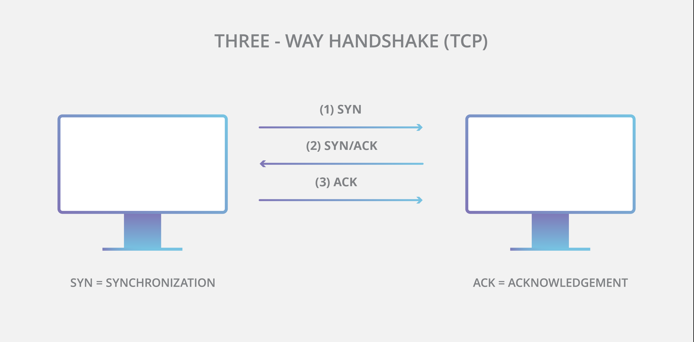
TCP/IP and UDP/IP Concepts
Transmission Control Protocol/Internet Protocol is a set of standardized rules that allow computers to communicate on a network such as the internet.
IP is the part that obtains the address to which data is sent. TCP is responsible for data delivery once that IP address has been found.

Slide 7
Connection Concepts and Diagrams
Simple Explanation: The IP address is like the phone number assigned to your smartphone. TCP is all the technology that makes the phone ring, and that enables you to talk to someone on another phone

Slide 8
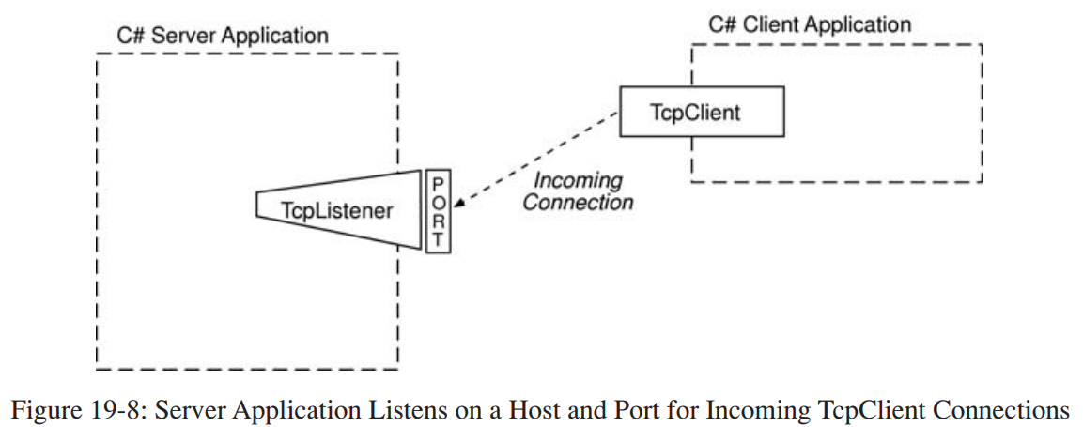
Socket Connection - Diagram

Slide 9
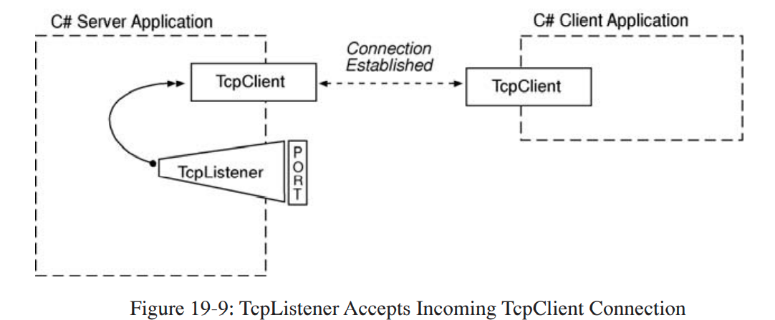
Socket Connection - Diagram

Slide 10
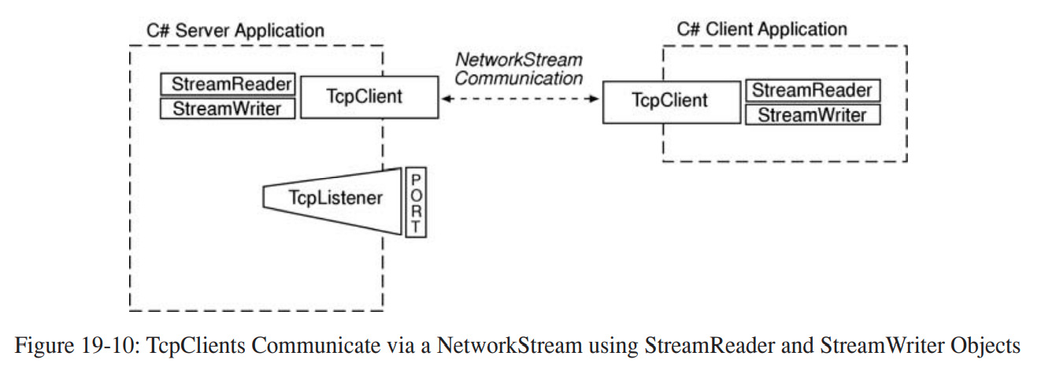
Socket Connection - Diagram

Slide 11
Client – Server Information/Tools/ Libraries
This example will be a Directional Application.
Visual Studio 2019 was used during the creation of the project.
The Client Program app will get the IP from the User to send message to the Server Program.
Make sure that your computers firewall allow the usage of the “Port 8080”.
Project was made as an new Console Application (.Net Core)
No external libraries are needed.
No external tools are needed.
Project .EXE will be given to run the Program without seeing code.

Slide 12
Single Threaded Client – Server Example

Slide 13
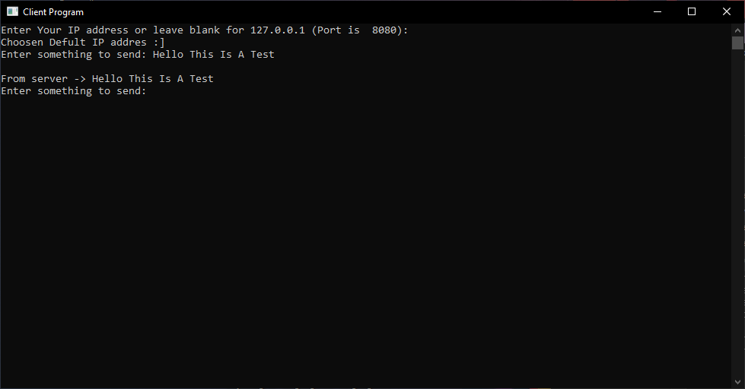
Client - Example
Single Threaded Client – Server Example
As you can see the Client Program can Send a message and Receive a reply from the server on the chosen Local IP address.
./NormalClientServer-Project-EXE/NormalClient-Project.exe

Slide 14
Client Imports
Single Threaded Client – Server Example
To use the TCP Programming our application firstly must include the following imports
using System;
using System.IO;
using System.Net;
using System.Net.Sockets;
After this we can start writing the program.
System.Net.Sockets and System.Net are two namespaces that Microsoft .NET framework provides and are used for managing the implementation of Internet protocols that applications use.

Slide 15
Code Class Explanation - Client
Single Threaded Client – Server Example
Some basics, with the help of “Console.Title” is used for changing the name of the Console.
TcpListener is simply a class that listens for connections from TCP network clients.
Listens to a specified IP (one or more) and Port.
IPAddress is simply a class that stores IP address and network configuration.
TcpClient is a class that provides simple methods for connecting, sending, and receiving data.
StreamReader and StreamWriter
The server/client uses these StreamReader and StreamWriter objects to communicate with the client/server
Console.Title = “Client Program";
TcpListener listener = null;
listener = new TcpListener(ip_address_def, port);
listener.Start();
listener.Stop()
IPAddress ip_address_def = IPAddress.Parse("127.0.0.1");
TcpClient client = listener.AcceptTcpClient();
StreamReader reader = new StreamReader(client.GetStream());
StreamWriter writer = new StreamWriter(client.GetStream());

Slide 16
Client Example Explanation
namespace NormalClient_Project {
class Program {
static void Main(string[] args) { // Main Method
Console.Title = "Client Program";
string ipAdd = string.Empty;
TcpClient client = new TcpClient();
IPAddress ip_address_def = IPAddress.Parse("127.0.0.1");
int port = 8080;
try {
Console.Write("Enter Your IP address or leave blank for 127.0.0.1 (Port is 8080): ");
ipAdd = Console.ReadLine();
if (ipAdd == "") {
Console.WriteLine("Choosen Defult IP addres :]");
client = new TcpClient(ip_address_def.ToString(), port);
}
else {
Console.WriteLine("Choosen IP addres" + ipAdd);
client = new TcpClient(ipAdd, port);
}
//Continue…
In line 7 we are setting a default fallback IP address.
In line 8 we are setting a Port,
Line 7 and 8 are used, if the user doesn't specify an IP or Port.
In the if/else block we get user inputs or set the default values.
In line 14, a new TcpClient is created and started with the default IP address.
In line 18, a new user specified TcpClient is created.
Single Threaded Client – Client Example

Slide 17
Client Example Explanation
//Continue…
StreamReader reader = new StreamReader(client.GetStream());
StreamWriter writer = new StreamWriter(client.GetStream());
string s = string.Empty;
while (!s.Equals("Exit") || !s.Equals("exit"))
{
Console.Write("Enter something to send: ");
s = Console.ReadLine();
Console.WriteLine();
writer.WriteLine(s);
writer.Flush();
string server_string = reader.ReadLine();
Console.WriteLine(server_string);
}
reader.Close();
writer.Close();
client.Close();
}//try
//Continue…
Inside the Try/Catch, in line 22 we start a StreamReaders , so that we can get the received data(32), than we can print the received data.
Inside the Try/Catch, in line 23 we start a StreamWriter, sends the data(30) to the server.
On line 25, the while loop checks the received message and prints the received until it receives an “Exit” message, than the server closes all readers and TCP received connections.
In line 31, writer.Flush() is used for clearing all buffered data and the data is sent to the Stream
So the next message dose not mix or get altered by the previous message.
Is used to send the data.
Single Threaded Client – Client Example

Slide 18
Client Example Explanation
//Continue…
catch (FormatException e) {
Console.WriteLine("Not an IP address closing the server.. :[");
//Console.WriteLine(e);
}
catch (SocketException e) {
Console.WriteLine("Not an IP address closing the server :[");
//Console.WriteLine(e);
}
catch (IOException e) {
Console.WriteLine("Client Connection has been interrupted, closing the server :[");
//Console.WriteLine(e);
}
}//Main
}//class
}//namespace
This part is for error catching as the program has multiple point of failures, so we have 3 different error catching.
FormatException is for IP address parsing errors from line 18.
SocketException is for all TCP connections and TCP listeners Errors.
IOException is for all Client connections.
Single Threaded Client – Client Example

Slide 19
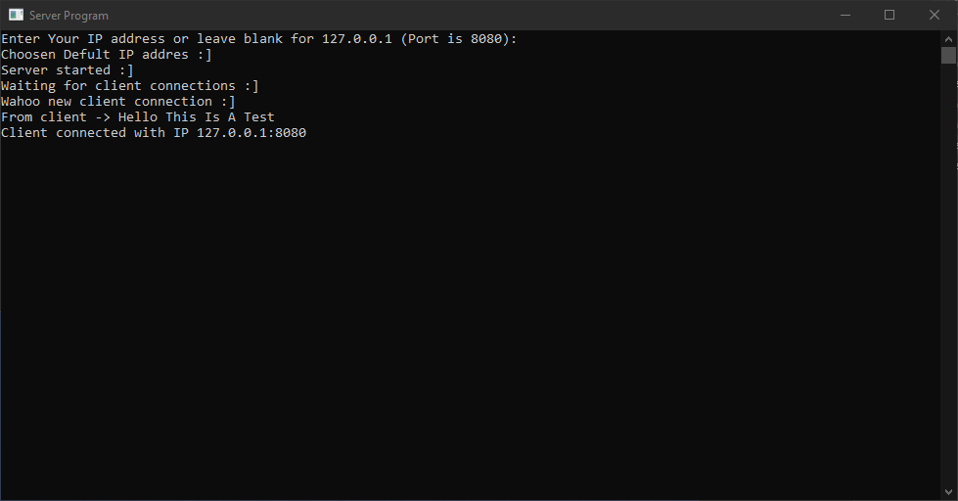
Server - Example
Single Threaded Client – Server Example
As you can see the Server Program can Receive a message from the Client on the chosen Local IP address.
The server also logs it startup in the window.
.EXE location ./NormalClientServer-Project-EXE
./NormalClientServer-Project-EXE/NormalServer-Project.exe

Slide 20
Server Imports – Same as Client
Single Threaded Client – Server Example
To use the TCP Programming our application firstly must include the following imports
using System;
using System.IO;
using System.Net;
using System.Net.Sockets;
After this we can start writing the program.
System.Net.Sockets and System.Net are two namespaces that Microsoft .NET framework provides and are used for managing the implementation of Internet protocols that applications use.

Slide 21
Code Class Explanation - Server
Single Threaded Client – Server Example
Some basics, with the help of “Console.Title” is used for changing the name of the Console.
TcpListener is simply a class that listens for connections from TCP network clients.
IPAddress is simply a class that stores IP address and network configuration.
TcpClient is a class that provides simple methods for connecting, sending, and receiving data.
StreamReader and StreamWriter
The server/client uses these StreamReader and StreamWriter objects to communicate with the client/server
Console.Title = "Server Program";
TcpListener listener = null;
listener = new TcpListener(ip_address_def, port);
listener.Start();
listener.Stop()
IPAddress ip_address_def = IPAddress.Parse("127.0.0.1");
TcpClient client = listener.AcceptTcpClient();
StreamReader reader = new StreamReader(client.GetStream());
StreamWriter writer = new StreamWriter(client.GetStream());

Slide 22
Server Example Explanation
namespace NormalServer_Project{
class Program{
private static void Main(string[] args){
Console.Title = "Server Program";
TcpListener listener = null;
string ipAdd = string.Empty;
IPAddress ip_address_def = IPAddress.Parse("127.0.0.1"); //Default
int port = 8080; //Default
try{
Console.Write("Enter Your IP address or leave blank for 127.0.0.1");
ipAdd = Console.ReadLine();
if (ipAdd == ""){
Console.WriteLine("Choosen Defult IP addres :]");
listener = new TcpListener(ip_address_def, port);
listener.Start();
}
else{
Console.WriteLine("Choosen IP addres" + ipAdd);
listener = new TcpListener(IPAddress.Parse(ipAdd), port);
listener.Start();
}
Console.WriteLine("Server started :]");
//Continue…
In line 7 we are setting a default fallback IP address.
In line 8 we are setting a Port,
Line 7 and 8 are used, if the user doesn't specify an IP or Port.
In the if/else block we get user inputs or set the default values. Once these are set we start the TcpListener
In line 14, a new TcpListener is created and started with the default IP address. If the user specified an IP than in line 19, the TcpListener is created accordingly.
Lasty the user promoted with an server stared message.
Single Threaded Client – Server Example

Slide 23
Server Example Explanation
try{
//Continue…
Console.WriteLine("Server started :]");
while (true){
Console.WriteLine("Waiting for client connections :]");
TcpClient client = listener.AcceptTcpClient();
Console.WriteLine("Wahoo new client connection :]");
StreamReader reader = new StreamReader(client.GetStream());
StreamWriter writer = new StreamWriter(client.GetStream());
string s = string.Empty;
while (!(s = reader.ReadLine()).Equals("Exit") || s.Equals("exit") || (s == null))
{//while
Console.WriteLine("From client -> " + s);
writer.WriteLine("From server -> " + s);
Console.WriteLine("Client connected with IP {0}", client.Client.LocalEndPoint);
writer.Flush();
}
reader.Close();
writer.Close();
client.Close();
}
}//try
//Continue…
Inside the Try/Catch, In line 29, we start the TcpClient Listeners, so that we can assign the Clients a TCP connections. Waits for an client connection. To the set IP and Port.
In line 31, we start a StreamReaders , so that we can get the received data(34). And write the received message to the console on line 36.
In line 32, we start a StreamWriter, so that we can get the received data(37), use writer.WriteLine() send an echo message to the Client.
On line 34, the while loop checks the received message and prints the received until it receives an “Exit” message, than the server closes all readers and TCP received connections.
In line 31, writer.Flush() is used for clearing all buffered data and the data is sent to the Stream
So the next message dose not mix or get altered by the previous message.
Is used to send the data.
Single Threaded Client – Server Example

Slide 24
Server Example Explanation
//Continue…
}//try
catch (FormatException e) {
Console.WriteLine("Not an IP address closing the server :[");
//Console.WriteLine(e);
}
catch (SocketException e) {
Console.WriteLine("Not an IP address closing the server :[");
//Console.WriteLine(e);
}
catch (IOException e) {
Console.WriteLine("Client Connection has been interrupted, clo sing the server :[");
//Console.WriteLine(e);
}
finally {
if (listener != null) {
listener.Stop();
}
}
}//Main()
}//Class
}//namespace
This part is for error catching as the program has multiple point of failures, so we have 3 different error catching.
FormatException is for IP address parsing errors from line 19.
SocketException is for all TCP connections and TCP listeners.
IOException is for all TCP connections and TCP listeners.
And finally, in line 61, after an error the server stops listing for TCP connections.
Single Threaded Client – Server Example

Slide 25
Multi Threaded Client – Server Example

Slide 26
Multi Threaded and Single Threaded Difference
Actually there isn’t much difference from the Single Threaded application but I made some improvements overall. So it looks a bit different.
Other than my own improvements the only major change happens in the Server Program Code.
The Client Program Code does not need to change, but I made some improvements over the Single Threaded one.
Server Program Code, the change is;
New import “using System.Threading;”
The StreamReader, StreamWriter and the while loop are all in an different function for easier use of Thread creation.

Slide 27
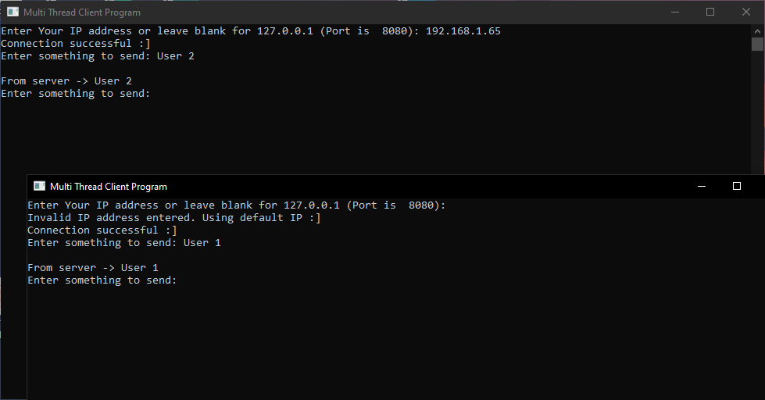
Client - Example
Multi Threaded Client – Server Example
There are multiple Clients that use different IP address and can send messages to the Multi Thread Server Program.
The server also logs it startup in the window.
The different IP address connection was the Improvement that I was talking about.
.EXE location ./MultiThreadedClientServer-EXE
./MultiThreadedClientServer-EXE/MultiTClient-Project.exe

Slide 28
Server Imports – Same as Single Thread Client
Multi Threaded Client – Server Example
To use the TCP Programming our application firstly must include the following imports
using System;
using System.IO;
using System.Net;
using System.Net.Sockets;
After this we can start writing the program.
System.Net.Sockets and System.Net are two namespaces that Microsoft .NET framework provides and are used for managing the implementation of Internet protocols that applications use.

Slide 29
Code Class Explanation - Client
Single Threaded Client – Server Example
Some basics, with the help of “Console.Title” is used for changing the name of the Console.
TcpListener is simply a class that listens for connections from TCP network clients.
IPAddress is simply a class that stores IP address and network configuration.
TcpClient is a class that provides simple methods for connecting, sending, and receiving data.
StreamReader and StreamWriter
The server/client uses these StreamReader and StreamWriter objects to communicate with the client/server
Console.Title = "Multi Thread Client Program";
TcpListener listener = null;
listener = new TcpListener(ip_address_def, port);
listener.Start();
listener.Stop()
IPAddress ip_address_def = IPAddress.Parse("127.0.0.1");
TcpClient client = listener.AcceptTcpClient();
StreamReader reader = new StreamReader(client.GetStream());
StreamWriter writer = new StreamWriter(client.GetStream());

Slide 30
Client Example Explanation
namespace MultiTClient_Project{
internal class Program {
private static void Main(string[] args) {
Console.Title = "Multi Thread Client Program";
IPAddress ip_address = IPAddress.Parse("127.0.0.1"); //Default
int port = 8080; //Default
string ipAdd = string.Empty;
try{
Console.Write("Enter Your IP address or leave blank for 127.0.0.1 (Port is 8080): ");
ipAdd = Console.ReadLine();
if (ipAdd == ""){
Console.WriteLine("Invalid IP address entered. Using default IP :]");
}
else{
ip_address = IPAddress.Parse(ipAdd);
}
}//try
catch (FormatException){
Console.WriteLine("Invalid IP address entered. Using default IP of: " + ip_address.ToString());
}
//Continue…
In line 5 we are setting a default fallback IP address.
In line 6 we are setting a Port,
Line 5 and 6 are used, if the user doesn't specify an IP or Port.
In the if/else block, in line 11 we make the check to see if the user gave any inputs and if they did not than, a new TcpClient with “ip_address” will be created with the default IP address.
If the user specified an IP than the TcpClient is created accordingly, with the parsed “ipAdd” string.
Lastly we have an FormatException because we receive an IP from the user.
Multi Threaded Client – Server Example

Slide 31
Client Example Explanation
//Continue…
try{
TcpClient client = new TcpClient(ip_address.ToString(), port);
Console.WriteLine("Connection successful :]");
StreamReader reader = new StreamReader(client.GetStream());
StreamWriter writer = new StreamWriter(client.GetStream());
string s = String.Empty;
while (!s.Equals("Exit") || !s.Equals("exit")){
Console.Write("Enter something to send: ");
s = Console.ReadLine();
Console.WriteLine();
writer.WriteLine(s);
writer.Flush();
if (!s.Equals("Exit") || !s.Equals("exit")) {
String server_string = reader.ReadLine();
Console.WriteLine(server_string);
}
}//while
reader.Close();
writer.Close();
client.Close();
}//rty
catch (Exception e){ Console.WriteLine(e); }
}//Main
}//class
}//namespace
Inside the Try/Catch, In line 21 we start the TcpClient so that we can assign the Clients TCP connections.
Inside the Try/Catch, in line 25 we start a StreamReaders , so that we can get the received data(35), than we can print the received data.
Inside the Try/Catch, in line 26 we start a StreamWriter, sends the data(32) to the server.
On line 28, the while loop checks the received message and prints the received until it receives an “Exit” message, than the server closes all readers and TCP received connections.
In line 33, writer.Flush() is used for clearing all buffered data and the data is sent to the Stream
So the next message dose not mix or get altered by the previous message.
Is used to send the data.
Multi Threaded Client – Server Example

Slide 32
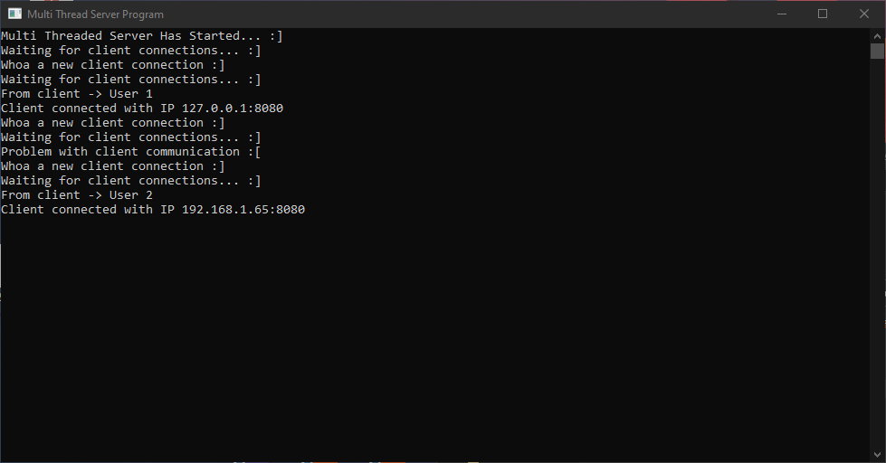
Server - Example
Multi Threaded Client – Server Example
As you can see the Server Program can Receive a message from the multiple Clients at the same time, from different IP addresses.
The server also logs it startup in the window.
Again, the different IP addres connection was the Improvement that I was talking about.
./MultiThreadedClientServer-EXE/MultiTServer-Project.exe

Slide 33
Server Imports
Multi Threaded Client – Server Example
To use the TCP Programming our application firstly must include the following imports
using System;
using System.IO;
using System.Net;
using System.Net.Sockets;
using System.Threading;
After this we can start writing the program.
System.Net.Sockets and System.Net are two namespaces that Microsoft .NET framework provides and are used for managing the implementation of Internet protocols that applications use.
System.Threading is simply for thread configuration and controling

Slide 34
Code Class Explanation - Server
Single Threaded Client – Server Example
Some basics, with the help of “Console.Title” is used for changing the name of the Console.
TcpListener is simply a class that listens for connections from TCP network clients.
IPAddress is simply a class that stores IP address and network configuration.
TcpClient is a class that provides simple methods for connecting, sending, and receiving data.
StreamReader and StreamWriter
The server/client uses these StreamReader and StreamWriter objects to communicate with the client/server
Console.Title = "Multi Thread Server Program";
TcpListener listener = null;
listener = new TcpListener(ip_address_def, port);
listener.Start();
listener.Stop()
IPAddress ip_address_def = IPAddress.Parse("127.0.0.1");
TcpClient client = listener.AcceptTcpClient();
StreamReader reader = new StreamReader(client.GetStream());
StreamWriter writer = new StreamWriter(client.GetStream());

Slide 35
Server Example Explanation
namespace MultiTServer_Project{
internal class Program{
private static void Main(string[] args){
Console.Title = "Multi Thread Server Program";
TcpListener listener = null;
int port = 8080;
try{
//Unlike our Single Threaded Server IPAddress.Any will listen to all Netwotk Interfaces and their Ip address
//Ex. Wifi Module is 192.168.1.2 and Ethernet Interface is 172.0.0.1
//IPAddress.Any will listen to both
listener = new TcpListener(IPAddress.Any, port);
listener.Start();
Console.WriteLine("Multi Threaded Server Has Started... :]");
while (true)
{
Console.WriteLine("Waiting for client connections... :]");
TcpClient client = listener.AcceptTcpClient();
Console.WriteLine("Whoa a new client connection :]");
//Start a new Thread for every new client connection
Thread t = new Thread(ProcessClientRequests);
t.Start(client);
}
}//try
//Continue…
TcpListener(IPAddress.Any, port);
With IPAddres.Any the Server is listening all network interfaces and IP address.
Thread t = new Thread(ProcessClientRequests);
On every new ProcessClientRequests function a new thread is opened and a new connection is started.
Multi Threaded Client – Server Example

Slide 36
Server Example Explanation
//Continue…
while (true) {
Console.WriteLine("Waiting for client connections... :]");
TcpClient client = listener.AcceptTcpClient();
Console.WriteLine("Whoa a new client connection :]");
//Start a new Thread for every new client connection
Thread t = new Thread(newClientRequests);
t.Start(client);
} //while
}//try
catch (Exception e){
Console.WriteLine(e);
}
finally{
if (listener != null) {
listener.Stop();
}
}
}//Main()
//Continue…
Inside the Try/Catch, In line 19, we start the TcpClient Listeners, so that we can assign the Clients a TCP connections. Waits for an client connection. To the set IP and Port.
In line 20, Pass TcpClient object to the newly created Thread/Function.
Since we have a while loop for every new TcpClient we create a new Thread.
This wont constantly open new Thread because the listener.AcceptTcpClient(); function locks the process and the program continues once a new Client has connected.
Multi Threaded Client – Server Example

Slide 37
Server Example Explanation ProcessClientRequests()
private static void newClientRequests(object argument) {
//Same Code Taken From Single Threaded Server Program
TcpClient client = (TcpClient)argument;
try{
StreamReader reader = new StreamReader(client.GetStream());
StreamWriter writer = new StreamWriter(client.GetStream());
string s = String.Empty;
while (!(s = reader.ReadLine()).Equals("Exit") || s.Equals("exit") || (s == null))
{
Console.WriteLine("From client -> " + s);
writer.WriteLine("From server -> " + s);
//Show Connected IP
Console.WriteLine("Client connected with IP {0}", client.Client.LocalEndPoint);
writer.Flush();
}
reader.Close();
writer.Close();
client.Close();
Console.WriteLine("Client connection terminated :[");
}//try
//Continue…
In line 35, this method takes one argument of type Object, which is cast immediately to a TcpClient object.
The reason this cast is necessary is because the newClientRequests() method has the signature of a ParameterizedThreadStart.
Meaning to execute a static method and an instance method. With sent parameters
https://docs.microsoft.com/en-us/dotnet/api/system.threading.parameterizedthreadstart?view=net-5.0
Multi Threaded Client – Server Example

Slide 38
Server Example Explanation ProcessClientRequests()
private static void newClientRequests(object argument) {
//Same Code Taken From Single Threaded Server Program
TcpClient client = (TcpClient)argument;
try{
StreamReader reader = new StreamReader(client.GetStream());
StreamWriter writer = new StreamWriter(client.GetStream());
string s = String.Empty;
while (!(s = reader.ReadLine()).Equals("Exit") || s.Equals("exit") || (s == null))
{
Console.WriteLine("From client -> " + s);
writer.WriteLine("From server -> " + s);
//Show Connected IP
Console.WriteLine("Client connected with IP {0}", client.Client.LocalEndPoint);
writer.Flush();
}
reader.Close();
writer.Close();
client.Close();
Console.WriteLine("Client connection terminated :[");
}//try
//Continue…
In line 38, we start a StreamReaders , so that we can get the received data(41). And write the received message to the console on line 43.
In line 39, we start a StreamWriter, so that we can get the received data(46), use writer.WriteLine() send an echo message to the Client.
On line 41, the while loop checks the received message and prints the received until it receives an “Exit” message, than the server closes all readers and TCP received connections.
In line 47, writer.Flush() is used for clearing all buffered data and the data is sent to the Stream
So the next message dose not mix or get altered by the previous message.
Is used to send the data.
Multi Threaded Client – Server Example

Slide 39
Server Example Explanation ProcessClientRequests()
//Continue…
// Have only one exception unlike the Single Threaded Server Program because we don't have any IP inputs here
catch (IOException){
Console.WriteLine("Problem with client communication :[");
}
finally {
if (client != null){
client.Close();
}
}
}//newClientRequests()
}//class
}//namespace
This part is for error catching as the program has multiple point of failures, so we have 1 error catching.
IOException is for all TCP connections and TCP listeners.
And finally, in line 60, after an error the server stops listing for TCP connections.
Multi Threaded Client – Server Example

Slide 40
Show All IP Address Listened - Server
private static void ShowServerNetworkConfig(){
Console.ForegroundColor = ConsoleColor.Yellow;
NetworkInterface[] adapters = NetworkInterface.GetAllNetworkInterfaces();
foreach(NetworkInterface adapter in adapters){
Console.WriteLine(adapter.Description);
Console.WriteLine("\tAdapter Name: " + adapter.Name);
Console.WriteLine("\tMAC Address: " + adapter.GetPhysicalAddress());
IPInterfaceProperties ip_properties = adapter.GetIPProperties();
UnicastIPAddressInformationCollection addresses =
ip_properties.UnicastAddresses;
foreach(UnicastIPAddressInformation address in addresses){
Console.WriteLine("\tIP Address: " + address.Address);
}//foreach-UnicastIPAddressInformation
}//foreach-NetworkInterface
Console.ForegroundColor = ConsoleColor.White;
}//ShowServerNetworkConfig()
try{
//Unlike our Single Threaded Server IPAddress.Any will listen to all Netwotk Interfaces and their Ip address
//Ex. Wifi Module is 192.168.1.2 and Ethernet Interface is 172.0.0.1
//IPAddress.Any will listen to both
ShowServerNetworkConfig(); // Shows all IP that are being listened.
listener = new TcpListener(IPAddress.Any, port);
listener.Start();
Console.WriteLine("Multi Threaded Server Has Started... :]");
while (true)
{
ShowServerNetworkConfig() This function can be used to show all IP that are being listed by the fowling line
listener = new TcpListener(IPAddress.Any, port);
To run this put call the function in the main function in side the try/catch.
Multi Threaded Client – Server Example

Slide 41
Program .EXE
File - MultiThreadedClientServer-EXE
MultiTServer-Project.exe
MultiTClient-Project.exe
File - NormalClientServer-Project-EXE
NormalClient-Project.exe
NormalServer-Project.exe

Slide 42
Thank You, That’s All

Slide 43
References - 1
TCP Diagrams - https://www.cloudflare.com/en-gb/learning/ddos/glossary/tcp-ip/
Socket Diagrams - https://www.pulpfreepress.com/csharp-for-artists-1st-edition/
https://www.geeksforgeeks.org/socket-programming-in-c-sharp/
https://docs.microsoft.com/en-us/dotnet/framework/network-programming/using-client-sockets
https://docs.microsoft.com/en-us/dotnet/framework/network-programming/how-to-create-a-socket
https://docs.microsoft.com/en-us/dotnet/framework/network-programming/
https://docs.microsoft.com/en-us/dotnet/api/system.threading.parameterizedthreadstart?view=net-5.0

Slide 44
References - 2
http://csharp.net-informations.com/communications/csharp-chat-client.htm
http://csharp.net-informations.com/communications/csharp-chat-server-programming.htm
http://csharp.net-informations.com/communications/csharp-chat-server.htm
http://csharp.net-informations.com/communications/csharp-multi-threaded-socket.htm
http://csharp.net-informations.com/communications/csharp-server-socket.htm
http://csharp.net-informations.com/communications/csharp-socket-programming.htm
https://www.youtube.com/watch?v=QrdfegS3iDg
https://foxlearn.com/articles/chat-tcp-ip-client-server-in-csharp-98.html

