Slide 1
00:00.500
When sight and sound
disagree about time
Can visual duration change how long a sound seems?
Duration judgments with conflicting audiovisual cues
1/6
Notes:
Source: Yildiran, Ni, and Landy, Duration judgments with conflicting audiovisual cues, bioRxiv preprint.

Slide 2
The question
Small conflict
Large conflict
The senses may belong
to one event
Do the senses still seem
to share a cause?
Integrate
Segregate?
Causal inference predicts less integration as the conflict grows.
2/6
Notes:
Source: Introduction and causal-inference model sections of the manuscript.

Slide 3
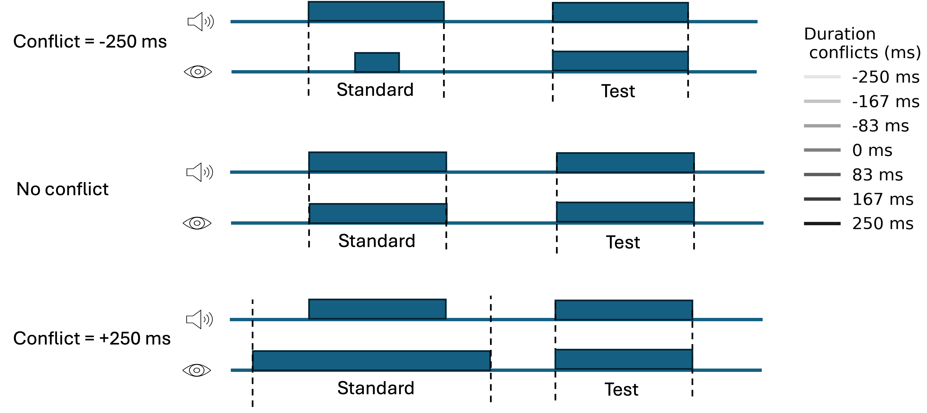
Audiovisual duration conflict
Participants judged the sound. The visual duration varied.
7 conflict levels
2 auditory noise levels
−250 to +250 ms
clear sound / noisy sound
3/6
Notes:
Source: Manuscript Figure: Audiovisual conflict in the bimodal experimental task. Seven conflicts from -250 to +250 ms and two auditory-noise conditions.

Slide 4
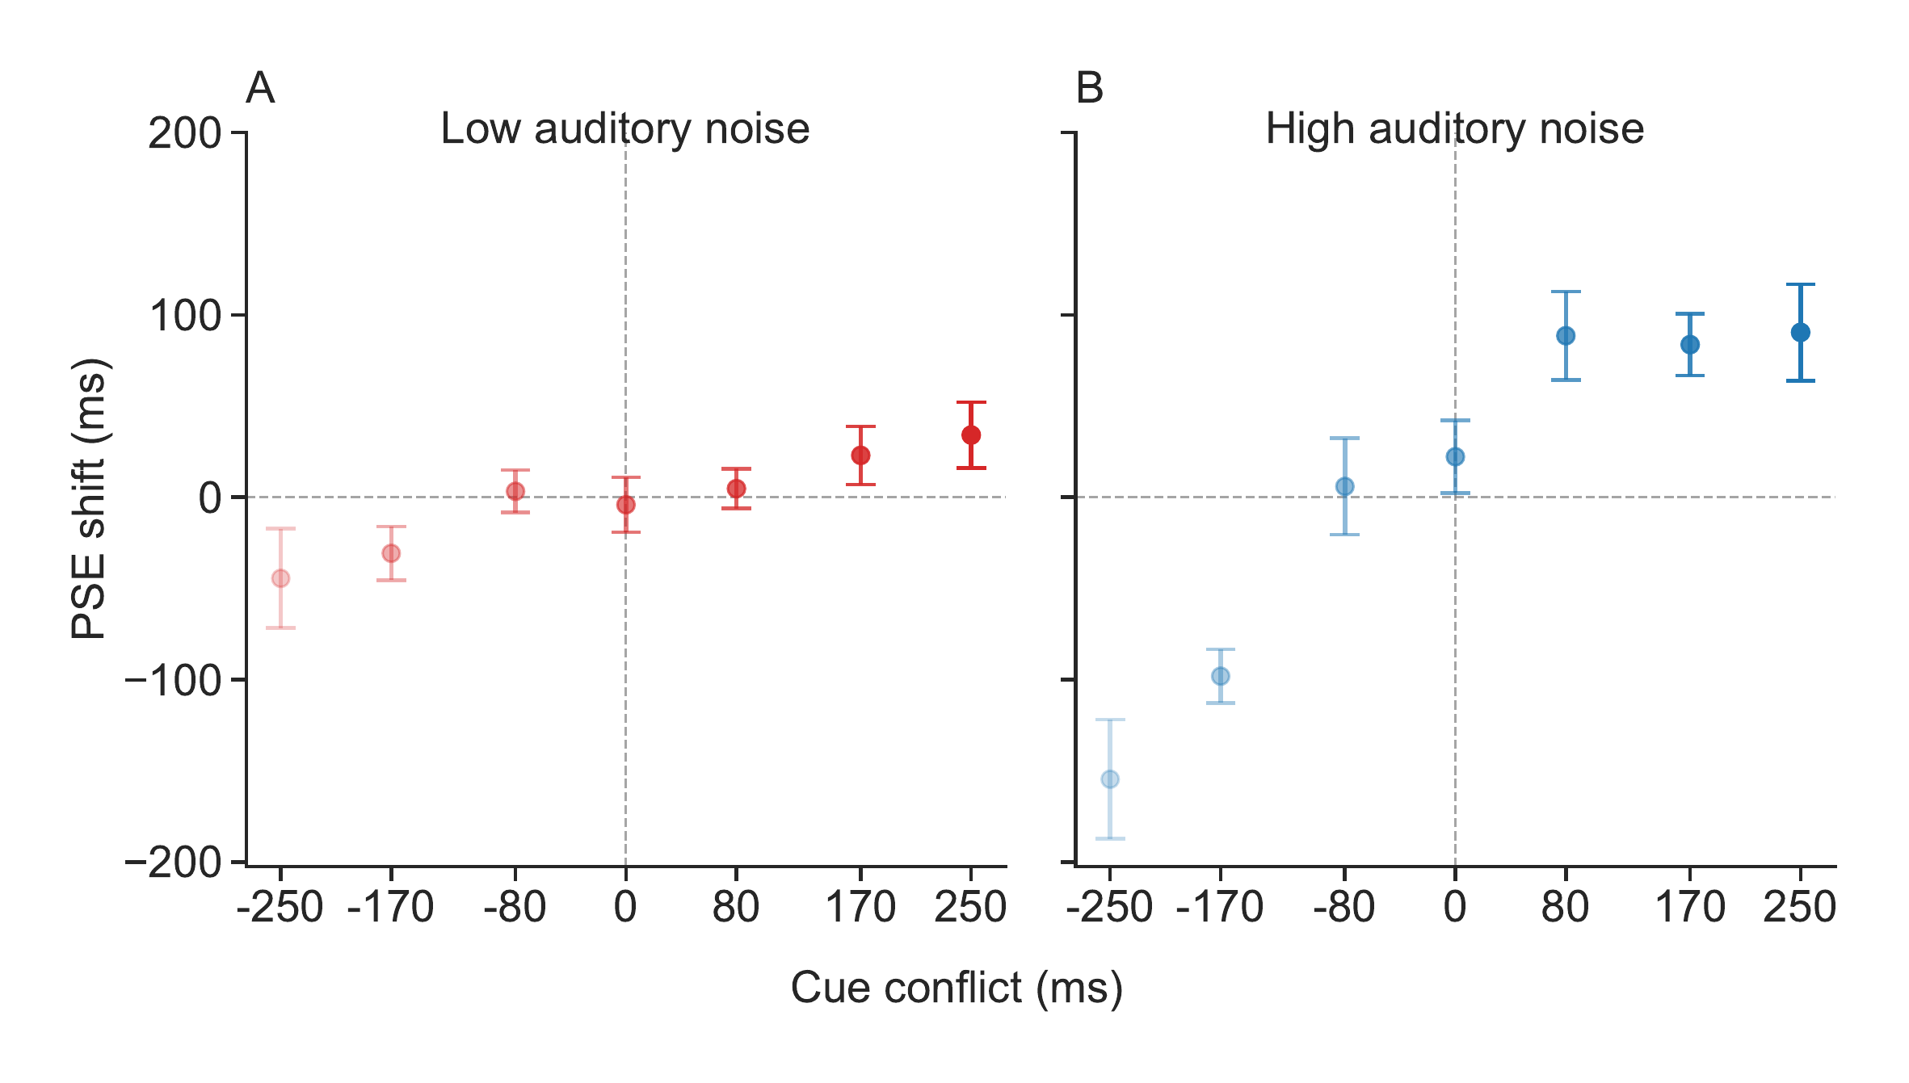
Vision pulled auditory judgments
The pull grew with cue conflict and became much stronger when sound was noisy.
Less reliable sound gave vision more influence.
4/6
Notes:
Source: Manuscript Figure: Effect of audiovisual conflict on perceived auditory duration. Low-noise mean slope 0.148 ms/ms; high-noise mean slope 0.505 ms/ms.

Slide 5
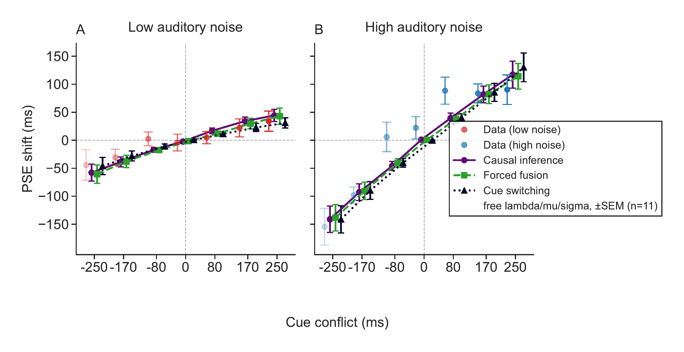
Three models, almost one prediction
Forced fusion, causal inference, and cue switching produced nearly overlapping shifts.
The predicted causal-inference bend was weak within the tested range.
5/6
Notes:
Source: Manuscript Figure: Measured and predicted PSE shifts. All three models produce overlapping, approximately linear predictions across the tested conflict range.

Slide 6
What did the models say?
8 / 11
participants were best fit by
probabilistic cue switching
But the differences among models were small.
High sensory noise made forced fusion and causal inference especially difficult to tell apart.
No clear breakdown of integration within the tested conflict range
6/6
Notes:
Source: Model fitting, model comparison, and conclusions sections of the manuscript. Cue switching had the lowest AIC for 8 of 11 participants, while model-performance differences remained small.

