Slide 1


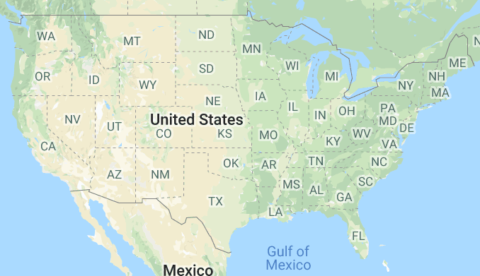
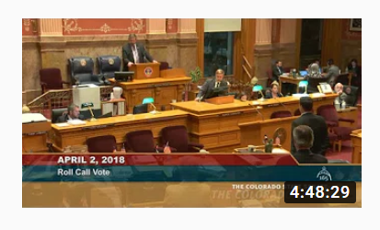

Landing Page
Welcome to OMF
Search for a Site:
Search for a Topic Everywhere:
Go
Go
Recent Sessions on OMF
Colorado State Legislature
March 16, 2019
Legislative Day 83
Go to Site Page
Watch on YouTube
Colorado State Legislature
March 16, 2019
Legislative Day 83
Go to Site Page
Watch on YouTube

Slide 2
Site SERP
Search for a Site:
Colorado
Go
Site Name
Session Count
Population
Last Session Date
Most recent session:
Colorado State Legislature
March 16, 2019
Legislative Day 83
Watch on YouTube
Site Name
Session Count
Population
Last Session Date
Most recent session:
Colorado State Legislature
March 16, 2019
Legislative Day 83
Watch on YouTube

Slide 3
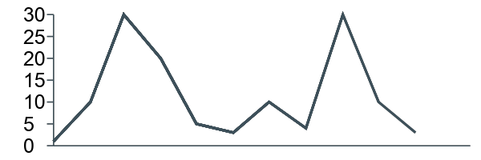
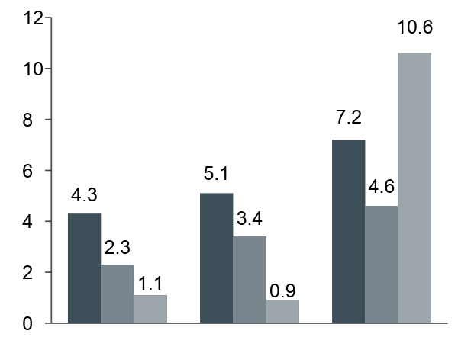
Site PAGE
Colorado State Legislature
Site Activity by month
Search for a Topic/Keyword on this Site
Go
1/1/2018
4/1/2018
7/1/2018
10/1/2018
1/1/2019
Hours discussed for Topics
Recent Sessions on this Site
Colorado State Legislature
March 16, 2019
Legislative Day 83
Transit
Voting
Water
Go to Site Page
Watch on YouTube
Colorado State Legislature
March 16, 2019
Legislative Day 83
Go to Site Page
Watch on YouTube
March
April
May

Slide 4
Site PAGE
Colorado State Legislature
Voting
Go
Info
Agenda
Caption
Title
Date
State Legislature Meeting
Info
Agenda
Caption
Title
Date
State Legislature Meeting

