Slide 1

Human Emotion Recognition
Team members:
Om Gaikwad
Ameya Deshmukh

Slide 2

What is Emotion Recognition?
Human Emotion Recognition → Use of deep learning algorithms to detect and understand human emotions based on facial expressions.
Primary Purpose → To enhance human-machine interaction, improve user experience, and make applications more responsive to human emotions.

Slide 3
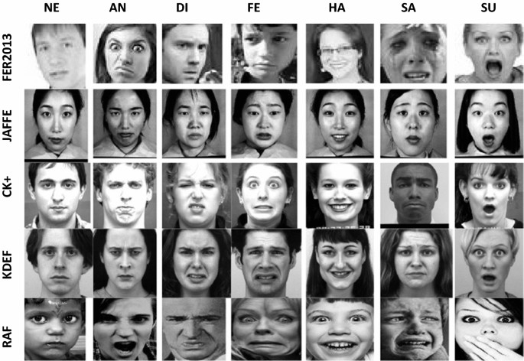
Dataset
Introduction:
The Facial Expression Recognition 2013 (FER2013) dataset is a well-known dataset specifically designed for the task of facial expression recognition.
Key Characteristics:
Size: Contains 35,887 grayscale images of faces.
Annotations: Each image is categorized into one of seven facial expression categories (Anger, Disgust, Fear, Happy, Sad, Surprise, and Neutral).
Diversity: The dataset comprises faces from a variety of age groups and ethnicities, reflecting real-world diversity.
Advantages:
Focused Scope: With its specific focus on facial expressions, FER2013 is ideal for targeted research and development in emotion recognition.
Balanced Categories: The dataset provides a relatively balanced number of examples across different expression categories, aiding in unbiased model training.
Challenges:
Image Quality: The images, being in grayscale and of varying resolutions, may pose challenges in extracting fine-grained facial expression details.
Emotional Complexity: The categorization into seven basic emotions might not capture the subtleties and complexity of human expressions fully.

Slide 4
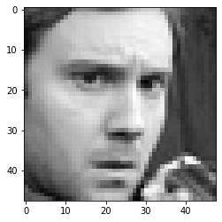
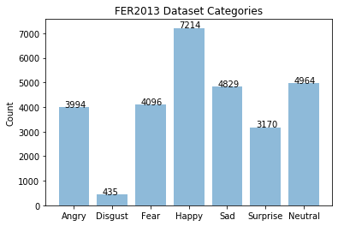
Preprocessing
Image Data Processing:
Each image: Grayscale, 48x48 pixels.
Reshaping image data into 3D arrays for model compatibility.
Label Processing:
Total of 7 expression categories (0=Angry, 1=Disgust, 2=Fear, 3=Happy, 4=Sad, 5=Surprise, 6=Neutral).
Conversion of labels into categorical format for classification.
Dataset Splitting:
Allocation: 80% training, 20% testing.
Shapes: x_train (22967, 48, 48, 1), x_test (5742, 48, 48, 1).
Normalization:
Scaling pixel values between 0 and 1 for efficient training.
Utilization of Min-Max scaling technique.

Slide 5
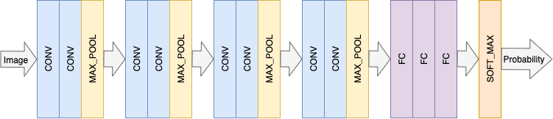
Model Architecture
Inspiration from VGGNet
Convolutional Layers:
All layers with 3x3 kernel size.
Activation Functions:
ReLU (Rectified Linear Unit) & Softmax
Pooling Layers:
Max Pooling Configuration: 3x3 pooling size with 2x2 stride.
Dense (Fully Connected) Layers:
Three dense layers for deeper learning and classification.
Dropout Layers:
Incorporated to prevent overfitting.
Batch Normalization:
Applied after activation layers.
Layer Stacking:
5 stacks of layers in total.
Model Compilation:
Adam optimizer & Sparse Categorical Crossentropy
Model design influenced by VGGNet architecture.
Notes:
Inspiration from VGGNet:
Model design influenced by VGGNet architecture.
Focus on simplicity and depth.
Convolutional Layers:
Primary building blocks of the model.
All layers with 3x3 kernel size.
Purpose: Extracting features by learning from small regions of the image.
Activation Functions:
ReLU (Rectified Linear Unit) for most layers to introduce non-linearity.
Softmax activation in the output layer for probability distribution across 7 facial expressions.
Pooling Layers:
Max Pooling used to reduce spatial dimensions.
Configuration: 3x3 pooling size with 2x2 stride.
Role: Reducing computation and extracting dominant features.
Dense (Fully Connected) Layers:
Serve as decision-makers based on features learned.
Three dense layers for deeper learning and classification.
Dropout Layers:
Incorporated to prevent overfitting.
Randomly deactivates a fraction of neurons during training.
Batch Normalization:
Applied after activation layers.
Speeds up learning and stabilizes training by normalizing layer outputs.
Layer Stacking:
5 stacks of layers in total.
First 4 stacks: 2 convolutional layers followed by 1 pooling layer.
Final stack: 3 dense layers leading to Softmax output.
Model Compilation:
Utilizing Adam optimizer for efficient learning.
Loss function: Sparse Categorical Crossentropy, suitable for classification tasks.

Slide 6
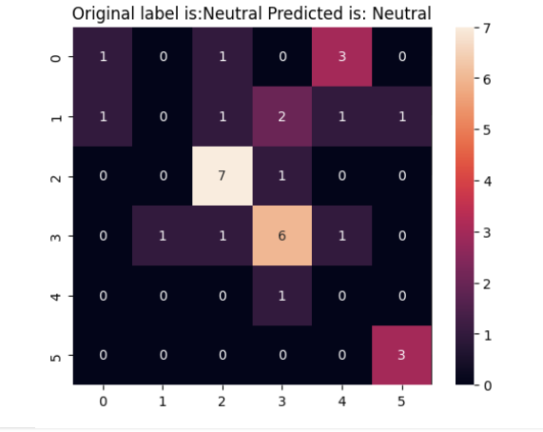
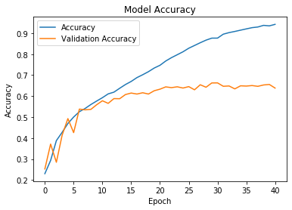
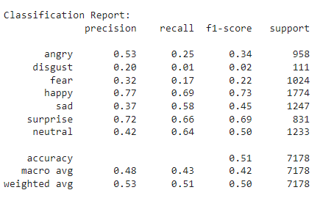
Model Improvement
Training Strategy & Initial Results:
Early Stopping & Learning Rate Adjustments
Initial Performance: ~64 % validation accuracy.
Model Improvement Techniques:
Hard Data Generation
Data Augmentation
Retraining with Hard Data & Augmentation:
Selective Retraining
Augmentation Methods
Evaluation and Analysis:
Post-Improvement Performance: 73.3 % validation accuracy.
Kaggle Benchmarking
Notes:
Training Strategy & Initial Results:
Early Stopping: To halt training when validation accuracy ceases to improve.
Learning Rate Adjustments: Dynamic tuning for optimal convergence.
Initial Performance: Achieved ~64% validation accuracy.
Model Improvement Techniques:
Hard Data Generation: Focusing on misclassified instances for retraining.
Data Augmentation: Enhancing dataset with transformations like rotation and flipping.
Purpose: To refine model's accuracy and robustness.
Retraining with Hard Data & Augmentation:
Selective Retraining: Targeting hard data to address specific misclassifications.
Augmentation Methods: Including zoom, shift, and shear for diversity.
Overfitting Mitigation: Ensuring model generalizes well to new data.
Evaluation and Analysis:
Post-Improvement Performance: Validation accuracy increased to ~68%.
Kaggle Benchmarking: Comparative analysis with competition standings.
Confusion Matrix Insights: Noted challenges in classifying 'Disgust' expressions.

Slide 7
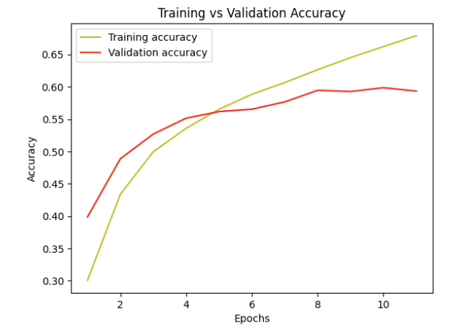
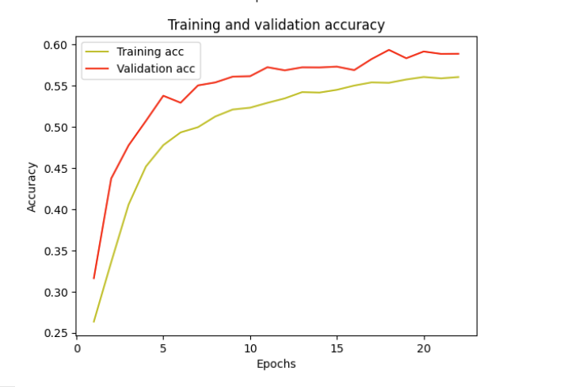
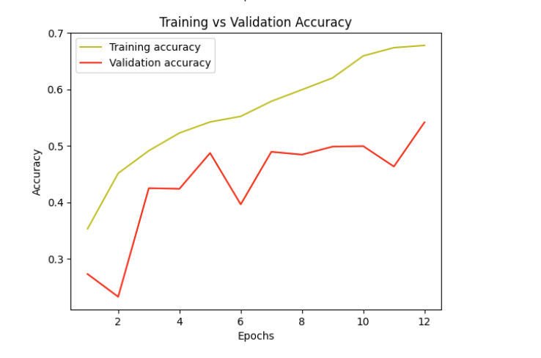
Accuracy Comparison
Model | VGG Net Inspired | Resnet 50 | CNN 4 layers | LSTM
Accuracy (%) | 73.3 | 59.9 | 55.2 | 53.2
VGG
Resnet 50
LSTM
CNN-4 layers

Slide 8
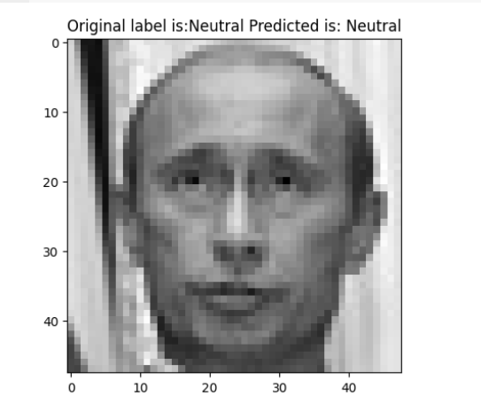
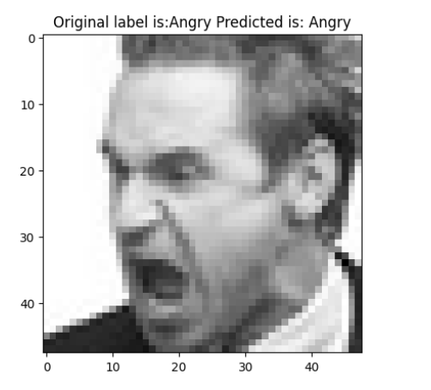
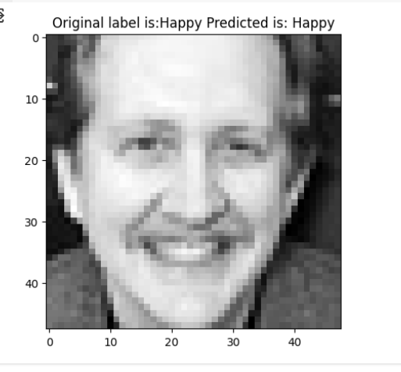
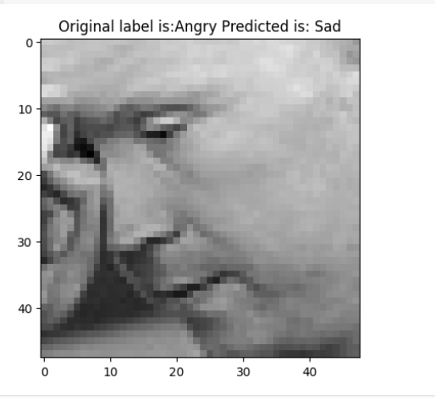
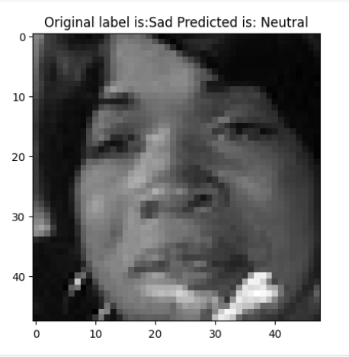
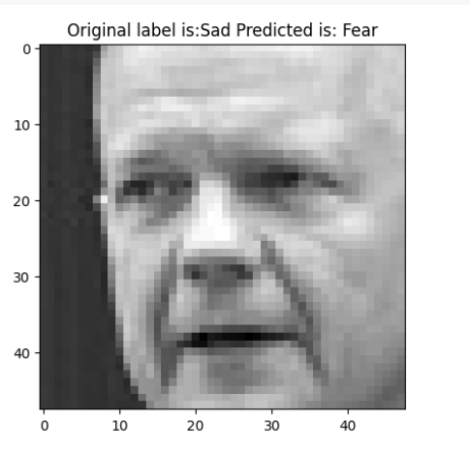
Results (Resnet50)

Slide 9
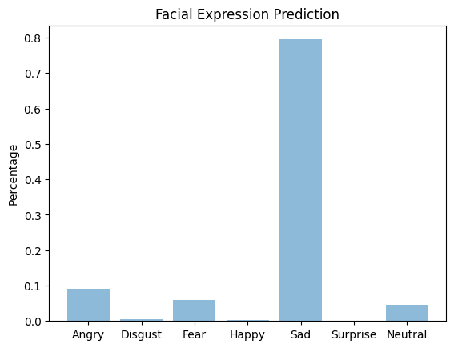
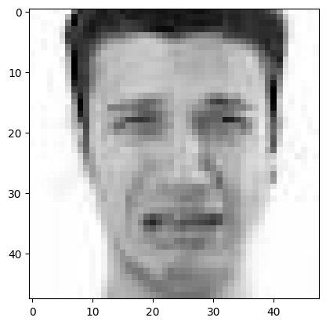
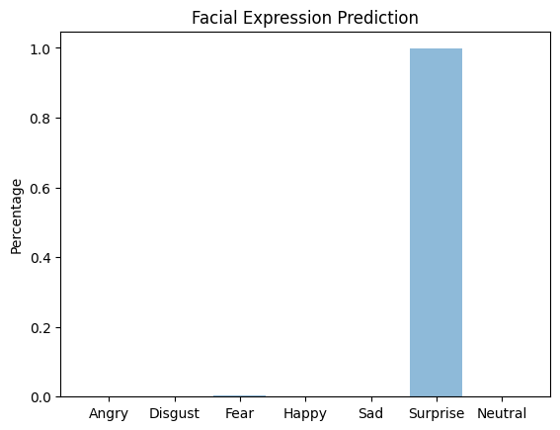
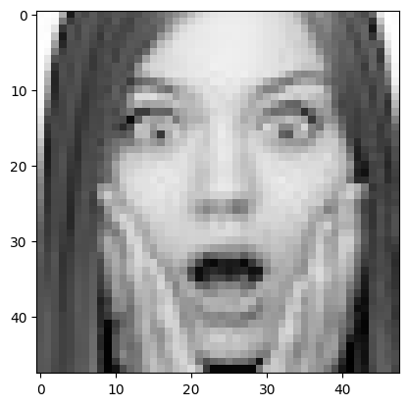
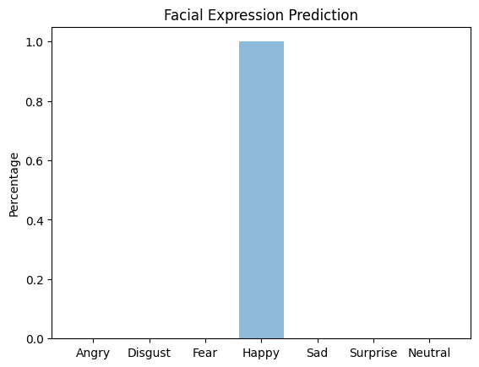
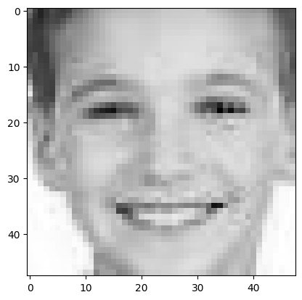
Main Results (VGG)
We tried some other human facial expression images found online.

Slide 10
Continued...
Try to get the AffectNet dataset for better results.
Try and see if Transformers could help us better our results

Slide 11


