Slide 1

SMART INDIA HACKATHON 2026
Problem Statement Details
Problem Statement ID:
Problem Statement Title: AI-Driven Spatio-Temporal Tracking of Extreme Weather Anomalies in Medium-Range Forecasts
Theme:
PS Category: Software
Team ID:
Team Name: Stealth Choppers

Slide 2
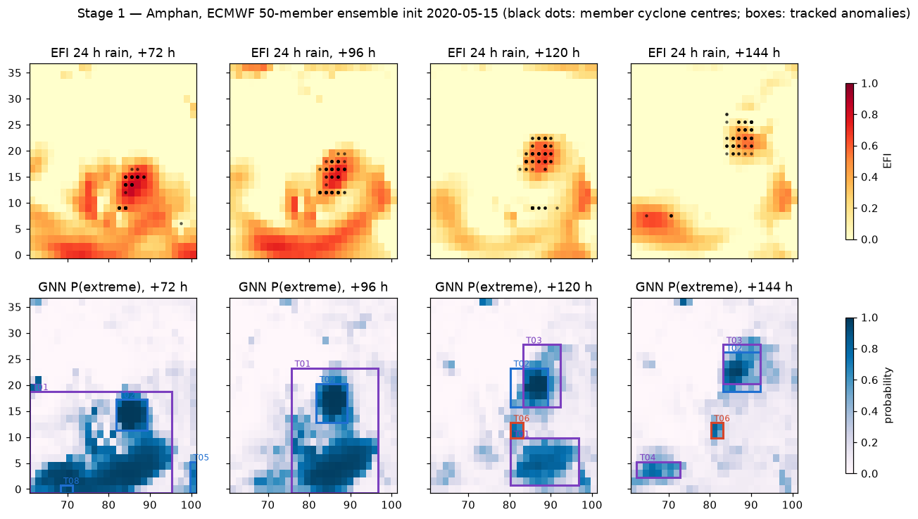
AI-Driven Spatio-Temporal Tracking of Extreme Weather Anomalies
Stealth Choppers
Proposed Solution: two-stage hybrid AI pipeline
Stage 1 – EFI against a 30-yr ERA5 climate + icosahedral-mesh GNN give P(extreme) for rain, wind and heat from a 50-member, 0–10 day ensemble
Tracker – draws 4D bounding boxes around each moving anomaly across 6-hourly leads
Stage 2 – physics-informed diffusion downscales the worst anomaly into low / moderate / severe alerts within 5 km
How it addresses the problem
Replaces manual scanning of 50 members × 40 leads with one tracked, calibrated product
Held-out Cyclone Amphan tracked 5.5 days ahead; landfall alert core over south Bengal
Innovation and uniqueness
Mesh GNN beats raw EFI on heavy rain (AUC 0.955 vs 0.896)
Diffusion keeps 98% of peak rain vs 84% for MSE U-Net; water conserved within 4%
Prototype output, Cyclone Amphan (ECMWF 50-member ensemble, init 15 May 2020): EFI (top) and GNN P(extreme) with tracked boxes (bottom)
5.5 days
lead time on Amphan
0.955
heavy-rain AUC (GNN)
98%
peak rain kept

Slide 3
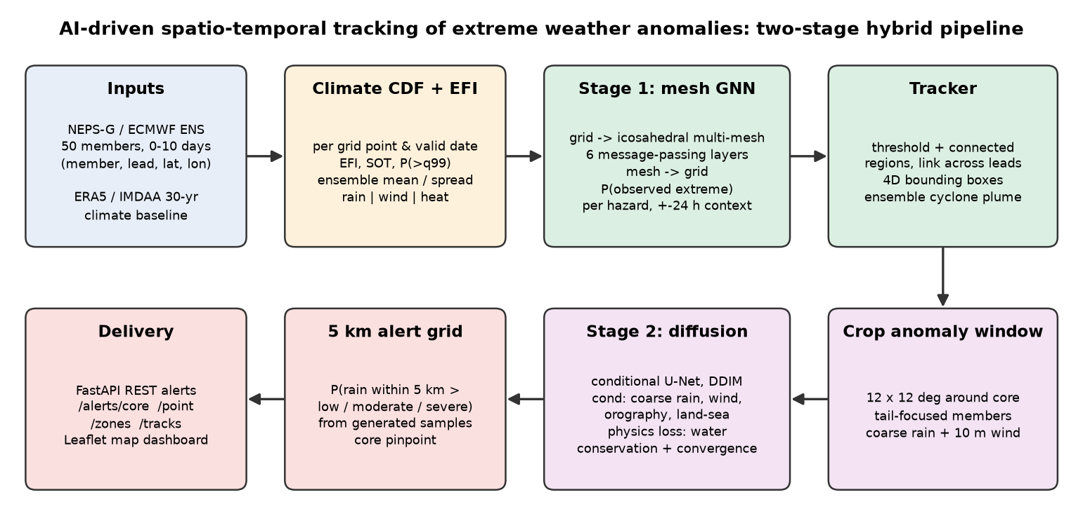
TECHNICAL APPROACH
Stealth Choppers
Technologies used
Language: Python 3.11
AI / ML: PyTorch – mesh GNN (scatter-op message passing) and conditional U-Net diffusion (DDPM / DDIM)
Data: xarray + Dask; NetCDF, GRIB2 (cfgrib), Zarr
Inputs: ECMWF ENS 50 members (NEPS-G ready); ERA5 1990–2019 climate via WeatherBench 2
Serving: FastAPI + Uvicorn REST alerts
Map: Leaflet (Folium) dashboard
Hardware: laptop CPU, no GPU needed
Outputs
Tracks: 4D anomaly boxes + ensemble cyclone plume
API: /alerts/core, /point, /zones, /tracks
Methodology and process for implementation
Stage 1: EFI, Shift of Tails and P(>q99) per grid point → GNN on icosahedral multi-mesh (6 layers, ±24 h context) → P(observed extreme)
Stage 2: 12 × 12 degree crop around the core → 30-step DDIM with water-conservation and moisture-convergence loss → 5 km alert lattice

Slide 4
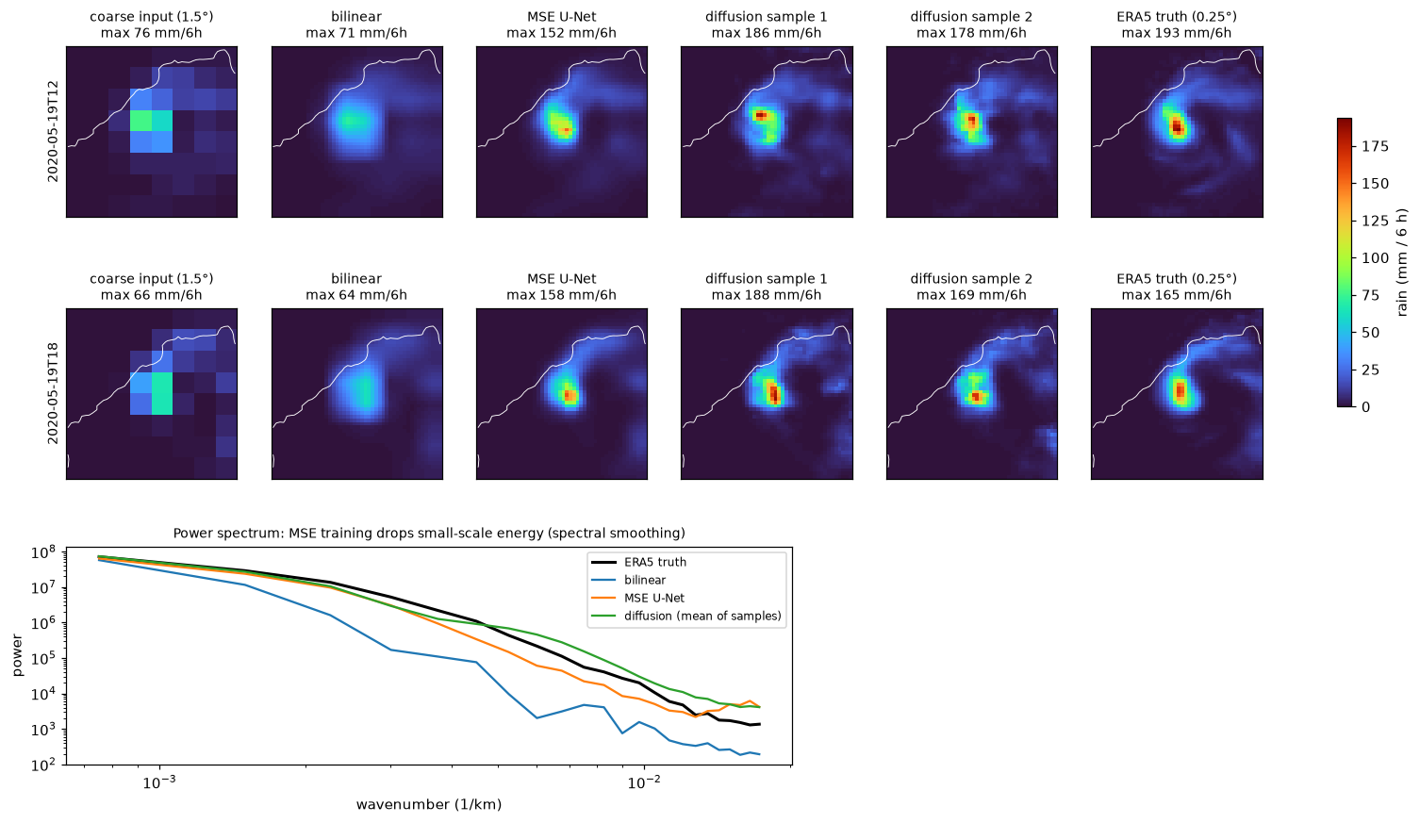
FEASIBILITY AND VIABILITY
Stealth Choppers
Feasibility
Working prototype: one command runs the full pipeline on real Amphan data in ~1 min on a laptop CPU
Cheap to retrain: ~5 min for Stage 1, 30–60 min for Stage 2, no GPU
Plug-in ready: loader maps NEPS-G, NCUM, ECMWF and IMDAA files to one layout
Challenges and strategies
No open 5 km truth for India → code trains on any coarse/fine pair, e.g. NEPS-G 12 km with IMDAA-R 4 km
Small training set (6 cases) → scale up with the NCMRWF archive; heat skill (AUC 0.84) needs more heatwaves
No internet at venue → fully offline synthetic mode with identical file formats
Viability
Skill on a held-out cyclone: AUC 0.955 rain, 0.952 wind
Easy to operate: REST service that runs after each ensemble cycle
Downscaling method | Peak kept | 99th pct | Water error
Bilinear | 41% | 63% | 22%
MSE U-Net | 84% | 91% | 11%
Physics-informed diffusion | 98% | 97% | 4%

Slide 5
IMPACT AND BENEFITS
Stealth Choppers
5.5 days
early warning, Amphan
5 km
alert resolution
3 hazards
rain, wind and heat
~1 min
full run on a laptop CPU
Potential impact on the target audience
Forecasters (IMD, NCMRWF): one tracked, calibrated view of extremes instead of scanning 50 members by hand
Disaster managers (NDMA, SDMAs): 4D tracks days ahead to pre-position teams and plan evacuations
District officials and citizens: point alerts for a town or village, e.g. Kolkata at Amphan landfall
Benefits of the solution
Social: earlier, location-specific warnings for coastal and flood-prone communities
Economic: lead time to protect crops, fishing fleets and property; runs on existing CPUs with no GPU cost
Environmental: far less compute and energy than re-running high-resolution NWP; supports climate-resilience planning

Slide 6
RESEARCH AND REFERENCES
Stealth Choppers
Extreme forecast indices and data
Lalaurette, F. (2003). Early detection of abnormal weather conditions using a probabilistic extreme forecast index. QJRMS 129
Zsótér, E. (2006). Recent developments in extreme weather forecasting (EFI and Shift of Tails). ECMWF Newsletter 107
Hersbach, H. et al. (2020). The ERA5 global reanalysis. QJRMS 146
Rasp, S. et al. (2024). WeatherBench 2: a benchmark for data-driven global weather models. JAMES
Rani, S. I. et al. (2021). IMDAA: high-resolution regional reanalysis for India. BAMS
Graph neural networks on meshes
Lam, R. et al. (2023). Learning skillful medium-range global weather forecasting (GraphCast). Science 382
Battaglia, P. et al. (2018). Relational inductive biases, deep learning and graph networks. arXiv:1806.01261
Diffusion models and downscaling
Ho, J. et al. (2020). Denoising diffusion probabilistic models. NeurIPS
Song, J. et al. (2021). Denoising diffusion implicit models (DDIM). ICLR
Salimans, T. & Ho, J. (2022). Progressive distillation for fast sampling of diffusion models (v-prediction). ICLR
Mardani, M. et al. (2025). Residual corrective diffusion modeling for km-scale atmospheric downscaling (CorrDiff). Commun. Earth Environ.
Operational context
IMD (2020). Super cyclonic storm Amphan over the southeast Bay of Bengal: preliminary report
NCMRWF. NEPS-G global ensemble prediction system documentation
Holland, G. J. (1980). An analytic model of the wind and pressure profiles in hurricanes. Mon. Wea. Rev. 108

Slide 7
IMPORTANT INSTRUCTIONS
Please ensure below pointers are met while submitting the Idea PPT:
Kindly keep the maximum slides limit up to six (6). ( Including the title slide)
Try to avoid paragraphs and post your idea in points /diagrams / Infographics /pictures
Keep your explanation precise and easy to understand
Idea should be unique and novel.
You can only use provided template for making the PPT without changing the idea details pointers (mentioned in previous slides).
You need to save the file in PDF and upload the same on portal. No PPT, Word Doc or any other format will be supported.
Note - You can delete this slide (Important Pointers) when you upload the details of your idea on SIH portal.

