Slide 1


E-Learning Application
Presented by :-
OM GAYE (180847)

Slide 2
Technology used
JSP
Servlet
Jdbc
Mysql
Mvc (model view controller structure)

Slide 3
services
Register user
Update user
Delete user

Slide 4
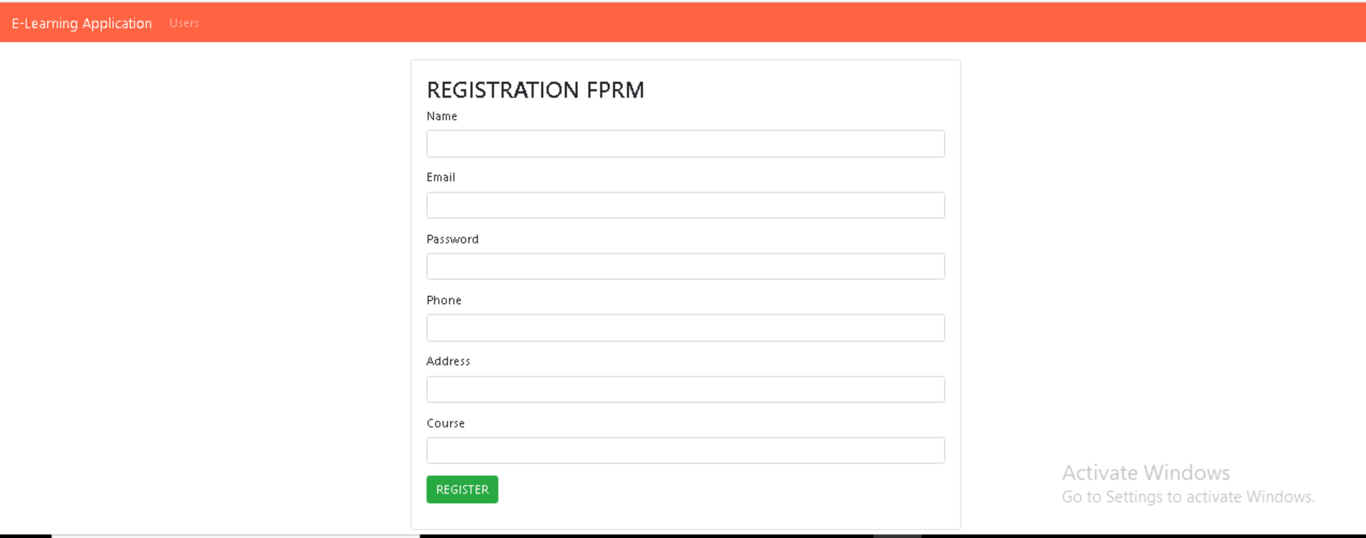
Result

Slide 5
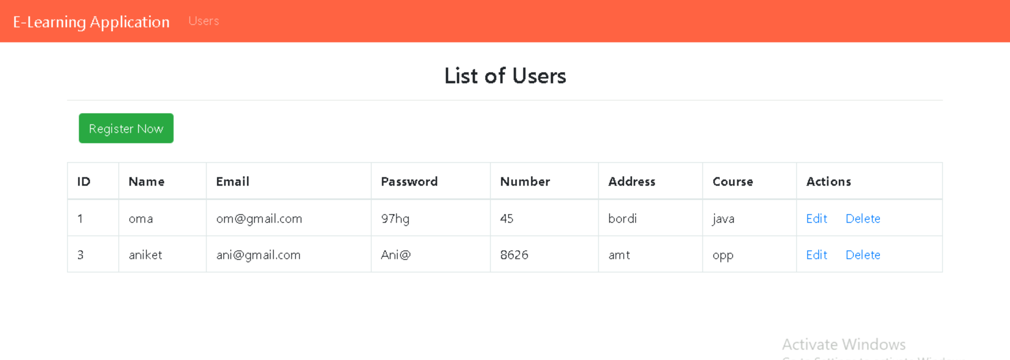

Slide 6

Thank you

