Slide 1

DEANQA: Combing Techniques for Accurate Question Answering
Alex Conrad, Yann Le Gall, Eric Heim

Slide 2
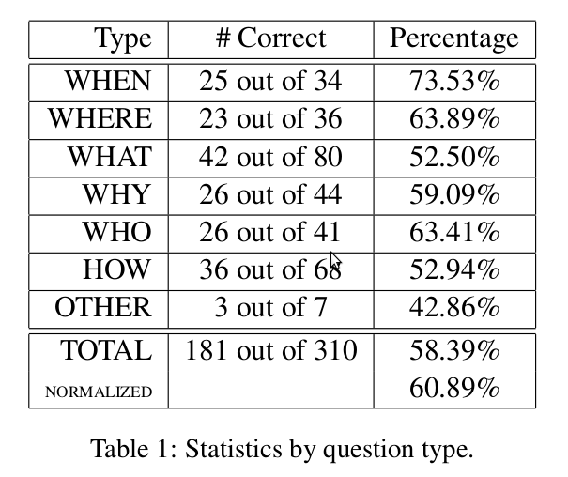
Results

Slide 3
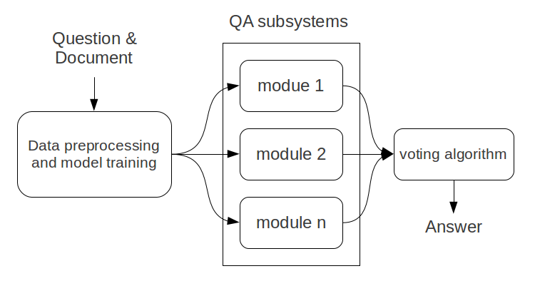
System Architecture

