Slide 1

DEANQA: Combing Techniques for Accurate Question Answering
Alex Conrad, Yann Le Gall, Eric Heim

Slide 2
Introduction
Each member of our group developed a model (or models) that give how probable each sentence in the document is the answer to a given question
Bag-of-Words Model
Rule-Based Model
Bag of N-Grams Model
Discourse Model
NER Model
Support Vector Machine Model
Combined these models via a weighted averaging.
Picked the most probabilistic model.

Slide 3
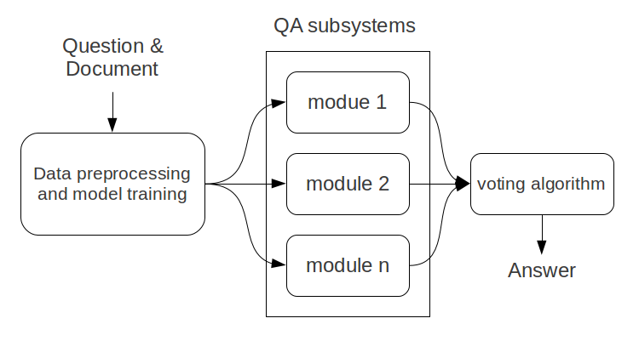
System Model

Slide 4
Bag-of-Words and Rule-Based Components
Bag-of-Words Model
Simple and efficient
Alone, accuracy is generally above 50%
Rule-Based Model
Riloff et al. 2000 [6]
Different rules for each question type
Sentences are given points for matching rules
Most rules incorporate bag-of-words, named-entity-recognition, and other lexical hints
Example rules for a WHEN question:
+1 points if the line contains {during, before, after, time, etc.}
+2 points if the line contains a DATE

Slide 5
Bag of N-Grams
Intuition: sentences which match multi-word expression(s) in a question may be more likely to be answers
Strategy: rank sentences in terms of how many n-grams matched, not just individual words (unigrams)
Outperformed bag of words on some question types

Slide 6
Discourse Component
Intuition: specific kinds of discourse relations may frequently be part of an answer to a specific kind of question
Ex: a “Synchronous” or “Asynchronous” relation may frequently be part of an answer to a “When” question
Strategy:
Learn question type / discourse relation type correlation from training set
Depending on the type of the question, increase likelihood of sentences participating in strongly-correlated discourse relations
Discourse parser trained on PDTB [9]
Flat tagset, similar domain, used in other published work [10]

Slide 7
Named Entity Recognizer Component
Intuition: different kinds of questions may require different kinds of named entities in their answer
Example: an answer to a “Where” question may frequently contain a “Location” entity
Strategy:
Identify the kinds of entities present in each sentence
Depending on the type of the question, increase likelihood of sentences containing instances of the appropriate entity type
Uses pre-trained “muc.7class.distsim.crf” model provided with Stanford parser
Overall, not too useful (low recall)

Slide 8
Support Vector Machine Component
So how about a Machine Learning approach?
Design a classifier that can predict whether a sentence answers a question or not.
Extract data from training documents, questions, and answers.
Every data point is a sentence-question pair with a label if the sentence is the answer to its pair (1) or not (-1)
Each feature captures some information from the sentence-question pair (POS, NER, Co-occurrence of lemmas).
When classifying pick the sentence-question pair that is most likely (but not necessarily classified) to be the answer.
These features were taken from Ng et al. [4] with one set of Question Type features added.

Slide 9
Support Vector Machine Component
The main difference from [4] is that they used a C5 classifier. We substituted this for a Support Vector Machine (SVM).
In short, this model attempts to create a decision boundary between classes that maximizes the margin between the boundary and either class, penalizing instances that cross it.
Very popular right now.
On the training set (“input-test1”), using the same features and training set (“input”) the SVM model classified sentences with higher accuracy.
SVM (148 out of 310)
C4.5 implementation (131 out of 310).
Software used: WEKA [3], LibSVM [1], Stanford CoreNLP [2], [8]

Slide 10
Answer Predictor Combinations
Answer predictor modules combined using different weights for each question type
Weights learned by experimenting using test1 data
Q. Type | Weights
Why | 0.45*bow + 0.45*boNGrams + 0.1*ner
Other | 1.0*boNGrams
What | 0.4*SVM + 0.4*boNGrams + 0.1*ner + 0.1*disc
Who | 0.33*bow + 0.33*boNGrams + 0.33*SVM
How | 0.45*bow + 0.45*boNGrams + 0.1*ner
When | 0.8*bow + 0.2*ner
Where | 0.2*boNGrams + 0.2*bow + 0.2*SVM + 0.2*rule + 0.1*ner + 0.1*disc

Slide 11
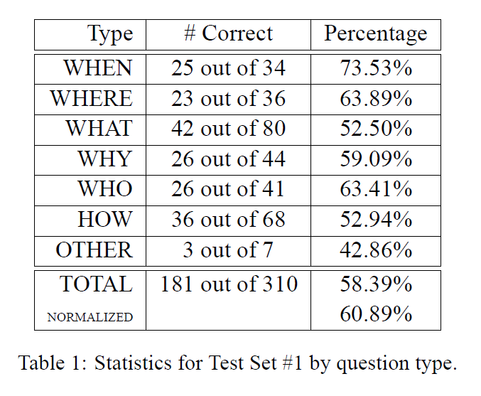
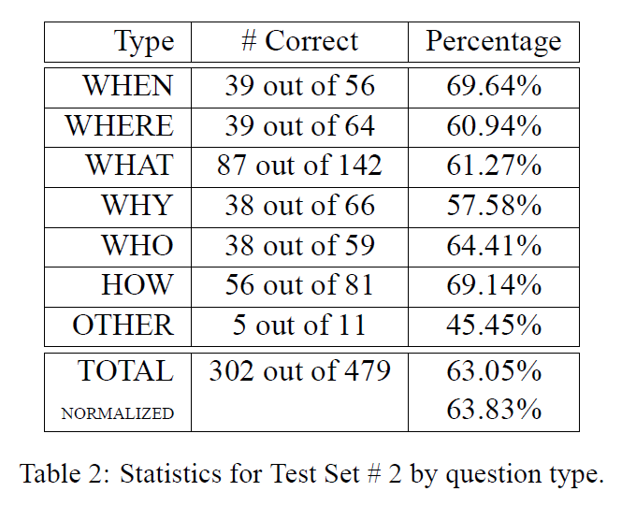
Results

Slide 12
Conclusions
Components:
Simple Bag-of-Words, Bag of N-Grams
Linguistic, Rule-based Strategy
Discourse Parser, Named Entity Recognizer
Support Vector Machine
Each component answers fairly accurately for certain kinds of questions but not for others.
By combining the components, we can improve overall accuracy.
Possible Improvements:
Anaphora resolution for SVM.
More investigation of how to weight components.
Can easily add other components.

Slide 13
References
[1] Chih-Chung Chang and Chih-Jen Lin. 2001. Libsvm: a library for support vector machines.
[2] Jenny Rose Finkel, Trond Grenager, and Christopher Manning. 2005. Incorporating non-local information into information extraction systems by gibbs sampling. In ACL, pages 363– 370.
[3] Mark Hall, Eibe Frank, Geoffrey Holmes, Bernhard Pfahringer, Peter Reutemann, and Ian H. Witten. The weka data mining software: An update.
[4] Hwee Tou Ng, Leong Hwee Teo, Jennifer Lai, and Jennifer Lai Pheng Kwan. 2000. A machine learning approach to answering questions for reading comprehension tests. In Proceedings of EMNLP/VLC-2000 at ACL-2000.
[5] J. Ross Quinlan. 1993. C4.5: programs for machine learning. Morgan Kaufmann Publishers Inc., San Francisco, CA, USA
[6] Ellen Riloff and Michael Thelen. 2000. A rule-based question answering system for reading comprehension tests. In Proceedings of the 2000 ANLP/NAACL Workshop on Reading comprehension tests as evaluation for computer-based language understanding sytems – Volume 6, ANLP/NAACL-ReadingComp ’00, pages 13–19, Stroudsburg, PA, USA. Association for Computational Linguistics.
[7] M. Rotaru and D.J. Litman. 2005. Improving Question Answering for Reading Comprehension Tests by Combining Multiple Systems. In Proceedings of the American Association for Artificial Intelligence: Workshop on Question Answering in Restricted Domains.
[8] Kristina Toutanova and Christopher D. Manning. 2000. Enriching the knowledge sources used in a maximum entropy part-of-speech tagger. In EMNLP/VLC 2000, pages 63–70.
[9] Ziheng Lin, Hwee Tou Ng, and Min-Yen Kan. A PTDB-Styled End-to-End Discourse Parser. Technical Report TRB8/10, School of Computing, National University of Singapore, Singapore.
[10] Ziheng Lin, Hwee Tou Ng, and Min-Yen Kan. Automatically Evaluating Text Coherence Using Discourse Relations. ACL, 2011.

