Slide 1

DEANQA: Combing Techniques for Accurate Question Answering
Alex Conrad, Yann Le Gall, Eric Heim

Slide 2
Support Vector Machine Component
So how about a Machine Learning approach?
Design a classifier that can predict whether a sentence answers a question or not.
Extract data from training documents, questions, and answers.
Every data point is a sentence-question pair with a label if the sentence is the answer to its pair (1) or not (-1)
Each feature captures some information from the sentence-question pair (POS, NER, Co-occurance of lemmas).
When classifying pick the sentence-question pair that is most likely (but not necessarily classified) to be the answer.
These features were taken from Ng et al. [4] with one set of Question Type features added.

Slide 3
Support Vector Machine Component
The main difference from [4] is that they used a C5 classifier. We substituted this for a Support Vector Machine (SVM).
In short, this model attempts to create a decision boundary between classes that maximizes the margin between the boundary and either class, penalizing instances that cross it.
Very popular right now.
On the training set (“input-test1”), using the same features and training set (“input”) the SVM model classified sentences with higher accuracy.
SVM (148 out of 310)
C4.5 implementation (131 out of 310).
Software used: WEKA [3], LibSVM [1], Stanford CoreNLP [2], [6]

Slide 4
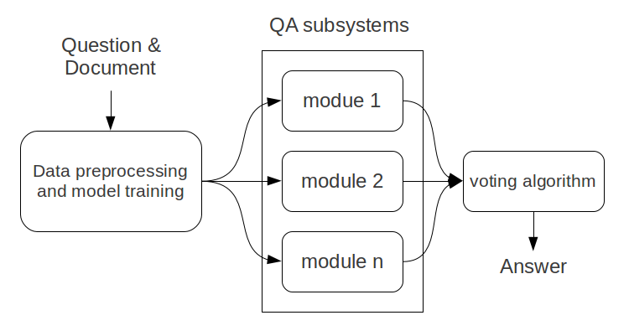
System Model

Slide 5
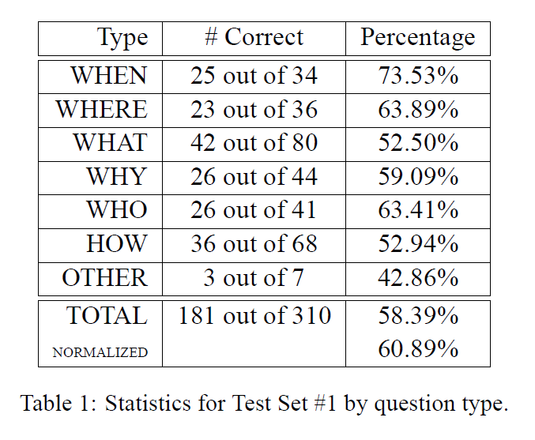
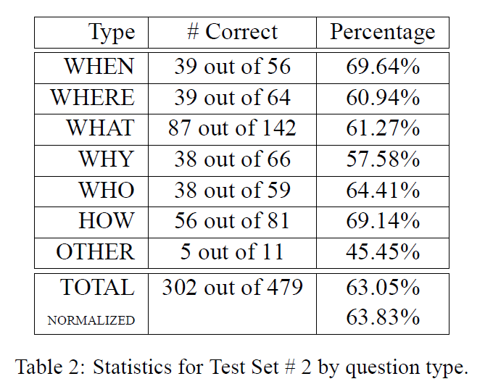
Results

Slide 6
Conclusions
Components:
Simple Bag of Words
Linguistic, Rule-bed Strategy
ALEX PUT YOUR COMPONENTS HERE
Support Vector Machine
Each component answers fairly accurately for certain kinds of questions but not for others.
By combining the components intelligently, we can improve overall accuracy.
Possible Improvements:
Anaphora resolution for SVM.
More investigation of how to weight components.
Can easily add other components.

Slide 7
References
[1] Chih-Chung Chang and Chih-Jen Lin. 2001. Libsvm: a library for support vector machines.
[2] Jenny Rose Finkel, Trond Grenager, and Christopher Manning. 2005. Incorporating non-local information into information extraction systems by gibbs sampling. In ACL, pages 363– 370.
[3] Mark Hall, Eibe Frank, Geoffrey Holmes, Bernhard Pfahringer, Peter Reutemann, and Ian H. Witten. The weka data mining software: An update.
[4] Hwee Tou Ng, Leong Hwee Teo, Jennifer Lai, and Jennifer Lai Pheng Kwan. 2000. A machine learning approach to answering questions for reading comprehension tests. In Proceedings of EMNLP/VLC-2000 at ACL-2000.
[5] J. Ross Quinlan. 1993. C4.5: programs for machine learning. Morgan Kaufmann Publishers Inc., San Francisco, CA, USA
[6] Ellen Riloff and Michael Thelen. 2000. A rule-based question answering system for reading comprehension tests. In Proceedings of the 2000 ANLP/NAACL Workshop on Reading comprehension tests as evaluation for computer-based language understanding sytems – Volume 6, ANLP/NAACL-ReadingComp ’00, pages 13–19, Stroudsburg, PA, USA. Association for Computational Linguistics.
[7] M. Rotaru and D.J. Litman. 2005. Improving Question Answering for Reading Comprehension Tests by Combining Multiple Systems. In Proceedings of the American Association for Artificial Intelligence: Workshop on Question Answering in Restricted Domains.
[8] Kristina Toutanova and Christopher D. Manning. 2000. Enriching the knowledge sources used in a maximum entropy part-of-speech tagger. In EMNLP/VLC 2000, pages 63–70.

