Slide 1

DEANQA: Combing Techniques for Accurate Question Answering
Alex Conrad, Yann Le Gall, Eric Heim

Slide 2
System Architecture

Slide 3
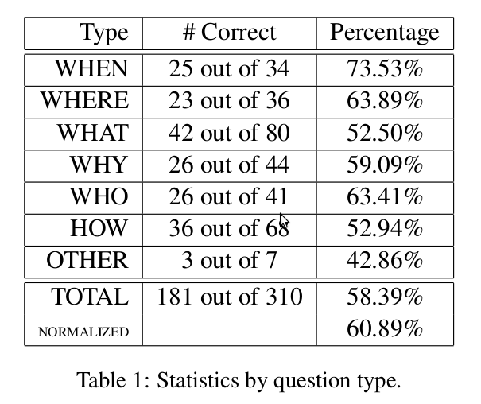
Results

