Slide 1

Job Preparation Module
Your complete guide to becoming job-ready in the tech industry. Master practical skills, build impressive projects, and position yourself for success.

Slide 2

Four Pillars of Job Readiness
Resume & LinkedIn
Portfolio Development
Optimize your professional presence with ATS-friendly resumes and compelling profiles that get noticed.
Build a showcase of prompt engineering case studies and projects that demonstrate your skills.
Interview Skills
Personal Brand
Master technical rounds, DSA fundamentals, and communication strategies that land offers.
Build visibility through strategic content creation and consistent online presence.

Slide 3
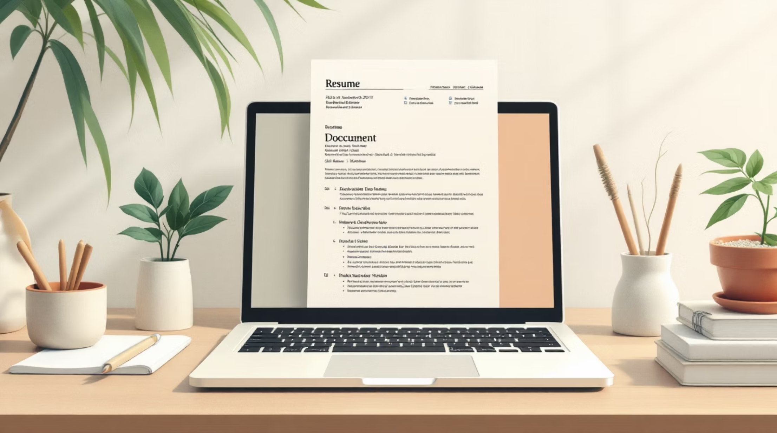
Resume Optimization Essentials
What Makes a Resume ATS-Friendly?
Applicant Tracking Systems (ATS) filter resumes before human eyes see them. Include strategic keywords like skills, tools, and role titles that match job descriptions.
Key Sections to Master
Header with contact info, LinkedIn, GitHub
Impact-focused summary (2-3 lines)
Categorized skills: Languages, Tools, Frameworks
Projects formatted as Problem → Solution → Tech → Impact

Slide 4
LinkedIn Profile Mastery
01
02
Craft Your Headline
Tell Your Story
Use the formula: Role + Skills + Value. Example: "Aspiring Software Engineer | Python | AI Projects | Problem Solver"
Write an About section that connects past → present → future. Make it compelling and authentic.
03
04
Optimize Profile Elements
Build Visibility
Professional profile picture, engaging banner, featured projects section, and consistent activity.
Post regularly using the Hook → Value → CTA formula. Engage with others' content to grow your network.

Slide 5

Master Prompt Engineering
Types of Prompts to Master
Instruction-Based
Clear commands that tell AI exactly what to do
Role-Based
Assign a specific persona or expertise to the AI
Few-Shot
Provide examples to guide the AI's pattern recognition
Chain-of-Thought
Break complex problems into step-by-step reasoning
Portfolio Structure Formula
Each case study needs: Problem statement → Prompt used → Output generated → Improvements made. Create 5 projects and showcase them on GitHub or Notion.

Slide 6
Interview Preparation Strategy
Technical Round Focus
HR Round Essentials
Master DSA fundamentals: arrays, strings, maps. Practice the problem-solving approach:
Tell me about yourself using past → present → future. Discuss strengths and weaknesses authentically. Explain your projects clearly and concisely.
Understand the problem completely
Propose a brute force solution
Optimize with better algorithms
Mock Interview Practice
Conduct at least 2 mock interviews per student. Focus on communication clarity and project explanation. Provide constructive feedback.
AI-Specific Questions
Be ready to explain: How do you write effective prompts? What techniques improve output quality? Share your case studies.

Slide 7



Build Your Personal Brand
Create Hook
Deliver Value
Call to Action
Start with attention-grabbing opening: "I built an AI chatbot in 3 days — here's what I learned…"
Share actionable insights, lessons learned, and practical takeaways for your audience
End with clear next steps: "Try this approach" or "Follow for more tech insights"
Post consistently 3 times per week on LinkedIn. Mix learning posts, project showcases, and engaging threads. Engage with others' content to build your network and visibility.

Slide 8

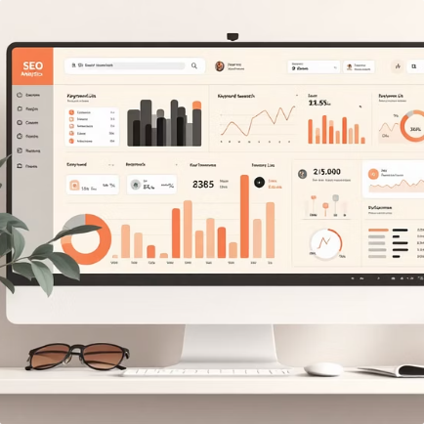
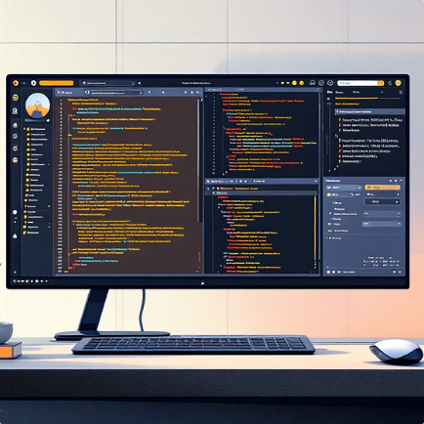



Capstone Projects Showcase
AI Chatbot with Memory
SEO Research System
Prompt-Powered Code Generator
Personal Branding Assistant
Generate keyword strategies and search intent analysis with AI
Build context-aware chatbots using LLM APIs and chat history storage
Create intelligent systems that transform natural language into working code
Develop AI that crafts LinkedIn posts, bios, and resume content
Vision + Text AI Agent
Document Analyzer
Build multimodal systems that process images and text together
Create PDF and text processors that generate summaries and insights

Slide 9


Assessment & Evaluation
Grading Breakdown
40%
20%
Project Completion
Portfolio Quality
Quality and functionality of capstone projects
Case studies and documentation standards
20%
20%
Resume & LinkedIn
Interview Performance
Professional presence optimization
Technical and communication skills
What Success Looks Like
Students who complete this module can confidently apply for tech roles, showcase impressive projects, crack technical interviews, and maintain strong online presence.

Slide 10

Instructor Success Tips
Focus on Hands-On Learning
80% of time should be dedicated to practical exercises, not lectures. Students learn by doing.
Use Real-World Examples
Show actual resume samples, live LinkedIn profiles, and real interview scenarios from industry.
Encourage Consistency
Build routines: weekly resume updates, daily practice problems, regular content posting habits.
Provide Continuous Feedback
Review work frequently, offer constructive criticism, and celebrate incremental improvements.

