Slide 1
Machine Learning SS20 Assignment 3
Model Inversion Attack
Dominik Eitler, 01633008 Gwendolyn Rippberger, 01307685
Marko Spegel-Grünberger, 08726501

Slide 2
Task
Training of different neural networks for image recognition
Using a white-box model inversion attack to reproduce input images
Testing this algorithm on different networks and evaluate results

Slide 3
Models
Softmax Regressor
Multi-Layer Perceptron
Stacked denoising Autoencoder
Convolutional Neural Network

Slide 4
Models
Softmax Regressor:
1 linear layer with Softmax activation that maps 112x92 input image to 40 class-probabilities
trained with Stochastic Gradient Descent and Cross Entropy Loss

Slide 5
Models
Multi-Layer Perceptron:
1 hidden layer of 3000 nodes with Sigmoid activations
1 Softmax output layer as described in Softmax
trained with Stochastic Gradient Descent and Cross Entropy Loss

Slide 6
Models
Stacked denoising Autoencoder:
2 pretrained Autoencoder layers (1000 and 300 nodes) with tanh activation functions (trained with partly corrupted input)
trained with Adam Optimizer and Mean Squared Error
1 Softmax output layer as described in Softmax
trained with Stochastic Gradient Descent and Cross Entropy Loss

Slide 7
Models
Convolutional Neural Network:
2 convolutional layers using kernel size of 3
Relu activation function
max pooling on convolutional layers
then using one linear layer of 512 neuros converting to 40 nodes output layer

Slide 8
Inversion
algorithm uses Stochastic Gradient Descent to find optimal input to a model to get a certain class label
this input can be understood as a reconstructed image of the input data
for the SDAE a processing function can be applied in each iteration, which denoises and sharpens the generated picture

Slide 9
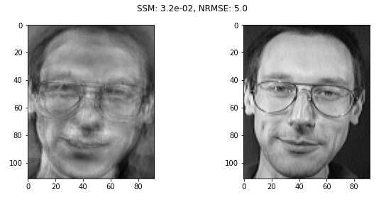
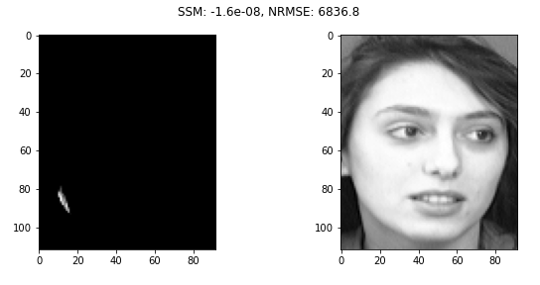
Results (Softmax)
generally worked well (see picture on top)
although had bad performance on a few instances (see picture on the bottom)

Slide 10
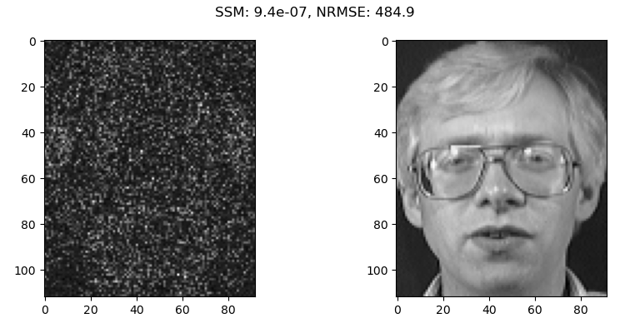
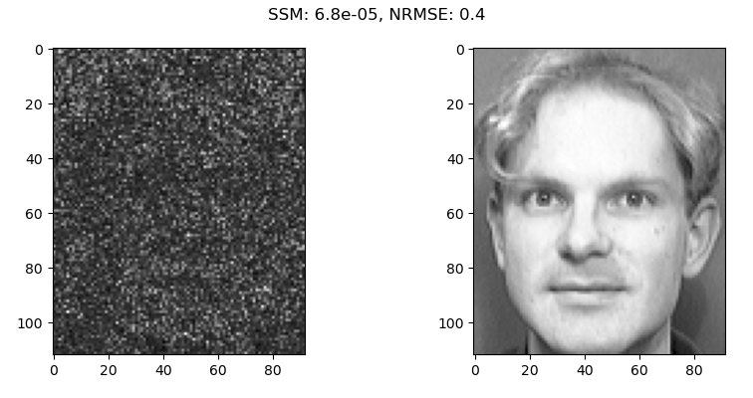
Results (MLP)
outputs generally resemble only noise
in the noise, slight patterns and outlines can be found (see picture on top)
raising beta did not improve results

Slide 11
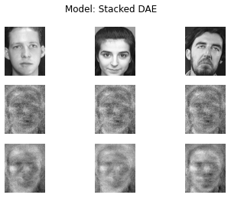
Results (SDAE)
surprisingly, the autoencoder did not work well
for every class, the same image was generated (see middle row)
also processing did not improve it (see bottom row)

Slide 12
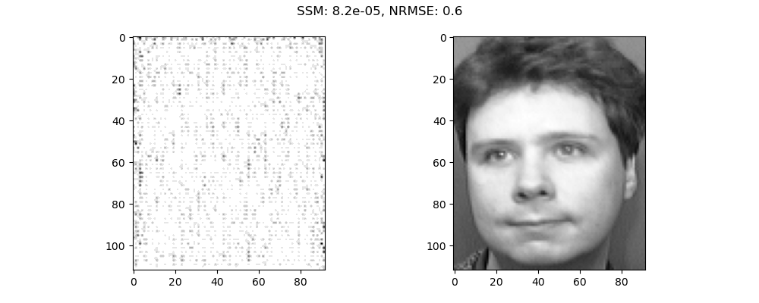
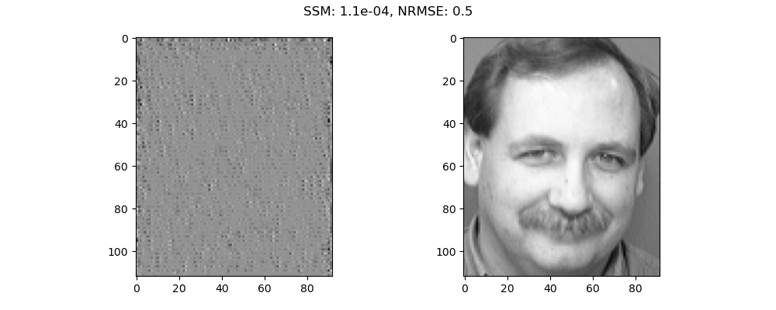
Results (CNN)
results are either all white or grey
we can see the blurring from the convolution
probably due to convolution more difficult to reconstruct
algorithm failed

Slide 13
Conclusions
difficult to reproduce results from paper
algorithm was “wrong”
only successfully reconstructed images for Softmax
fastest model inversions were Softmax (model simplicity) and DAE (vector size)
CNN probably “safe” due to using convolution

