Slide 1
TIME SERIES ANALYSIS AND FORECASTING
Dr. Abdus Sattar

Slide 2
Business firms must make decisions about the nature of their activities and make plans for the future in order to accomplish their objectives. They must make decisions and plans for production, finance personnel, marketing, and other phases of management.
Decisions making and planning often require forecasting of future events that will probably occur. Forecasting, in turn, is usually based on what is occurring at the present and what has occurred in the past. Thus time has been considered as one the most important factors in many management situations. A time series can be used by management to make current decisions and for long-term forecasting and planning. We usually assume past patterns will continue into the future.

Slide 3
Definition: A time series is a collection of data recorded over a period of time – weekly, monthly, quarterly, or yearly.
Among the most frequently mentioned time series are such economic indicators as
Gross National Product(GNP)
Index of Industrial Production
National Income
Employment
Unemployment and
Consumer Price Index (CPI).
The annual sales, revenue, and net income of a business enterprise over a number of years are other examples of time series.

Slide 4
The time series and the related techniques are not limited to the fields of business and economics. They apply also to other variables, such as rainfall in a certain locality, enrollment in an educational institution, and population of a region or a nation.
A time series describes the variations in the values of a variable as a function of time. It can be represented by a graph whose vertical coordinate gives the value of the variable plotted against time on the horizontal axis.

Slide 5
COMPONENTS OF A TIME SERIES
A time series is usually broken down into four distinct components: trend (secular trend), cyclical variation (fluctuation), seasonal variations and irregular variations (changes).
In studying time series, we may take the observed series as a whole for analysis, or analyze any of the components individually. When some components are singled out for study, we have to decompose the series into its parts. Before considering the methods of decomposition of time series, let us first acquaint ourselves with the nature of each of the four components.

Slide 6
SECULAR TREND
The long-term trends of sales, employment, stock prices, and other business and economic series follow various patterns. Some move steadily upward, others decline, and still others stay the same over time.
Secular Trend: The smooth long-term direction of a time series.
The basic objective of the study of trend is to predict the future behavior of the data.

Slide 7
Examples of secular trend
Mean selling price of single-family apartments in a city from 1993until 2001. Chart 1: Apartment Sales in a city, 1993 – 2000.
The long-run direction of the time series is increase
Year | Price($)
1993 | 96577
1994 | 102742
1995 | 103942
1996 | 124500
1997 | 141232
1998 | 146740
1999 | 150900
2000 | 169527

Slide 8
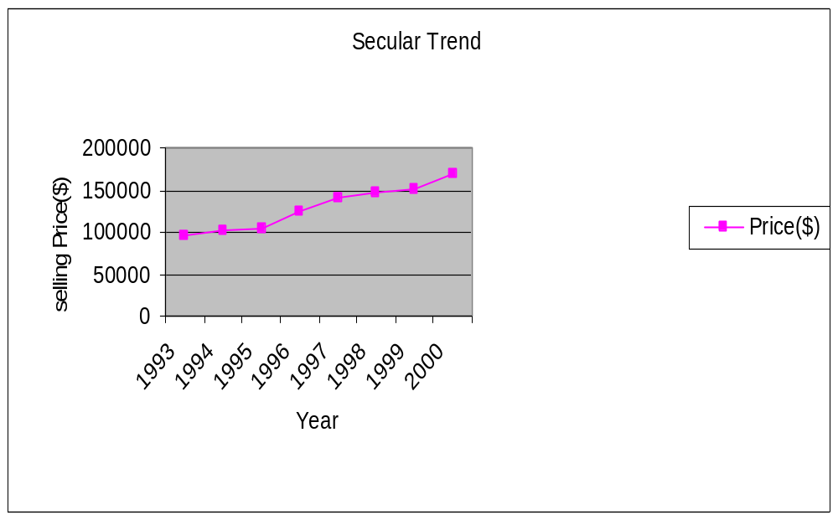

Slide 9
The following is an example of a declining long-run trend
Year | New shopping centers opened |  | Year | New shopping centers opened
1988 | 36 |  | 1994 | 27
1989 | 43 |  | 1995 | 22
1990 | 40 |  | 1996 | 13
1991 | 25 |  | 1997 | 7
1992 | 28 |  | 1998 | 7
1993 | 32 |  | 1999 | 5
Chart 2: New Shopping Opened in country, 1988 – 1999.

Slide 10
CYCLICAL VARIATIONS:
The second component of a time series is cyclical variation. A typical business cycle consists of a period of prosperity, followed by periods of recession, depression and then recovery. There are sizable fluctuations unfolding over more than one year in time above and below the secular trend.

Slide 11
Cyclical Variation: The rise and fall of a time series over periods longer than one year.
Chart 3: Battery Sales by a certain Company, 1984 – 2001.

Slide 12
SEASONAL VARIATIONS
The third component of a time series is the seasonal variation. Many sales, production, and other series fluctuate with the seasons. The unit of time reported is either quarterly or monthly. These are variables related to the seasons of the year and hence the name “seasonal variations” is used. In actual practice, the term may be used to indicate any kind of periodic movement: daily, weekly, or monthly, with a year as its maximum period of recurrence.
Seasonal variations are attributable to a number of factors. Among the most important are climatic conditions, social customs, and religious festivities.

Slide 13
Seasonal Variation: Patterns of change in a time series within a year. These patterns tend to repeat themselves each year.

Slide 14
Irregular Variation
The fourth component of a time series is the irregular, or random, variation. This kind of variation represents the upward and downward movements of the series after secular trend, cyclical fluctuations, and seasonal variations have been accounted for. For this reason, it is often referred to as residual variation. It is caused by sporadic factors such as weather, earthquakes, political actions and many other events.

Slide 15
Irregular variations are sub-divided into:
episodic and
residual variations.
Episodic fluctuations are unpredictable, but they can be identified. The initial impact on the economy of a flood, a major strike, or a war can be identified, but a flood, a war or a strike cannot be predicted.
After the episodic fluctuations have been removed, the remaining variation is called the residual variation.
The residual fluctuations, often called chance fluctuations, are unpredictable and they cannot be identified.
Neither episodic nor residual variation can be projected into the future.

Slide 16
LINEAR TREND
The long-term trend of many business series, such as sales, exports,, and production, often approximate a straight line. If so, the equation to describe this growth is:
Linear Trend Equation, Y = a + bt

Slide 17
Where,
Y is the projected value of the Y variable for a selected value of t.
a is the Y-intercept. It is the estimated value of Y when t = 0. Another way to put is: a is the estimated value of Y where the line crosses the Y-axis when t is zero.
b is the slope of the line, or the average change in Y for each change of one unit in t.
t is any value of time is selected.
The values of a and b are computed by the least squares method.

Slide 18
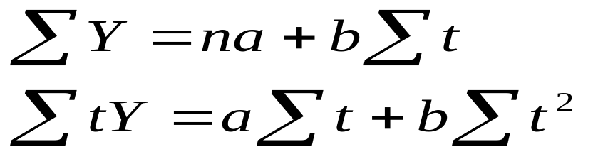
LEAST SQUARES METHOD
The least squares method of computing the equation for a line through the data of interest gives the “best fitting” line. Two equations may be solved simultaneously to arrive at the least squares trend equation.
Equations for the Trend line are:

Slide 19
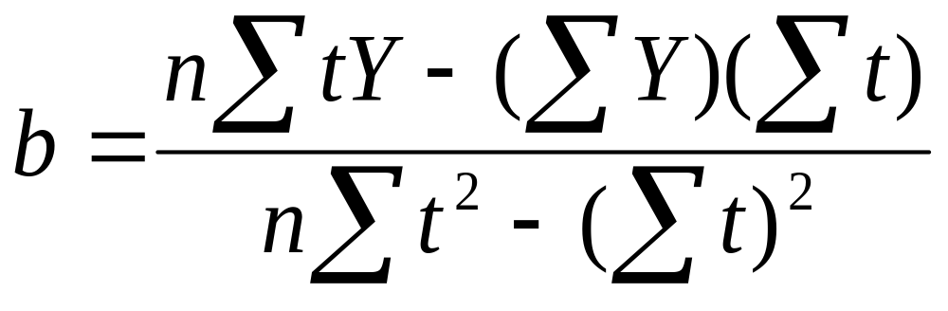
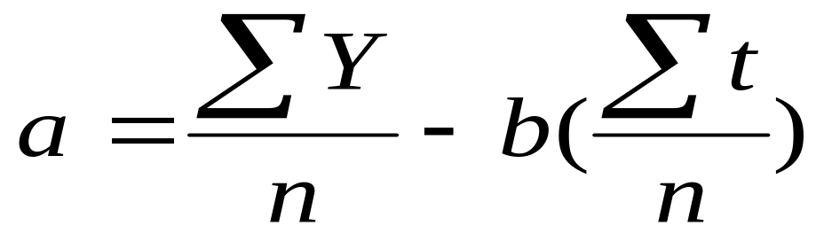
The Slope
The Intercept

Slide 20
Example
The sales of small grocery chain are given here:
Determine the Least Squares Trend – Line Equation.
Interpret the Equation
Plot the original data and the trend line.
Forecast the sales for 2015.
Year | Sales(tk.in million)
2009 2010 2011 2012 2013 | 7 10 9 11 13

Slide 21
Solution
a) To simplify the calculations, the years are replaced by coded values. That is, we let 1997 be 1, 1998 be 2, and so forth. This is often referred to as the coded method.
Table: Computations Needed for determining the Trend Equation

Slide 22
Solution
Year | Sales(in million taka) | t | tY | t²
1997 | 7 | 1 | 7 | 1
1998 | 10 | 2 | 20 | 4
1999 | 9 | 3 | 27 | 9
2000 | 11 | 4 | 44 | 16
2001 | 13 | 5 | 65 | 25
Total | 50 | 15 | 163 | 55

Slide 23
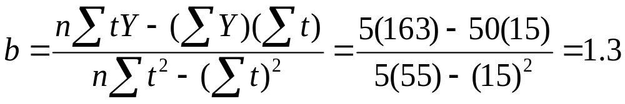
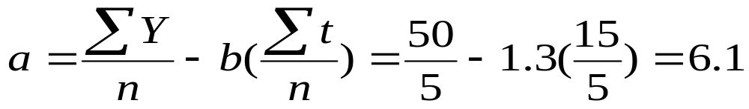
The Slope
The Intercept

Slide 24
The trend equation is, Y = 6.1 + 1.3t,
Where: Sales are in millions of taka. The origin, or year 0, is 1996, and t increases by one unit for each year.
b) Interpretation of the equation
The value of 1.3 indicates sales increased at a rate of 1.3 million taka per year.
The value 6.1 is the estimated sales when t = 0. That is, the estimated sales amount for 1996 (the base year) is 6.1 million taka.

Slide 25
c) Plotting the line
The least squares equation can be used to find points on the line through the data.
Table: Calculations Needed for Determining the Points on the Straight Line using the Coded Method.
Year | Sales(million taka) | t | Y/ | Found by
1997 1998 1999 2000 2001 | 7 10 9 11 13 | 1 2 3 4 5 | 7.4 8.7 10.0 11.3 12.6 | 6.1 + 1.3(1) 6.1 + 1.3(2) 6.1 + 1.3(3) 6.1 + 1.3(4) 6.1 + 1.3(5)

Slide 26
Forecasting the sales for 2004.
In 2004, t = 8. Substituting this value for t in the equation:
Y = a + bt = 6.1 + 1.3(8) = 16.5
Thus based on past sales, the estimate for 2004 is 16.5 million taka.
Self – Review: 19 – 1. Page 698 ; Exercises: 1- 4 Page 698 – 699.

Slide 27
THE MOVING - AVERAGE METHOD
The moving – average method is not only useful in smoothing a time series to see its trend, it is the basic method in determining the seasonal variation. The moving – average method smoothes out fluctuations.
A three-year, five – year, seven – year moving average is usually used.To apply the moving – average method to a time series, the data should follow a fairly linear trend and have definite rhythmic pattern of fluctuations. The annual data have no seasonal variation and have only three components – trend, cycle, and irregular, abbreviated T, C, and I. What the moving – average method does, in effect, is average out C and I. The residual is trend.

Slide 28
Example
Year | Production, Y | 3 year moving total | 3 year average
1990 | 7
1991 | 10 | 29 | 9.7
1992 | 12 | 33 | 11.0
1993 | 11 | 32 | 10.7
1994 | 9 | 33 | 11.0
1995 | 13 | 37 | 12.3
1996 | 15 | 46 | 15.3
1997 | 18 | 48 | 16.0
1998 | 15 | 44 | 14.7
1999 | 11 | 40 | 13.3
2000 | 14 | 42 | 14.0
2001 | 17
A three – year moving – average for some production data are shown here

Slide 29
Even numbered moving – average (4, 6, 8 year etc.) present one minor problem regarding the centering of moving totals and moving average. There is no center time period, so the moving totals are positioned between two time periods.

Slide 30
Example:
Year | Sales,Y | 4 - year Moving Total | 4 - year Moving Average | Centered 4 - year Moving Average
1993 | 8
1994 | 11
 |  | 42 | 10.50
1995 | 9 |  |  | 10.625*
 |  | 43 | 10.75
1996 | 14 |  |  | 10.625
 |  | 42 | 10.50
1997 | 9 |  |  | 10.625
 |  | 43 | 10.75
1998 | 10 |  |  | 10.000
 |  | 37 | 9.25
1999 | 10 |  |  | 9.625
 |  | 40 | 10.00
2000 | 8
2001 | 12
Note: (10.50+10.75)/2=10.625
Self – Review: 19 – 2 Page: 702.

Slide 31
NONLINEAR TRENDS
Till now the emphasis was given on a time series whose growth or decline approximated a line. A linear trend equation is used to represent the time series when it is believed that the data are increasing (or decreasing) by equal amounts, on the average, from one period to another.
Data that increase (or decrease) by increasing amounts over a period of time appear curvilinear when plotted on paper having an arithmetic scale. To put it another way, data that increase (or decrease) by equal percents or proportions over a period of time appear curvilinear on arithmetic paper.

Slide 32
The trend equation for a time series that does approximate a curvilinear trend may be computed by using the logarithms of the data and the least squares method.
The general equation for the logarithmic trend equation is:
LOG TREND EQUATION,
LOGY = loga+logb(t)

Slide 33
Example
Year | Sales(million taka)
2009 | 2.13
2010 | 18.10
2011 | 39.80
2012 | 81.40
2013 | 112.00
The following data are for the sales of a factory
a) Determine the logarithmic trend equation for the sales data.
b) Sales increased by what percent annually?
c) What is the projected sales amount for 2014?

Slide 34
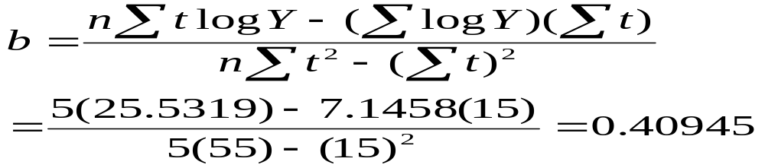
Solution
Year | Y | log Y | t | tlogY | t²
1997 | 2.13 | 0.3284 | 1 | 0.3284 | 1
1998 | 18.10 | 1.2577 | 2 | 2.5154 | 4
1999 | 39.80 | 1.5999 | 3 | 4.7997 | 9
2000 | 81.40 | 1.9106 | 4 | 7.6424 | 16
2001 | 112.00 | 2.0492 | 5 | 10.2460 | 25
TOTAL | - | 7.1458 | 15 | 25.5319 | 55
The Slope

Slide 35
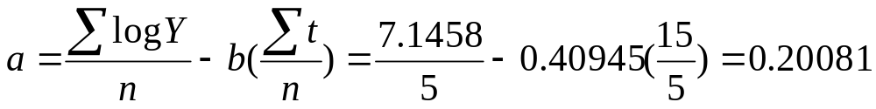
The Intercept
The trend equation is
Y/ = 0.20081 + 0.40945t, which is the log form. We now have a trend equation in terms of percent change. That is, the value 0.40945 is the percent change in Y/ for each unit change in t

Slide 36
b)The log b is 0.40945 and its antilog or inverse is 2.5671. Subtracting 1 yields 1.5671. Sales increased by 156.7 percent annually. [Note: If we subtract 1 from this value (b value), the value 1.5671 indicates the geometric mean rate of increase from 1997 to 2001. We conclude that sales increased at a rate of 156.7 percent annually during the period.]
c) The log of sales for the year 2002 is
Y = 0.20081 + 0.40945 (6) = 2.65751.
The antilog of 2.65751 is 454.5. The projected sales amount for 2002 is 454.5 million taka.
Exercises 5 and 6. Page No. 705.

Slide 37
DETERMINING A SEASONAL INDEX
A typical set of monthly indexes consists of 12 indexes that are representative of the data for a 12 - month period. There are four typical seasonal indexes for data reported quarterly. Each index is a percent, with the average for the year equal to 100.0; that is each monthly index indicates the level of sales, production, or another variable in relation to the annual average of 100.0. a typical index of 96.0 for January indicates that sales ( or whatever the variables is) are usually 4 percent below the average for the year. An index of 107.2 for October means that the variable is typically 7.2 percent above the annual average.

Slide 38
Several methods have been developed to measure the typical seasonal fluctuation in a time series. The method most commonly used to compute the typical seasonal pattern is called the Ratio - to - Moving - Average Method. It eliminates the trend, cyclical, and irregular components from the original data (Y). We will denote trend by T, cyclical by C, seasonal by S, and irregular by I. The numbers that result are called the typical seasonal index.

Slide 39
Example
The following table shows the quarterly sales for toys of factory for the years 1996 through 2001. Determine a quarterly seasonal index using the ratio - to - moving - average method.
Table: Quarterly Sales of Toys (million $)
Year | Winter | Spring | Summer | Fall
1996 1997 1998 1999 2000 2001 | 6.7 6.5 6.9 7.0 7.1 8.0 | 4.6 4.6 5.0 5.5 5.7 6.2 | 10.0 9.8 10.4 10.8 11.1 11.4 | 12.7 13.6 14.1 15.0 14.5 14.9

Slide 40
Solution
There are six steps to determining the quarterly seasonal indexes.
Step 1. Determine the four- quarter moving total for 1996, we add:
$6.7 +$4.6 +$ 10.0 +$12.7 = 34.0(million). The four-quarter total is "moved along" by adding the spring, summer, and fall sales of 1996 to the winter sales of 1997. The total is $33.8(million) found by 4.6 +10.0 +12.7 +6.5. This procedure is continued for the quarterly sales for each of the six years.
[ It can be done in another way: 34.0 - 6.7 +6.5 = 33.8]

Slide 41
Moving total 34.0 is positioned between the spring and summer sales of 1996. The next moving total, 33.8, is positioned between sales for summer and fall of 1996, and so on. Check the totals frequently to avoid arithmetic errors.
Step 2. Each quarterly moving total in is divided by 4 to give the four-quarter moving average and positioned in the same manner as the total.
Step 3. The moving averages are then centered. The first centered moving average is found by:
(8.500 + 8.450)/2= 8.475.
It is centered opposite to summer of 1996.

Slide 42
The second moving average is found by:
(8.450 + 8.425)/2 = 8.45
It is centered opposite to fall of 1996. The others are found and centered similarly. A centered moving average is positioned on a particular quarter.
Step 4. The specific seasonal for each quarter is then computed by dividing the sales in column 3 by the centered moving average in column 6.The specific seasonal reports the ratio of the original time series value to the moving average.
To explain further, if the time series is represented by TSCI and the moving average by TCI, then algebraically, if we compute
TSCI/TCI = S, the result is the seasonal component.
The specific seasonal for 1996 is 1.180 found by:
10.0/8.475.

Slide 43
Step 5. The specific seasonals are organized in a table. To find a typical seasonal index is to average the estimates of the specific seasonal indexes of each quarter.
For example, typical index for the summer quarter
= (1.180 + 1.130 + 1.141+ 1.126 + 1.143)/5 = 5.720/5 =1.144. Typical indexes for the other quarters are found in the same way.
Step 6. The four quarterly means(0.767, 0.576, 1.144, and 1.522) should theoretically total 4.00 because the average is set at 1.0. The total of the four quarterly may not exactly equal 4.00 due to rounding. In this problem the total of the means is 4.009.
A correction factor is, therefore, applied to each of the four means to force them to total 4.00.

Slide 44
Correction factor for Quarterly Means
Correction factor=4.00/Total of four means=4.00/4.009= 0.997755
The adjusted winter quarterly index is 0.767(0.997755) = 0.765.
Each of the means is adjusted downward so that the total of the four quarterly means is 4.00.
Indexes are expressed in percentages. So each is multiplied by 100.
The index for the winter quarter is 76.5
How to interpret the indexes?
Sales for the fall quarter are 51.9 percent above the typical quarter., and for winter they are 23.5 below the typical quarter.(100.0 - 76.5).

Slide 45
DESEASONALIZING DATA
A set of typical indexes is very useful in adjusting a sales series for seasonal fluctuations. The resulting sales series is called deseasonalized sales or seasonally adjusted sales. The reason for deseasonalizing the sales series is to remove the seasonal fluctuations so that the trend and cycle can be studied.
Table: Slide (or from the text book, page 712 Table No. 19 – 10)
To remove the effect of seasonal variation, the sales amount for each quarter (which contains trend, cyclical, irregular, and seasonal effects ) is divided by the seasonal index for that quarter, that is, TSCI/S. For example, the actual sales for the first quarter of 1996 were $6.7 million.

Slide 46
By dividing the actual sales of $6.7 million by 76.5 and multiplying the result by 100, we find the deseasonalized sales value for the first quarter of 1996. It is $8,758,170 found by
($6,700,00/76.5)100. We continue the process for the other quarters with the results reported in millions of dollars.Because the seasonal components have been removed (divided out) from the quarterly sales, the deseasonalized sales figure contains only the trend(T), cyclical(C), and irregular(I) components. Scanning the deseasonalized sales in column 5, of the above table, we see that the sales of toys showed a moderate increase over the six-year period. We are now able to determine the regression equation of the trend and use it to forecast future sales.

Slide 47
Using the deseasonalized data to forecast
The procedure for identifying trend and the seasonal adjustments can be combined to yield seasonally adjusted forecasts. To identify the trend, we determine the least squares trend equation on the deseasonalized historical data. Then we project this trend into future periods, and finally we adjust these trend values to account for the seasonal factors.
Example: Forecast the sales for each quarter of 2002 for the toy company. (Using the information in the previous table)

Slide 48
Solution
The first step is to use the deseasonalized data in column 5 of the previous table to determine the least squares trend equation.
The deseasonalized trend equation is: Y/ = a + bt
The winter quarter of 1996 is the period t = 1, and t = 24 corresponds to the fall quarter of 2001.
b=? a =? (Done on the board).
Table
The trend equation is: Y/ = 8.1096 + 0.0899t
The slope of the trend line is 0.0899. This shows that over the 24 quarters the deseasonalized sales increased at a rate of 0.0899($million) per quarter, or $89,900 per quarter. The value of 8.1096 is the intercept of the trend line on the Y - axis (i.e., for t = 0).

Slide 49
If we assume that the past 24 periods are a good indicator of future sales, we can use the trend equation to estimate the future sales. For example, for the winter quarter of 2002, the value of t is 25.The estimated sales total for that period is
Y = 8.1096 + 0.0899(25) = 10.3571
Using the trend equation, we can forecast sales for the toys company for the four quarters of 2002. These estimates are shown in the following table:

Slide 50
Table: Quarterly Forecast for Toy Company for 2002
Quarter t Estimated Sales Seasonal Index Quarterly Forecast
Winter 25 10.3571 .765 7.923 Spring 26 10.4770 .575 6.024 Summer 27 10.5369 1.141 12.03 Fall 28 10.6268 1.519 16.142
Now we have the forecasts for the four quarters of 2002, we can seasonally adjust them. The index for the winter quarter is 0.765, so we can estimate the sales in this quarter by 10.3571(0.765) = 7.923. The estimates for the four quarters of 2002 are shown in the above table.
[Notice how the seasonal adjustments drastically increase the sales estimates for the last two quarters of the year].

