Slide 1
Time Series Analysis and Forecasting

Slide 2
What is forecasting?

Slide 3
Types of forecasting
Economic Forecast
Technological Forecast
Demand Forecast

Slide 4
What is Machine Learning?

Slide 5
process

Slide 6
Gathering data
1st

Slide 7
Preparing that data
2nd

Slide 8
Choosing a model
3rd

Slide 9
4rd
Training

Slide 10
Evaluation
5th

Slide 11
Hyper parameter tuning
6th

Slide 12
Prediction
7th

Slide 13
End of process

Slide 14
Forecasting
Mean squired error(mse)
Average approach
Mean absolute percentage error(mape)
Naive approach
Mean absolute deviation(mad)
Drift method

Slide 15
Different uses of Forecasting in Real Life

Slide 16
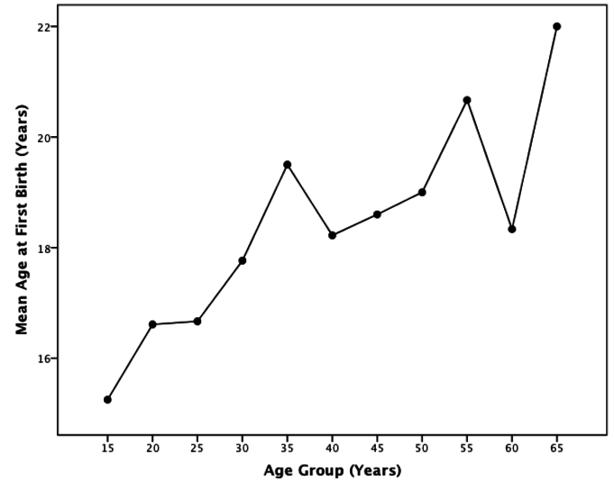
Simple Planning
SECULAR TREND

Slide 17
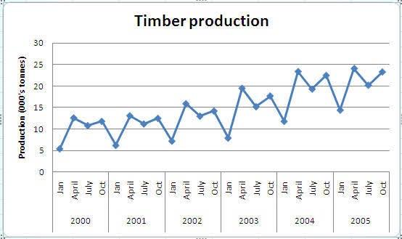
Market Segmentation
SEASONAL VARIATIONS

Slide 18
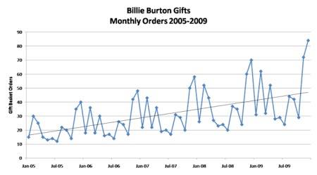
Intelligence of Judgmental
CYCLICAL VARIATIONS

Slide 19
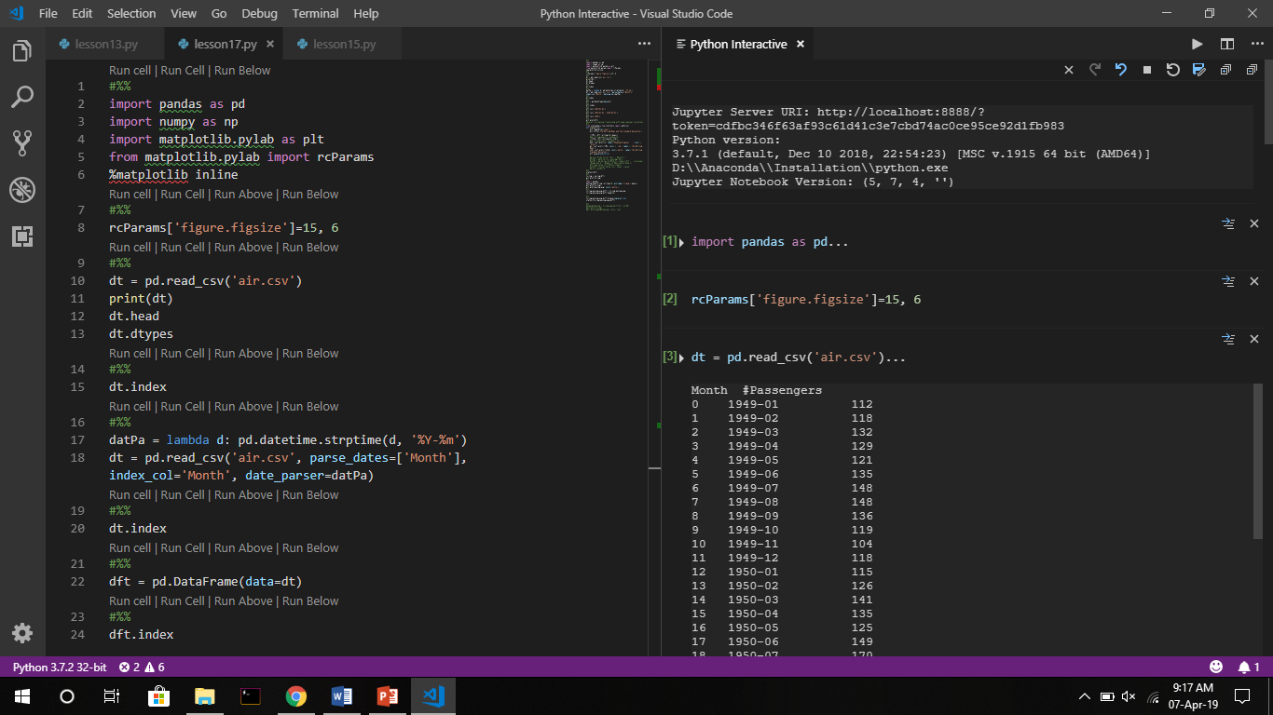

Slide 20
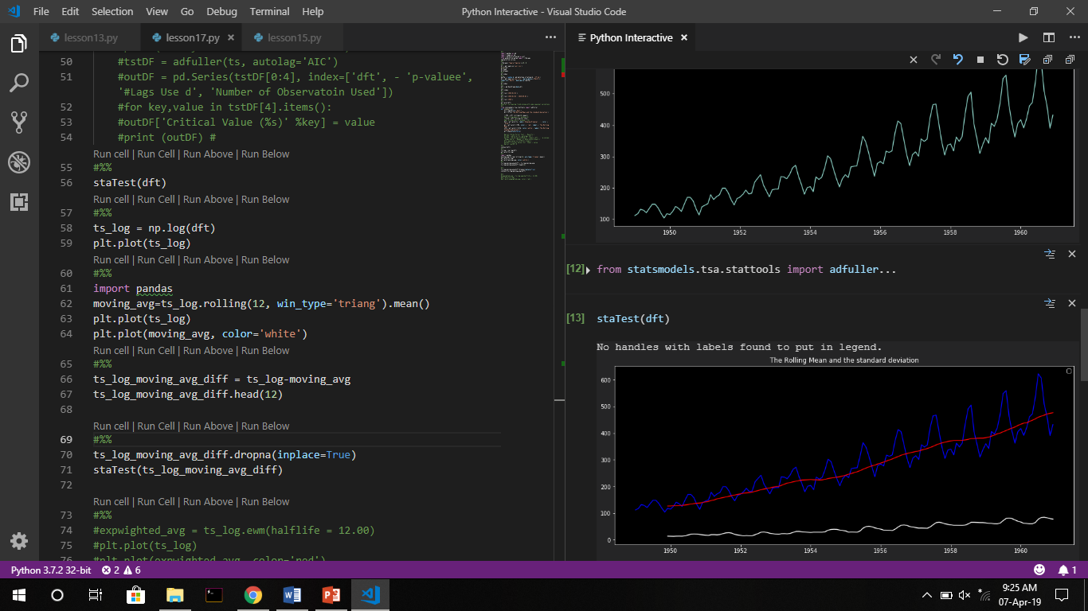

Slide 21
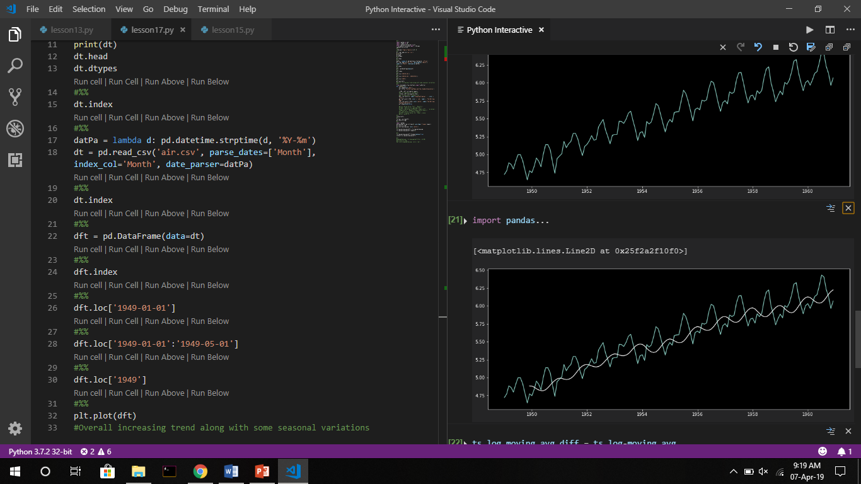

Slide 22
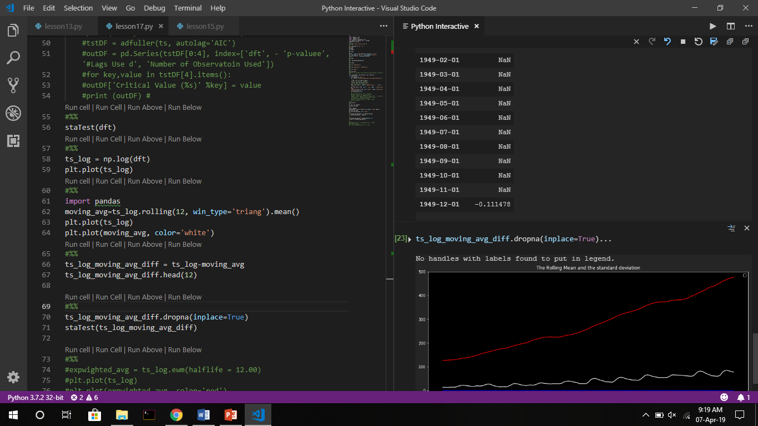

Slide 23
COFFEE BREAK
Notes:
Hapus Shadow di teks maupun iconnya

