Slide 1
Data Mining

Slide 2

What is Data Mining?

Slide 3
Steps in Data Mining Techniques
Clustering
Regression
Prediction

Slide 4
Data Mining Examples

Slide 5
Gathering data
1st

Slide 6
Preparing that data
2nd

Slide 7
Choosing a model
3rd

Slide 8
4rd
Training

Slide 9
Evaluation
5th

Slide 10
Hyper parameter tuning
6th

Slide 11
Prediction
7th

Slide 12
End of process

Slide 13
Different Tools

Slide 14
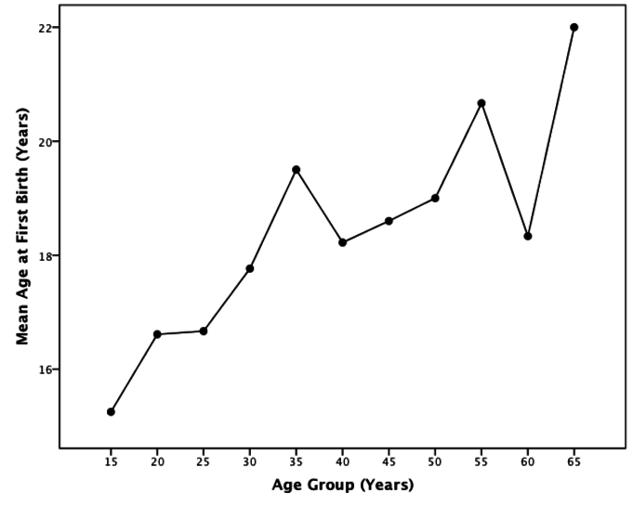
Simple Planning
SECULAR TREND

Slide 15
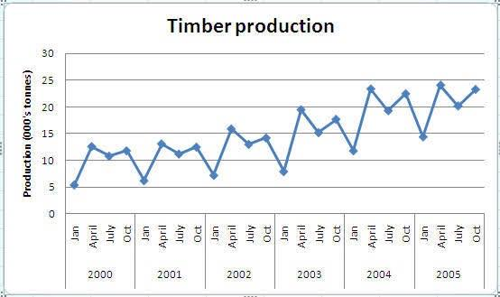
Market Segmentation
SEASONAL VARIATIONS

Slide 16
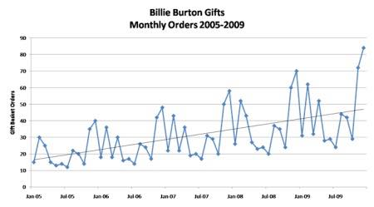
Intelligence of Judgmental
CYCLICAL VARIATIONS

Slide 17
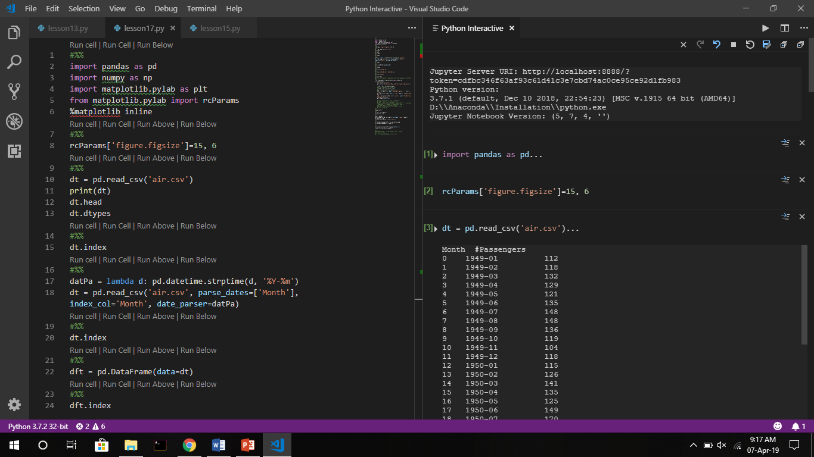

Slide 18
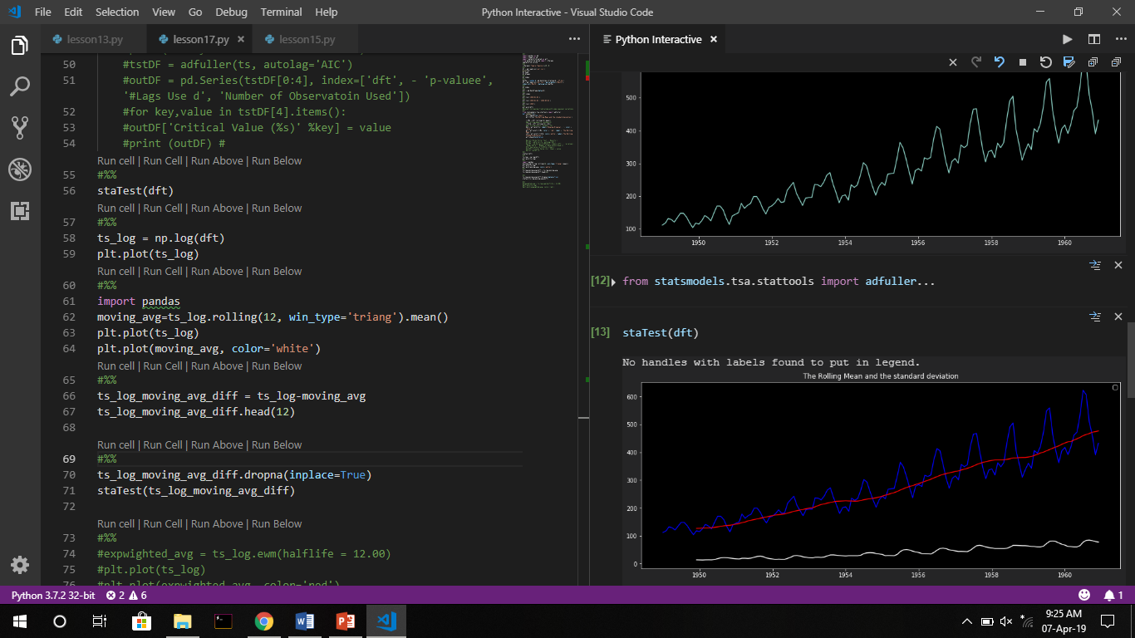

Slide 19
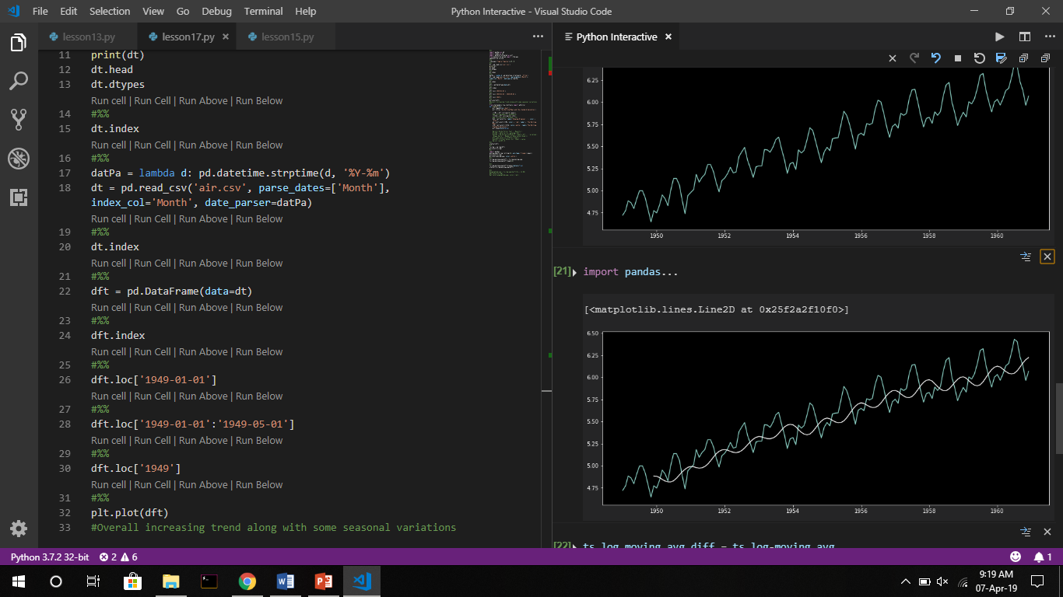

Slide 20
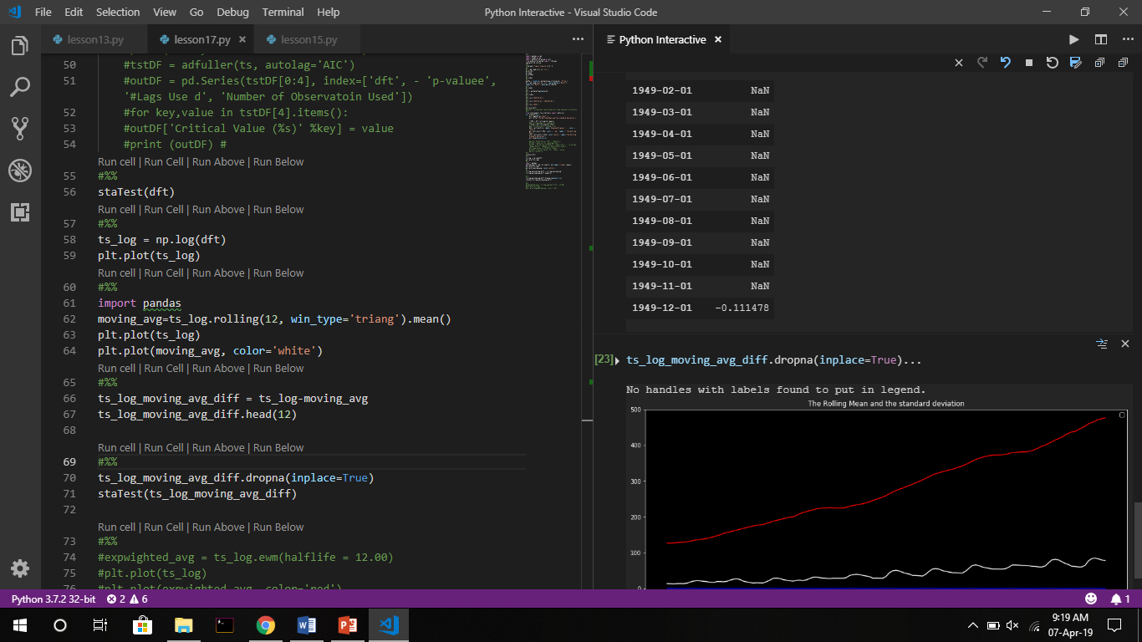

Slide 21
Thank
You
Notes:
Hapus Shadow di teks maupun iconnya

