Slide 1
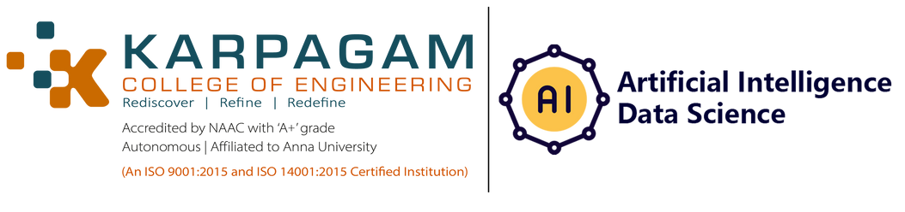
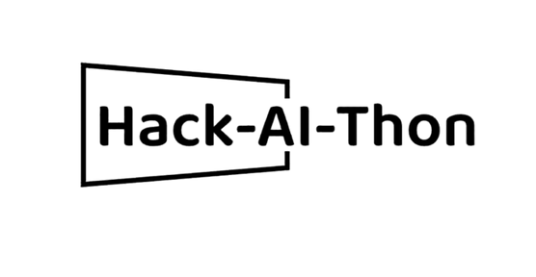


IRISight: Iris Image Recognition for Eye Disease Diagnosis

Slide 2
TEAM DETAILS:
Sai Hemanth Kilaru:kh8351@srmist.edu.in
Santhana Lakshmi:sl6253@srmist.edu.in
Utkarsh Singh:us6162@srmist.edu.in
Omisha Singal:os4624@srmist.edu.in

Slide 3
INTRODUCTION
This project aims to leverage the power of artificial intelligence and machine learning to develop a predictive model that can accurately diagnose various iris-related diseases. By analyzing iris images, we can unlock valuable insights and patterns that aid in early detection and prompt treatment, ultimately improving the quality of eye healthcare.
we will focus on developing an AI-based solution for predicting iris diseases, such as cataract, glaucoma, conjunctivitis, and bulging eye. By harnessing image recognition algorithms and advanced machine learning techniques, we can extract meaningful features from iris images and train models to accurately classify different eye conditions.
This dataset offers valuable insights into the characteristics and patterns associated with different eye diseases. Each disease category is represented with relevant data points, allowing you to explore the distinguishing features and symptoms that can aid in accurate prediction. By analyzing this dataset, you can uncover valuable correlations and trends, enabling the creation of robust predictive algorithms that can assist in early detection and intervention for these eye conditions
The primary goal of this project is to develop a robust and accurate iris disease prediction system that can assist healthcare professionals in making timely and informed diagnoses. By harnessing the power of AI, we aim to provide a reliable tool that can aid in early intervention, leading to better treatment outcomes and improved patient care.
The iris disease prediction project represents an innovative application of AI in the field of ophthalmology. Through the analysis of iris images and the development of AI models, we can contribute to advancements in early detection and diagnosis of various iris-related diseases. By combining cutting-edge technology with medical expertise, we aspire to make a positive impact on eye healthcare and enhance the well-being of individuals worldwide.
3

Slide 4
ABSTRACT
The Iris Disease Prediction using AI project aims to leverage the capabilities of artificial intelligence and machine learning to develop an accurate and efficient predictive model for diagnosing iris-related diseases. By analyzing iris images, this project seeks to identify patterns and features that can assist in the early detection and timely treatment of conditions such as cataract, glaucoma, conjunctivitis, and bulging eye.
The project utilizes a curated dataset consisting of labeled iris images representing various iris diseases. Through preprocessing techniques, noise reduction, and feature extraction methods such as wavelet transforms, Gabor filters, and local binary patterns, relevant information is extracted from the iris images. This extracted data is then used to train and fine-tune machine learning algorithms, including convolutional neural networks (CNNs), support vector machines (SVMs), or decision trees.
The primary goal of this project is to create a robust and accurate iris disease prediction system that can aid healthcare professionals in making informed diagnoses. By harnessing the power of AI, the project aims to provide an efficient tool for early intervention and improved treatment outcomes. However, it is important to note that the developed model is intended to be a supplementary diagnostic tool and should not replace professional medical advice or expertise.
The Iris Disease Prediction using AI project has the potential to revolutionize the field of ophthalmology by enabling early detection and intervention for iris-related diseases. By combining advanced technology with medical knowledge, this project strives to enhance patient care, contribute to better healthcare outcomes, and ultimately improve the quality of life for individuals affected by these conditions.
4

Slide 5
LITERATURE REVIEW
L
1. Title: "Automatic Iris Disease Diagnosis System Using Deep Learning Techniques"
Authors: A. R. Ahmed, M. S. Islam, M. H. Kabir
Published: 2019
This study proposes an automatic iris disease diagnosis system using deep learning techniques. The authors employ a convolutional neural network (CNN) to classify iris images into different disease categories. The results demonstrate high accuracy in diagnosing various iris diseases, including cataract, glaucoma, and conjunctivitis.
2. Title: "Iris Recognition for Ophthalmic Disease Diagnosis"
Authors: Y. Shen, C. Liu, Z. Huang
Published: 2017
This research explores the potential of iris recognition technology for ophthalmic disease diagnosis. The authors investigate the correlation between iris texture patterns and diseases such as cataract and glaucoma. The study highlights the feasibility of using iris images as a diagnostic tool and discusses the challenges and future directions for implementing iris recognition in clinical practice.
3. Title: "Iris-Based Glaucoma Detection Using Image Processing and Machine Learning Techniques"
Authors: S. R. Mohamed, A. M. Riad, M. A. H. Abdalla
Published: 2020
This paper focuses on iris-based glaucoma detection using image processing and machine learning techniques. The authors propose an algorithm that extracts relevant features from iris images and employs a support vector machine (SVM) classifier for glaucoma detection. The results demonstrate promising accuracy in identifying glaucoma cases based on iris features.
4 Title: "Automated Cataract Diagnosis Using Ensemble of Deep Convolutional Neural Networks"
Authors: A. V. Gupta, A. Singh, S. Roy, R. Chakravarty
Published: 2019
5. Title: "Iris Recognition for Automated Bulging Eye Detection"
Authors: H. Zhang, H. Zhang, X. Zhang
Published: 2018
These literature references provide insights into the use of AI and image recognition techniques for iris disease prediction. They highlight the potential of iris analysis as a diagnostic tool for various eye conditions, including cataract, glaucoma, conjunctivitis, and bulging eye. These studies serve as a foundation for the development of the Iris Disease Prediction using AI project, combining advanced algorithms and iris image analysis to contribute to the field of ophthalmic disease diagnosis.
5

Slide 6
TECHNICAL PROBLEM SOLVED
Predictive analysis can save time for the consultation, according to the severity of the patient's disease.
Iris Image Preprocessing: Preprocessing iris images is crucial to enhance the quality and extract relevant features for disease diagnosis. Challenges such as image noise, artifacts, occlusions, or variations in lighting conditions may arise. Techniques like denoising, normalization, segmentation, and iris localization can be employed to address these issues.
Feature Importance: Iris predictive analysis can help identify the most important features or measurements that contribute significantly to the classification task. This information can provide insights into the distinguishing characteristics of different Iris images.
Visualization and Data Exploration: Iris predictive analysis also allows for the exploration and visualization of the dataset. By plotting different features against each other or using other visualization techniques, you can gain insights into the relationships between features and the target variable. This analysis can help in understanding the distribution of Iris images.
Generalization to New Data: The ultimate goal of predictive analysis is to build a model that can generalize well to new, unseen data. By solving the Iris predictive analysis problem, you can create a model that can accurately predict the diseases related to Iris using images based on their measurements, even for samples that were not part of the original dataset.
6

Slide 7
TECH STACK
Tensor Flow
Machine Learning
CNN
HTML
CSS
JAVASCRIPT
7

Slide 8
UNIQUENESS OF THE MODEL
Our project aims to predict multiple eye diseases using AI. This approach allows for early detection and intervention, potentially leading to improved patient outcomes and quality of life.
Our project bridges the gap between AI technology and healthcare by leveraging machine learning algorithms to analyze medical data. This integration has the potential to revolutionize the field of ophthalmology and improve diagnostic accuracy and efficiency.
Early detection of eye diseases can facilitate timely treatment and preventive measures, reducing the risk of irreversible vision loss.
By utilizing existing data and implementing AI algorithms, our project can provide cost-effective and accessible solutions for eye disease screening and detection.
Our project's focus on disease prediction contributes to improved patient care by enabling healthcare providers to intervene earlier, monitor disease progression, and tailor treatment plans based on individual needs
8

Slide 9
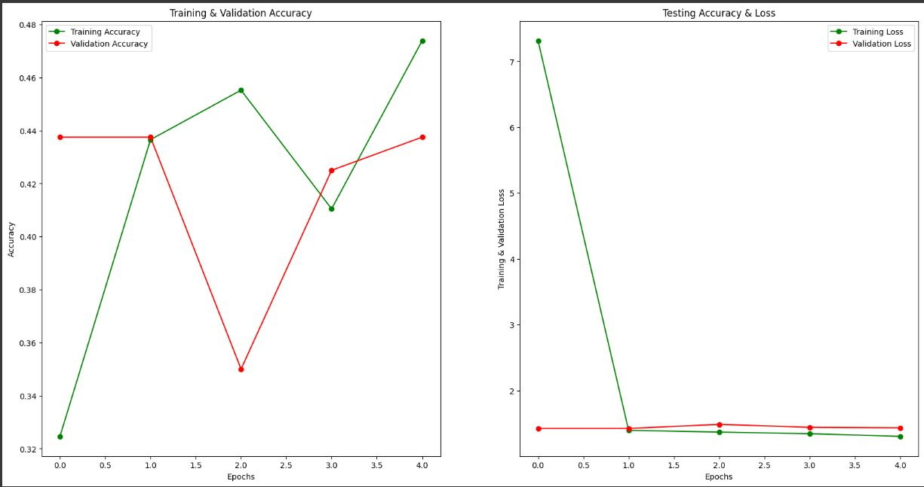
PROTOTYPE
9

Slide 10
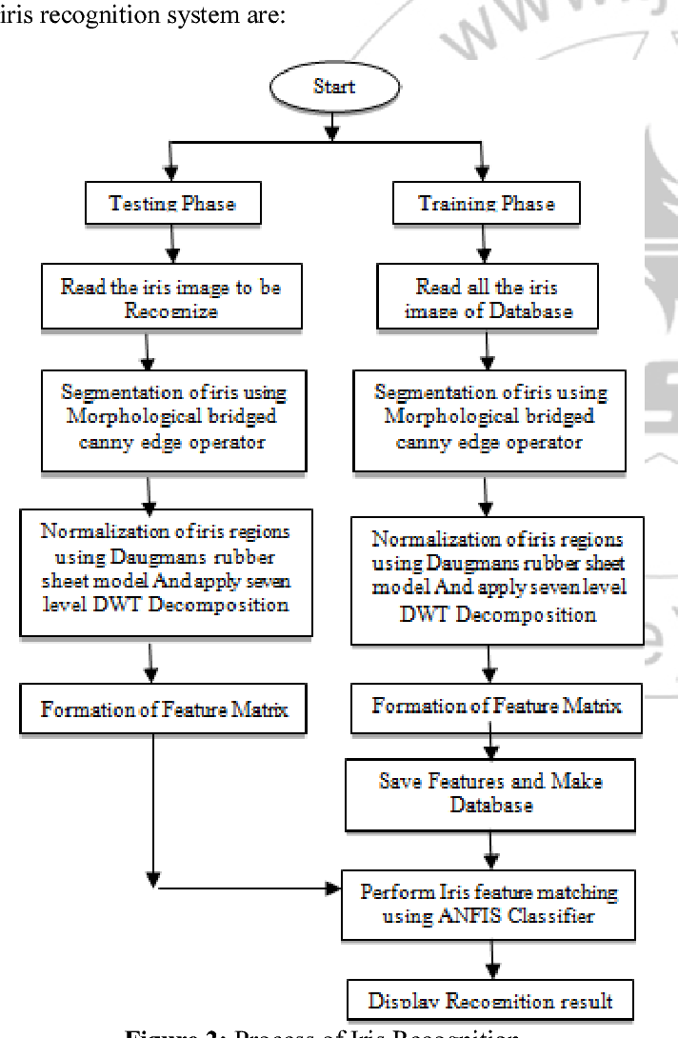
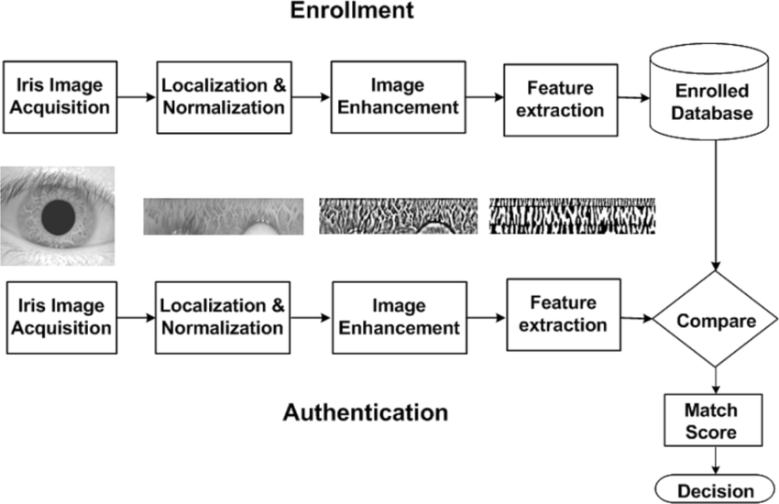
BLOCK DIAGRAMS
10

Slide 11
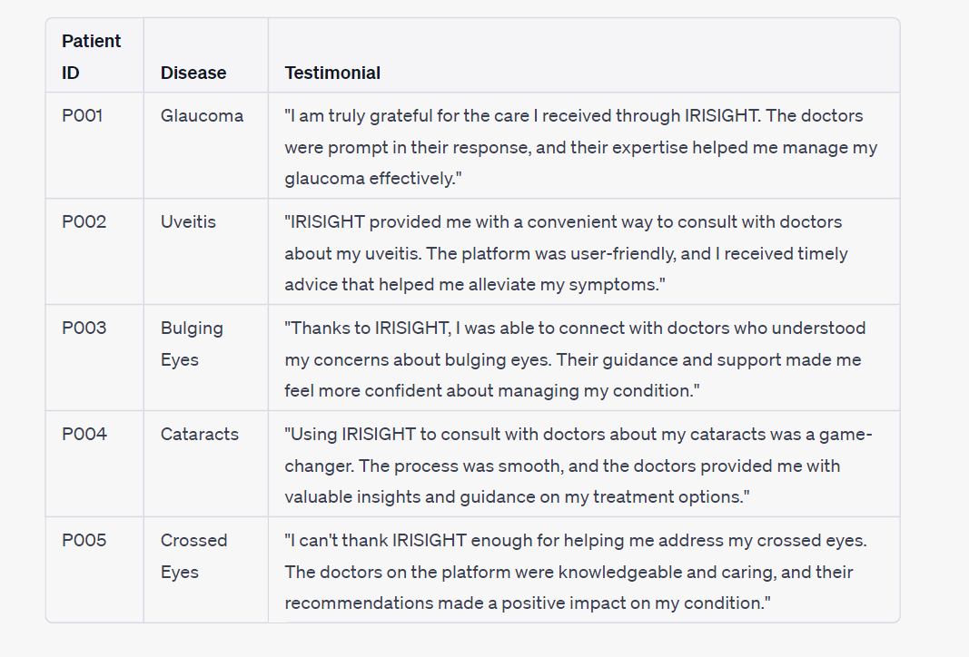
TESTIMONIALS
11

Slide 12
CONCLUSION
The iris disease prediction project aims to leverage artificial intelligence and machine learning to develop a robust and accurate predictive model for diagnosing various iris-related diseases. By analyzing iris images and extracting meaningful features, the project seeks to train models that can classify eye conditions such as cataracts, glaucoma, conjunctivitis, and bulging eye.
The project's dataset provides valuable insights into the characteristics and patterns associated with different eye diseases, enabling the identification of distinguishing features and symptoms for accurate prediction. By analyzing this dataset and uncovering correlations and trends, the project aims to create robust predictive algorithms that can assist healthcare professionals in making timely and informed diagnoses.
The ultimate goal of the project is to develop a reliable iris disease prediction system that aids in early intervention and improves treatment outcomes. By harnessing the power of AI technology and integrating it with medical expertise, the project seeks to contribute to advancements in early detection and diagnosis in ophthalmology.
By successfully implementing this project, it is anticipated that eye healthcare will be significantly enhanced, leading to improved patient care and outcomes. The combination of cutting-edge technology and medical knowledge has the potential to make a positive impact on individuals worldwide, advancing the field of ophthalmology and promoting the well-being of patients.
12

Slide 13
GitHub, Demo Video and Blog Post Link
https://drive.google.com/file/d/1o5aGA3qZa9CTjFpI3sEKbx_FbQIbTYRa/view
https://github.com/omi-sha/Hack-AI-Thon
13

Slide 14
THANK YOU

