Slide 1
Mid Progress Presentation
Chest diseases classification using DenseNet121
Computer vision and Machine learning
Omikumar Makadia, Pratham Mehta, Purvansh Barodia
BTech. CSE, School of Engineering and Applied Sciences
Mentor
Professor Mehul Raval, School of Engineering and Applied Sciences

Slide 2
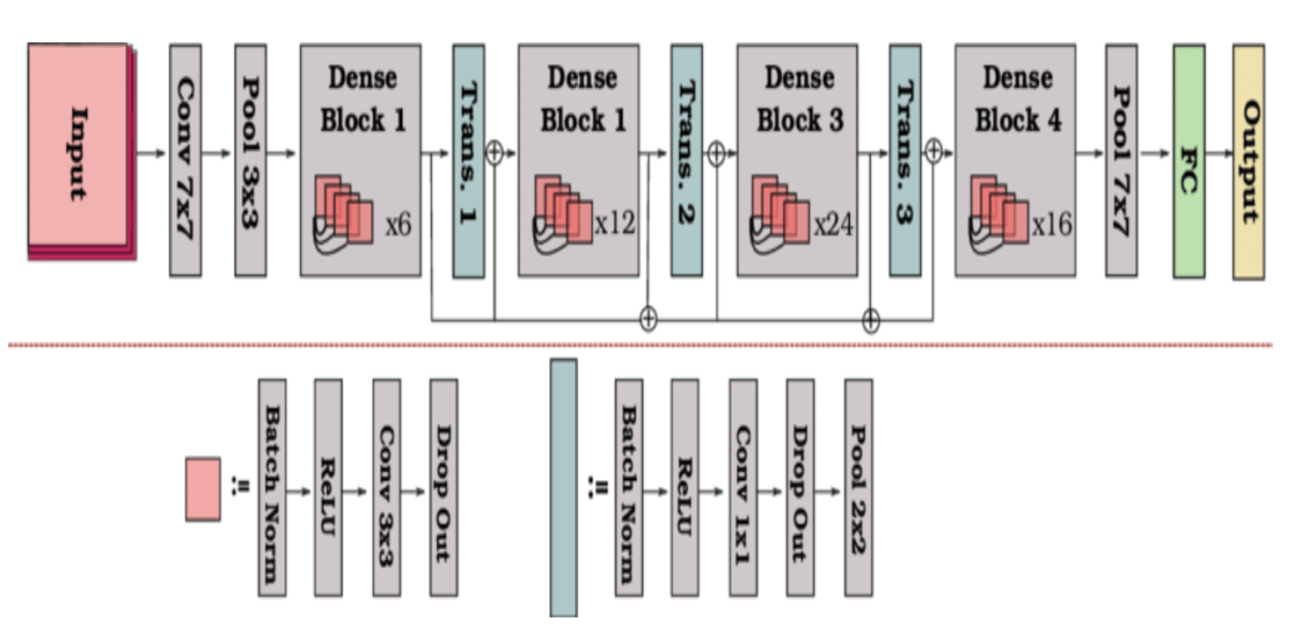
Introduction and Problem statement
Medical imaging aids chest disease diagnosis.
Deep learning automated image analysis
Chest diseases classification using DenseNet121
DenseNet architecture[1]
[1] Architecture of densenet-121. (2021, August 26). OpenGenus IQ: Computing Expertise & Legacy. https://iq.opengenus.org/architecture-of-densenet121/
Notes:
[1] Reference here as well

Slide 3
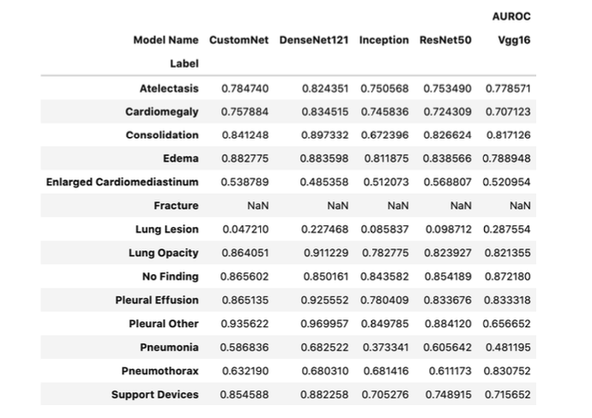
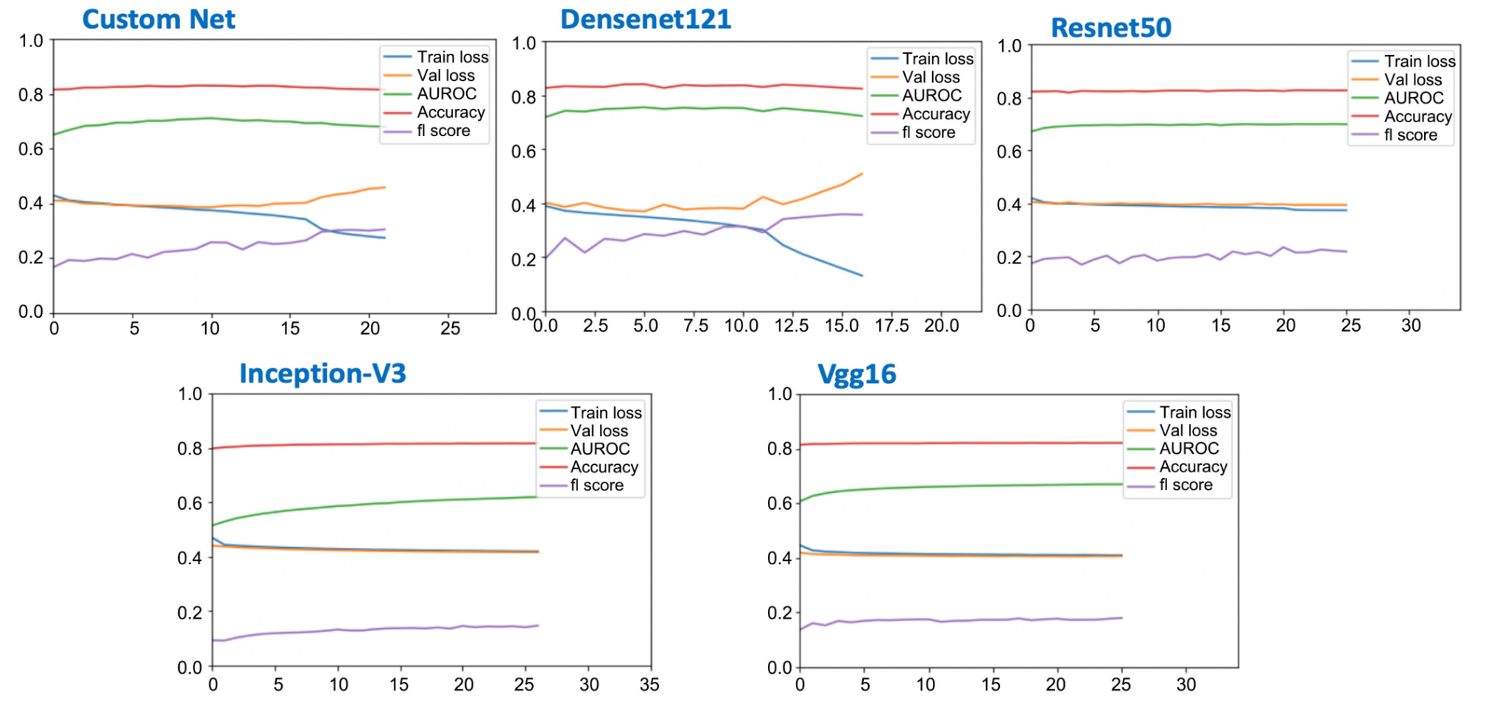
Existing body of work
Deep learning models achieve high accuracy.
Imbalanced training data affects positive case prediction.
Careful management of training data enhances performance.
Comparison of AUCROC of different models on test labels [2]
Training metrics per epoch.[2]
[2] Multi-label chest X-ray classification via deep learning. (2022, October 31). https://doi.org/10.4236/jilsa.2022.144004

Slide 4
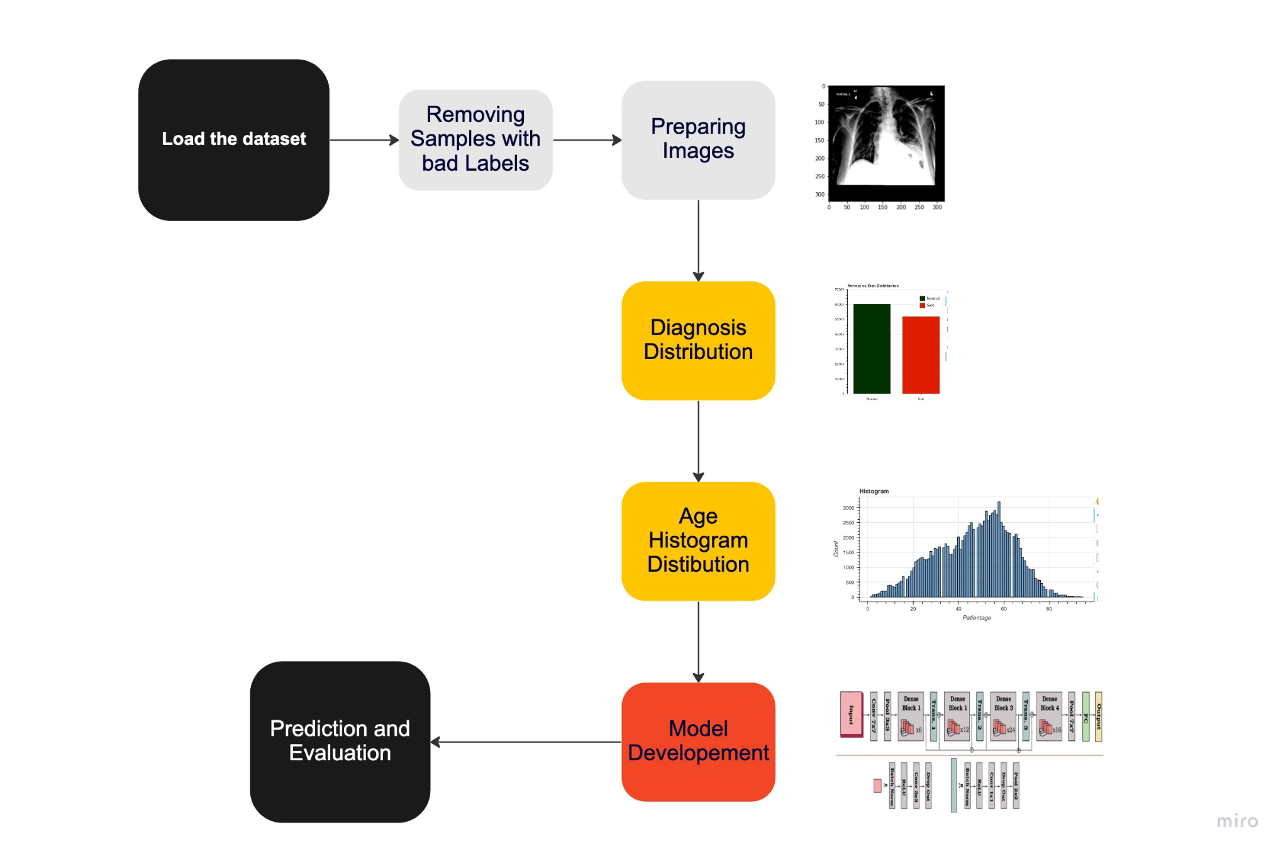
Your Approach
Approach [3]
[3] Approach_ML. (n.d.). miro.com. https://miro.com/app/board/uXjVMe16ijI=/?share_link_id=565798120623

Slide 5
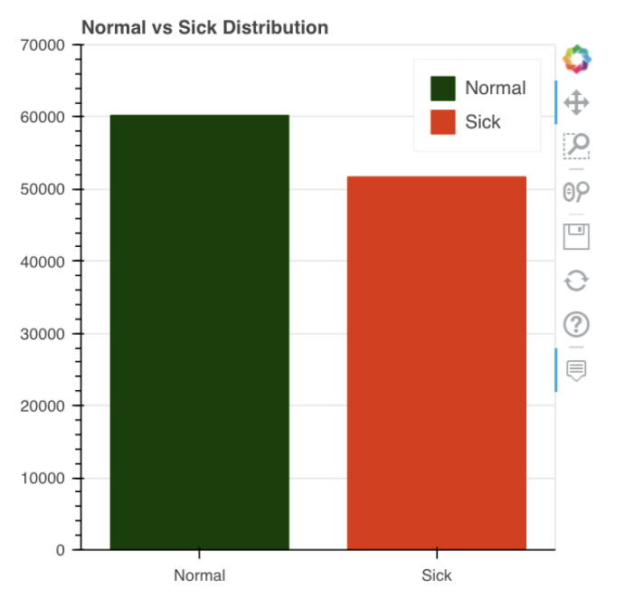
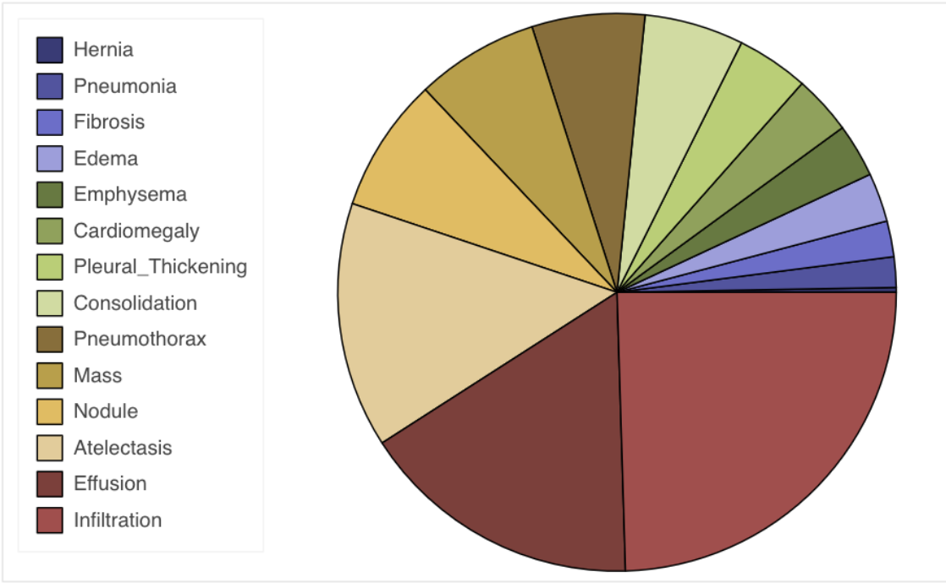
Results(1/3)
Diagnosis distribution - normal vs sick [5]
Diagnosis Distribution [6]
[5-6] Omikumarmakadia2121. (2023, March 10). Chest X-ray classifier DenseNet + Begineer's code. Kaggle: Your Machine Learning and Data Science Community. https://www.kaggle.com/code/omikuxmarmakadia2121/chest-x-ray-classifier-densenet-begineer-s-code/notebook

Slide 6
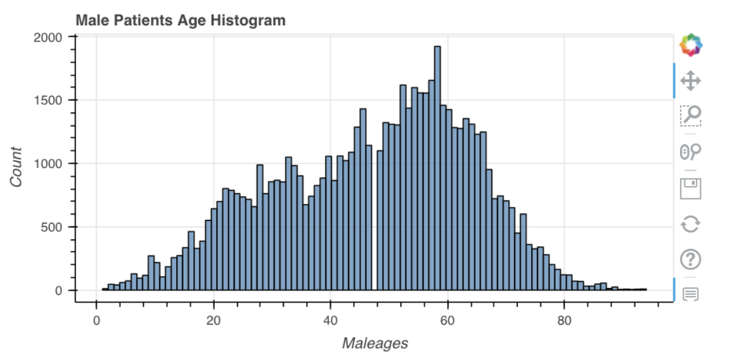
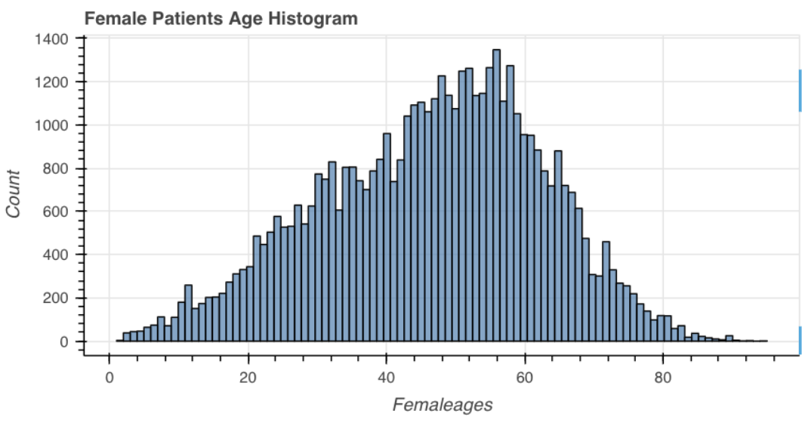
Results(2/3)
Age Histogram Distribution - Male[7]
Age Histogram Distribution - Female[8]
[7-8] Omikumarmakadia2121. (2023, March 10). Chest X-ray classifier DenseNet + Begineer's code. Kaggle: Your Machine Learning and Data Science Community. https://www.kaggle.com/code/omikuxmarmakadia2121/chest-x-ray-classifier-densenet-begineer-s-code/notebook

Slide 7
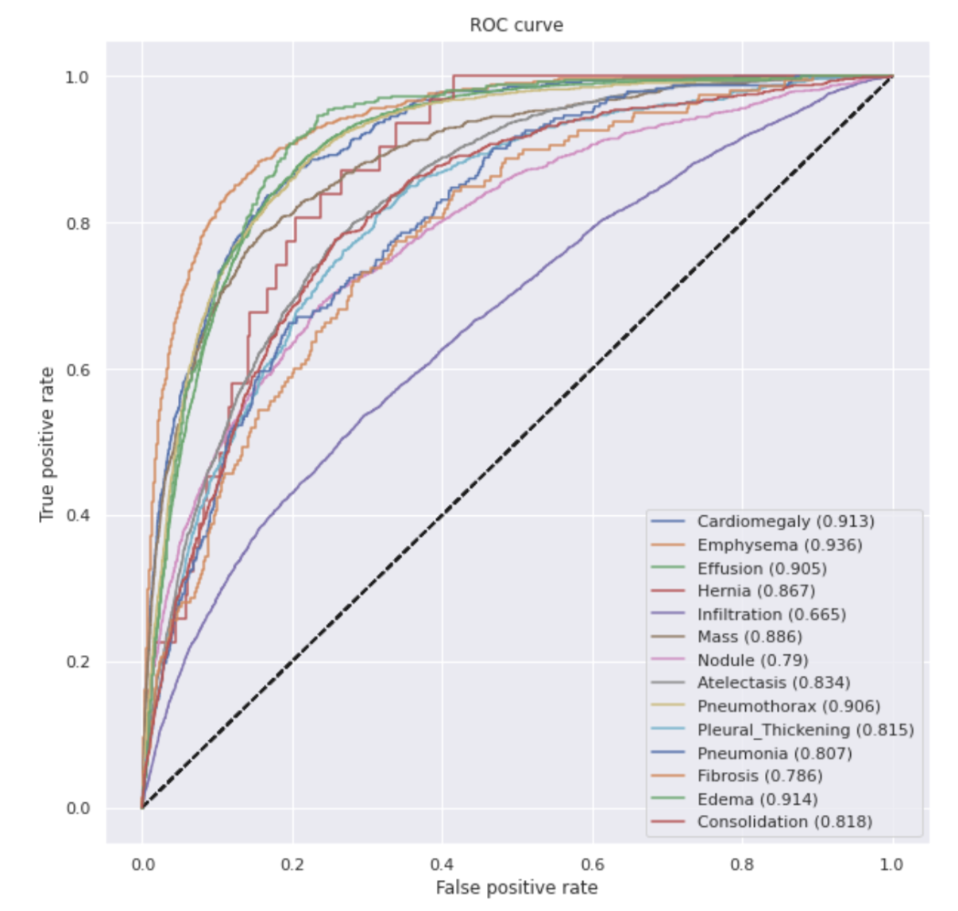
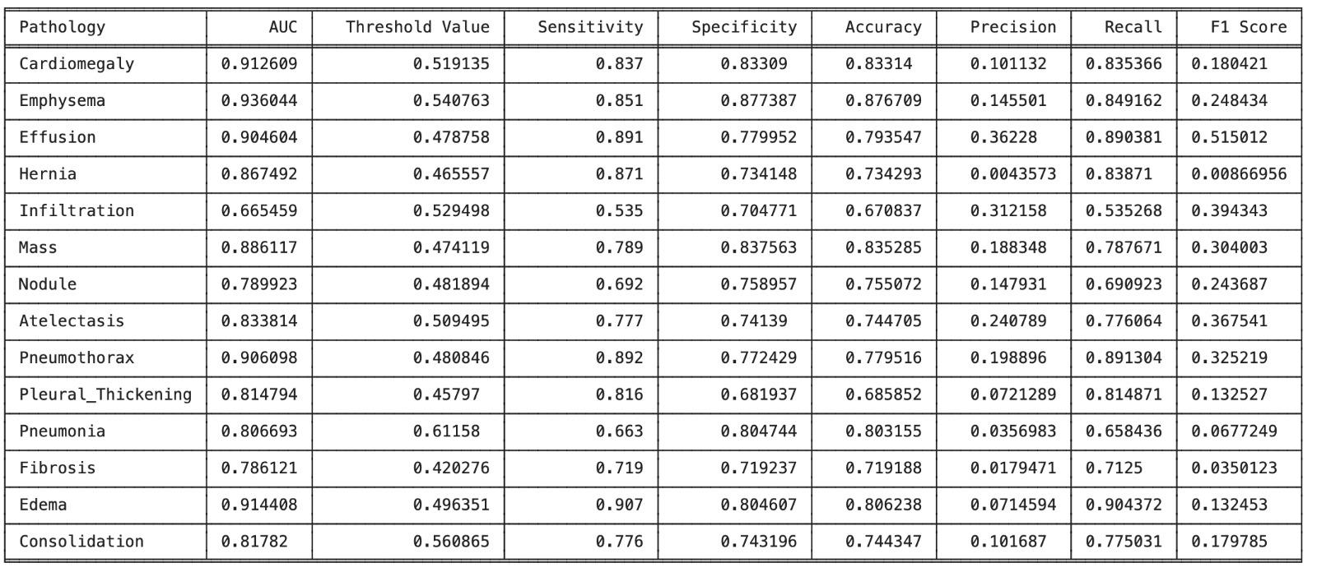
Results(3/3)
Various performance measures for each class present in the ChestXray 8 dataset [10]
The ROC curve [9]
[9-10] Omikumarmakadia2121. (2023, March 10). Chest X-ray classifier DenseNet + Begineer's code. Kaggle: Your Machine Learning and Data Science Community. https://www.kaggle.com/code/omikuxmarmakadia2121/chest-x-ray-classifier-densenet-s-code/notebook

Slide 8
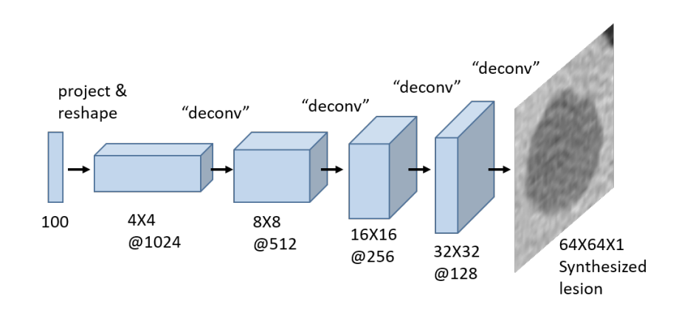
Role of each group member in project and future work
Omikumar - Doing literature Survey, LaTex report, PPT making, Dataset implementation
Pratham - Model implementation, weekly report, report content , PPT making
Purvansh - Model understanding, weekly report, PPT making, report content
Generator architecture [4]
[4]Frid-Adar, M., Diamant, I., Klang, E., Amitai, M., Goldberger, J., & Greenspan, H. (2018). GAN-based synthetic medical image augmentation for increased CNN performance in liver lesion classification. Neurocomputing, 321, 321-331.

Slide 9
References
Architecture of densenet-121. (2021, August 26). OpenGenus IQ: Computing Expertise & Legacy. https://iq.opengenus.org/architecture-of-densenet121/
Multi-label chest X-ray classification via deep learning. (2022, October 31). https://doi.org/10.4236/jilsa.2022.144004
Frid-Adar, M., Diamant, I., Klang, E., Amitai, M., Goldberger, J., & Greenspan, H. (2018). GAN-based synthetic medical image augmentation for increased CNN performance in liver lesion classification. Neurocomputing, 321, 321-331.
Omikumarmakadia2121. (2023, March 10). Chest X-ray classifier DenseNet + Begineer's code. Kaggle: Your Machine Learning and Data Science Community. https://www.kaggle.com/code/omikuxmarmakadia2121/chest-x-ray-classifier-densenet-begineer-s-code/notebook
Approach_ML. (n.d.). Miro.com. https://miro.com/app/board/uXjVMe16ijI=/?share_link_id=565798120623

Slide 10
Thank you

