Slide 1
MEDICARE: STREAMLINING HEALTHCARE OPERATIONS Hospital management system
Presented by GROUP
PERSON 1 PERSON 2 PERSON 3
PERSON 4 PERSON 5

Slide 2
CONTENT
Abstract
PROBLEM DEFINITION
OBJECTIVES & SCOPE
ADVANTAGES OF DEVELOPED SOLUTION
System Design
IMPLEMENTATION
USER INTER FACE
TESTing
CONCLUSION

Slide 3
ABstract
Hospital management systems (HMS) are comprehensive software solutions designed to streamline and automate various administrative, operational, and clinical processes in healthcare facilities.
This abstract provides an overview of hospital management systems, highlighting their key features and benefits. It discusses the modules typically included in an HMS, such as patient registration, appointment scheduling, electronic health records (EHR), billing and invoicing, inventory management, and reporting.
The abstract also emphasizes the importance of A user-friendly interface, data security, interoperability, and scalability in A hospital management system.
Furthermore, it emphasizes the role of HMS in enhancing patient care, optimizing resource utilization, improving operational efficiency, and facilitating decision-making.
Overall, hospital management systems serve as essential tools for modern healthcare organizations, enabling them to deliver high-quality care while ensuring effective management of hospital operations.

Slide 4
PROBLEM DEFINITION
The absence of a well-established information system to support patients and staff has caused inconveniences due to the limitations of the current system, particularly its heavy reliance on paperwork. Paper-based files occupy a significant amount of office space and hinder the recording, processing, and retrieval of patient details. Storing physical documents poses challenges as different document types require varying sizes of folders or storage spaces.
Additionally, handling paper records involves time-consuming and costly tasks such as copying, faxing, collecting, and transporting them to a single or multiple locations for review by healthcare providers.
Moreover, paper records are prone to being lost, misplaced, or becoming illegible. Implementing electronic health record technology would address these issues and bring significant improvements to patient care, enhancing health and safety.

Slide 5
OBJECTIVES
Generate Reporting And Analytics
The System Generates Reports On Many Operational Aspects Of The Healthcare Industry, Including Number Of Patients, Staffing, And Finances.
Enhancing Data Management Hospital Management Systems Enhance Data Management By Giving Healthcare Professionals A Centralised Foundation To Administer Patient Records
Reduce Mistakes Hospital Management Systems Reduce Inefficiencies By Ensuring Proper Data Entry And Giving Healthcare Personnel Data In Real-time.
Minimise Operating Expenses By Streamlining Processes And Eliminating Paperwork, Hospital Management Systems Lower Operating Expenses.
Better Patient Care Hospital Management Systems Enhance Patient Care By Giving Medical Workers Precise And Current Patient Information.
Streamline Hospital Operations Streamlining Hospital Operations Is One Of The Main Goals Of Hospital Management Systems (Hms).

Slide 6
SCOPE
The developed hospital management system is available to be in use by any hospital, clinic, dispensary and healthcare centers to get, store and process information about the patients, for future reference and for accounting purposes.

Slide 7
ADVANTAGES OF DEVELOPED SOLUTION
Easy access to data. Hospital management software stores all patient data in an electronic format: medical history, methods of treatment, tests results. The system ensures that these records are available at any time
Cost-efficiency. With a patient management system, hospitals don’t need to hire more staff, allowing them to keep down labor costs.
Reduced scope for error. What is the cost of errors in medical records? It can be the difference between dying and making a full recovery. Yearly, such errors contribute to 200,000 deaths. An HMS reduces the number of errors caused by illegible handwriting and missing or duplicate records.
Better patient experience. Hospital management software works not only for you. An HMS is patient-oriented, making interactions with your medical center/hospital less stressful for patients.
Better staff interactions. Hospital software improves cooperation and teamwork. For example, laboratory staff in charge of medical tests can use this software to share test results with a doctor in minutes.
Improved revenue management. Even though hospitals serve people, profitability is important. It requires a fortune to run a hospital. An HMS brings revenue management to a new level. With hospital management software, managers can receive fast and accurate financial reports. This gives them a feeling of control over how the business is running.

Slide 8
Limitation of the system
Its accessibility is very dependent on the availability of network. Lack of internet connection will hinder one from accessing the application on the computer. Therefore, it will not be used in areas that have poor network connection.
The users are required to fill in the correct information to avoid errors i.E. If the lab technician input wrong figures, the doctor may will not make the right decision regarding the ailment of the patient and sometimes result to repetition of same test hence wastage of resources.

Slide 9
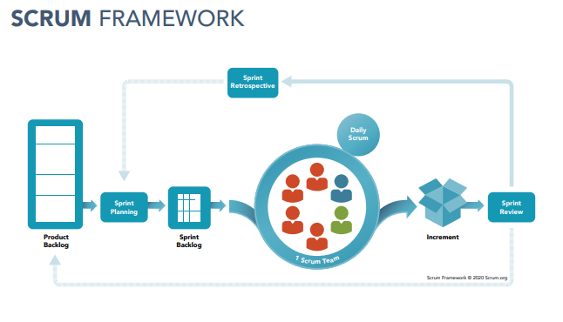
SYSTEM DESIGN
The development of this medipro hospital management system using agile technique: scrum methodology. Scrum is an iterative and incremental framework that helps teams deliver high-quality products in a timely manner. The scrum framework poster provides a graphical view of how scrum is implemented at a team level within an organization as shown in the diagram below below.
steps
Product Backlog
Sprint Backlog/Planning
Daily Scrum/Stand-up
Sprint Review
Sprint Retrospective

Slide 10
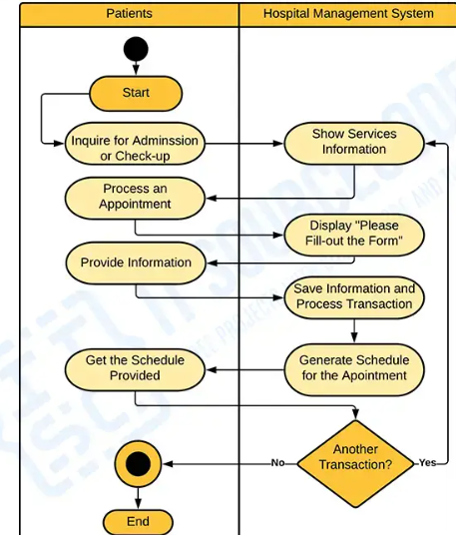
Tools for the designing HMS
UML(Unified Modelling Language)
a. Use case b. Activity Diagram
Bb

Slide 11
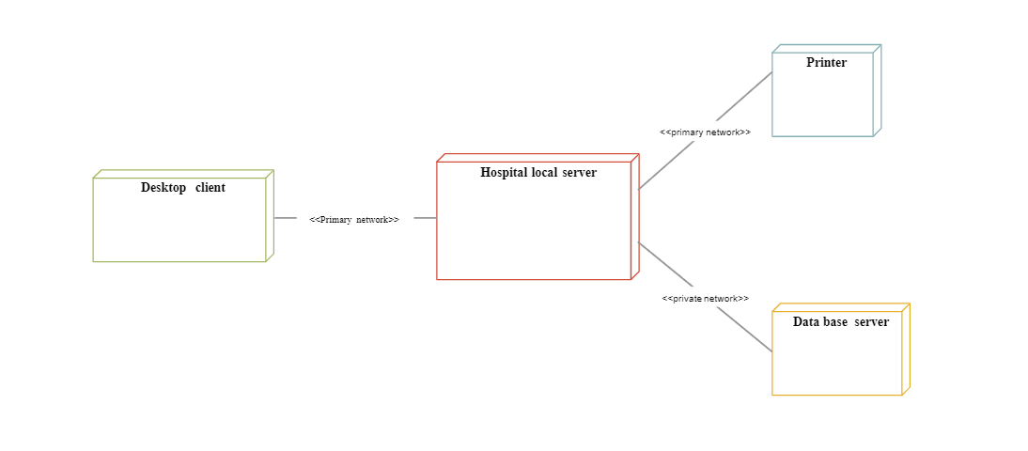
Tools for the designing HMS
UML(Unified Modelling Language)
c. Sequence diagram d. Deployment Diagram

Slide 12
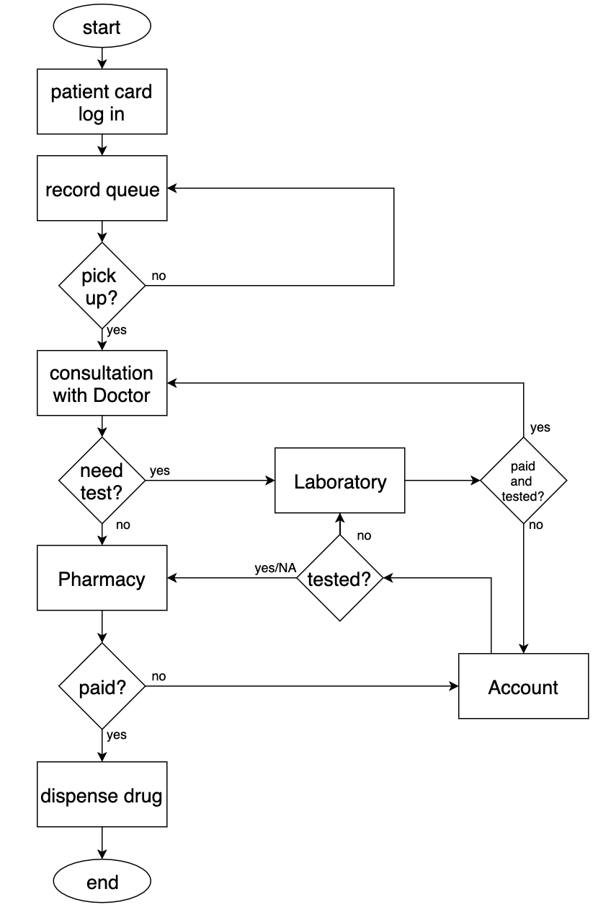
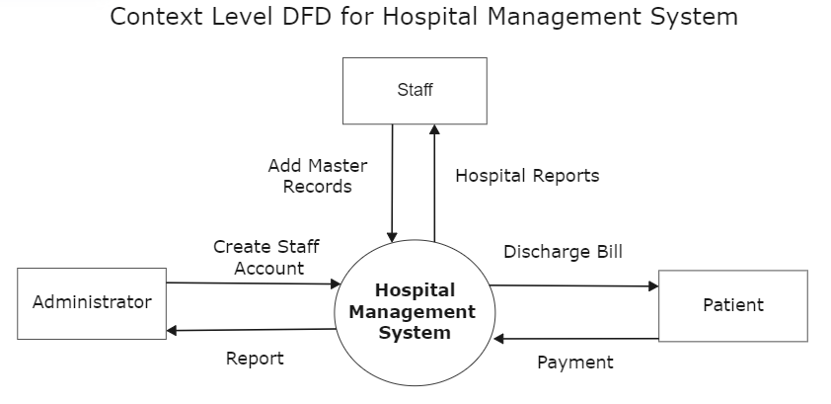
Tools for the designing HMS
ii. Flow Chart iii. Data flow Diagram

Slide 13
System IMPlementation
The implementation of software design starts in terms of writing program code in the suitable programming language and developing error-free executable programs efficiently
The system frontend was developed with HTML, Bootstrap(css framework) and jQuery(Javascript framework)
The server side – PHP with database Maria Db and using XAMPP as the server.
Development specification
We used these specification for the development of the hospital management system
Software specifications
Operating system: windows 10/11
Web browser: chrome / brave/ mozilla browser
Database: Xampp apache 2.0 as web server
Hardware specifications
Processor: core i 3 and above
RAM: 2GB or higher
Disk space: 500 mb
LAN ethernet 10/100mbps card/bus.

Slide 14
Code efficiency
Code efficiency is a broad term used to depict the reliability, speed and programming methodology used in developing codes for an application.
We use the following to achieve code efficiency:
Used of loops for repeated actionsUse of compound data structures
Use of functions & procedures
Use of in-built features / external code libraries
Use of object orientated coding.
Separation of data from the code
Used comments to enhance readability of code

Slide 15
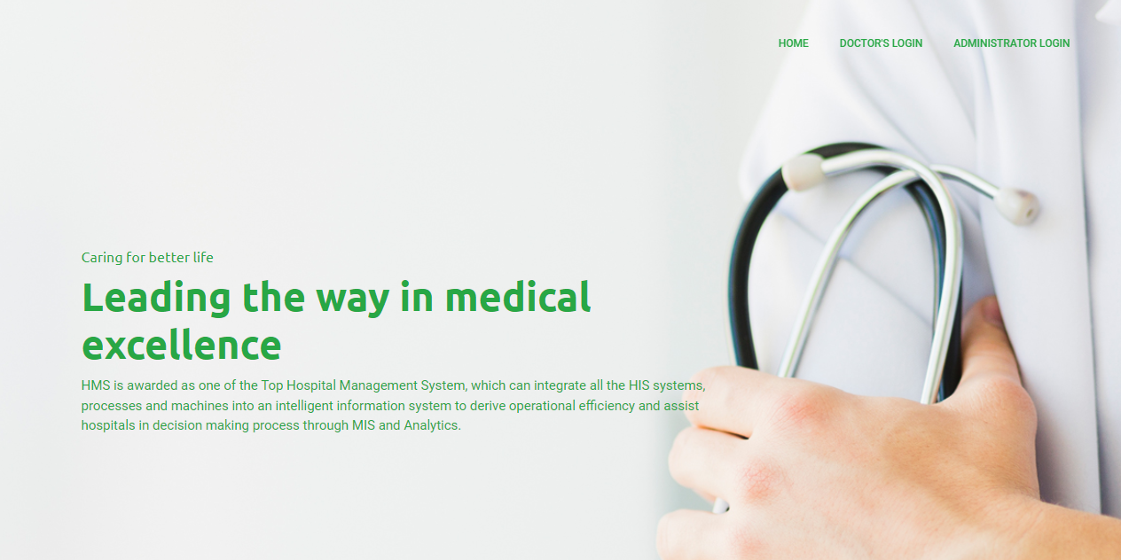
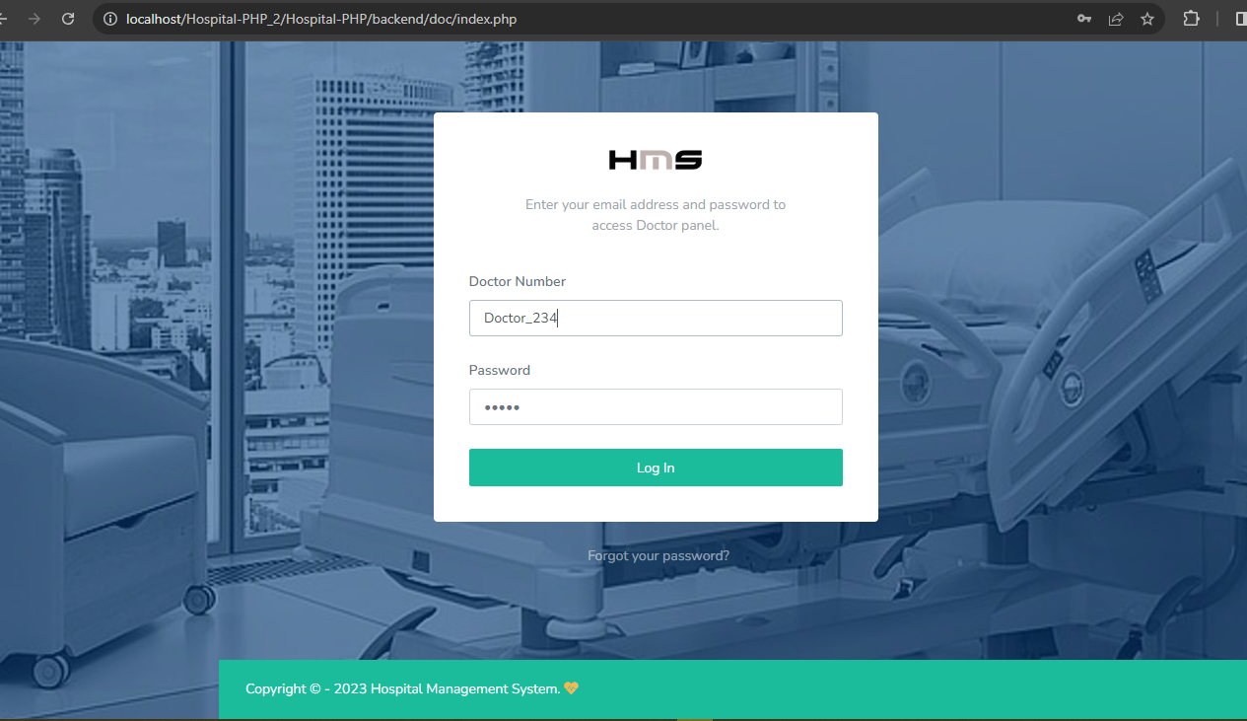
User Interface Implementation
Landing Page Login page

Slide 16
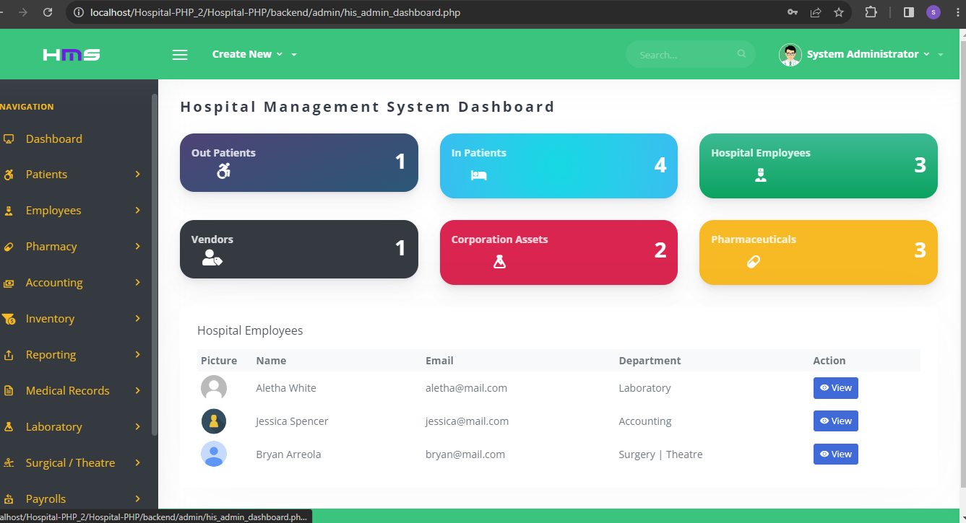
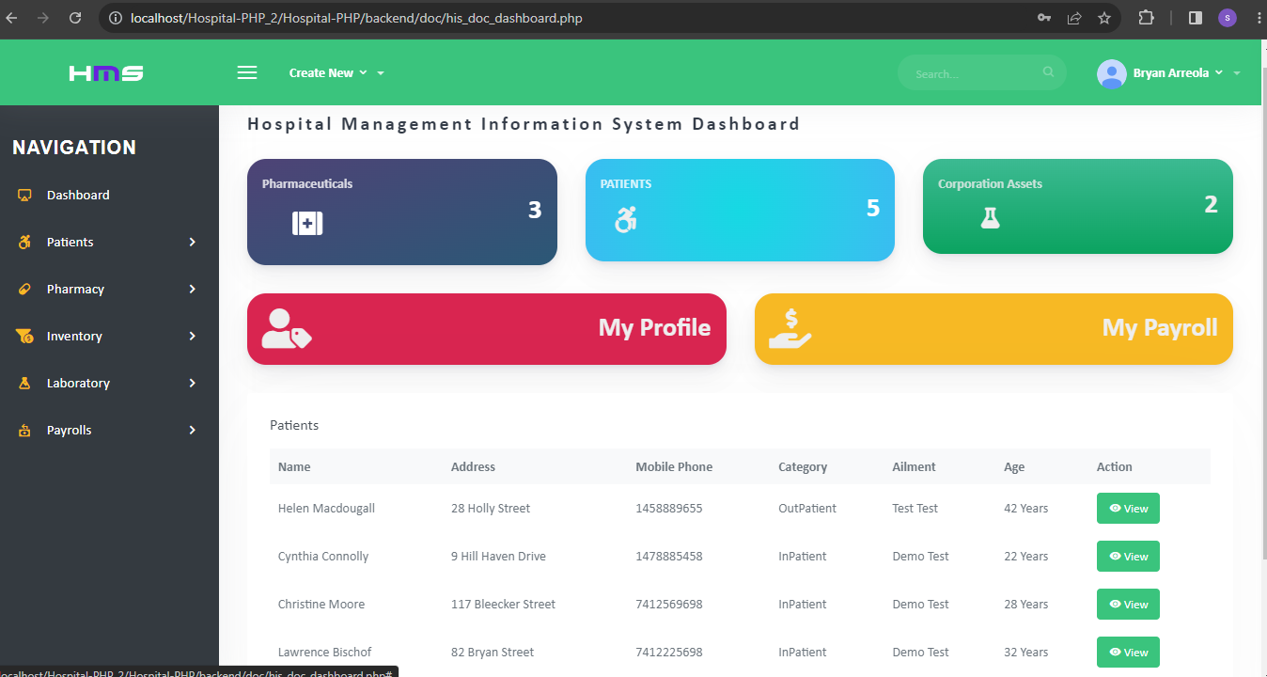
User Interface Implementation
Admin Dashboard Doctors Portal

Slide 17
TESTIng
Software testing for a hospital management system is an essential process that ensures the system functions effectively and reliably in a critical healthcare environment.
Software testing has the power to point out all the defects and flaws during development.
The testing phase helps identify and rectify any errors, vulnerabilities, or usability issues that may arise in the software, thus enhancing the overall quality and performance of the system.
Test done:
FUNCTIONAL TESTING : Unit Testing, Integrating Testing, System Testing
USABILITY TESTING
ACCEPTANCE TESTING.

Slide 18
UNIT TEST CASES
no | Test objective | Test input | expectation | Result
1 | Verify that doctors can access patient medical records. | Clicking view patient record | See correct patient record | PASSED
2 | Verify that the system can login with correct credential | Right credential | Logging into admin/Doctors portal. | PASSED
3 | Verify that the system can login with wrong credential | Wrong credential | Does not logging and prompts an alert | PASSED
4 | Test that the system can generate reports on patient visits and treatment. | Click patient data | Able to see patient visit history and treatments | PASSED
5 | Test that the system can handle laboratory test results. | Stores the data of the patient test and result | View result to the doctor and see the test | PASSED
6 | Test that lab technician can view the result send by doctor | Enter result of test and click submit | Send result to the doctor | PASSED
7 | Update the details of the patients | Change patient details and click submit button | Changes details of the patient | PASSED

Slide 19
EVALUATION OF SOFTWARE SOLUTIONS AND QUALITY
Evaluating software solutions and ensuring their quality is particularly crucial in the context of a hospital management system. The evaluation process helps hospitals and healthcare organizations select the most suitable software solution that meets their unique requirements and maintains a high standard of quality.
Importance of Evaluating Software Solutions:
Fit-for-purpose/ alignment with specific requirements:
An effective evaluation process ensures that the chosen software solution aligns with the unique requirements of a hospital
Performance and scalability:
Hospitals operate under demanding conditions, with numerous concurrent users and large amounts of data. When evaluating a software solution, it is vital to assess its performance and scalability.
Security and compliance:
Hospitals handle sensitive patient data, making security a top priority. Evaluating software solutions includes assessing their security measures and compliance with healthcare regulations
Usability and user experience:
The usability of a hospital management system significantly impacts its adoption and efficiency.
Integration and interoperability:
Hospital management systems need to integrate with various other healthcare systems

Slide 20
EVALUATION OF SOFTWARE SOLUTIONS AND QUALITY
Ensuring quality in hospital management systems:
To ensure the quality of a hospital management system, the following considerations and practices are important:
Comprehensive testing:
Conduct functional testing to validate each module's functionality, such as patient registra
2. Performance testing:
Evaluate the system's performance by stress testing it with a high number of concurrent users and a large dataset. Measure response times, resource utilization, and system stability to ensure optimal performance under peak loads.
3. Security testing:
Perform penetration testing and vulnerability assessments to identify and address security loopholes
4. Usability testing:
Engage users, including doctors, nurses, and administrative staff, to gather feedback on the system's usability.
5. Integration testing:
Test the integration of the hospital management system with other systems, ensuring seamless data exchange and smooth interoperability.
6. Continuous quality improvement:
Regularly collect user feedback, analyze system usage data, and prioritize enhancements based on user needs.

Slide 21
CONCLUSION AND RECOMMENDATIONS
Summary
In conclusion, from a proper analysis and assessment of the designed system, it can be safely conclude that the system is an efficient, usable and reliable records management system. It works properly and adequately meets the minimum expectations that were set per the requirements. The new system is expected to give benefits increased overall productivity, performance and efficient records management.
Recommendation
Integration of artificial intelligence (AI) and machine learning (ML)
Blockchain for data security and interoperability
Mobile applications and patient engagement
Data analytics and business intelligence
Enhanced interoperability and health information exchange

Slide 22
CONCLUSION AND RECOMMENDATIONS
Conclusion:
Future developments in hospital management systems hold immense promise for revolutionizing healthcare delivery. By embracing emerging technologies, such as AI, ML, iot, blockchain, and mobile applications, hospital management systems can transform patient care, enhance operational efficiency, improve data security, and enable better decision-making.
Additionally, advanced analytics, enhanced interoperability, and telemedicine capabilities will play a crucial role in shaping the future of hospital management systems, ultimately leading to improved healthcare outcomes and patient experiences.

Slide 23
References
References:
Http://www.Academia.Edu/11154016/A_PROJECT_REPORT_ON_PATIENT_MONITORING_SYSTEM
Https://www.Google.Com/url?Sa=t&rct=j&q=&esrc=s&source=web&cd=1&cad=rja&uact=8&ved=2ahukewiew87d7eleahxb0qqkhwm5cueqfjaaegqiebab&url=https%3a%2f%2fwww.Capterra.Com%2fpatient-management-software%2f&usg=aovvaw2jqzikddhhlizdylpjouem
Https://www.Google.Com/url?Sa=t&rct=j&q=&esrc=s&source=web&cd=3&cad=rja&uact=8&ved=2ahukewj57-nw7eleahxezkqkhupvcxiqfjacegqiabab&url=
Https%3a%2f%2fwww.Researchgate.Net%2fpu blication%2f228569210_clinics_management_system_cms_based_on_patient_centered_process_ontology&usg=aovvaw0tnonaqwb0eczxektznm7x
Https://www.Google.Com/url?Sa=t&rct=j&q=&esrc=s&source=web&cd=35&cad=rja&uact=8&ved=2ahukewiew87d7eleahxb0qqkhwm5cueqwaicmcj6bagbea4&url=
Https%3a%2f%2fen.Wikipedia.Org%2fwiki%2fpatient_management_software&usg=aovvaw0bs_n8fwymrcpao6u0iluyhttps://www.Ncbi.Nlm.Nih.Gov/pmc/articles/PMC2233054/
Https://www.Researchgate.Net/publication/236583120_electronic_patient_record_management_system_ EPRMS
Melogoza, P. And gyeszly, S.D (2002) information overloads”.Collection building 21, 1:32-42
Jantz, R. (2001) “knowledge management in academic libraries: special tools and processes to support information professionals‟
Reference service services review 29, 1:33 -39

