Slide 1


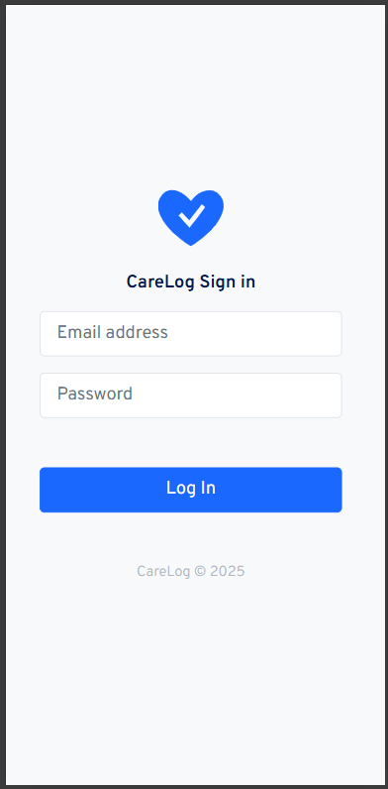
CareLog Project
Modern-Health Information System
Project Presentation
By Onwonga Samson Michira
April 2025

Slide 2



Project Overview
Problem Statement
Solution Overview
Key Features
Technology Stack
System Architecture
REST API Overview
Testing and Validation
Database Design
Security Considerations
Deployment Readiness
Future Enhancements
Conclusion

Slide 3


The Problem We Solve
Manual records are inefficient and risky
Lack of secure system integrations
Difficult tracking of patient-program enrollment

Slide 4


Our Solution:
CareLog
+ 73%
Patient & Program Management
Enrollment Tracking
Secure API Access

Slide 5
Key Features
of CareLog
Authentication with Email/Password
Patient Registration & Profile View
Program Creation, Edit, Delete
Enrollments Management
Search & Filter by Gender, Program
Secure REST API Access

Slide 6

Laravel 12 (PHP 8.3)
Laravel Sanctum (API security)
Bootstrap 4 (Frontend)
MySQL 8 Database
Technology Stack

Slide 7


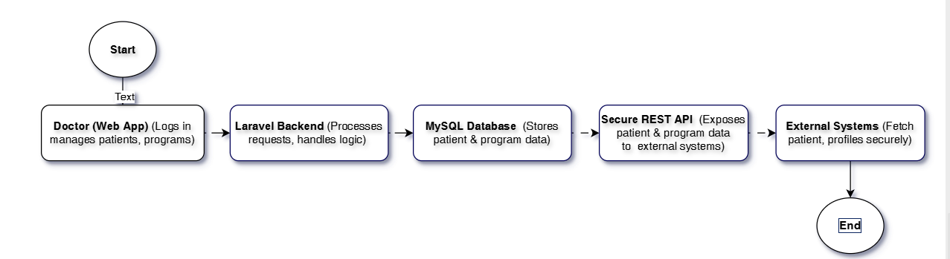
System Architecture
Doctor interacts via Web App
Laravel manages backend logic
MySQL stores patient & program data
Secure APIs expose client profiles

Slide 8
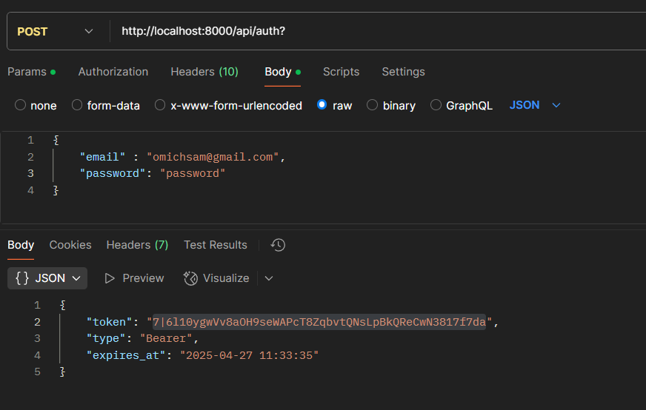
REST API Endpoints
POST /api/auth → Get Bearer Token
GET /api/patients/{patientNumber} → Retrieve Profile
401/404/500 Proper Error Responses

Slide 9
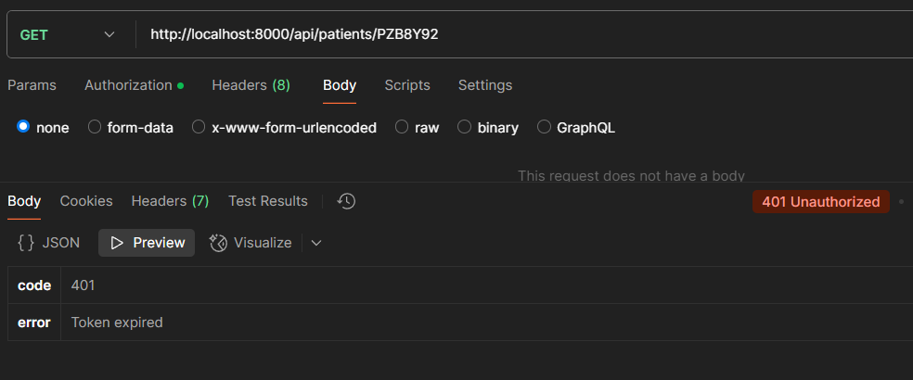
Testing and Validation
Unit Testing
Feature & API Testing
Security Validation
Login with valid/invalid credentials
Fetch patient profile via API
Enroll patients & view enrollments
Token-based auth with Laravel Sanctum
Unauthorized access handling (401)
Token expiry (5 mins) & secure error responses
Create/Delete Programs
Create/View Patients
Enroll Patients to Programs
Update Patient Details

Slide 10
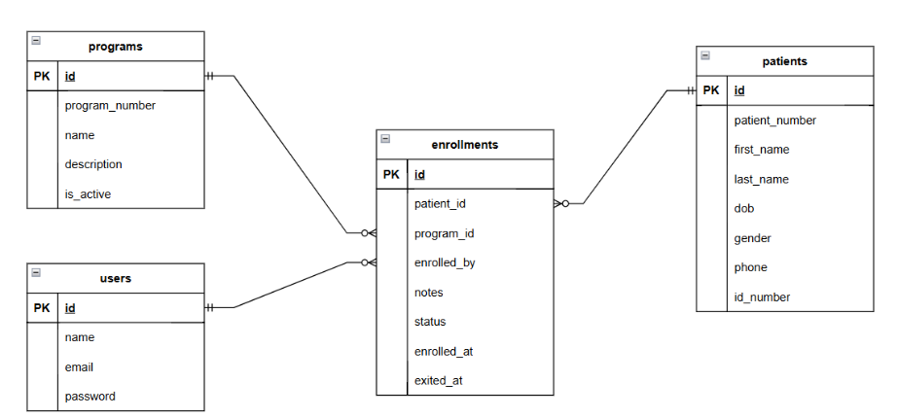
DATABASE DESIGN
users → System users (doctors)
patients → Registered patients
programs → Health programs
enrollments → Patient-Program link (pivot table)

Slide 11
Security Best Practices
Sanctum Token Authentication
Expiring Tokens (5 minutes)
Secure API Error Handling
Security Considerations

Slide 12
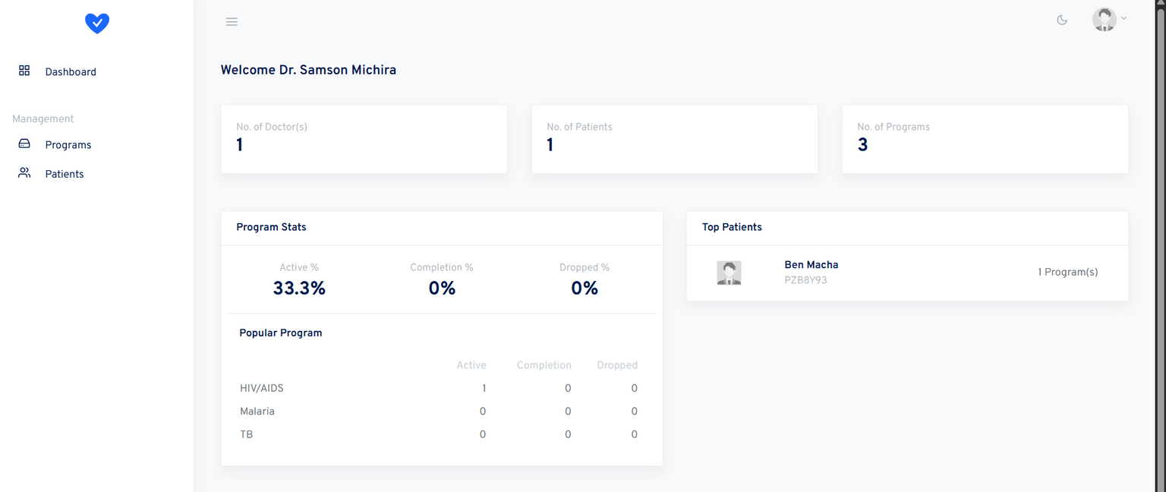
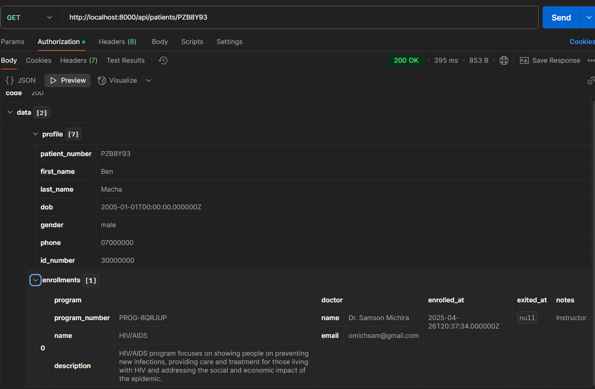
Live Demo Screens
(Screenshots)
Dashboard Overview
Patient Profile + Enrollments
Program Management Panel
API Response Sample
Video Demo Link

Slide 13


Innovations and Optimizations
Modal-first UX (fewer page reloads)
Cascade deletes for programs + enrollments
Token-based secure API
Responsive design for tablets & mobile
Clean codebase with commit history

Slide 14

Future Enhancements
1
2
3
4
Role-based Access Control (Admin/Doctor)
Advanced analytics (program success rates)
API Documentation (Swagger)
Dockerized Deployment

Slide 15
Conclusion & Impact
Addresses real-world healthcare challenges
Designed for simplicity, security, and scalability
Ready for integration, enhancement, and deployment

Slide 16


SOURCECODE
github.com/omichsam/carelog
omichsam@gmail.com

