Slide 1
PBL: Sound Localization
27-02-25 SIT Nagpur
for Gunshot Detection
Arya Kashikar - 22070521036 Aditya Joshi - 22070521016 Anvesh Khode - 22070521021

Slide 2
Problem Statements
Distance: Identifying the distance of a gunshot from multiple microphone arrays.
Direction: Determining the direction of the gunshot using Time Difference of Arrival (TDOA) and Direction of Arrival (DOA) techniques.
Optimization: Enhancing accuracy in urban environments with noise and reflections.
Real-time Applications: Implementing real-time localization for immediate response applications.

Slide 3
Current Study
⚠️ Identify a proper dataset ✅ Identify the distance and direction of a gunshot ✅ Used two different approaches to solve the problem: I] Formula-Based Approach: TDOA & DOA II] Machine Learning-Based Approach – 1. XGBoost 2. RandomForest 3. MLP
✅ Started working on the research paper

Slide 4
What will we determine?
Origin
Direction
Distance from Shooter
We determine the relative position of the origin of the gunshot.
This helps us react in a life-or-death situation faster than guessing.
Understanding where the shots are being directed to, will provide us with key insights about the intents of the attacker(s).
Maintaining distances from situations like these effectively increases the odds of survival in our favor.

Slide 5
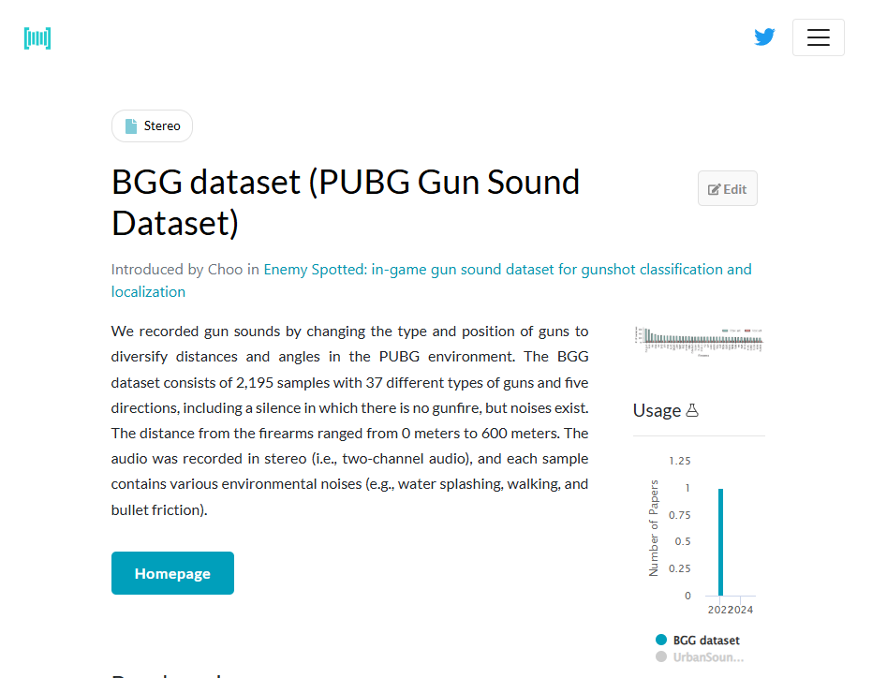
Existing Solutions
These are some existing solutions which have been used nowadays -
Acoustic Sensor Networks: - Large scale mic distributions used in systems like ShotSpotter.
TDOA-Based Localization: - Use multiple microphones to calculate the time delay between arrivals.
Beamforming Algorithms: - Enhance sound separation and functionality.

Slide 6
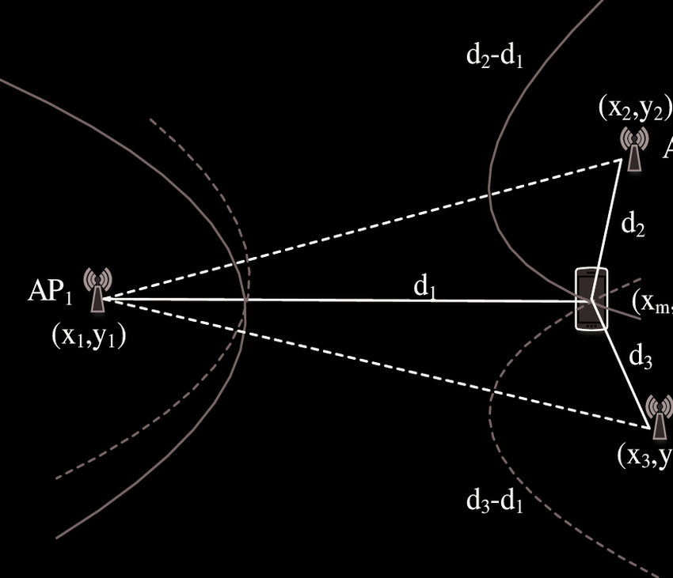
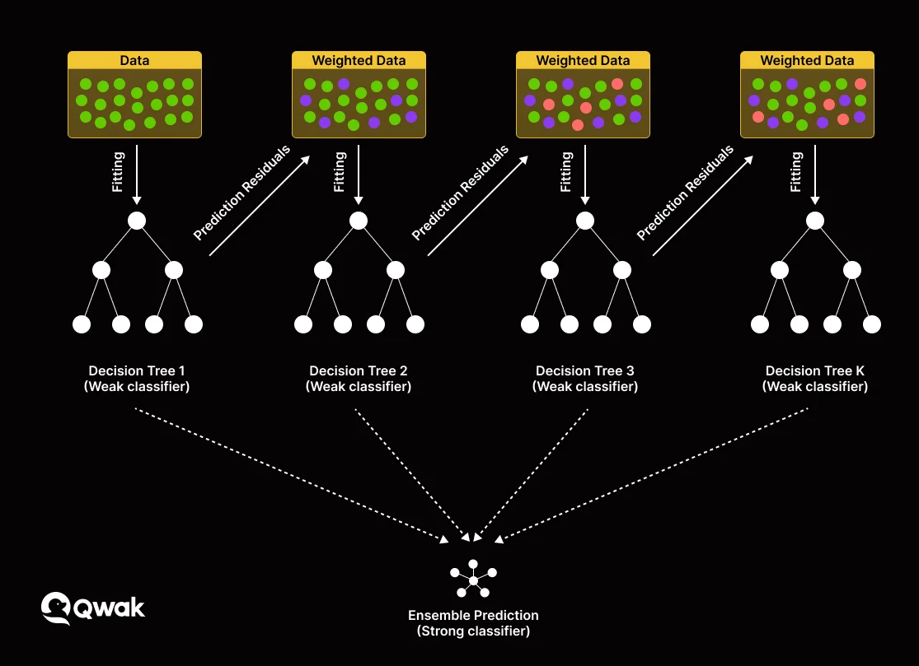
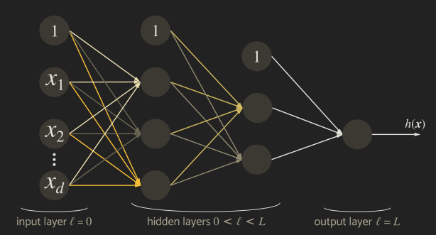
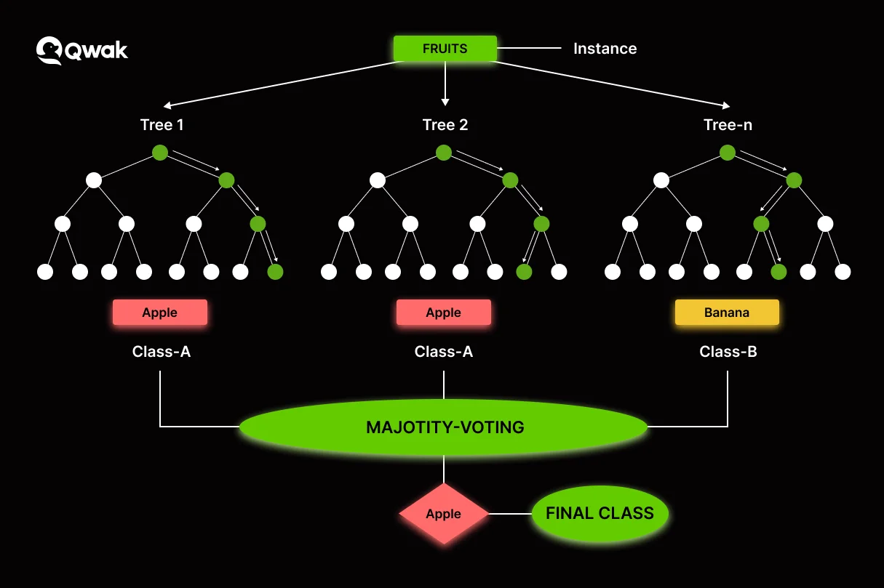


Approach 1 – Formula-Based Method
Key Metrics: Time Difference of Arrival (TDOA) and Direction of Arrival (DOA)
TDOA (Time Difference of Arrival)
Measures the time difference between when a sound reaches different microphones.
Helps estimate distance and direction of the gunshot.
DOA (Direction of Arrival)
Determines the angle from which the sound arrives at the microphone array.
Uses cross-correlation and phase differences to estimate the source direction.
$$∆t=\frac{d_{2}−d_{1}}{c}$$
TDOA
$$θ=arc\sin\left(\frac{c⋅Δt}{d}\right)$$
DOA, TDOA
DOA
XGBoost
MLPRegressor – Multi Layered Perceptron
Random Forest Regressor

Slide 7
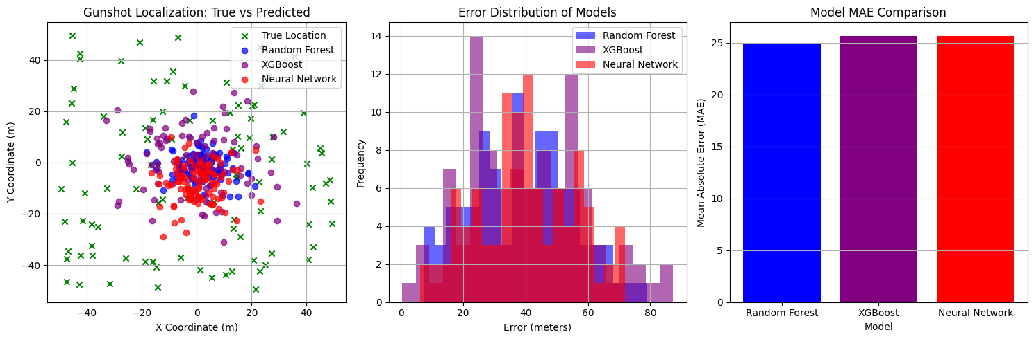
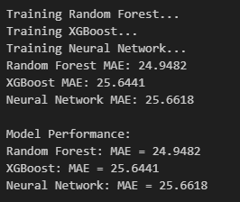
Approach 2 – Machine Learning-Based Method
We trained three models to estimate the gunshot’s location using sound features.
✅ XGBoost – Decision-tree-based boosting algorithm
✅ RandomForestRegressor – Ensemble of decision trees
✅ MLPRegressor (Multi-Layer Perceptron) – Neural network-based regression
XGBoost
Random Forest Regressor
MLPRegressor – Multi Layered Perceptron

Slide 8
Dataset Selection
We used a synthetically generated dataset for experiments.
What it includes: - Gunshot source positions (X, Y, Z) - Microphone locations (known positions) - Time Difference of Arrival (TDOA) between mics
(Note: Currently, The BGG Dataset is the only one which remotely satisfies the dataset requirements)

Slide 9
Evaluation & Performance Metrics
These are the metrics we plan to use for evaluating our models -
✅ Mean Absolute Error (MAE) – Average error in meters (scores shown in right image) ⌛ Localization Error – Distance between actual and predicted gunshot location. ⌛ Angular Error – Difference in estimated vs. actual direction

Slide 10
Current Progress
What We Have Done So Far:-
✅ Collected and processed a synthetic dataset ✅ Implemented TDOA & DOA formula-based approaches ✅ Trained XGBoost, RandomForest, and MLPRegressor models ✅ Evaluated initial accuracy of both methods. ✅ Implemented Latitude and Longitude Geolocations
⌛ Identify a dataset suitable for training the model at scale.
⌛ Implement CRNN model and test accuracy. ⌛ Improve ML model accuracy with data augmentation. ⌛ Test with real-world recordings instead of synthetic data.
Comparing both approaches in our models, we observe that:
⚠️ Formula-based methods are precise in ideal conditions, but they struggle with noise, which is present in many scenarios. ✅ ML models adapt better to complex environments but require a large dataset to train, which is hard to find.

Slide 11
Next Steps
⌛ Implement CRNN and hybrid models and test their accuracy. ⌛ Improve ML model accuracy with data augmentation. ⌛ Test with real-world recordings instead of synthetic data.
Thank You

Slide 12
Thank You

