Slide 1
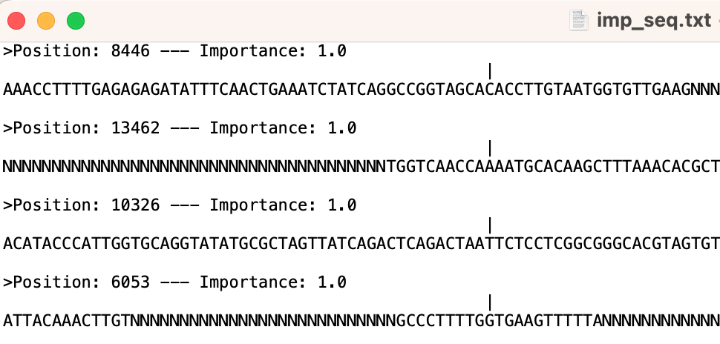
Name of the file
Position and importance value
position
ACA >> T
AAA >> K
Sequence around the position
T478K

