Slide 1

Bioinformatics Bootcamp
Biomedical Machine Learning with Python
PART II: Machine Learning for Biomedical Applications
Module 7: Classification

Slide 2
Contact Info
Daniel Montemayor Ph.D.
Assistant Professor / Research
Center for Renal Precision Medicine
Department of Medicine
UT Health San Antonio
Email: montemayord2@uthscsa.edu
Office hours: https://calendly.com/daniel_montemayor/montemayor-office-hours

Slide 3
Part II : Overview
Getting to know your data
Formatting | Visualization | Partitioning | Normalization | Integrity
Feature Selection
Parsimony | Dimension Reduction | Supervised and Unsupervised Methods
Classification Models
Cross-Entropy and other Error Metrics | Random Forest | Logistic Regression
Regression Models
Linear Regression | Regularization | LASSO | Elastic-Net
End-to-End ML Workflow – Leukemia Project (two weeks)
Convolutional Neural Networks – MRI Brain Tumor Project
Adv. Topics – Sequence. Models | Encoders |GANs | Reinforcement Learning

Slide 4
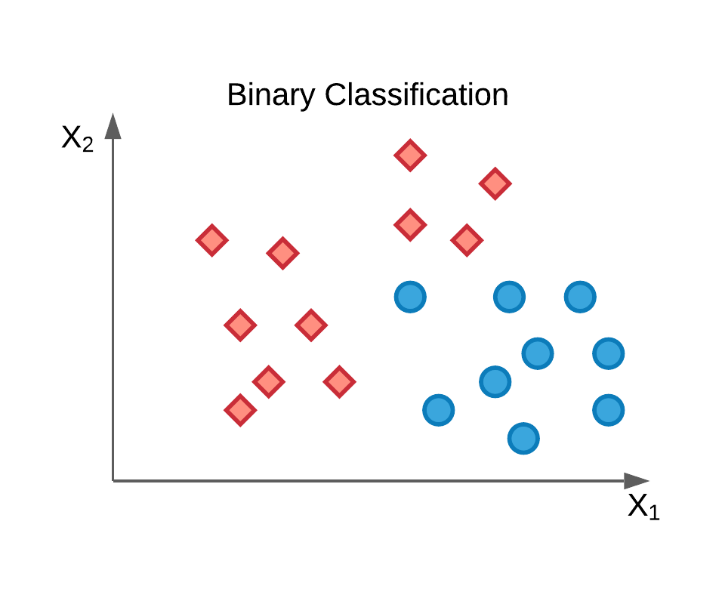
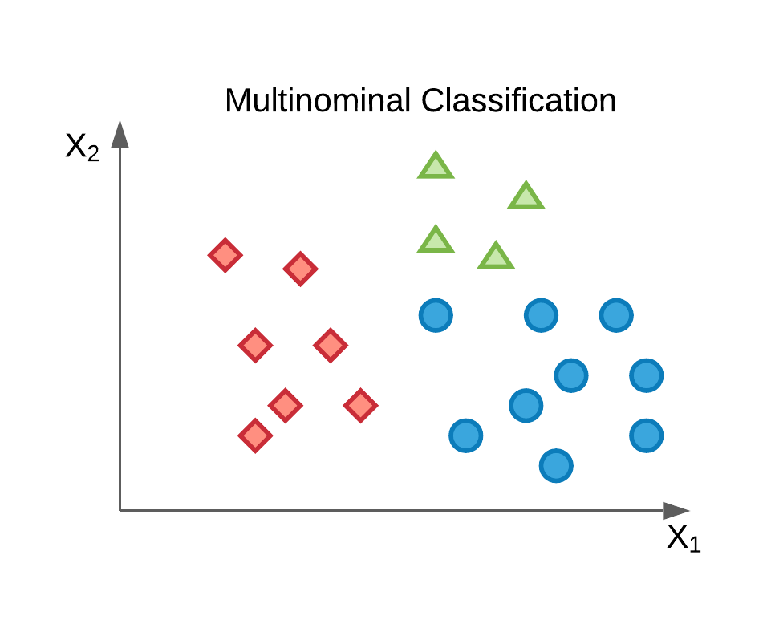
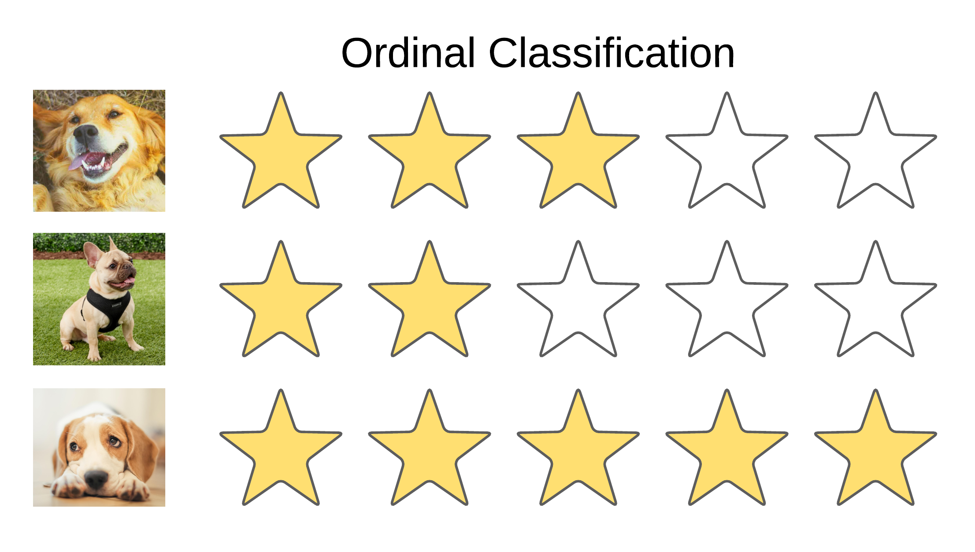
What is classification
Classification is the task of predicting categorical outcomes/labels
Categorical variables can be binary, multinominal, or ordinal

Slide 5
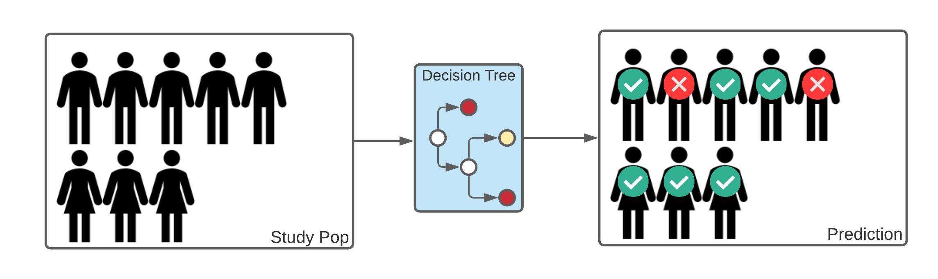
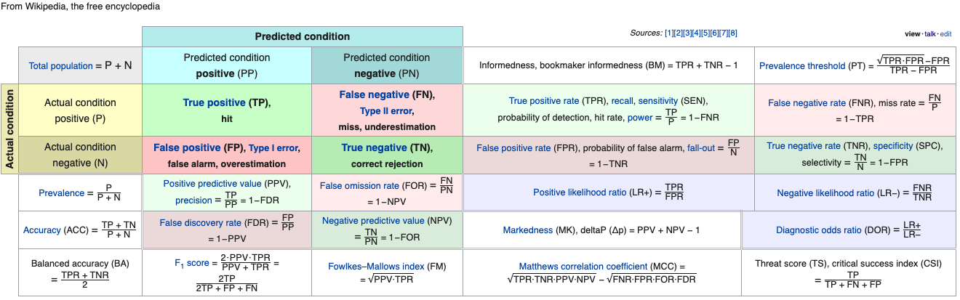
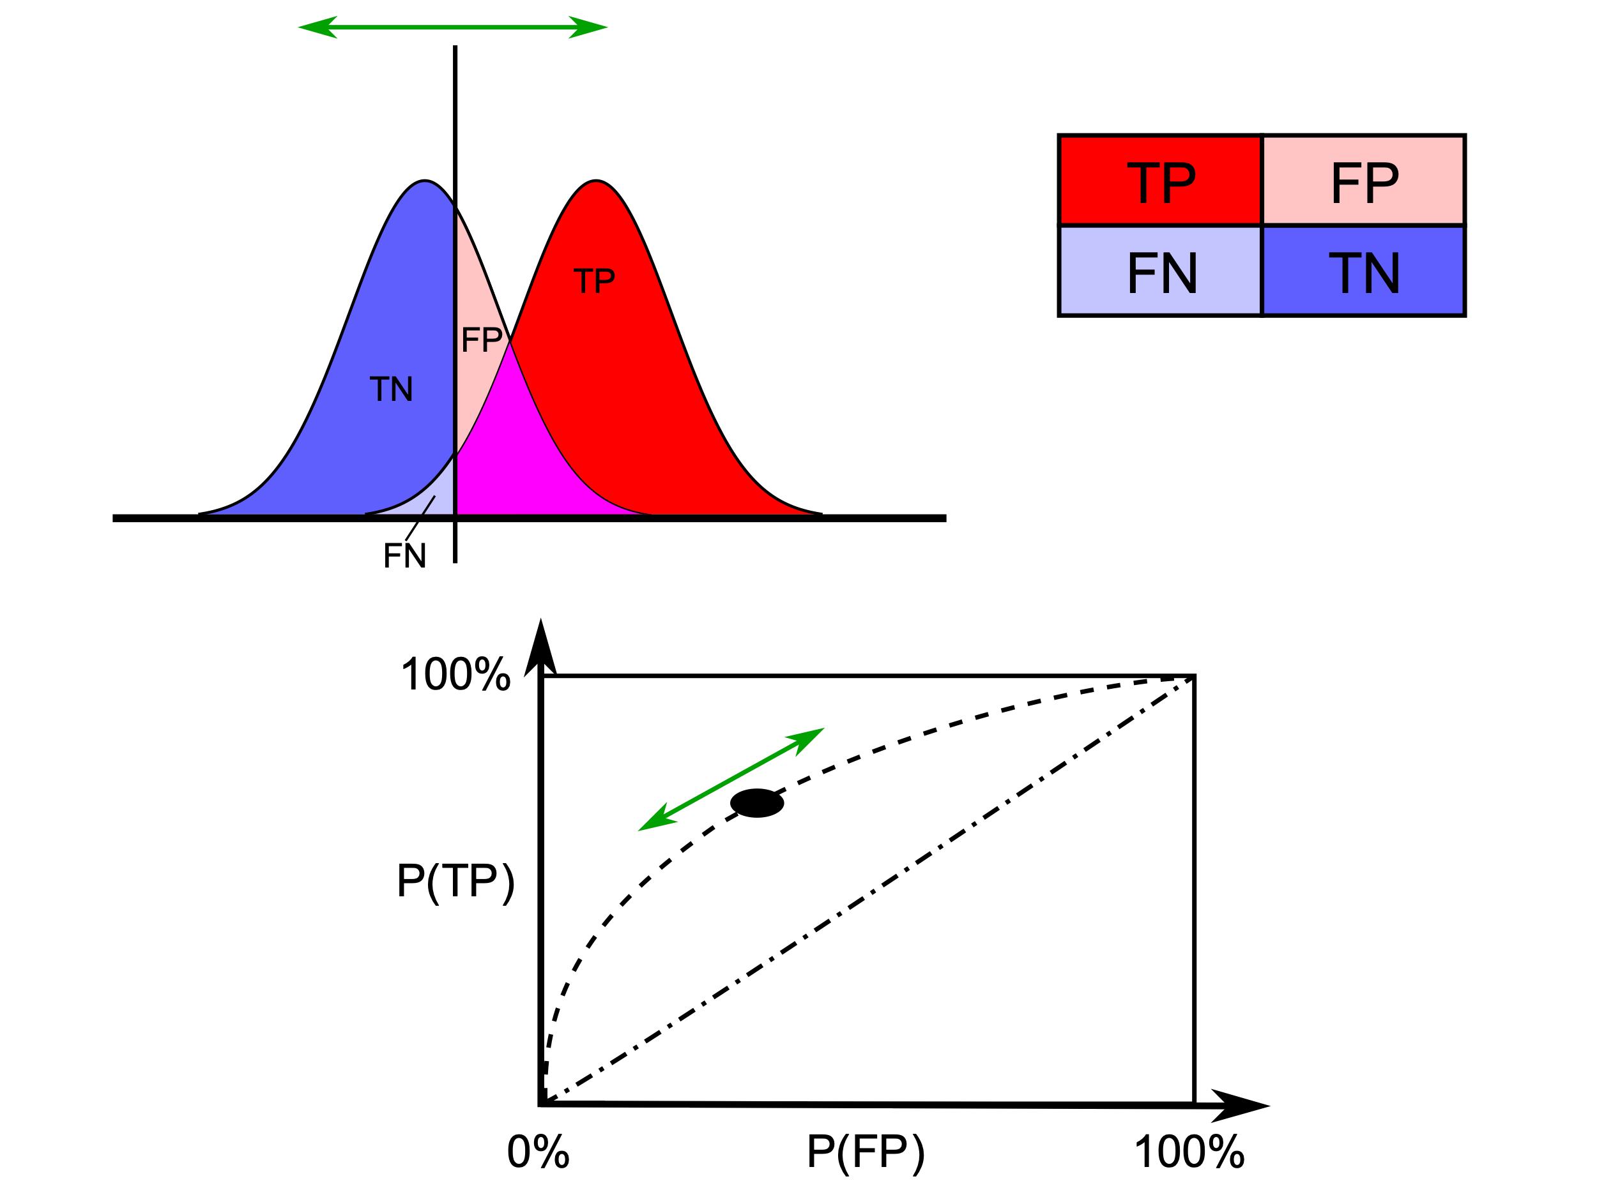
Type I and Type II Errors
(Top Right) Misclassification in an example classifier
(Above) Diagnostic testing diagram
(Bottom Right) Receiver operating characteristic (ROC) curve

Slide 6

Prevalence
Prevalence of the outcome should inform how you quantify the classifier performance
Use sensitivity if interested in correctly classifying minority class
Use precision if interested in minimizing the number of false positive
Consider the error metric accuracy for rare diseases.

Slide 7
Error Metrics: F-score
F₁-score (aka dice coefficient) balances precision and sensitivity. It is an equal weighted average known as the harmonic mean of precision and recall.

Slide 8
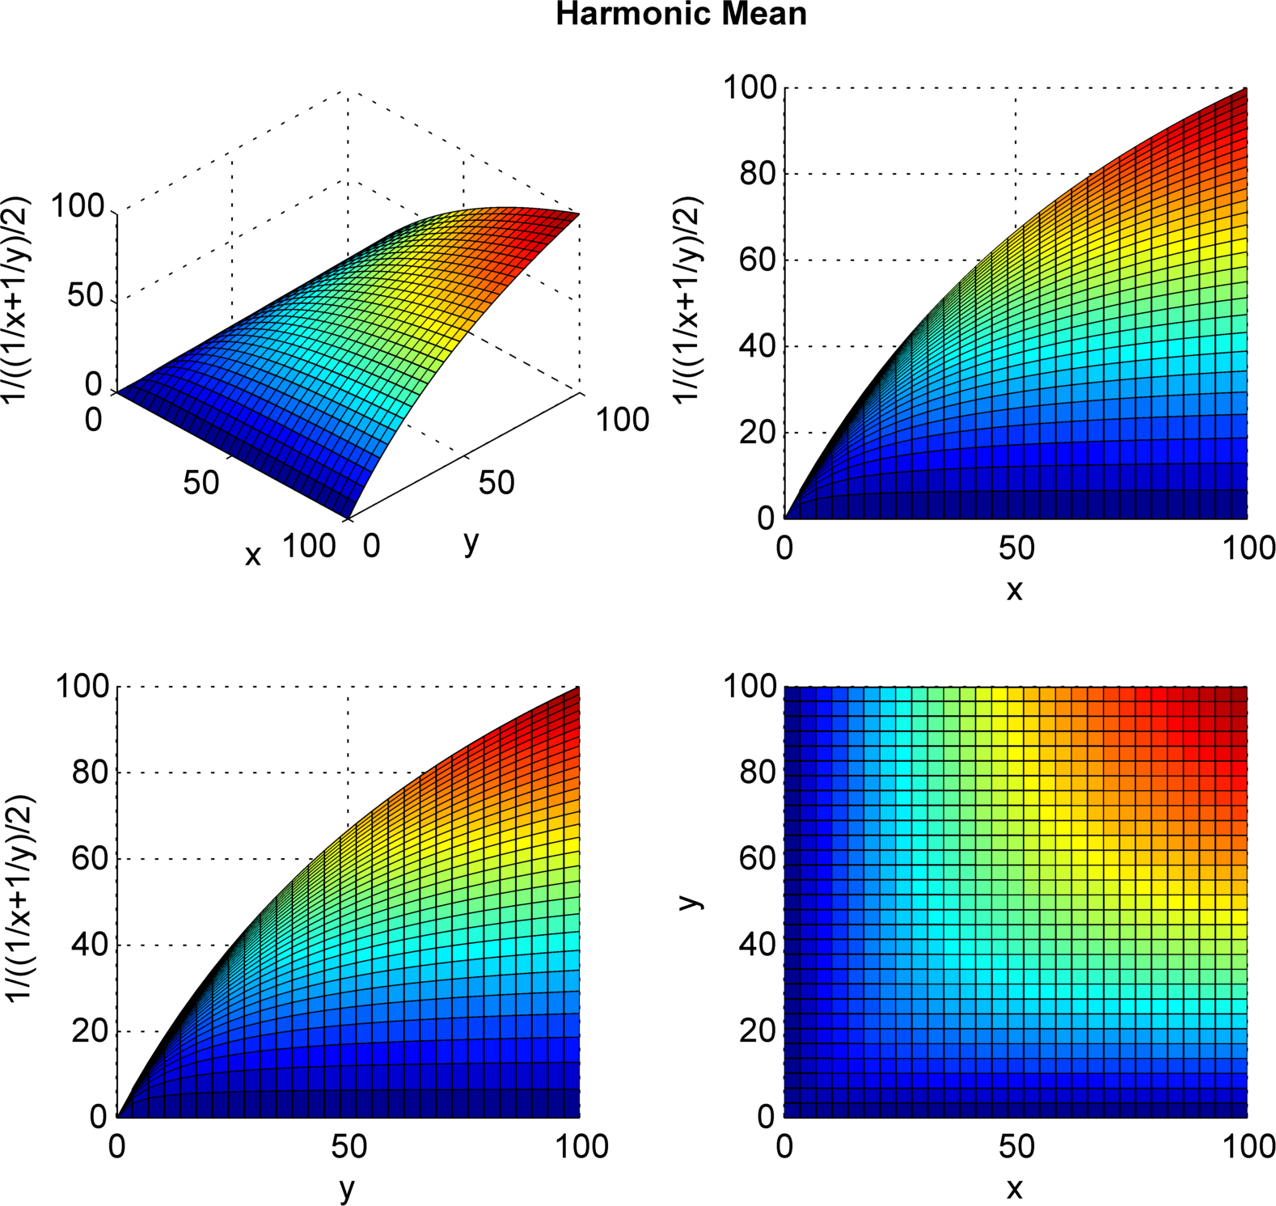
Error Metrics : F-score
F₁-score (aka dice coefficient) balances precision and sensitivity. It is an equal weighted average known as the harmonic mean of precision and recall. Range 0-1
Normalized harmonic mean plot where x is precision, y is recall and the vertical axis is F₁ score, in percentage point

Slide 9
Error Metrics: MCC
Matthews correlation coefficient: Correlation of the predicted labels with the actual labels. Range -1 to 1

Slide 10
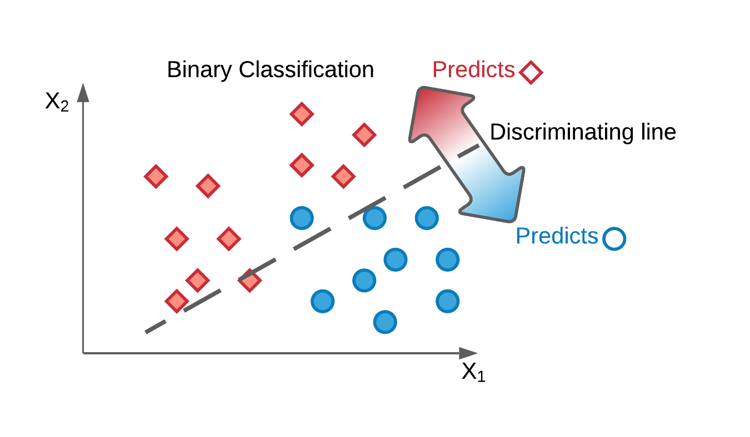
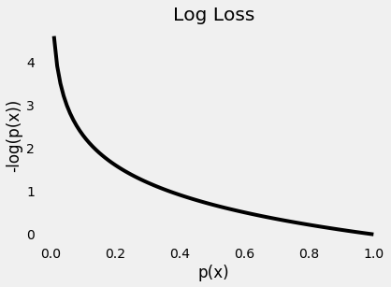
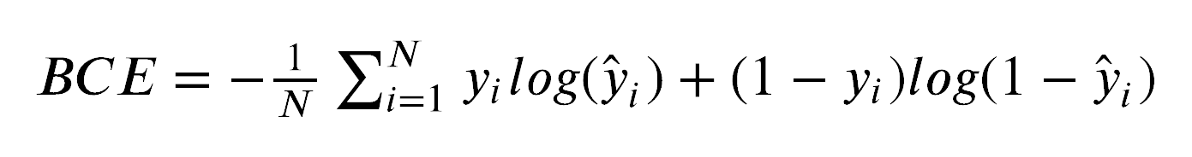
Error Metrics: Binary Cross Entropy
Error estimate as a function of predicted probability
Actual value
Predicted value
Penalizes
FN (T2 error)
Penalizes
FP (T1 error)

Slide 11
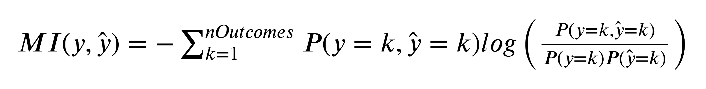
Error Metrics: Mutual Information
Can be used for multiple classes and for continuous variables
Measures how much information I get from one variable by observing the other.
Related to intersection over union (IOU aka Jaccard distance) error metric

Slide 12
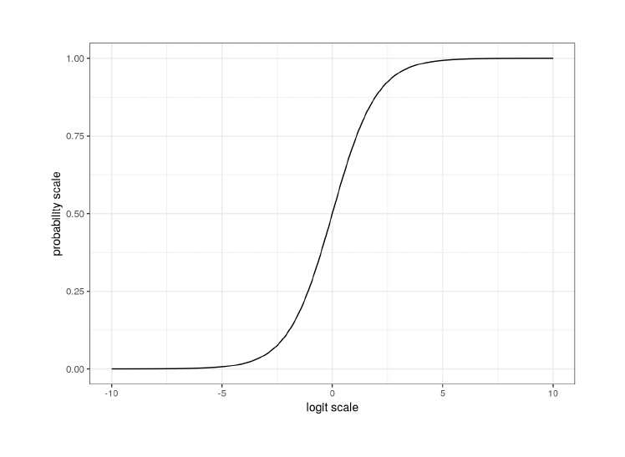
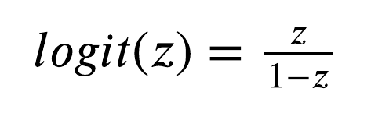
Logit Function
Returns a probability
Can take any real number as input
Wrap over a linear model to get logistic regression

Slide 13
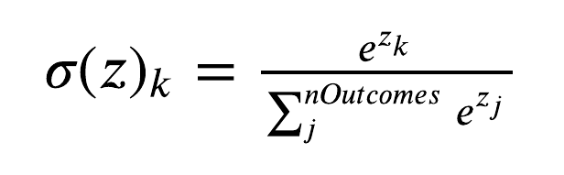
Softmax function
Returns a probability for each outcome
Denominator ensures sum of probabilities = 1

Slide 14
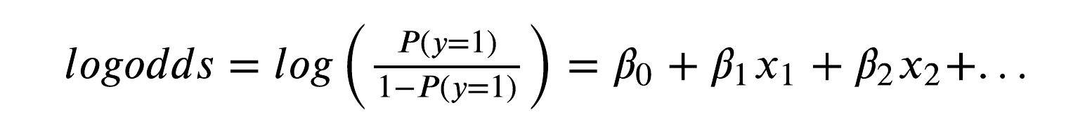
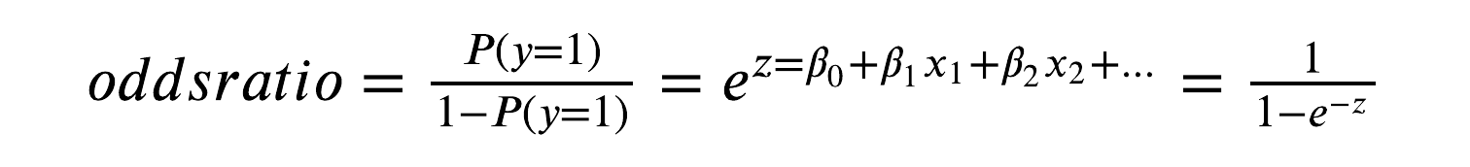
Logistic Regression
Log-odds can be written as linear expansion of coefficients on the predictors

Slide 15
Implementation – Logistic Regression
class sklearn.linear_model.LogisticRegression(
penalty={‘l1’, ‘l2’, ‘elasticnet’, ‘none’}, default=’l2’,
C=(regularization constant),
fit_intercept=True,
solver={‘newton-cg’, ‘lbfgs’, ‘liblinear’, ‘sag’, ‘saga’}, default=’lbfgs’,
For small datasets, ‘liblinear’ is a good choice, whereas ‘sag’ and ‘saga’ are faster for large ones.
For multiclass problems, only ‘newton-cg’, ‘sag’, ‘saga’ and ‘lbfgs’ handle multinomial loss; ‘liblinear’ is limited to one-versus-rest schemes.
‘newton-cg’, ‘lbfgs’, ‘sag’ and ‘saga’ handle L2 or no penalty
‘liblinear’ and ‘saga’ also handle L1 penalty
‘saga’ also supports ‘elasticnet’ penalty
‘liblinear’ does not support setting penalty='none'
max_iter={max iterations for solver to reach convergence},
multi_class={‘auto’, ‘ovr’, ‘multinomial’}, default=’auto’,
l1_ratio=float, default=None (elastic net mixing parameter range 0-1 : 0 for L1 and 1 for L2)
)

Slide 16
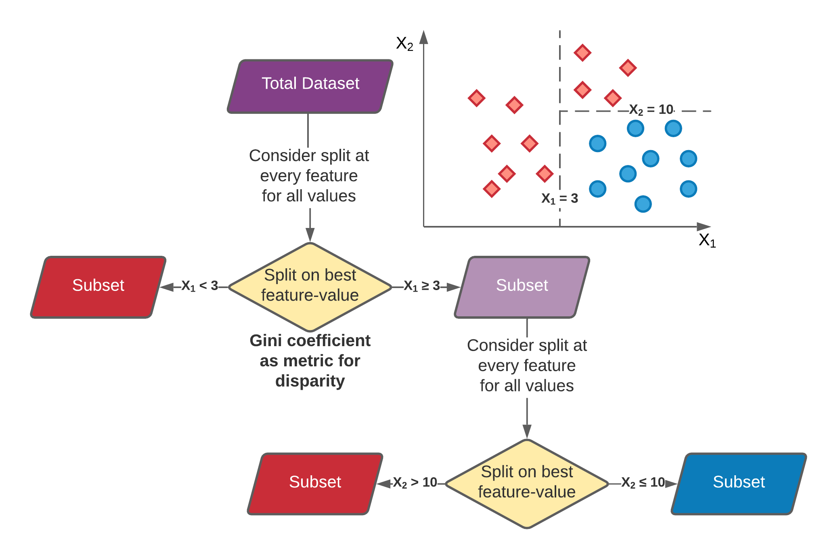
Decision Trees
Can achieve 100 accuracy
Limit branching depth and number of features considered to reduce expense. Random forest is stochastic realizations of DTs

Slide 17
Random Forest
class sklearn.ensemble.RandomForestClassifier(
n_estimators= (number of trees)
criterion={“gini”, “entropy”}
max_depth=None, (how many branches)
min_samples_split=(samples needed to consider a split),
min_samples_leaf=(minimum samples allowed in a leaf),
max_features={“auto”, “sqrt”, “log2”, None}, int or float, default=”auto” (features considered per split)
bootstrap={True, False}; False=use the whole dataset
max_samples={number of bootstrap samples, or fraction of number of data set observations}
)

