Slide 1

Bioinformatics Bootcamp
Biomedical Machine Learning with Python
PART II: Machine Learning for Biomedical Applications
Module 8: Regression

Slide 2
Contact Info
Daniel Montemayor Ph.D.
Assistant Professor / Research
Center for Renal Precision Medicine
Department of Medicine
UT Health San Antonio
Email: montemayord2@uthscsa.edu
Office hours: https://calendly.com/daniel_montemayor/montemayor-office-hours

Slide 3
Part II : Overview
Getting to know your data
Formatting | Visualization | Partitioning | Normalization | Integrity
Feature Selection
Parsimony | Dimension Reduction | Supervised and Unsupervised Methods
Classification Models
Cross-Entropy and other Error Metrics | Random Forest | Logistic Regression
Regression Models
Linear Regression | Regularization | LASSO | Elastic-Net
End-to-End ML Workflow – Leukemia Project (two weeks)
Convolutional Neural Networks – MRI Brain Tumor Project
Adv. Topics – Sequence. Models | Encoders |GANs | Reinforcement Learning

Slide 4
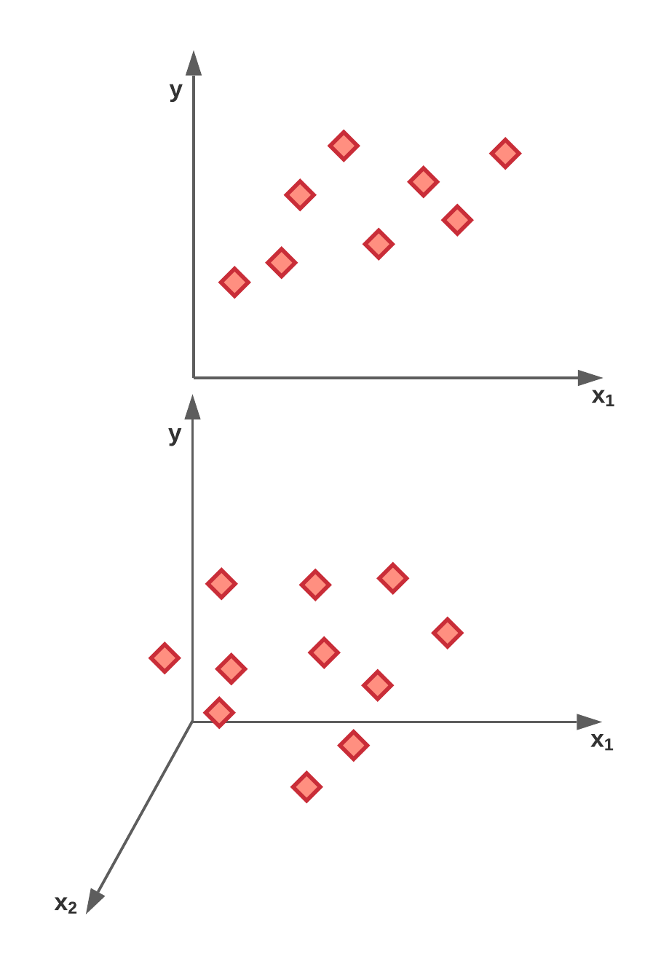
What is Regression
Assumes a linear relationship between input (x) and a continuous output y(x)
Simple vs multiple linear regression Base Algorithm – Ordinary Least Squares (OLS)
Task is to assign a scaling factor (β) for each predictor that minimizes some kind of error metric.

Slide 5
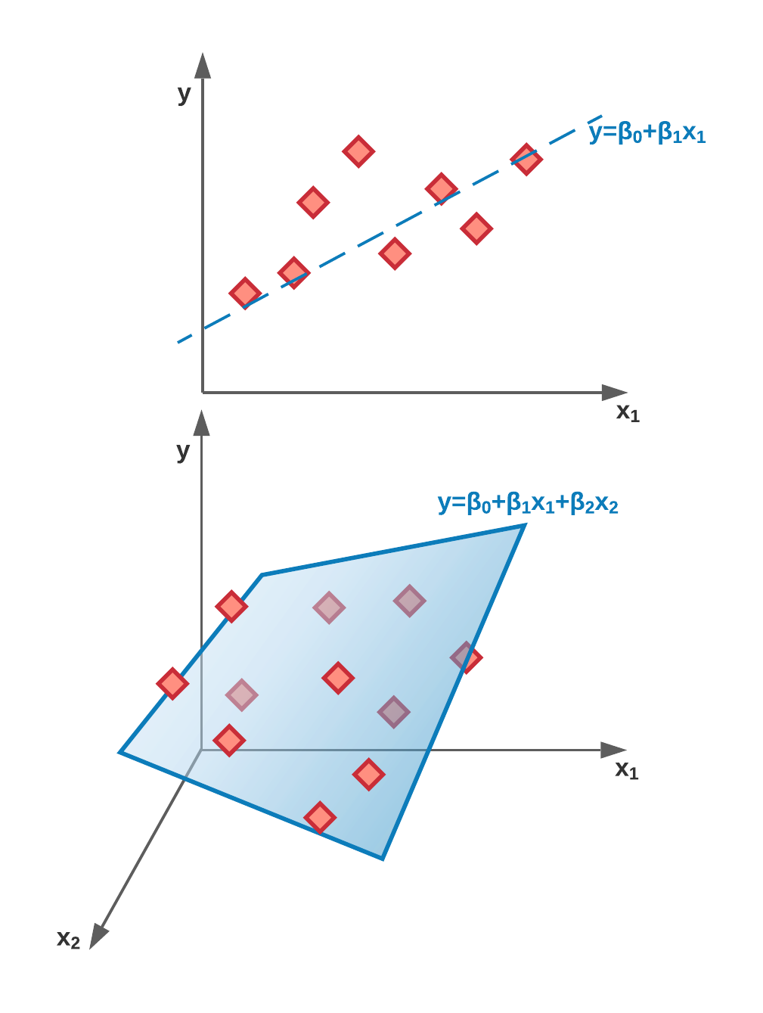
What is Regression
Assumes a linear relationship between input (x) and a continuous output y(x)
Simple vs multiple linear regression Base Algorithm – Ordinary Least Squares (OLS)
Task is to assign a scaling factor (β) for each predictor that minimizes some kind of error metric.

Slide 6
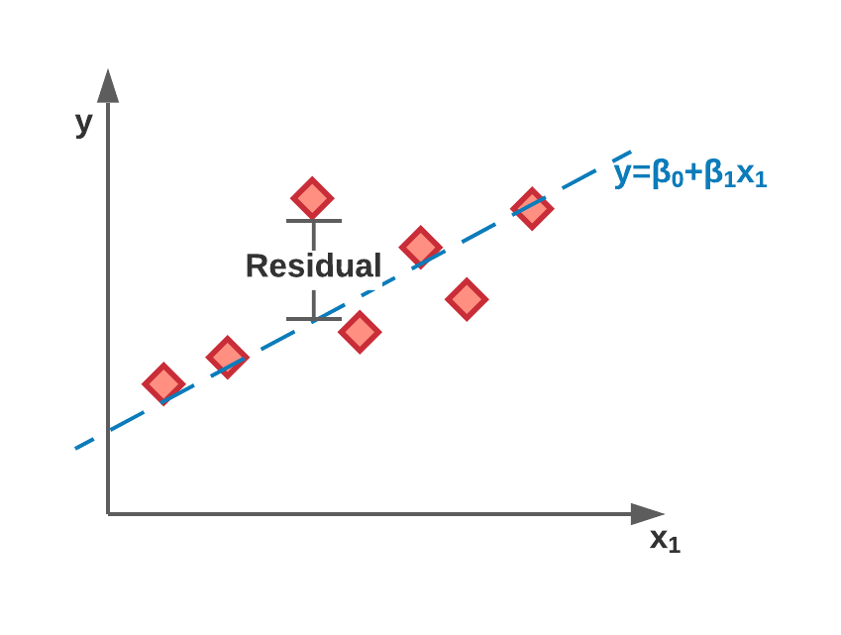
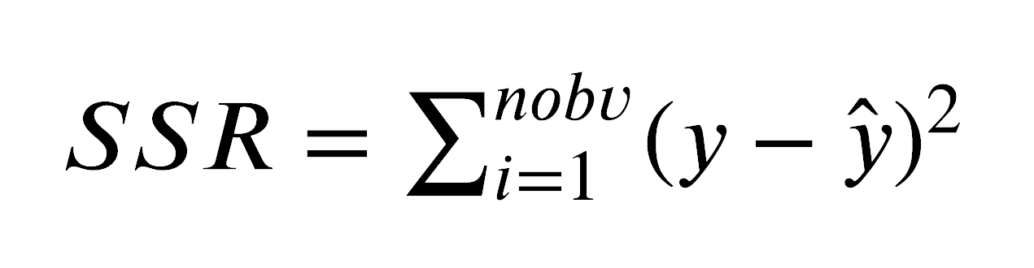
Ordinary Least Squares
Minimize sum of squared residuals
Returns the feature weights that minimize the error via linear algebra

Slide 7
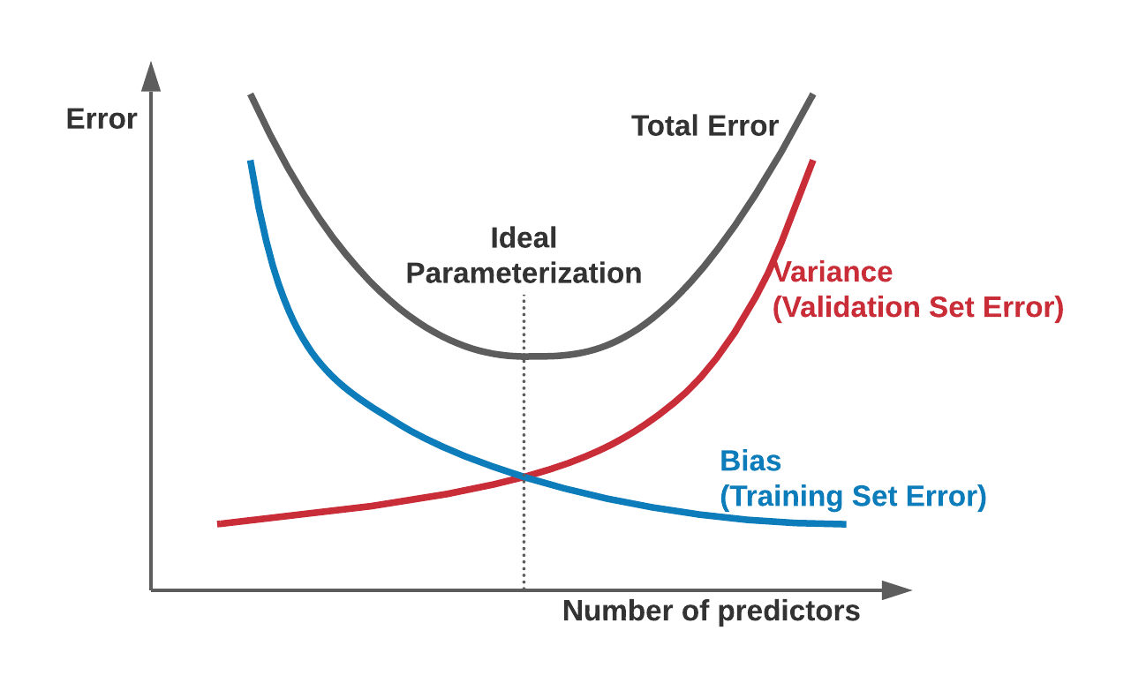
Why Regularization
Bias-Variance tradeoff
OLS will give you the lowest error - low bias
Uninformative features have unbounded weights since they do not influence model performance

Slide 8
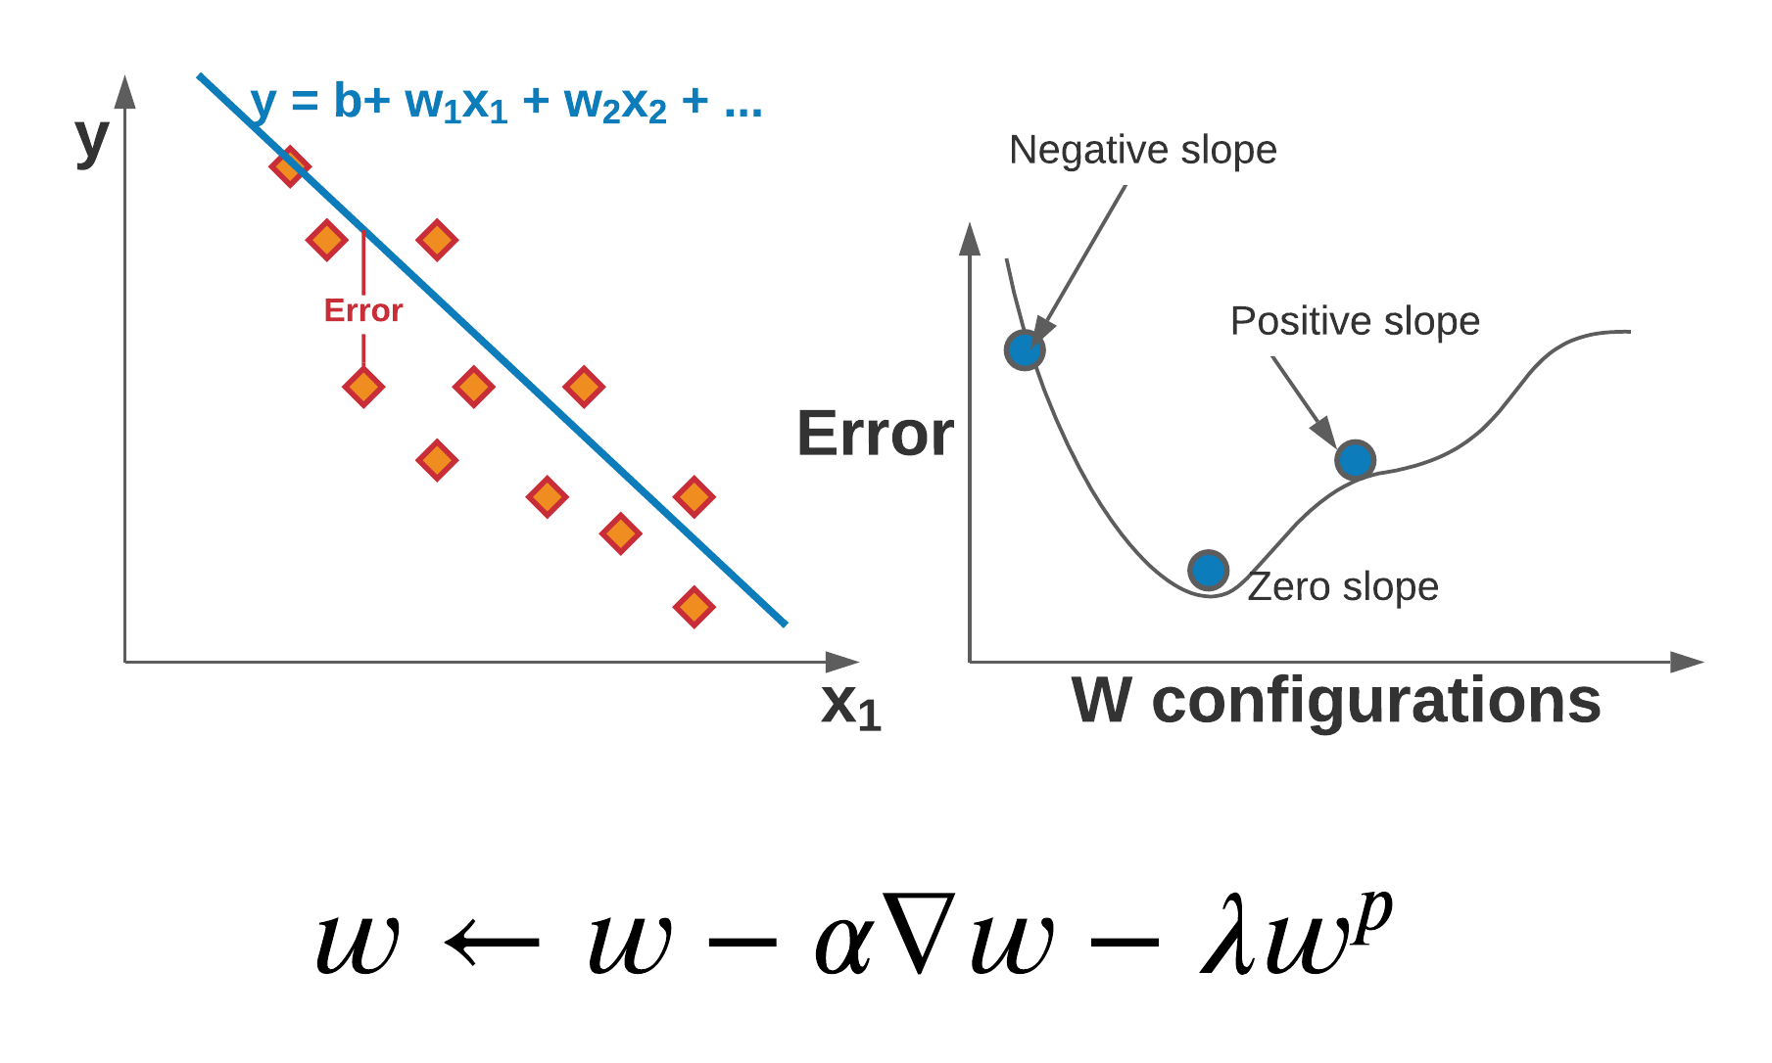
Gradient Decent with regularization
Iteratively minimize Error (SSR) from a random initial configuration
α is the learning rate
λ is the regularization strength
p is the L-norm number
Weights converge where slope and regularization terms balance

Slide 9
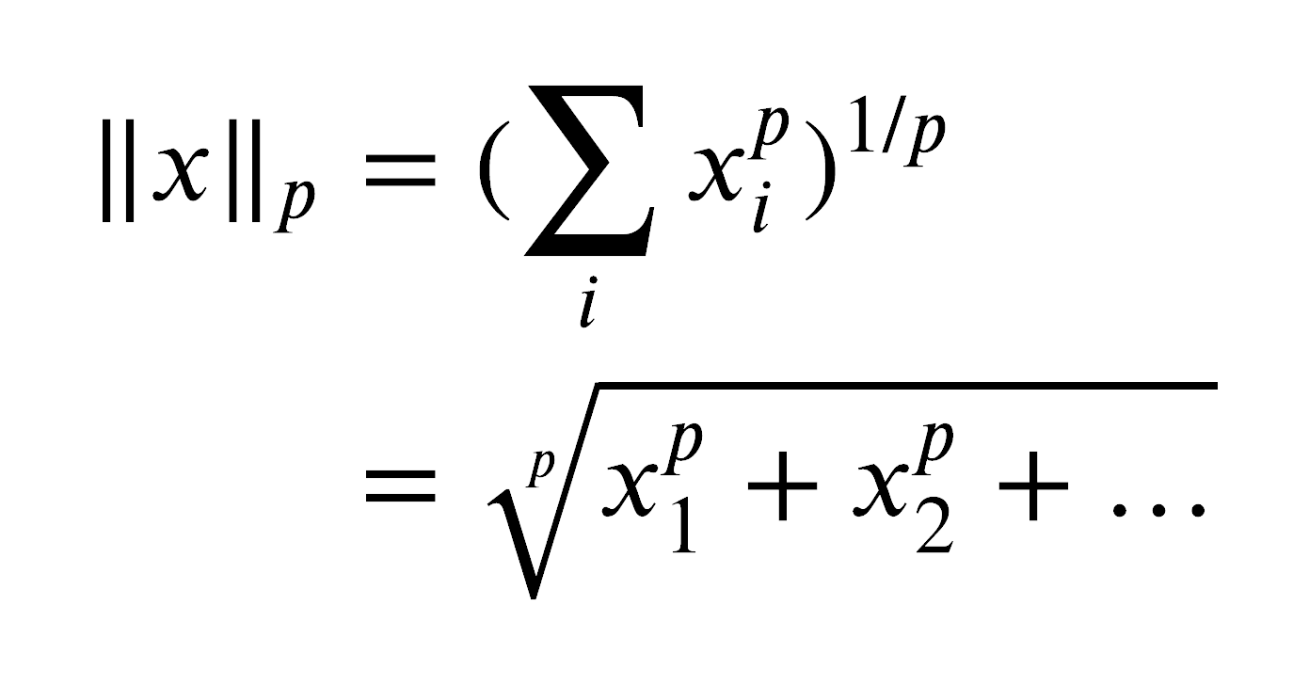
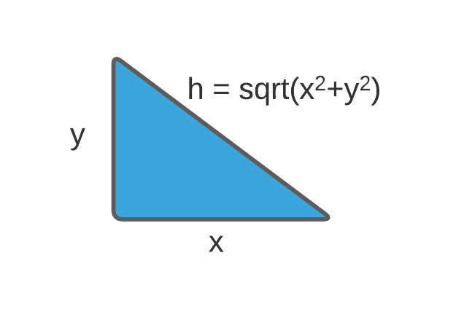
L2 - Normalization
From P normalization
Where L2 (aka Euclidean normalization) is when p=2.
L1 normalization is when p=1
(Less common) - L0 is special case that counts number of nonzero x’s

Slide 10
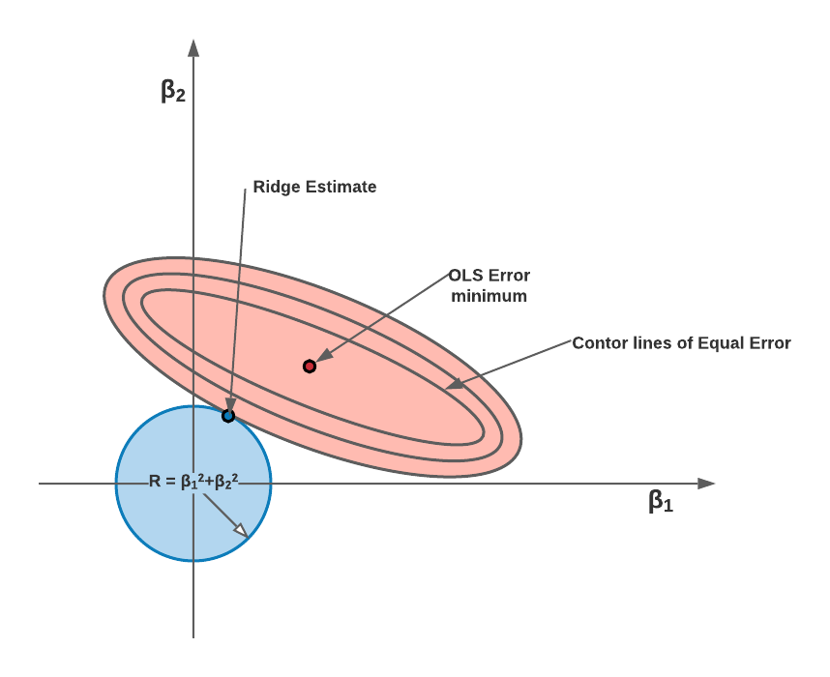
Ridge Regression
OLS with L2 normalization
Overcomes issues with correlated inputs (collinearities)
Ridge estimate is at the point where slope and regularization terms balance

Slide 11
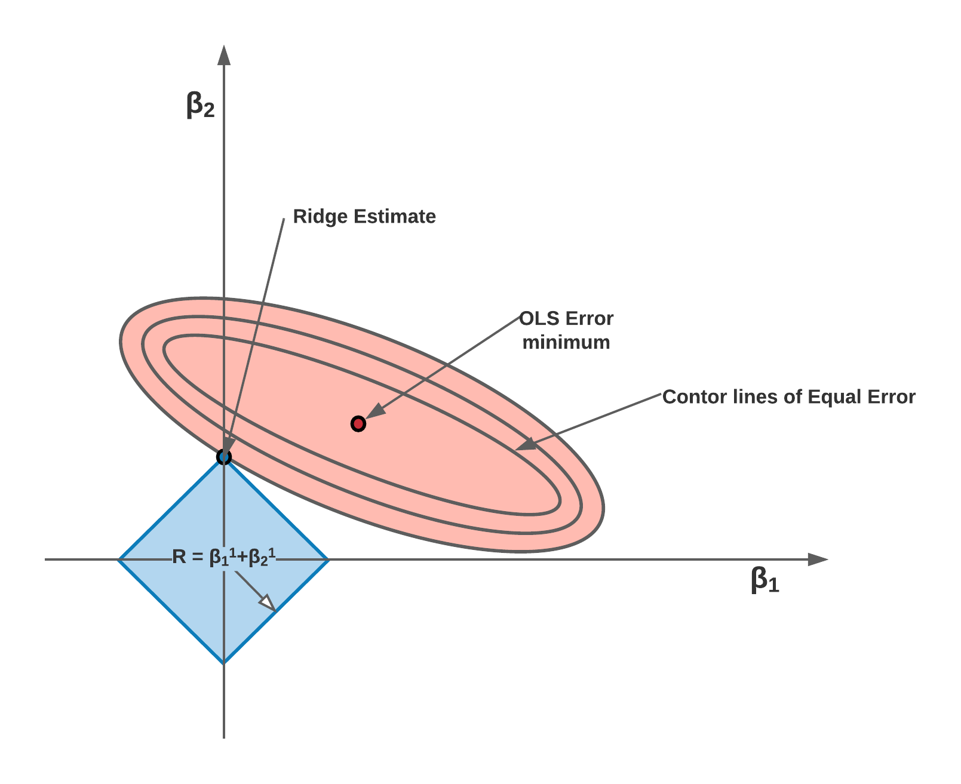
LASSO
Least absolute shrinkage & selection operator
OLS with L1 normalization
Tends to collapse coefficients to zero
Will select one feature when predictors are correlated

Slide 12

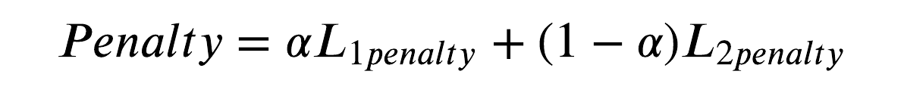
Elastic Net
Includes both L1 and L2 penalty terms
α is proportion of L1 to L2 penalty
Use grid search on discovery set or (repeated k-fold CV) to set α coefficient.

Slide 13
Elastic Net
Includes both L1 and L2 penalty terms
α is proportion of L1 to L2 penalty
Use grid search on discovery set or (repeated k-fold CV) to set α coefficient.
sklearn.linear_model.ElasticNetCV(
l1_ratio= {number or list of ratios} ,
eps={alpha step size},
n_alphas={number of alphas for each L1 ratio},
cv= {int of k-fold cross validation, default =5}
selection={‘cyclic’ or ‘random’}

Slide 14
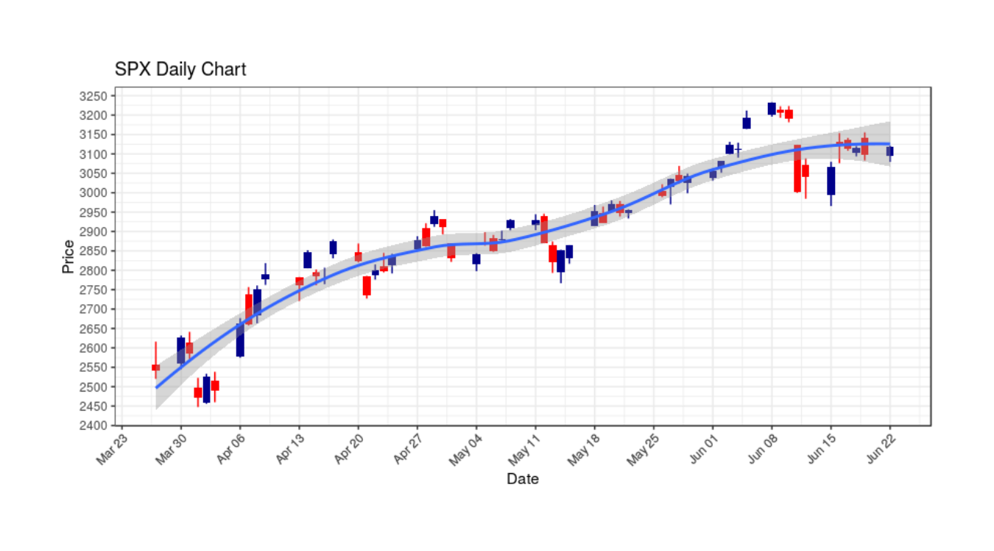
Prerequisites – Model assumptions
IID - Independent and identically distributed
Normally distributed data

Slide 15
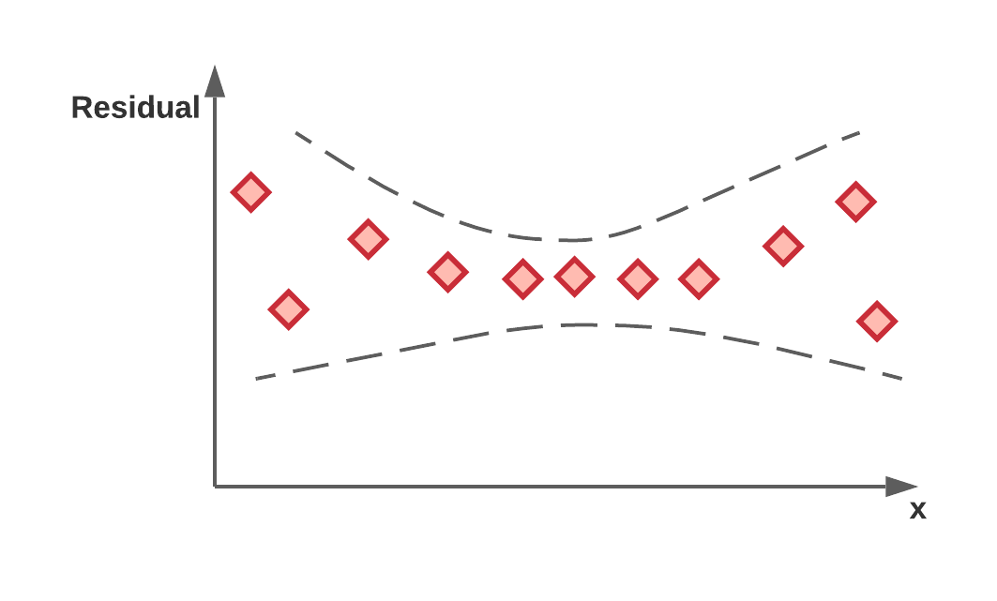
Prerequisites – Model assumptions
Homoscedasticity
Residual error is equal for full range of inputs
Heteroscedasticity implies a breakdown of linear assumption
Use to justify using a non-linear model.

