Slide 1

Transfer learning from datasets with unshared features for detecting Autism Spectrum Disorder using AutDB
Minimal, reproducible baseline across two privacy-preserving datasets.
Ruslan Kurmashev,
Adina Yessimova,
Traore Denis

Slide 2
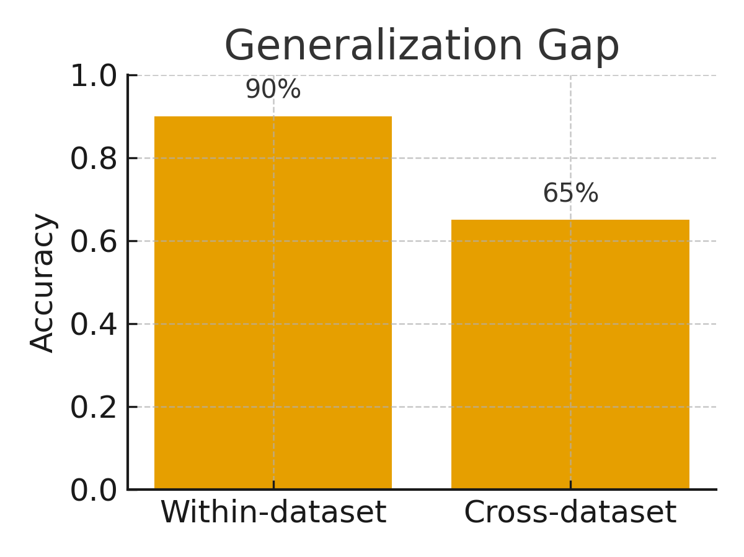
Background.
Why Transferability Matters in ASD Video Models
Rising ASD prevalence & time‑intensive diagnosis
  US: ~1 in 54 (8‑year‑olds).
  Europe: heterogeneous rates across countries.
  Behavioral assessment takes hours (e.g., ADOS).
Promise of video + ML
  Home/clinic videos enable scalable triage.
  Strong metrics on the training dataset.
Regulatory & reporting frameworks
  TRIPOD‑AI & PROBAST‑AI → transparent methods, fairness, reproducibility, robustness.
  Need: reproducible cross‑dataset benchmark for ASD video models.
But poor cross‑dataset generalization
  Performance drops across populations & setups.
  Demographic & setting shifts → reliability risk.

Slide 3
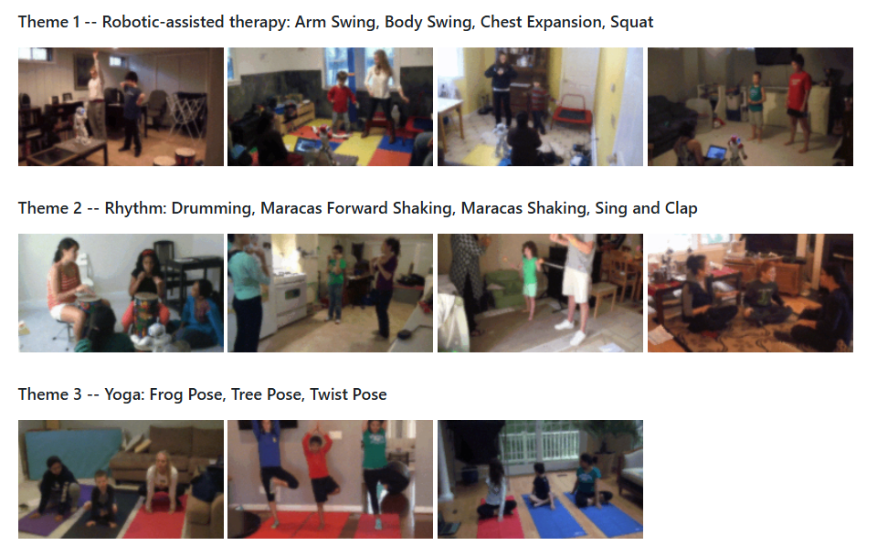
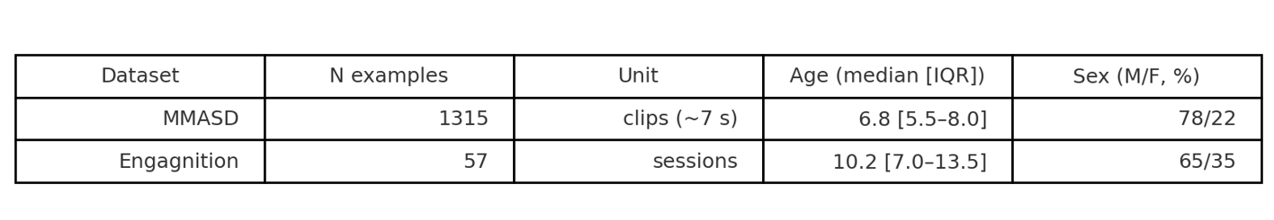
Datasets
MMASD — 32 children with ASD, 1,315 clips (~7 s), 11 activity classes; available privacy-preserving modalities: optical flow, 2D skeletons, plus demographic/clinical data.
Table 1. Descriptive statistics per dataset (N examples, age, sex).

Slide 4
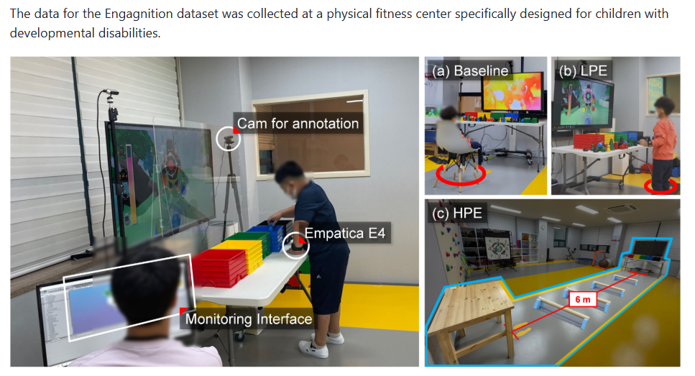
Datasets
Engagnition — 57 participants (ages 4–16), serious-game setting with Baseline/LPE/HPE conditions, engagement annotations, gaze fixations and intervention prompts.
Table 1. Descriptive statistics per dataset (N examples, age, sex).

Slide 5
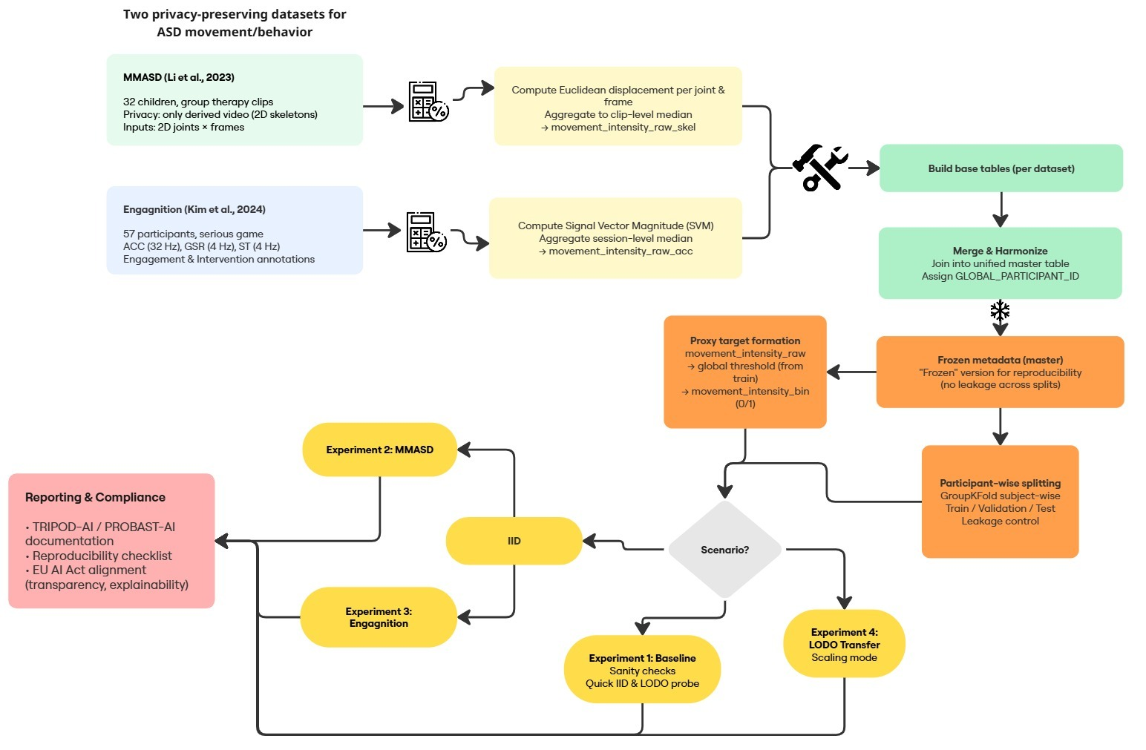
Methodology Pipeline

Slide 6
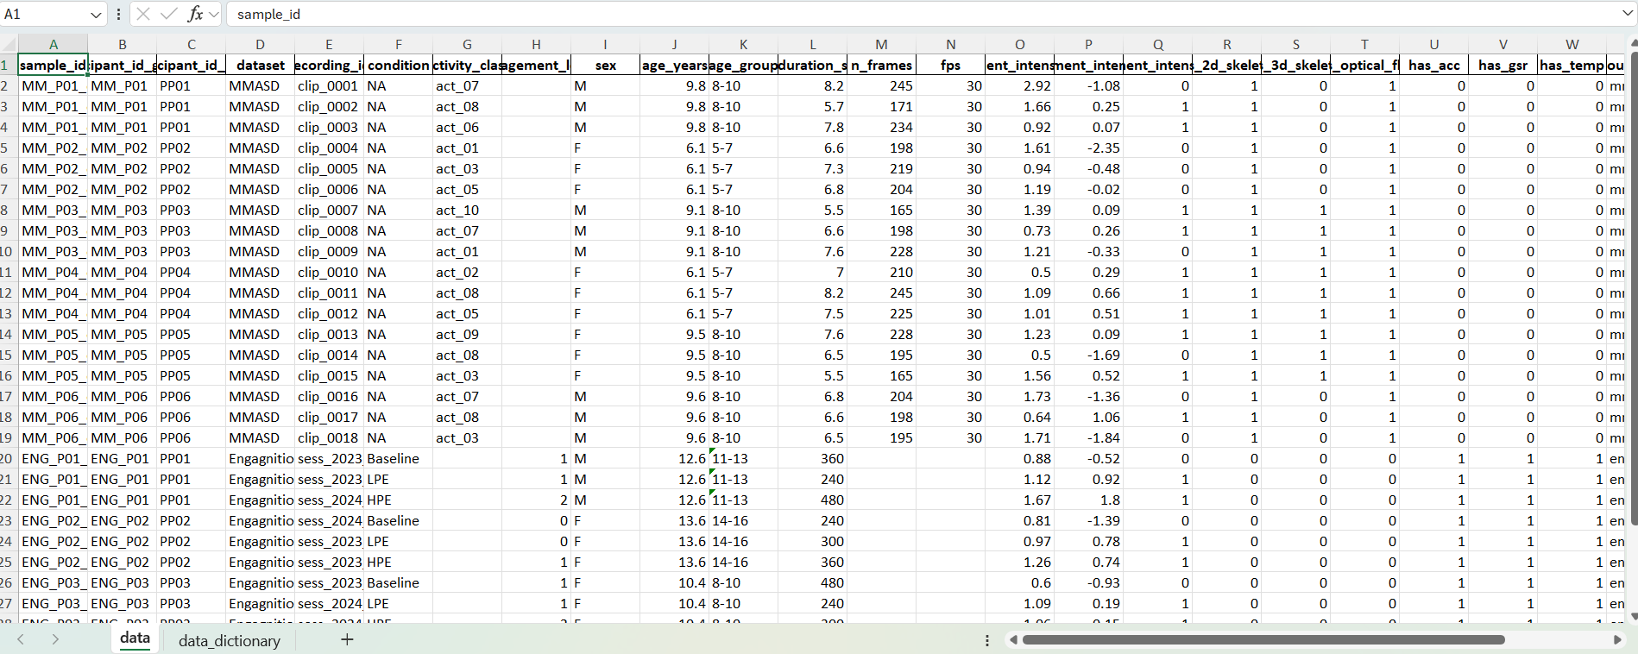
Table 2. Unified meta-table (“one source of truth”)

Slide 7
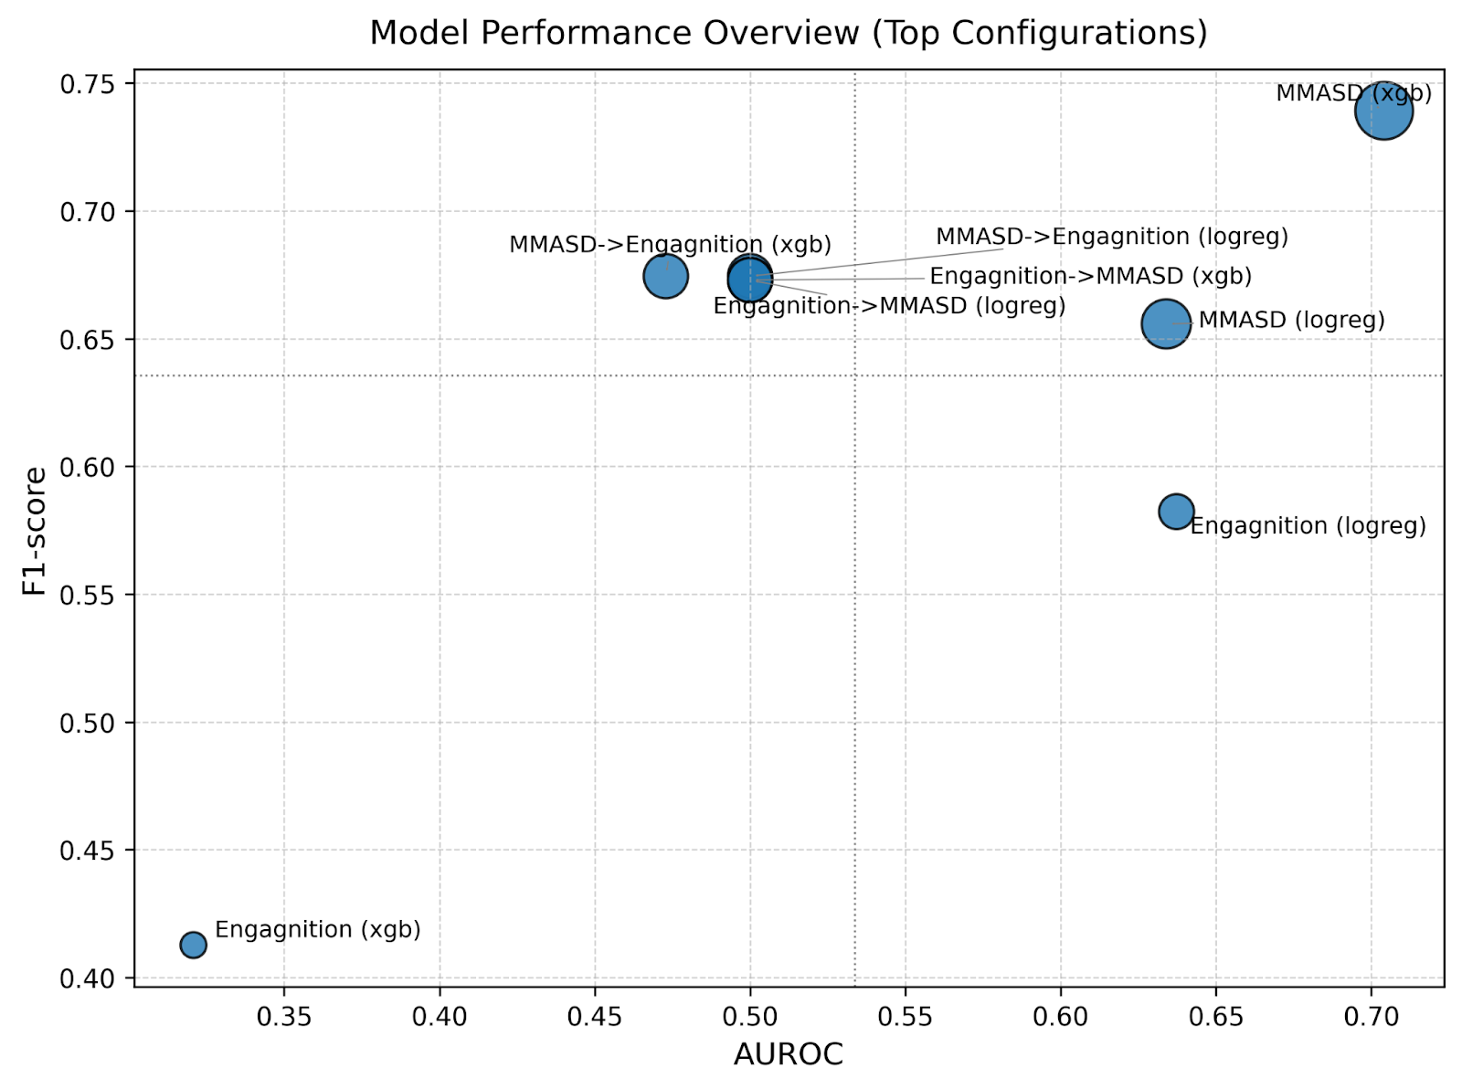
Experiment 1: Baseline
Fig. 2 demonstrates the comparative performance of all model configurations and datasets using AUROC and F1-score metrics, reflecting the balance between class discrimination ability and accuracy at a selected threshold. Each point on the graph represents a separate configuration, and the bubble size is proportional to the balanced accuracy, allowing visual comparison of the results both within a single dataset and across cross-dataset transfers (LODO).

Slide 8
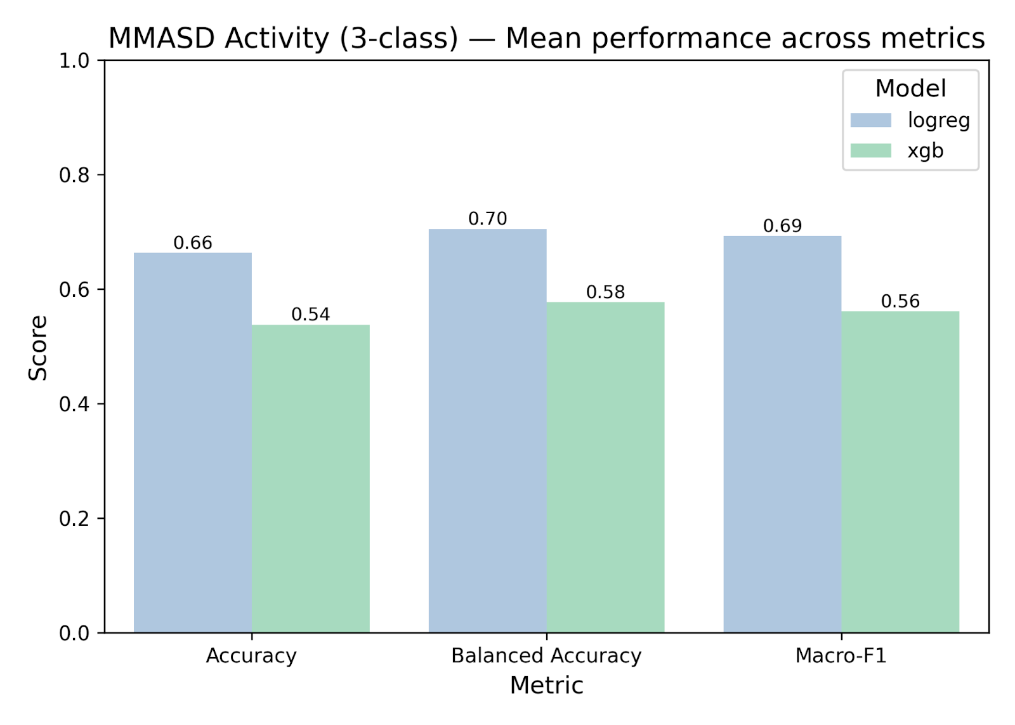
Experiment 2: MMASD (IID)
Fig. 3 shows a comparison of the average performance of logistic regression and XGBoost models in solving a three-class activity classification problem (MMASD Activity). It can be seen that logistic regression demonstrates higher values for all major metrics (accuracy, balanced accuracy, and macro-F1), indicating better class consistency and stability when working with skeletal activity data. The XGBoost model shows lower but comparable results, which may reflect a reduced generalization capability for this type of data.

Slide 9
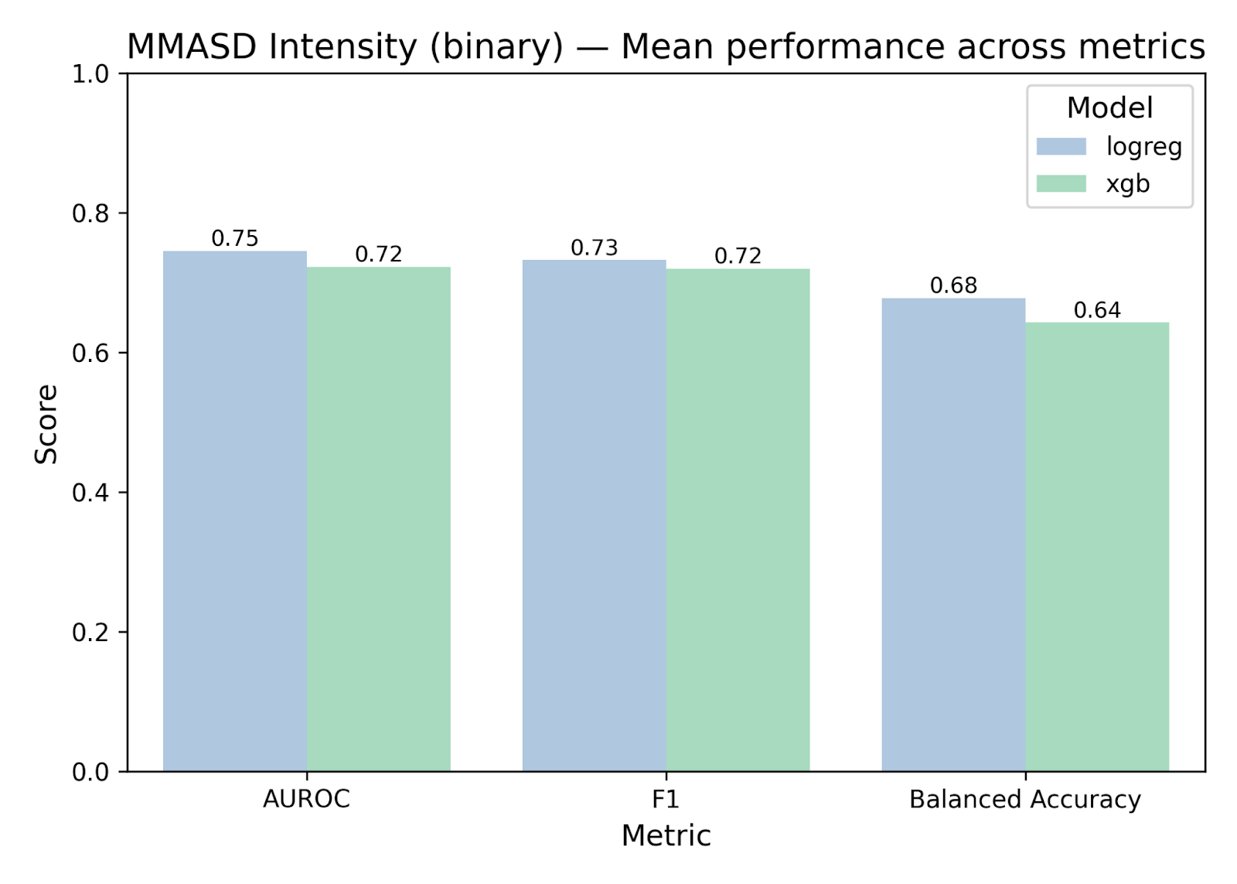
Experiment 2: MMASD (IID)
Fig. 4 shows a comparison of logistic regression and XGBoost models on a binary motion intensity classification (MMASD Intensity) problem. Both models demonstrate similar results across all metrics (AUROC, F1, and balanced accuracy), but logistic regression shows a slight advantage in terms of AUROC, reflecting a more stable ability to distinguish classes under the given learning conditions. Overall, both models are characterized by balanced performance and an absence of pronounced overfitting.

Slide 10
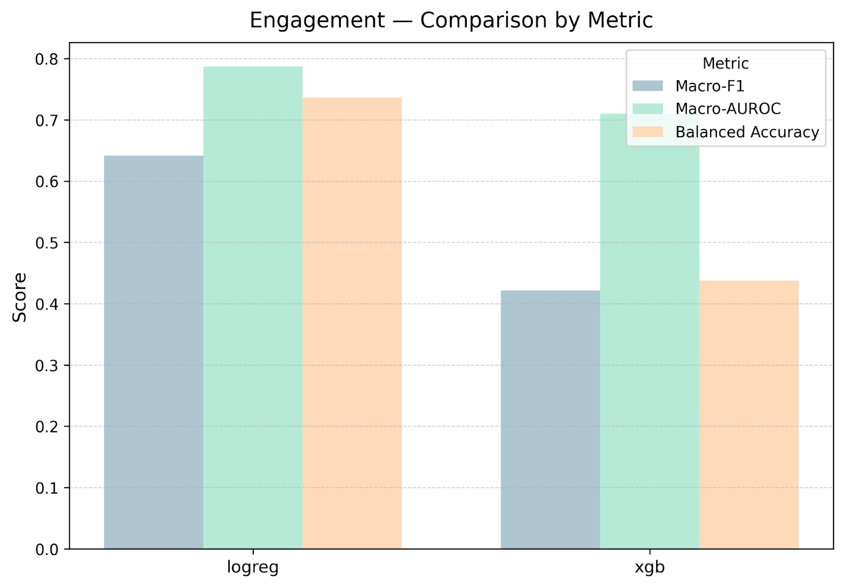
Experiment 3: Engagnition (IID)
Fig. 5 A comparison of model performance in classifying engagement levels shows the advantage of logistic regression over XGBoost in all key metrics (macro-F1, macro-AUROC, balanced accuracy). The linear model demonstrates more stable class recognition, reflecting its ability to generalize behavioral patterns without overfitting.

Slide 11
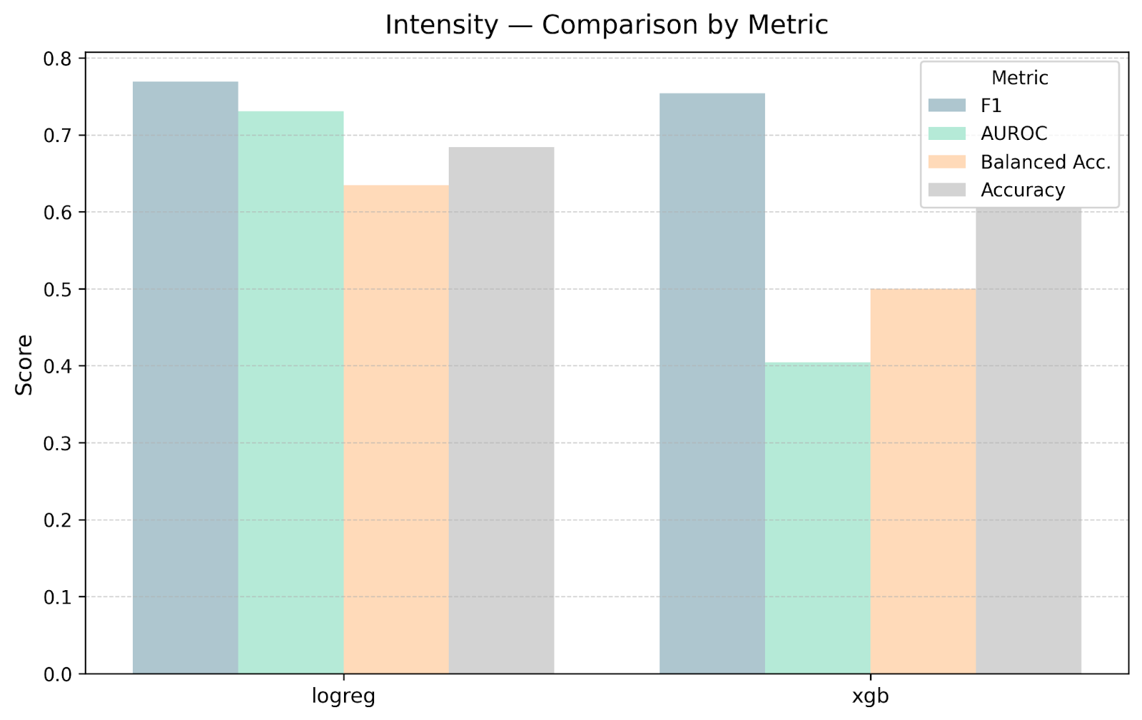
Experiment 3: Engagnition (IID)
Fig. 6 In the task of classifying movement intensity, logistic regression also showed the best or comparable results across all metrics (F1, AUROC, balanced accuracy, and accuracy), confirming its stability and interpretability when analyzing movement data.

Slide 12
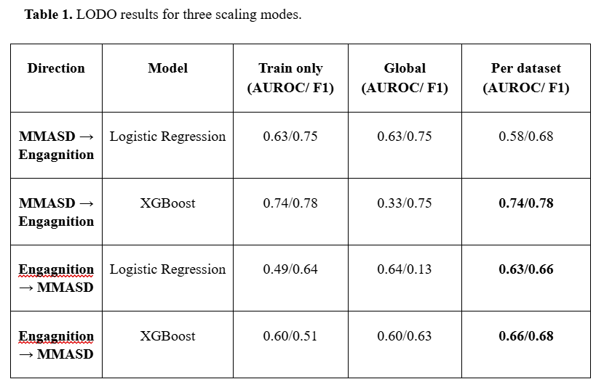
Experiment 4: LODO Transfer

Slide 13
TRIPOD‑AI (short): Core Reporting Domains
Participants
  All eligible records included; rows w/o target modality excluded.
  No demographics used; splits were subject‑wise.
Study / Source of data
  Open, privacy‑preserving datasets:
  • MMASD (32 children, 1,315 clips, 2D skeletons)
  • Engagnition (57 children, 270.6 min; ACC/GSR/TEMP; expert engagement)
Predictors
  Tabular aggregates from 2D skeletons (MMASD) and sensors (ACC; GSR/ST in variants).
  IDs/aux fields removed; no demographics.
Outcome
  Binary proxy: movement_intensity_bin
  • MMASD: median Euclidean joint displacement (clip level)
  • Engagnition: median accelerometer SVM (32 Hz)
  Fixed threshold derived on train; applied to val/test.
Model development
  LogReg (L2, RobustScaler; pairwise interactions for MMASD)
  XGBoost (shallow depth, regularization)
  Threshold tuned for F1; isotonic calibration baseline;
  Nested subject‑wise GroupKFold for HP tuning.
Sample size & missing
  MMASD: 1,315 clips. Engagnition: 57 participants × 3 conditions (270.6 min).
  Dropped rows lacking target modality; median imputation for numerics.
Performance
  MMASD (IID): AUROC LogReg=0.75, XGB=0.72;
  Engagnition (IID): LogReg=0.73, XGB≈0.40;
  LODO strongly sensitive to scaling regime;
  Metrics: AUROC, Balanced Acc, F1, Acc.
Validation
  Internal: subject‑wise GroupKFold (IID).
  External: Leave‑One‑Dataset‑Out (MMASD↔Engagnition) with scaling:
  train_only • global • per_dataset.
Limitations
  Proxy outcome (not clinical).
  No sex/age stratification (demographics unavailable).
  Small, heterogeneous cohorts; differing modalities.
  Research baseline — not for clinical use.

Slide 14
PROBAST‑AI Domains (simplified)
Domain | Risk of Bias | Applicability Concerns | Rationale from the study
Participants | Moderate | High | ASD‑only cohorts; small N (MMASD: 32; Engagnition: 57); heterogeneous protocols (skeletons vs wearable sensors). No demographics (no sex/age).
Predictors | Low–Moderate | Moderate | Computed before outcome; IDs removed; robust scaling; structured pipelines. Modalities differ (2D skeletons vs ACC/GSR/TEMP); no demographic predictors.
Outcome | Low–Moderate | Moderate | Proxy target movement_intensity_bin harmonised across datasets (train‑derived threshold applied to val/test). Not a clinical endpoint; threshold/aggregation sensitive.
Analysis | Moderate | Moderate | Internal subject‑wise GroupKFold & nested CV; external LODO with 3 scaling regimes; leakage avoided. Calibration only in baseline; limited power; no subgroup/fairness analyses.
Overall risk of bias: Moderate
Stable within‑dataset performance but weak external validity without domain adaptation.
Overall applicability: High concerns
Narrow ASD cohorts, proxy target, and differing sensing modalities restrict applicability to broader clinical populations/settings.

Slide 15
Discussion - Key takeaways
Generalization gap: strong within-dataset, weaker cross-dataset due to modality/protocol/context shifts.
Normalization matters: scaling choice can change LODO conclusions; use train-only as default, report the regime explicitly.
Proxy target: binary movement_intensity is useful for reproducible benchmarking, not a clinical endpoint.
Transparency: participant-wise splits, fixed feature rules/thresholds, baseline calibration, and external LODO improve trust.
Limitations: no demographics ⇒ no fairness/strata; small heterogeneous cohorts; video-skeletons vs wearables hinder transfer.
Recommendations
Pre-specify and report normalization regime alongside split scheme.
Extend with matched modalities/demographics; add fairness and confidence intervals.
Treat this as a baseline for portability, not a deployable diagnostic.

Slide 16
Key Findings (MMASD + Engagnition)
privacy‑first • reproducible • portability‑oriented baseline
WHAT WE BUILT
  Harmonized MMASD + Engagnition into a unified meta‑table with movement_intensity_bin.
  Operationalized proxy across modalities: joints (MMASD) vs accel SVM 32 Hz (Engagnition).
WHAT WE OBSERVED
  IID/MMASD: Logistic Regression ≥/ XGBoost
  IID/Engagnition: Logistic Regression > XGBoost
  LODO is fragile — transfer depends on normalization.
  LR: MMASD→Engagnition global; reverse per_dataset. XGB: mostly per_dataset.
  AUROC–F1 threshold brittleness under distribution shift.
NORMALIZATION DRIVES LODO
  train_only → honest deployment evaluation
  global → helps if domains are close
  per_dataset → diagnostic upper bound
Limitations: non‑clinical proxy; no demographics/fairness;
small heterogeneous cohorts; differing modalities.

Slide 17

Conclusion
We provide a minimal, privacy-first, reproducible baseline for ASD movement analysis using the proxy movement_intensity_bin under IID and LODO.
Within-dataset: Logistic Regression on tabular features yields more stable/balanced metrics than XGBoost.
Cross-dataset: transfer is fragile and highly dependent on normalization; the regime must be reported.
TRIPOD-AI / PROBAST-AI reporting clarifies assumptions and limits (proxy target, no demographics, heterogeneous modalities).
The baseline + LODO scaling setups form a starting point for cross-dataset feature unification and distribution matching.
Next steps: multimodal fusion, domain adaptation, personalization — with privacy by default, transparent reporting, and alignment to EU AI Act / FDA PCCP.

Slide 18

Availability & Requirements
Project name: autdb-baseline
Project home page: https://github.com/omicscodeathon/autdb
Operating system(s): Platform independent (tested on Windows)
Programming language: Python ≥ 3.10
Other requirements: NumPy 1.26.4, Pandas 2.2.2, Scikit-learn 1.4.2, Matplotlib 3.9.2, and
XGBoost 2.0.3.
License: MIT License
Restrictions for non-academics: None
Availability of data and materials
MMASD and Engagnition are publicly available from their original sources under privacy-preserving terms. The project repository (https://github.com/omicscodeathon/autdb/tree/main) will include the metadata schema, configuration files, and scripts to reproduce all baseline tables/figures without distributing raw identifiable video. Documentation and usage guidelines will be provided in the repository README.
Access to our GitHub

