Slide 1
Big Data Analysis of Educational Attainment and Nutritional Quality
Omid Hashemzadeh

Slide 2
Introduction To The Problem
This study explores the relationship between educational attainment and nutritional quality, aiming to identify patterns and gaps that can inform policy decisions in health and education systems.
Importance of the research
Poor nutrition quality leads to serious health problems. [1] So the outcomes of this analysis can directly help educational and health systems implement better policies to minimize the health problems.

Slide 3
Dataset Overview
Data source: U.S. Government’s Official Open Data [2]
https://catalog.data.gov/dataset/nutrition-physical-activity-and-obesity-behavioral-risk-factor-surveillance-system
Number of records: 104,273
Important Indicators:
Educational Attainment
Fruit & Vegetable Consumption
Obesity Level
Physical Activity Level
Geographical Location
Dataset covers US-wide data on health behaviour & Education - between 2011 – 2023 (Over 13 years period)

Slide 4
Dataset Justification
Why This Dataset ?
Represents data relevant to the topic (both educational attainment and nutrition quality)
Publicly available
High validity, because it is downloaded from a valid resource (U.S government website)
Easy integration with HDFS and Hive for big data processing
Clean, structured data ideal for HDFS-based processing (csv tabular data)

Slide 5



Overview Of The Technical Solution Developed
System Architecture Flowchart
Dataset
csv file
Analysing & Querying
Apache Hive
Visualisation
Apache Zeppelin
Collect & Storage
Apache HDFS

Slide 6
Overview Of The Technical Solution Developed
Technical Solution In More Detail
Uploading Files into HDFS:
Start HDFS services.
Create target directory in HDFS (if not existing).
Upload the local CSV dataset into the HDFS directory.
Converting Dataset into Hive Tables:
Launch Hive shell.
Create a Hive table structure matching the CSV schema.
Load the CSV data from HDFS into the Hive table.
Running Hive Queries:
Execute SQL-like queries with HiveQL on the Hive table to explore, filter, and aggregate data.
Visualisation (Using Zeppelin):
Use Zeppelin for visualization
Create graphs, charts, and summary statistics based on the dataset insights.

Slide 7
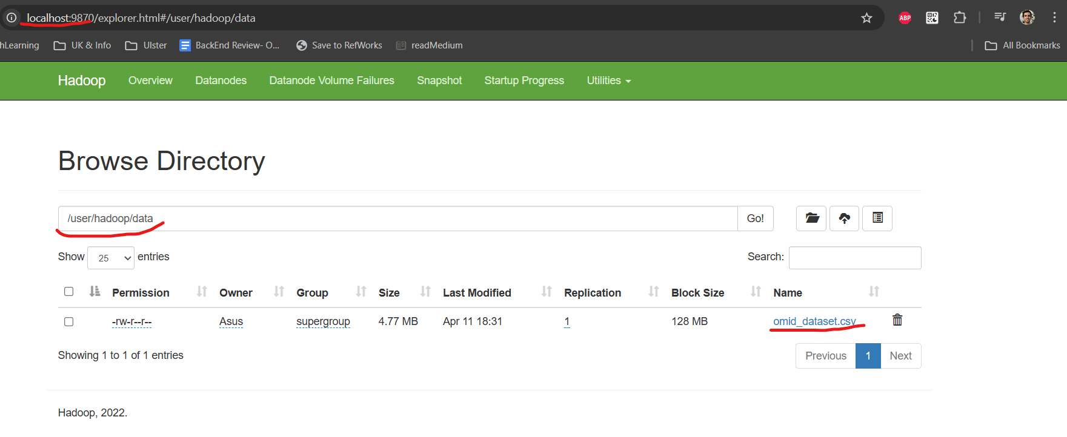
HDFS Data Ingestion
HDFS: Hadoop Distributed File System
Downloading dataset and moving it from local machine to Hadoop (HDFS) ecosystem for data processing.
wget https://data.cdc.gov/api/views/hn4x-zwk7/rows.csv --no-check-certificate
hdfs dfs -mkdir -p /user/hadoop/data/
cd D:\+UlsterProjects\BigData\Dataset
hdfs dfs -put omid_dataset.csv /user/hadoop/data
hdfs dfs -du /user/hadoop/data
Downloads the dataset from the given URL.
Creates a directory in HDFS to store the data.
Change Directory.
Uploads the local dataset to HDFS.
Displays the disk usage of the directory in HDFS.
Fig 1. Proof Of File Upload in HDFS GUI

Slide 8
Data Analysis Using Hive
Why Apache Hive ?
Why I preferred Apache Hive over other options (Spark, and Pig)
SQL-like Querying: Hive uses HiveQL, a SQL-like language to query data [3], making it more structured (compared to spark)
Good Compatibility with tabular dataset: For my CSV dataset (compared to Spark and Pig), because my dataset was tabular, so Hive is the best option available.
Integration with Hadoop: Hive can be integrated well with Hadoop to process large-scale CSV data stored in HDFS [4].
Scalability and Cost-Effectiveness: Hive can scale horizontally to handle massive datasets and is often more cost-effective for batch processing workloads (compared to Spark).

Slide 9
Hive Table Creation
I used below Hive commands to convert the dataset I had in HDFS into Hive Table:
CREATE EXTERNAL TABLE omid_dataset (
YearStart INT,
YearEnd INT,
LocationAbbr STRING,
LocationDesc STRING,
Class STRING,
Topic STRING,
Question STRING,
Data_Value_Unit DOUBLE,
Data_Value_Type STRING,
Data_Value DOUBLE,
Data_Value_Alt DOUBLE,
Low_Confidence_Limit DOUBLE,
High_Confidence_Limit DOUBLE,
Sample_Size DOUBLE,
Education STRING,
Sex STRING,
GeoLocation STRING,
ClassID STRING,
TopicID STRING,
QuestionID STRING,
LocationID INT,
StratificationCategory1 STRING,
Stratification1 STRING,
StratificationCategoryId1 STRING,
StratificationID1 STRING
)
ROW FORMAT SERDE 'org.apache.hadoop.hive.serde2.OpenCSVSerde'
STORED AS TEXTFILE
LOCATION '/user/hadoop/data'
TBLPROPERTIES ("skip.header.line.count"="1");
Table Name
Column names and their Datatype
Dataset File Location On HDFS
To Consider the first row as Header

Slide 10
Hive Queries
Apache Hive is used to run multiple complex queries on the dataset to gain insights, which will be discussed in the Key Insights section.
I have taken Sample_Size into account to measure a weighted average in the queries.
The weighted average takes into account the sample size for each group, providing a more accurate representation of the data.

Slide 11
Hive Queries
✅ Query 1 – Weighted Average Physical Activity by Education
SELECT
Education,
SUM(Data_Value * Sample_Size) / SUM(Sample_Size) AS weighted_avg_physical_activity
FROM omid_dataset
WHERE Class = 'Physical Activity' AND Data_Value IS NOT NULL
GROUP BY Education;
🟢 Gives average physical activity rate, weighted by the number of people
❓Question: What is the percentage of people engaging in physical activity across different levels of education?
📉 Insights:
🔹 College graduates have the highest weighted average physical activity (~31.23%).
🔹 Less educated groups (especially "Less than high school") consistently have lower physical activity.
🔹 📉 A clear education–activity gradient exists: more education → more physical activity.

Slide 12
Hive Queries
✅ Query 2 – Weighted Obesity Rate by Question and Education Level
SELECT
Education,
Question,
SUM(Data_Value * Sample_Size) / SUM(Sample_Size) AS weighted_avg_obesity_rate
FROM omid_dataset
WHERE Class = 'Obesity / Weight Status' AND Data_Value IS NOT NULL
GROUP BY Education, Question
ORDER BY Education, weighted_avg_obesity_rate DESC;
🟢 Measures average obesity rates per question by education, giving more weight to larger samples.
❓Question: For each obesity-related question, what is the weighted average obesity rate among different education levels?
📉 Insights:
🔹 Obesity rates are highest among lower education levels.
🔹 One key question shows "College graduates" at ~23.9% obesity, vs. ~36.8% for the same question among less educated.
🔹 Consistently, education appears protective against obesity

Slide 13
Hive Queries
✅ Query 3 – Weighted Low Vegetable Intake by Location and Education Level
SELECT
LocationDesc,
Education,
SUM(Data_Value * Sample_Size) / SUM(Sample_Size) AS weighted_avg_low_veg_intake
FROM omid_dataset
WHERE Class = 'Fruits and Vegetables' AND Data_Value IS NOT NULL
GROUP BY LocationDesc, Education
ORDER BY LocationDesc, weighted_avg_low_veg_intake DESC;
🟢 Shows how often adults eat fewer vegetables (less than daily), accurately reflecting population size.
❓Question: In each U.S. state, what is the weighted average adults proportion who eat vegs less than 1 time each day, across education levels?
📉 Insights:
🔹 Across US states, this pattern holds consistently - poor nutrition is more common in lower-educated populations.

Slide 14
Hive Queries
✅ Query 4 – Weighted Trends in Physical Activity Over Time
SELECT
YearStart,
Education,
SUM(Data_Value * Sample_Size) / SUM(Sample_Size) AS weighted_avg_physical_activity
FROM omid_dataset
WHERE Class = 'Physical Activity' AND Data_Value IS NOT NULL
GROUP BY YearStart, Education
ORDER BY YearStart, Education;
🟢 Tracks changes in physical activity over time by education level, accounting for varying sample sizes.
❓Question: How has the weighted average physical activity level changed over the years for each education group?
📉 Insights:
🔹 Over the years, physical activity has fluctuated, but the gap between education levels remains.

Slide 15
Hive Queries
✅ Query 5 – Weighted Average of Low Vegetable Intake by Education
SELECT
Education,
SUM(Data_Value * Sample_Size) / SUM(Sample_Size) AS weighted_avg_low_veg_intake
FROM omid_dataset
WHERE Class = 'Fruits and Vegetables' AND Data_Value IS NOT NULL
GROUP BY Education;
🟢 Accurate measure of poor vegetable consumption by education level.
❓Question: What is the weighted average percentage of low vegetable consumption (less than once daily) for each education level?
📉 Insights:
🔹 People with less than a high school education are most likely to consume vegetables less than once daily (~38.16%).
🔹 College graduates are much less likely to have low vegetable intake (~22.5%).

Slide 16
Analysis Goals
Query 1 – Physical Activity by Education
What is the percentage of people engaging in physical activity across different levels of education?
Query 2 – Obesity Rates by Education
For each obesity-related question, what is the weighted average obesity rate among different education levels?
Query 3 – Low Vegetable Intake by Location and Education
In each U.S. state, what is the weighted average percentage of adults who consume vegetables less than once daily, across education levels?
Query 4 – Physical Activity Trends Over Time by Education
How has the weighted average physical activity level changed over the years for each education group?
Query 5 – Low Vegetable Intake by Education
What is the weighted average percentage of low vegetable consumption (less than once daily) for each education level?

Slide 17
Visualisation in Zeppelin
Hive Used to create interactive visualisations
Why Zeppelin?
Ease of Use: User-friendly interface with a visual layout, making it simple to navigate and instantly view outputs through its GUI [5].
SQL-Like Querying: Leverages SQL-like queries for intuitive and efficient data analysis, allowing for seamless visualization of results.
Big Data Compatibility: Integrates seamlessly with Hive and Hadoop ecosystem tools, providing a powerful platform for processing and analyzing large datasets.
Multi-language Support: Offers support for multiple languages (e.g., SQL, Python, Scala), giving flexibility to choose the best language for your data analysis needs.
Collaborative Environment: Facilitates real-time collaboration on shared notebooks, promoting team-based analysis and enabling effective communication and discussions.

Slide 18
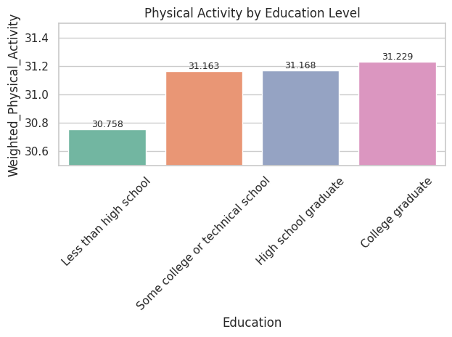
Visualisation in Zeppelin
Bar Chart: Physical Activity By Education Level

Slide 19
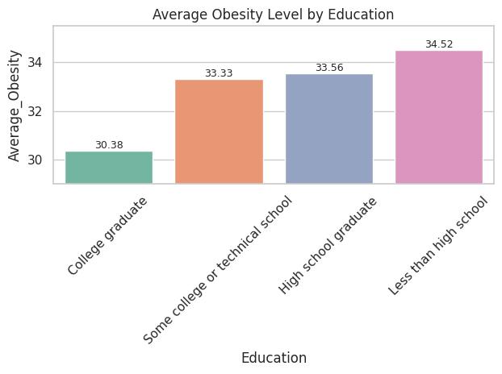
Visualisation in Zeppelin
Bar Chart: Average Obesity Level By Education Level

Slide 20
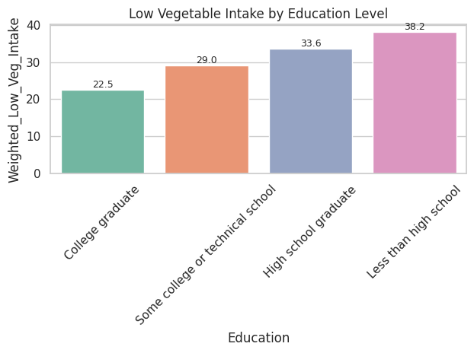
Visualisation in Zeppelin
Bar Chart: Low Vegetable Intake By Education Level

Slide 21
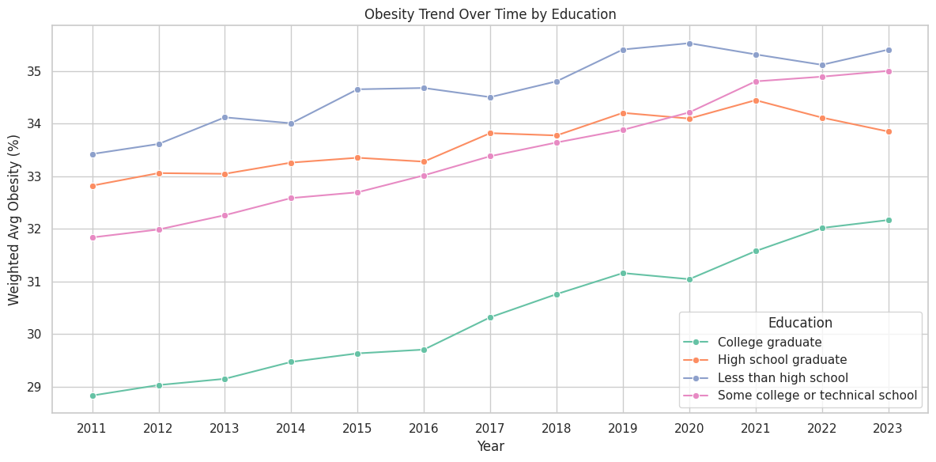
Visualisation in Zeppelin
Line Chart – Obesity Trend Over Time by Education

Slide 22
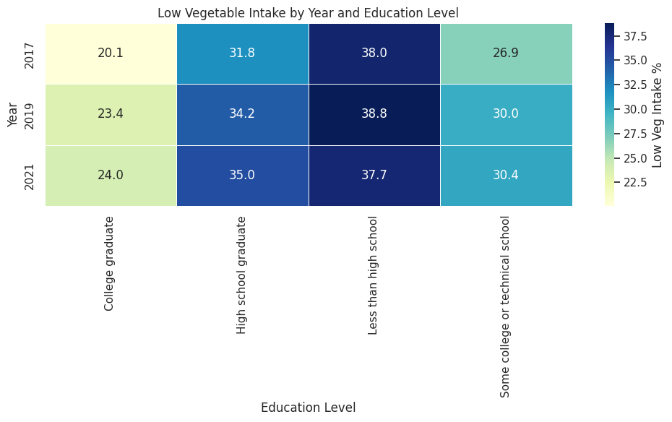
Visualisation in Zeppelin
heatmap: low veg intake by Year and Education

Slide 23
Key Insights Obtained
Physical Activity (Query 1 & 4)
🔹 College graduates have the highest weighted average physical activity (~31.23%).
🔹 Less educated groups (especially "Less than high school") consistently have lower physical activity.
🔹 📉 A clear education–activity gradient exists: more education → more physical activity.
🔹 Over the years (Query 4), physical activity has fluctuated, but the gap between education levels remains.
Obesity / Weight Status (Query 2)
🔹 Obesity rates are highest among lower education levels.
🔹 One key question shows "College graduates" at ~23.9% obesity, vs. ~36.8% for the same question among less educated.
🔹 Consistently, education appears protective against obesity.
Vegetable Consumption (Query 3 & 5)
🔹 People with less than high school education are most likely to consume vegetables less than once daily (~38.16%).
🔹 College graduates are much less likely to have low vegetable intake (~22.5%).
🔹 Across US states (Query 3), this pattern holds consistently - poor nutrition is more common in lower-educated populations.

Slide 24
Conclusion
Higher Education Level leads to the better nutrition and health outcomes.
🎓 Education level is a strong predictor of:
More physical activity
Lower Obesity
Better nutrition (Fruits and Vegetables)
📉 Public health efforts should target lower-educated groups to address activity and nutrition gaps.
I successfully measured the relationship between educational attainment and nutrition quality using bigdata tools.

