Slide 1
Scalable Solution For Web App Design Using Microsoft Azure
Omid Hashemzadeh
📧 omidh2015@gmail.com
🔗 LinkedIn: https://www.linkedin.com/in/omid-hashemzadeh/
🔗 GitHub: https://github.com/omidcodes
🔗 Google Scholar: https://scholar.google.com/citationsuser=rMD-3b0AAAAJ

Slide 2
Introduction
Discussion of the problem (Scalability Issues in Web Apps)
Cloud-based applications are growing quickly due to the reduction of hosting expenses and the enhanced accessibility and efficiency of computing resources.[1]. “Scalability is the ability of the cloud-based system to increase the capacity of the software service delivery by expanding the quantity of the software service provided” [2], especially in response to fluctuating demand over time [3].
Scalability Challenges in Web Applications:
Resource limitations during traffic spikes can cause downtime
Poor scalability leads to slow response times and inefficient resource use
Difficulties managing large data volumes and concurrent user requests
Without a scalable design, apps risk service interruptions under load

Slide 3
Identifying Scalability Issues
To overcome scalability challenges, cloud-native apps must adopt strategies like efficient resource usage, auto-scaling infrastructure, and component-level fault tolerance. These practices ensure consistent performance even during traffic spikes or user surges.
Scalability Focus Areas:
Scaling the Azure SQL Database to handle increasing reads/writes from ratings and comments
Ensuring efficient image storage and delivery using Azure Blob Storage
Using Azure Application Insights for real-time monitoring and diagnostics
Maintaining fault tolerance across the Django backend and Azure Web App hosting layer

Slide 4








Overview Of The Technical Solution
System Architecture
End User
Sends HTTPS request
Automated deployment
CI/CD pipeline
Azure Web App Service
- Hosting Python/Django app
- with the auto-scaling feature
Read/Write Cached Data
Azure Redis Cache
Reads/Writes
Reads/Writes
Sends Metrics
Sends Metrics
(User Data, App State, HA & Scalability)
Images & Media
Sends Metrics
Sends Metrics
(Monitoring, Diagnostics, Performance Tracking)
Microsoft Azure

Slide 5
Overview Of The Technical Solution
I built a cloud-native, scalable photo-sharing web application using the Django framework. Inspired by Instagram, it supports user registration, photo uploads, commenting, and rating. The architecture uses Azure services and DevOps tools to ensure scalability, performance, reliability, and ease of deployment.
🔧 Backend: Django Framework (Python) — handles user authentication, media processing, and core logic
🗃️ Database: Azure SQL Database — scalable, high-availability relational storage
🖼️ Media Storage: Azure Blob Storage — efficient and cost-effective for user-uploaded images
🌐 Hosting: Azure Web App (Linux) — supports automatic horizontal scaling
⚡ Caching: Azure Cache for Redis — caches gallery content, reducing DB load and latency
🚀 Deployment: GitHub Actions — automated CI/CD triggered on push
🔐 Configuration: Azure App Settings + environment variables for managing credentials and secrets
📈 Monitoring: Azure Application Insights — real-time logging, performance tracking, and diagnostics

Slide 6
Overview Of The Technical Solution
Step-by-Step solution summary
Built the application using Django (Python) : Handles user authentication, media processing, and core app logic.
Set up Azure SQL Database: Provides high-availability, scalable storage for users, comments, and ratings.
Integrated Azure Blob Storage: Efficiently stores and serves user-uploaded images.
Deployed the app on Azure Web App (Linux) : Supports automatic horizontal scaling based on load.
Added Azure Redis Cache: Caches gallery data to reduce SQL load and improve performance.
Configured automated deployment with GitHub Actions: CI/CD runs on every push to the 'main' branch, deploying to Azure.
Secured configuration using Azure App Settings and environment variables: Manages credentials, secrets, and scalable settings.
Monitored system health using Azure Application Insights: Tracks performance, logs, and detects real-time issues.

Slide 7
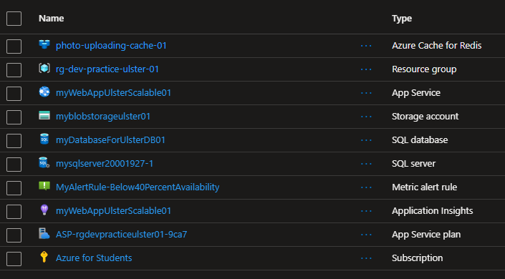
Azure Resources Used

Slide 8
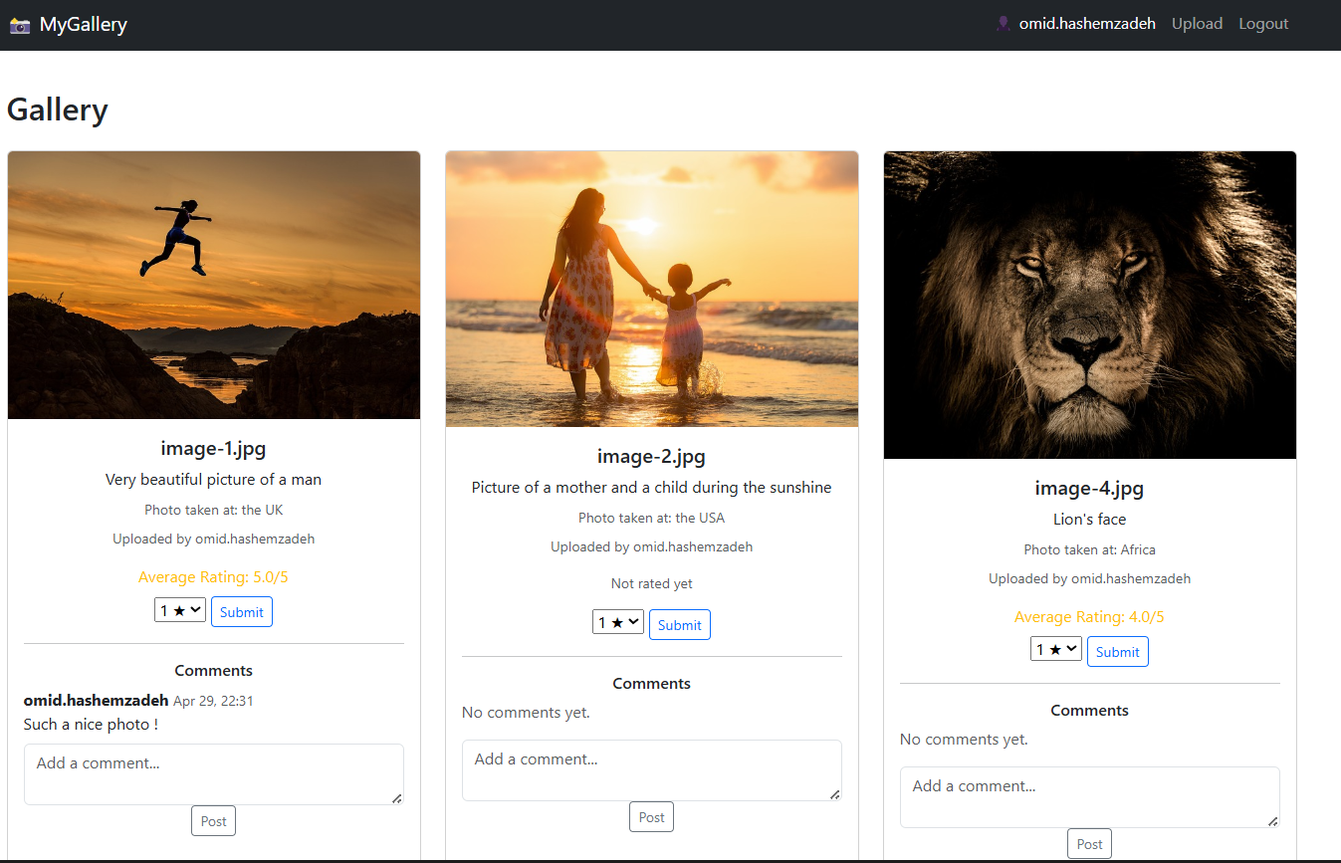
Screenshots Of The Website

Slide 9
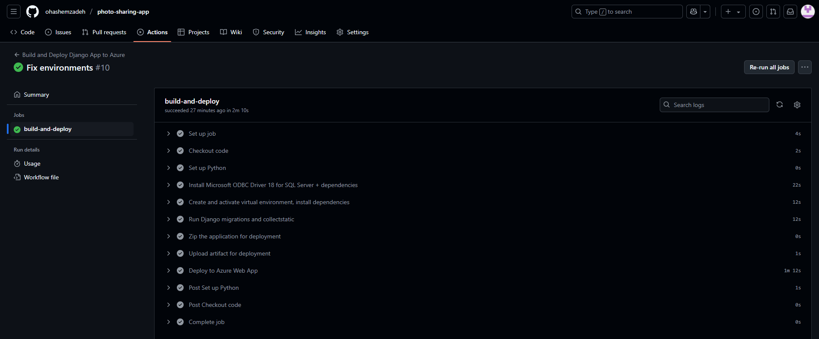
GitHub Automated Deployment Pipeline (CI/CD)
CI/CD is automated via GitHub Actions. Every code push to the main branch triggers a pipeline that installs dependencies, runs database migrations, collects static files, and deploys to Azure Web App. Azure auto-scaling ensures the app responds to increased load by spawning new instances automatically, without downtime.
Github Actions showing successful deployment pipeline on Azure

Slide 10
Azure Web Services (App Service)
Azure App Service is a fully managed platform for building, deploying, and scaling web applications [4]. It abstracts infrastructure management and provides a seamless web hosting environment with built-in scalability features.
Auto-scaling is the process of automatically adjusting the number of running instances of a service based on its current demand, ensuring optimal resource utilisation. When traffic increases, the system scales out (adds more instances), and when traffic decreases, it scales in (removes unnecessary instances) to optimise costs and performance [5].
Supports horizontal scaling (adding more instances) and vertical scaling (increasing instance capacity).
Load balancing is built-in, ensuring high availability and optimised resource distribution.
Allows easy deployment through GitHub or Azure CLI.
Integrated monitoring and logging through Application Insights and Azure Monitor enable performance tracking and proactive scalability management.
Offers staging slots for zero-downtime deployment and testing.

Slide 11
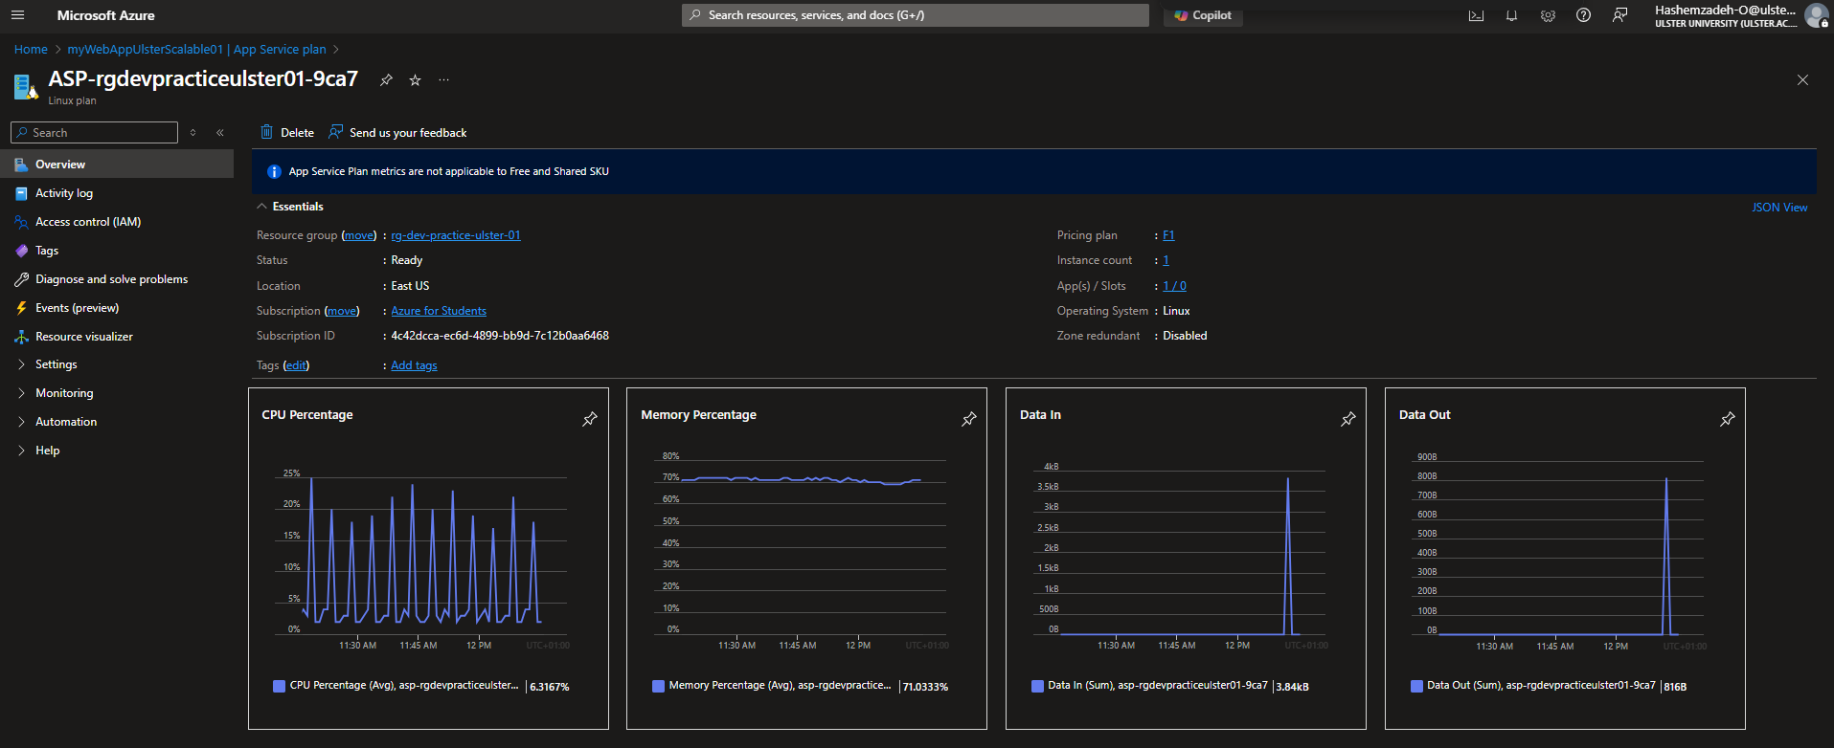
Azure Web Services (App Service)
Auto-Scaling with Azure
Auto-scaling enables the web app to dynamically adjust its resources based on traffic demand.
Azure App Service automatically scales the number of instances up or down to match workload fluctuations. This ensures the web app can efficiently manage peak loads and maintain optimal performance during traffic spikes.
Azure Web Apps offer auto-scaling for horizontal scaling.
Resource Performance Metrics
Azure Web Services | App Service Plan

Slide 12
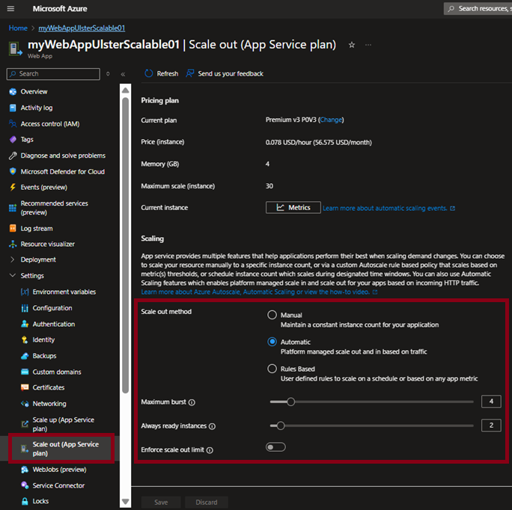
Azure Web Services (App Service)
Auto-Scaling with Azure
Below is a summary of the horizontal scaling parameters I configured for automatic scaling:
Maximum Scale (Instance) : Allows the app to scale out automatically up to some number of instances, ensuring the application can handle high traffic and increased demand efficiently.
Scale-out Method: Automatically adjusts the number of instances based on real-time demand, optimizing performance and ensuring cost efficiency without manual intervention.
Maximum Burst: Allows for additional instances during traffic spikes, ensuring the app remains responsive during short-term increases in demand.
Always Ready Instances: Keeps some instances running at all times to reduce cold start times, ensuring immediate availability and faster response times.
Azure Auto Scaling Features (Scale Out/IN horizontally)

Slide 13
Azure SQL
Azure SQL Database is a fully managed relational database service built on Microsoft SQL Server, offering high availability, security, and scalability for cloud applications [7].
Built-in scalability with support for vertical scaling (adjusting compute size) and horizontal scaling through read replicas and elastic pools.
Offers a hyperscale tier, which allows databases to scale out storage up to 100 TB and scale compute independently.
Enables auto-scaling performance tiers based on workload demand, reducing manual intervention.
Provides active geo-replication for global distribution and business continuity.
Supports serverless compute tier, which automatically pauses during inactivity and resumes on demand — ideal for variable workloads.
Ensures high availability SLA, load balancing, and automatic tuning for query performance optimisation.

Slide 14
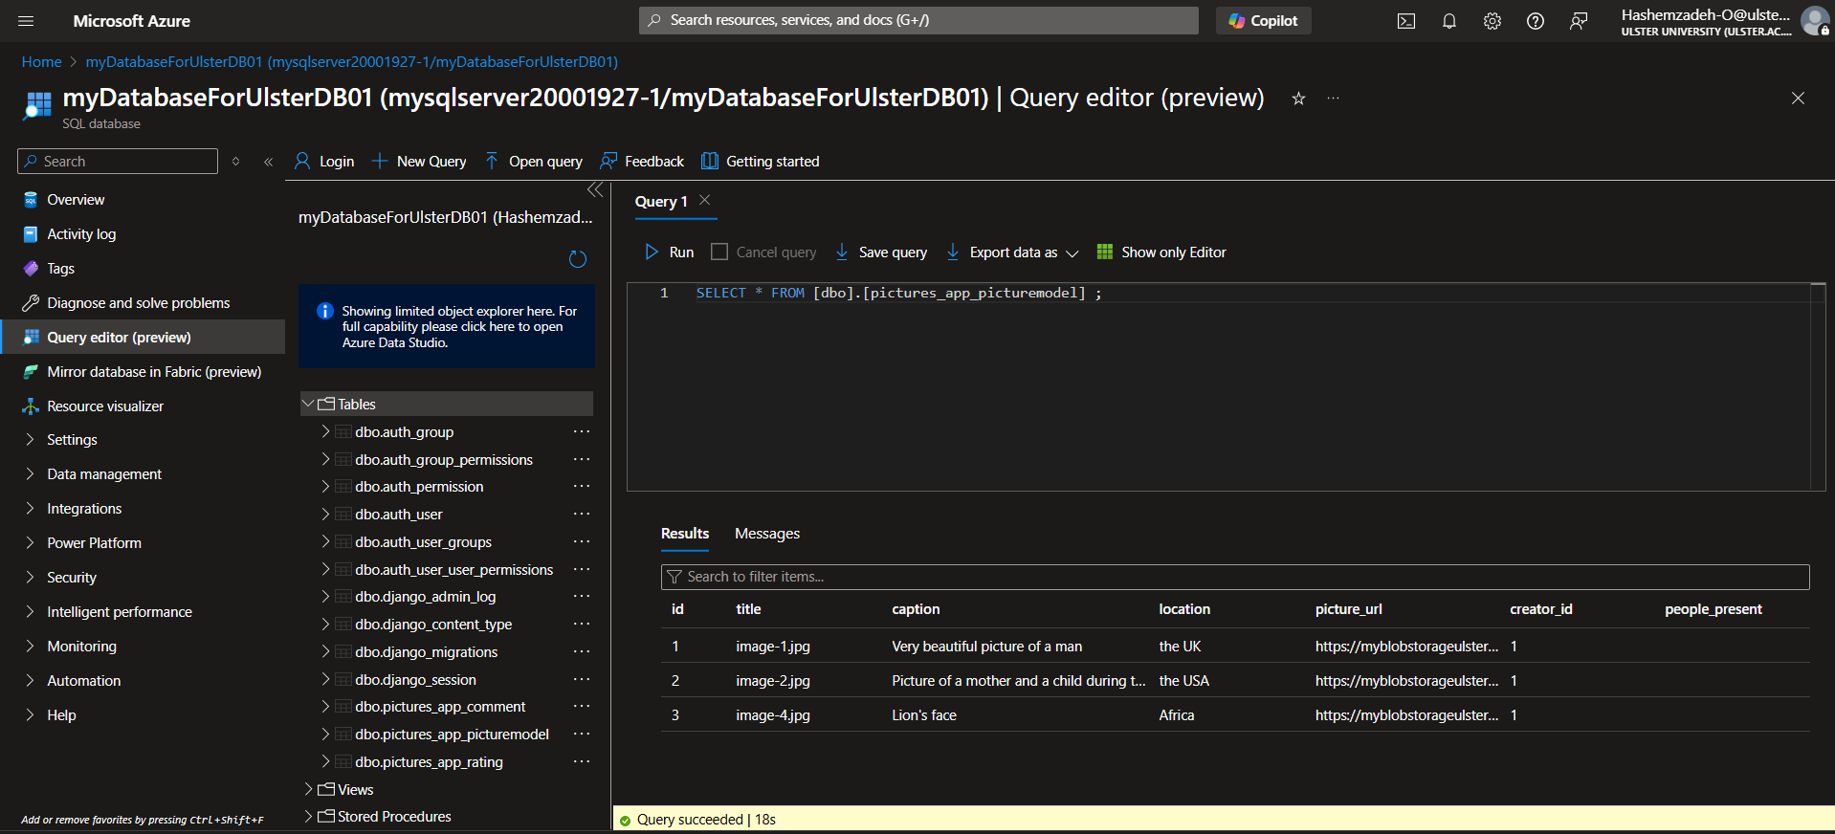
Azure SQL
Sample Query In Azure SQL

Slide 15
Azure Blob Storage
Microsoft's Azure Blob Storage is an object storage service that is designed to handle large volumes of unstructured data, including files like videos, images, and backups. It is inherently scalable, secure, and cost-effective, making it ideal for media-rich web applications [8].
Automatically scales based on storage size and access frequency (hot, cool, and archive tiers).
Optimised for storing large volumes of media content with high availability and durability.
Enables distributed access globally, supporting high-performance delivery.
It is possible to be combined with Azure Content Delivery Network (CDN) to minimise latency and improve the overall user experience.

Slide 16
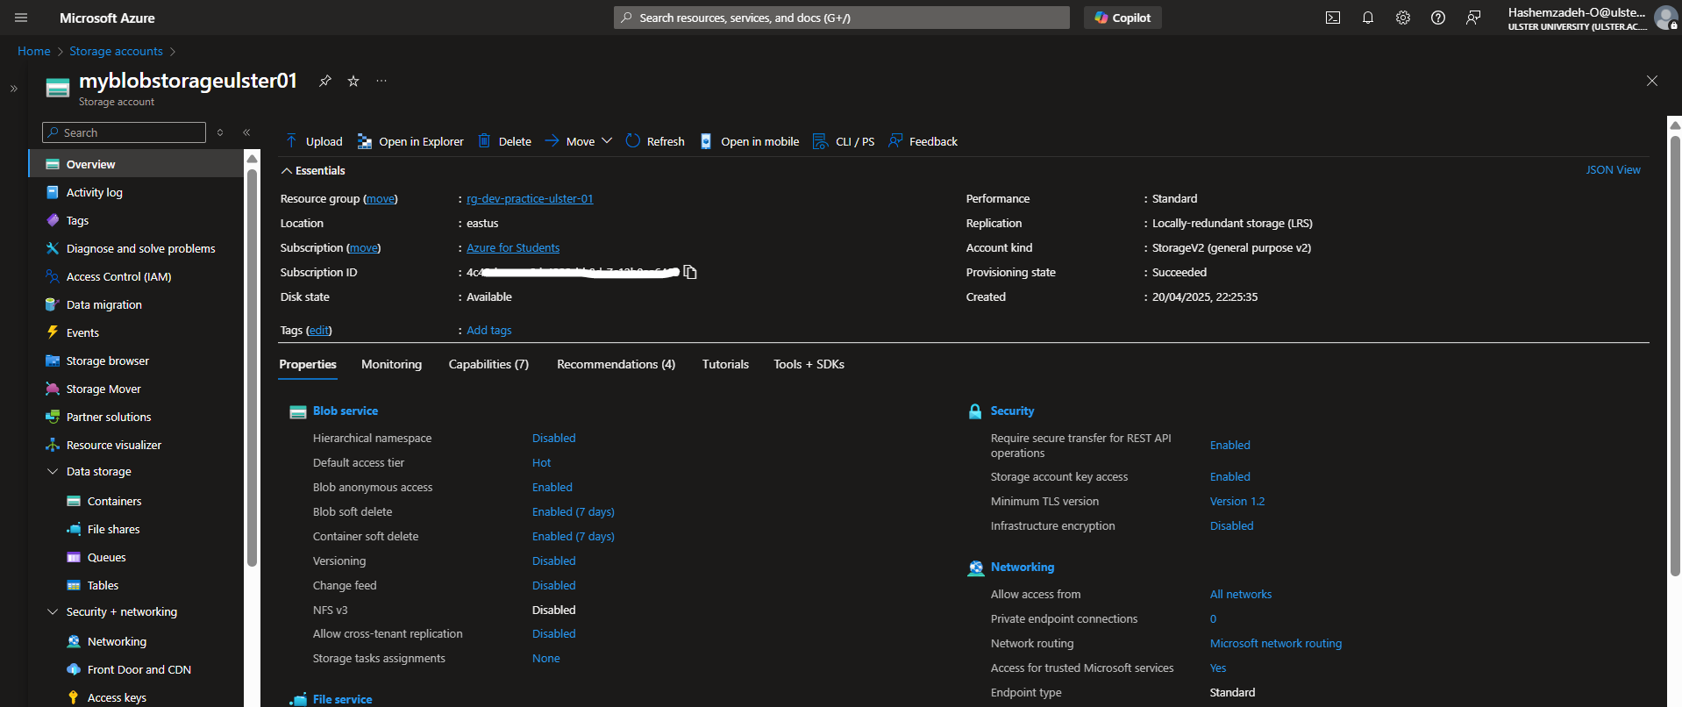
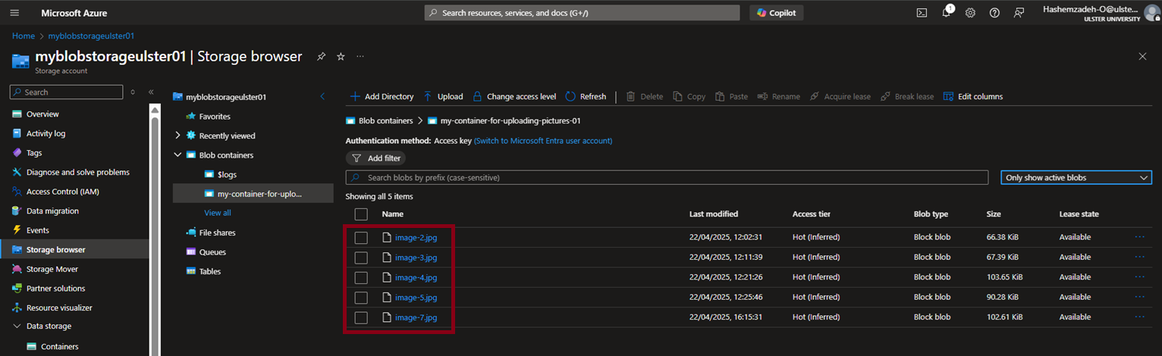
Azure Blob Storage
Overview of Azure Blob Storage
Azure Blob Storage Container Storage Browser (Showing the uploaded images)

Slide 17
Azure Cache for Redis
What is Azure Cache for Redis?
It is a fast and efficient data storage system that holds data in RAM to allow rapid access and retrieval.
Caches frequently accessed data (e.g., gallery listings)
Reduces DB hits and speeds up responses
Scalability Benefits
Reduces load on Azure SQL Database
Faster performance for high-traffic pages
Supports horizontal scaling of the Web App
Lays groundwork for multi-region/CDN support
How It's Used in This App
Caches enriched gallery data in memory
Invalidated on image upload, comment, or rating
Cache timeout is configurable.
Why Redis?
Fully managed on Azure with low ops overhead
Supports SSL and diagnostics
Reliable and cost-effective for web apps

Slide 18
Monitoring & Observability
Azure Application Insights enables deep observability into app behavior. It provides request tracing, failure analysis, and custom metrics. Alerts can be configured to notify developers when performance thresholds are breached or errors increase.
Integrated Azure Application Insights for:
Real-time performance metrics (CPU, memory, latency)
Request tracing and error tracking
Custom alerts and thresholds (e.g., > 1s response time)
Logs can be streamed or exported to Azure Monitor
Enables fast detection and debugging of issues

Slide 19
Azure Application Insights
This tool is a flexible APM (Application Performance Management) that enables developers to track live application performance, identify problems, and enhance overall efficiency [9].
Enables real-time monitoring of web applications, including response times, request rates, and failure trends.
Automatically detects performance bottlenecks, unhandled exceptions, and application crashes.
Captures telemetry data such as requests, dependencies, logs, and custom events from Django apps.
Integrates with Azure Monitor to provide full-stack observability and rich query capabilities.
Enhances fault tolerance by enabling proactive detection and resolution of issues before they impact users.
Complements Azure App Service’s high availability and load balancing, ensuring a resilient and responsive application.
Application Insights allows setting up alerts based on metrics or logs. Alerts notify developers in case of performance issues, errors, or failed requests. Provides automatic monitoring of app behavior, ensuring proactive resolution of issues before they affect users.

Slide 20
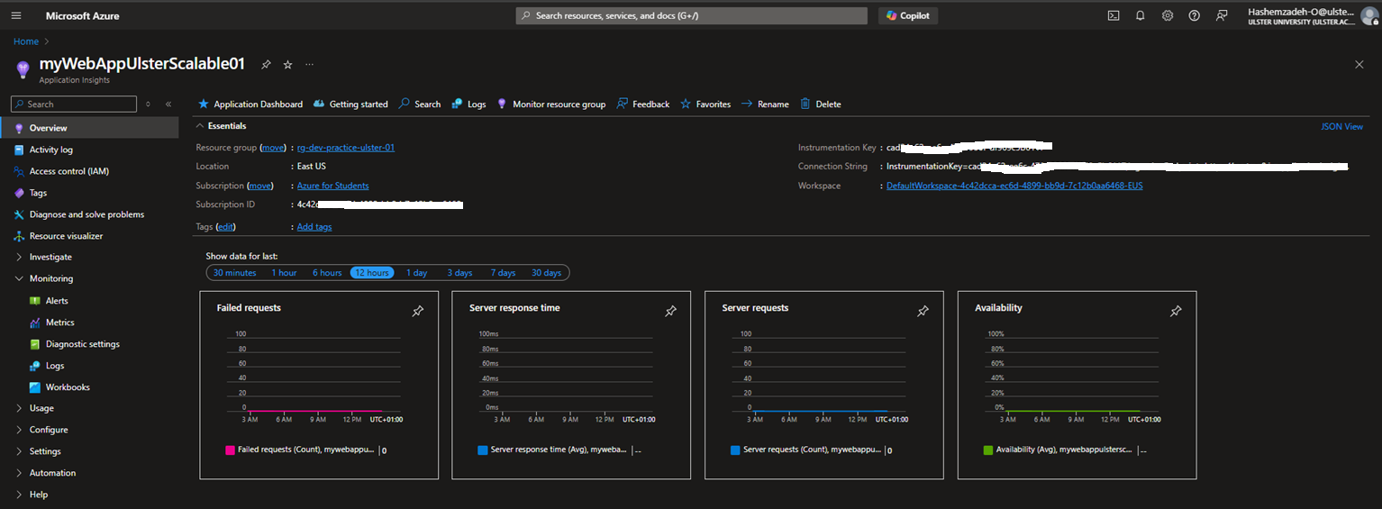
Azure Application Insights
Live Metrics Stream provides real-time monitoring of the application’s performance and health, allowing us to detect and address issues instantly. This enables proactive performance management and rapid issue resolution.
Performance Metrics
Failed Requests: Tracks errors or failures in requests (e.g., HTTP 4xx/5xx), identifying performance issues.
Server Response Time: “the average time that the system takes to process a request once it was received”[10].
Server Requests: Counts total server requests, showing load and traffic patterns.
Availability: Tracks uptime and app accessibility by monitoring successful and failed requests.

Slide 21
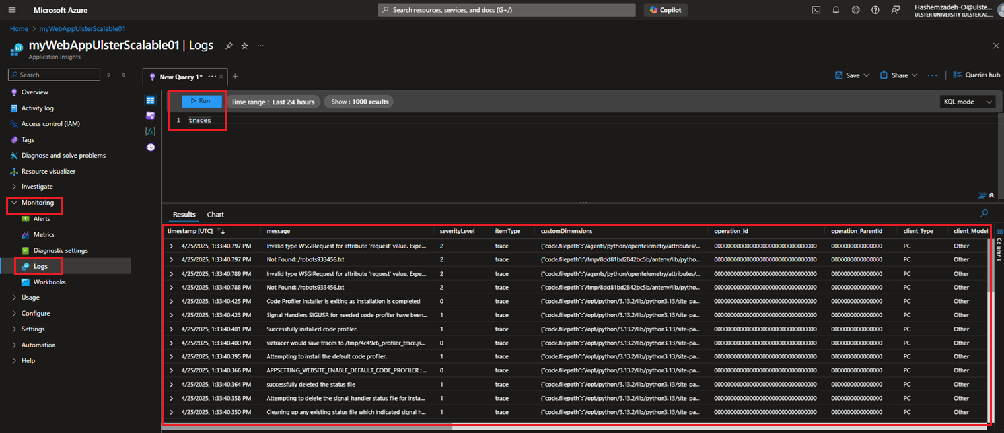
Azure Application Insights
Logs Query
The logs section of this service provides real-time insights into application performance, errors, and user interactions. They help diagnose issues quickly through detailed request tracing, metrics, and custom queries
Azure Application Insights Logs Query

Slide 22
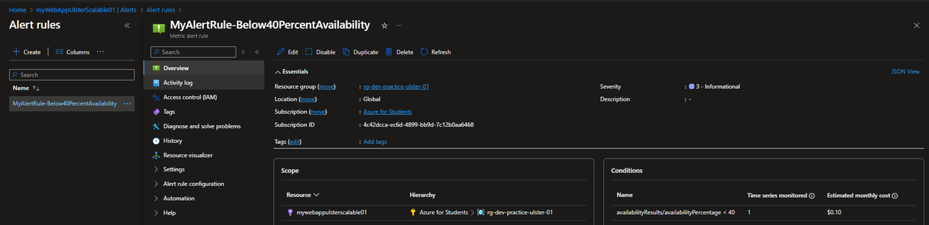
Azure Application Insights
Alerts
Application Insights allows setting up alerts based on metrics or logs.
Alerts notify developers in case of performance issues, errors, or failed requests.
Provides automatic monitoring of app behavior, ensuring proactive resolution of issues before they affect users.
Azure Application Insights Alert Rules

Slide 23
Evaluation of Scalability
This solution achieves high scalability by using Azure’s built-in auto-scaling, load balancing, and cloud-native orchestration capabilities as demand grows and traffic increases:
Azure App Service automatically scales out/in based on demand, handling traffic spikes without service disruption.
Azure SQL Database supports scaling through hyperscale storage, read replicas, and high-concurrency processing.
Azure Blob Storage handles large volumes of image data with seamless scaling for varied access patterns.
Azure Redis Cache reduces database load by caching frequently accessed content like the gallery view.
GitHub Actions CI/CD ensures fast, repeatable deployments
Azure Application Insights enables real-time performance monitoring and fixing issues diagnostics to detect and address issues quickly.
Together, these services ensure the application scales efficiently in computing and storage while maintaining high scalability, availability, performance, and user experience under variable load.

Slide 24
Limitations
While the solution is scalable, there are several limitations to consider:
Cost with Scale: As the application grows, costs for services like Azure Blob Storage, SQL Database, and App Service increase, especially with auto-scaling and high storage demands. The premium tiers required for higher performance also add to the costs.
Free-tier Limitations: Free-tier resources have usage limits, and as the app scales, upgrading to paid services may be necessary, leading to higher operational costs.
Scaling Complexity: While auto-scaling offers flexibility, fine-tuning scaling policies for optimal resource allocation can become complex and may lead to inefficiencies if not managed carefully.
Data Transfer Costs: Increased data transfer between Azure resources, especially across regions, may lead to higher costs.
Service Dependencies and Downtime: Interdependencies between services can result in cascading issues, making failover management and redundant configurations important but complex.

Slide 25
Future Research
Future Enhancements 🔧
Cost optimisation through refined scaling policies and tier adjustments,
Performance tuning of queries and storage access, using caching or CDN for faster media file retrieval.
Predictive Scaling with Machine Learning: Implement machine learning models to predict traffic and automatically adjust scaling policies, enabling proactive resource management and better performance.
Automated Fault Detection: Integrate AI-powered tools to automatically detect performance anomalies and adjust scaling policies, improving availability and resilience.

Slide 26
✅ Conclusion
The solution successfully demonstrates a scalable and resilient architecture by integrating key Azure services, including Azure App Service, Azure Blob Storage & Application Insights & Azure Redis Cache, and Azure SQL Database.
Together, these cloud-native components ensure scalable, high availability, performance, and adaptability under changing workloads, making the application ready for large-scale real-world deployment.
cloud-native, automated, and ready for real-world traffic.

