Slide 1

TMDB Box Office Prediction
Omid Ghamiloo
Master of data science
1859134

Slide 2


Libraries
Pandas
Numpy
matplotlib
Bs4
BeautifulSoup

Slide 3
Libraries
scikit-learn
Model selection
Cross validation
Repeated Kfold
RandomizedSearchCV
Preprocessing
MinMaxScaler
metrics
mean_squared_error
mean_absolute_error

Slide 4
Dataset
The dataset
3000 observation on train
5000 observation on test
Variables
id, cast, crew, keywords, budget, posters, release dates, original languages, spoken language, belong to collection, genres, production companies, IMDB id, runtime, status, overview, tagline, original title, revenue, popularity, homepage and countries.

Slide 5
Extra Variables
IMDB Rate
IMDB website web scraping
Number of votes
IMDB website web scraping

Slide 6
Data Cleaning
Spoken languages: is replaced by original languages variable.
Production companies: is replaced by the IMDB website.
Runtime: is replaced by the mean value of it.
Status: is replaced by the maximum value of it.
Genres: is replaced by the IMDB website.
Summary: is replaced by the IMDB website.
Keywords: is replaced by the IMDB website.
Homepage: is removed.
Poster path: is removed.

Slide 7
Data extraction
Genres
Number of genres
Genres dummy
Spoken language
Companies
Countries
Number of language
Is english
Number of companies
Number of top companies
Number of countries

Slide 8
Data extraction
Number of total crews
Number of female crews
Number of male crews
Top directors, writers, producers and music composers
Crew
Number of directors
Number of writers
Number of producers
Number of music composer
Number of total casts
Number of female casts
Number of male casts.
Top cast by mean of its revenue.
Cast

Slide 9
Data extraction
Month
Day
Day of week
Week of year
Keyword:
Number of keywords
Number of Top keywords
Release Date:
Year
season

Slide 10
Data extraction
Has collection
Length of title
Length of status
Length of summary

Slide 11
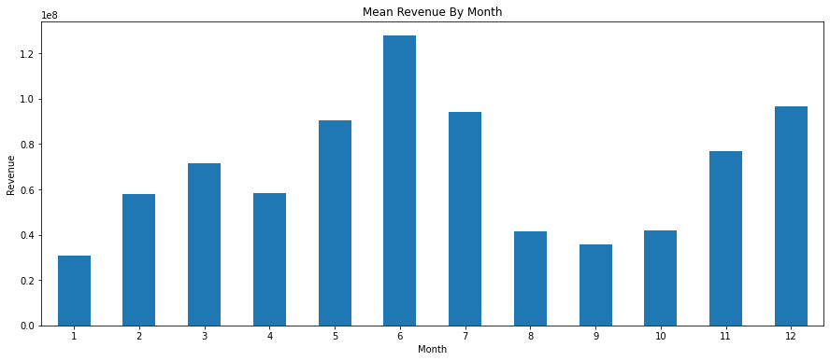
Mean revenue by months

Slide 12
Feature engineering
Weighted rate (The Bayesian Average):
Weighted rate = ((v / (v + m)) * r) + ((m / (v + m)) * c)
Others:
ratio of budget on year
budget on popularity

Slide 13
Normalization
Logarithm
MinMaxScale
Number votes
Ratio of new features
budget
Population
Revenue
rate

Slide 14
Fixing outlier
Budget: because of 0
‌predicting 0 by LGBM
Runtime: because of 0
Replace the 0 by mean

Slide 15
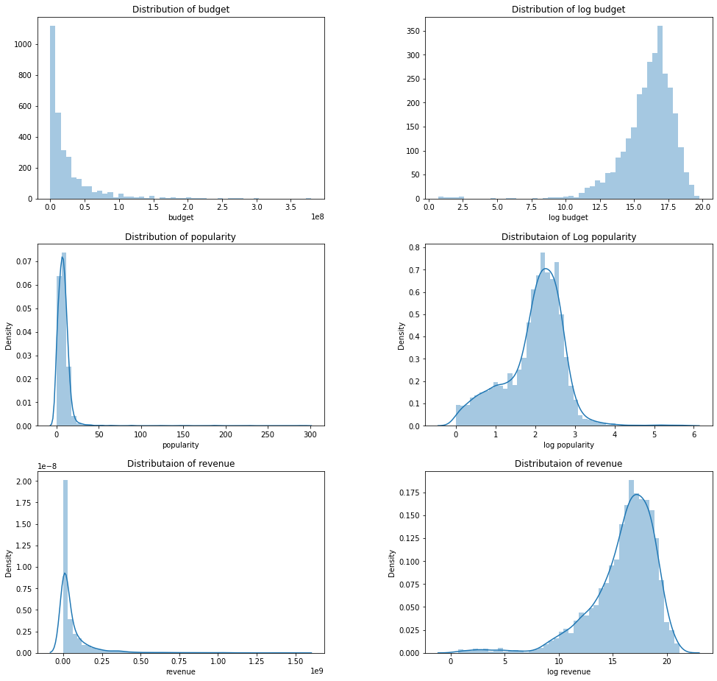
Normalization

Slide 16
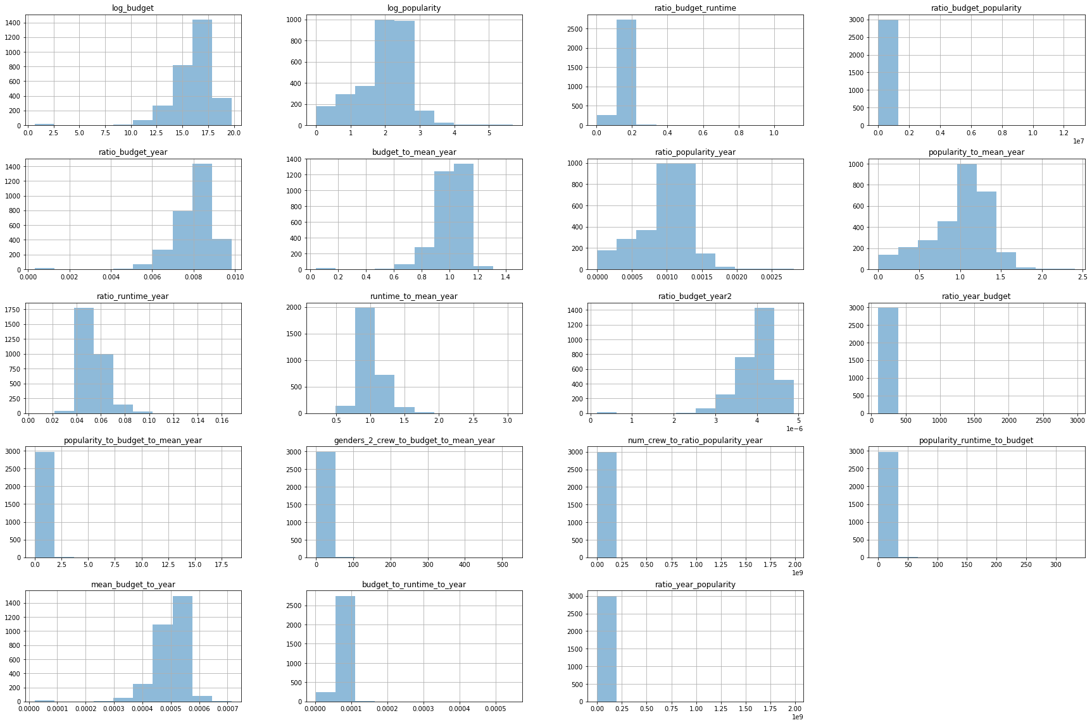
Normalization

Slide 17



Modeling
Linear Regression
Lasso
Ridge
Elastic Net
Random Forest
Lighting GBM
Cat boost

Slide 18
Modeling Base
Base | RMSE | MAE | Accuracy | CV
Linear Reg | 1.854 | 1.341 | 89.020 | 1.730
Lasso | 1.948 | 1.440 | 88.514 | 1.636
Ridge | 1.848 | 1.345 | 89.067 | 1.3973
Elastic | 1.947 | 1.434 | 88.619 | 1.613
Rand Forest | 1.682 | 1.150 | 90.463 | 1.2367
Cat boost | 1.667 | 1.122 | 90.522 | 1.196
LGBM | 1.721 | 1.138 | 90.426 | 1.212

Slide 19
Modeling Tuned
Tuned | RMSE | MAE | Accuracy | CV
Linear Reg | 1.854 | 1.341 | 89.020 | 1.730
Lasso | 1.868 | 1.343 | 89.270 | 1.450
Ridge | 1.847 | 1.351 | 89.115 | 1.402
Elastic | 1.871 | 1.343 | 89.263 | 1.450
Rand Forest | 1.685 | 1.148 | 90.436 | 1.2363
Cat boost | 1.658 | 1.129 | 90.414 | 1.198
LGBM | 1.683 | 1.119 | 90.647 | 1.207

Slide 20
Modeling
Lasso
alpha
Ridge
alpha
Elastic Net
Alpha
L1_ratio
Random Forest
max depth
min samples leaf
min samples split
Number of estimators
Cat boost
Learning rate
L2 leaf reg
Depth
Lighting GBM
feature fraction
learning rate
Lambda_l1
max depth
Number of leaves
Max bin
Bagging fraction
Subsample
Number of boost round

Slide 21
The best models
RMSE
Cat boost tuned
1.65881283422061
MAE
LGBM Tuned
1.1198599722006688
Cross Validation
Cat boost Base
1.1965434932087693
Accuracy
LGBM Tuned
90.64770979755164

Slide 22
The best models
RMSE
MAE
Cat boost tuned
Lighting GBM tuned
1.6588
1.1198
Cross Validation
Accuracy
Cat boost base
Lighting GBM tuned
1.1965
90.6477

Slide 23
Combination
Cat
LGBM
RF
New
10%
60%
30%
MAE = 1.11
Accuracy = 90.68%

Slide 24
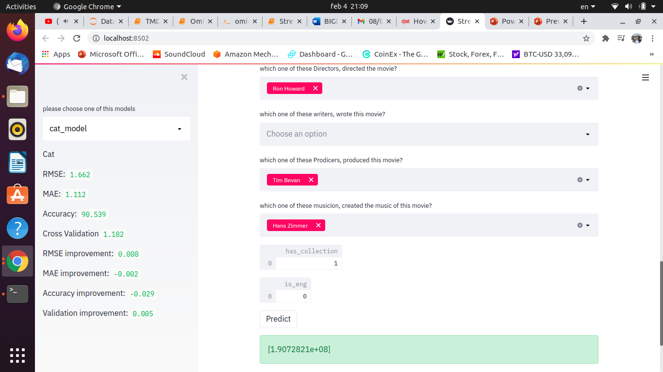
Dashboard

