Slide 1
Incident Hypertension Prediction in Obstructive Sleep Apnea by Machine Learning
Omid Halimi Milani
2023

Slide 2
Machine learning is a powerful tool in pattern recognition, can work with massive data from polysomnography, combine multiple signals
Treatment of OSA with CPAP therapy only showed modest reduction in blood pressure and yet to prove benefits in minimizing cardiovascular risk.
Predict incident hypertension could help develop an effective personalized treatment approach to prevent cardiovascular risk in patients with OSA
our project aim to use machine learning to create a models that can predict incident hypertension in 5 years from PSG.

Slide 3
Using ML to predict HTN from PSG
Input: PSG and clinical data from the sleep heart health study** (SHHS), a longitudinal community-based cohort study.
In this cohort, 4,797 participants of age 40 and older had OSA.
After excluding participants with pre-existing hypertension at baseline, the sample size was 2,652.
1,814 participants had follow-up data at 5 years, and 50% (911/1,814) had incident hypertension.

Slide 4
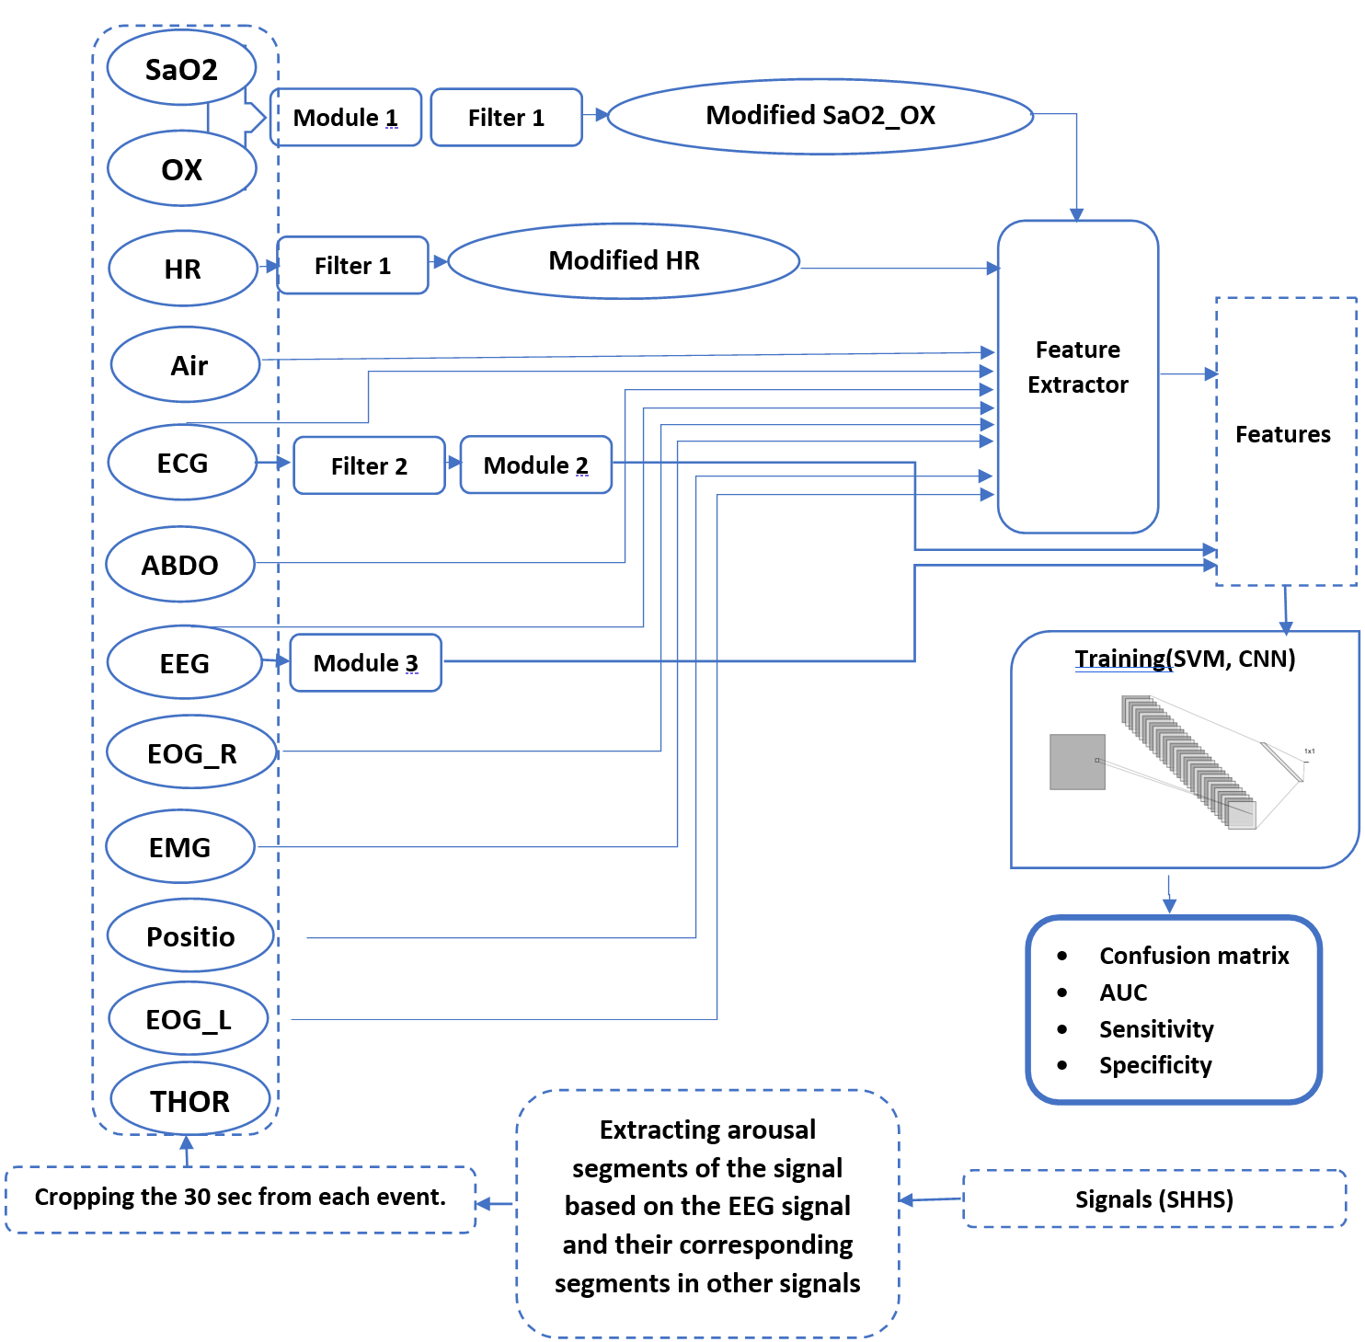
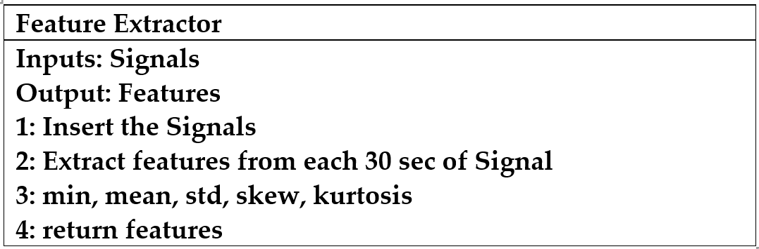
Methods
The overview of the idea is described in Figure. Artifacts in the oxygen saturation signal were annotated to determine valid or invalid data, and interpolation was used to reconstruct the invalid segments. Further non-physiologic drops in oxygen saturation (e.g.,to“0”) removed(Module1, Filter1).
ECG artifacts (from muscle activity or movement) were also detected using a filter and replaced by interpolated values. Since heart rate variability is indicative of autonomic activity, an important factor in the pathogenesis of OSA, heart rate variability (HRV) features were calculated based on the R-R interval and included as input into the ML model.
EEG delta power (over other EEG frequencies) was also used as a feature in the ML model. Additional inputs were the mean, min, standard deviation, skewness, and kurtosis of signals (Filter 2, Module 2, and Module 3).

Slide 5
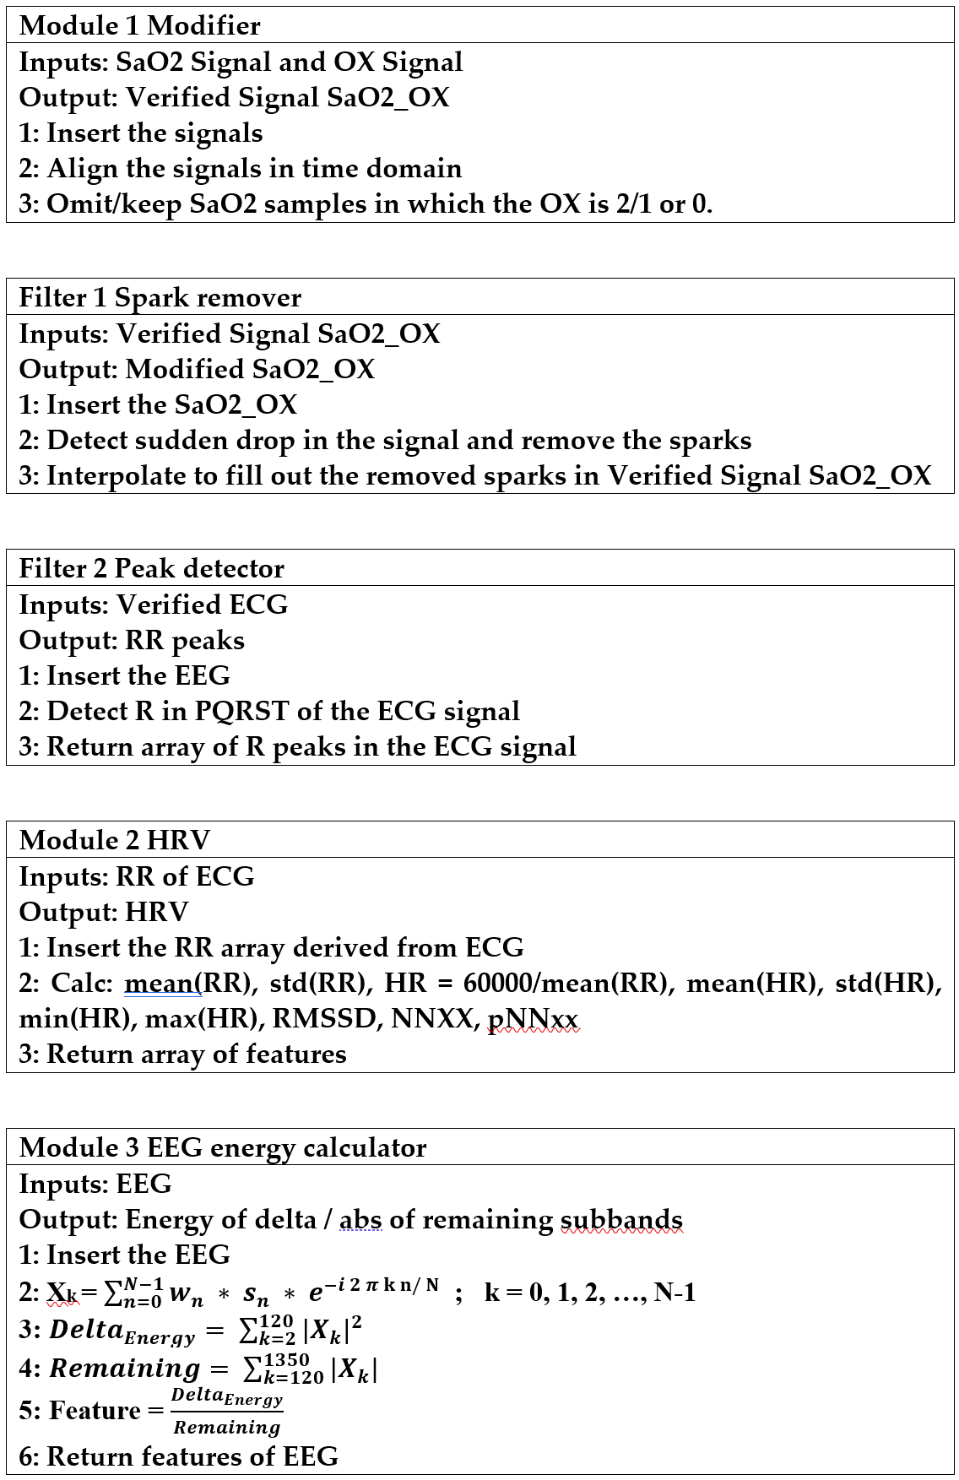
Methods

Slide 6
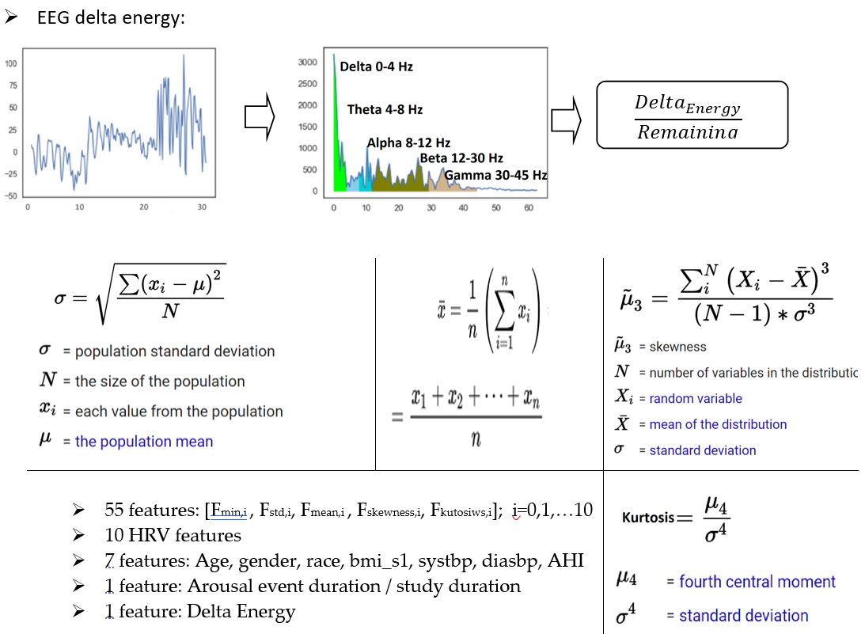
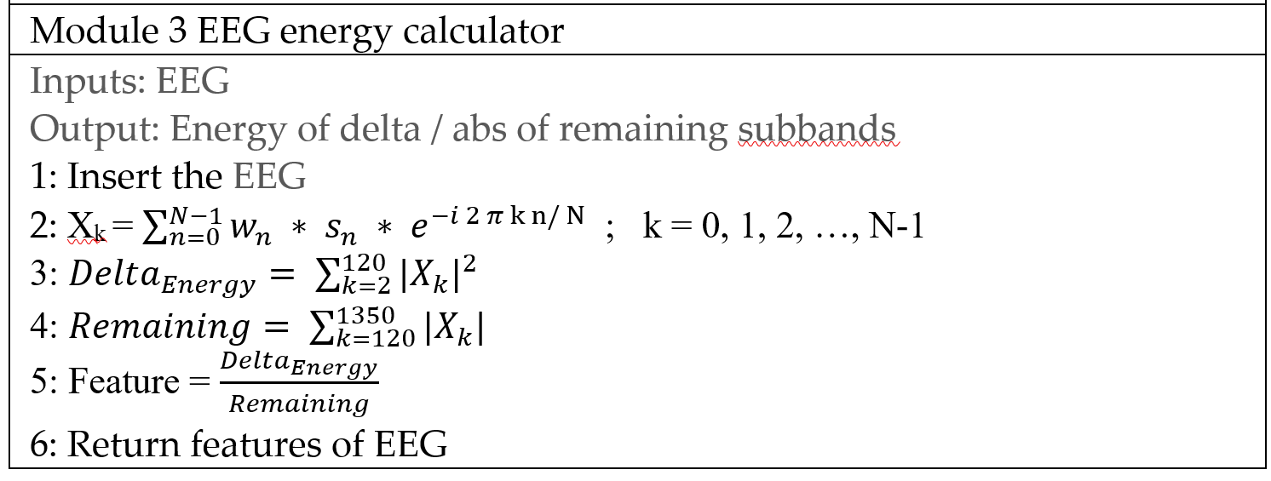
Methods

Slide 7
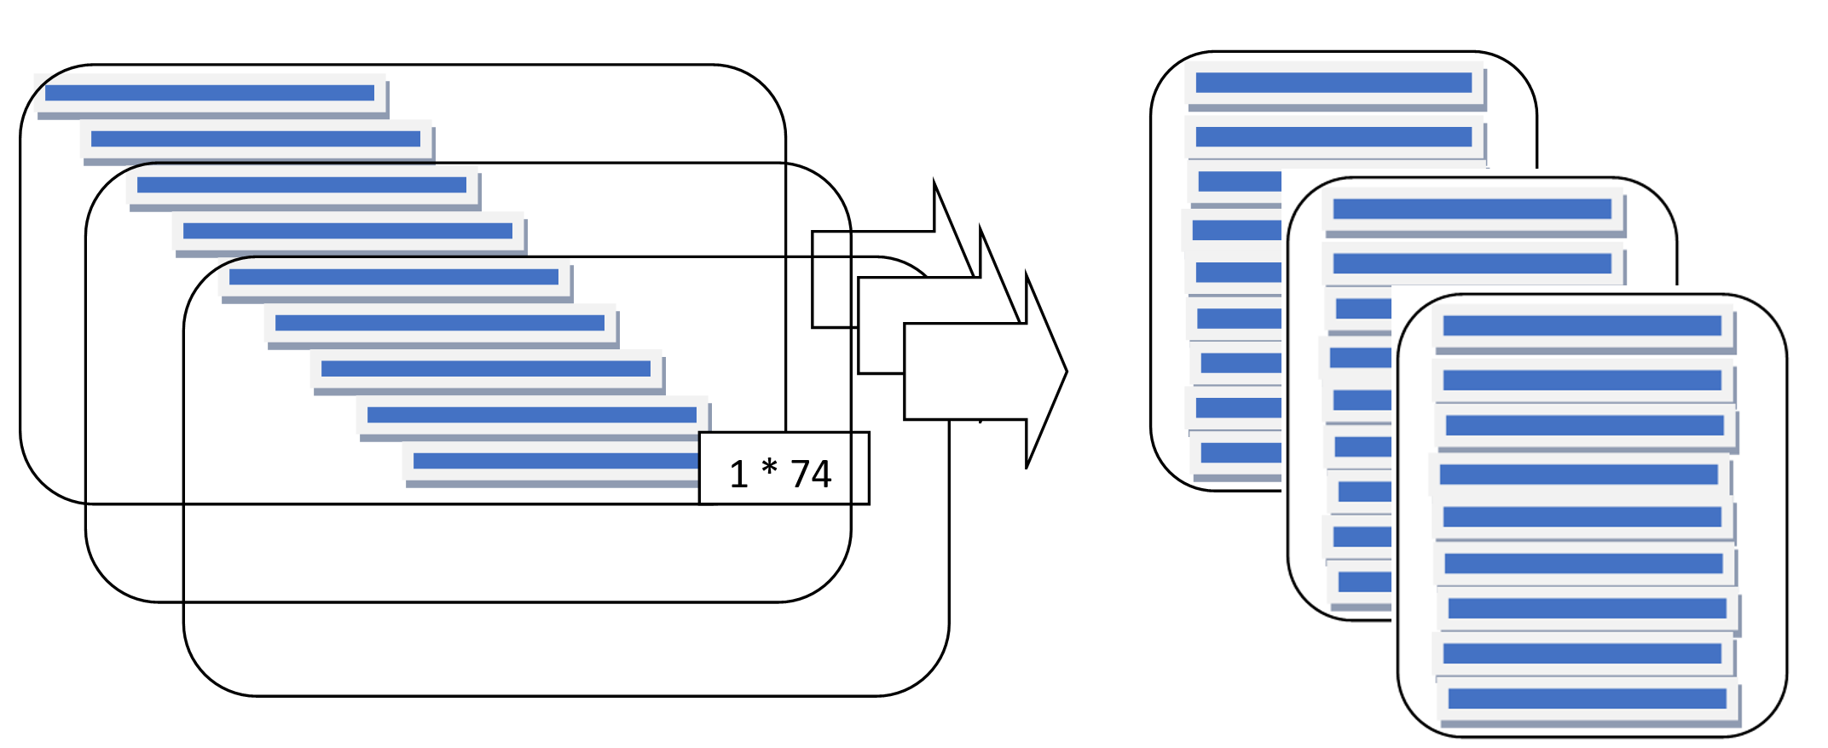
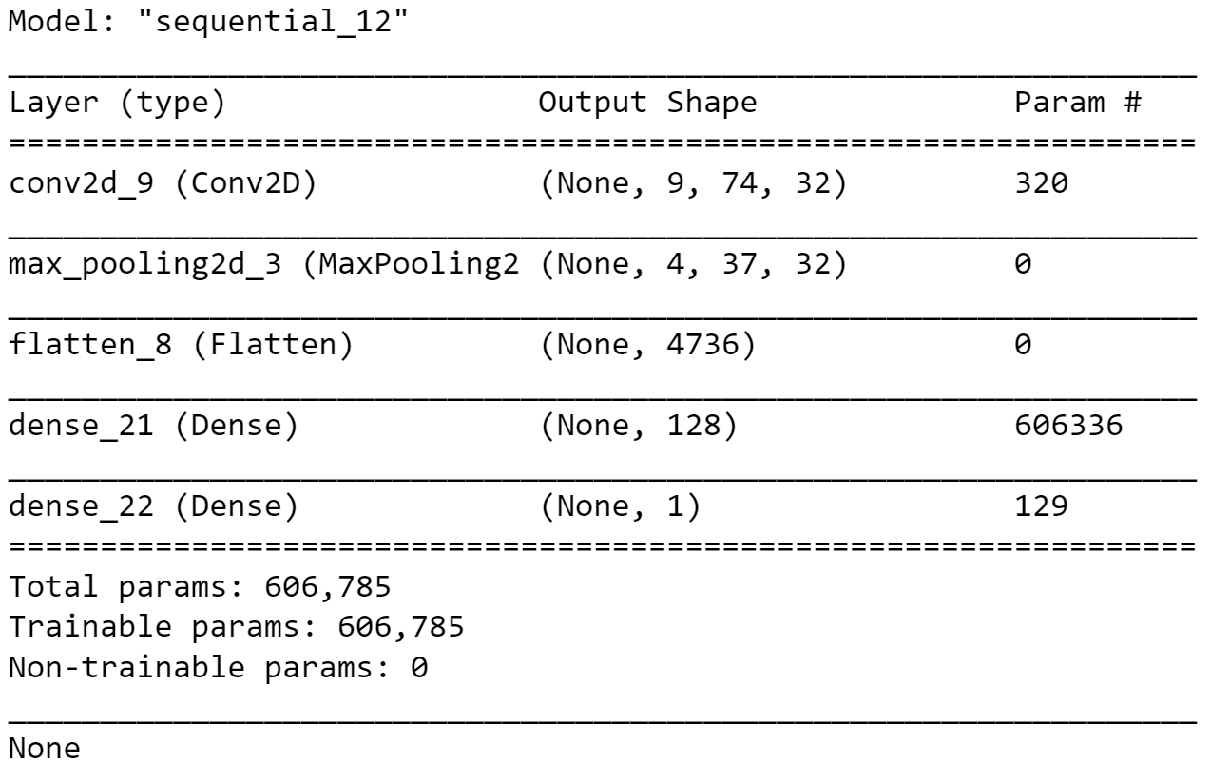
Results: CNN

Slide 8
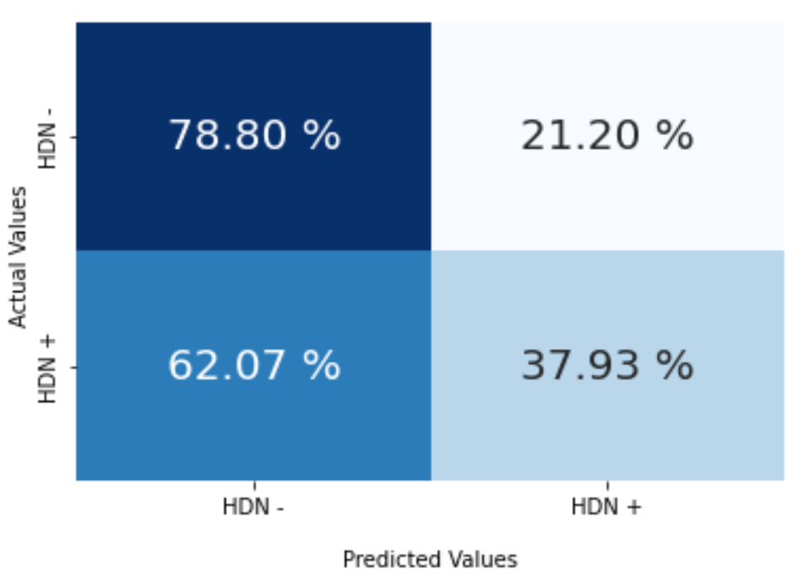
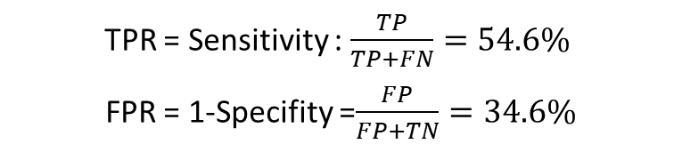
Results: CNN
TPR = Sensitivity : $\frac{TP}{TP+FN}=54.6\%$
FPR = 1-Specifity =$\frac{FP}{FP+TN}=34.6\%$

Slide 9
SVM
Support Vector Machines (SVMs) are a powerful machine learning algorithm used for classification and regression tasks. SVMs are widely used in medical research and diagnosis, as they are particularly effective in separating data into different categories based on specific features.
The fundamental principle of SVMs is to find a hyperplane that maximally separates two classes of data.
The hyperplane is defined as the boundary that separates the two classes with the maximum margin, or distance between the closest points of each class.
The points closest to the hyperplane are known as support vectors, and their location and distance from the hyperplane help determine the boundary.

Slide 10
SVM
SVMs are particularly useful in cases where the data is not linearly separable. In these cases, SVMs use a kernel function to transform the input data into a higher-dimensional space, where a linear separation is possible. The choice of kernel function is important and depends on the nature of the data and the problem at hand.
In medical research and diagnosis, SVMs have been used for a variety of tasks, including identifying disease biomarkers, predicting patient outcomes, and classifying medical images. For example, SVMs have been used to predict the recurrence of breast cancer based on gene expression data, and to classify skin lesions as benign or malignant based on dermatological images.
One of the advantages of SVMs is their ability to handle high-dimensional data and avoid overfitting. SVMs also have a solid theoretical foundation, with mathematical guarantees of the algorithm's performance and optimality under certain conditions.
In summary, SVMs are a powerful machine learning algorithm with many applications in medical research and diagnosis. Their ability to handle high-dimensional data and nonlinear relationships make them particularly useful in these domains. However, the choice of kernel function and other parameters must be carefully considered to ensure optimal performance.

Slide 11
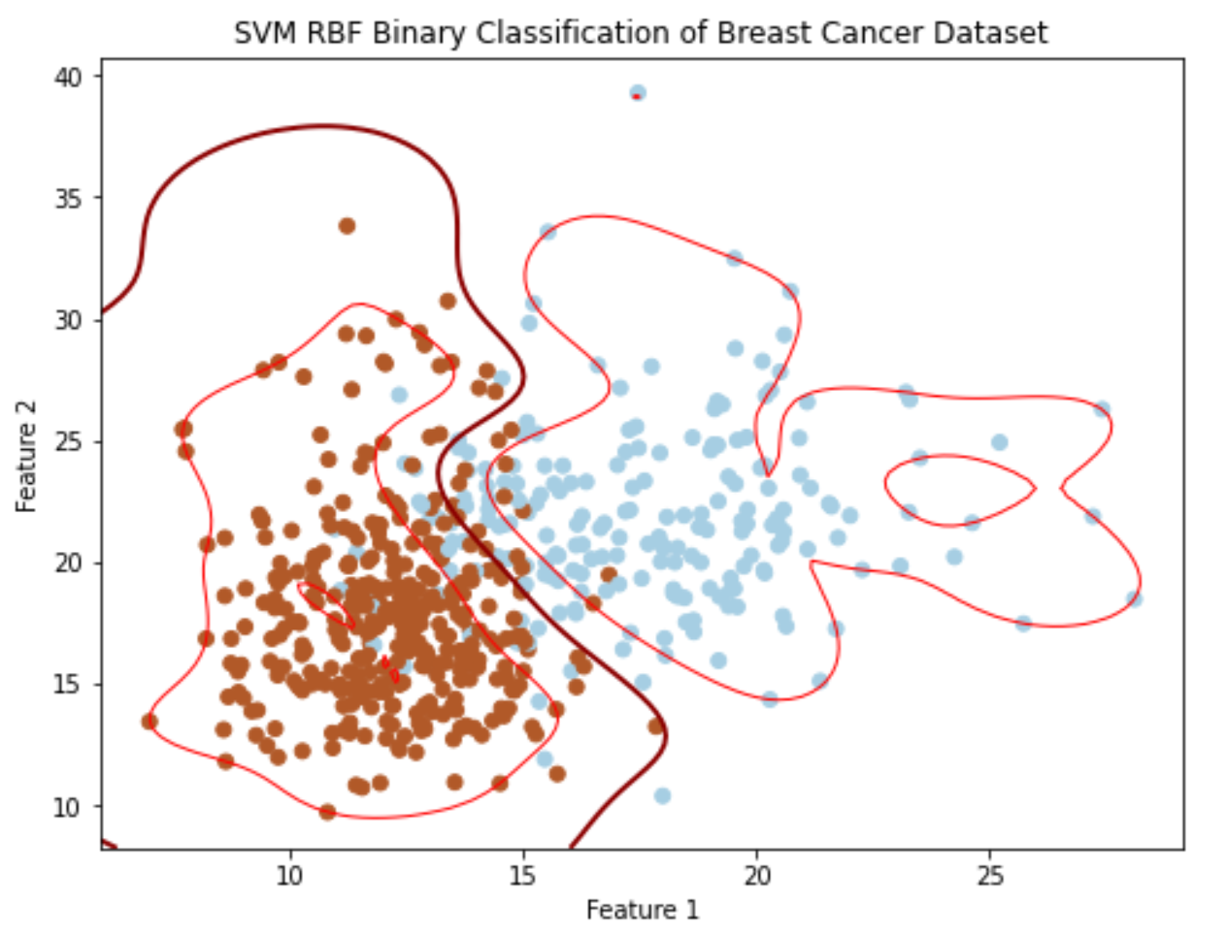
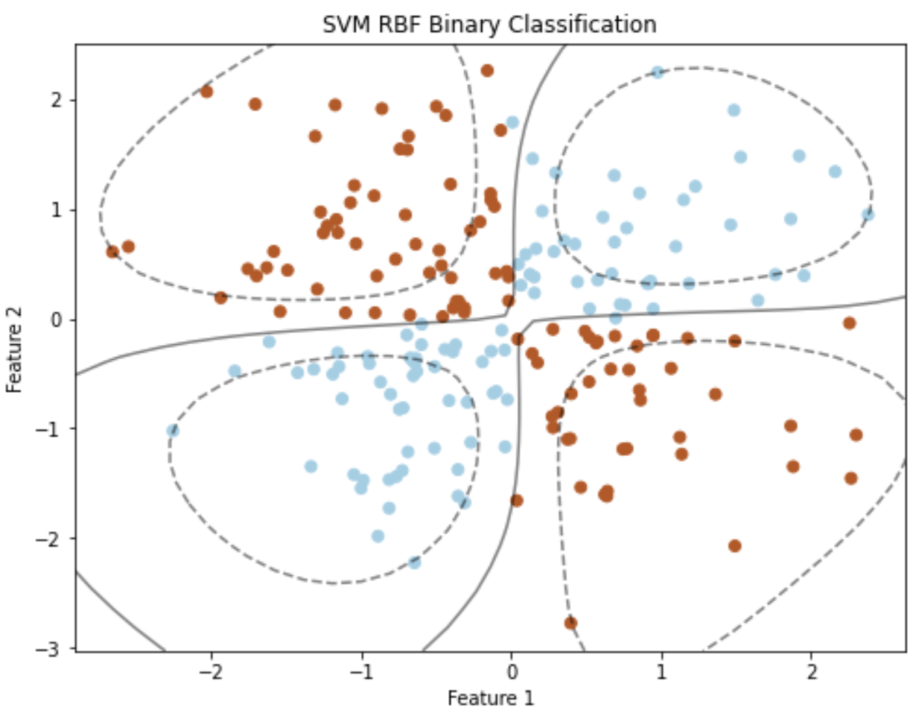
SVM

Slide 12
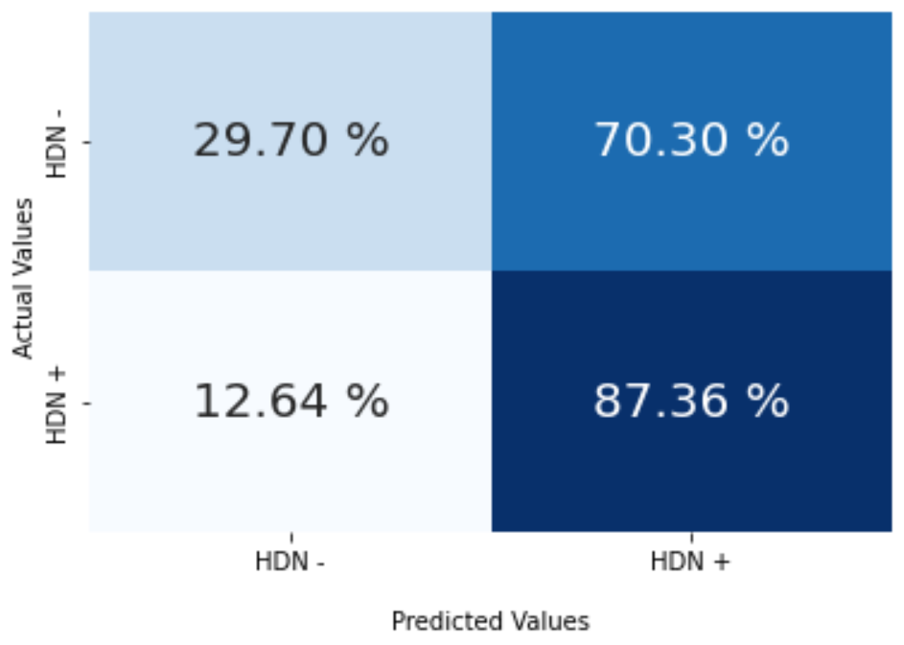
Results: SVM
55 features: [F_{min,i} , F_{std,i}, F_{mean,i} , F_{skewness,i}, F_{kutosiws,i}]; i=0,1,…10
10 HRV features
7 features: Age, gender, race, bmi_s1, systbp, diasbp, AHI
1 feature: Arousal event duration / study duration
1 feature: Delta Energy

Slide 13
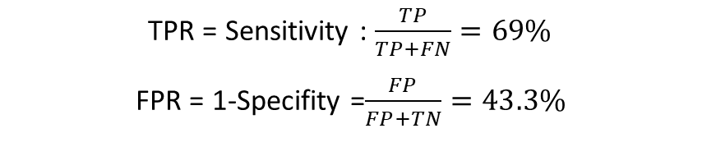
Results: SVM
55 features: [F_{min,i} , F_{std,i}, F_{mean,i} , F_{skewness,i}, F_{kutosiws,i}]; i=0,1,…10
10 HRV features
7 features: Age, gender, race, bmi_s1, systbp, diasbp, AHI
1 feature: Arousal event duration / study duration
1 feature: Delta Energy
Sleep journal
TPR = Sensitivity : $\frac{TP}{TP+FN}=69\%$
FPR = 1-Specifity =$\frac{FP}{FP+TN}=43.3\%$

Slide 14
Train a thereshold (T1)
If #one>T1:predict=1
Else:predict=0
SVM 1
Train a thereshold (T2)
If #one>T2:predict=1
Else:predict=0
SVM 2
Decide based on the voting
Train a thereshold (Tn)
If #one>T1:predict=1
Else:predict=0
SVM n

Slide 15
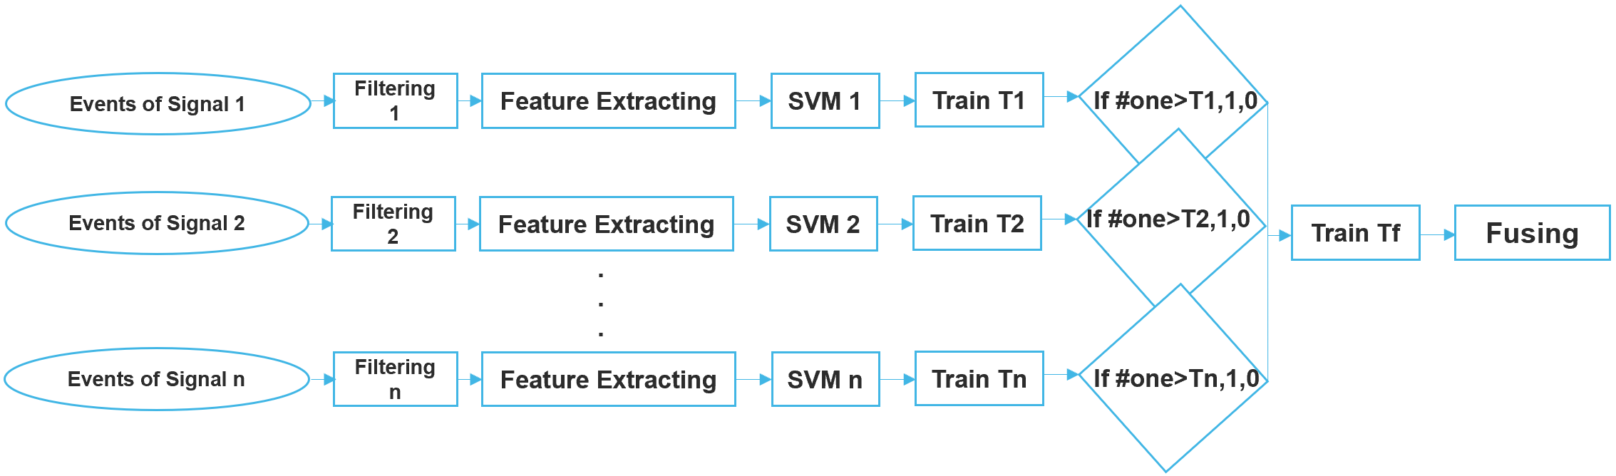
Results: SVM on new Structure

Slide 16
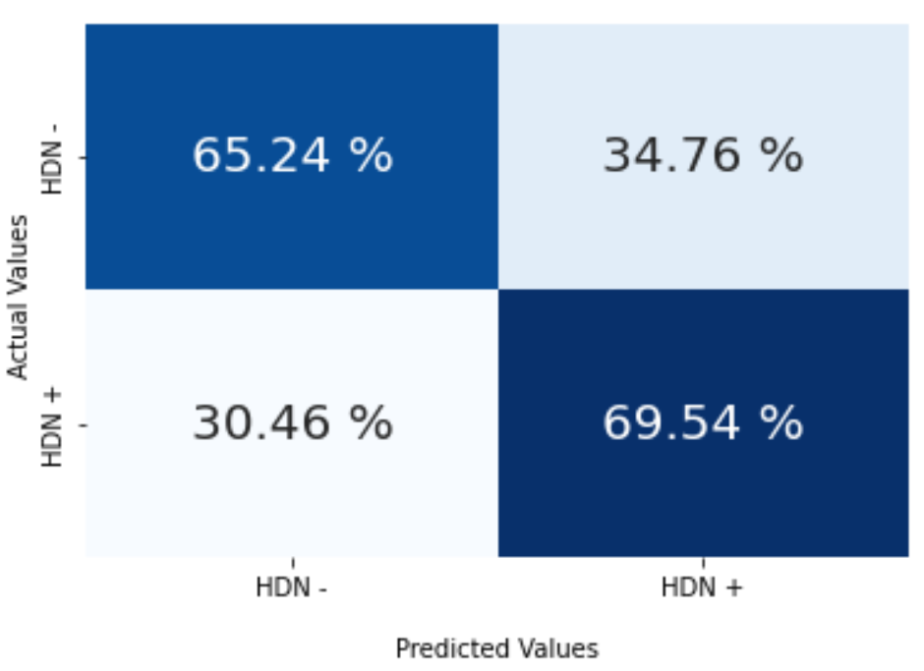
SVM results based on high AHI => 4
67.45%
True Positive Rate (TPR) or Sensitivity: 67%
False Positive Rate (FPR): 32%

Slide 17
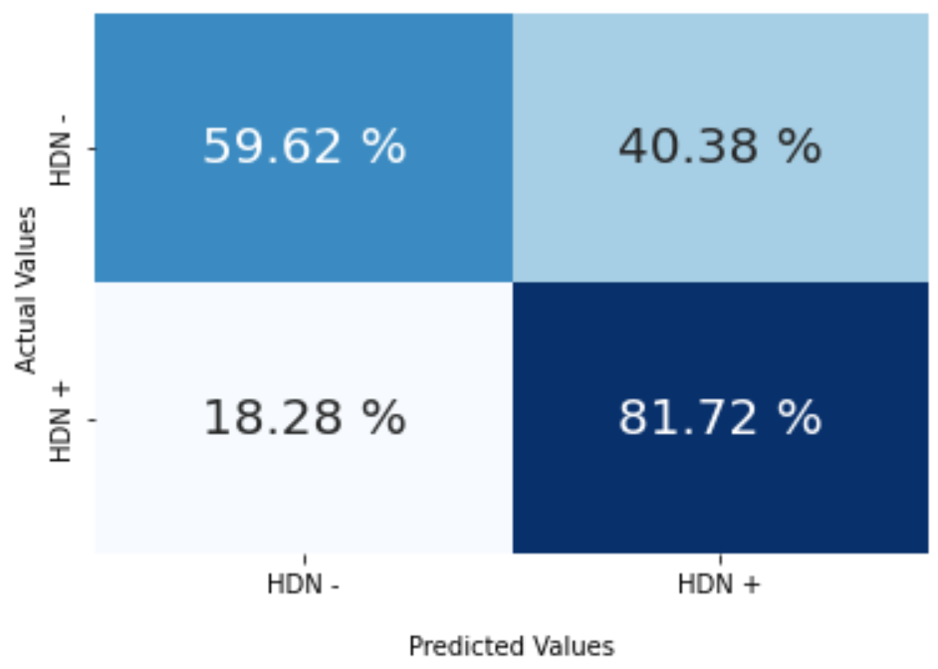
SVM results based on high AHI => 10
70%
True Positive Rate (TPR) or Sensitivity: 78.48%
False Positive Rate (FPR): 35.7%

Slide 18
Conclusion
This proof-of-concept study showed that incident hypertension in OSA may be predicted by powerful supervised ML models.
To boost the accuracy of the ML models, we will explore novel EEG features, respiratory events segments, add selected static clinical data, and apply data augmentation to the training dataset.
We envision the effective ML model can be integrated into polysomnography reading software or electronic medical record software to provide the clinician information of incident hypertension.
Explore more ML models and practice new Dataset.

Slide 19
References
Quan SF, Howard BV, Iber C, Kiley JP, Nieto FJ, O'Connor GT, Rapoport DM, Redline S, Robbins J, Samet JM, Wahl PW. The Sleep Heart Health Study: design, rationale, and methods. Sleep. 1997 Dec;20(12):1077-85. PMID: 9493915
Azarbarzin A, Sands SA, Younes M, Taranto-Montemurro L, Sofer T, Vena D, Alex RM, Kim SW, Gottlieb DJ, White DP, Redline S, Wellman A. The Sleep Apnea-Specific Pulse-Rate Response Predicts Cardiovascular Morbidity and Mortality. Am J Respir Crit Care Med. 2021 Jun 15;203(12):1546-1555. PMID: 33406013
Mazzotti DR, Keenan BT, Lim DC, Gottlieb DJ, Kim J, Pack AI. Symptom Subtypes of Obstructive Sleep Apnea Predict Incidence of Cardiovascular Outcomes. Am J Respir Crit Care Med. 2019 Aug 15;200(4):493-506. PMID: 30764637
Li A, Roveda JM, Powers LS, Quan SF. Obstructive sleep apnea predicts 10-year cardiovascular disease-related mortality in the Sleep Heart Health Study: a machine learning approach. J Clin Sleep Med. 2022 Feb 1;18(2):497-504. PMID: 34437053

