Slide 1
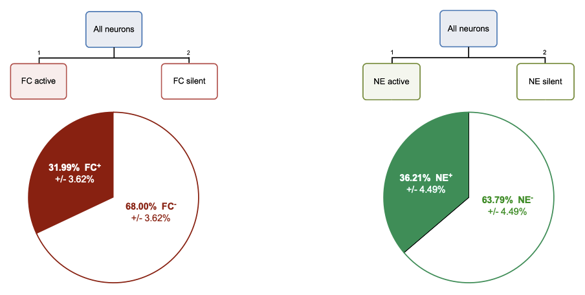
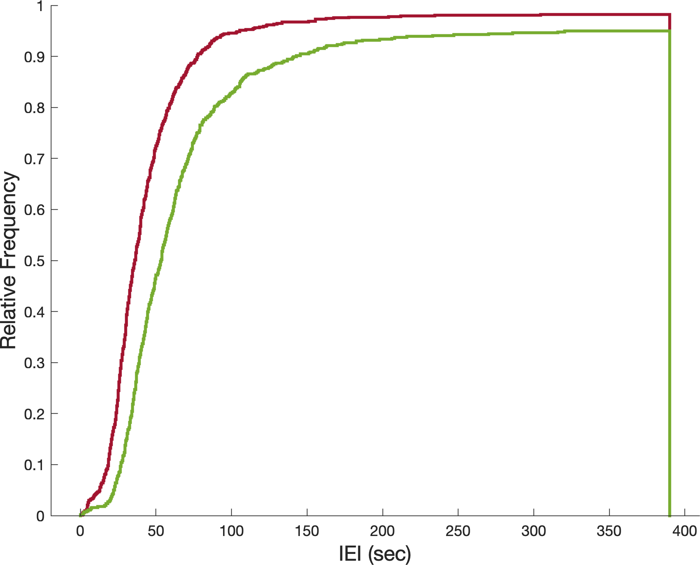
Fear conditioning elicits higher activity in participating neurons than a neutral experience does
Distribution of IEI | Entire Experience
Frequency | Pre-shock
Frequency | Post-shock
*
Notes:
If higher activity is what leads to greater reactivation, thein it would make sense that the engram cells have higher activity than fear conditioning active cells that were not reactivated.

Slide 2
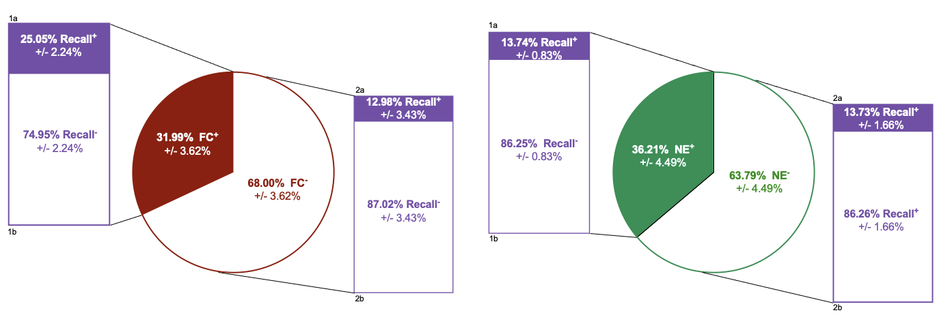
Engram neurons are more active during Fear Conditioning than non-engram neurons
Frequency | Pre-shock
Frequency | Post-shock

Slide 3
Engram neurons are more active during Fear Conditioning than non-engram neurons
Frequency | Pre-shock
Frequency | Post-shock
Frequency | Mapping sessions

Slide 4
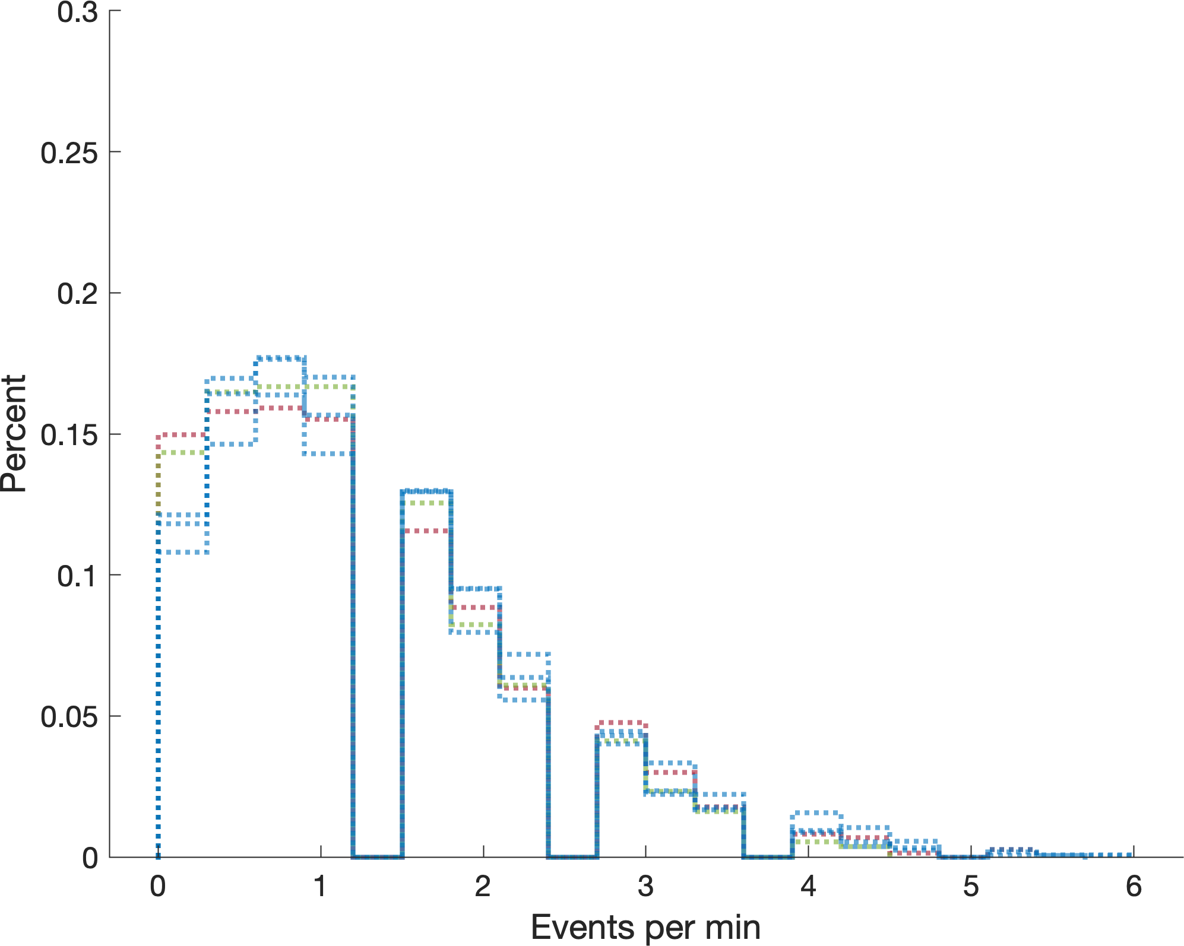
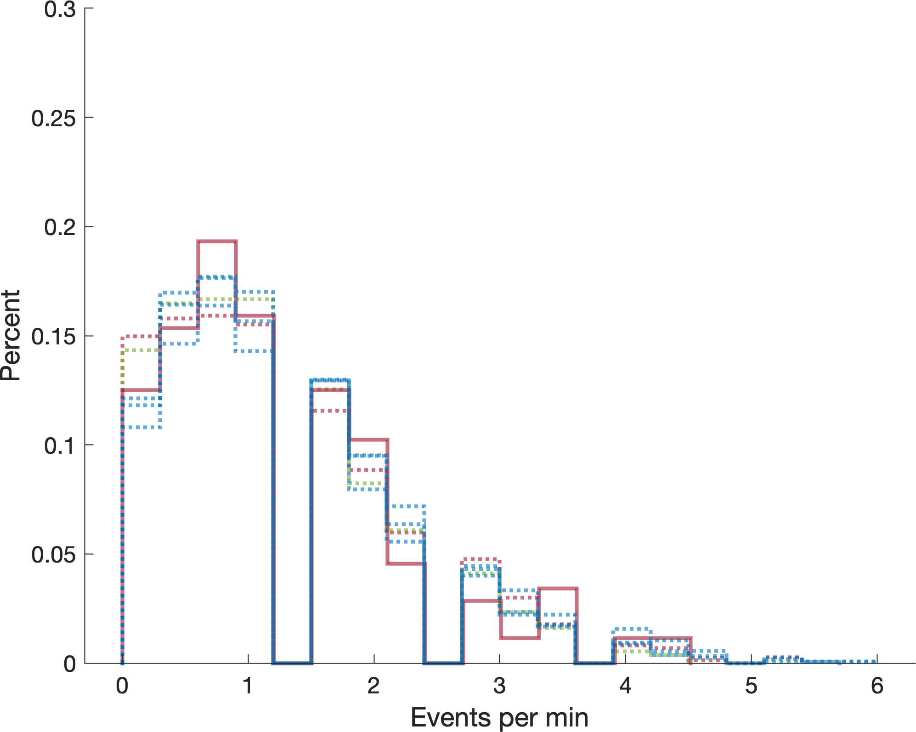
First 2.5 minutes of each experience
+ engram
Fear conditioning
FC engram
Neutral experience
Exploration sessions

Slide 5
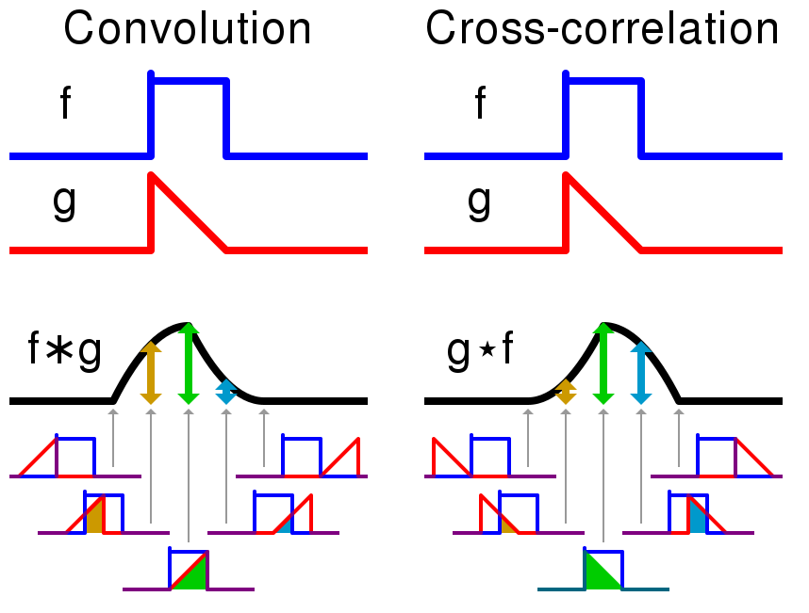
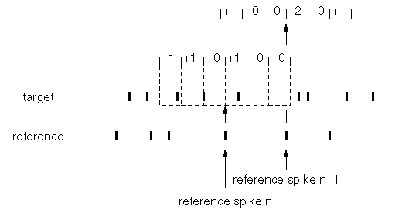
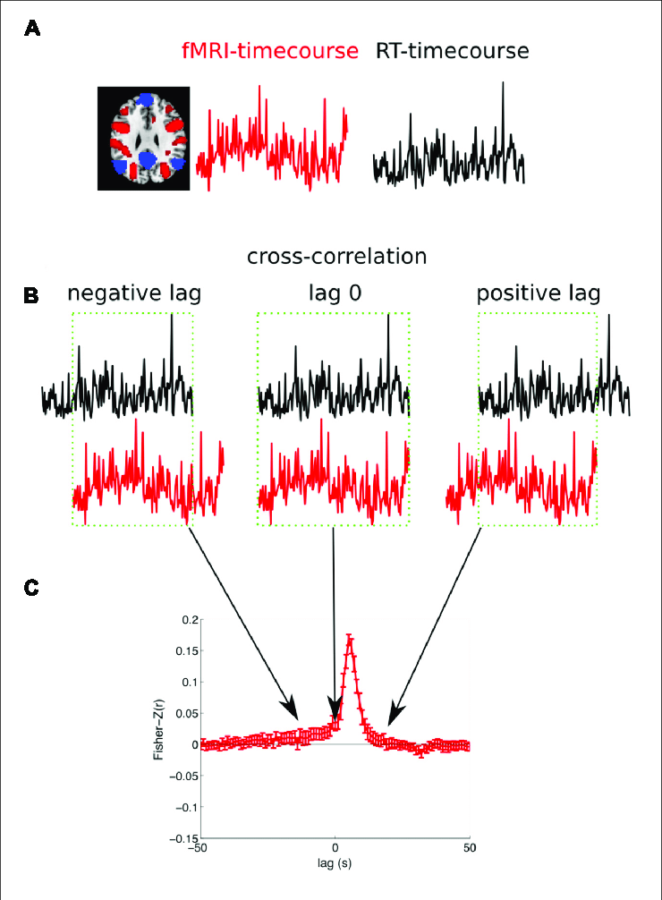
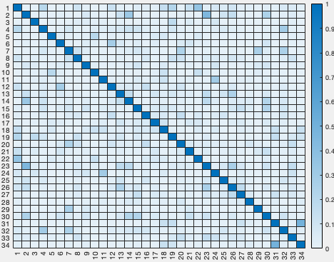
1. What are the network rules for engram allocation in the hippocampus?
Engram neuron cross-correlation coefficients for mouse #1

Slide 6
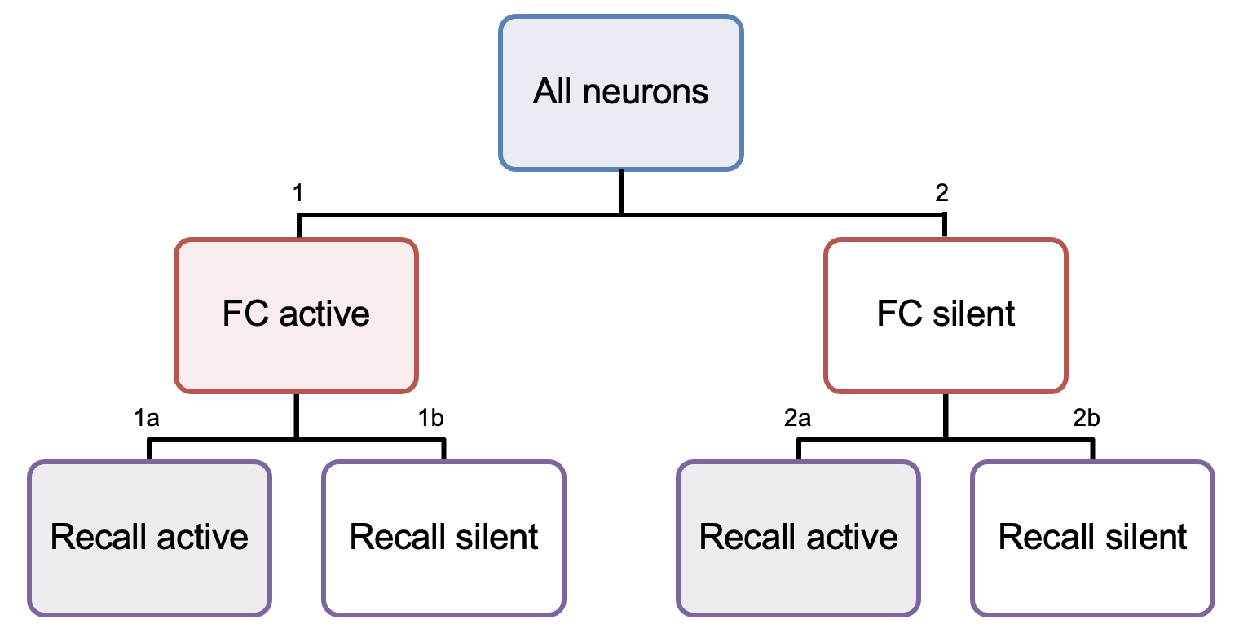
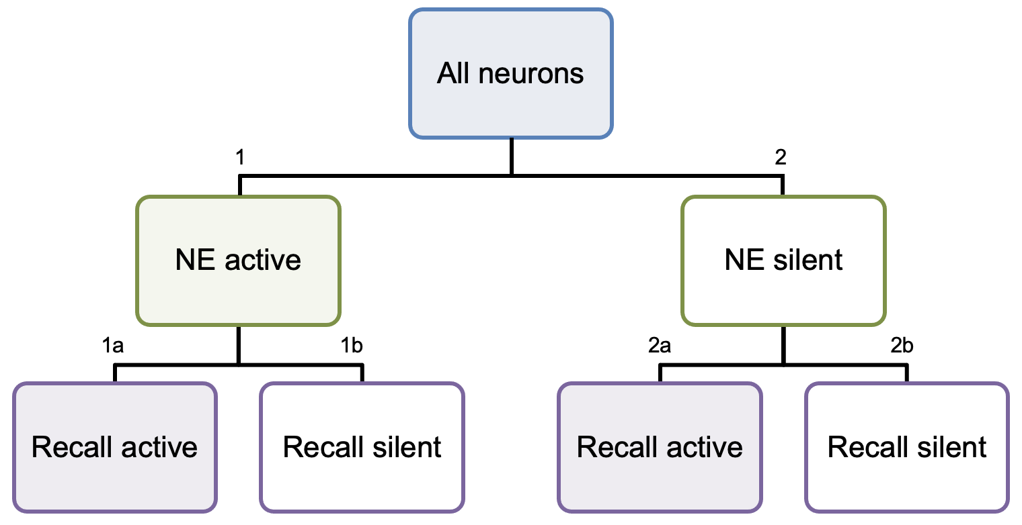
1. What are the network rules for engram allocation in the hippocampus?
The FC engram is more synchronous during FC and recall
FC engram
shuffled peak times
NE engram
shuffled peak times

Slide 7
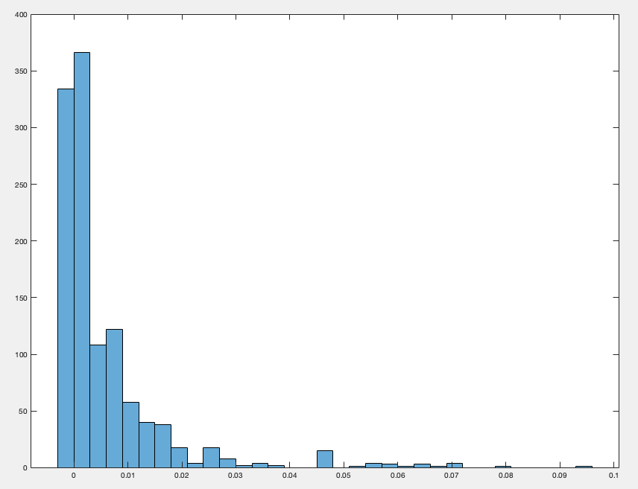
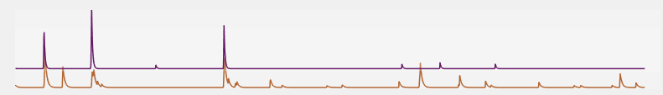



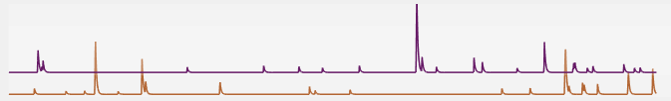

1. What are the network rules for engram allocation in the hippocampus?
Example cell pairs with corr coeff > 0.01
Pair 1
Number of cell pairs
Pair 2
Pair 3
correlation coefficient
Example cell pairs with corr coeff < 0.01
Pair 1
Pair 2
Pair 3

Slide 8
All neurons (FC mice)
vs
All neurons (NE mice)
FC engram vs NE engram
(Pre-shock exploration period)
FC engram vs NE engram
(Days 1-3 Exploration)
FC engram vs NE engram
FC engram
shuffled peak times
NE engram
shuffled peak times

Slide 9
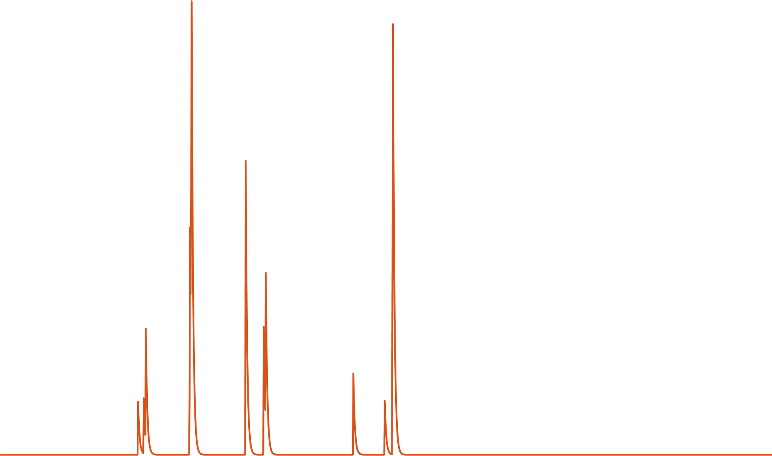

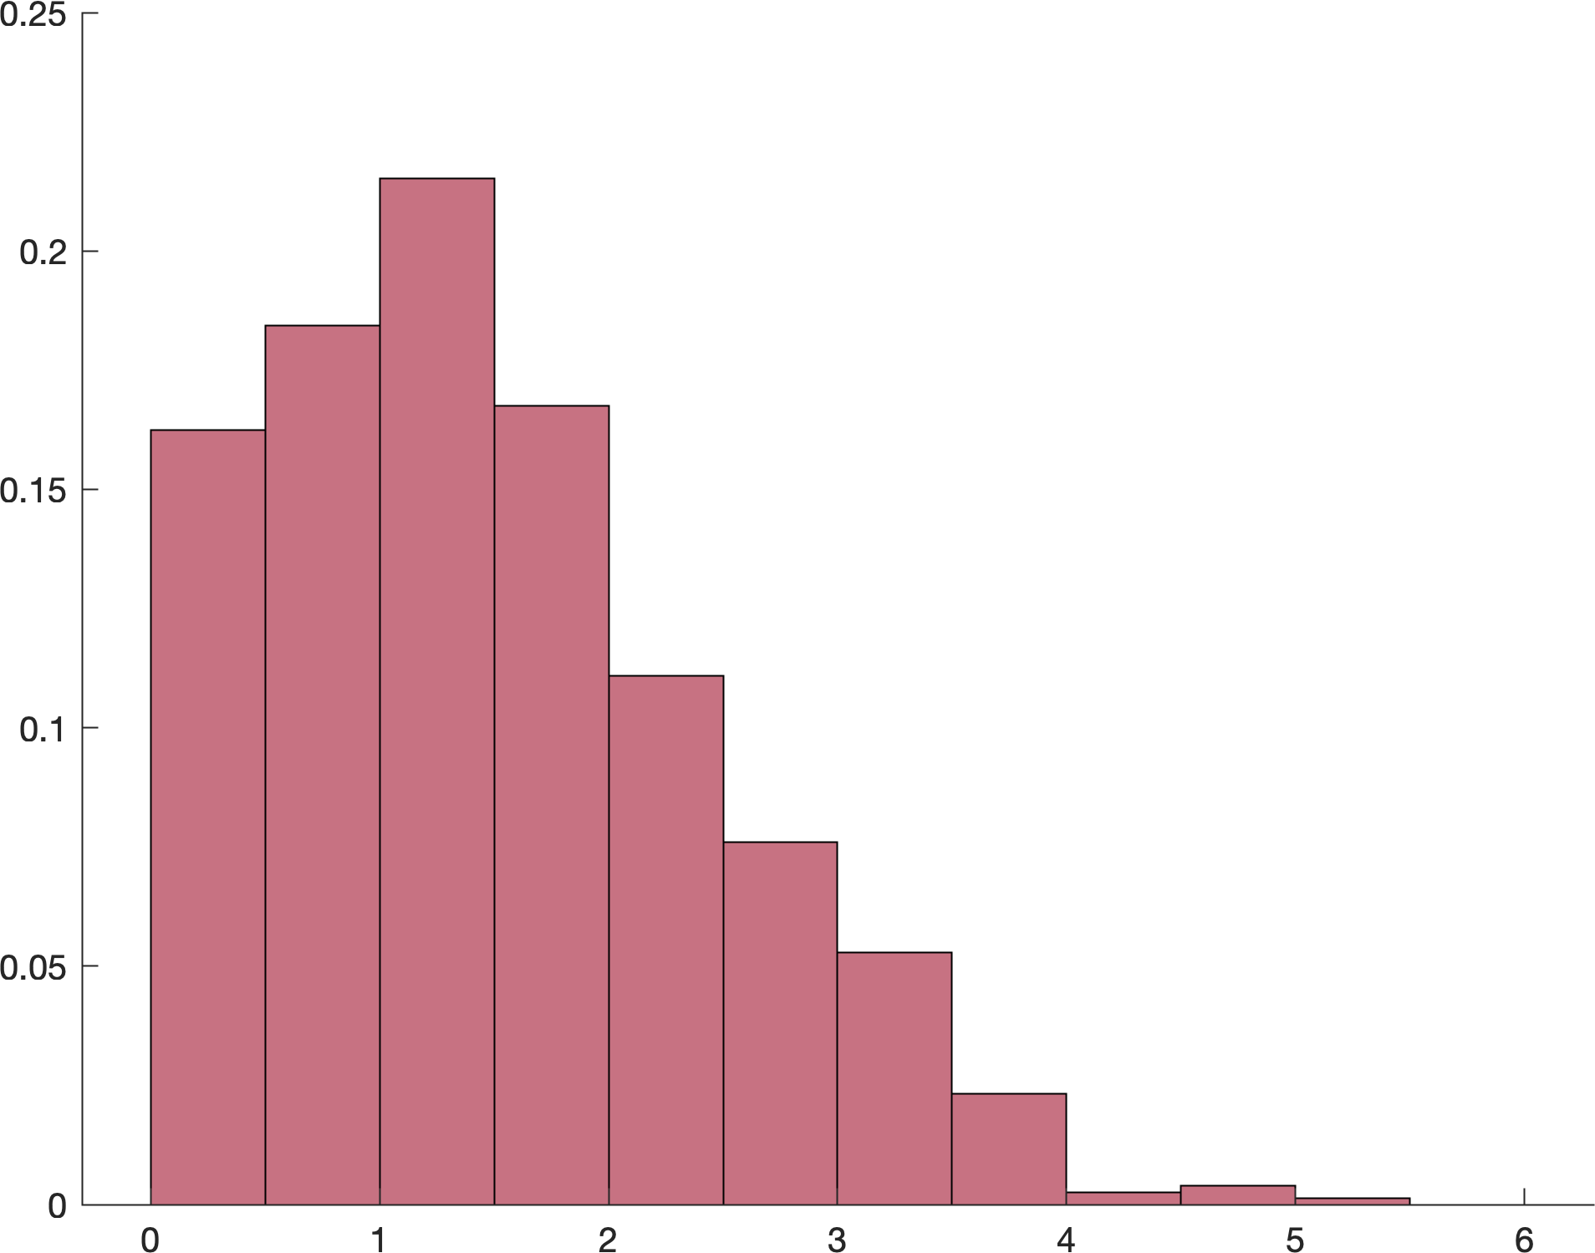
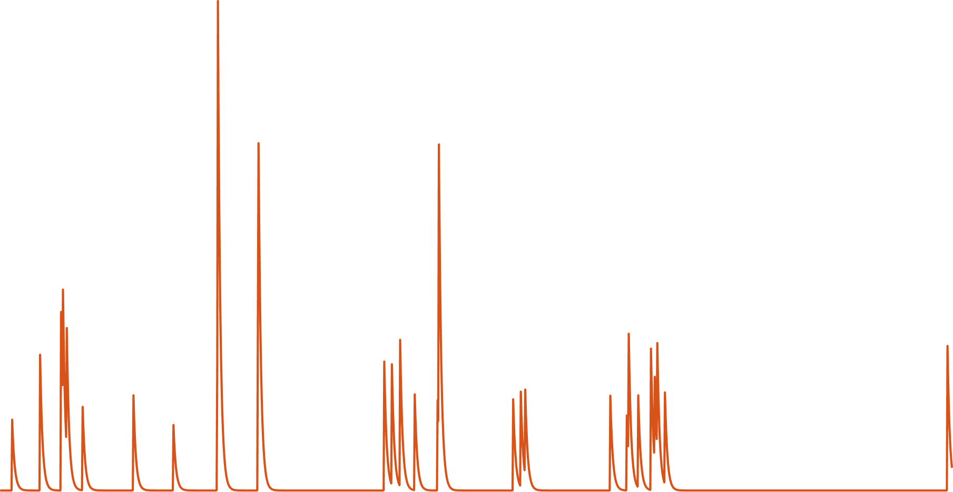
1. What are the network rules for engram allocation in the hippocampus?
Freezing coefficient = 3.27
“Freeze cells” during fear conditioning are > 2X more likely to become engram neurons
95% Bootstrap confidence interval
Probability
Freezing coefficient
Freezing coefficient = 0.29

