Slide 1
How to design microservices architecture

Slide 2
whoami
Omid Pourhadi
Twitter : @omidbiz
http://mupra.ir
opensource contributor

Slide 3
outline
What this talk is about :
Microservices introduction?
Cloud native app (12 factors) introduction
Difference between monolithic and microservices
Tools & frameworks with a demo app
What this talk is not about :
Monitoring
Distributed transactions
Argu the best solution

Slide 4
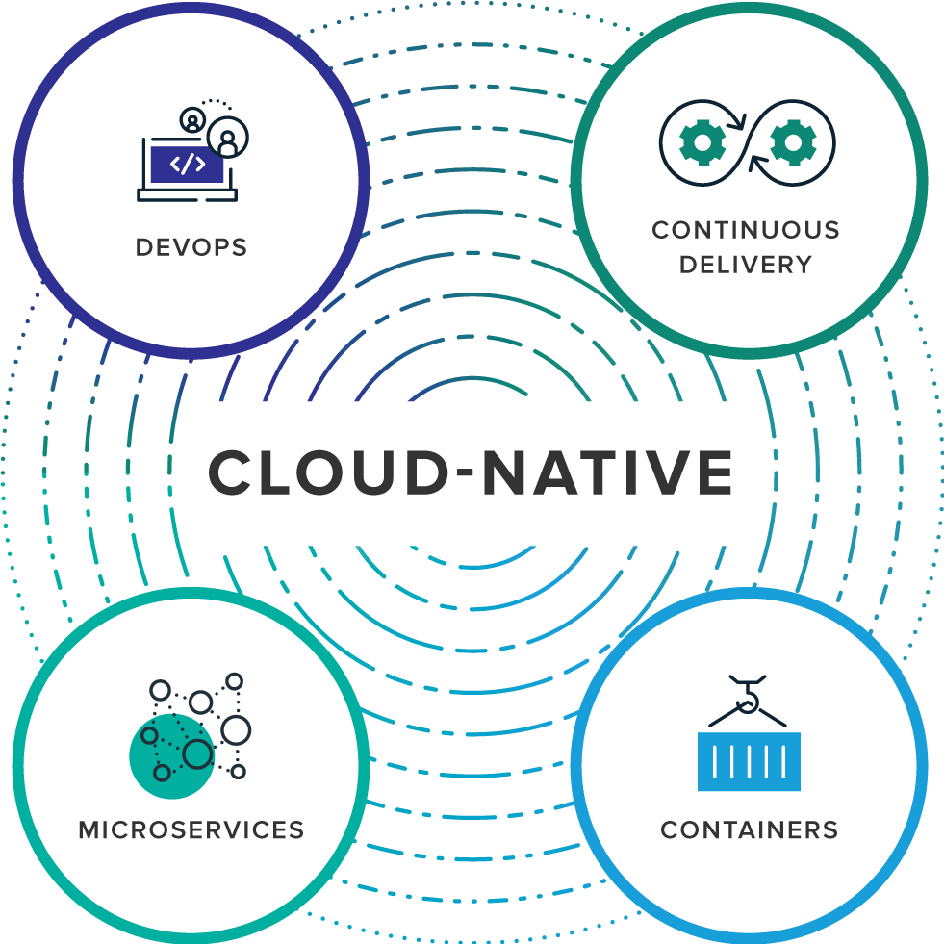
Cloud-Native App (https://12factor.net/)
The twelve-factor app is a methodology for building software-as-a-service
Vertical scaling Vs horizontal scaling

Slide 5
Microservices
Microservices can help create scalable, testable software that can be delivered weekly, not yearly.
Microservices are a software development technique
organizations which design systems are constrained to produce designs which are copies of the communication structures of these organizations. conway law
jeff bezos two pizza rule

Slide 6


Slide 7
Microservices Architecture
DB1
Client1
M1
CQRS, Event sourcing
Message broker
REST
GRPC
DB2
M2
Client2
DB3
M3
e.g : digikala website

Slide 8
Microservices Architecture
Android
API
Gateway
M1
DB
UI
React/Primefaces
M2
Vert.x
REST APIs
M3
IOS
protobuf

Slide 9
API Gateway
Routing
Security
Monitoring
Canarying
Resiliency
Tools
(eureka, hystrix,prometheus, micrometer, zipkin,..)

Slide 10
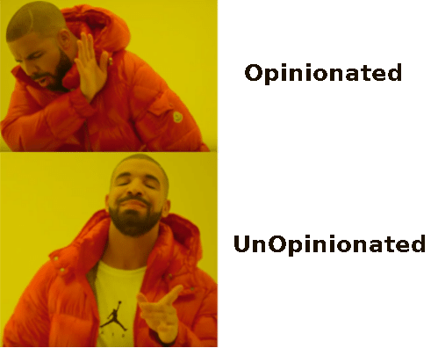

Spring (boot) Framework
Spring boot

Slide 11
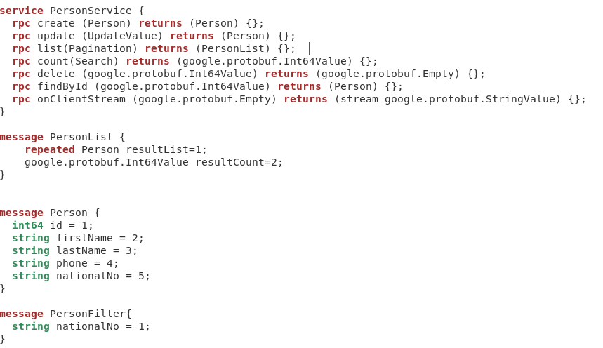
Protocol buffers
Protocol buffers are Google's language-neutral, platform-neutral, extensible mechanism for serializing structured data – think XML, but smaller, faster, and simpler.

Slide 12
GRPC
gRPC is a modern, open source remote procedure call (RPC) framework that can run anywhere. It enables client and server applications to communicate transparently, and makes it easier to build connected systems.
gRPC can use protocol buffers as both its Interface Definition Language (IDL) and as its underlying message interchange format.
In gRPC a client application can directly call methods on a server application on a different machine as if it was a local object, making it easier for you to create distributed applications and services

Slide 13
JSF(Primefaces)
a new standard Java framework for building Web applications. It simplifies development by providing a component-centric approach to developing Java Web user interfaces
implementation : Mojara, Myfaces
Libraries:Richfaces, Primefaces, Openfaces,...

Slide 14
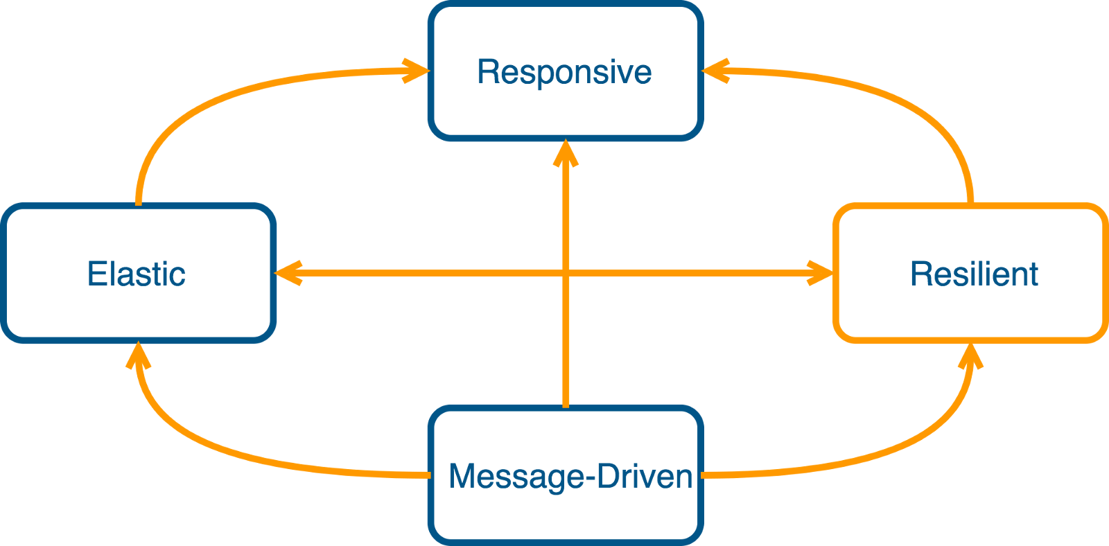
Vert.x
Vert.x is a tool-kit for building reactive applications on the JVM.

Slide 15
Q & A
http://github.com/omidp/grpc-crud
Thank you

