Slide 1

In the name of God 8-puzzle solver
Ap midterm project
Dr.Amir Jahanshahi
Omid razzaghi 9623053

Slide 2
Content
Installation on Docker
BFS and DFS
Help

Slide 3
Installation on Docker container
Dockerfile
Build it
docker build –t CONTAINER_NAME .
Run it
docker run –v %CD%:/usr/src/app –e DISPLAY=192.168.43.23:0.0 –it –-rm CONTAINER_NAME bash -l

Slide 4
BFS and DFS
DFS
BFS

Slide 5
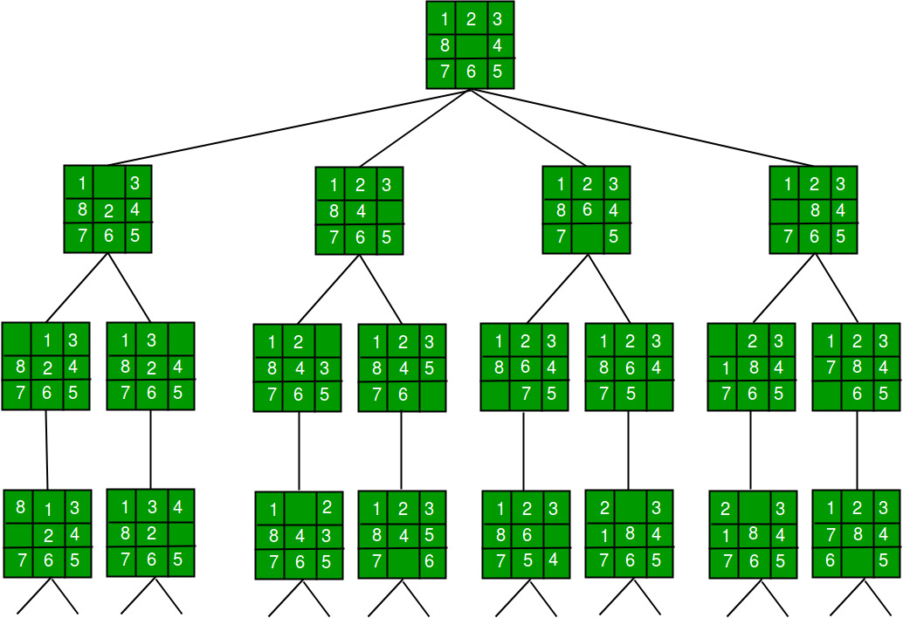
BFS - DFS

Slide 6
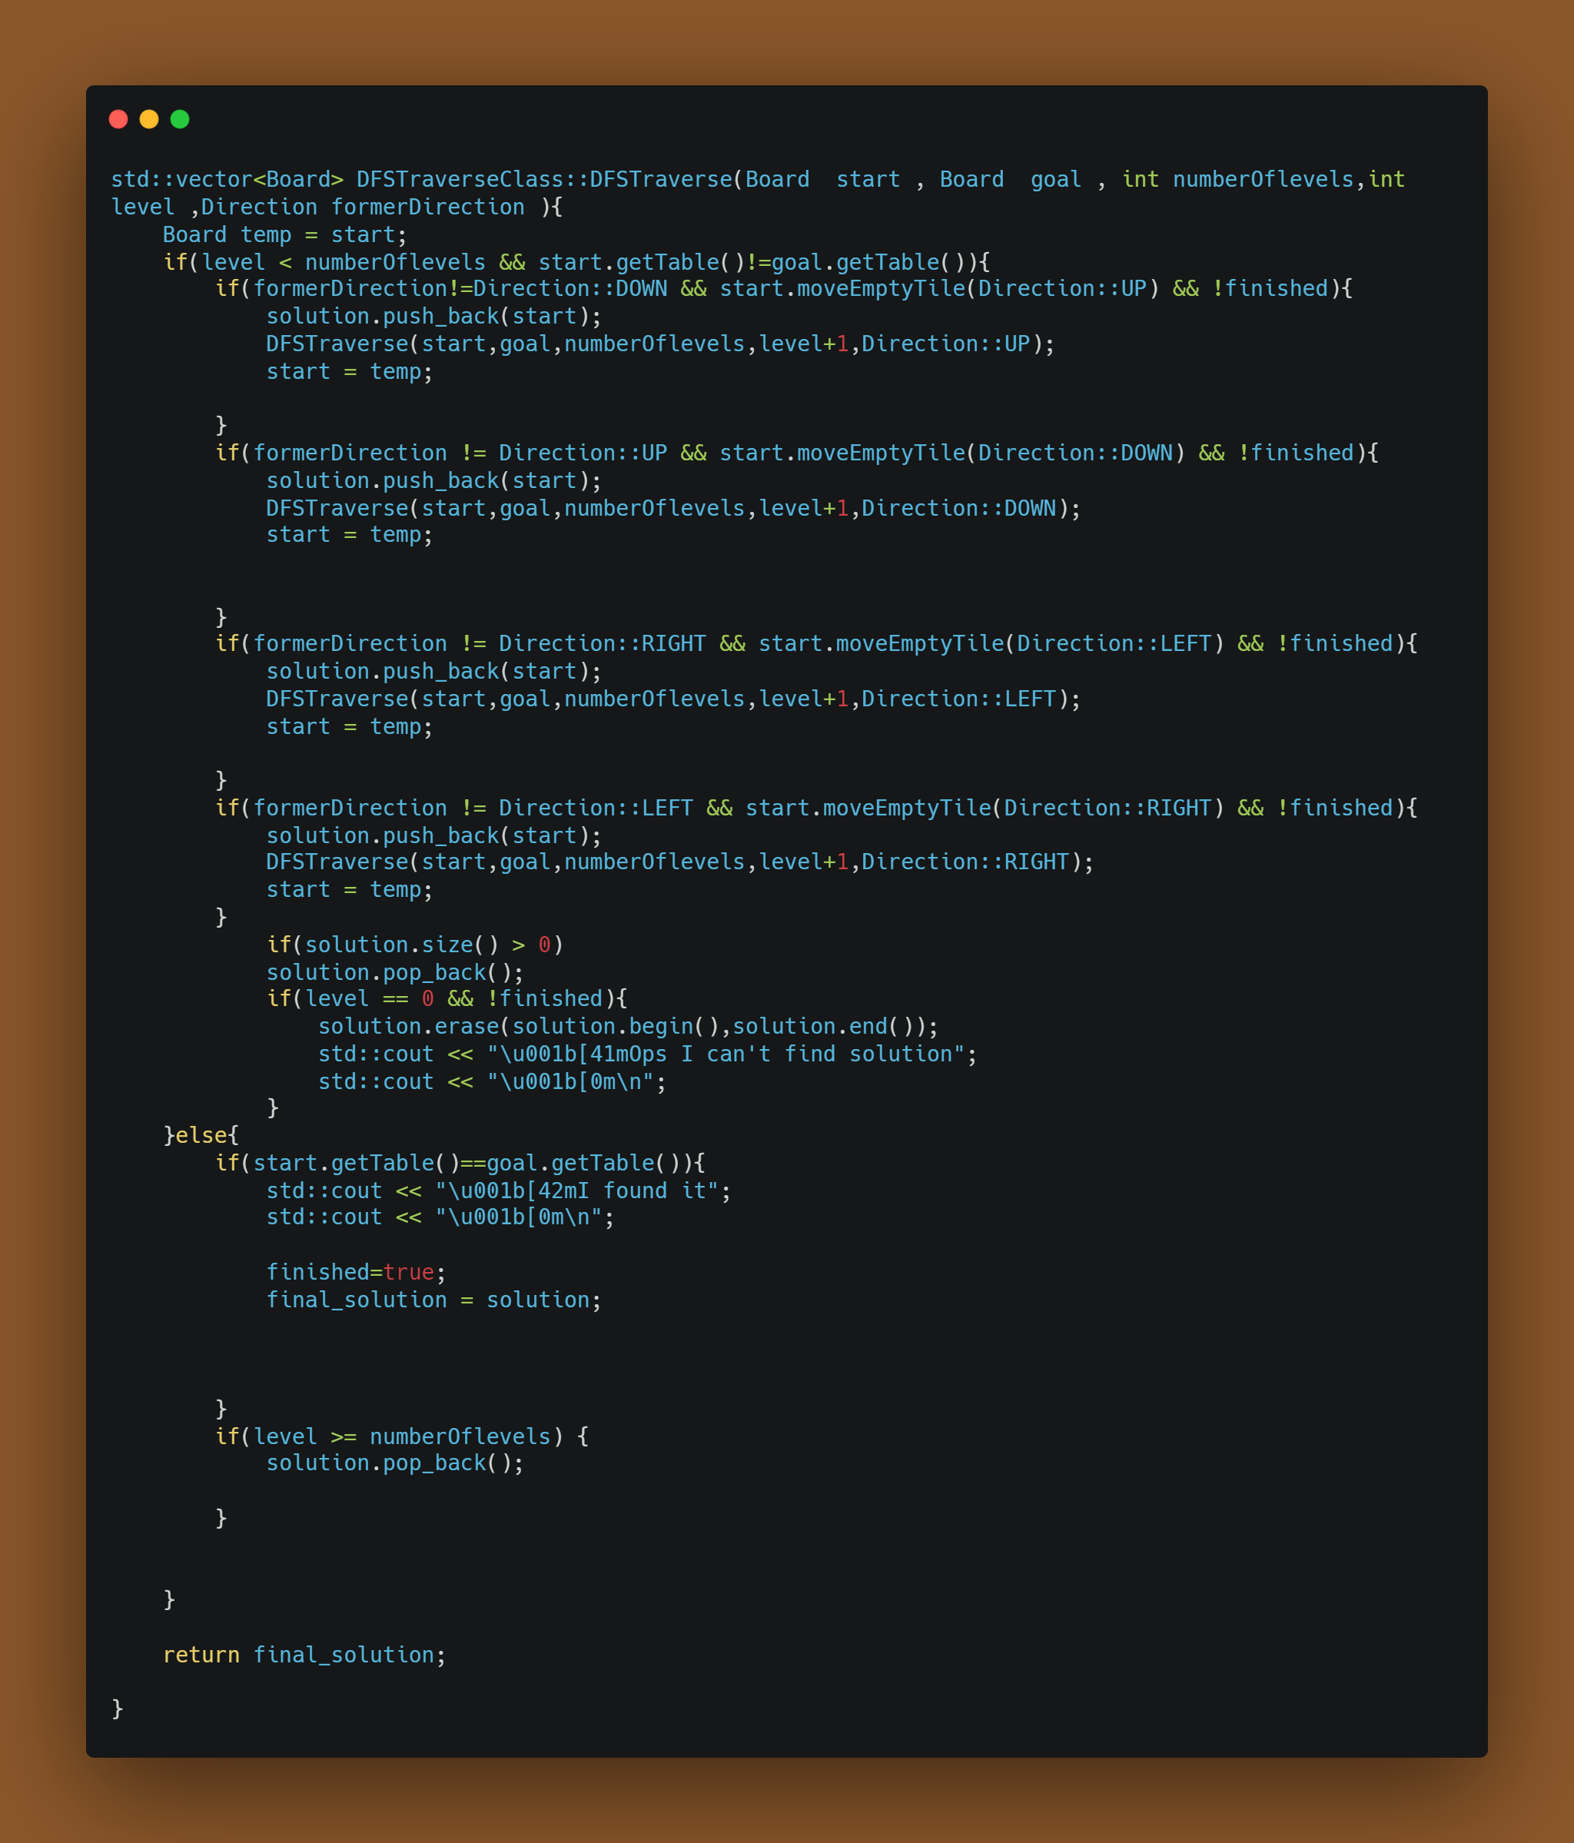
$$DFS\left(root\right)=DFS\left(UP\right)+DFS\left(DOWN\right)+DFS\left(RIGHT\right)+DFS(LEFT)$$

Slide 7
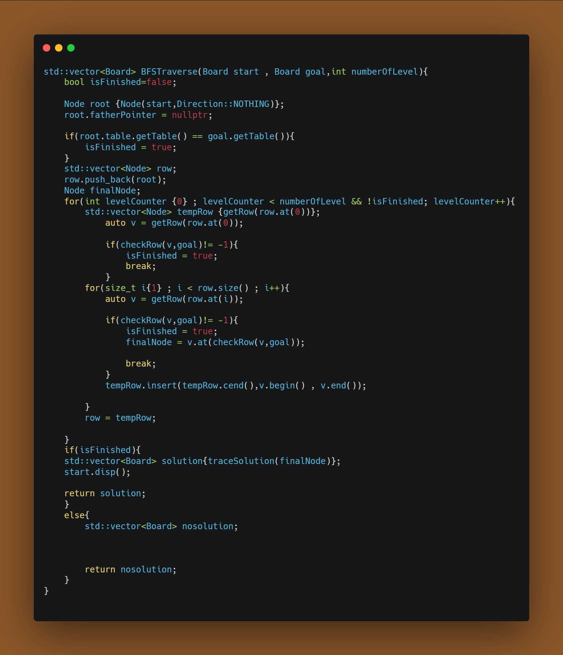

Slide 8
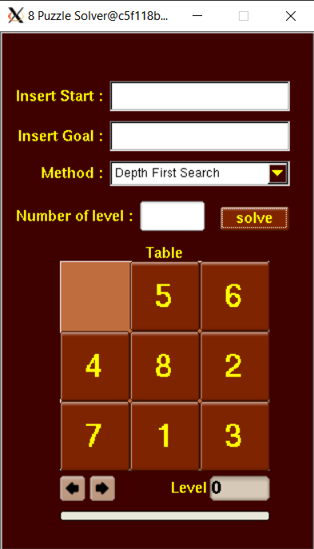
Help

Slide 9
