Slide 1
x1
w1
w2
F(x)
x2
y
°
°
°
wn
xn
b

Slide 2
Input
Perceptron Layer
a = hardlim(n)

Slide 3
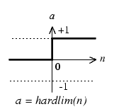
P
a
W
n
1
b
R
S

Slide 4
Input Vector
Input Layer (1)
Hidden Layer (2)
Output Layer (3)
Bias
Inputs

Slide 5
Input Test Image
Adaptive Histogram Equalization [20 20]
Template
Finding Peaks
*
Cell.state
Cross-Correlation

Slide 6
a
+1
n
0
-1
a = logsig(n)

Slide 7
a
+1
n
0
-1
a = tansig(n)

Slide 8
a
+1
n
0
-1
a = purelin(n)

Slide 9
a
+1
n
0
-1
a = hardlim(n)

