Slide 1
Grid
Breakpoint

Slide 2
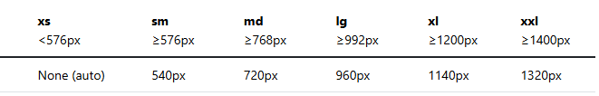
Breakpoint

Slide 3
Row
Display: flex;
Flex-wrap: wrap;

Slide 4
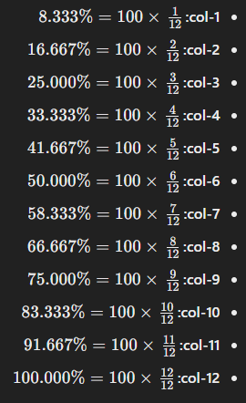
Col

