Slide 1
Grid
Breakpoint

Slide 2
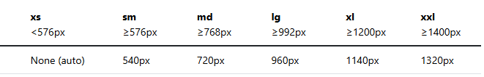
Breakpoint

Slide 3
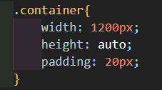
Container

Slide 4
Row
Display: flex;
Flex-wrap: wrap;
Spaces

Slide 5
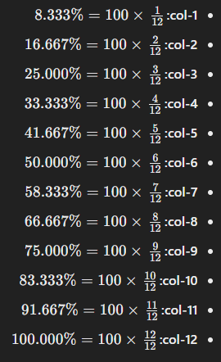
Col

