Slide 1

BY🡺 SNEHAL PURSWANI 107 GIRISH SALUNKE 117 SUSHANT SAWANT 119 AYUSHI SHAH 122
IOT PROJECT
GAS LEAK DETECTOR
To build an ideal, full proof, Budget friendly and Flexible device that can detect gaseous leakage before it reaches a hazardous concentration level and notify the user or the authorities in time to prevent loss of property and life.

Slide 2
INTRODUCTION
As a part of this IoT project we have created :
A cheap gas detector that can detect leakage before it crosses the hazardous level.
Make it simple, portable and battery operated.
The Internet of Things will come into picture to make autonomous alert possible even when the user is not at home.
The gas sensor is highly flexible and can be calibrated to detect any particular gas.
It is designed to detect household gas leaks . However…
This simple device finds it application even in the industries especially chemical plants and factories.

Slide 3


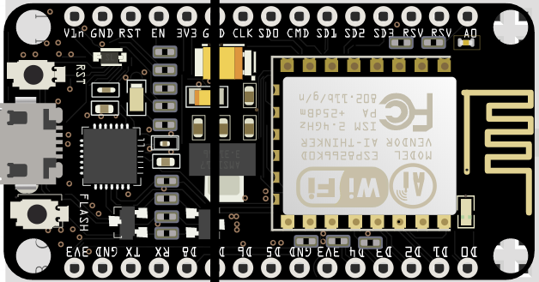







BLOCK DIAGRAM
MQ135
Gas Detector
(Input Device)
O/P
LED AT PIN D2
Send:
Analogue readings to A0 & Digital reading to D0 pin.
O/P
BUZZER AT PIN D4
Arduino Node MCU
Send data
over
WiFi
IOT Platform 1
Ubidots Server
IOT Platform 2
Blynk App Server
User Email
Client
User Smartphone
Push notification Manager
User SMS
Client

Slide 4
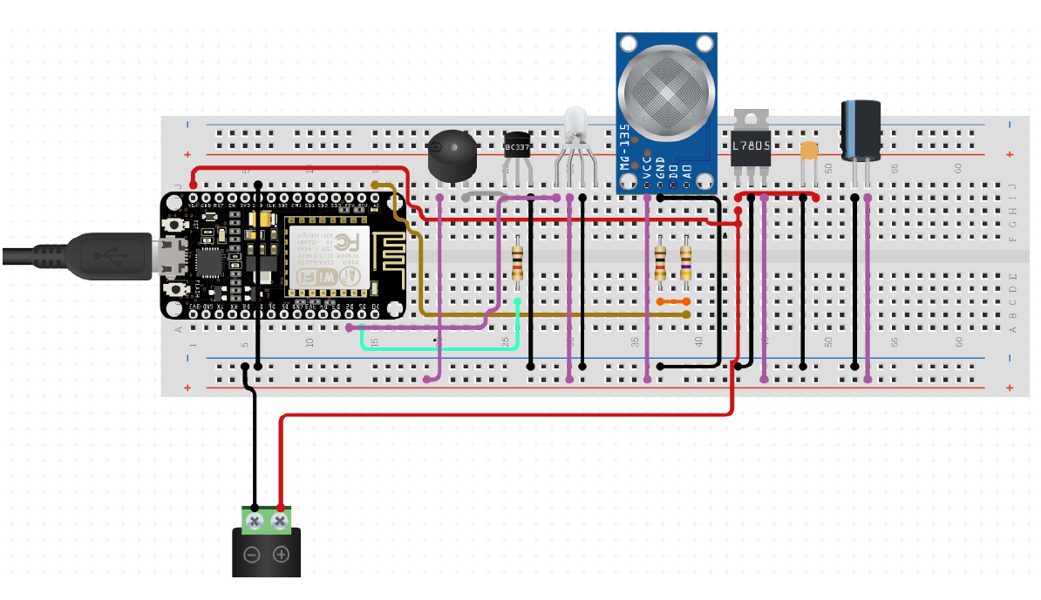
SCHEMATICS
SCHEMATIC DIAGRAM OF THE GAS DETECTOR
(AS CONSTRUCTED ON A BREADBOARD)

Slide 5



CODE (PART 1)
#include "UbidotsMicroESP8266.h"
#include <ESP8266WiFi.h> IoT platform header files
#include <BlynkSimpleEsp8266.h>
#define TOKEN "BBFF-EGEN31ho5xgqOylskN74F6m4pYFjbJ"
char auth[] = "8sl1lR6EMRsWVw-MZtJ-2e0lqytxcy2i";
#define WIFISSID "Girish's $10" WiFi Credentials
#define PASSWORD "12345678"
Ubidots client(TOKEN);
unsigned long lastMillis = 0;
WidgetLED leds(V1);
WidgetLED ledd(V2); Virtual Led configuration for Blynk App
BlynkTimer timer;
int LDR = A0;
int ldr_data = 0;
int buzer= 4;
int flag=0; Initialisation of variables and pin constants.
int sig=1;
int led=2 ;
void setup(){
Serial.begin(115200);
pinMode(LDR, INPUT);
pinMode(led, OUTPUT);
digitalWrite(led,LOW); Configuring pins and initialising them.
digitalWrite(buzer,LOW);
pinMode(buzer,OUTPUT);
delay(10);
Blynk.begin(auth, WIFISSID, PASSWORD);
timer.setInterval(10L, myTimerEvent); Connection to Blynk Using WiFi
client.wifiConnection(WIFISSID, PASSWORD);
}

Slide 6
CODE (PART 2)
void loop(){
Blynk.run();
timer.run();
ldr_data = analogRead(LDR);
sig=digitalRead(16);
if(sig==0){ 26
Serial.println("Accessing the sensor and current sensor value is greater than normal value ");
Serial.print(ldr_data);
Serial.print("DANGER!!!");
digitalWrite(buzer,HIGH);
digitalWrite(led,HIGH);
if(flag==0)
{
Blynk.email("omigirish1999@gmail.com","Gas Leak Alert","A Gas leak is detected in your house.");
Blynk.notify("Gas Leak Detected");
Blynk.virtualWrite(V4, "Gas Leak Detected.");
leds.off();
ledd.on();
flag=1;
}
}
else
{
Serial.println("accessing the sensor and current sensor value is ");
Serial.print(ldr_data);
Serial.print("every thing is NORMAL!!!");
Blynk.virtualWrite(V4, "NO Gas Leaks Detected.");
digitalWrite(buzer,LOW);
digitalWrite(led,LOW);
flag=0;
leds.on();
ledd.off();
}
client.add("GasLeakage", ldr_data);
client.sendAll(true);
}
void myTimerEvent()
{
Blynk.virtualWrite(V5, ldr_data);
}
Virtual Write function is used to write values and data to Elements on the Blynk App UI.
Notify function sends out a push notification.
Email function sends an email.
The methods of client object are used to send data to Ubidots.

Slide 7
CONCLUSION
CONCLUSION
The project has proposed the idea of Gas Leakage Alert System that can support an email based electronic Alert System. A Gas Leak Alert System contains a connection between wireless communication, sensors, monitoring and sending email. Gas leak Alert System includes technologies and applications that can be used to provide efficiency and control of receiving mail easily. A alarm is a device that detects the presence of gas leak and atmospheric changes relating to smoke. The alarm operates to alert people to evacuate a location in which a gas accumulation is present after opening windows and turning of electric supply. When functioning properly, an alarm will sound to notify the people of an immediate fire emergency. This distinct sound exists to allow notifications to be heard. The alarm constructed by this work is reliable at low cost. In this project, an efficient approach for Gas Leak alert System was proposed and implemented.
FUTURE SCOPE
There are a variety of enhancements that could be made to this system to achieve greater accuracy in sensing and detection.
We can connect the device somehow to the main Gas supply of the building. Whenever a gas leak is detected the main Gas supply will be cut preventing any mishap.
This sensor can be used in conjunction with a flame sensor to defend against fires.
We can add a GSM Module to reduce dependency on WiFi during emergencies.

Slide 8


Demo Video
IOT
DEMO

