Slide 1
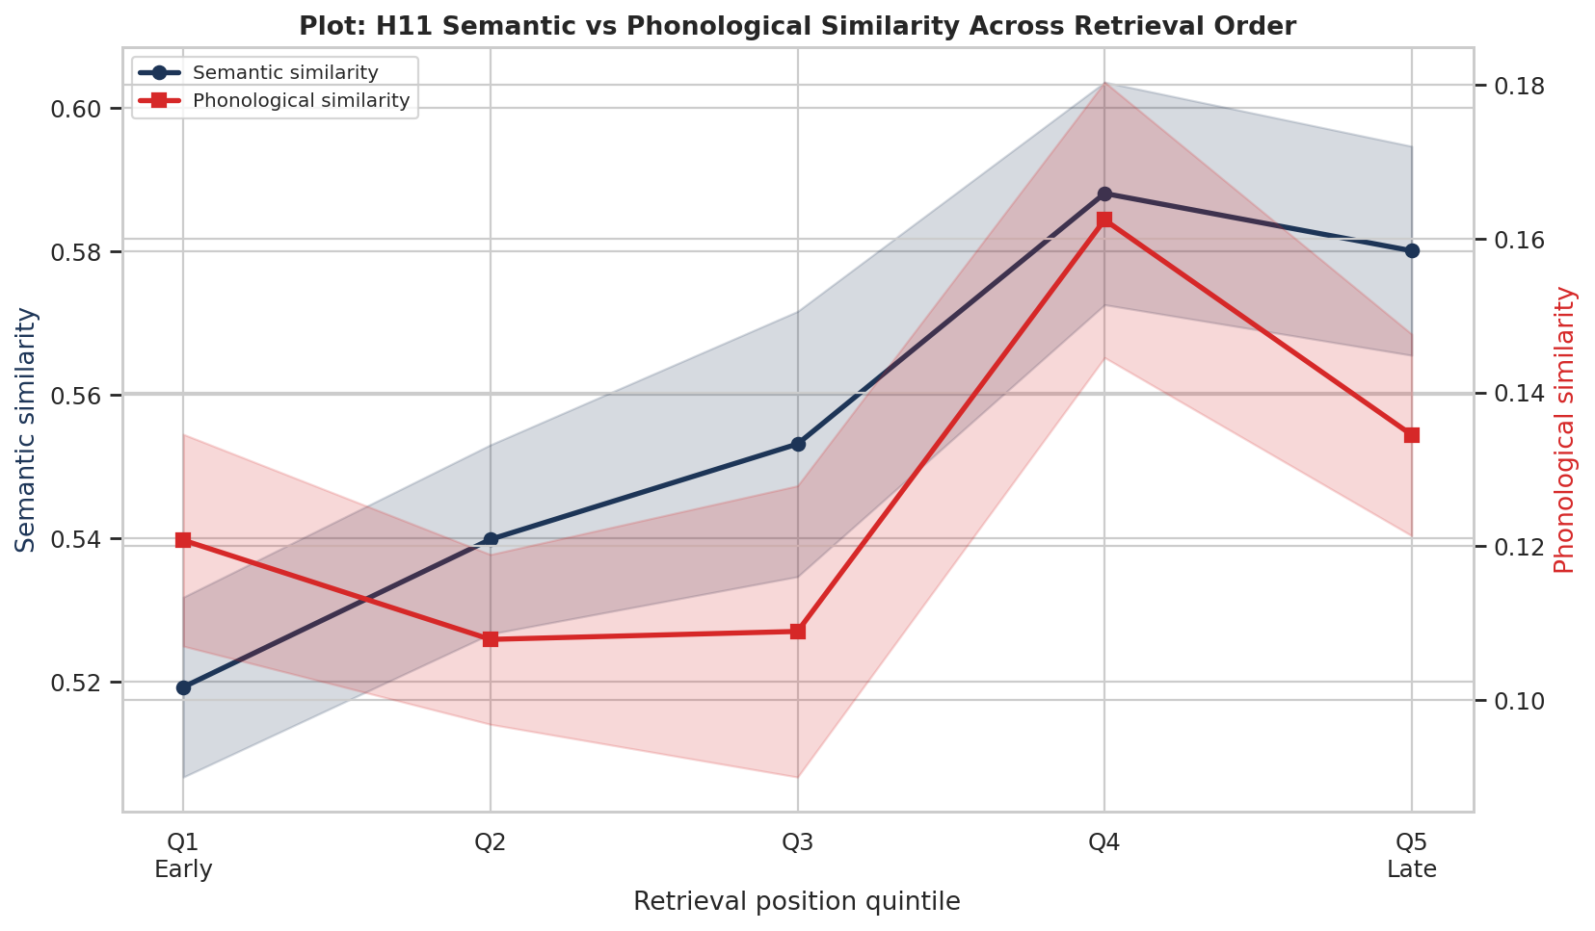
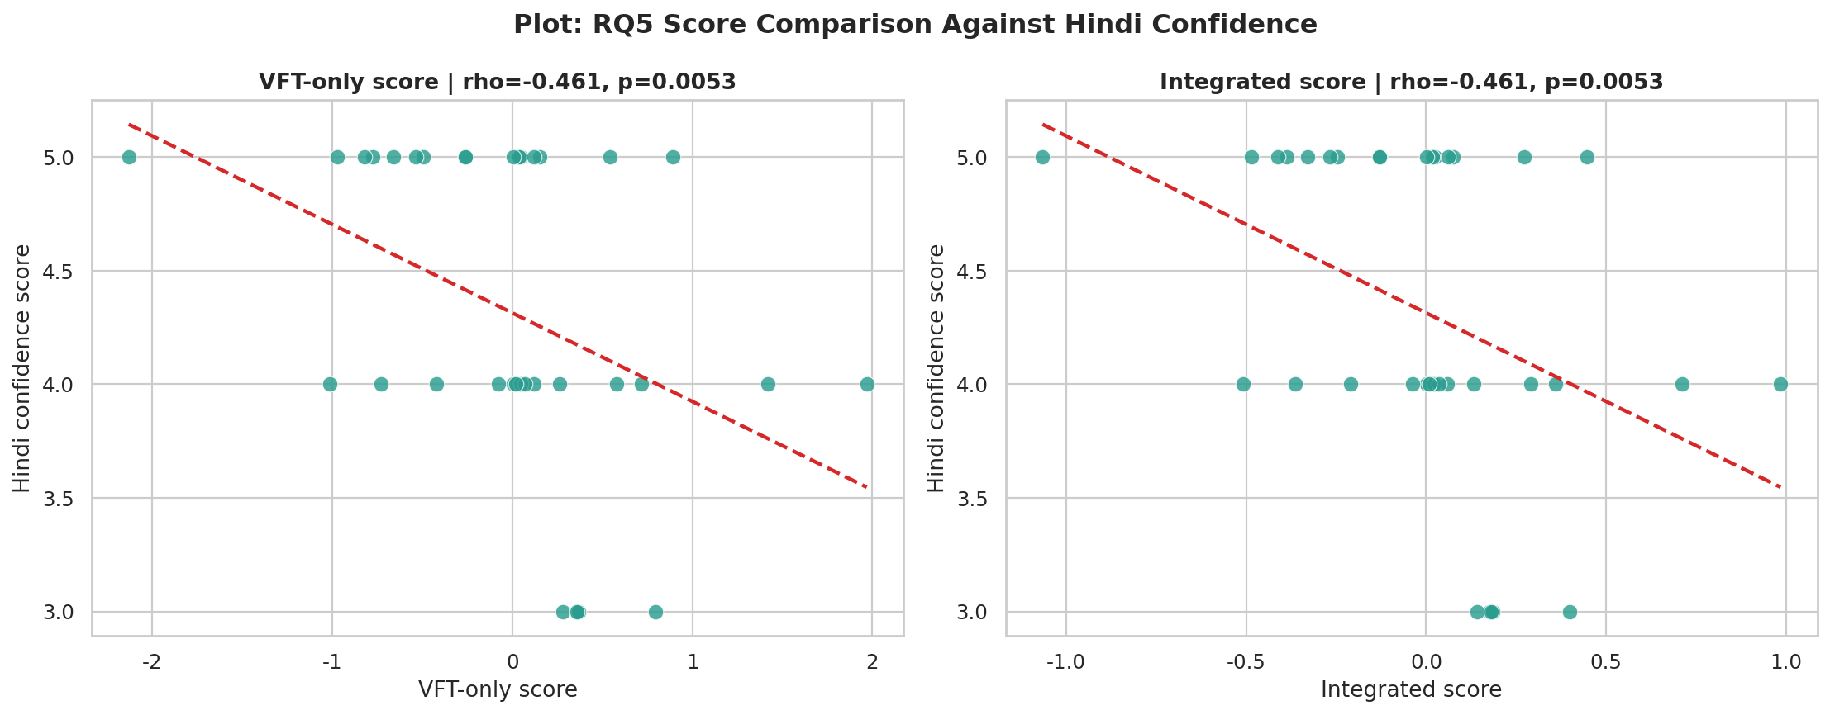
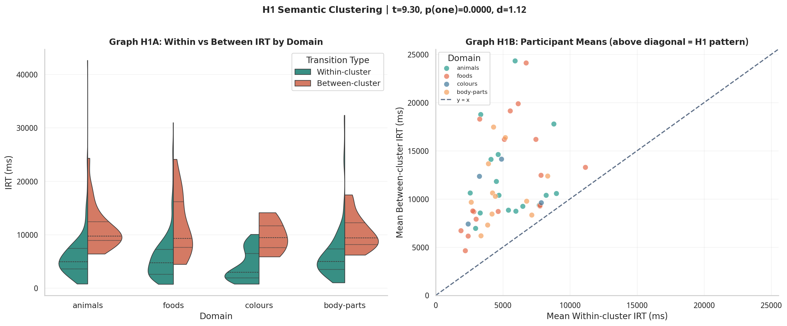
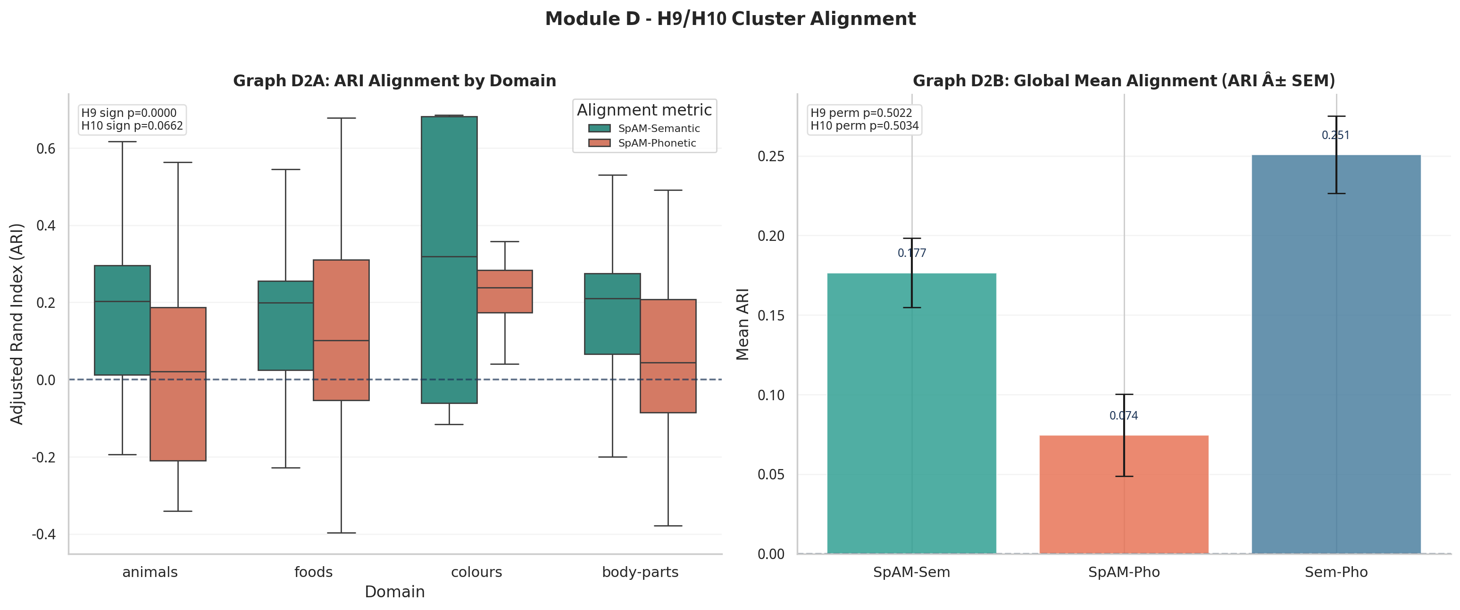
Hindi Verbal Fluency: VFT + SpAM Mental Lexicon Analysis
BRSM 2026 Poster
Team CTRL+ALT+DEL | Akshat Kotadia (2025201005) | Ankit Chavda (2025201045) | Om Mehra (2025201008)
INTRODUCTION + DATASET
HYPOTHESES TABLE (H1-H13)
SEMANTIC VS PHONETIC SUMMARY
- 35 Hindi-English bilingual participants
- VFT: 60-sec word generation in animals/foods/colours/body-parts
- SpAM: participants arranged words by similarity in 2D
- Analysis subset: 723 Hindi/Hinglish responses
- Colours coverage low (n=4), used mainly for descriptive reading
Notebook-derived (MuRIL rerun) values; concise interpretations included.
Semantic similarity: weak-to-moderate structure present (H9 mixed).
Phonetic similarity: no clear confirmatory support (H10/H12 not supported).
Hypothesis (description) | Test used | Result | Signif. | Interpretation
H1: Between-cluster IRT > within-cluster IRT (semantic boundary cost) | Welch t | t=9.30, d=1.12 | p<0.001 | Supported; strong effect.
H2: Positive serial slowing (lexical exhaustion) | Mixed LMEM | No positive slope (0/4 domains) | p>0.05 | Not supported.
H3: Domain effect on total words | Kruskal | H=3.264 | p=0.196 | No domain difference.
H4: Domain effect on IRT | Kruskal | H=3.903 | p=0.142 | No domain difference.
H5: Confidence positively linked to total words | Spearman | rho=-0.395 | p(one)=0.991 | Opposite direction.
H6: Confidence negatively linked to mean IRT | Spearman | rho=+0.276 | p(one)=0.945 | Opposite direction.
H7: Confidence positively linked to cluster size | Spearman | rho=-0.226 | p(one)=0.897 | Opposite direction.
H8: SpAM compactness differs by domain | Kruskal | H=3.445 (all), H=3.315 (excl. colours) | p=0.328/0.191 | Not supported.
H9: Semantic ARI above chance | Sign + Perm. | 68/86 positive; mean ARI=0.1765 | sign<0.001, perm=0.502 | Mixed/inconclusive.
H10: Phonetic ARI above chance | Sign + Perm. | 52/86 positive; mean ARI=0.0745 | sign=0.066, perm=0.503 | Not supported.
H11: Phon-over-sem similarity increases with position | Mixed model | beta=+0.003127 | p=0.0905 | Not supported.
H12: Higher phonological similarity -> higher productivity | Spearman | rho=+0.114 | p(one)=0.257 | Not supported.
H13: Integrated vs VFT-only correlation differs | Steiger | z=0.000; rho=-0.461 both | p=1.000 | No difference.
RESEARCH QUESTIONS (RQ1-RQ7)
IMPORTANT FIGURE 3 (H11/H12)
RQ1: Do semantic categories differ in productivity (words) or retrieval speed (IRT)? RQ2: Do participant-level factors (Hindi confidence, clustering) predict fluency? RQ3: Does SpAM compactness differ across domains? RQ4: Does participant spatial structure align with semantic or phonetic models? RQ5: Does an integrated VFT+SpAM score outperform VFT-only? RQ6: Does phonological-over-semantic similarity increase over retrieval order? RQ7: Does phonological similarity predict lexical productivity?
Interpretation: no reliable phonological facilitation trend over retrieval order.
IMPORTANT FIGURE 4 (H13)
REFERENCES
1) Troyer, A.K., Moscovitch, M., Winocur, G. (1997). Clustering and switching as two components of verbal fluency.
2) Kumar et al. (2022). Phonological and semantic dynamics in verbal fluency retrieval.
3) Kruskal, W.H., Wallis, W.A. (1952). Use of ranks in one-criterion variance analysis.
4) Steiger, J.H. (1980). Tests for comparing dependent correlations.
5) Source artifacts: Hindi_fluency_final.ipynb; deep-research-report (1).md.
Interpretation: integrated score does not show significant gain over VFT-only score.
METHODOLOGY + TRANSFORMERS
IMPORTANT FIGURE 1 (H1)
DISCUSSION + CONCLUSION
1) Merge VFT + SpAM + survey; keep Hindi/Hinglish rows.
2) Compute total words, IRT, cluster metrics, and compactness.
3) Normality checks (Shapiro), then robust/non-parametric tests.
4) H1 Welch t; H2 mixed models; H3/H4/H8 Kruskal; H5-H7/H12 Spearman.
5) H9/H10: sign + permutation tests; H13: Steiger test.
Model/preprocessing updates:
- Semantic model: google/muril-base-cased
- Devanagari kept in native script (no Devanagari-to-Latin conversion)
- Clustering/alignment via KMeans/Agglomerative/HDBSCAN + ARI/NMI
- Strongest and most reliable result is semantic clustering boundary cost (H1).
- Domain differences and confidence-linked effects were not statistically reliable.
- Sample size and confidence ceiling can suppress detectable associations.
- Semantic organisation appears clearer than phonetic organisation here.
Final conclusion: Hindi lexical retrieval is semantically structured,
but most secondary hypotheses remain unsupported in this dataset.
Interpretation: between-cluster pause is clearly higher than within-cluster pause.
IMPORTANT FIGURE 2 (H9/H10)
Interpretation: semantic ARI tends to be above phonetic ARI, but effect is modest.
VFT=Verbal Fluency Task | SpAM=Spatial Arrangement Method | IRT=Inter-Response Time | Semantic + Phonetic Similarity Both Included

