Slide 1
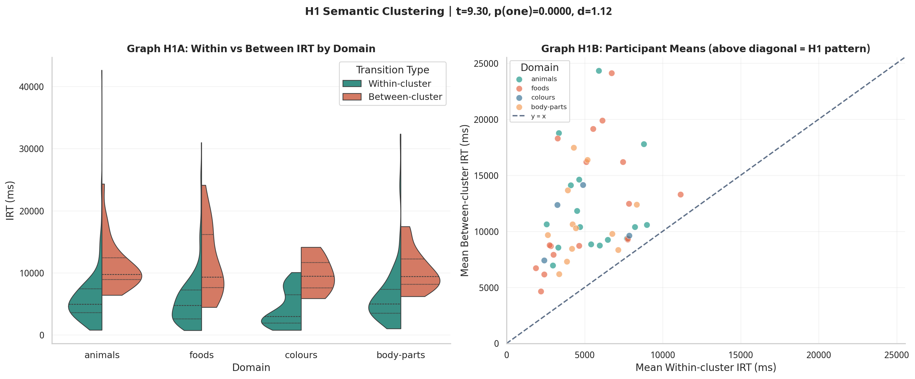
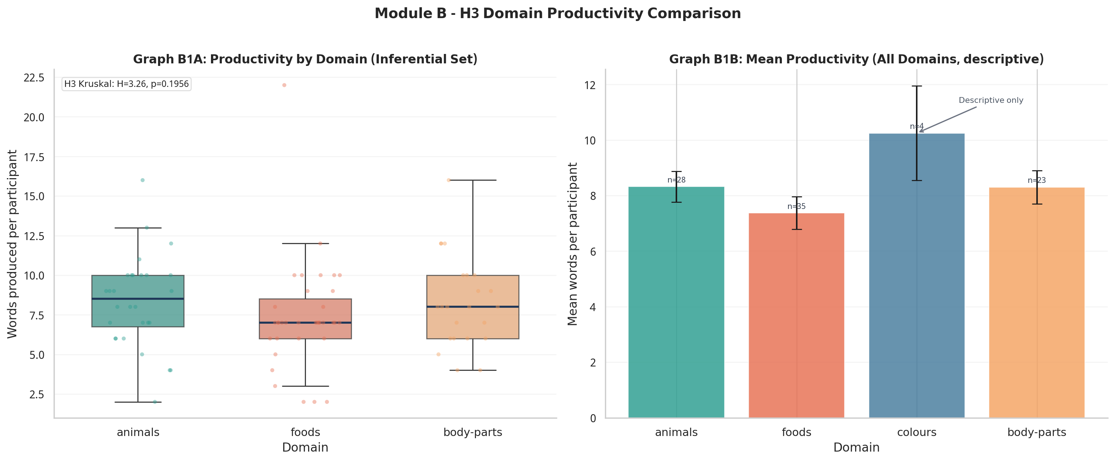
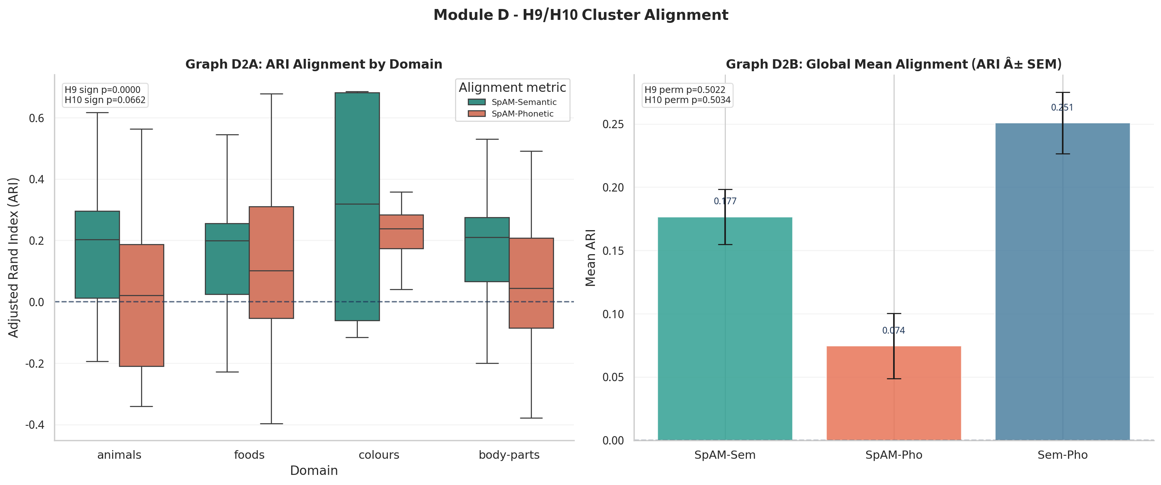
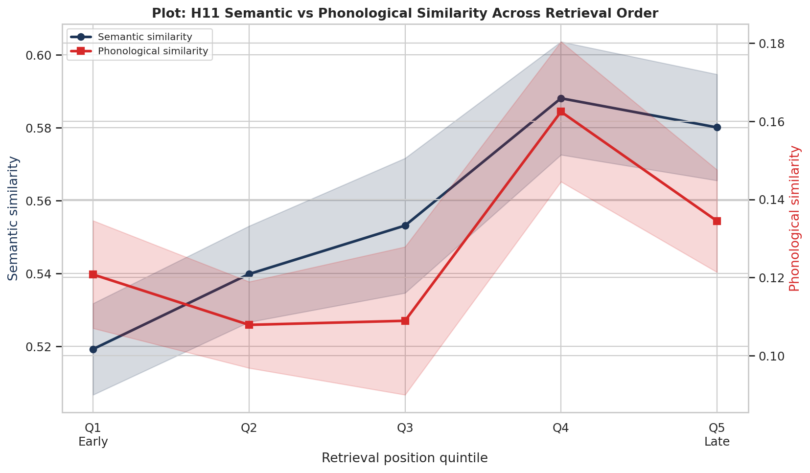
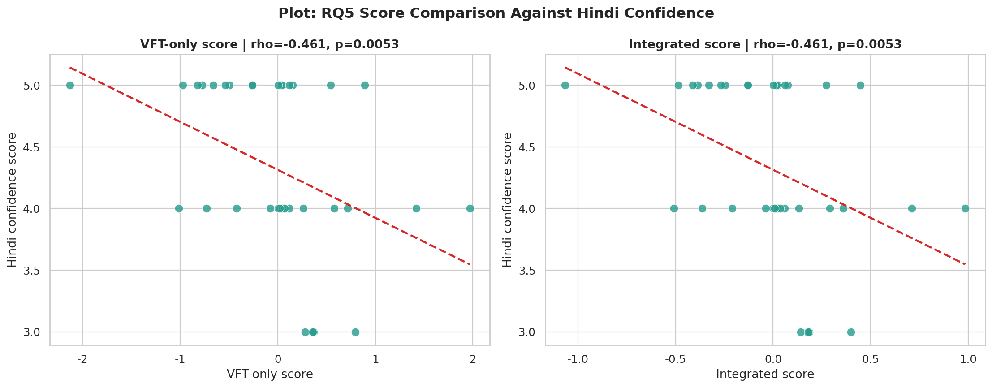

Hindi Verbal Fluency and Semantic Search: VFT + SpAM Analysis
BRSM 2026 Poster
Team CTRL+ALT+DEL | Akshat Kotadia (2025201005), Ankit Chavda (2025201045), Om Mehra (2025201008)
Introduction + Dataset
Methodology (Notebook Pipeline)
Models and Similarity Signals
Study setup: - 35 Hindi-English bilingual participants - VFT: 60 sec word generation in 4 domains - SpAM: 2D arrangement by similarity - Exit poll: self-rated Hindi confidence Dataset used in analysis: - 723 Hindi/Hinglish responses (from merged dataset) - Colours domain has very low coverage (n=4), so we keep it mainly descriptive Prior literature we followed: - Troyer et al.: semantic cluster and switching cost - Dautriche et al.: word-form similarity can affect search - Kumar et al.: possible semantic-to-phonological shift
1. Merge VFT + SpAM + survey data; keep Hindi/Hinglish rows. 2. Compute word counts, IRT, cluster size, switch count, spatial compactness. 3. Normality check (Shapiro-Wilk), then choose proper inferential tests. 4. H1: Welch t-test for within vs between cluster IRT. 5. H2/H11: mixed-effects models over retrieval position. 6. H3/H4/H8: Kruskal-Wallis across domains. 7. H5-H7 and H12: Spearman one-tailed tests. 8. H9/H10: ARI with sign test and permutation checks. 9. H13: Steiger test for dependent correlations.
Transformer used: - sentence-transformers/paraphrase-multilingual-MiniLM-L12-v2 - 384-d vectors for Hindi + Hinglish words Purpose: - semantic similarity space for clustering and ARI alignment - phonetic-key space (consonant-skeleton representation) for sound similarity checks Extra modelling: - FastText geometry in extended neighbourhood analysis - ARI/NMI for semantic and phonetic cluster agreement Simple take: semantic signal is present; phonetic signal is weak in this sample.
Results Table: All RQ, Hypotheses, Tests and Outcomes (from notebook outputs)
RQ | Hyp | Test | Result | Decision
Found. | H1 | Welch t (one-tailed) | Within 5841.9 vs between 10960.3 ms; t=9.2995, p<0.0001, d=1.1206 | Supported
Found. | H2 | MixedLM rt~position | Animals/Foods/Body slopes negative; colours +364.4 (p=0.0549); 0/4 domains pass | Not supported
RQ1 | H3 | Kruskal-Wallis | Word count across animals, foods, body-parts: H=3.2639, p=0.1956 | Not supported
RQ1 | H4 | Kruskal-Wallis | IRT across animals, foods, body-parts: H=3.9028, p=0.1421 | Not supported
RQ2 | H5 | Spearman one-tailed | Confidence vs total words: rho=-0.3951, p(one)=0.9906 | Not supported
RQ2 | H6 | Spearman one-tailed | Confidence vs mean IRT: rho=+0.2755, p(one)=0.9454 | Not supported
RQ2 | H7 | Spearman one-tailed | Confidence vs cluster size: rho=-0.2259, p(one)=0.8969 | Not supported
RQ3 | H8 | Kruskal-Wallis | SpAM compactness: H=3.4451, p=0.3280 (all domains); sensitivity p=0.1906 | Not supported
RQ4 | H9 | ARI sign + permutation | Semantic alignment: N=86, positives=68, sign p<0.0001, mean ARI=0.1765, perm p=0.5022 | Mixed / weak
RQ4 | H10 | ARI sign + permutation | Phonetic alignment: N=86, positives=52, sign p=0.0662, mean ARI=0.0745 | Not supported
RQ6 | H11 | LME similarity~type*pos | Interaction beta=-0.004144, p=0.1028 | Not supported
RQ7 | H12 | Spearman one-tailed | Mean phonological similarity vs productivity: rho=+0.114, p=0.2570 | Not supported
RQ5 | H13 | Steiger Z | VFT rho=-0.461 (p=0.0053) vs Integrated rho=-0.323 (p=0.0586); z=0.724, p=0.4689 | No difference
Key Figures Directly from Notebook Outputs
H1: Between-cluster IRT much higher
H3: Productivity overlap by domain
H9/H10: Semantic vs phonetic ARI
H11/H12: No phonological facilitation
H13: No reliable score advantage
Conclusion: Hindi fluency retrieval shows strong semantic clustering (H1), but most domain, confidence, and phonological hypotheses are not supported in this sample.

