Slide 1
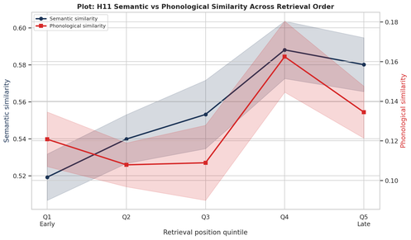
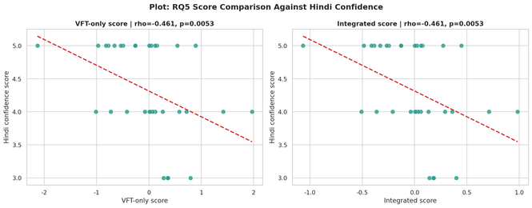
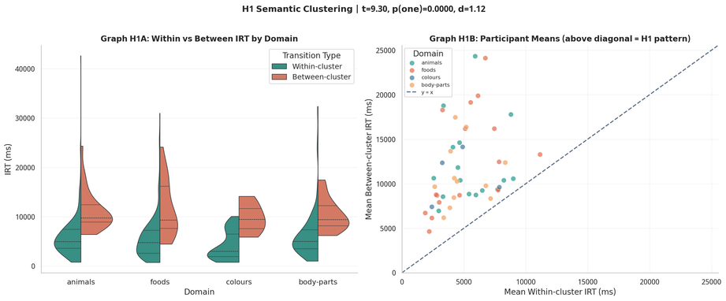
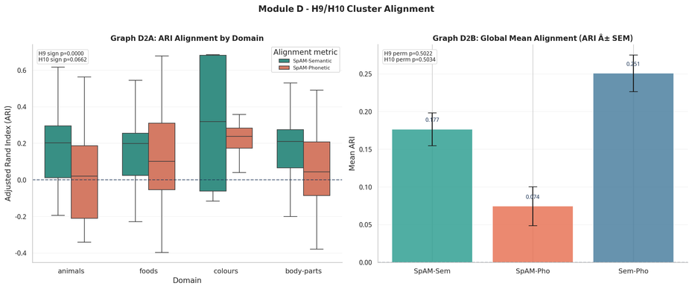
Hindi Verbal Fluency: VFT + SpAM Mental Lexicon Analysis
BRSM PROJECT POSTER PRESENTATION SP 2026
Team CTRL+ALT+DEL | Akshat Kotadia (2025201005) | Ankit Chavda (2025201045) | Om Mehra (2025201008)
INTRODUCTION + DATASET
HYPOTHESES TABLE (H1-H13)
SEMANTIC VS PHONETIC SUMMARY
• 35 Hindi-English bilingual participants
• VFT: 60-sec word generation in animals, foods, colours, body-parts
• SpAM: participants arranged words by similarity in 2D
• Analysis subset: 723 Hindi/Hinglish responses out of 1040
• Colours coverage low (n=4), used mainly for descriptive reading
Hypothesis (description) | Test used | Result | Signif. | Interpretation
H1: Between-cluster IRT > within-cluster IRT (semantic boundary cost) | Welch t | t=9.30, d=1.12 | p<0.001 | Supported strong effect.
H2: Positive serial slowing (lexical exhaustion) | Linear Mixed Effect Models | No positive slope (0/4 domains) | p>0.05 | Not supported.
H3: Domain effect on total words | Kruskal | H=3.264 | p=0.196 | No domain difference.
H4: Domain effect on IRT | Kruskal | H=3.903 | p=0.142 | No domain difference.
H5: Confidence positively linked to total words | Spearman | rho=-0.395 | p(one)=0.991 | Opposite direction.
H6: Confidence negatively linked to mean IRT | Spearman | rho=+0.276 | p(one)=0.945 | Opposite direction.
H7: Confidence positively linked to cluster size | Spearman | rho=-0.226 | p(one)=0.897 | Opposite direction.
H8: SpAM compactness differs by domain | Kruskal | H=3.445 (all), H=3.315 (excl. colours) | p=0.328/0.191 | Not supported.
H9: Semantic ARI above chance | Sign + Perm. | 68/86 positive; mean ARI=0.1765 | sign<0.001, perm=0.502 | Mixed/inconclusive.
H10: Phonetic ARI above chance | Sign + Perm. | 52/86 positive; mean ARI=0.0745 | sign=0.066, perm=0.503 | Not supported.
H11: Phon-over-sem similarity increases with position | Mixed model | beta=+0.003127 | p=0.0905 | Not supported.
H12: Higher phonological similarity -> higher productivity | Spearman | rho=+0.114 | p(one)=0.257 | Not supported.
H13: Integrated vs VFT-only correlation differs | Steiger | z=0.000; rho=-0.461 both | p=1.000 | No difference.
Semantic similarity: weak-to-moderate structure present(H9 mixed).
Phonetic similarity: no clear confirmatory support (H10/H12 not supported).
H11/H12 - FIGURE
PRIOR WORK
• Phonological similarity influences semantic memory retrieval showing that sound structure can bias access to meaning [1].
• Words that are phonologically similar tend to also be semantically related more than expected by chance [2].
• Spatial Arrangement Method efficiently captures human semantic similarity judgements by arranging items based on perceived relatedness [3].
RESEARCH QUESTIONS (RQ1-RQ7)
Interpretation: no reliable phonological facilitation trend over retrieval order.
RQ1: Do semantic categories differ in productivity (words) or retrieval speed (IRT)? - H1, H2, H3, H4
RQ2: Do participant-level factors (Hindi confidence, clustering) predict fluency? - H5, H6, H7
RQ3: Does SpAM compactness differ across domains? - H8
RQ4: Does participant spatial structure align with semantic or phonetic models? - H9, H10
RQ5: Does an integrated VFT+SpAM score outperform VFT-only? - H13
RQ6: Does phonological-over-semantic similarity increase over retrieval order? - H11
RQ7: Does phonological similarity predict lexical productivity? - H12
H13 - FIGURE
H1 - FIGURE
Interpretation: integrated score does not show significant gain over VFT-only score.
DISCUSSION + CONCLUSION
• Strongest and most reliable result is semantic clustering boundary cost (H1).
• Domain differences and confidence-linked effects were not statistically reliable.
• Sample size and confidence ceiling can suppress detectable associations.
• Semantic organisation appears clearer than phonetic organisation here.
Final conclusion: Hindi lexical retrieval is semantically structured, but most secondary hypotheses remain unsupported in this dataset.
METHODOLOGY + TRANSFORMERS
1) Merge VFT + SpAM + survey; keep Hindi/Hinglish rows.
2) Compute total words, IRT, cluster metrics, and compactness.
3) Normality checks (Shapiro), then robust/non-parametric tests.
4) H1 Welch t; H2 mixed models; H3/H4/H8 Kruskal; H5-H7/H12 Spearman.
5) H9/H10: sign + permutation tests; H13: Steiger test.
Model/preprocessing updates:
• Semantic model: google/muril-base-cased
• Devanagari kept in native script (no Devanagari-to-Latin conversion)
• Clustering/alignment via KMeans/Agglomerative/HDBSCAN + ARI/NMI
Interpretation: between-cluster pause is clearly higher than within-cluster pause.
H9/H10 - FIGURE
LIMITATION
• Dataset is too small, even in that, so many English words, which resulted in more lesser data.
• Small and uneven sample across domains (especially colours) limits statistical power and generalizability.
Interpretation: semantic ARI tends to be above phonetic ARI, but effect is modest.
REFERENCES
[1] Kumar et al. (2022) - Phonology in semantic memory retrieval
[2] Dautriche et al. (2016) - Wordform & semantic similarity
[3] Hout et al. (2013) - Spatial Arrangement Method for semantic similarity

