Slide 1
Project Title BUPBuddy: AI-Powered Admission Assistant
Developed by:
Md. Nazmus Sazzad Naiem ID: 2254901041
Jablay Noor Rahman (Omi) ID: 2254901093
Department of ICT Bangladesh University of Professionals (BUP)

Slide 2
Purpose of the Project
Why we made this app:
Admission candidates often feel confused about the admission process at BUP.
Important information like eligibility, program details, and results are scattered across different sources.
BUPBuddy was created to give a central platform that solves this problem.
Our goal is to simplify the entire admission journey and make it easier for every candidate to stay updated.
🗣 "With BUPBuddy, all answers are just one tap away."

Slide 3
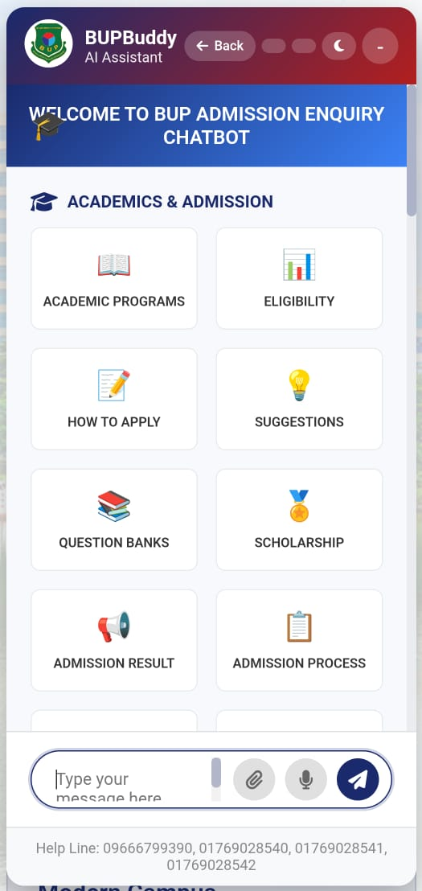
Features of the Project
What BUPBuddy Offers:
🧠 AI Chatbot: Answers admission-related queries instantly.
📘 Academic Info: Program lists, eligibility, and how to apply.
📋 Step-by-step admission process explained.
🎯 Suggestions and helpful resources for candidates.
📝 Question bank, scholarship details, result checking.
📞 Helpline numbers built-in for quick support.

Slide 4
Mobile App Development Tools
Tools used to develop the Android version:
Android Studio – IDE used for building the app.
JAVA – Programming language for app logic and behavior.
XML – Used for designing the layout and user interface.
Emulator Testing – Used to check the app on different Android screen sizes.
Material Design – Google's design system for consistent and attractive UI.
🗣 "We used modern tools to ensure a smooth and friendly experience for users."

Slide 5
Web App Development Tools
Tools used to develop the website:
HTML5 – Structured the content.
CSS3 – Styled the layout and made it responsive.
JavaScript – Made the site interactive and dynamic.
VS Code – Code editor used for writing and testing.
GitHub – For version control and backup.
🗣 "We made sure the web version works well across devices and provides the same helpful features."

Slide 6
Thank You

