Slide 1
Project Presentation
Project members:
Prithviraj Chowdhury-2254901101
Gazi Mohammad Abrar Zawad-2254901049
Jablay Noor Rahman-2254901093
Yusuf Abdullah Alieef-2254901133
Project topic:
Parking Management System

Slide 2
Introduction
The Java code provided above is an example of a parking management system that allows users to reserve and manage parking spots. The code is structured using object-oriented programming concepts and utilizes Java libraries for data storage. The system allows users to create accounts, reserve parking spots, view their reservations, and cancel them if needed. It also includes functionality for administrators to manage parking spots and view reservation statistics. Overall, the code provides a basic framework for a parking management system that can be further developed and customized based on specific requirements.

Slide 3
Code
Vehicle Interface:
// Interface for Vehicle
public interface Vehicle {
public String getPlateNumber();
public void checkIn();
public void checkOut();
}
Explanation:
•public interface Vehicle defines an interface for vehicles that need to be parked.
•public String getPlateNumber() is a method that returns the plate number of the vehicle.
•public void checkIn() is a method that is called when the vehicle checks into the parking lot.
•public void checkOut() is a method that is called when the vehicle checks out of the parking lot.
•The methods are implemented by the car class.

Slide 4
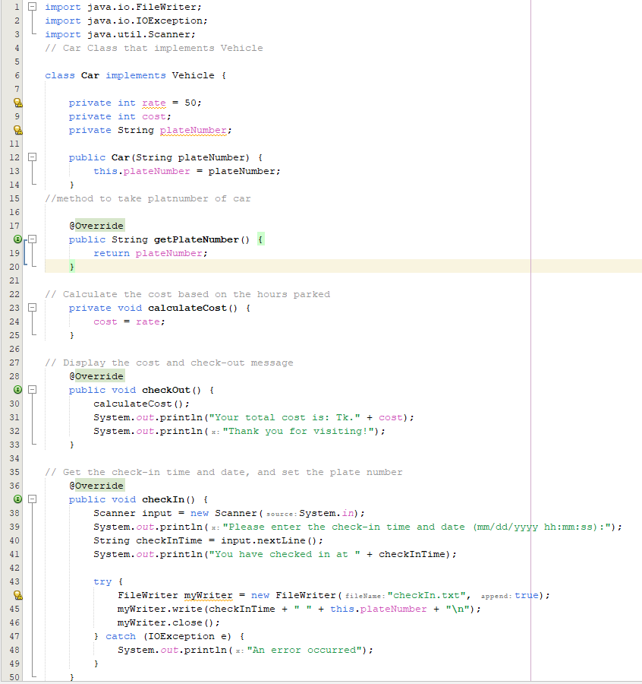
Car class:

Slide 5
Explanation:
•class Car implements Vehicle implements the Vehicle interface and defines a Car object.
•private int rate = 50 is the parking rate per hour for a car.
•private int cost is the total cost of parking the car.
•private String plateNumber is the plate number of the car.
•public Car(String plateNumber) is a constructor that initializes the plate number of the car.
•@Override public String getPlateNumber() is a method that returns the plate number of the car.
•private void calculateCost() is a private method that calculates the parking cost for the car based on the hours parked.
•@Override public void checkOut() is a method that is called when the car checks out of the parking lot. It calculates the cost of parking and displays it along with a checkout message.
•@Override public void checkIn() is a method that is called when the car checks into the parking lot. It prompts the user to enter the check-in time and date, and then writes it along with the plate number to a file.

Slide 6
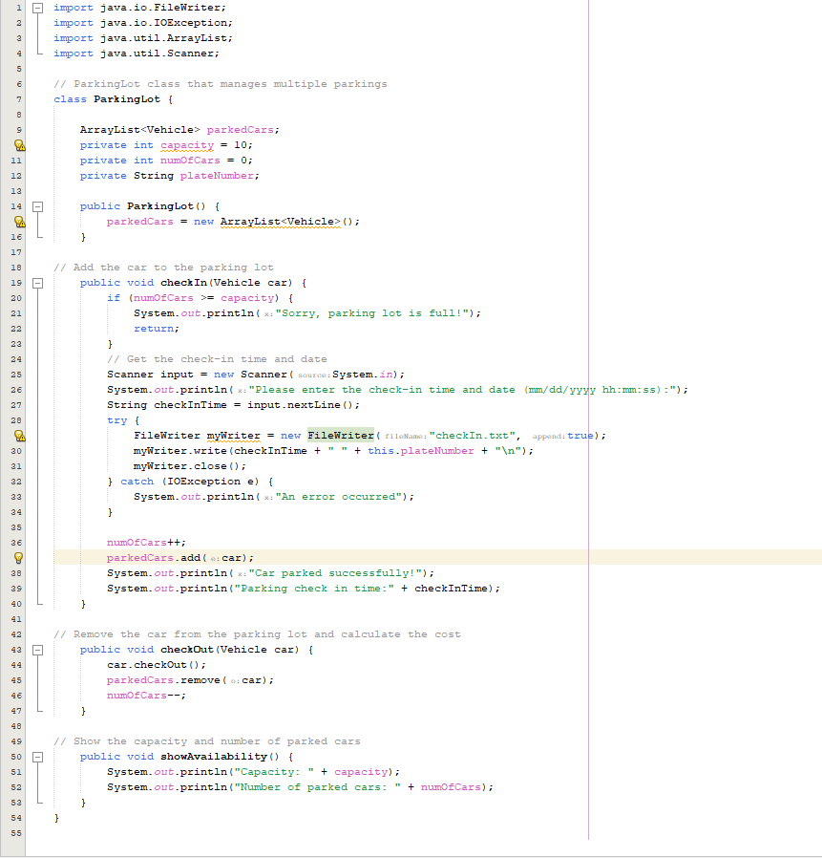
ParkingLot class

Slide 7
Explanation:
class ParkingLot manages the parked cars and the availability of parking spaces.
ArrayList<Vehicle> parkedCars is an ArrayList that stores the parked cars.
private int capacity = 10 is the maximum capacity of the parking lot.
private int numOfCars = 0 is the number of parked cars.
public ParkingLot() is a constructor that initializes an empty parkedCars ArrayList.
public void checkIn(Vehicle car) is a method that adds a car to the parking lot. If the parking lot is full, it displays a message.
public void checkOut(Vehicle car) is a method that removes a car from the parking lot and calls the checkOut() method of the car object.
public void showAvailability() is a method that displays the capacity and number of parked cars.

Slide 8
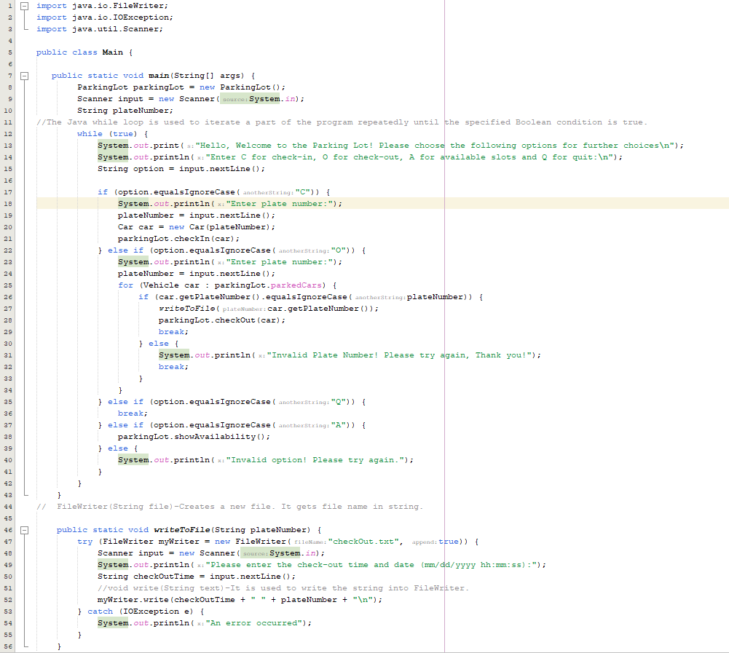
Main class

Slide 9
Explanation:
public class Main is the main class that runs the parking lot program.
public static void main(String[] args) is the main method that runs the program.
ParkingLot parkingLot = new ParkingLot() creates a new instance of the ParkingLot class.
while (true) creates an infinite loop that displays the menu options and prompts the user to choose an option.
if (option.equalsIgnoreCase("C")) prompts the user to enter the plate number of the car, creates a new Car object with the plate number, and calls the checkIn() method of the ParkingLot object to park the car.
else if (option.equalsIgnoreCase("O")) prompts the user to enter the plate number of the car, searches for the car in the parkedCars ArrayList, and calls the checkOut() method of the car object to remove the car from the parking lot.
else if (option.equalsIgnoreCase("Q")) breaks out of the infinite loop and ends the program.
else if (option.equalsIgnoreCase("A")) displays the capacity and number of parked cars using the showAvailability() method of the Parking.

Slide 10
Conclusion
In conclusion, the Parking Management System code provided in this conversation is a simple yet effective implementation of a parking lot management system. It uses object-oriented programming concepts such as interfaces, inheritance, encapsulation, and polymorphism to define the Vehicle and Car classes, and the ParkingLot class to manage the parking lot operations. The code is written in Java and makes use of basic I/O operations to read and write data from text files.

