Slide 1
N-body Gravity Simulator
ECE 806 Digital Design using FPGAs
Guide: Prof. Sumam D.
Team: Bhimreddy Y, Omkar Kamath, Aniket Uppin

Slide 2
Introduction

Slide 3
Project Details
How did we start?
We first compared our present knowledge and worked on improving to the level required by the project.
We gathered important information required for the projects such as :-
Individual components, bits and pieces of the project.
Methods and Techniques used in the project.
Hardware and software components and them working synchronously in harmony.
An example of this is we lacked knowledge of the custom 27-bit floating point arithmetic that is used, the reason being we can manage with 27 bits and also reduces the hardware usage.

Slide 4
Timing Profile:
No. of particles | Time taken by the HPS (us)
30 | 65
1009 | 78500
1681 | 233800
2200 | 411250

Slide 5
Key Observations
We saw the potential in the acceleration module to accelerate our computations involved in the design.
Why?
Acceleration computations are independent.
Exponential increase in the acceleration computation time as the #particles increases.

Slide 6
FPGA/Hardware progress

Slide 7
Floating Point Arithmetic
Custom 27-bit floating point number format:
[26] [25:18] [17:0]
The verilog modules designed mainly involve:
Floating point adder/subtractor
Floating point multiplier
Fast Inverse Square Root
Accelerator
Sign | Exponent | Mantissa

Slide 8
Floating Point Adder/Subtractor
The 2-stage pipelined adder/subtractor module performs the required operations on the before mentioned 27-bit floating point format numbers.
For both the operations, it normalises the smaller number i.e gets it to the same exponent as the greater number and appropriately shifts respective mantissas.
For addition operation, it perform addition of the new mantissas with 1 appended to the MSB side.
If the summation generates a final carry then we again normalize it by increasing the exponent and right shifting the obtained mantissa.
For subtraction operation, it performs the subtraction of the new mantissas with 1 appended to the MSB side and we check the resultant for any need of normalization.
This module has been extensively tested using automated scripts and reference design written in python.

Slide 9
The Multiplication module
The module computes product of 27-bit floating point numbers,according to the IEEE 754 Standard.
Addition of the exponents
Multiplication of the mantissas with 1 appended to the MSB side (if exponent is non-zero).
Normalise the resultant mantissa and update exponent
Truncate the resultant mantissa to 18 bits.
Compute the sign bit.
The multiplier module is entirely combinational.
The module is functionally verified for a wide range of inputs.

Slide 10
Fast Inverse Square Root
Module takes 27 bit floating point number as input and computes the inverse square root of the input with the help of Fast Inverse Square Root algorithm.
Steps involved QUAKE III algorithm:
Reinterprets the bits of the floating-point input as an integer. // i = * ( long * ) &y;
Do the integer arithmetic on resulting value. //i = 0x5f3759df - ( i >> 1 );
Convert it back to floating point number. // y = * ( float * ) &i;
Newton’s method to improve the approximation. // y = y * ( threehalfs - ( x2 * y * y ));
Verilog code tries to model this above algorithm with 5 pipelined stages.
Testing is completely automated using python.

Slide 11
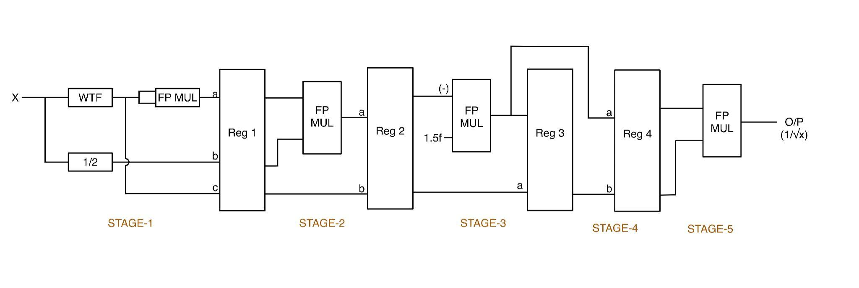
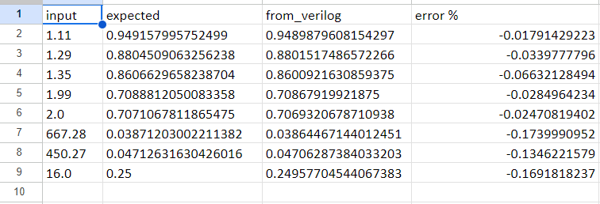
Fast Inverse Square Root
Figure shows 4 stage pipelined implementation of the fast inverse square root algorithm.
Figure compares the result from the verilog module to the expected results.

Slide 12

Accelerator
Accelerator is an 18-stage pipelined architecture used to determine the acceleration of one body as a result of the force applied by the other body.
This module makes use of 18 dsp blocks.
Inputs :
Mass of the second body.
X and Y positions of both the bodies.
Initial acceleration (both X and Y) of body one.
Output :
The acceleration is worked out using the following formula:

Slide 13
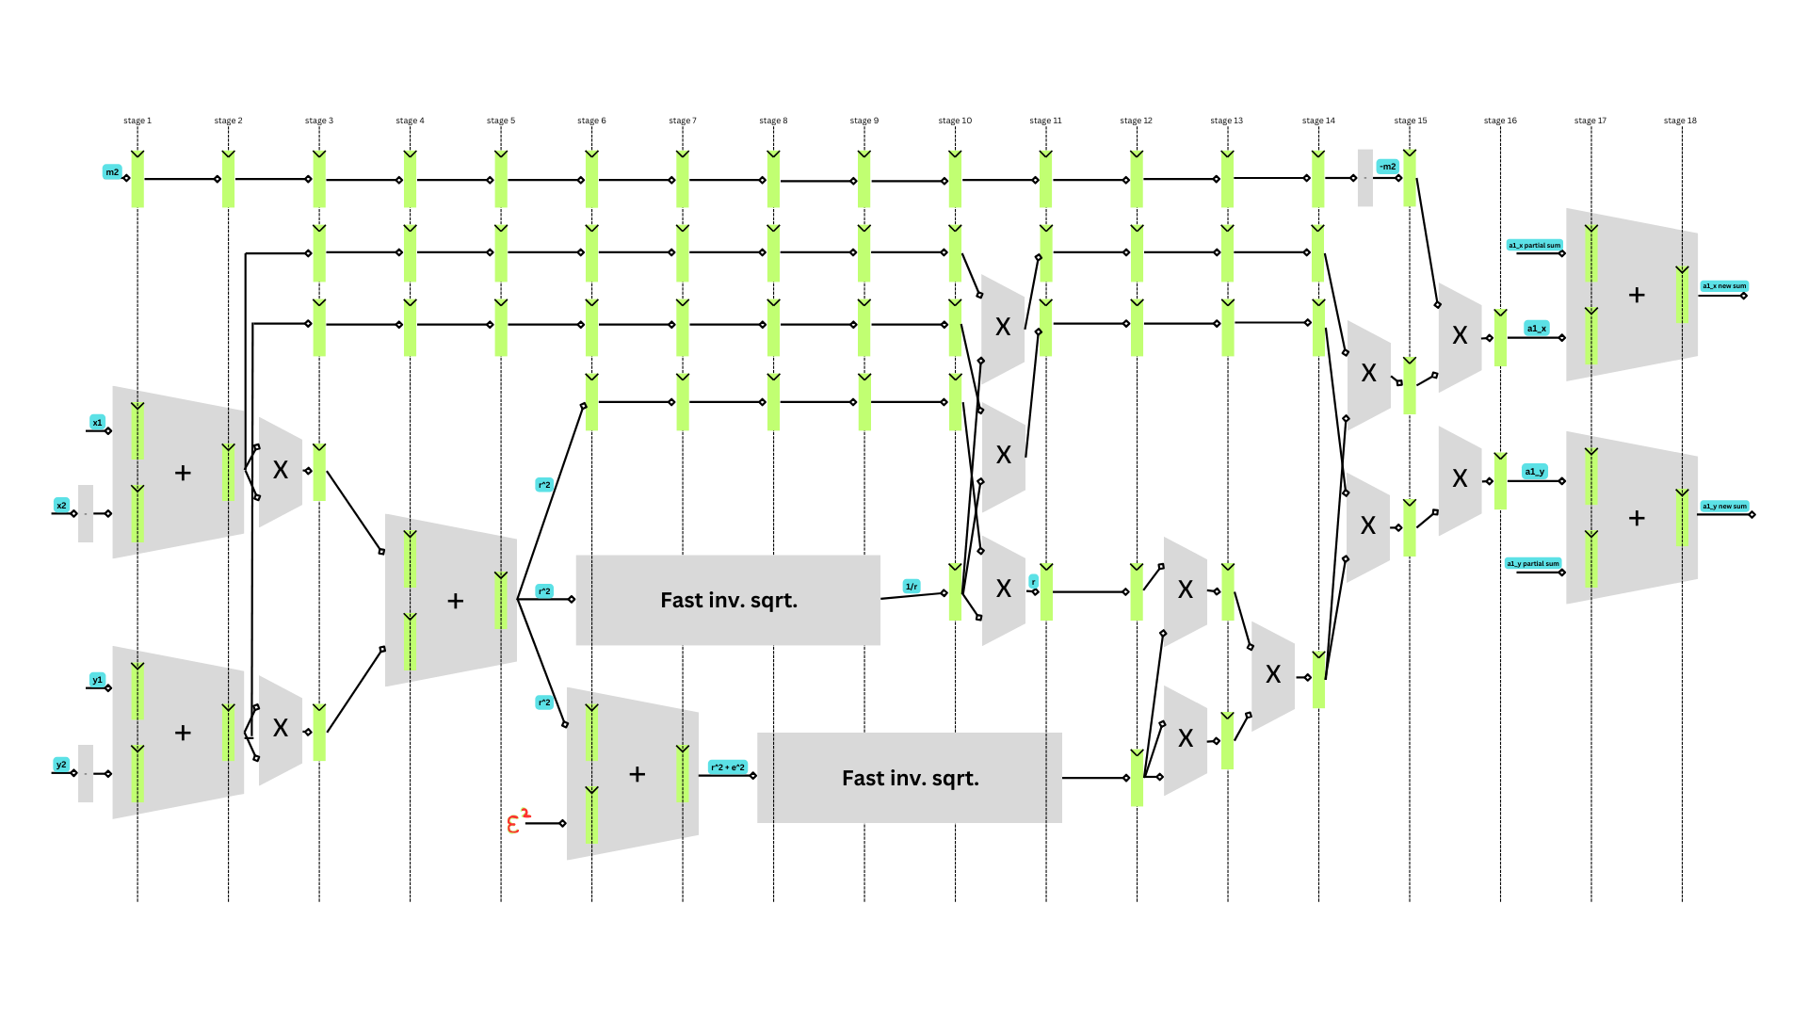
Accelerator
Fig: Pipelined structure of the accelerator

Slide 14
Neighborhood Algorithm:
The neighborhood algorithm considers the position and the mass of the particles sent by the HPS to the FPGA, computes the acceleration for each body and updates the result back to HPS.
The visitor center controller allows HPS to write the X, Y positions and mass of the object and also sends information about each visitor to the each neighbourhood.
3 M10k dual port RAM are used to store X, Y positions and mass of 1 particle respectively.
Each neighborhood contains some of the entire celestial bodies and stores X, Y positions and X, Y accelerations in 4 M10k dual port RAM blocks.
Acceleration on the visitor body is computed by the accelerator and updated to M10k accelerations memory by neighborhood controller.
Neighborhood controller also allows HPS to read the computed accelerations value by multiplexing one of the port of M10k RAM.

Slide 15
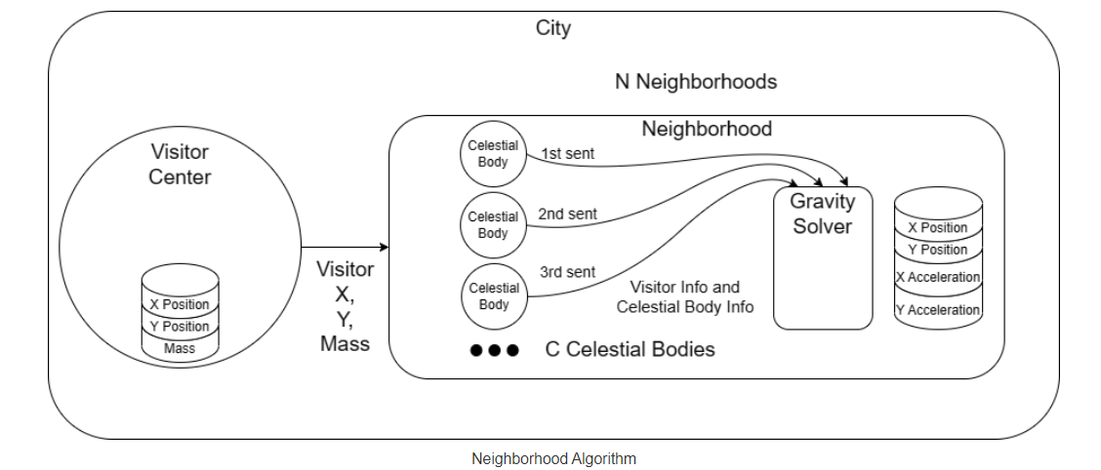
Neighborhood Algorithm:

Slide 16
Neighborhood Algorithm:
INPUT Neighborhood_1
Visitor Center
Neighborhood_0
1.0 | 1.0
3.0 | 3.0
5.0 | 5.0
7.0 | 7.0
9.0 | 9.0
11.0 | 11.0
13.0 | 13.0
15.0 | 15.0
Xi=Yi | Mass
1.0 | 1.0
2.0 | 2.0
3.0 | 3.0
2.0 | 2.0
4.0 | 4.0
6.0 | 6.0
8.0 | 8.0
10.0 | 10.0
12.0 | 12.0
14.0 | 14.0
16.0 | 16.0
.
.
.
.
.
15.0 | 15.0
16.0 | 16.0

Slide 17
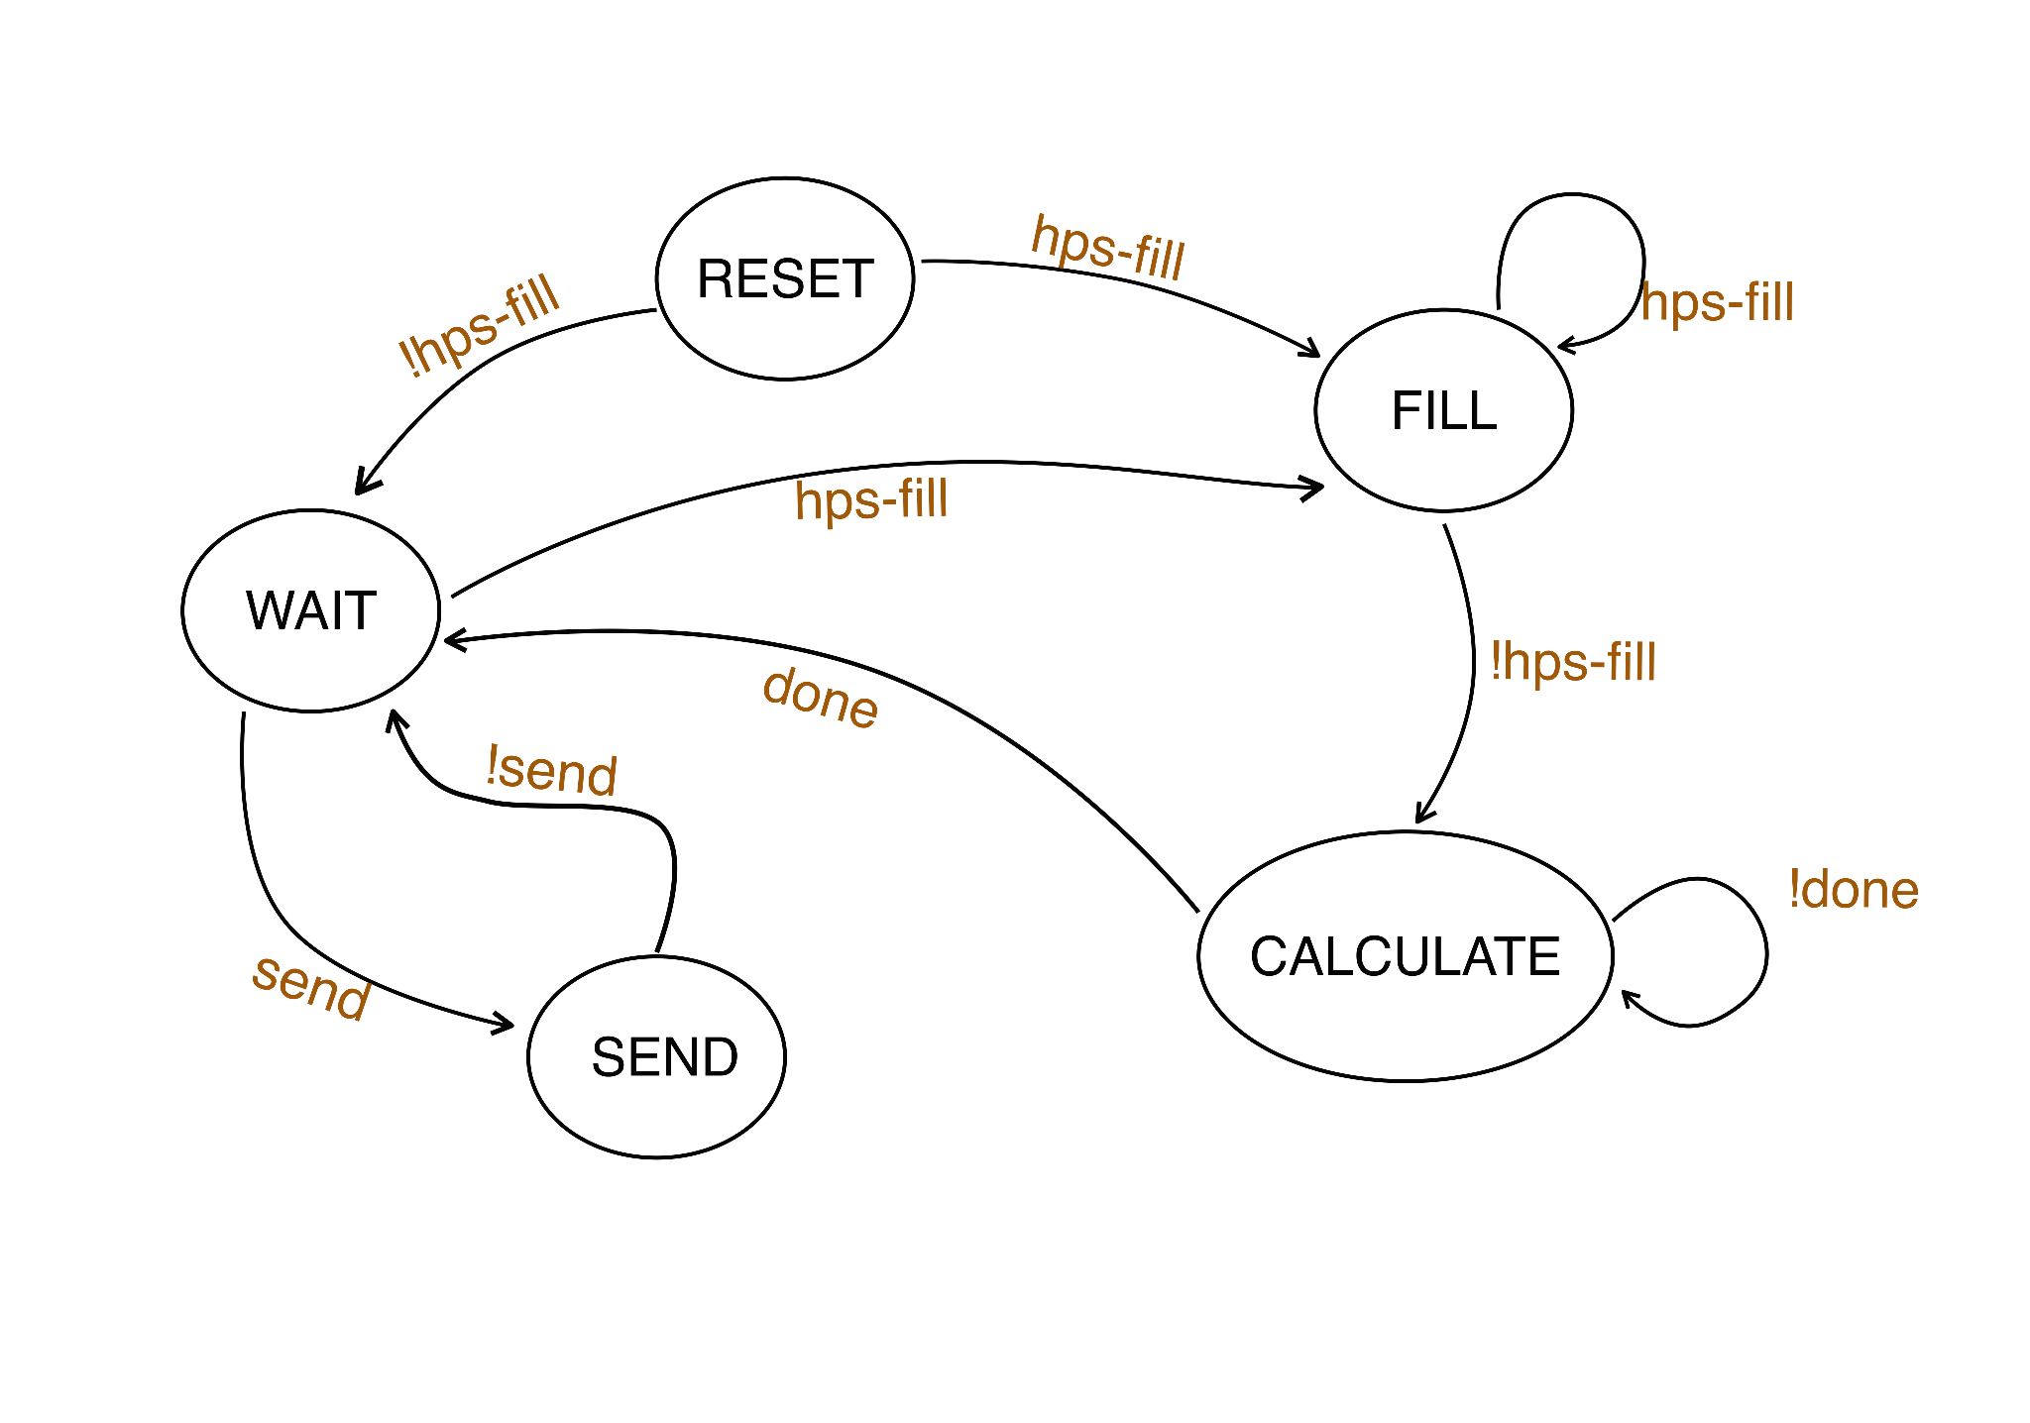
HPS State Diagram:

Slide 18
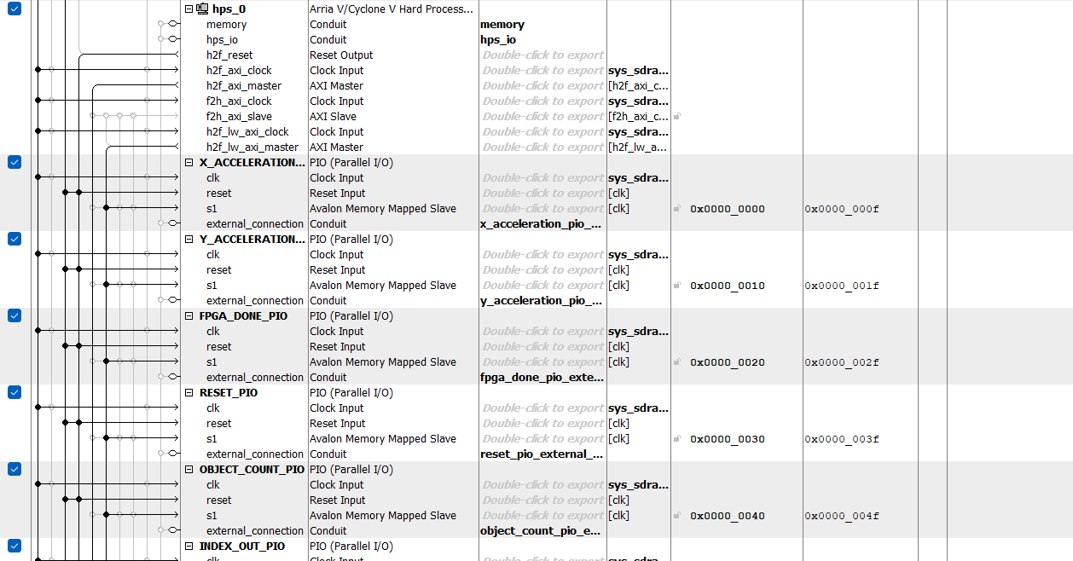
System qsys file:

Slide 19
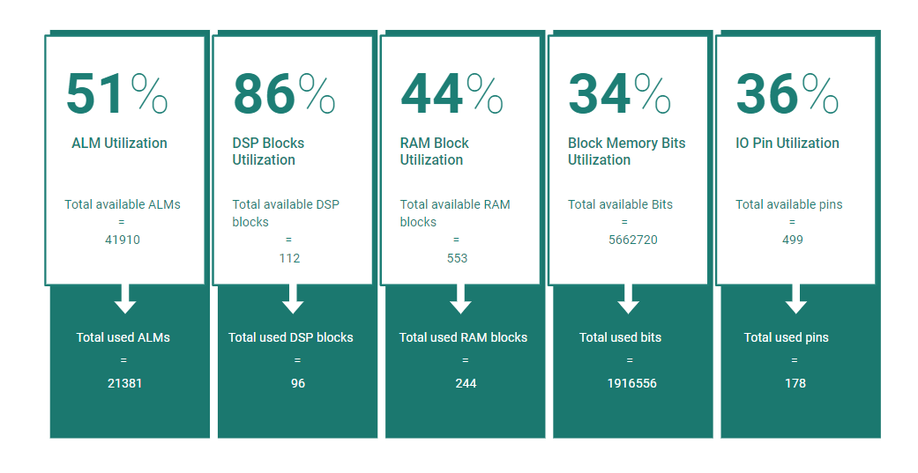
Resource Utilization of the design

Slide 20
Resource Utilization of the design
PLL utilisation = 3/15 (20%)
Total registers used = 20800 (for FPGA configuration)
ALM / Adder | DSP blocks / Adder
393 | 0
ALM / Multiplier | DSP blocks / Multiplier
30 | 1
Total ALMs | Total DSP | Number of accelerators | ALM/design | DSP/design | # add/design | # mul/design | Total Throughput
21381 | 96 | 5 | 3684 | 18 | 8 | 18 | 1*5 = 5

Slide 21
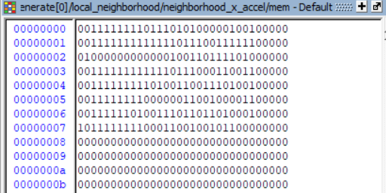
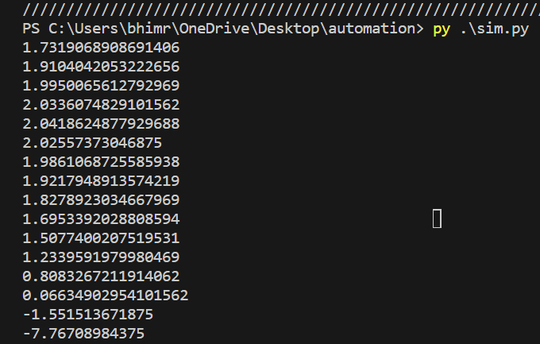
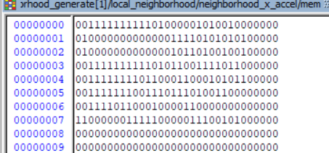
Simulation Results: Results from simulation
Expected results
1.7285499
1.9914512
2.0380401
1.9826164
1.8251075 1.5061149
0.8080158
-1.547823
1.9068756
2.0299453
2.0220413
1.9189071
1.6935234 1.2330017
0.0654723
-7.756988
The figures on the right shows acceleration of 16 bodies, calculated by the 2 neighborhoods

Slide 22
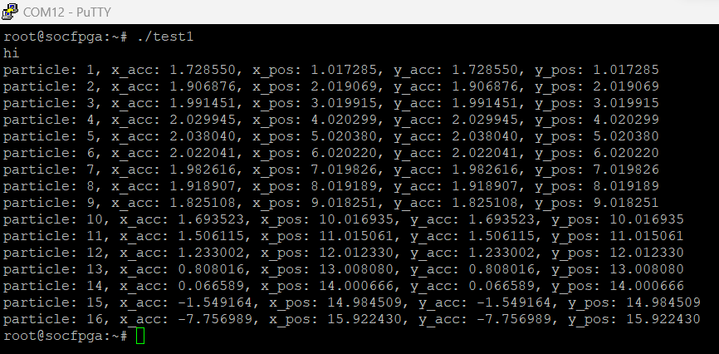
In-circuit Verification
First, send initial X and Y positions and mass of each celestial body from HPS to FPGA.
Second, receive the computed acceleration values from FPGA.
Third, integrate the acceleration to get new X, Y velocity and positions.
Finally, send the new X and Y positions to HPS.
Each iteration of all the above four steps create one frame on the display and our aim is to achieve maximum FPS by parallelizing computation as much as possible.

Slide 23
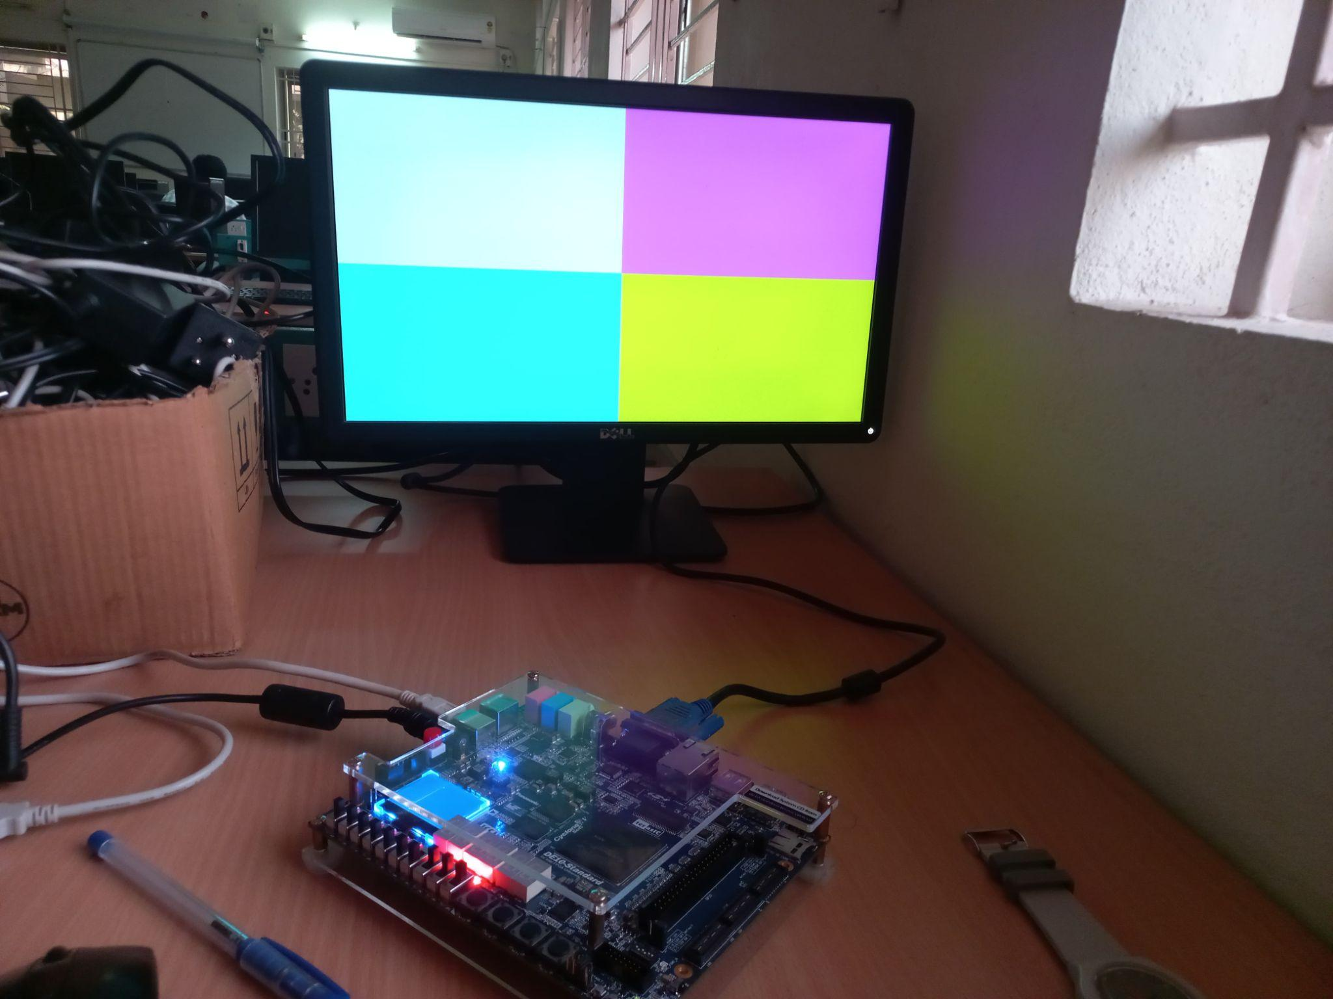
2) Generating a Static Image using VGA controller.
The initial strategy was to create a static image on the VGA to gain knowledge of the timing details of the VGA.
We created a Vga Controller verilog module that produces the 8 bit R,G,B signals and other synchronisation signals.
We have the control of all 640x480 pixels to create any static design.
The code was written to display 4 different colors to different regions on the screen.

Slide 24
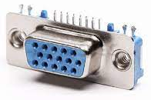
FPGA and VGA Interconnection
VGA Controller
(from fpga)
Vga_r [7:0]
VGA DAC
VGA 15 - pin connector
Vga_g [7:0]
vga_r
Vga_b [7:0]
Vga_clk
vga_g
Vga_sync_n
vga_b
Vga_blank_n
Vga H_sync
Vga V_sync

Slide 25
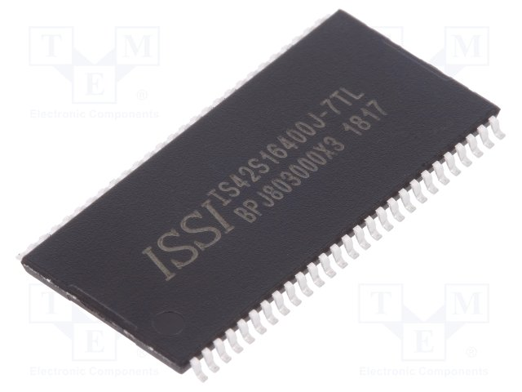
3) SDRAM controller
The SDRAM device on the DE10 Standard board is IS42S16320 speedgrade 7.
We studied the datasheets of this device and designed a memory controller for the same.
We can perform single reads/writes as well as burst read and writes.
We have used CAS latency mode as 2 cycles.
This SDRAM has very intricate initialization process which consists of some fixed time allocated to NOP (No Operation Instruction), precharge cycles, auto refresh cycles, load mode register cycle after which the device goes into a ready to function state.
To read/write you first need to go into row active state by lowering RAS, after which you raise RAS and lower CAS and together provide WE_N signal to indicate whether we want to read or write. After raising back the CAS, depending upon the CAS latency chosen through mode register.

Slide 26
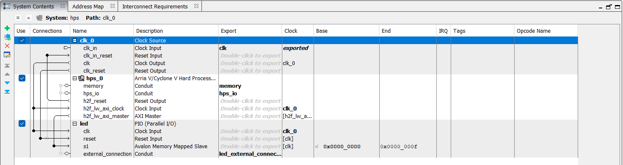
4) FPGA–HPS Communication
HPS to FPGA can be enabled with the help of following buses and in both the cases HPS is master and FPGA is slave.
AXI (32, 64 and 128 bit configurable) bus.
AXI_LIGHT_WEIGHT (32 bit) bus.
FPGA to HPS can be enabled with the help of following bus and in this the cases FPGA is master and HPS is slave.
AXI(32, 64 and 128 bit configurable) bus.
PIO (Parallel I/O) ports can be used to transfer data between HPS and FPGA and vice-versa.

Slide 27
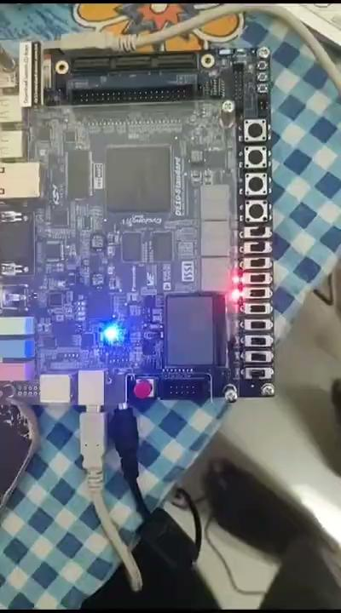
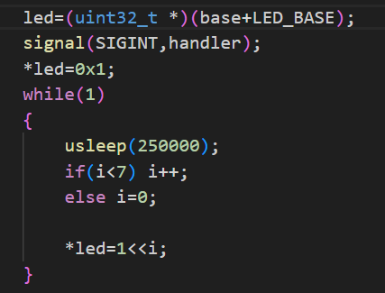
4) FPGA⟷HPS Communication

Slide 29
5) Video and Dynamic Image display using VGA
We estimated the complexity of designing Verilog modules for developing the pixel buffer, and found it to be too challenging.
So we switched to using direct IPs from Qsys .
Generated VGA-Subsystem and Computer System qsys files which replicates the design of writing frames to Pixel Buffer.
Developed C code that writes to the Pixel buffer and specifies the sequence of frames that have to be displayed on the VGA monitor.

Slide 30
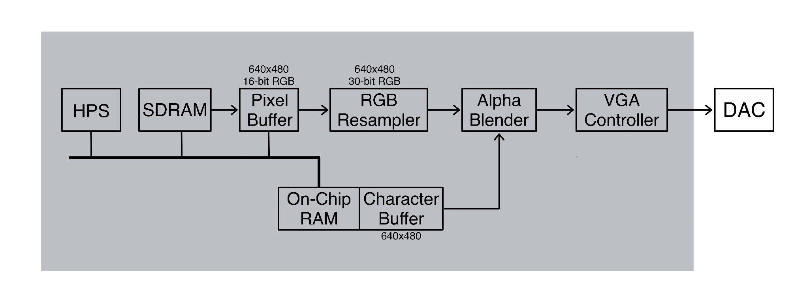
VGA Subsystem

Slide 31
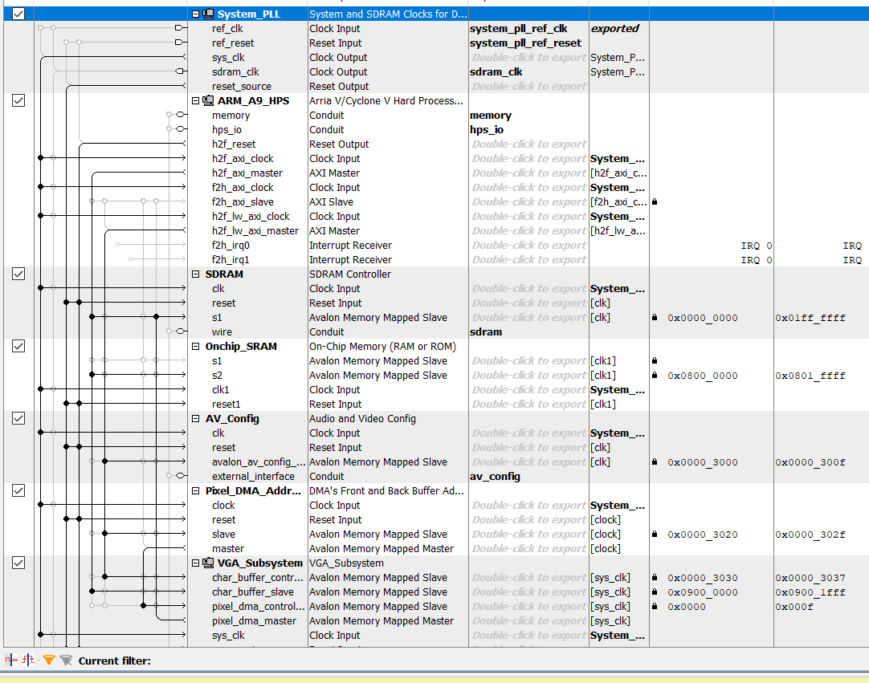
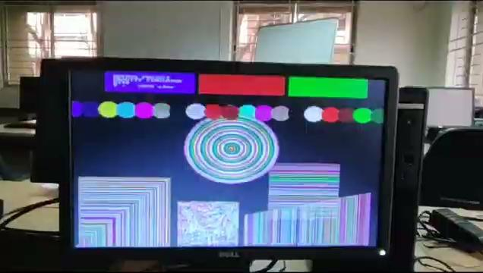
Fig: The Qsys shows the communication between HPS, SDRAM and VGA subsystem.

Slide 32
HPS/Software progress

Slide 33
Booting linux on ARM processor and file transfer
Linux was booted on HPS through the SD card image.
Initially, the linux desktop image was loaded onto the HPS.
Everything seemed to be working fine until…
Solution:
So, finally we decided to load the Console image to boot linux onto the HPS that will configure only the HPS peripherals on the board.
Good thing is that we can configure the FPGA peripherals as and when required by executing the .rbf file.

Slide 34
Booting linux on ARM processor and file transfer
Setting up the internet for file transfer was the biggest challenge faced.
First Method:
Establishing the internet by setting up a bridge connection between the WIFI port on the host and the Ethernet port on the board.
Unfortunately, led to many failed attempts.
This method doesn’t work as the internet on the host computer is disconnected ,after the bridge is established.
Second Method:
Assigned Static IP address to the Ethernet port on.
Eventually, this method turned out to be successful.
We were able to ping to other networks.
The executable files are transferred to the hps using SFTP(secure file transfer protocol). This makes use of tool called SoC EDS.

Slide 35
Configuring FPGA through HPS
The FPGA can be configured (also known as 'programmed') in several ways:
From an external configuration flash memory,
With the Quartus Programmer tool, (JTAG)
From HPS software.
Different ways of FPGA configuration options from HPS software:
From U-boot
Flashing the FPGA on boot up is a convenient way to have your design on the FPGA every time the board powers up.
We need to get .rbf file from .sof file and save into the location where we saved the linux console kernel image file, thats it whenever the FPGA boots up its reads soc_system.rbf file and tries to configure FPGA also.
From Linux.
The image file must be available to Linux, such as in the root filesystem or loaded up through networking or it could be in a mounted partition on the SD card.

Slide 36
Acceleration Speedup with FPGA
No. of particles | Time taken by FPGA (us) | Time taken by the HPS (us) | Speedup
30 | 30 | 65 | 2.17
1009 | 2950 | 78500 | 26.61
1681 | 7180 | 233800 | 32.56
2200 | 11670 | 411250 | 35.24

Slide 37
UI Design
Integrating the mouse with the VGA
Designing
Buttons
UI Design
Display
Bodies
DIfferent
Data Maps

Slide 38
Special buttons
We have incorporated 10 magic buttons to make the simulation more engaging and creative.
Reset button 🆁 : This button helps to reset the simulation to the initial state.
Increase button ➕ : We are able to increase the time-step of the simulation with the help of this button.
Decrease button ➖ : We are able to reduce the speed of the simulation with this button.
Add button 🅰 : This is an interesting feature.We can introduce celestial bodies into the simulation. We give the user full freedom to choose the mass,position and the velocity. Sounds interesting right!!!

Slide 39
▶ : This button helps to pause the simulation at any point of time.
⏸ :This button is used to resume the simulation.
🅵 : This is a powerful button, that allows us to switch the acceleration calculations onto the FPGA.
🅷 : This button will hold HPS responsible for doing all the calculations, leaving the fpga idle.
🅼 : This button will allow the user to load different dataset maps.
🅱: This is a bound button which will convert the screen borders into hard boundaries, which don’t allow any particle to escape
🆃 : This is a very unique feature known as trace. This helps us to track the trajectory of each and every body on the screen.

Slide 40
Comparing frames per second
No. of particles | Achieved fps by FPGA (1/s) | Achieved fps by the HPS (1/s)
30 | 680 | 671
1009 | 121 | 12
1681 | 65 | 4
2200 | 45 | 2

Slide 41
Conclusion
After parallelising using FPGA we can see the huge improvement in the frame time.
For 2200 particles FPS on HPS is just 2 but on FPGA it is 45, and it is nearly 22.5 times improvement of each frame computation time.
For fewer particles (around less than 100) the power of the FPGA cannot be explained much because even though HPS is computing sequentially it is operating at 925 Mhz but our FPGA is operating at 100 Mhz.
As the number of particles increases the effect can be easily observed.

Slide 42
THANK YOU

