Slide 1
DevOps CA2
Practical Project
GROUP MEMBERS
Gayatri Patil — 23070122096
Pritika Kurup — 23070122167
Jesline Pinto — 23070122243
Omika Shrestha — 23070122245
SUBMITTED TO
Arijit Dutta Sir

Slide 2
End-to-End System Architecture
SYSTEM ARCHITECTURE
Developer
GitHub Repository
GitHub Actions
Ansible Configuration
Docker Image
Writes and pushes code
Stores and versions source
Validates every push / PR
Prepares the app runtime
Versioned Flask image
image deployed to the cluster
KUBERNETES
Flask Application
Prometheus
Grafana
Deployment
3 Replicas
NodePort Service
manages pods
availability
:30001 → 5001
Serves app, exposes /metrics
Scrapes /metrics
Visualizes health
BUILD & CONFIGURE
PACKAGE & RUN
OBSERVE
GitHub stores and versions the code. GitHub Actions automatically validates changes. Ansible prepares the application runtime.
Docker packages the Flask app into versioned images. Kubernetes runs 3 replicas and manages deployment, update and rollback.
Prometheus collects application metrics from /metrics. Grafana visualizes application health and performance.

Slide 3
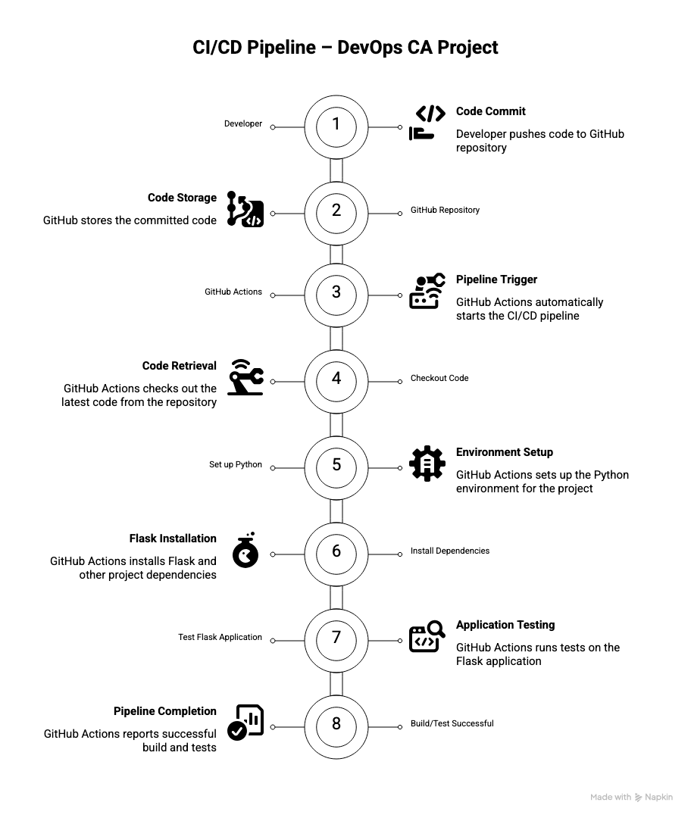
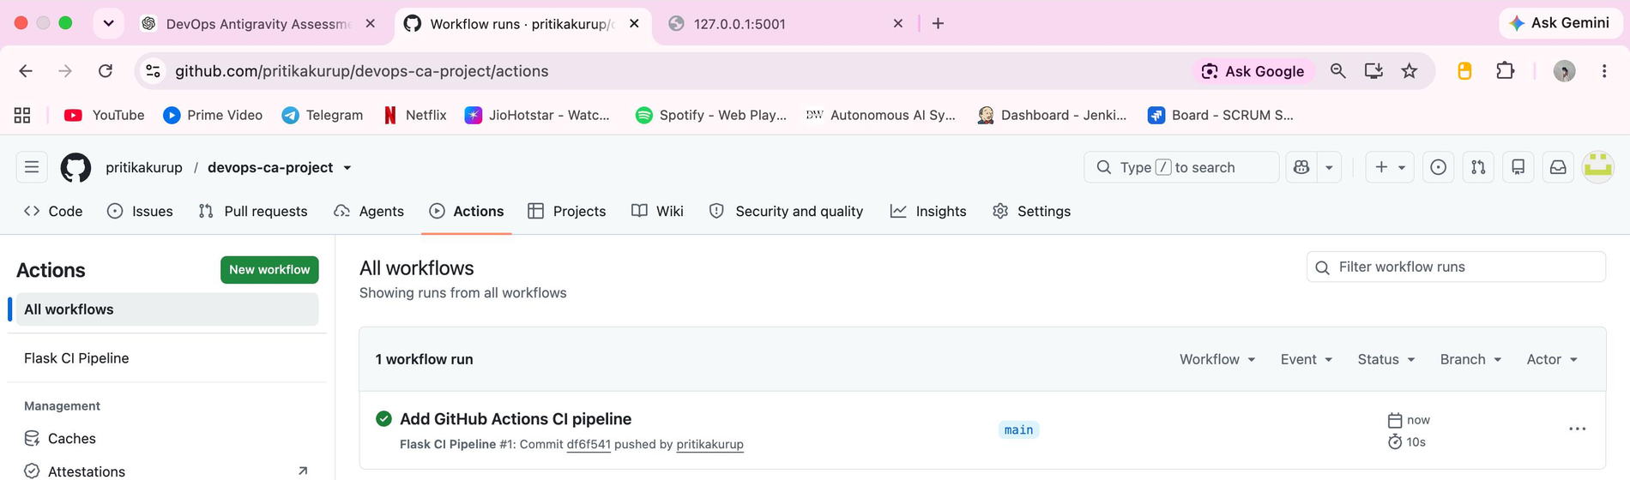
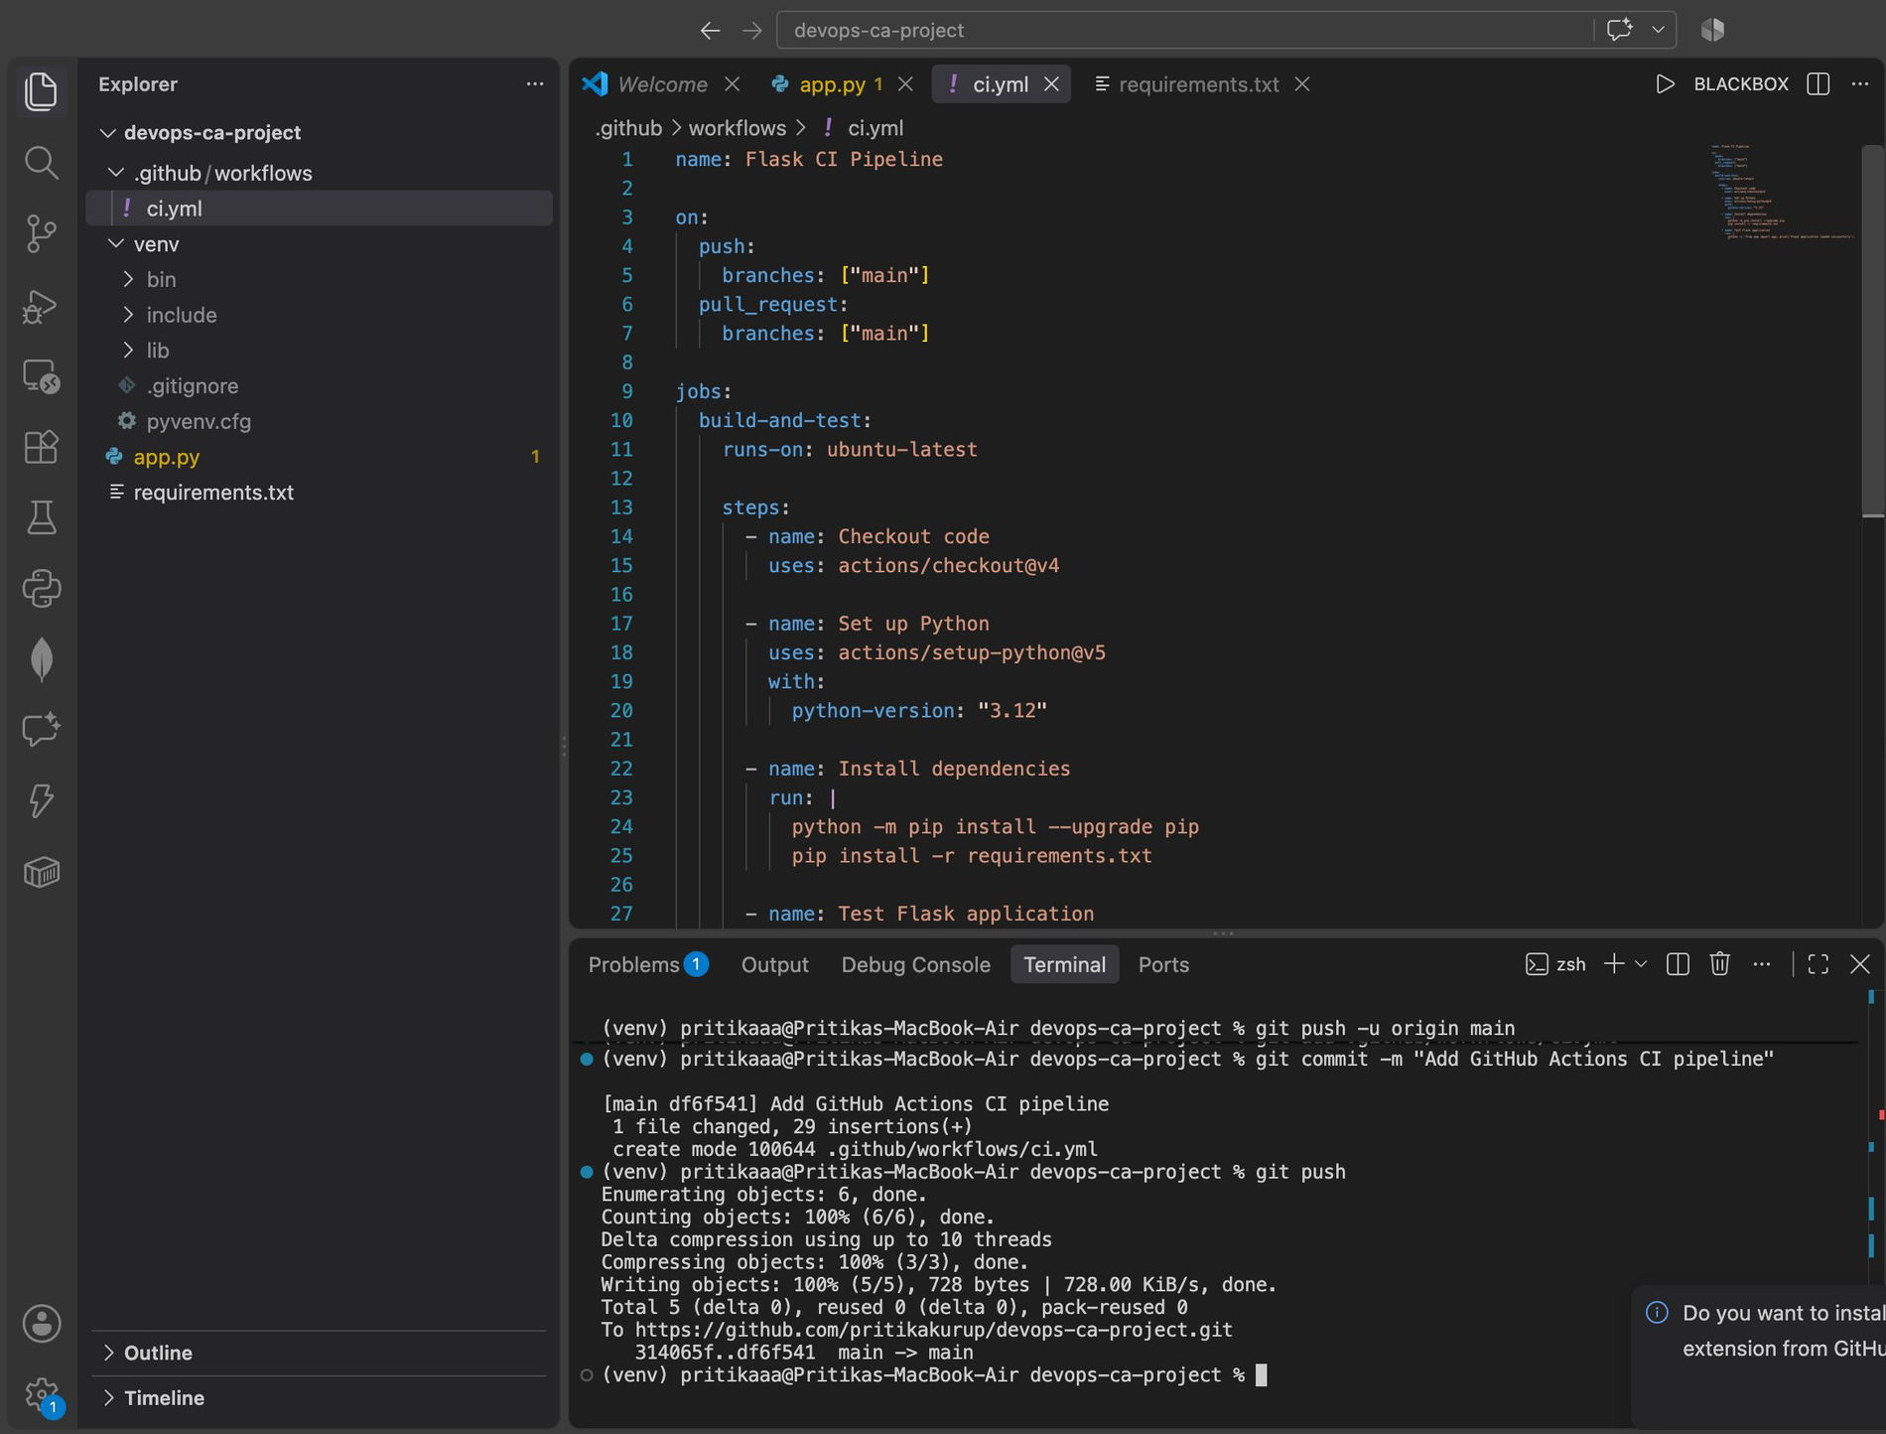
Step 1 — Deployment Strategy: GitHub Actions CI Pipeline
STEP 1
GitHub Actions page: the “Flask CI Pipeline” run for commit “Add GitHub Actions CI pipeline” completed successfully (green check) on main.
PURPOSE
GitHub Actions automates application validation whenever code is pushed or a pull request is created, reducing manual testing and improving repeatability.
Submitted CI/CD pipeline diagram

Slide 4
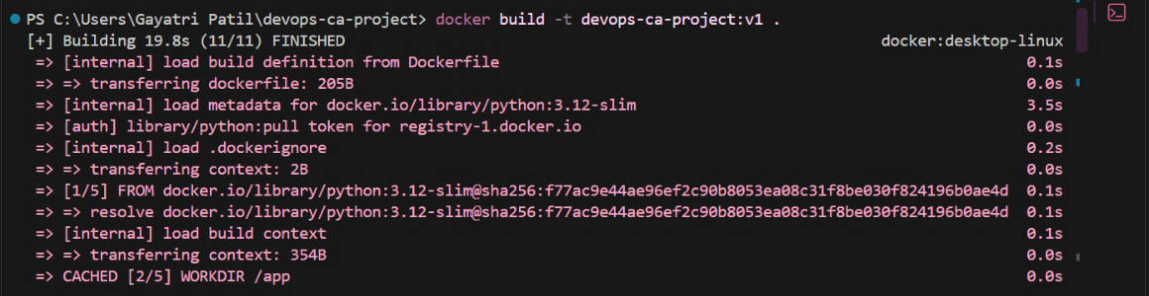
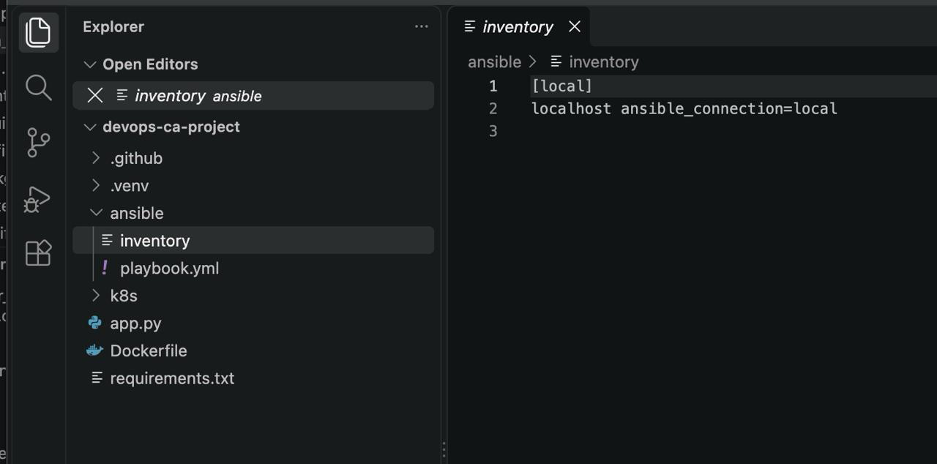
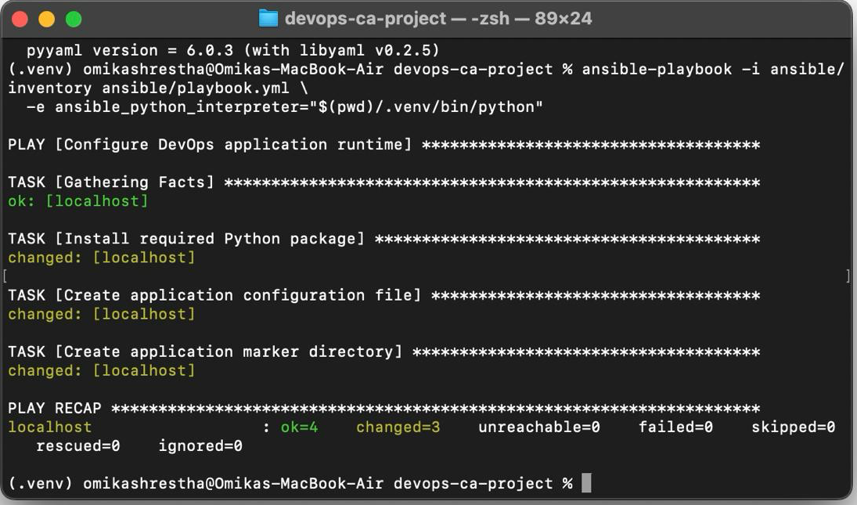
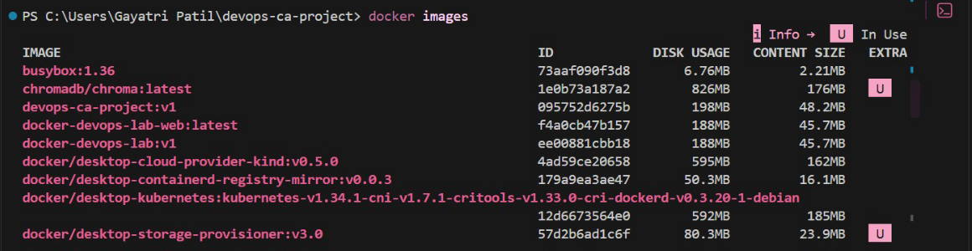
Steps 2–3 — Ansible Configuration & Docker Containerization
STEPS 2–3
ANSIBLE · CONFIGURATION MANAGEMENT
DOCKER · CONTAINERIZATION
Local inventory identifies the target host.
Playbook installs the required Flask dependency.
Configuration file is created.
Application marker directory is created.
Playbook completed successfully.
Flask application is packaged into a Docker image.
Versioned images such as devops-ca-project:v1 and v2 were used.
Versions support controlled Kubernetes updates and rollback.
PLAY RECAP: ok=4 | changed=3 | failed=0
docker build -t devops-ca-project:v1 . — build finished (11/11) from python:3.12-slim.
Inventory: [local] localhost, ansible_connection=local.
Playbook run: all 4 tasks OK, 0 failed.
docker images lists devops-ca-project:v1.

Slide 5
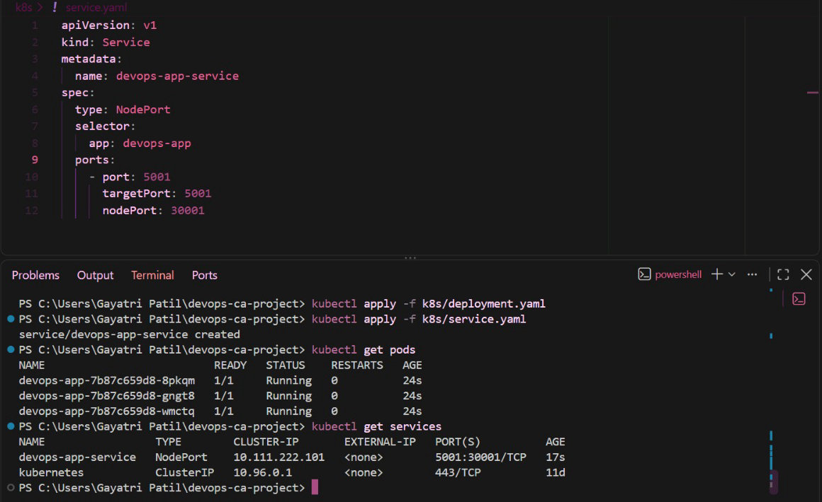
Step 3 — Kubernetes Deployment & Service
STEP 3
DEPLOYMENT
Manages the Flask application.
3 replicas are configured.
Multiple pods provide availability and controlled updates.
SERVICE
Type NodePort, NodePort 30001.
Maps to container port 5001.
RUNTIME
Pods were created successfully.
Pods reached Running, 1/1 Ready.
service.yaml (NodePort: port 5001 → targetPort 5001, nodePort 30001), then kubectl apply, kubectl get pods (three devops-app pods Running, 1/1) and kubectl get services (devops-app-service 5001:30001/TCP).

Slide 6
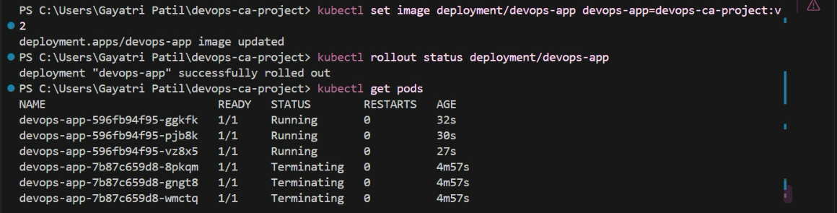
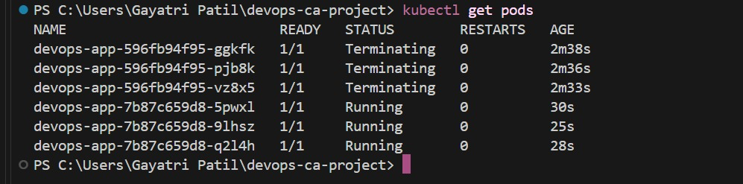
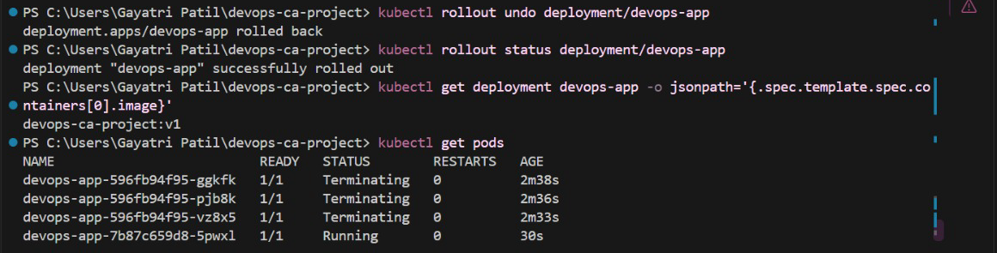
Step 3 — Rolling Update & Rollback
STEP 3
v1 Running
Update image to v2
New v2 pods start
Old v1 pods terminate
Rollout successful
Rollback requested
v1 restored
ROLLING UPDATE · v1 → v2
POD LIST AFTER ROLLBACK
kubectl set image → devops-ca-project:v2; rollout status: successfully rolled out; new pods Running, old pods Terminating.
Not a clean final state: the three earlier v2 pods are still Terminating while three restored pods are Running (1/1, 0 restarts).
ROLLBACK · v2 → v1
A rolling update introduces a new application version gradually while Kubernetes replaces the old pods.
kubectl rollout undo was used to restore the previous stable version, demonstrating deployment recovery.
kubectl rollout undo; deployment image check returns devops-ca-project:v1.

Slide 7
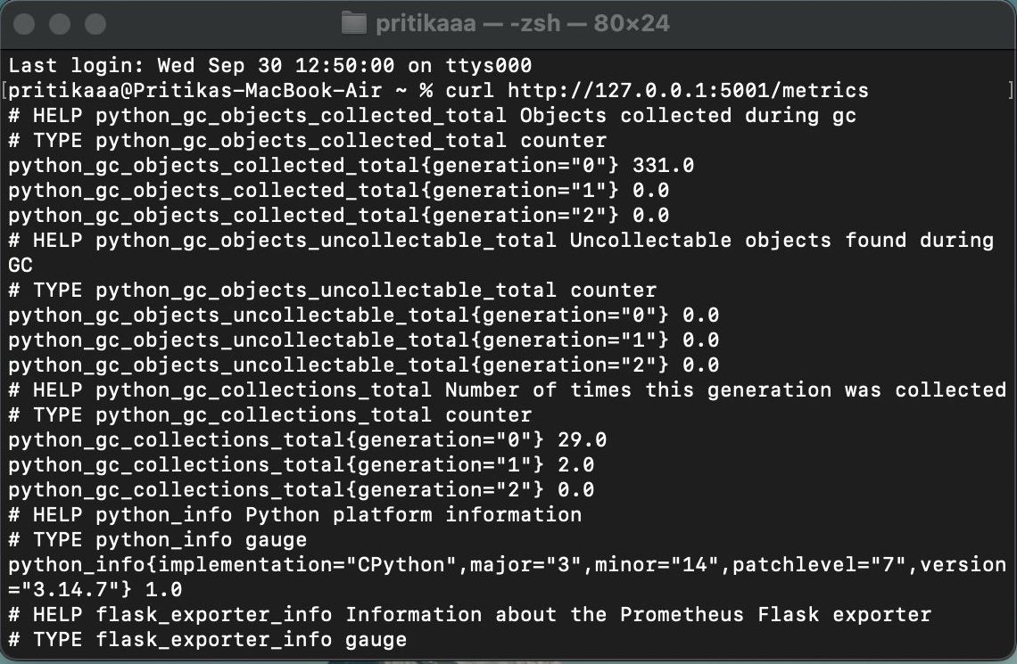
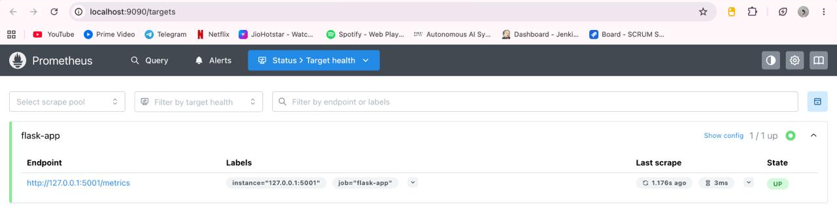

Step 4 — Prometheus Monitoring
STEP 4
Flask Application
Prometheus
Grafana
MONITORED SIGNALS
exposes /metrics
scrapes /metrics
visualizes metrics
Application uptime
Request latency
HTTP 500 error rate
Prometheus scrape health
Prometheus Target health: job flask-app, endpoint 127.0.0.1:5001/metrics, State UP (1/1 up).
Flask /metrics output (curl on 127.0.0.1:5001): Prometheus-format metrics.
Grafana data source: “Successfully queried the Prometheus API.”

Slide 8
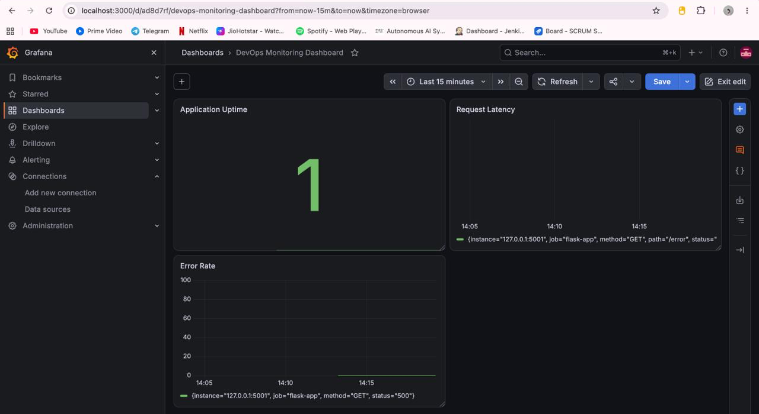
Step 4 — Grafana Application Monitoring Dashboard
STEP 4
APPLICATION UPTIME
Shows whether the Flask application is currently available.
REQUEST LATENCY
Visualizes request-duration behaviour over time.
ERROR RATE
Tracks HTTP 500 responses and demonstrates how application errors can be observed.
Grafana provides a single visual view of application health and performance, making operational issues easier to identify.
Final “DevOps Monitoring Dashboard” in Grafana with the Application Uptime, Request Latency and Error Rate panels.

Slide 9
Challenges & Solutions
STEP 5 · REFLECTION
CHALLENGE
SOLUTION
RESULT
1
Ansible dependency issue
The initial Ansible execution encountered a Python packaging / dependency issue.
A virtual environment was created, the required dependency was installed, and the appropriate Python interpreter was explicitly selected.
Playbook completed successfully: ok=4 | changed=3 | failed=0
2
Kubernetes version changes
Application updates needed to be introduced without losing the running deployment.
Versioned Docker images (v1, v2) were used with Kubernetes rolling updates.
The application was successfully updated to v2.
3
Deployment recovery
A safe way to return to a known working version was required.
Kubernetes rollout undo was used.
The previous v1 deployment was successfully restored.
4
Monitoring validation
Application health and errors needed to be measurable.
Prometheus Flask Exporter, /metrics, Prometheus and Grafana were configured.
Uptime, latency and HTTP 500 metrics became observable.

Slide 10
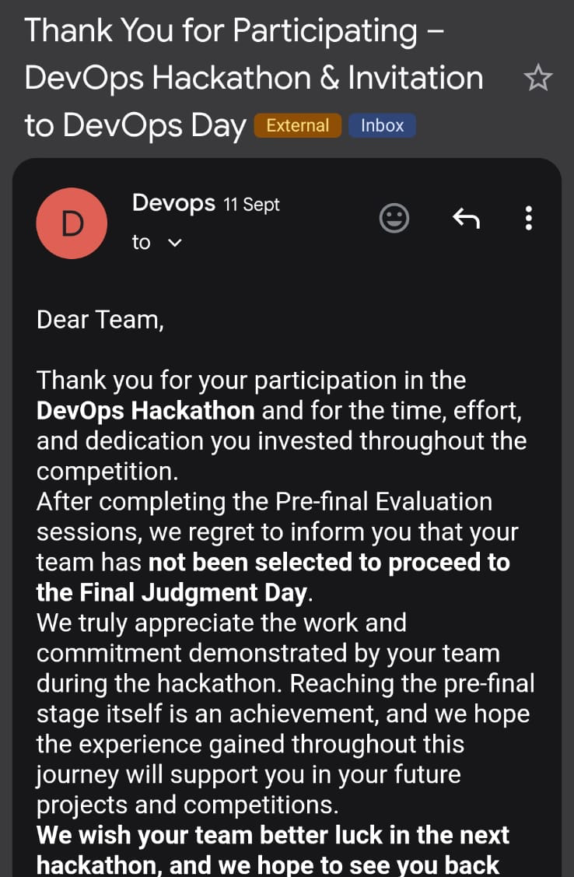
Lessons Learned, External Challenge & Outcome
STEPS 5–6
LESSONS LEARNED
EXTERNAL DEVOPS CHALLENGE
OVERALL OUTCOME
CI/CD: Automated validation improves repeatability.
Configuration Management: Ansible reduces manual environment setup.
Containerization: Docker provides reproducible and versioned application packaging.
Orchestration: Kubernetes enables replicas, controlled updates and rollback.
Monitoring: Prometheus and Grafana make application health measurable.
Recovery: Versioned deployments make rollback practical.
We participated in the DevOps Hackathon and completed the pre-final evaluation stage.
End-to-end DevOps workflow demonstrated:
CI
Configuration
Containerization
Kubernetes Deployment
Rolling Update
Rollback
Official participation / evaluation email from the DevOps Hackathon (team was not selected for the Final Judgment Day).
Monitoring

