Slide 1
- h (핑거 높이) :
9mm 12mm 15mm 18mm 21mm 24mm 27mm
- n (다각형 종류) :
- D (외접원 지름) :
- t (얇은 부분 thickness) : 18mm 대해서
0.5mm 0.6mm 0.7mm 0.8mm 0.9mm

Slide 2
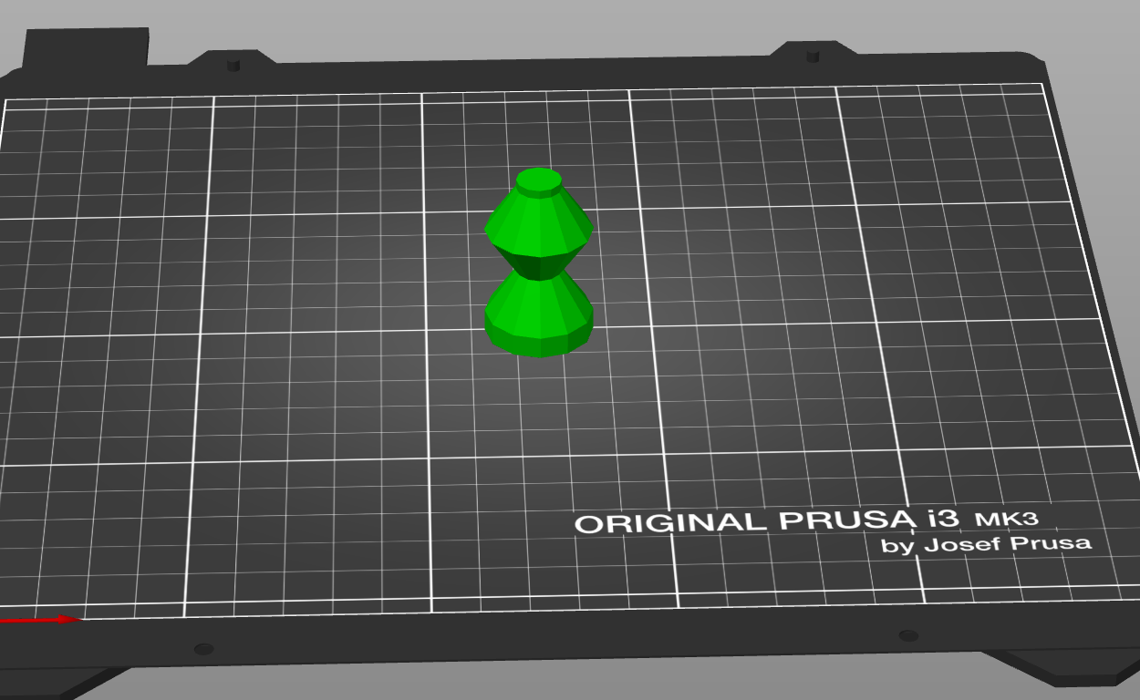
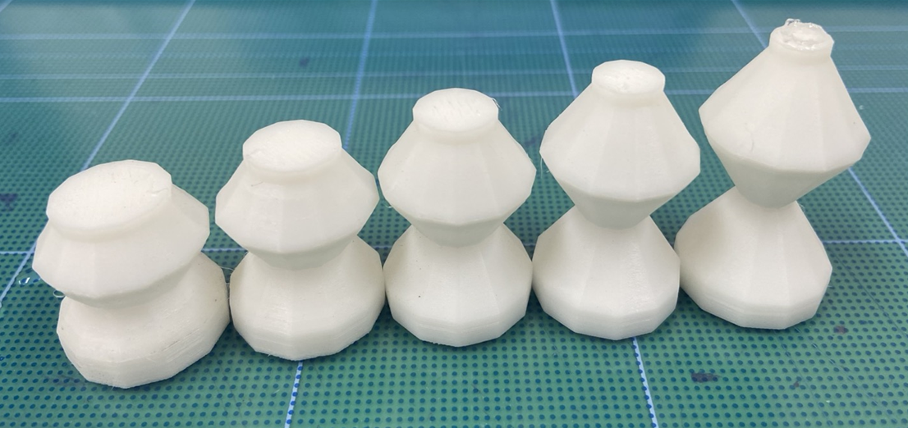
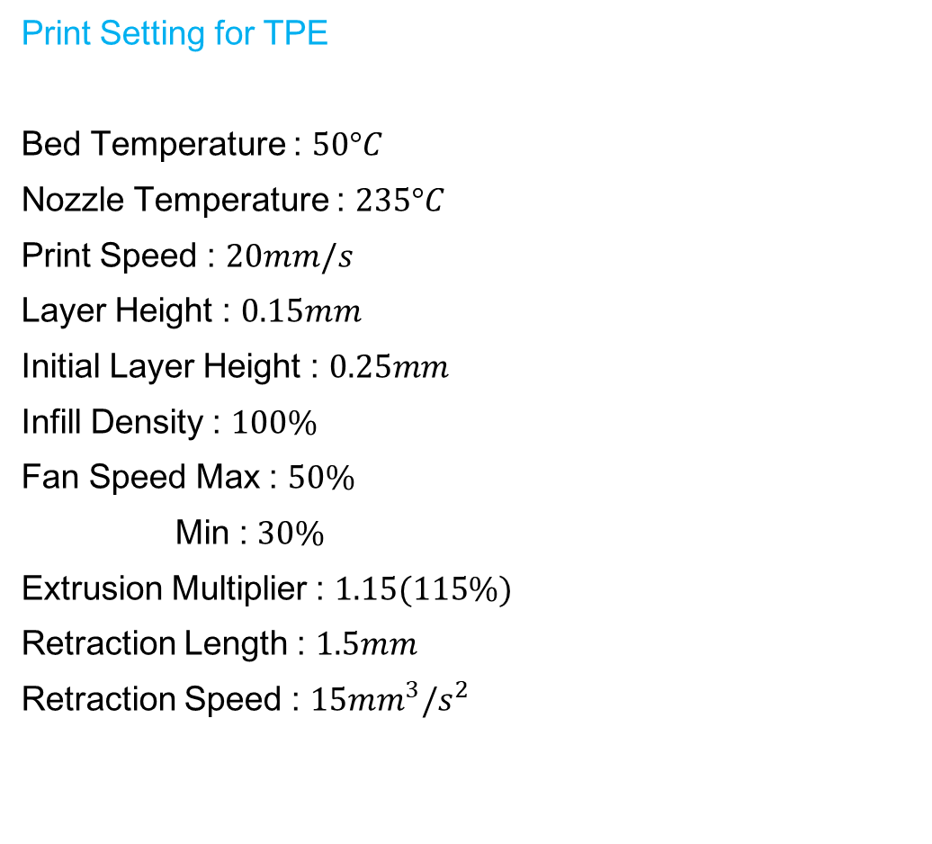
$$Print Setting for TPE$$
$$Bed Temperature :$$
$$50°C$$
$$Nozzle Temperature :$$
$$235°C$$
$$Print Speed :$$
$$20mm/s$$
$$Layer Height :$$
$$0.15mm$$
$$Initial Layer Height :$$
$$0.25mm$$
$$Infill Density :$$
$$100\%$$
$$Fan Speed Max :$$
$$50\%$$
$$Min :$$
$$30\%$$
$$Extrusion Multiplier :$$
$$1.15(115\%)$$
$$Retraction Length :$$
$$1.5mm$$
$$Retraction Speed :$$
$$15{mm}^{3}/s^{2}$$

Slide 3
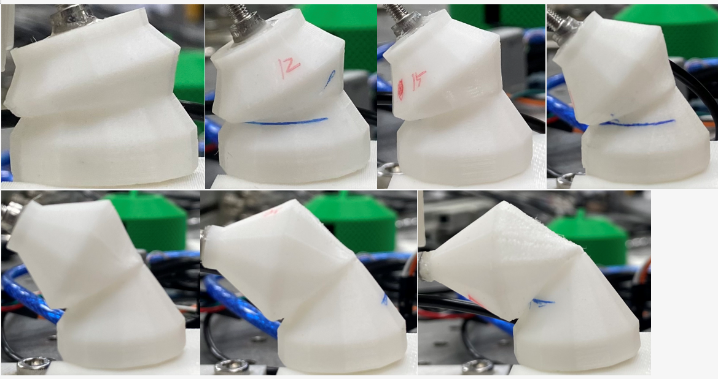
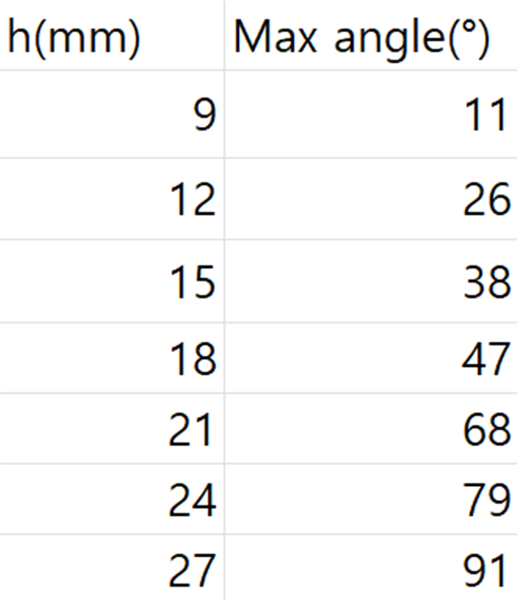
9mm
12mm
15mm
18mm
21mm
24mm
27mm

Slide 4
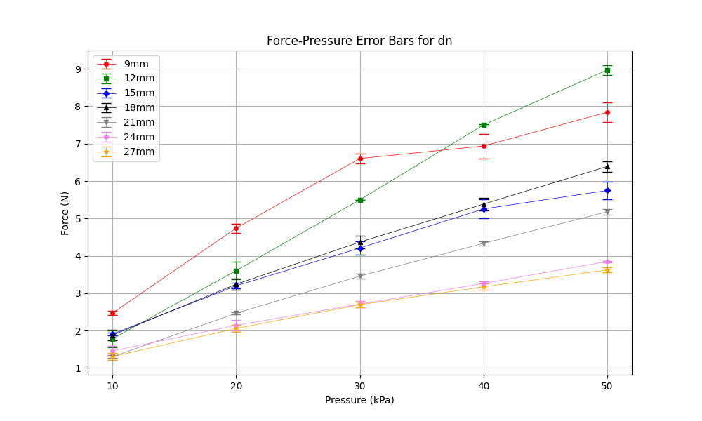
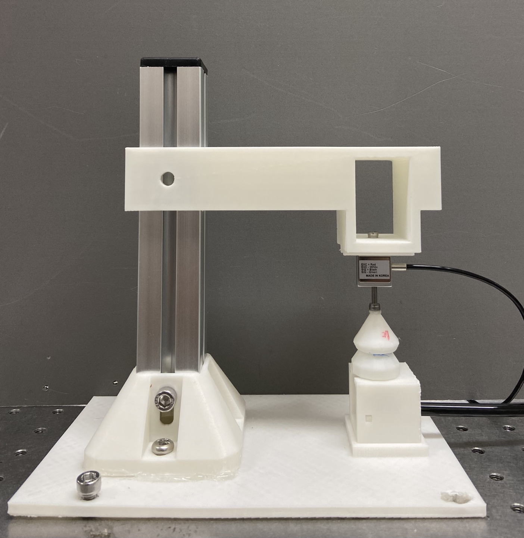
down position, negative pressure
dn

Slide 5
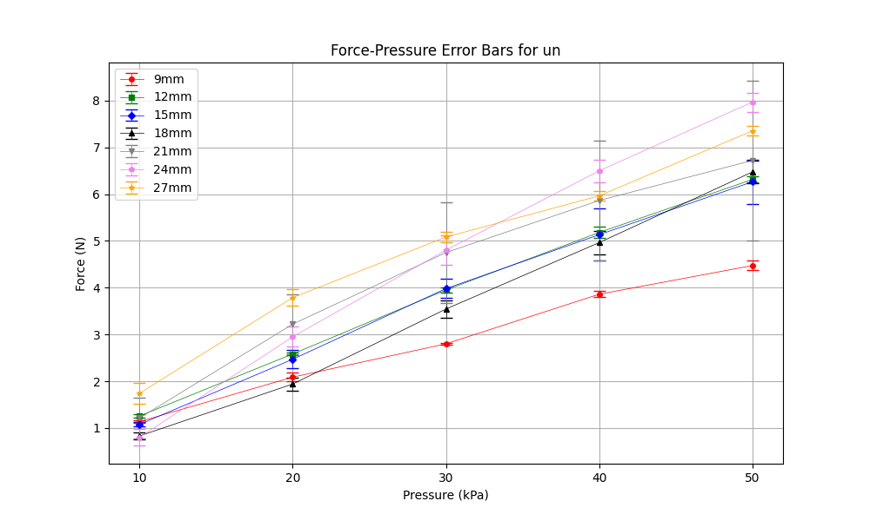
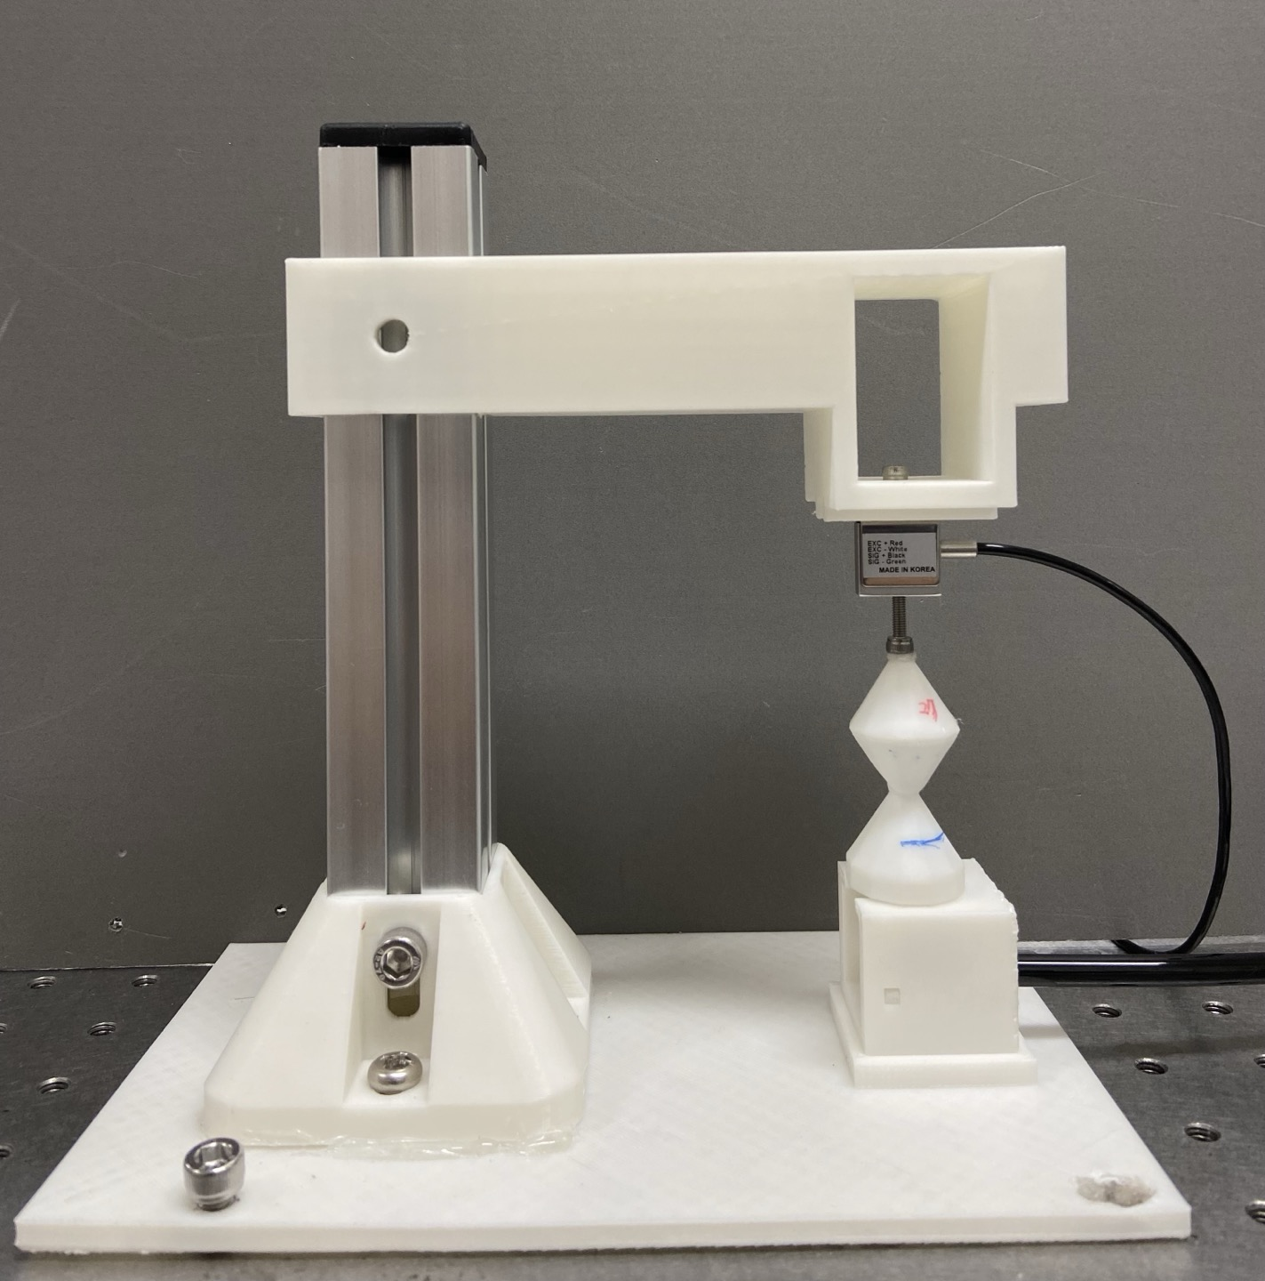
up position, negative pressure
un

Slide 6
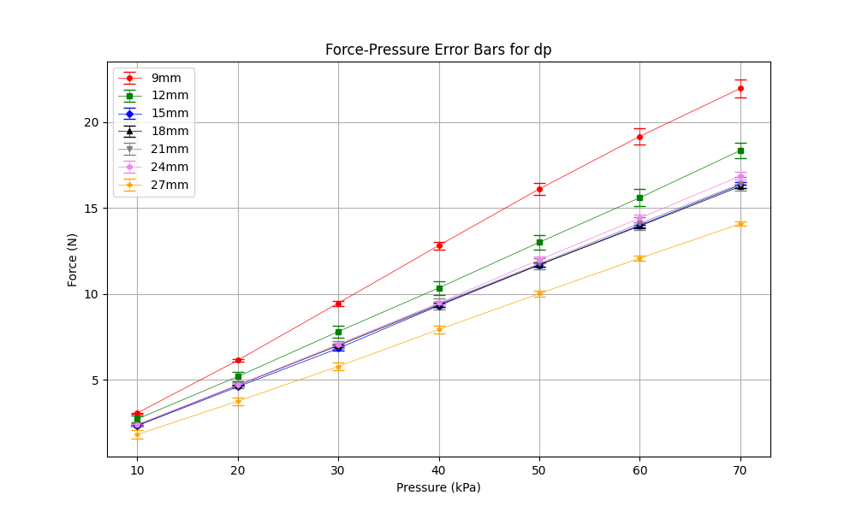
down position, positive pressure
dp

Slide 7
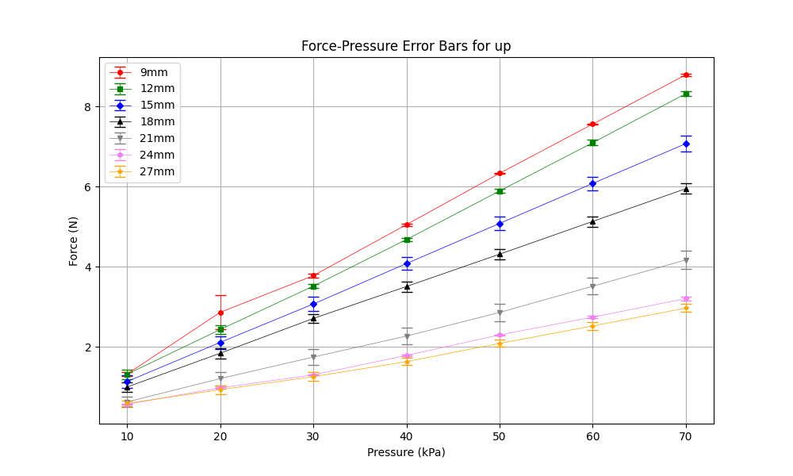
up position, positive pressure
up

