Slide 1
- h (핑거 높이) :
9mm 12mm 15mm 18mm 21mm 24mm 27mm
- n (다각형 종류) :
기준 12각형, 몇 단위로 2or3?
D (외접원 지름) :
18, 21, 24, 27, 30, 33mm
- t (얇은 부분 thickness) : 18mm 대해서
0.5mm 0.6mm 0.7mm 0.8mm 0.9mm

Slide 2
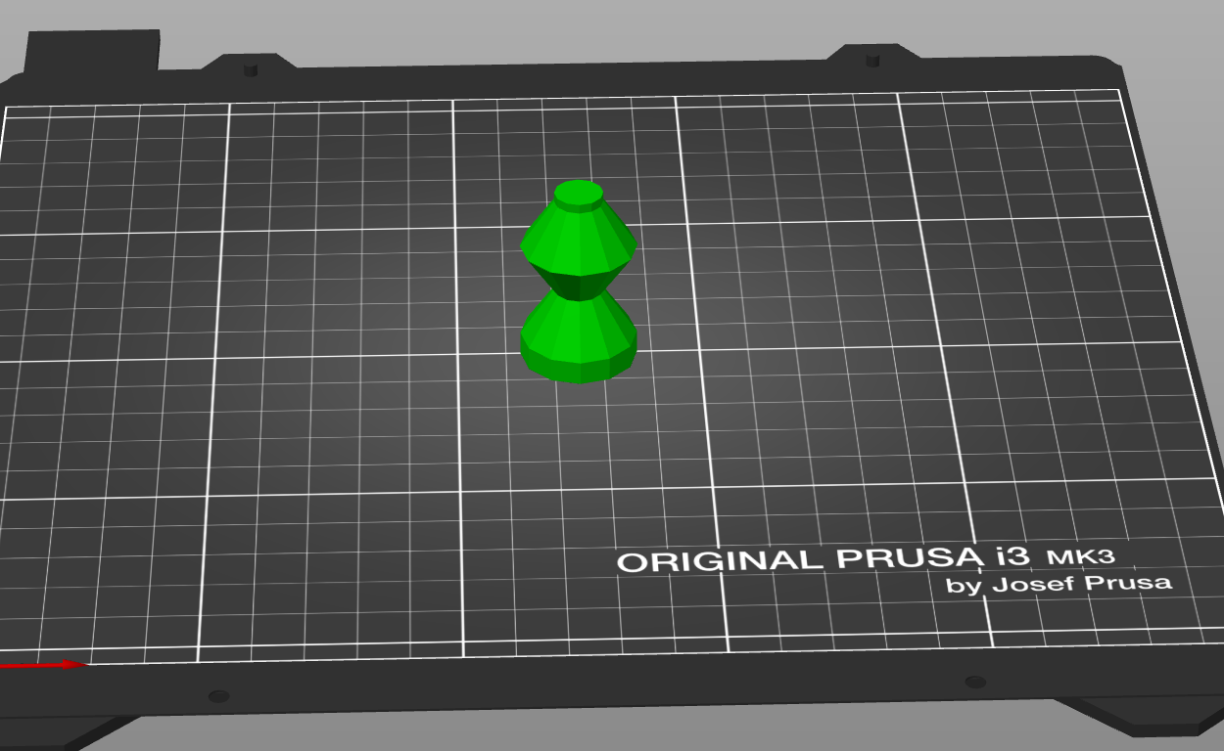
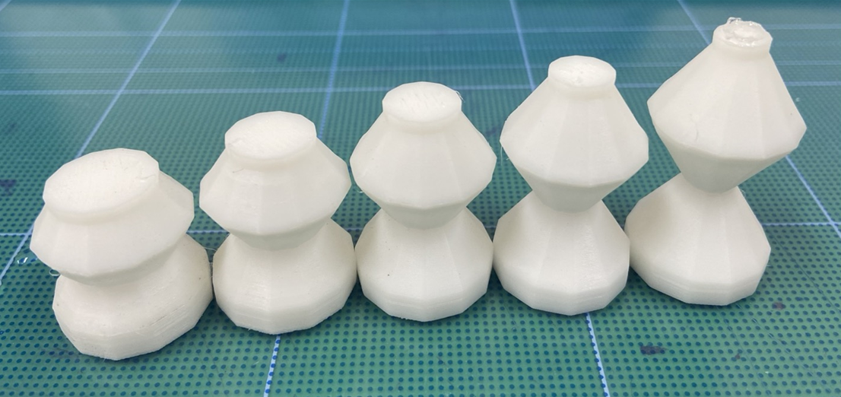
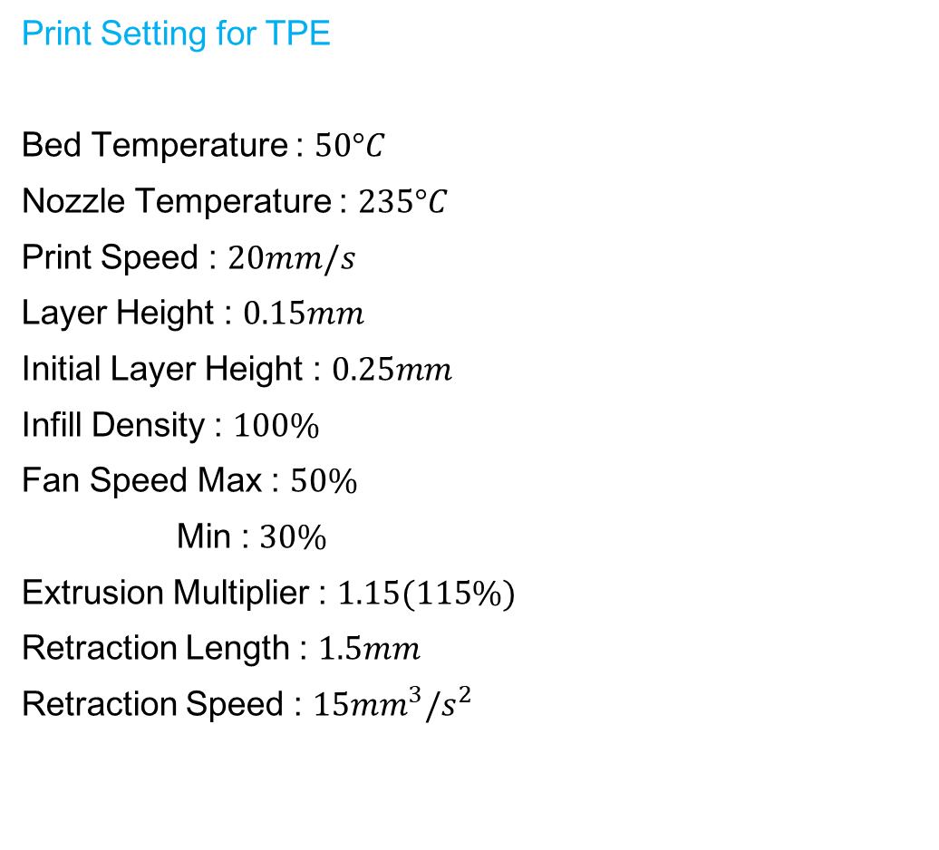
Print Setting for TPE
Bed Temperature : $50°C$
Nozzle Temperature : $235°C$
Print Speed : $20mm/s$
Layer Height : $0.15mm$
Initial Layer Height : $0.25mm$
Infill Density : $100\%$
Fan Speed Max : $50\%$
Min : $30\%$
Extrusion Multiplier : $1.15(115\%)$
Retraction Length : $1.5mm$
Retraction Speed : $15{mm}^{3}/s^{2}$

Slide 3
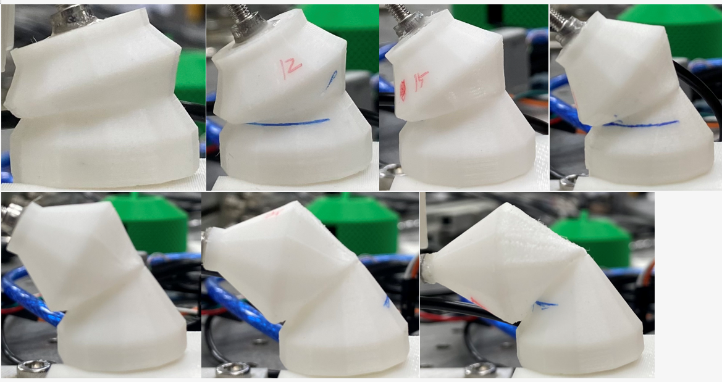
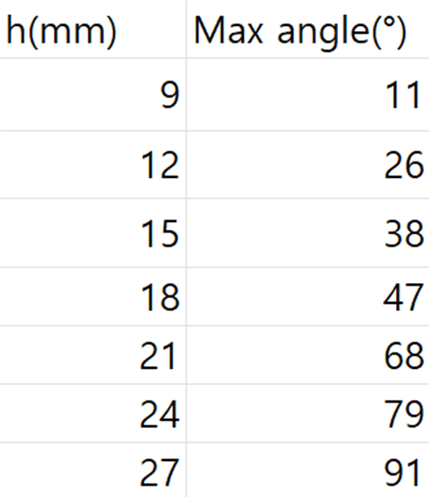
9mm
12mm
15mm
18mm
21mm
24mm
27mm

Slide 4
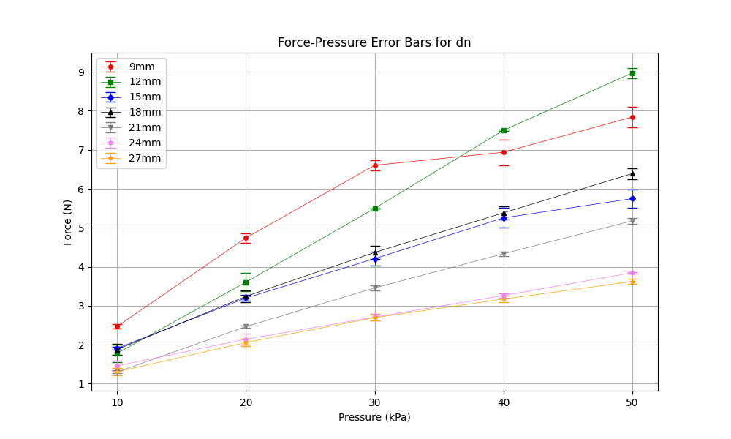
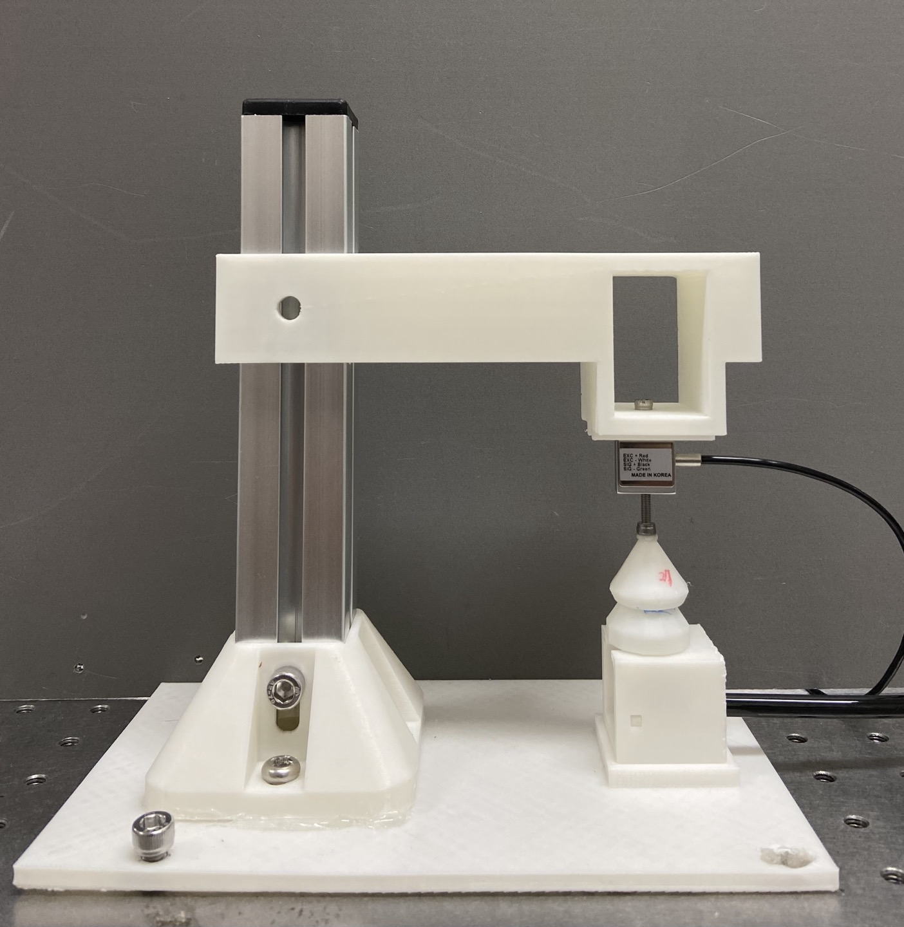
Down Position-Negative Pressure (DN)
1st-EXP, different h
down position, negative pressure
dn

Slide 5
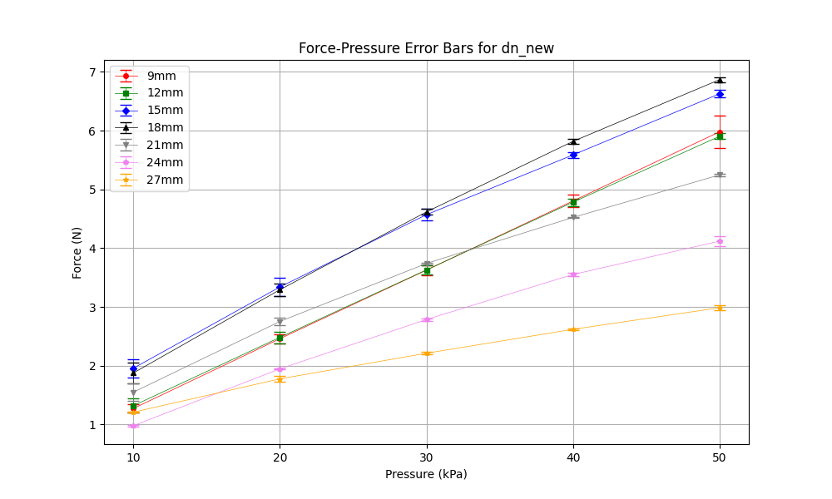
Down Position-Negative Pressure (DN)
2nd-EXP, different h
down position, negative pressure
dn

Slide 6
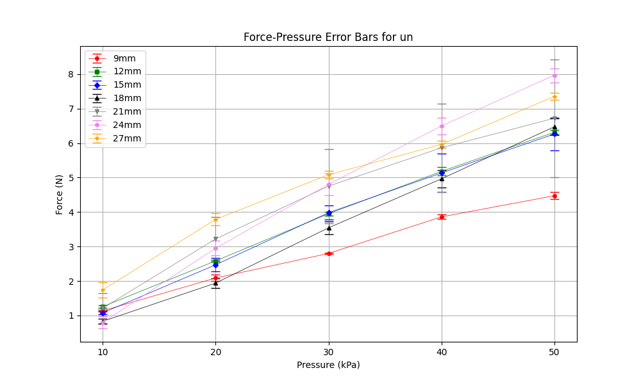
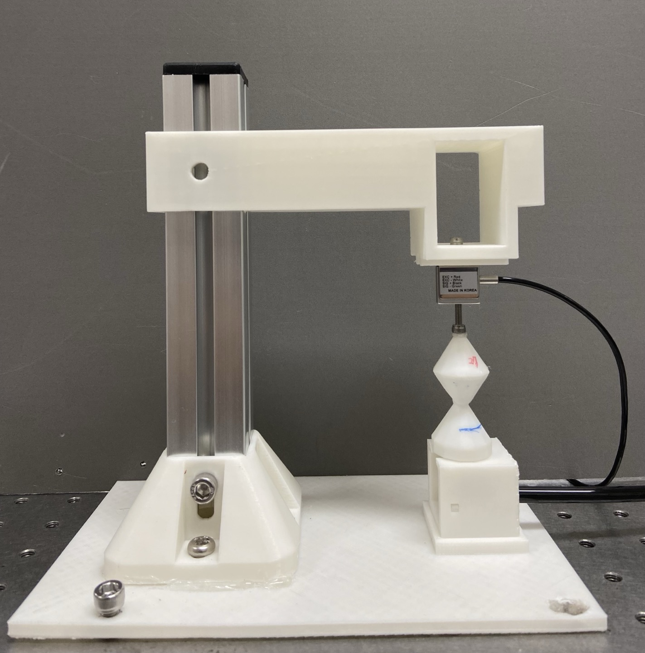
Up Position-Negative Pressure (UN)
1st-EXP, different h
up position, negative pressure
un

Slide 7
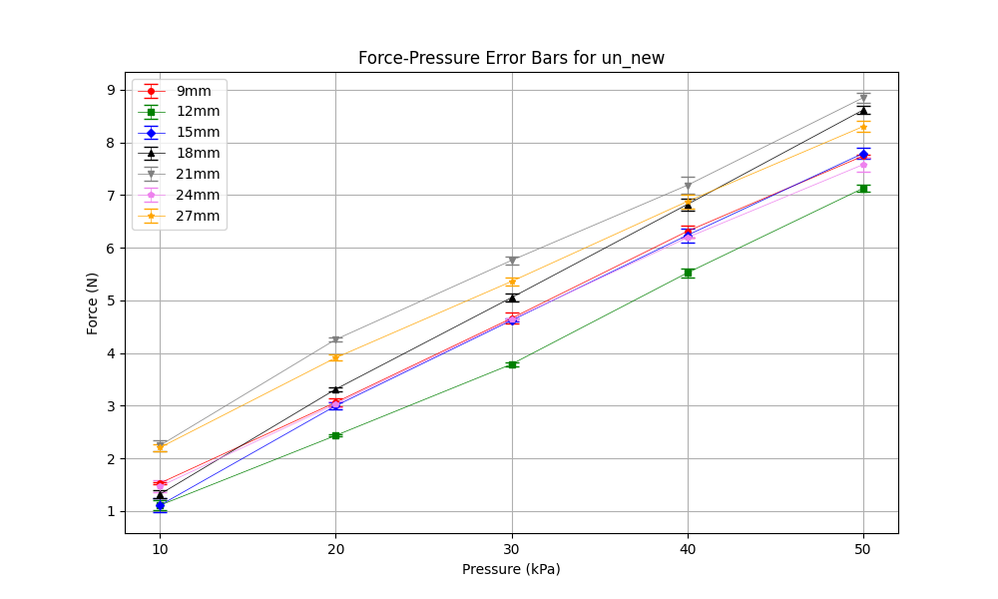
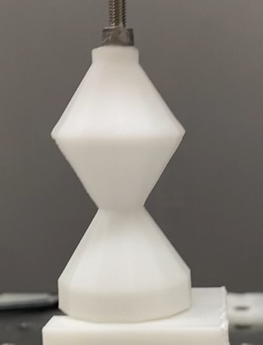
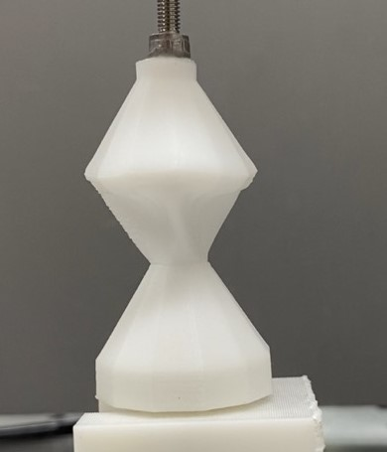
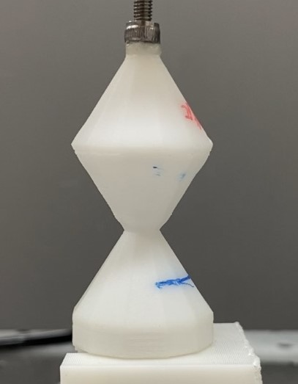
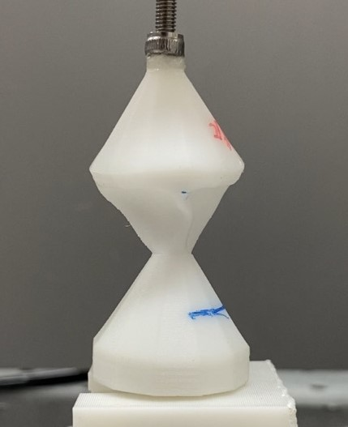
Up Position-Negative Pressure (UN)
2nd-EXP, different h
24mm
27mm

Slide 8
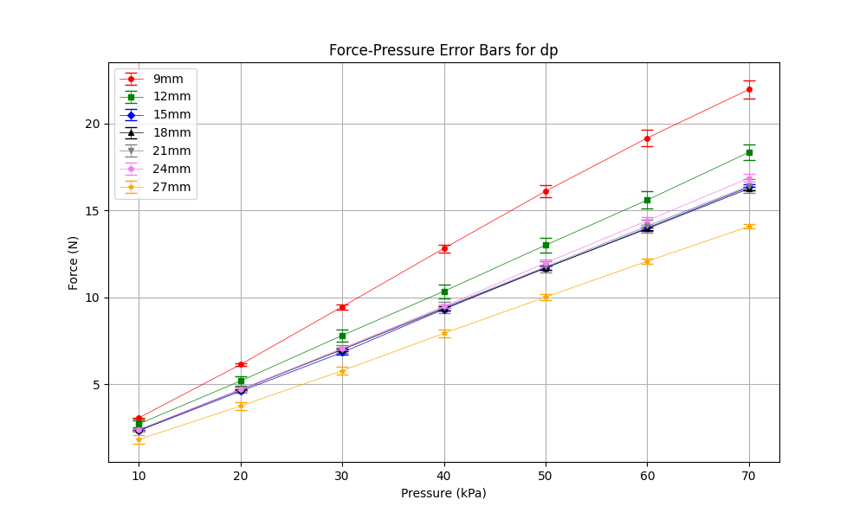
Down Position-Positive Pressure (DP)
1st-EXP, different h
down position, positive pressure
dp

Slide 9
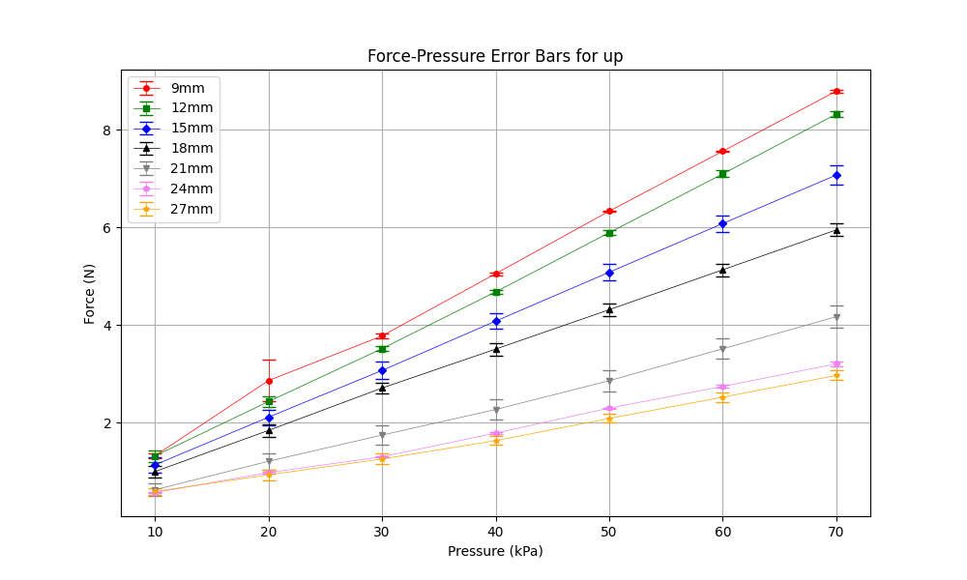
Up Position-Positive Pressure (UP)
1st-EXP, different h
up position, positive pressure
up

Slide 10
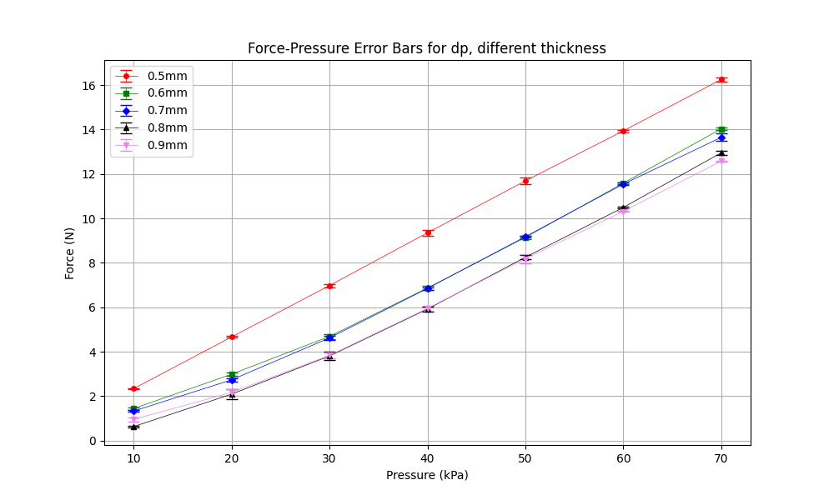
DPcase – different thickness

Slide 11
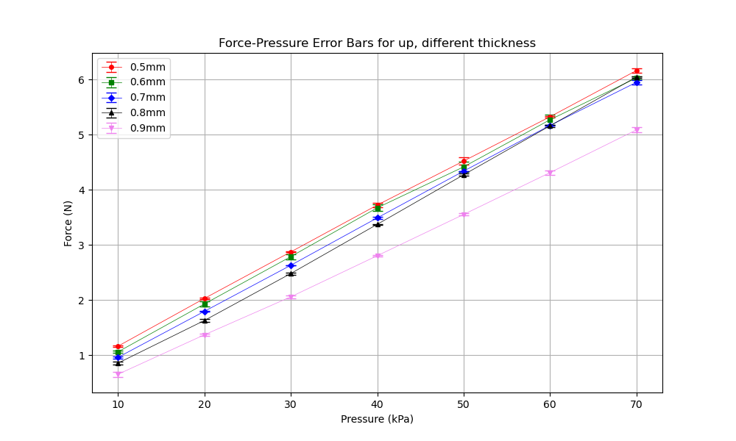
UPcase – different thickness

Slide 12
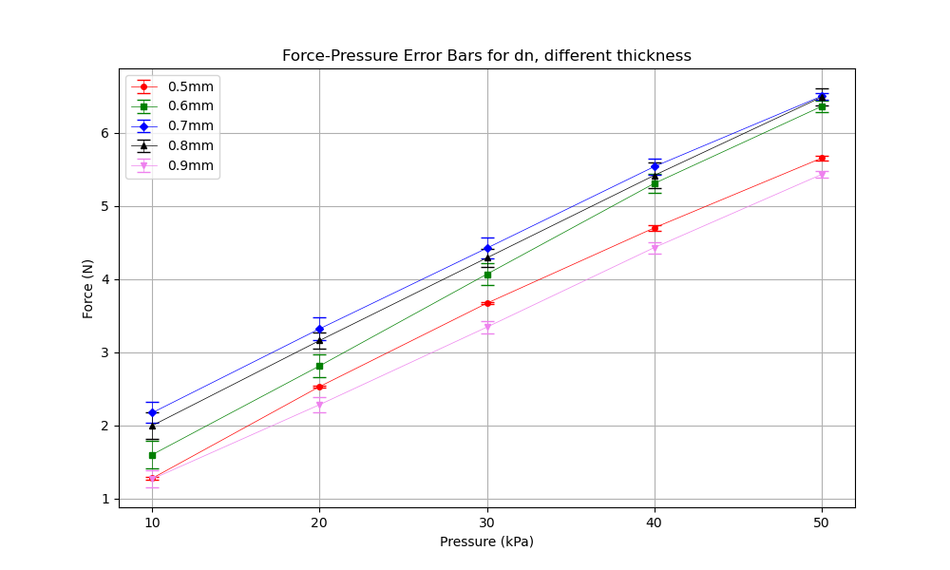
DNcase – different thickness

Slide 13
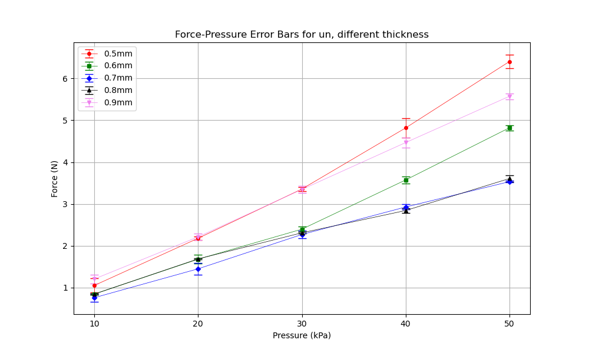
UNcase – different thickness

Slide 14
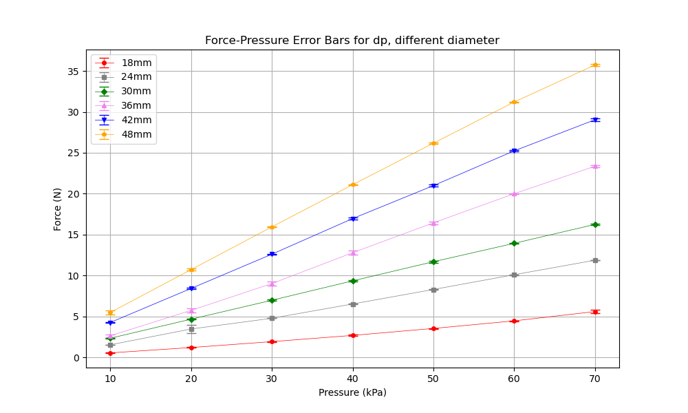
DPcase – different diameter

Slide 15
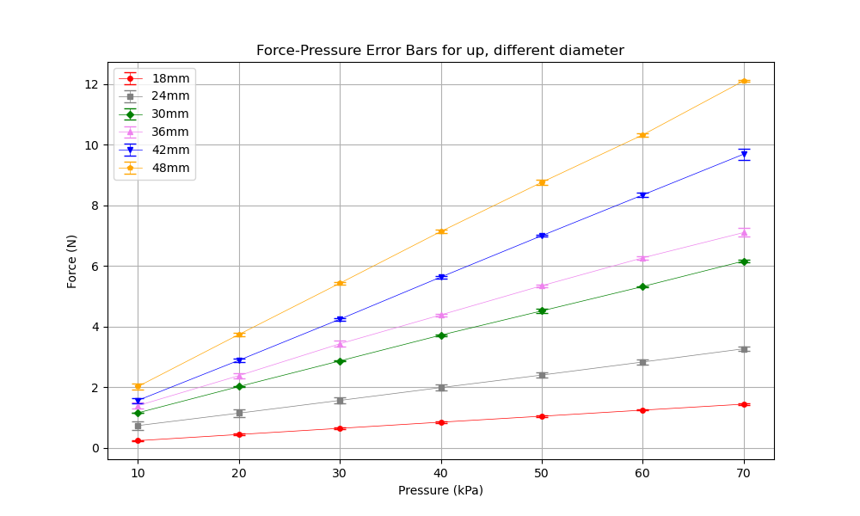
UPcase – different diameter

Slide 16
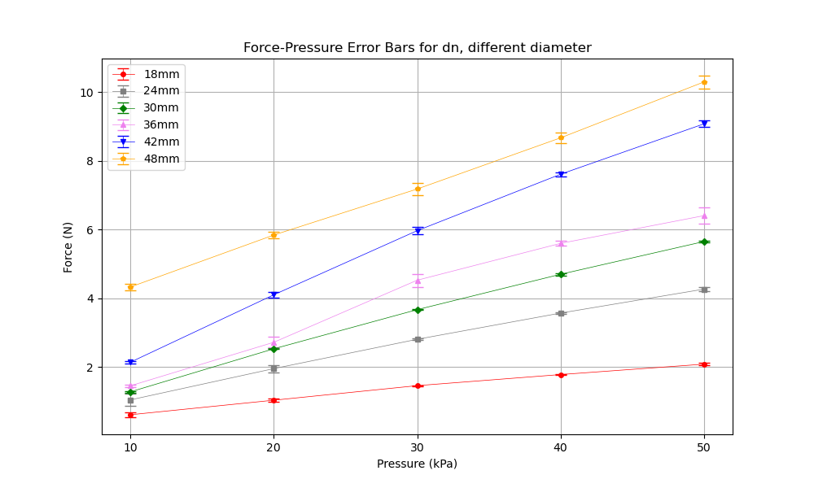
DNcase – different diameter

Slide 17
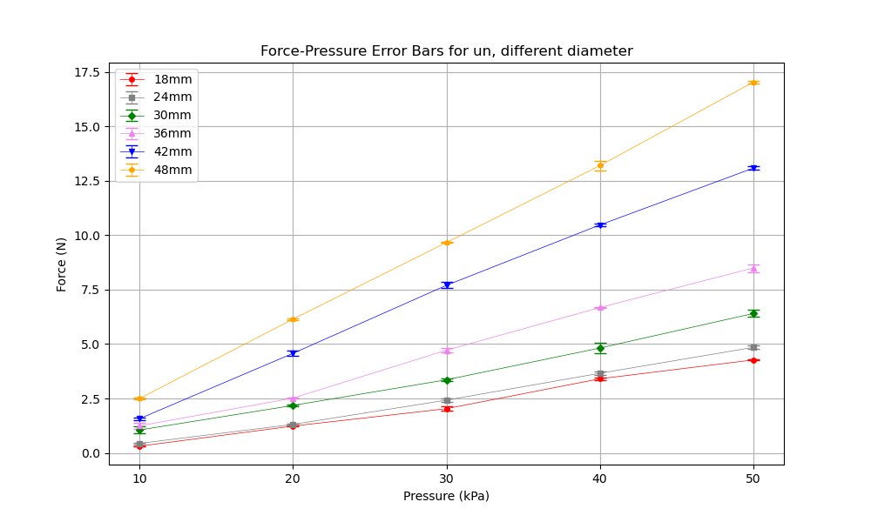
UNcase – different diameter

