Slide 1
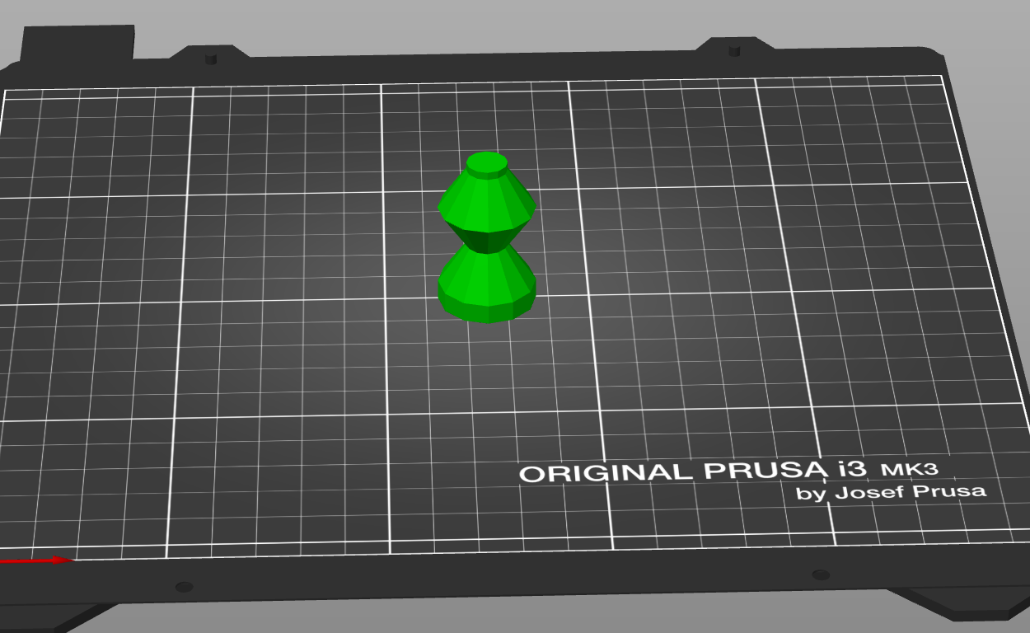
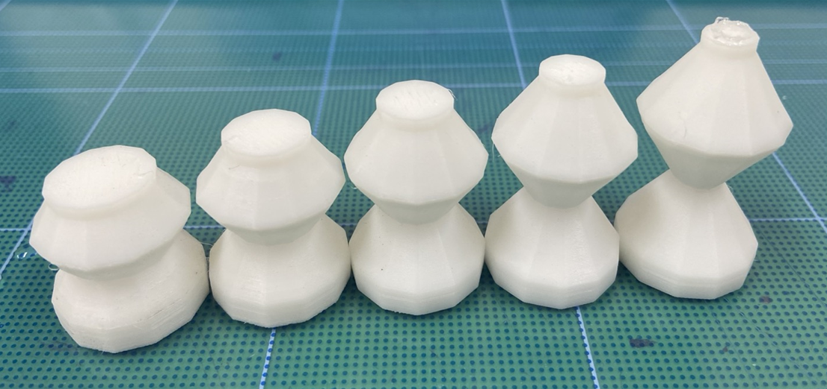
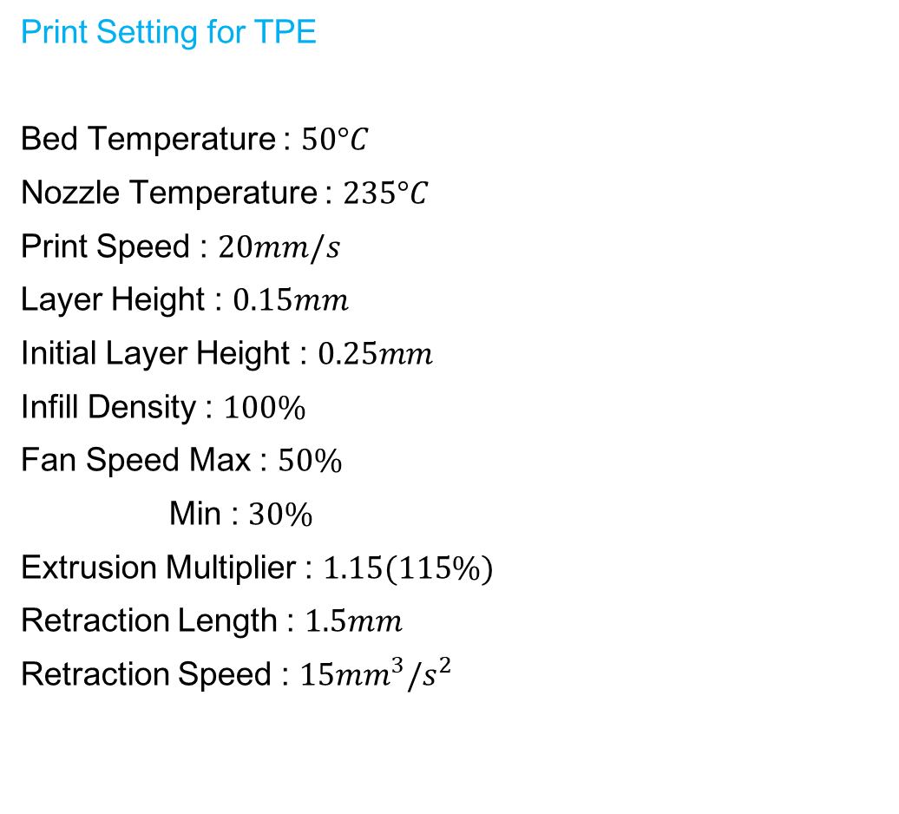
Print Setting for TPE
Bed Temperature : $50°C$
Nozzle Temperature : $235°C$
Print Speed : $20mm/s$
Layer Height : $0.15mm$
Initial Layer Height : $0.25mm$
Infill Density : $100\%$
Fan Speed Max : $50\%$
Min : $30\%$
Extrusion Multiplier : $1.15(115\%)$
Retraction Length : $1.5mm$
Retraction Speed : $15{mm}^{3}/s^{2}$

Slide 2
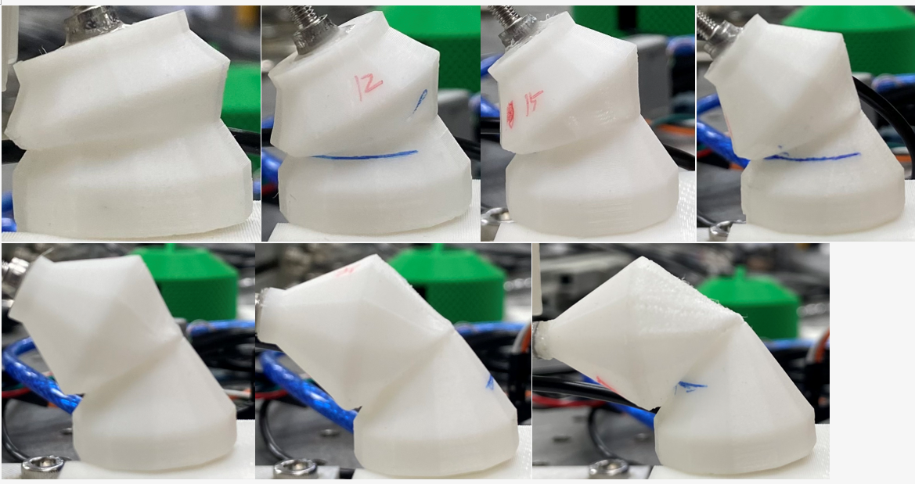
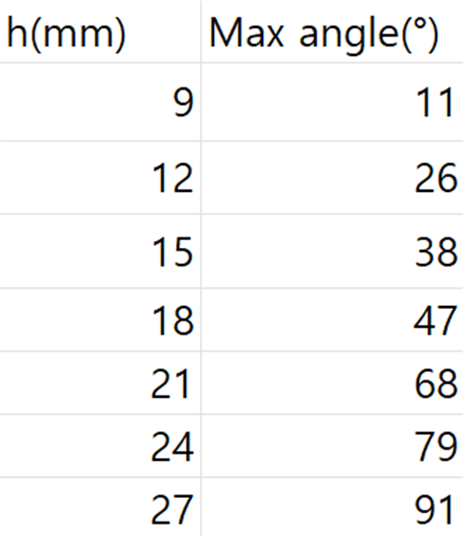
9mm
12mm
15mm
18mm
21mm
24mm
27mm

Slide 3
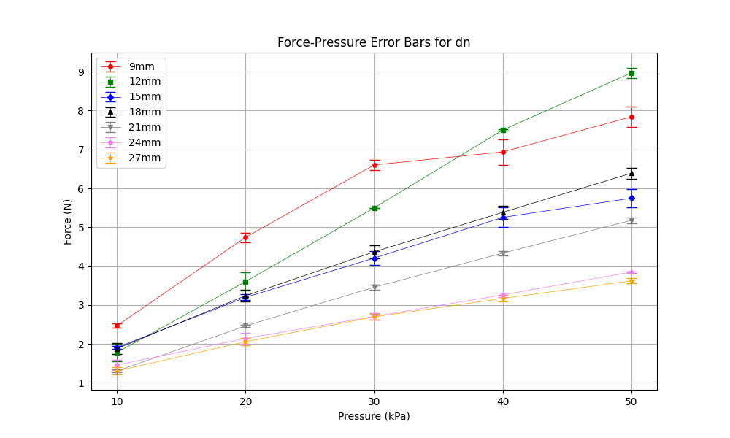
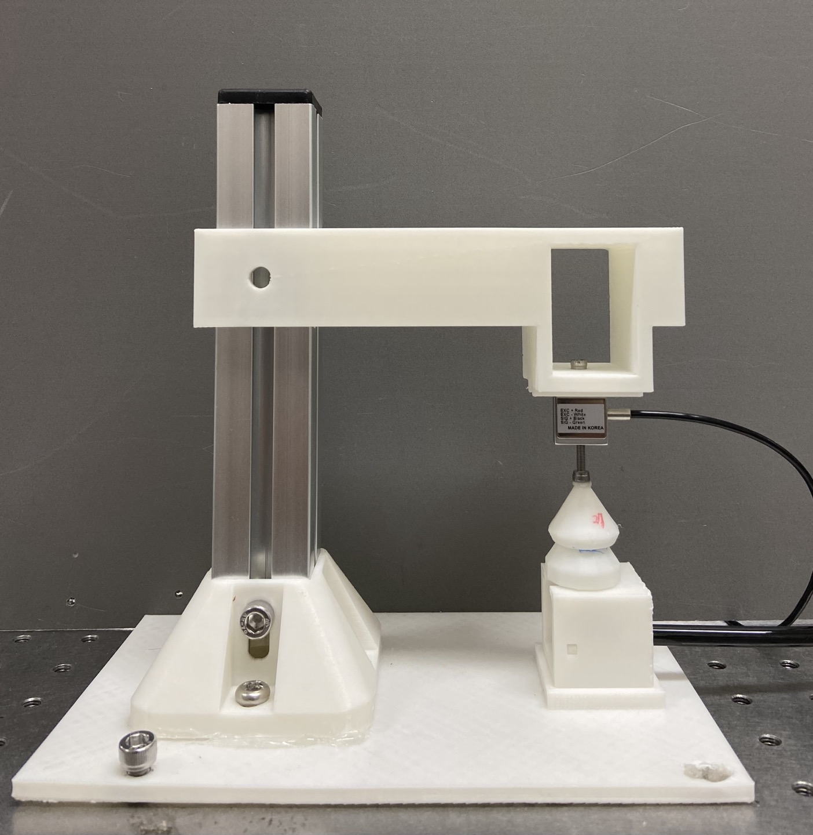
dn 1st
down position, negative pressure
dn

Slide 4
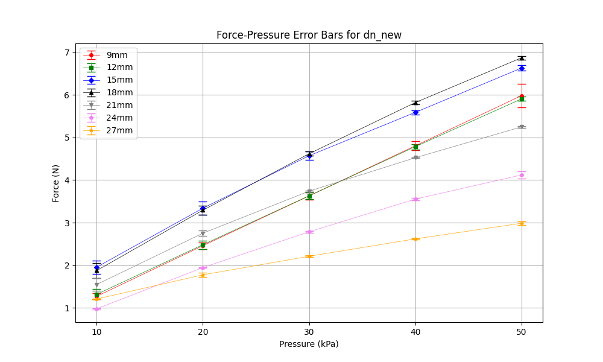
dn 2nd
down position, negative pressure
dn

Slide 5
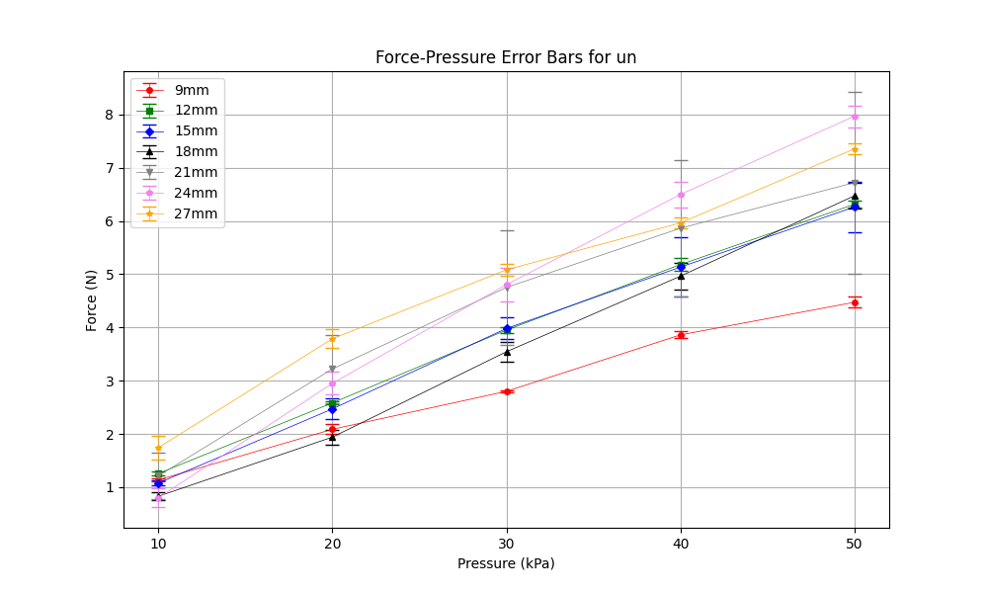
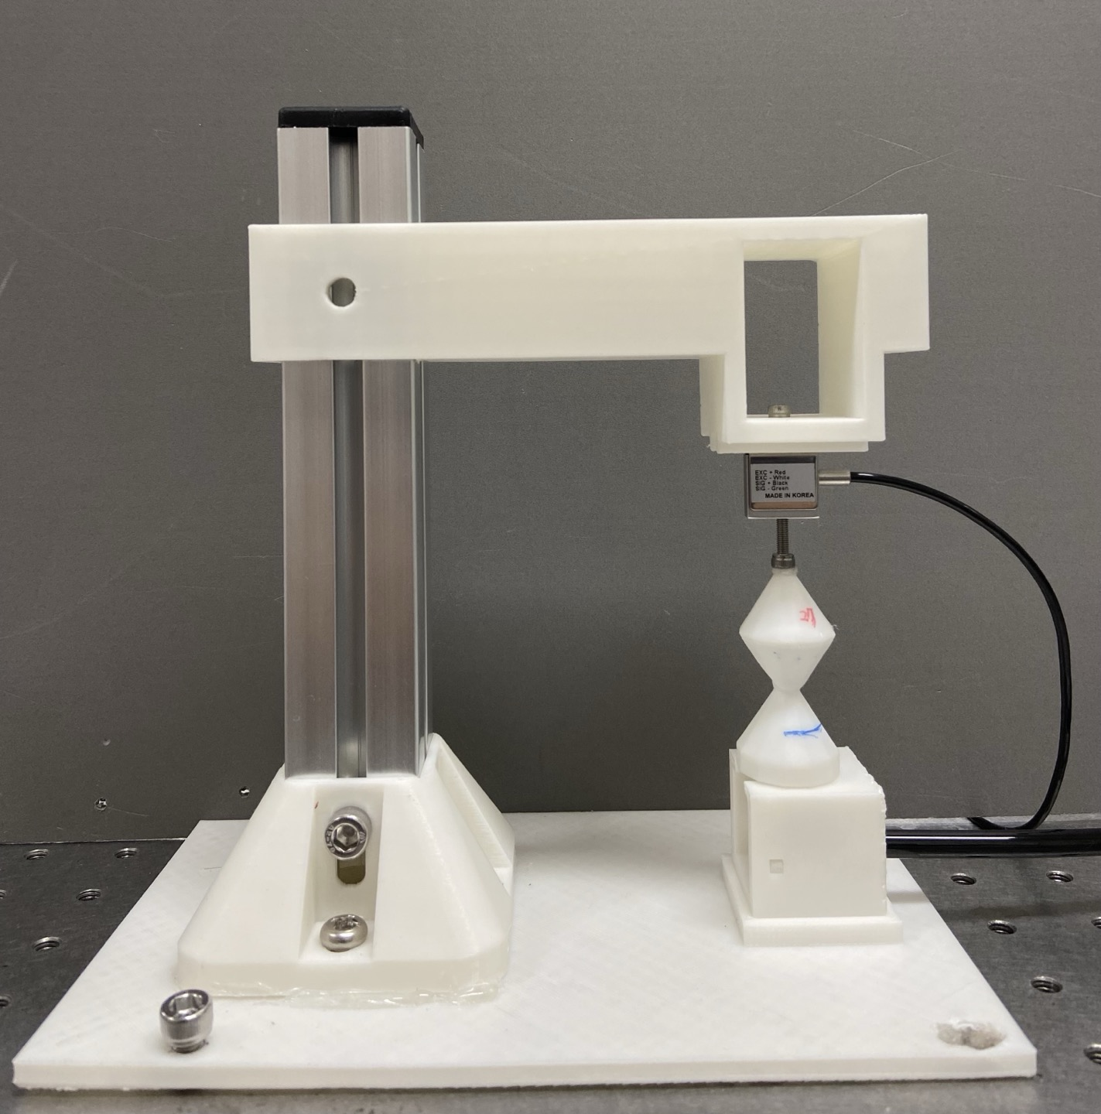
un 1st
up position, negative pressure
un

Slide 6
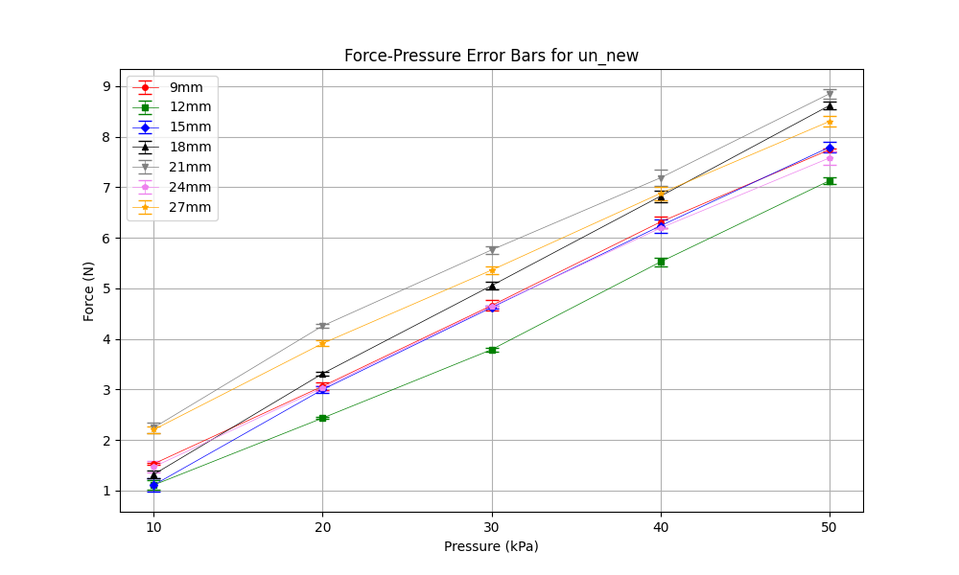
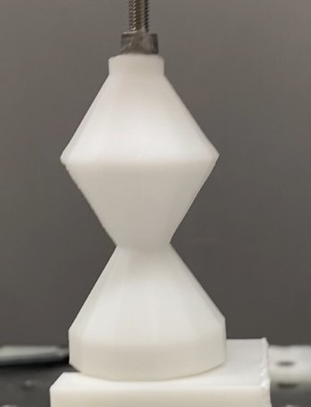
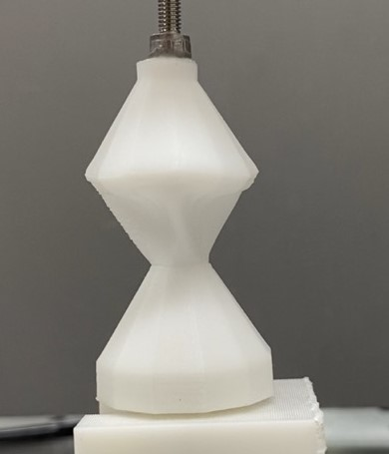
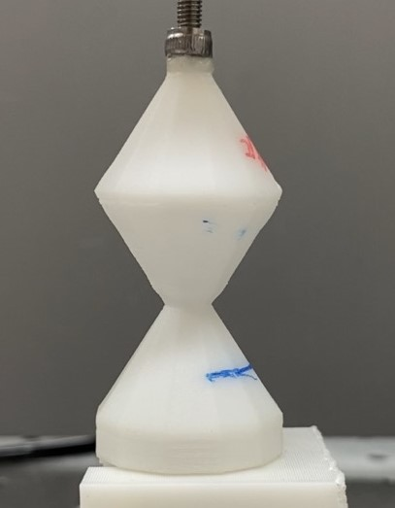
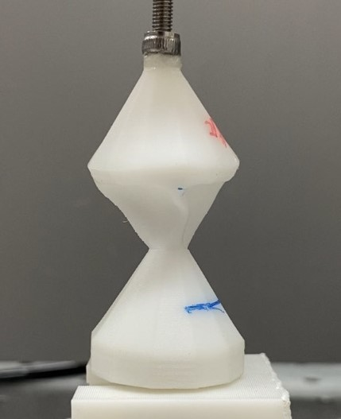
un 2nd
24mm
27mm

Slide 7
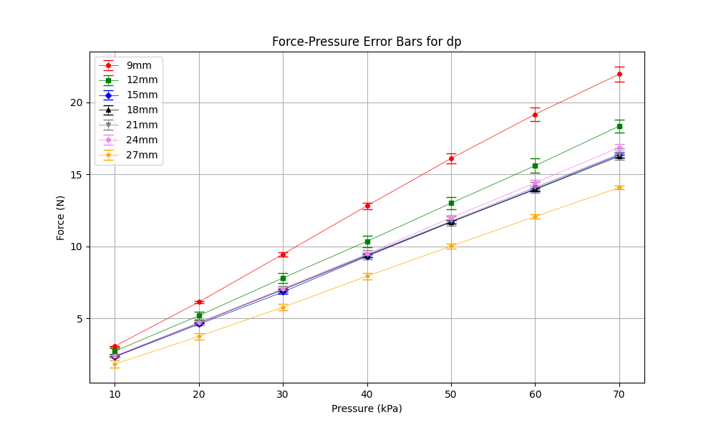
dp 1st
down position, positive pressure
dp

Slide 8
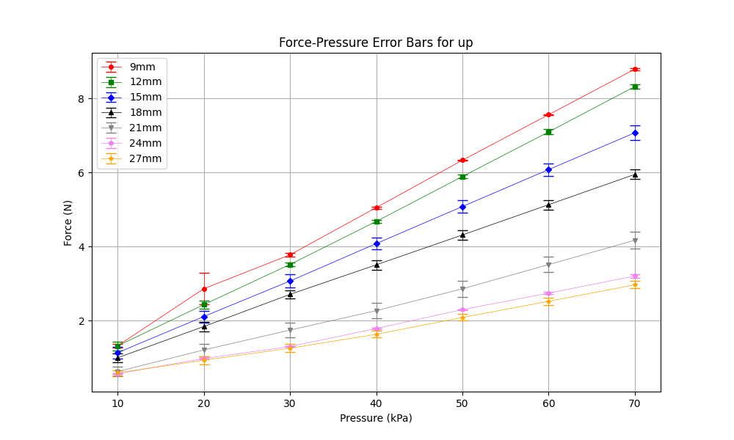
up 1st
up position, positive pressure
up

Slide 9
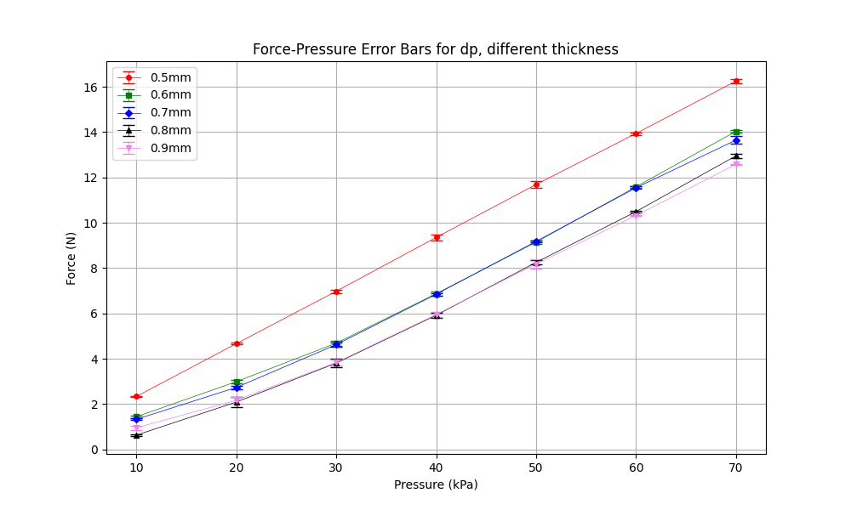
dpcase – different thickness

Slide 10
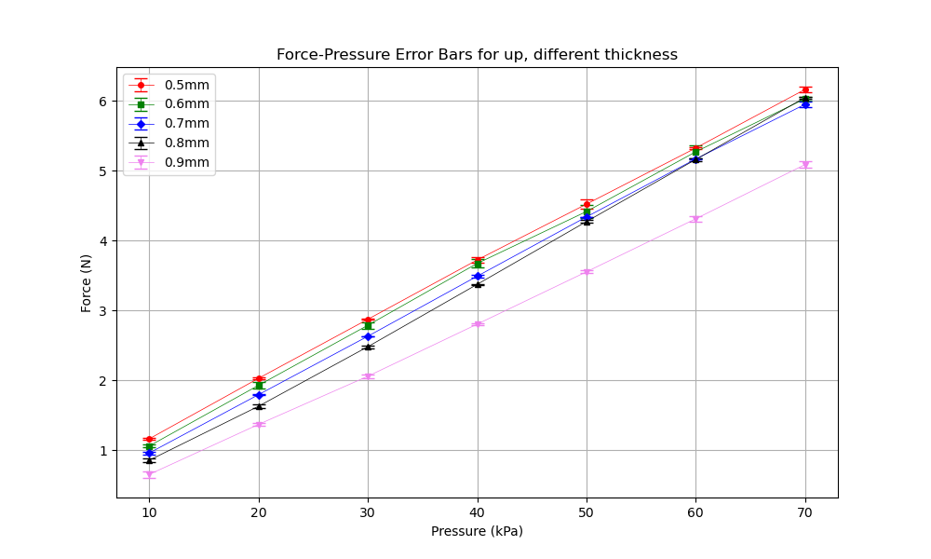
upcase – different thickness

Slide 11
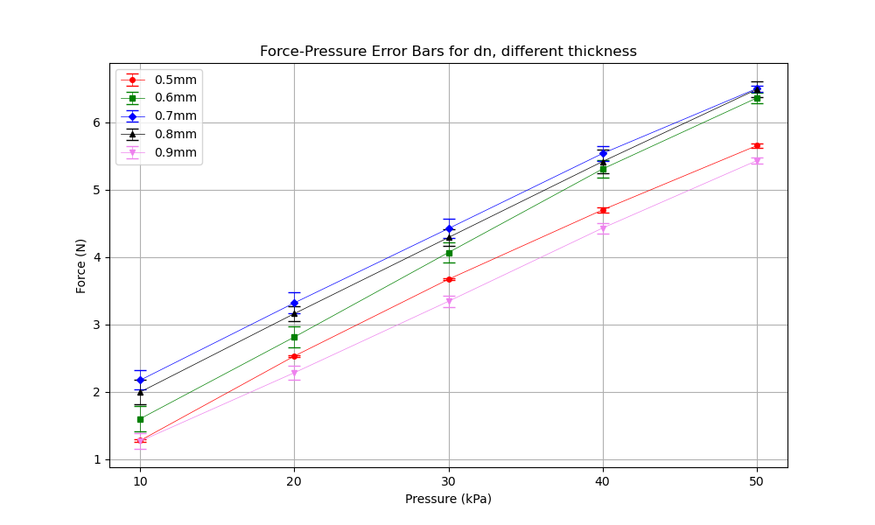
dncase – different thickness

Slide 12
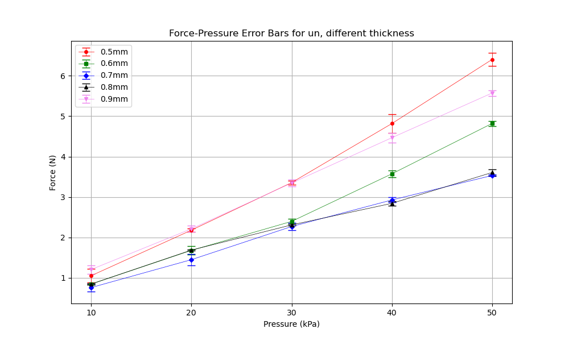
uncase – different thickness

