Slide 1
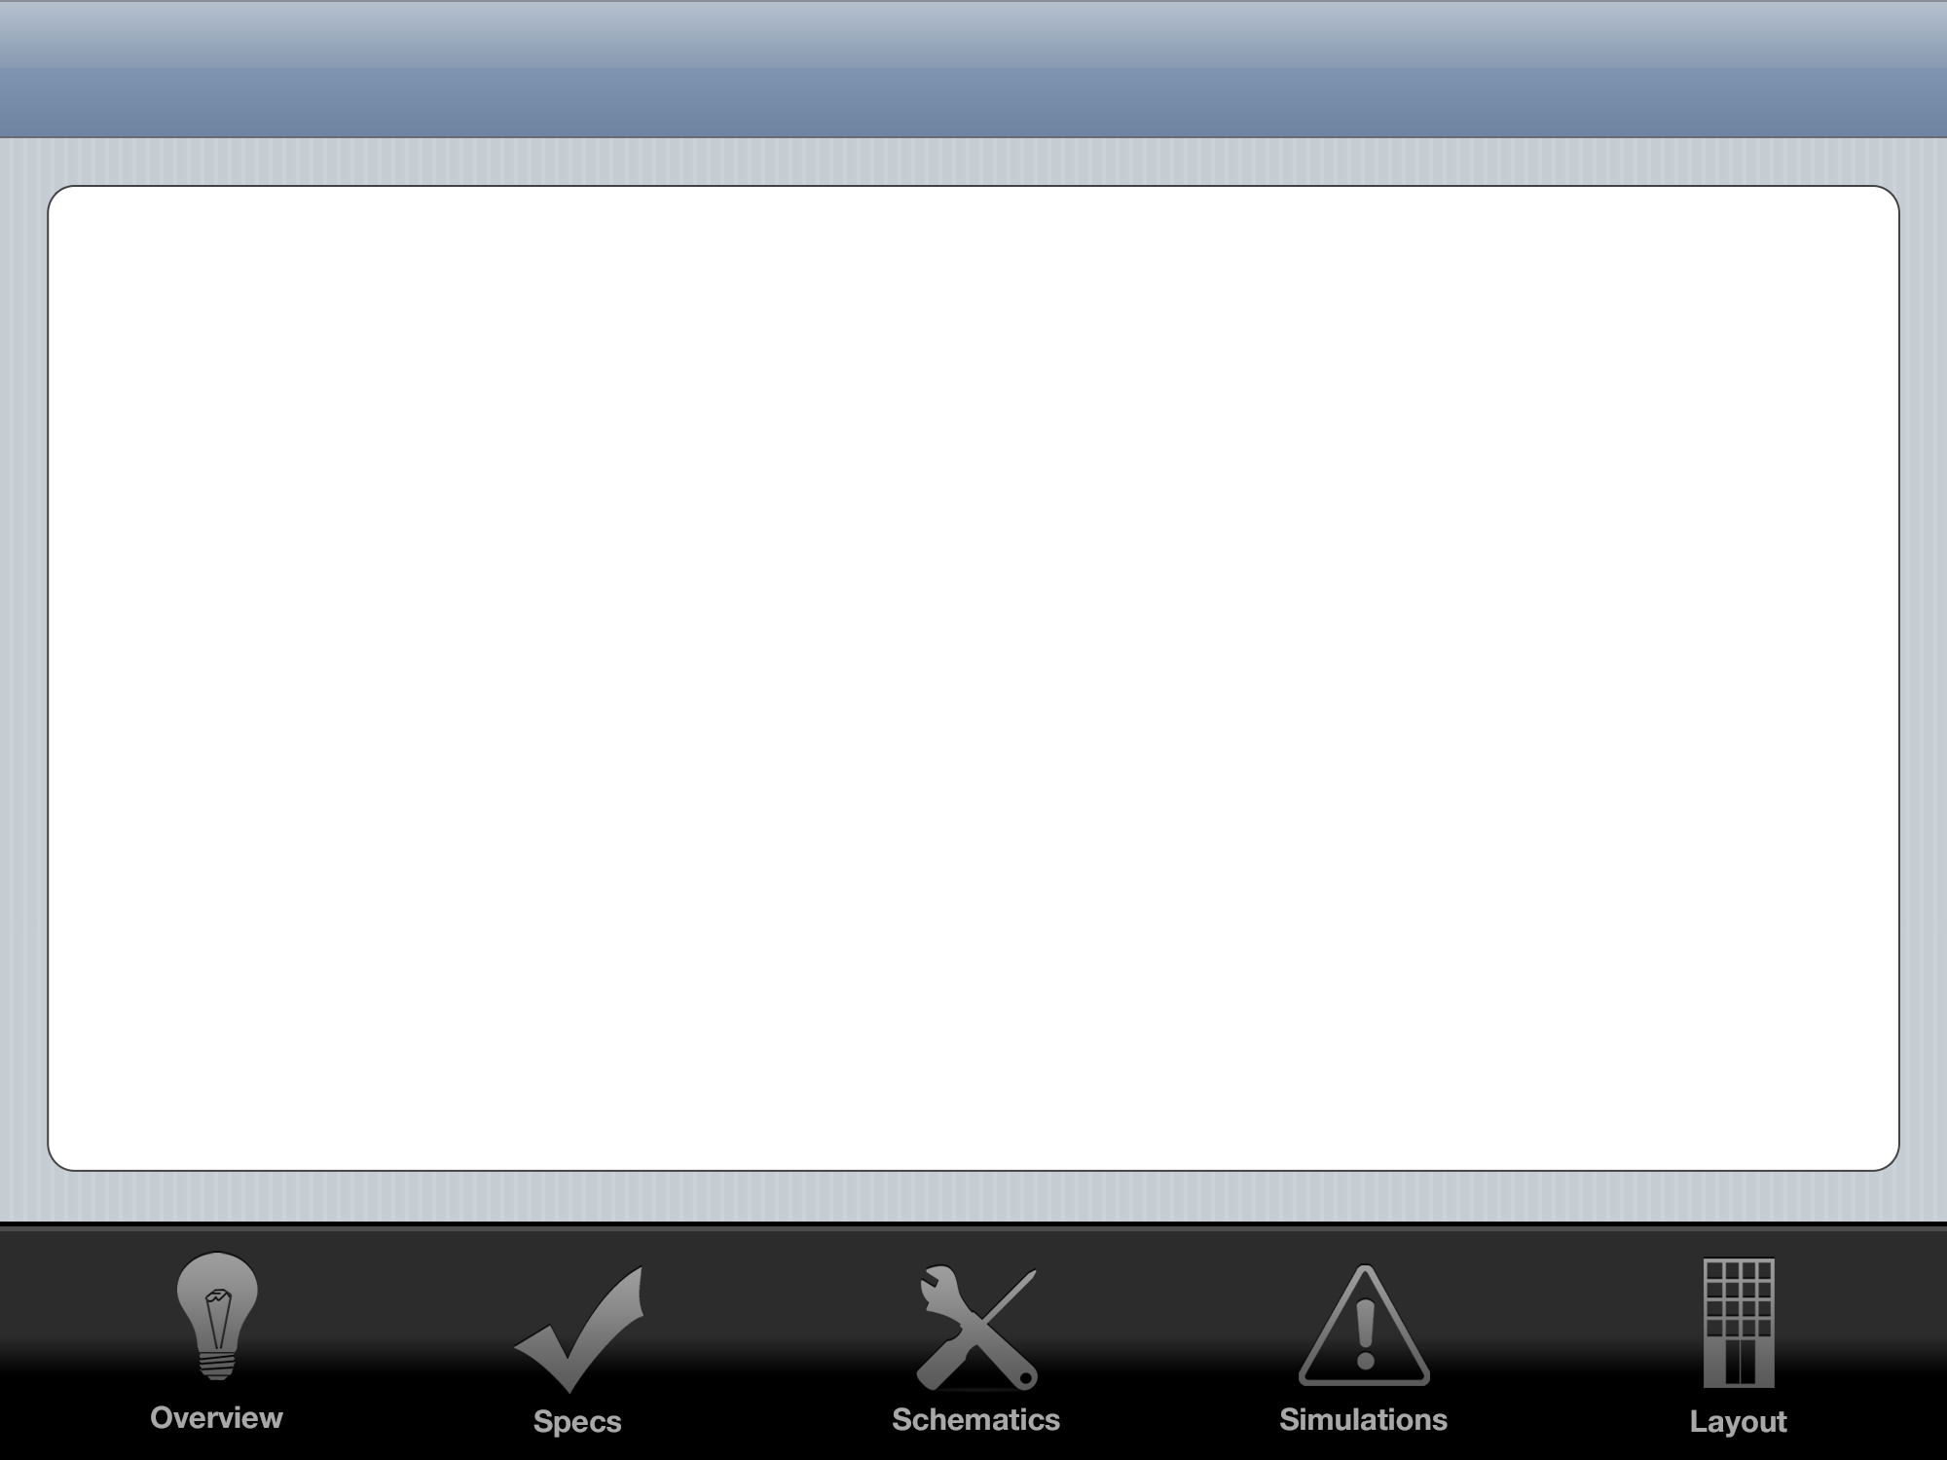
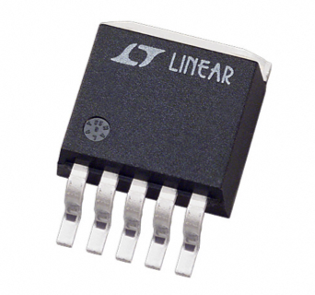
LDO Regulator
John O’Hollaren

Slide 2
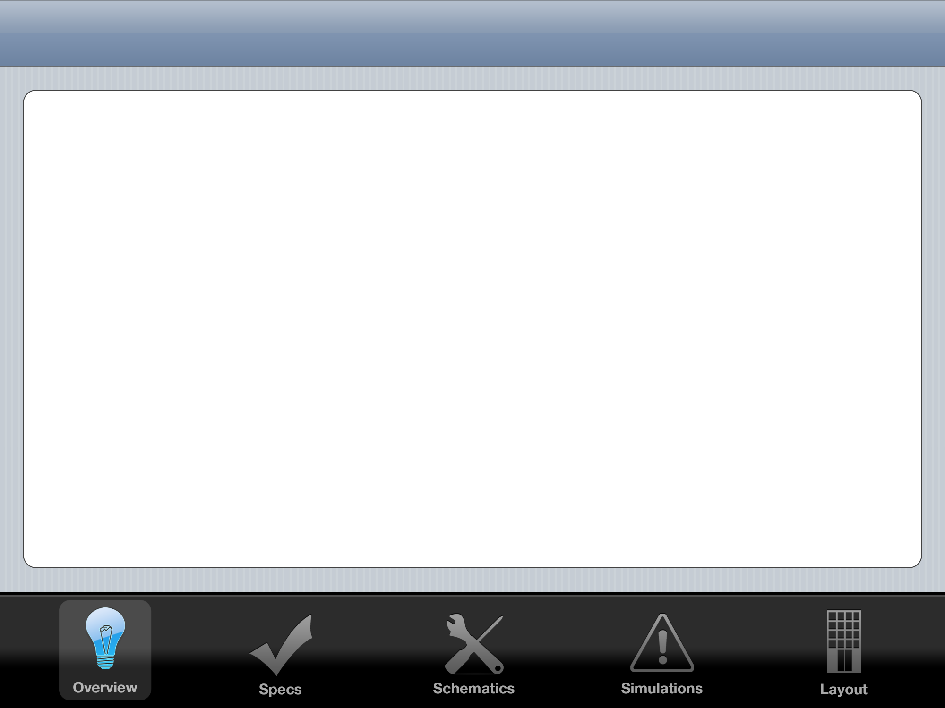


Linear Regulator Overview
Standard
Quasi-LDO
LDO
High Dropout
Stability not a problem
Medium Dropout
Stability a concern
Low Dropout
Stability is a big problem
ESR ‘Tunnel of Death’

Slide 3
Black Box I/O Diagram
LDO
Regulator
VIN
5 Volt VOUT
GND
GND
-10 Volt VSS
10 Volt VDD
1.3 Volt VBIAS

Slide 4
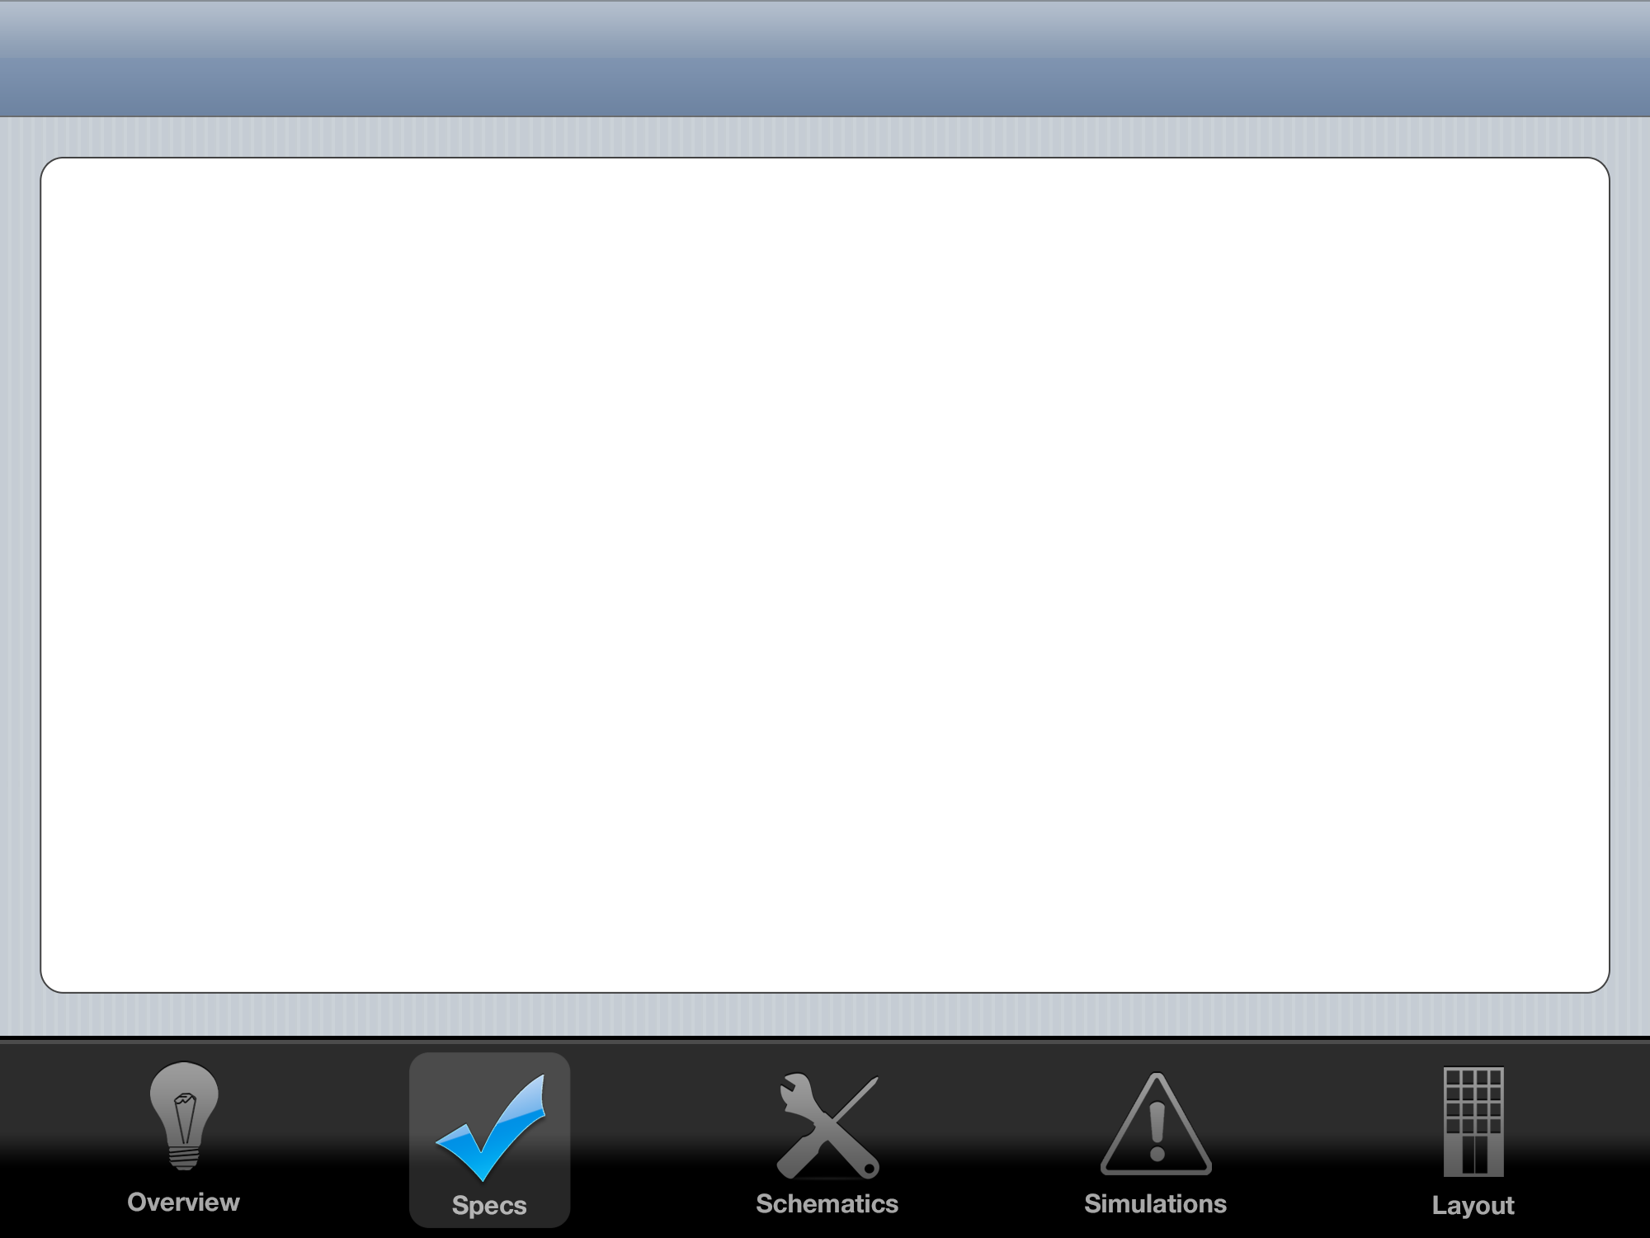


System Spec Goals
 | My LDO | Linear Technology LT1529
Drop Out | 1.1 V | 0.6 V
Required Capacitance | 1 pF | 22 μF
Pos. Settling Time | 2 μS | 150 μS
Neg. Settling Time | 0.1 μS | 100 μS
Quiescent PWR Loss | 1 mW | 0.5 mW
Area | 0.15 mm² | >> 0.15 mm²
Max. Input (+200 mV) | 8 Volts | 6 Volts
Min. Input (-200 mV) | 12 Volts | 15 Volts
Max Output Current | 0.5 A | 3 A

Slide 5
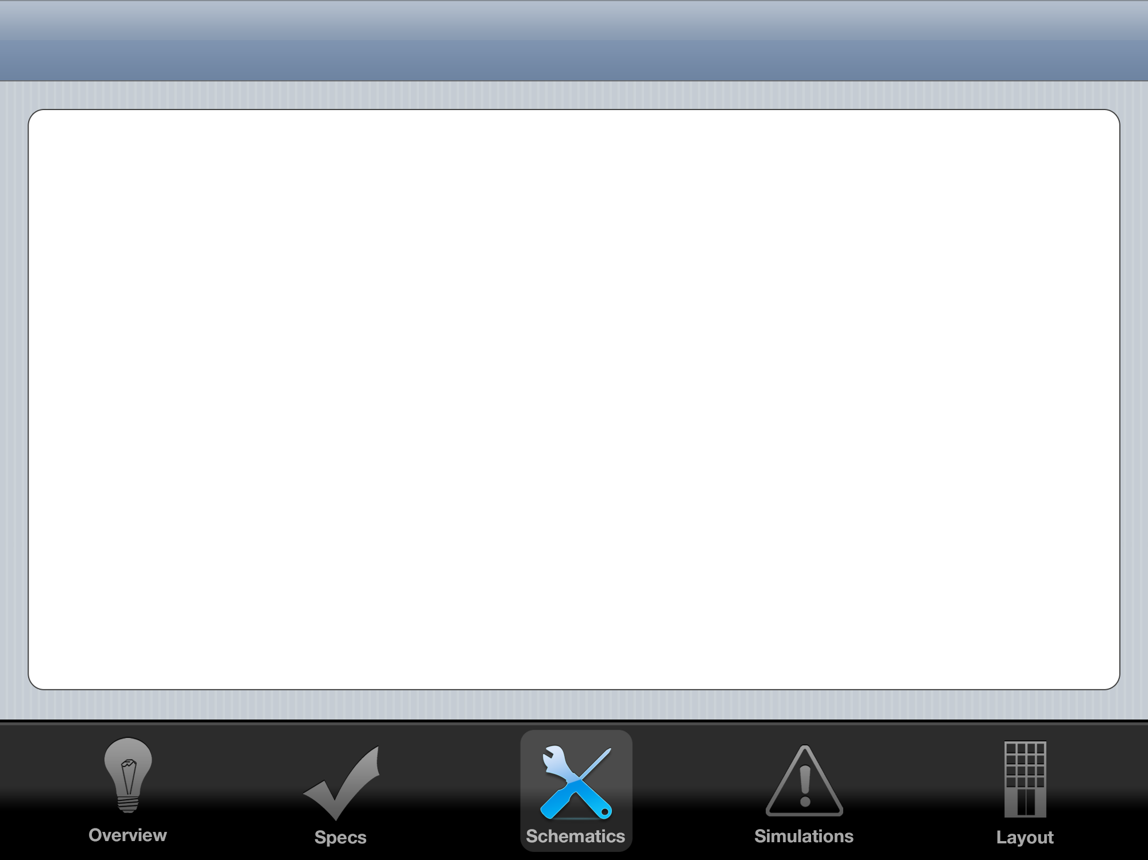
Control System: PID
K_{P}
+
-
Gate
Drive
+
+
+
H
Vout
Vref

Slide 6
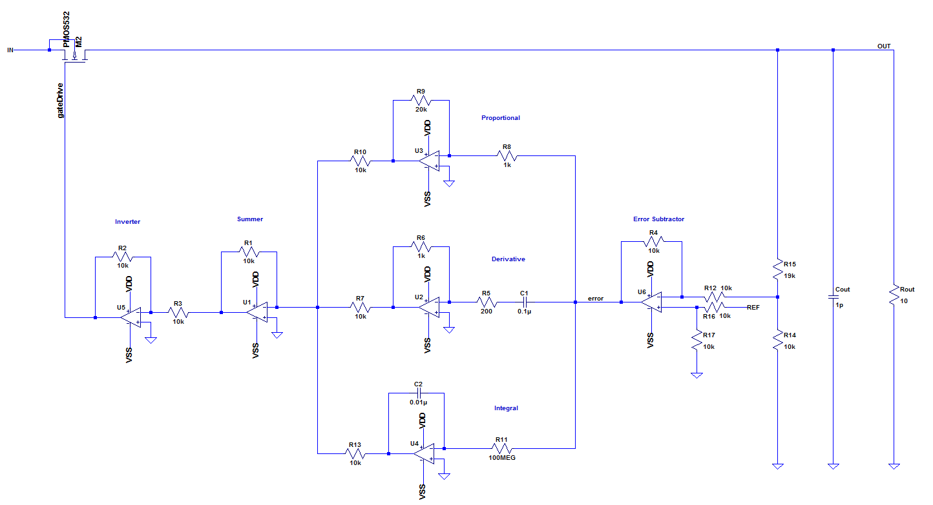
Control System: PID

Slide 7
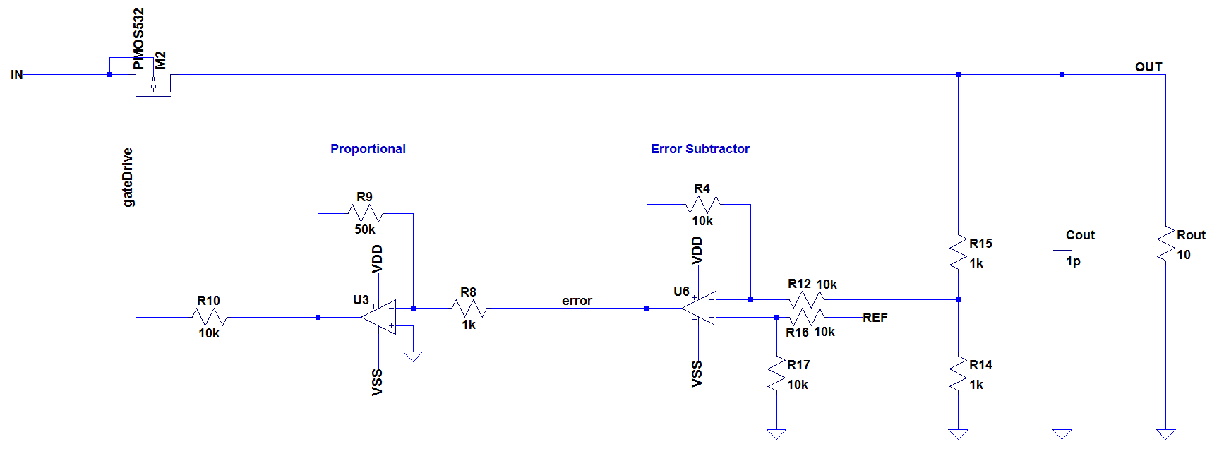
Control System: P

Slide 8
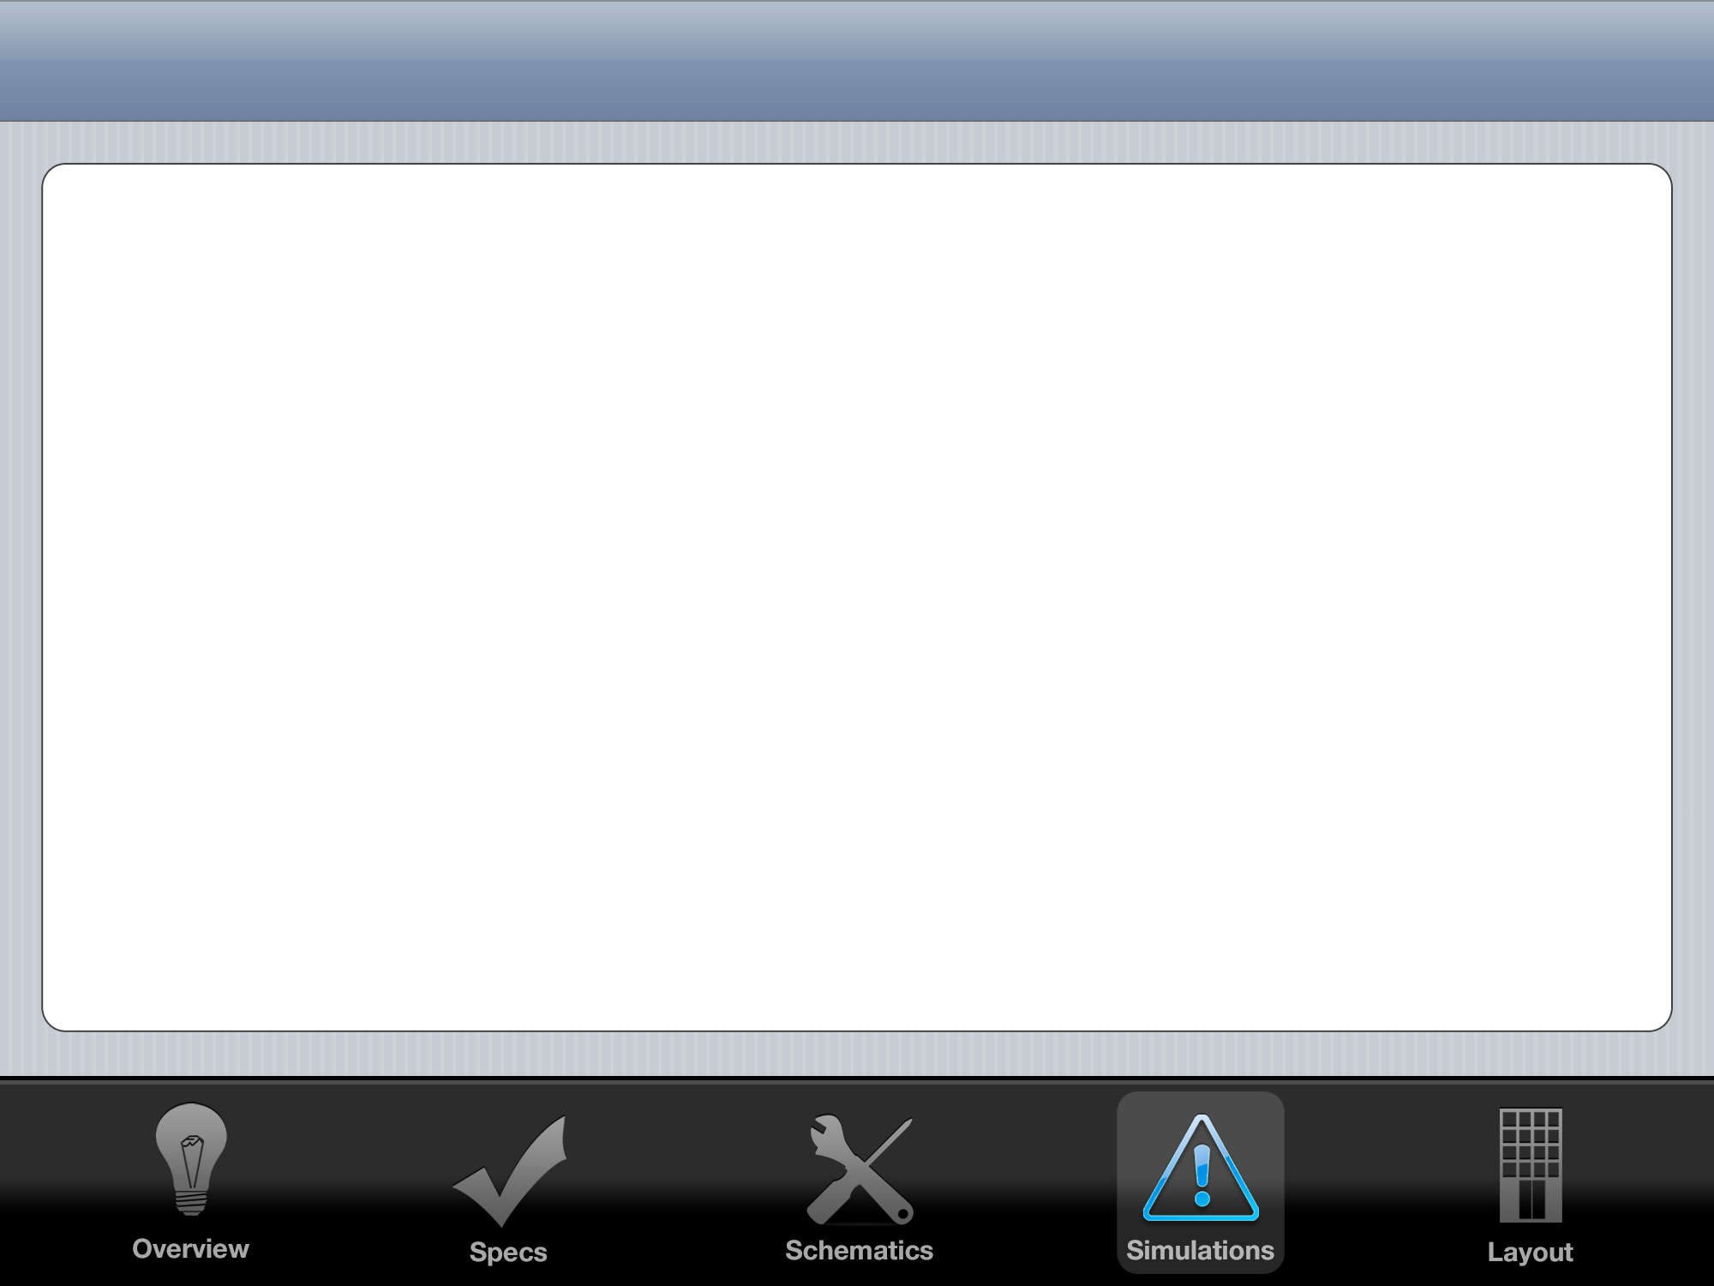
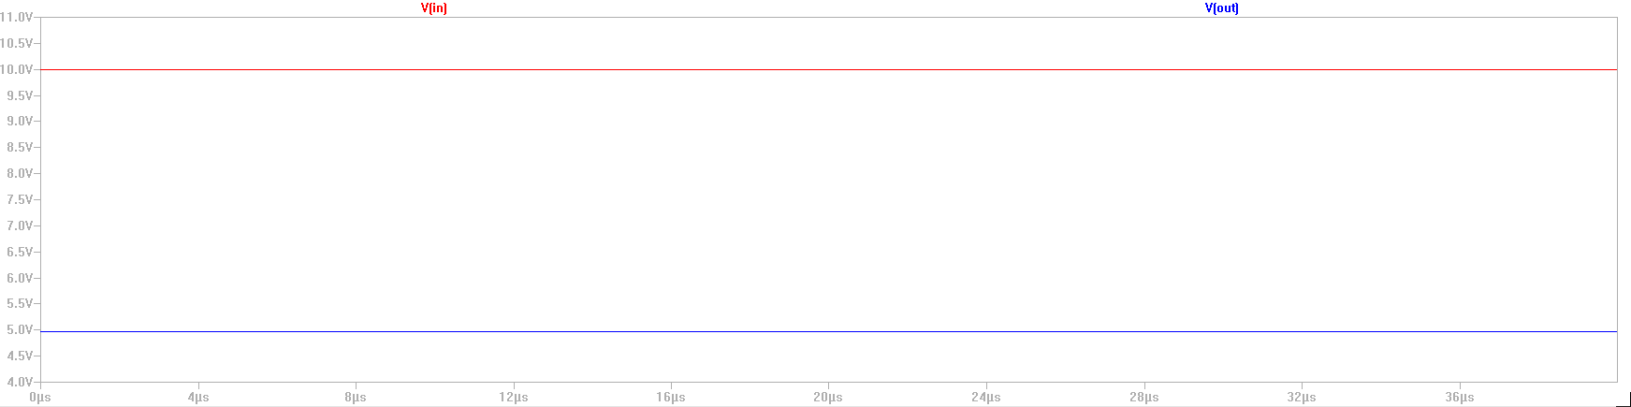
Steady State Output
Given 10 Volt Input
Easily Produces 5V Output

Slide 9
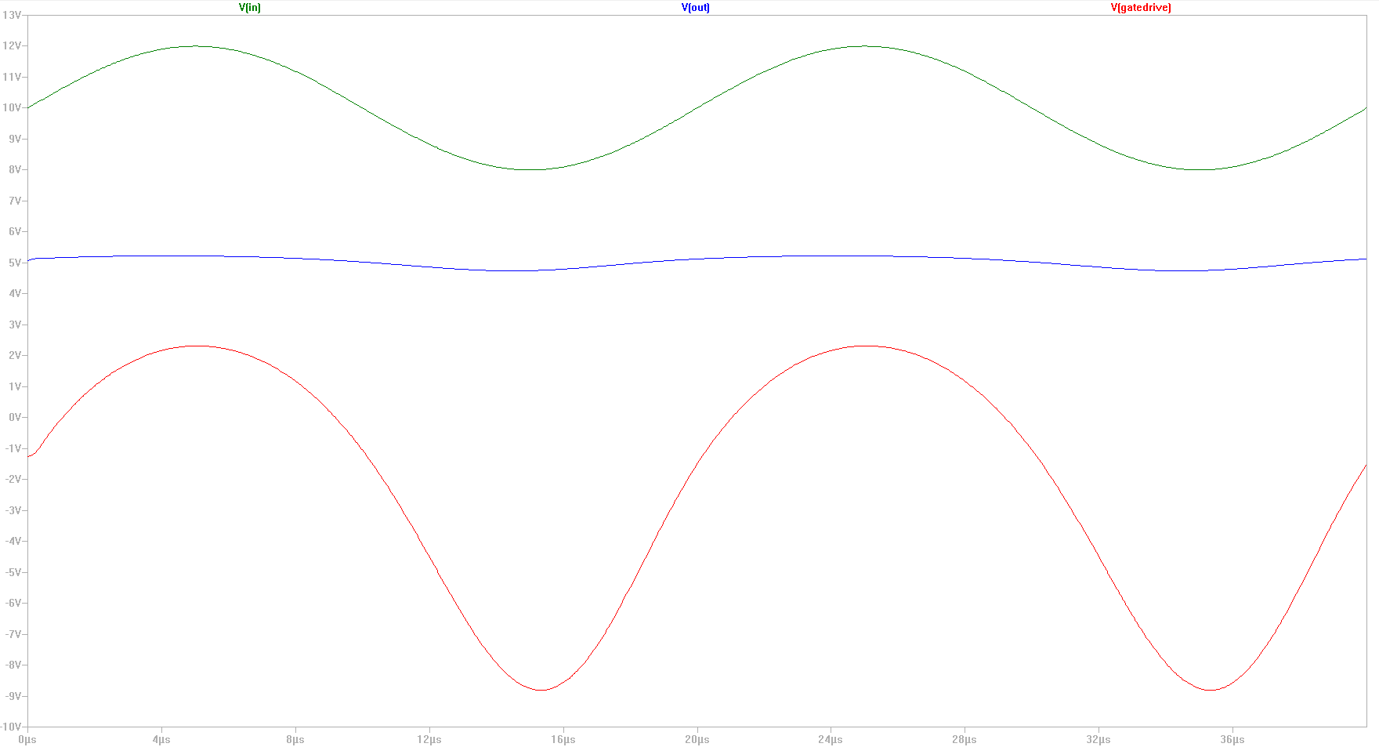
4V Sine Wave on Input

Slide 10
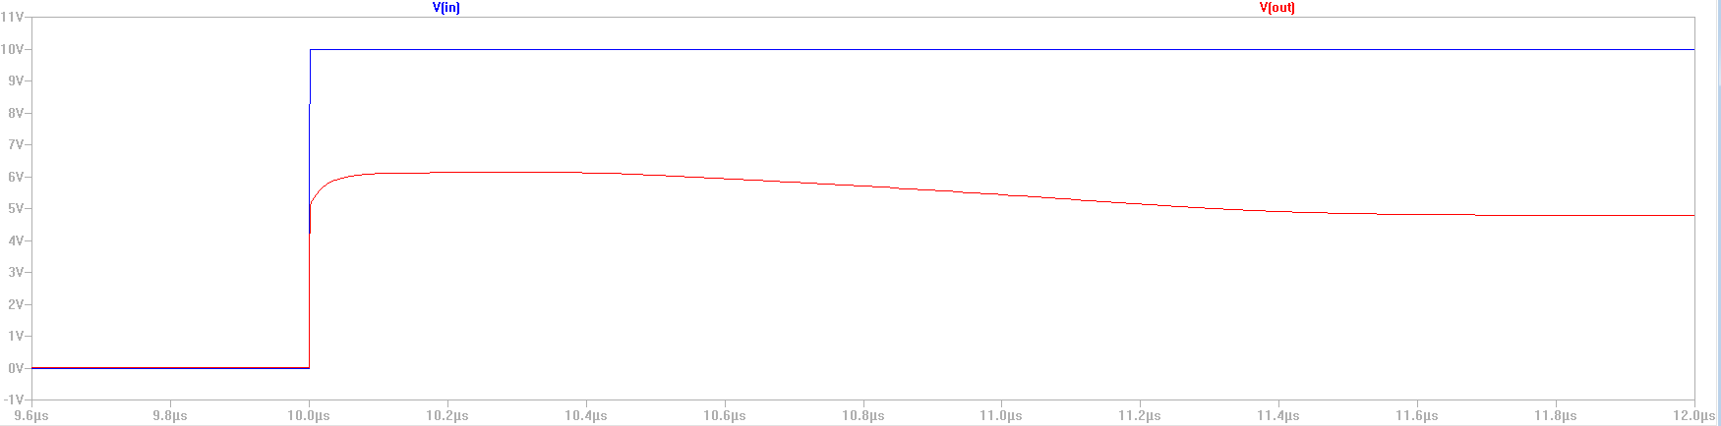
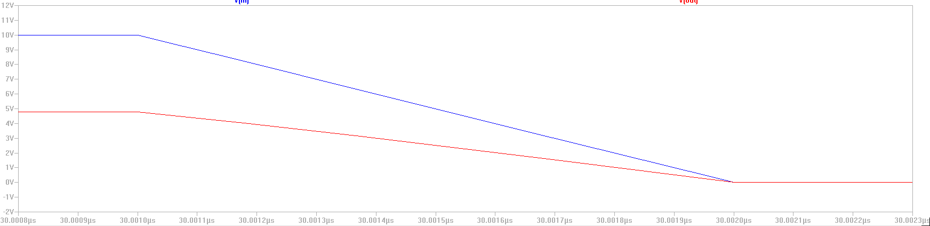
Step Response

Slide 11
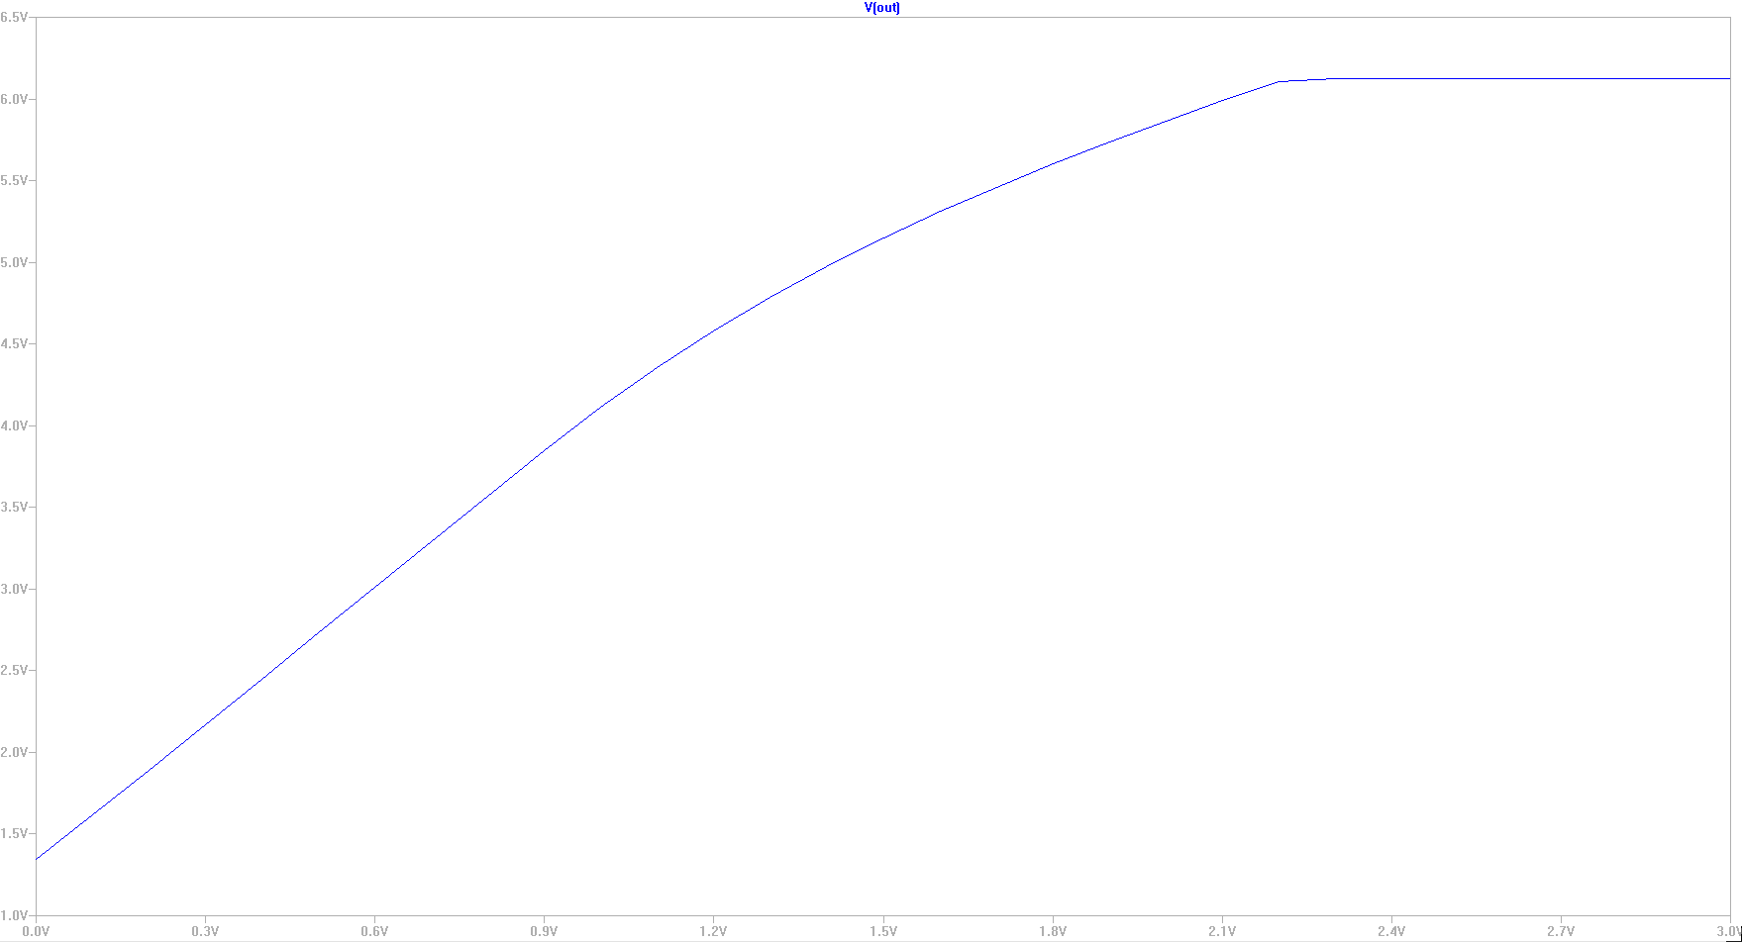
DC Sweep VREF

Slide 12
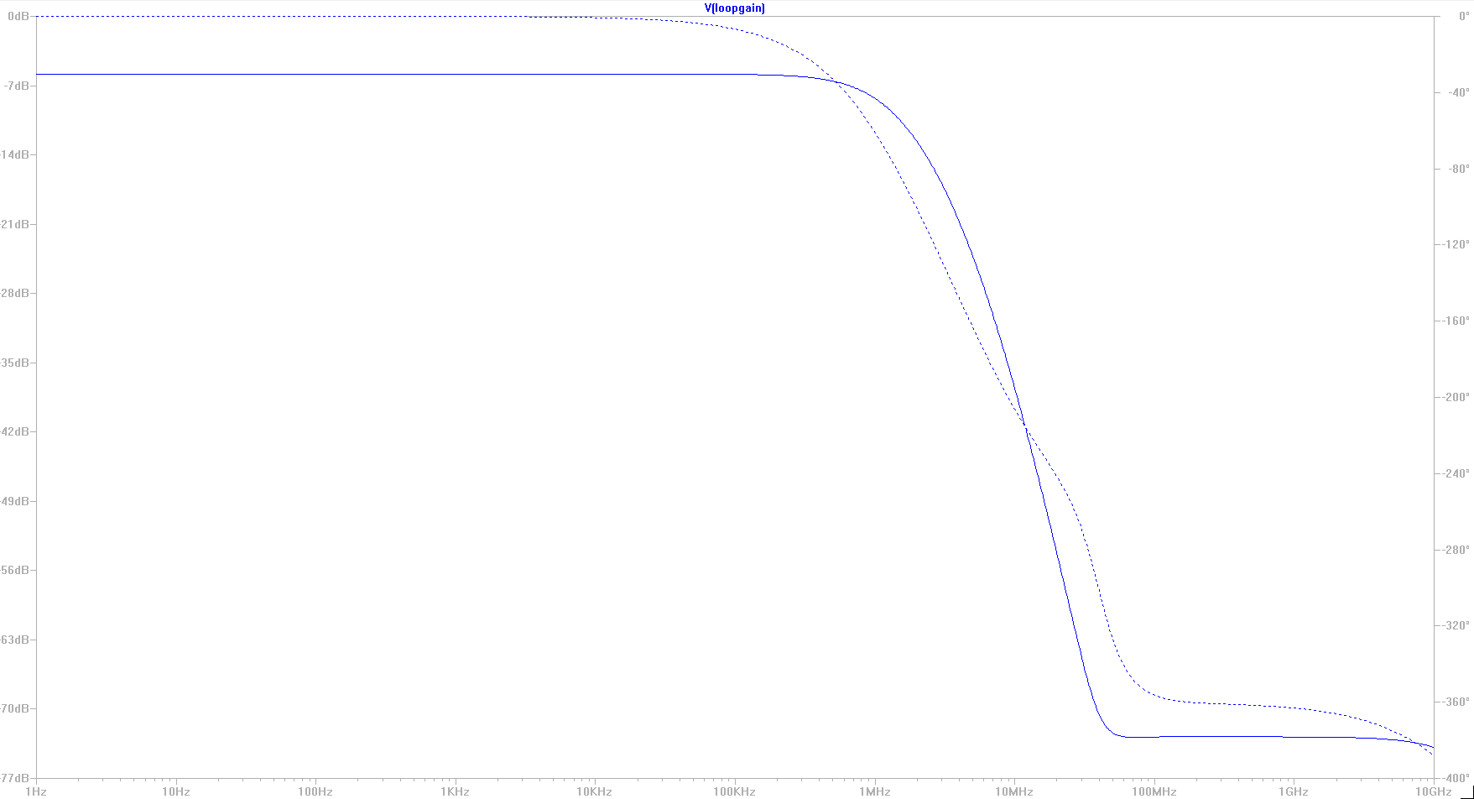
Loop Gain

Slide 13
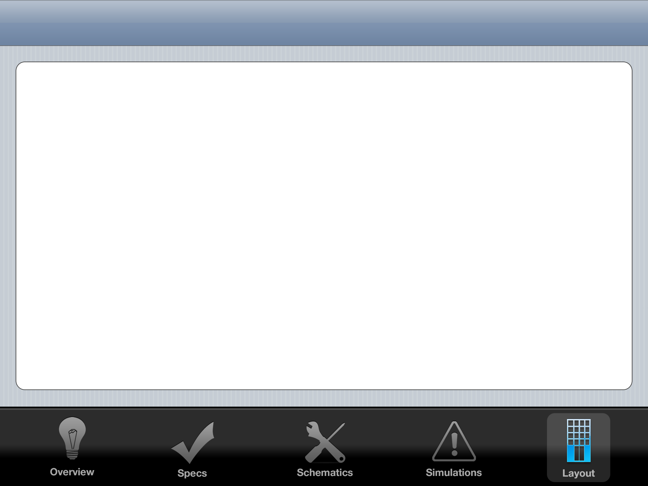
Layout Floorplan
0.47 mm
20 μm
VIN RAIL
VOUT RAIL
200 μm
200 μm
70 μm
OP AMP 1
OP AMP 2
Power
MOSFET
0.29 mm
250 μm
Common
Centroid
Precision
Resistors
20 μm
GND RAIL

Slide 14
Common Centroid Plan
Inverting
Amplifier
Differential
Amplifier
Feedback
Divider
Op Amps
R1: 50 kΩ
R2: 1 kΩ
Unit Resistor
for common
centroid:
1 kΩ
R1: 10 kΩ
R2: 10 kΩ
R3: 10 kΩ
R4: 10 kΩ
Unit Resistor
for common
centroid:
2.5 kΩ
R1: 1 kΩ
R2: 1 kΩ
Unit Resistor
for common
centroid:
500 Ω
Common centroid
already completed
in homework 4

Slide 15
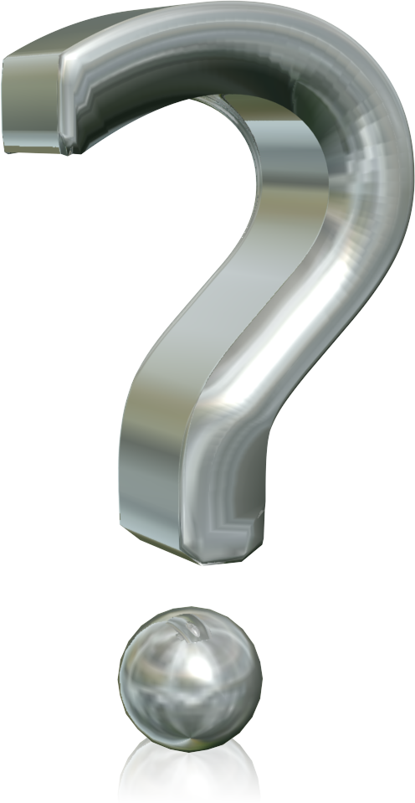
Thank You

