Slide 1
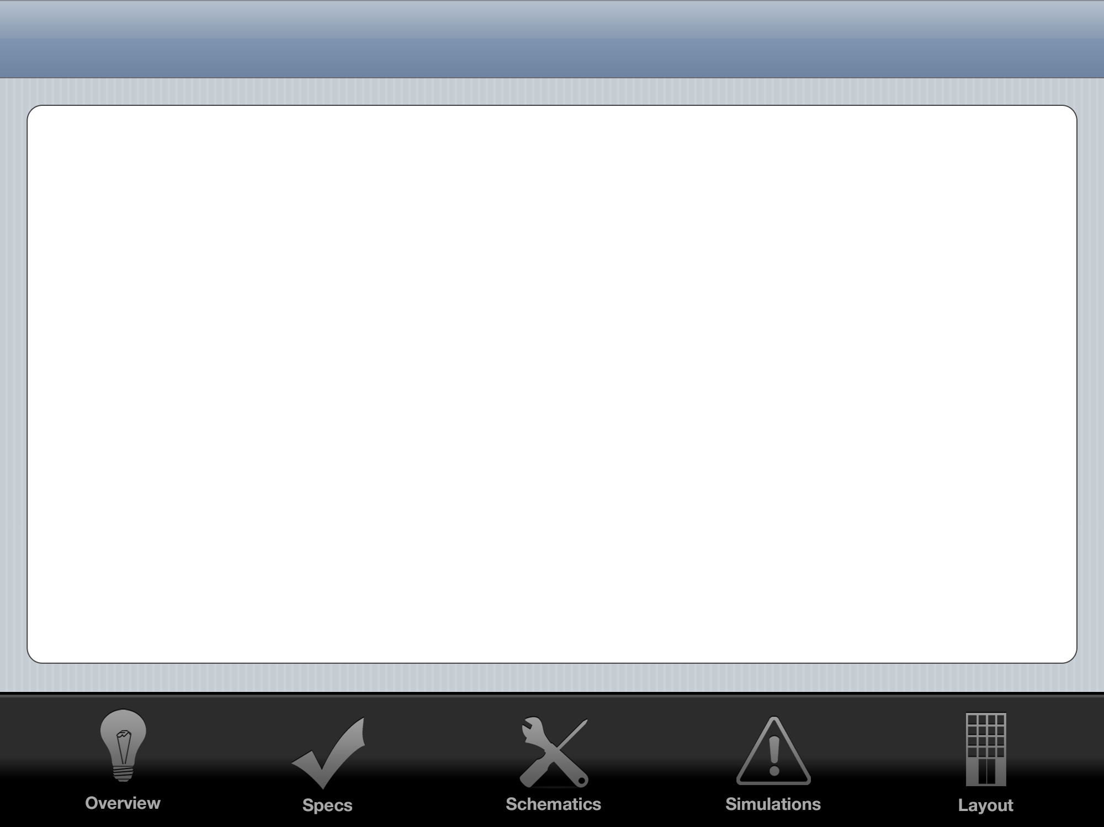
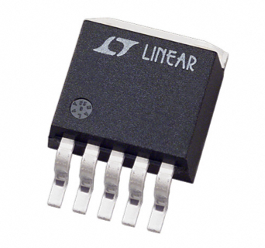
LDO Regulator
John O’Hollaren

Slide 2
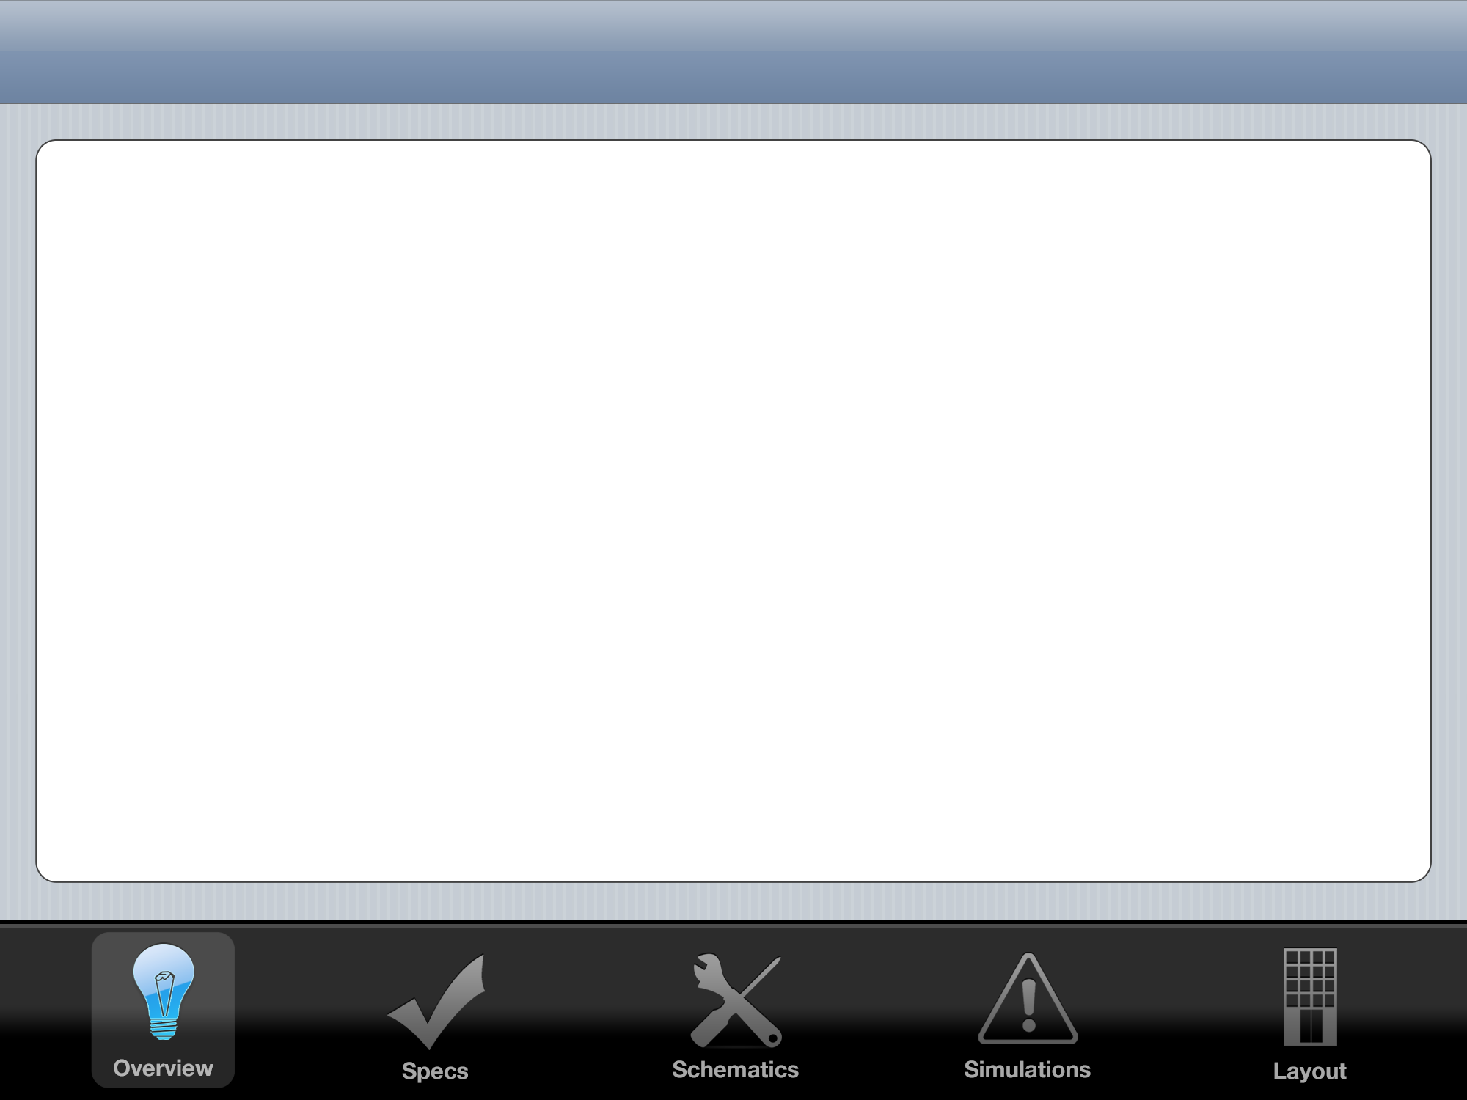


Linear Regulator Overview
Standard
Quasi-LDO
LDO
High Dropout
Stability not a problem
Medium Dropout
Stability a concern
Low Dropout
Stability is a big problem
ESR ‘Tunnel of Death’

Slide 3
Black Box I/O Diagram
LDO
Regulator
VIN
5 Volt VOUT
GND
GND
-10 Volt VSS
10 Volt VDD
1.3 Volt VBIAS

Slide 4
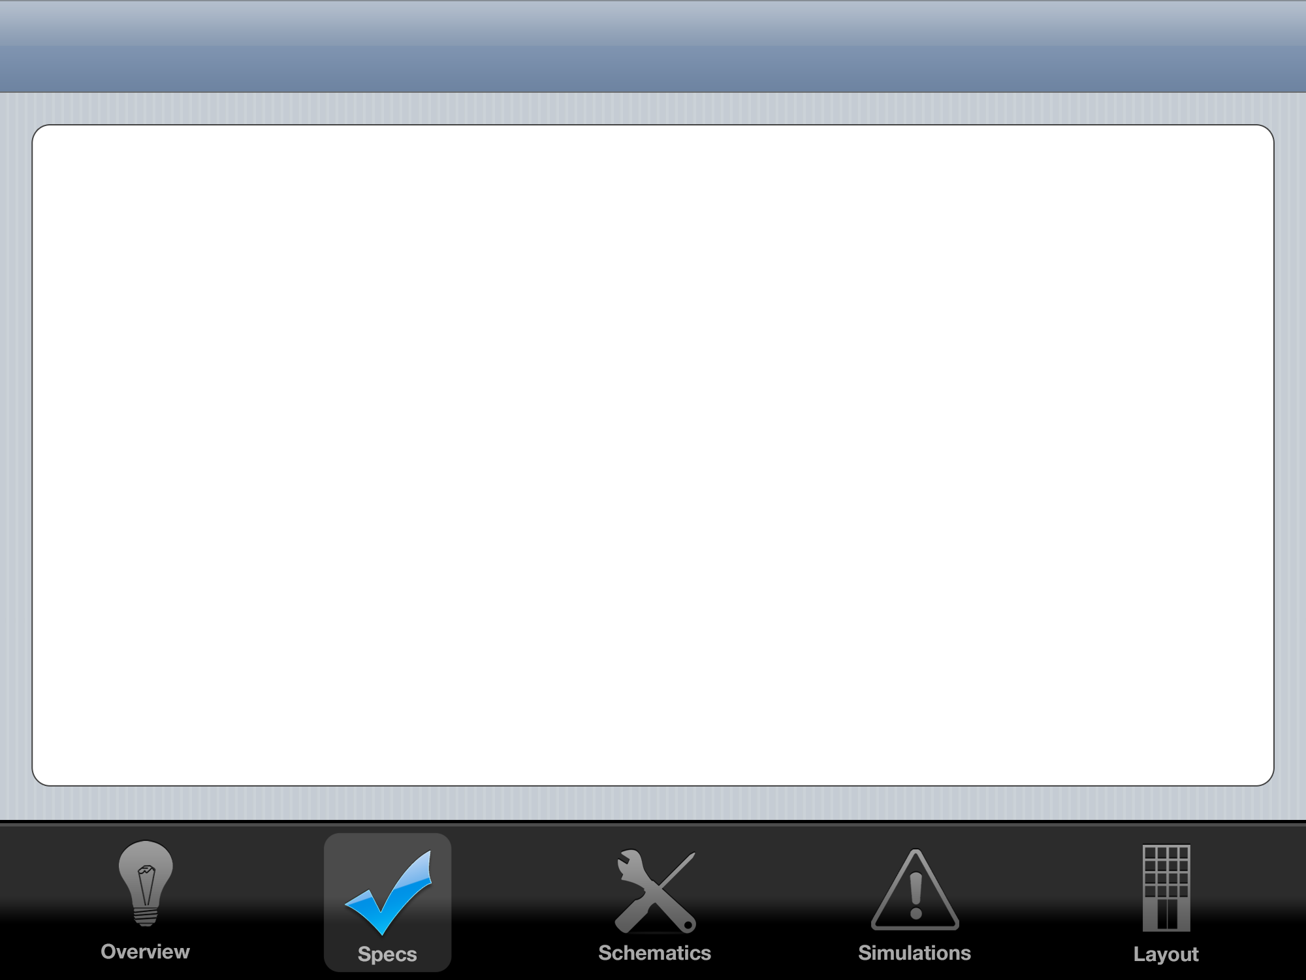


System Spec Goals
 | My LDO | Linear Technology LT1529
Drop Out | 1.1 V | 0.6 V
Required Capacitance | 1 pF | 22 μF
Pos. Settling Time | 2 μS | 150 μS
Neg. Settling Time | 0.1 μS | 100 μS
Quiescent PWR Loss |  | 0.5 mW
Area
Max. Input (+50 mV) |  | 6 Volts
Min. Input (-50 mV) |  | 15 Volts
Max Output Current | 0.5 A | 3 A

Slide 5
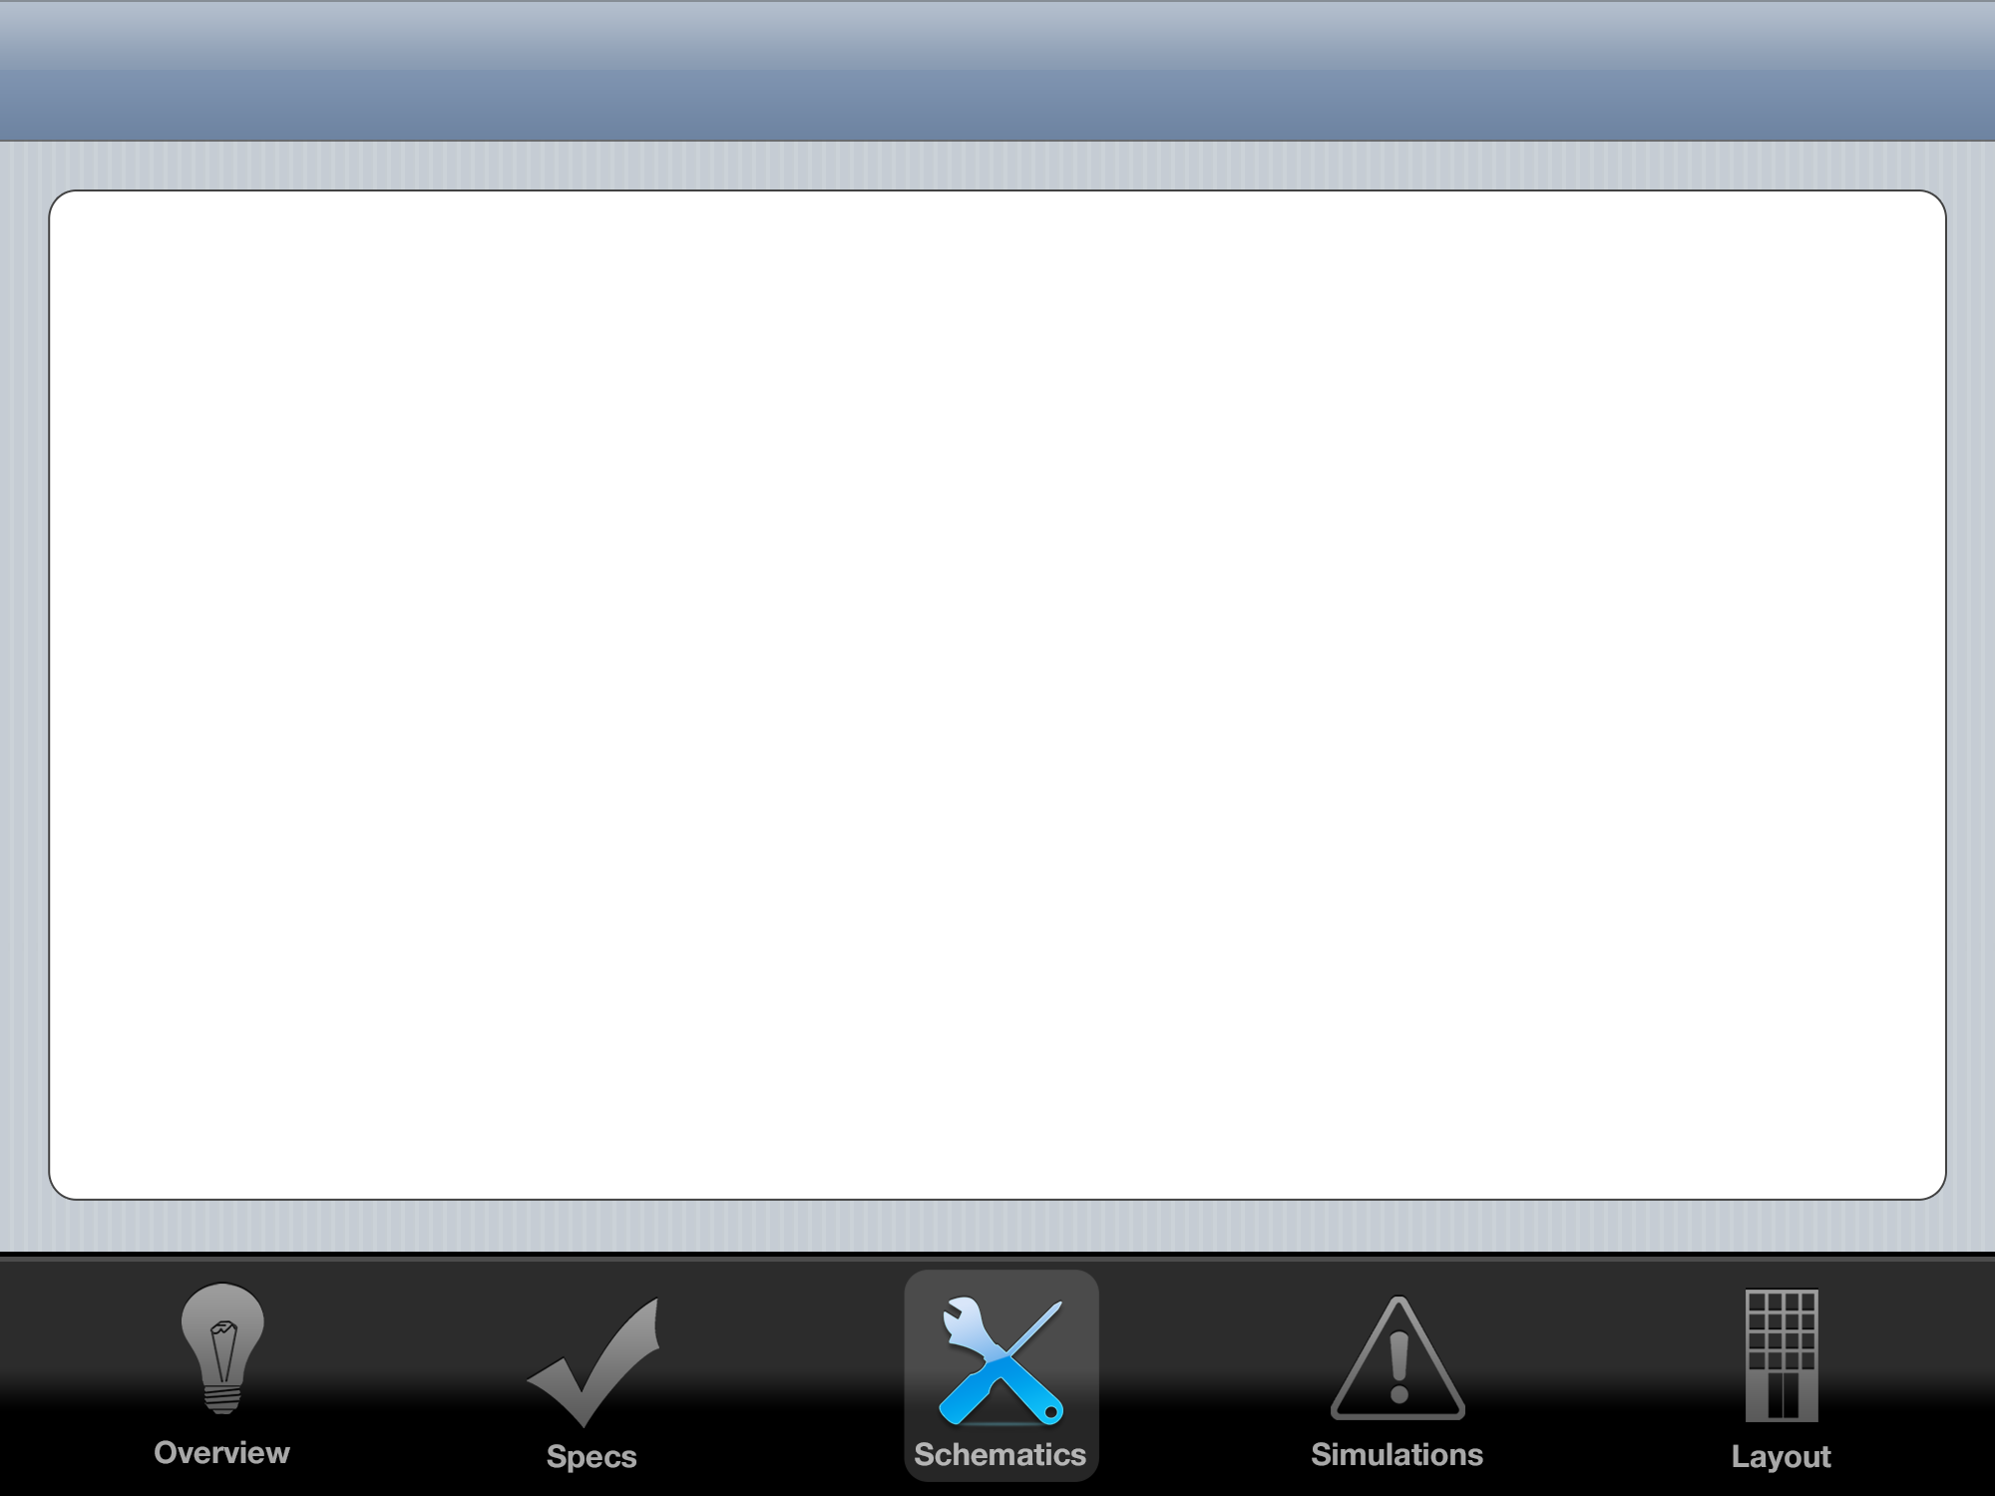
Control System: PID
K_{P}
+
-
Gate
Drive
+
+
+
H
Vout
Vref

Slide 6
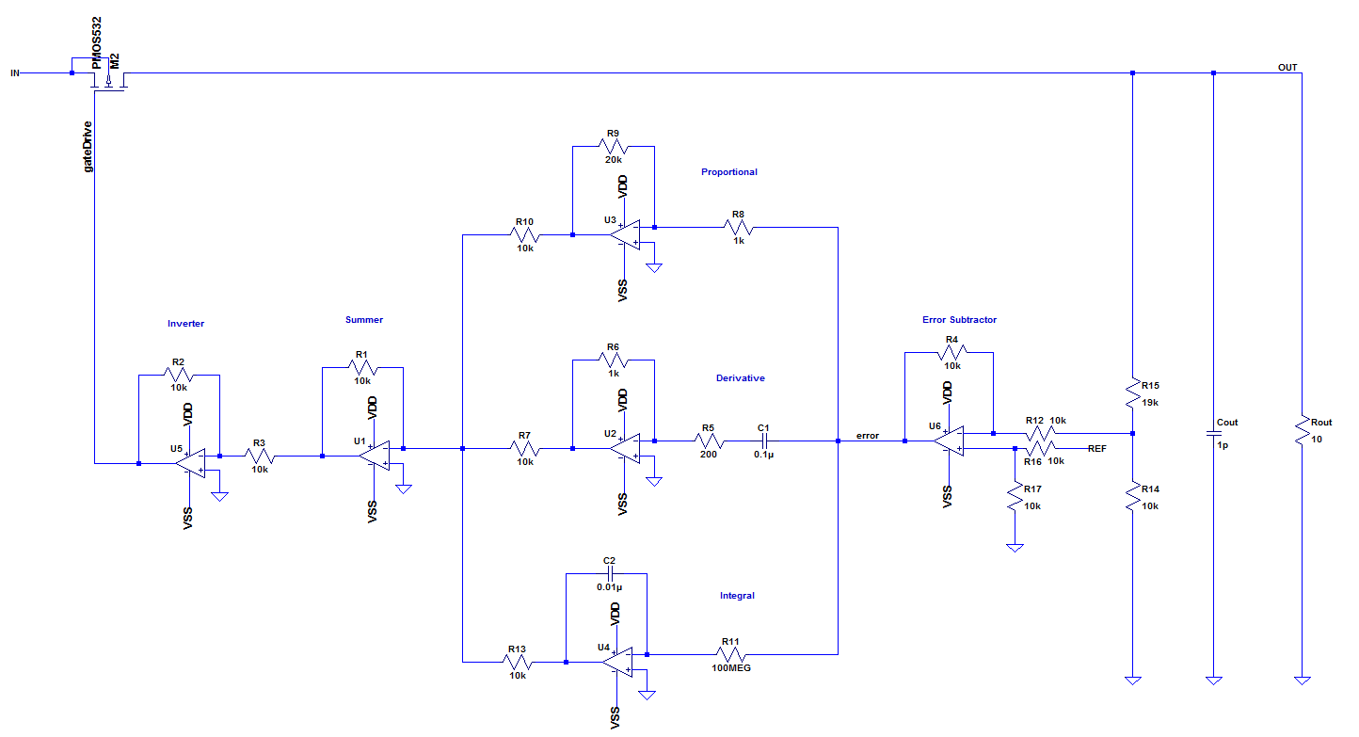
Control System: PID

Slide 7
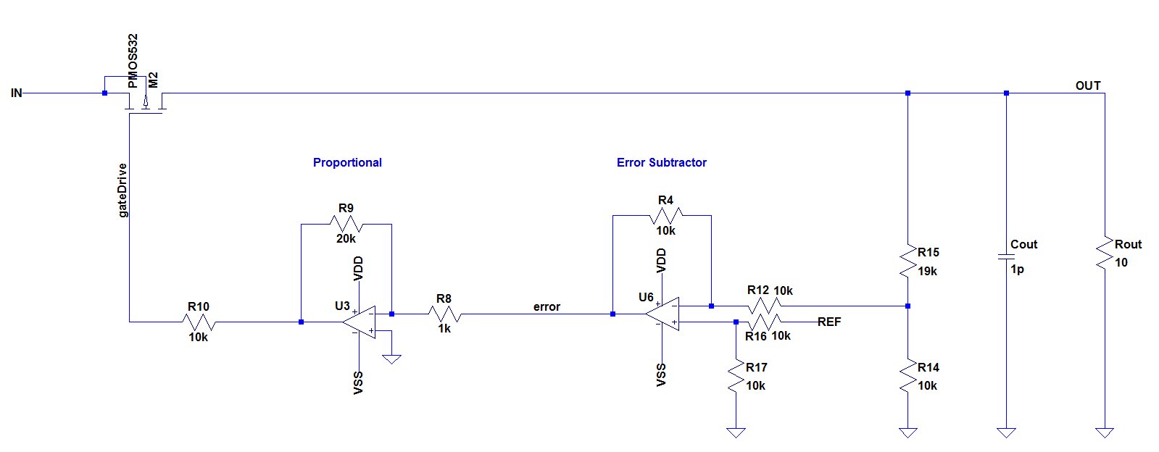
Control System: PID

Slide 8
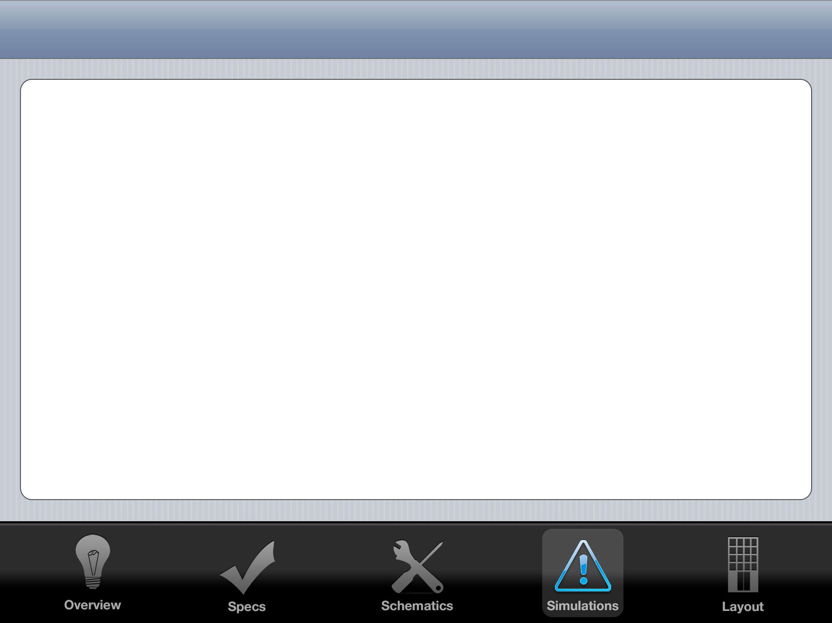
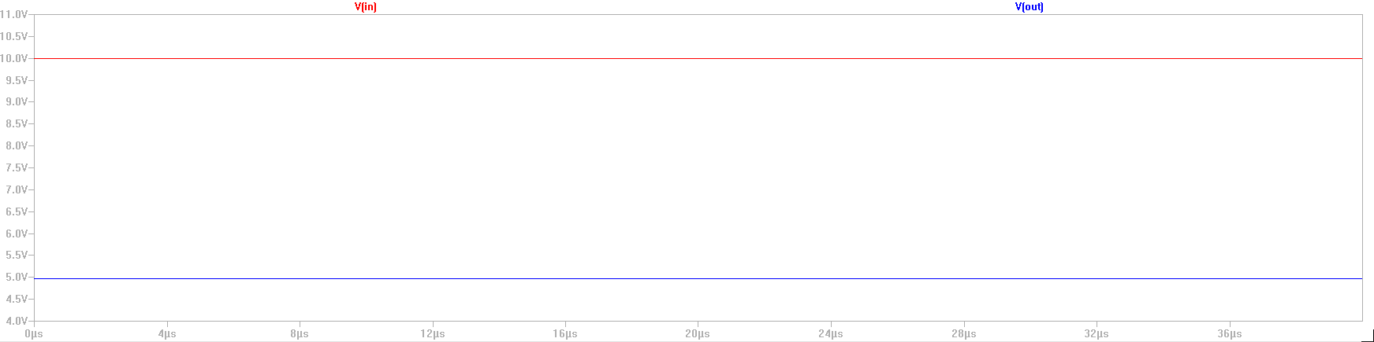
Steady State Output

Slide 9
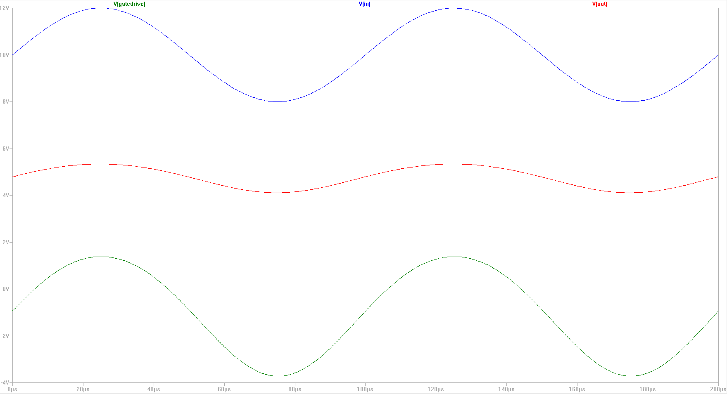
4V Sine Wave on Input

Slide 10
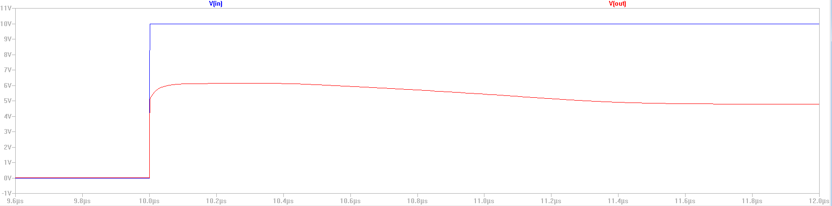
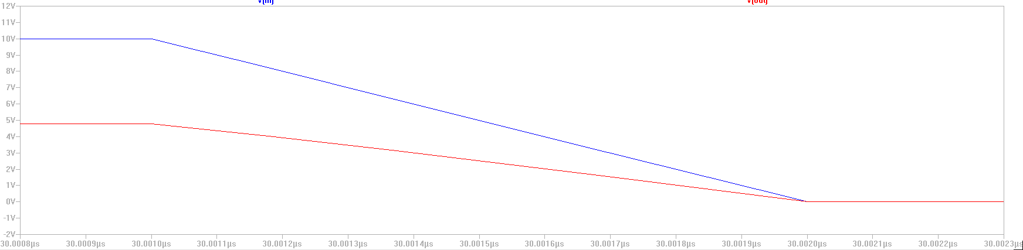
Step Response

Slide 11
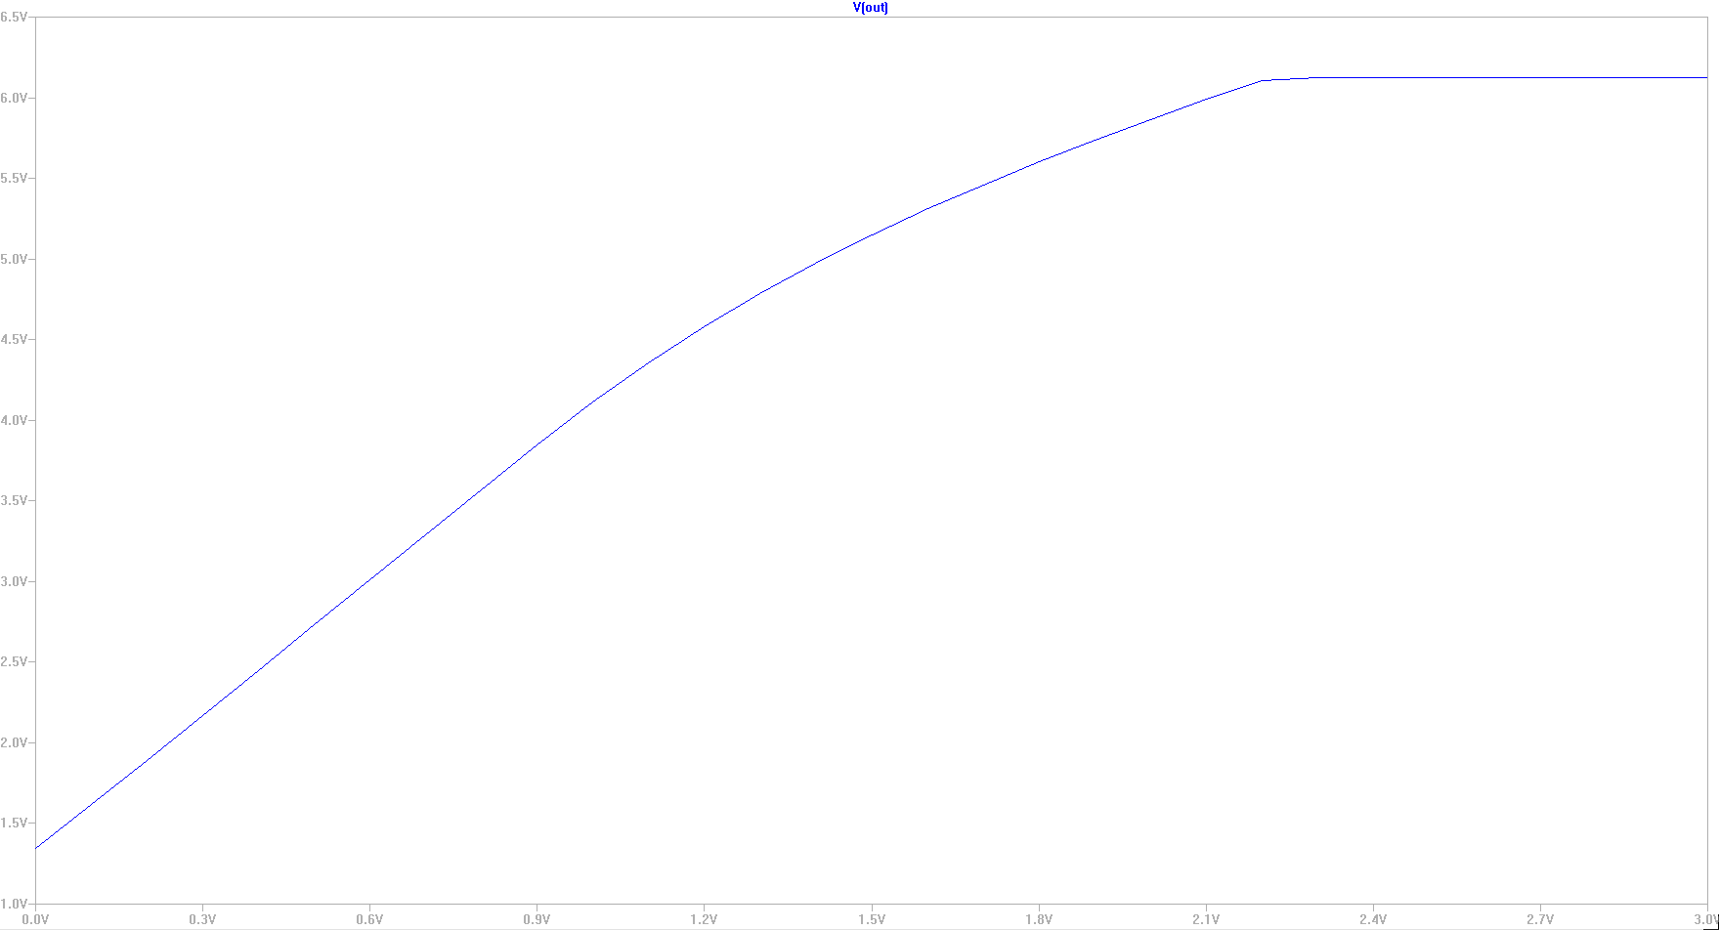
DC Sweep VREF

Slide 12
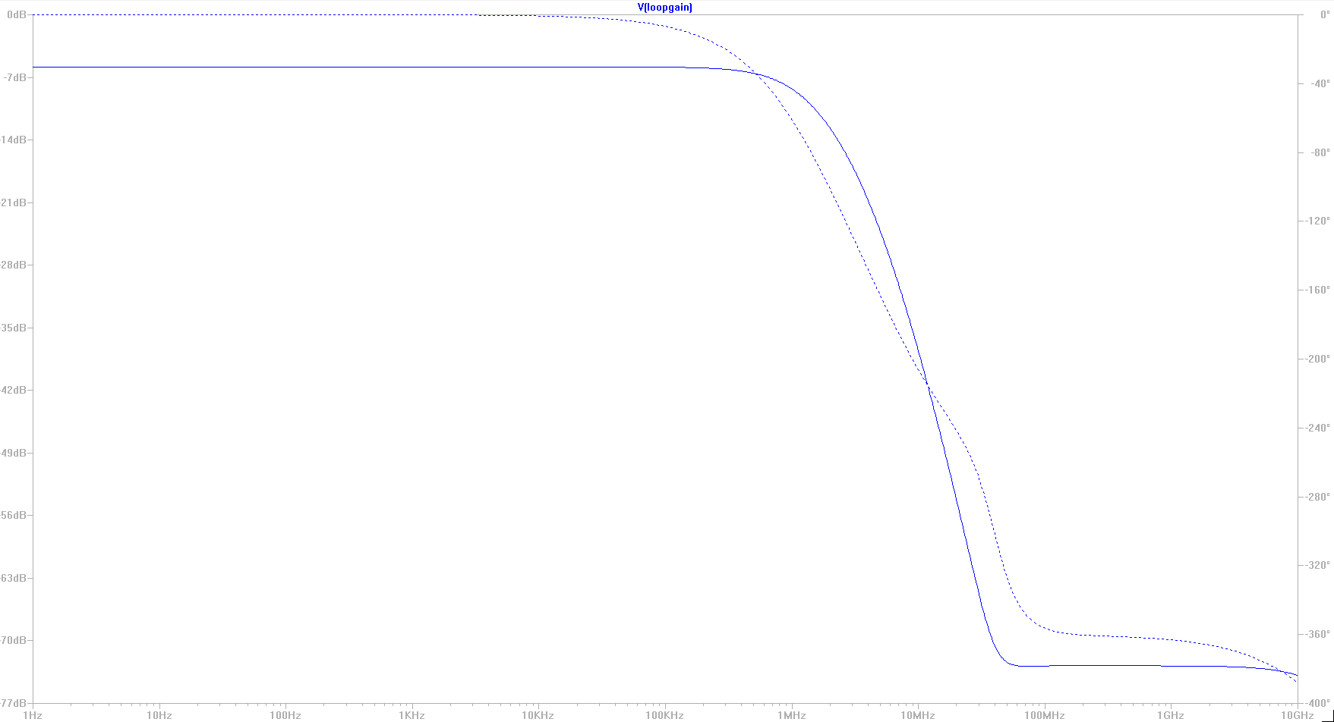
Loop Gain

Slide 13
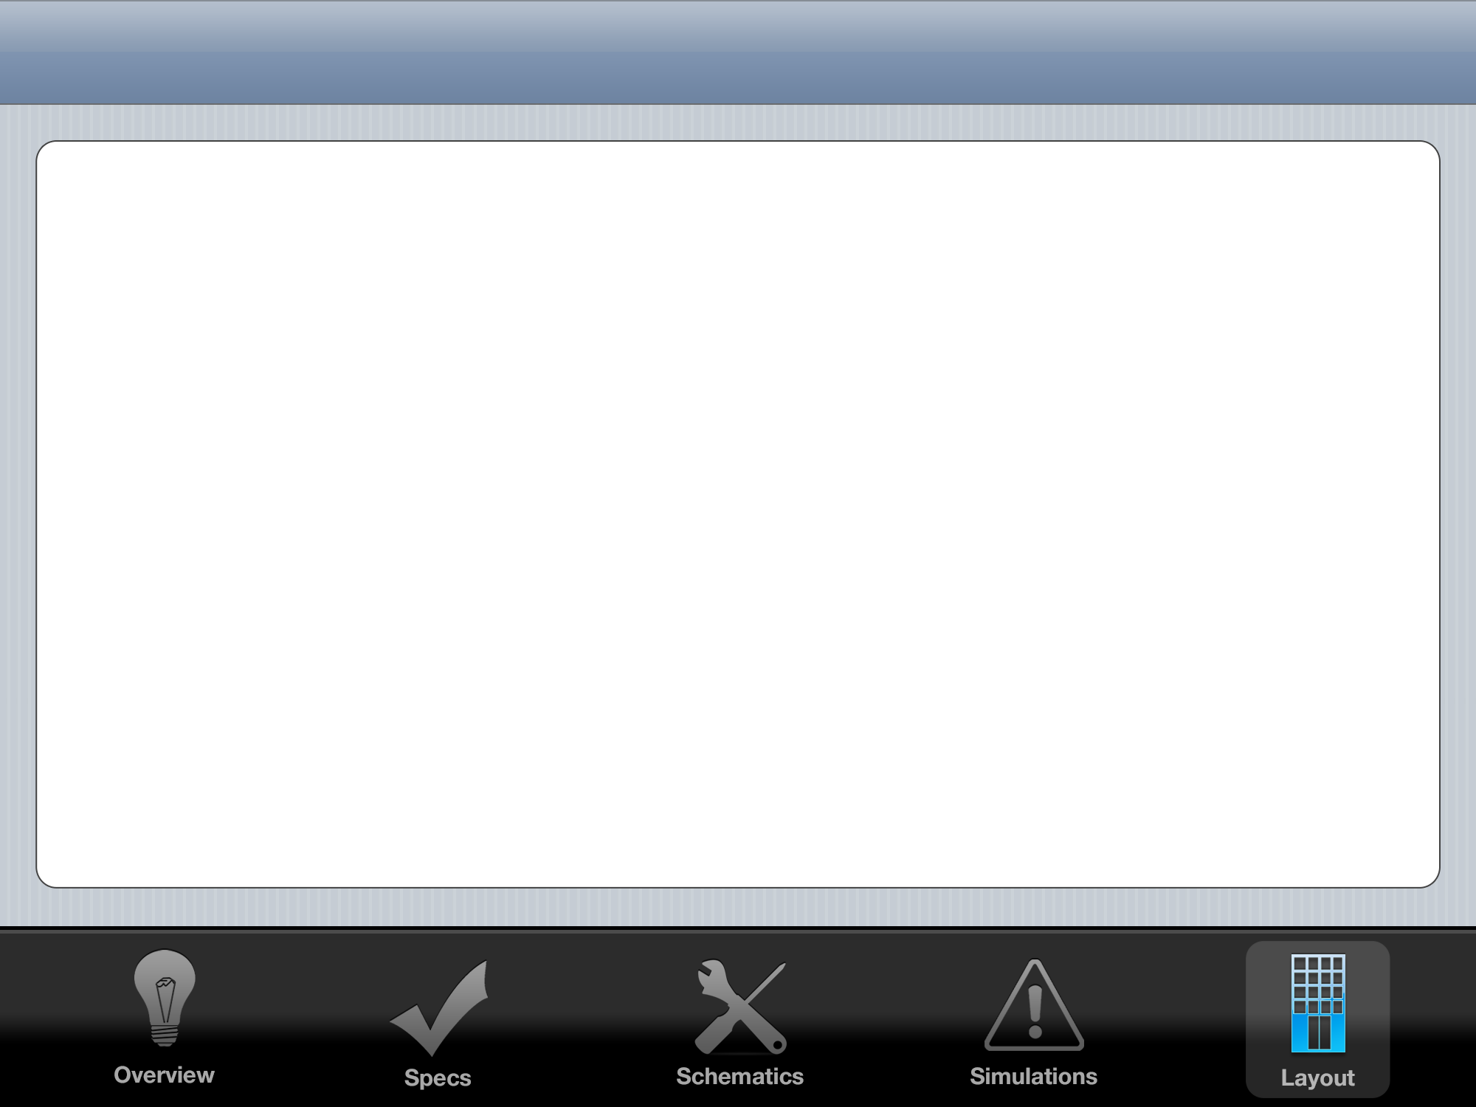
Layout

Slide 14
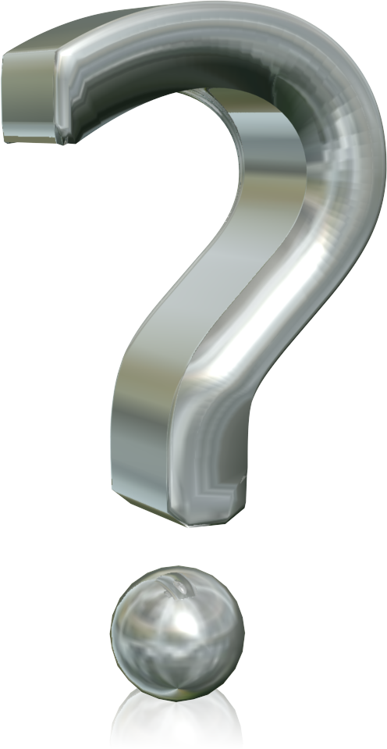
Thank You

