Slide 1
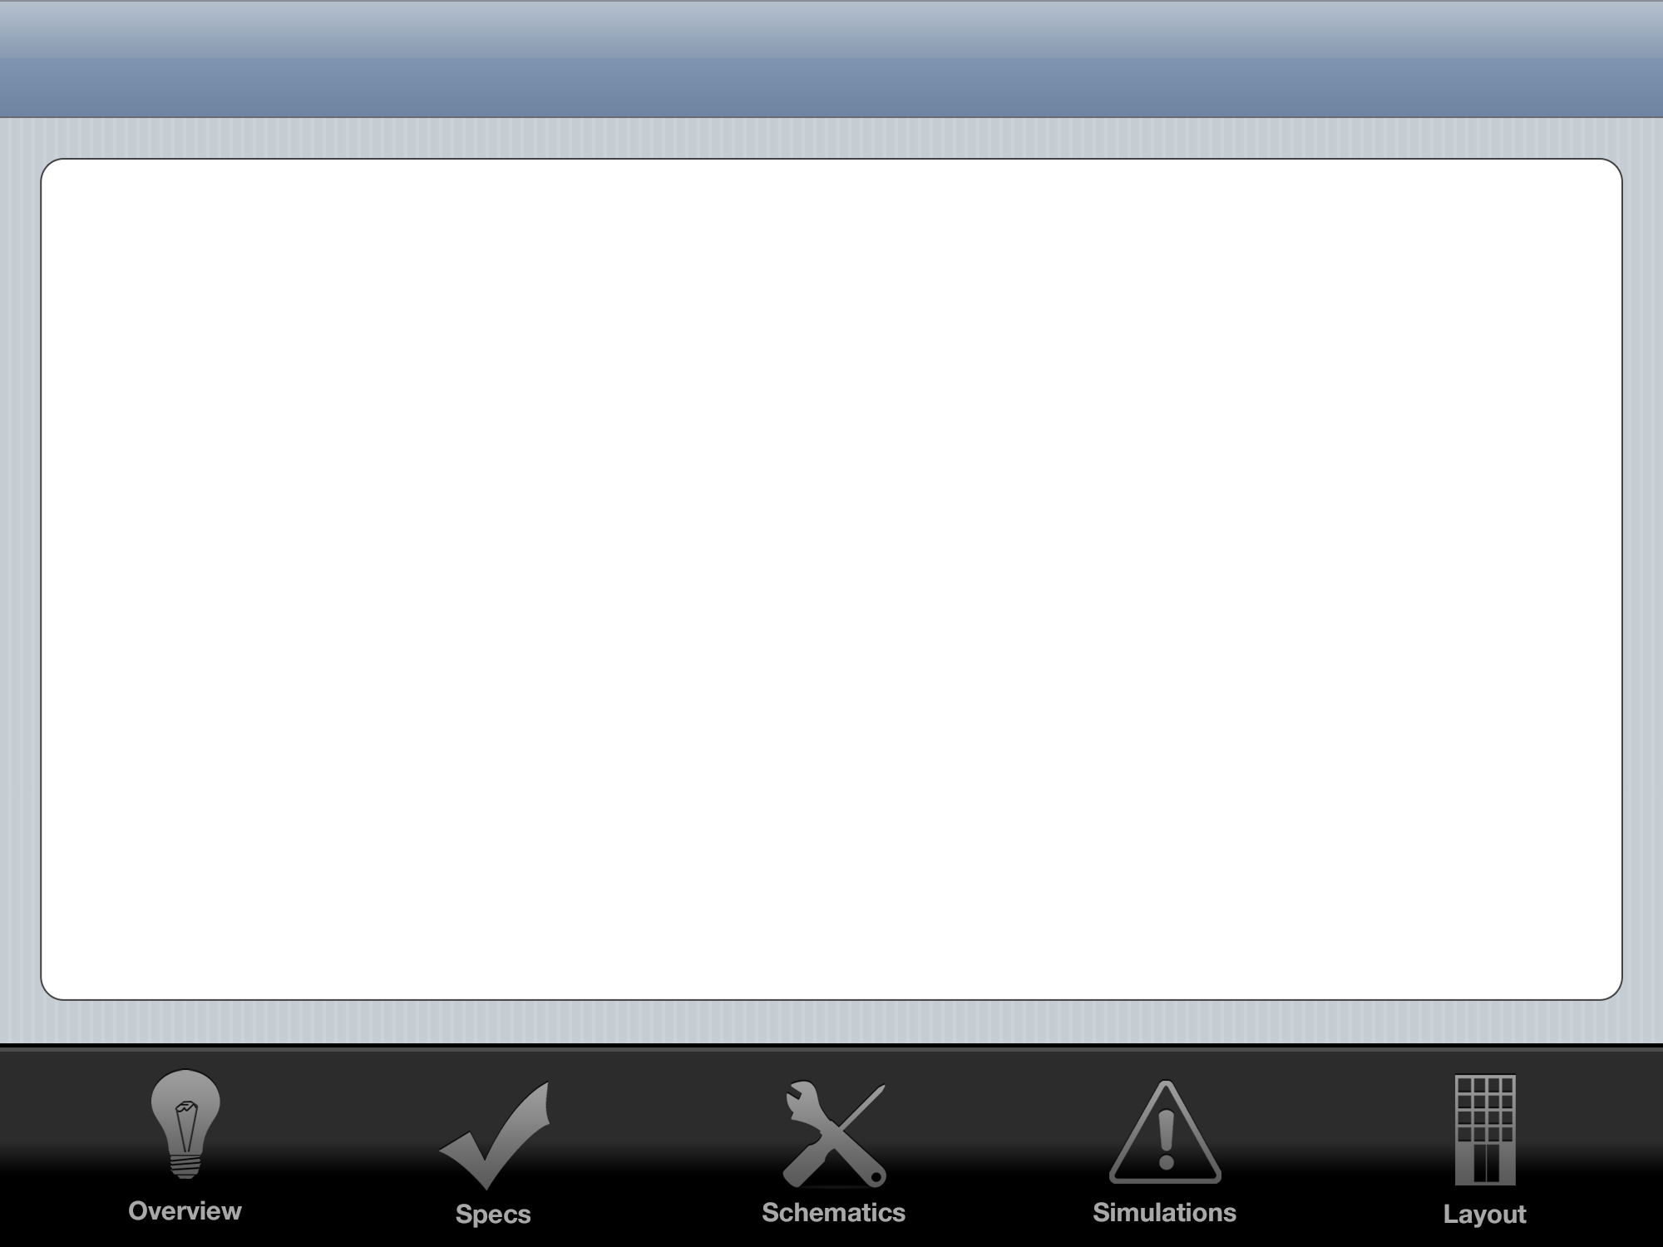
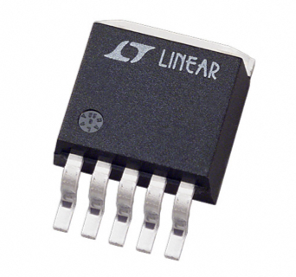
LDO Regulator
John O’Hollaren

Slide 2
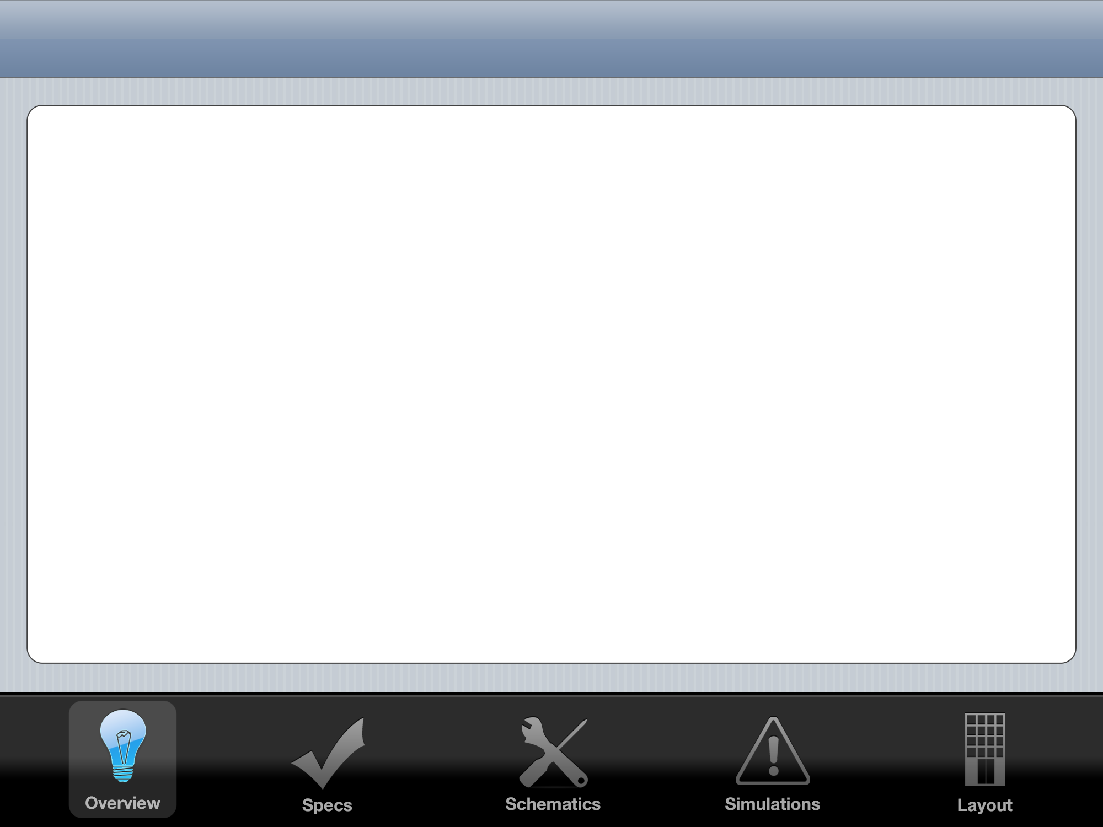


Linear Regulator Overview
Standard
Quasi-LDO
LDO
High Dropout
Stability not a problem
Medium Dropout
Stability a concern
Low Dropout
Stability is a big problem
ESR ‘Tunnel of Death’

Slide 3
Black Box I/O Diagram
LDO
Regulator
VIN
5 Volt VOUT
GND
GND
-10 Volt VSS
10 Volt VDD
1.3 Volt VBIAS

Slide 4
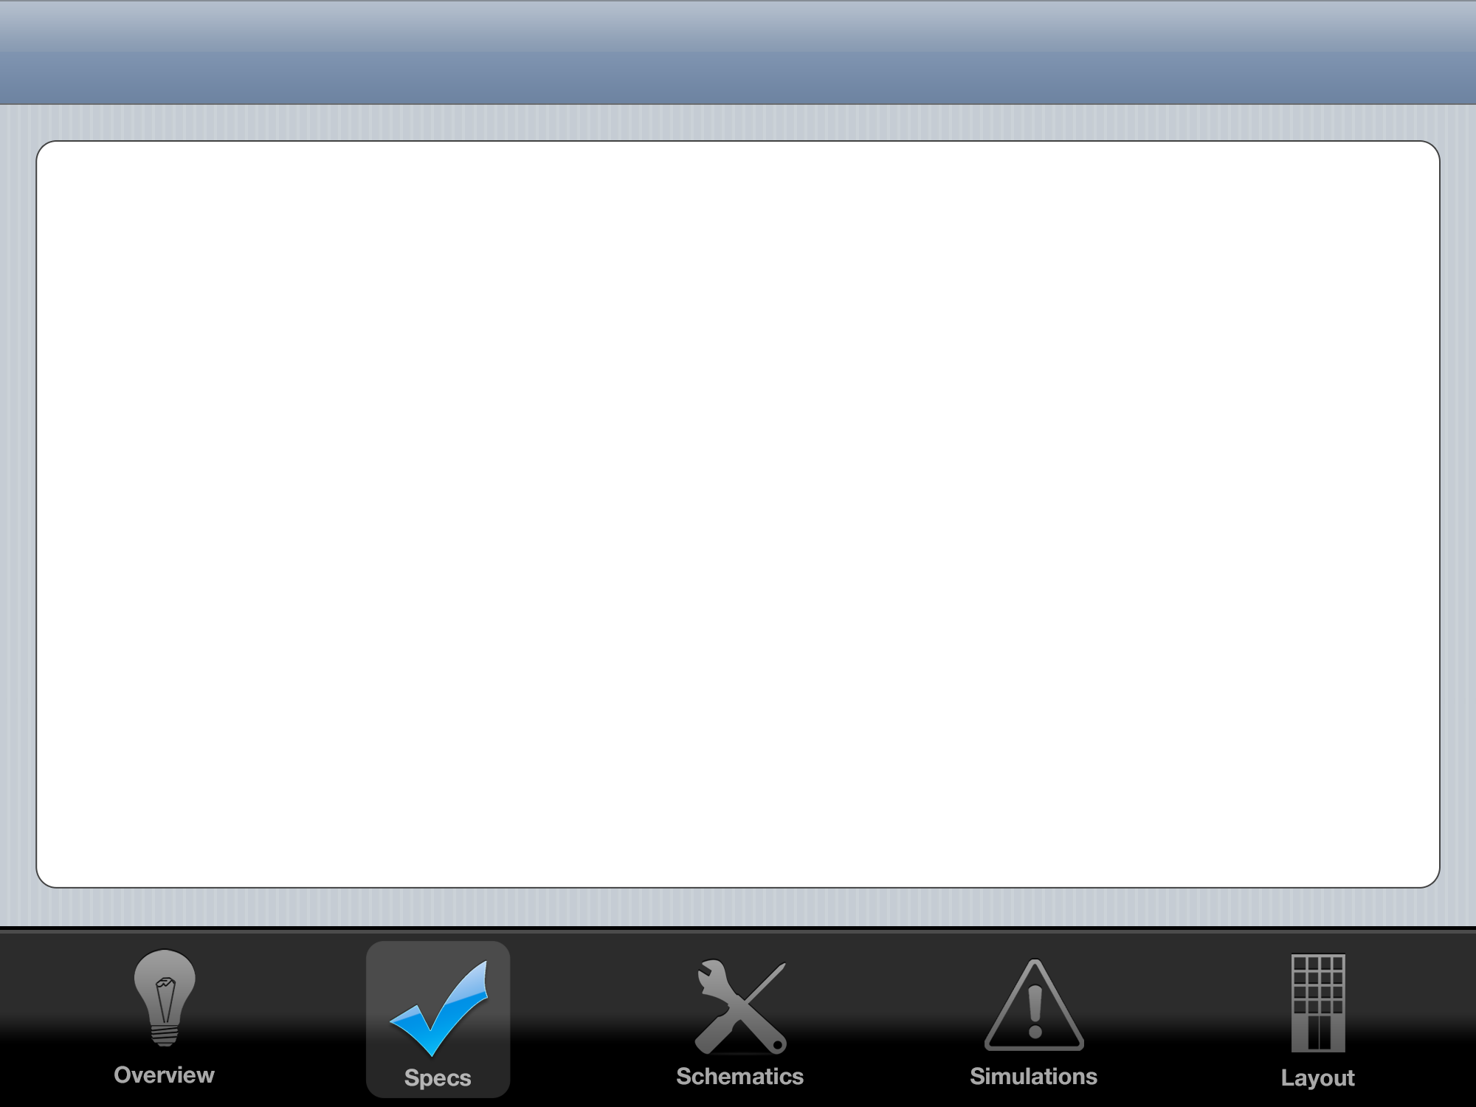


System Spec Goals
 | My LDO | Linear Technology LT1529
Drop Out | 1.1 V | 0.6 V
Required Capacitance | 1 pF | 22 μF
Pos. Settling Time | 2 μS | 150 μS
Neg. Settling Time | 0.1 μS | 100 μS
Quiescent PWR Loss | 1 mW | 0.5 mW
Area | 0.15 mm² | >> 0.15 mm²
Max. Input (+200 mV) | 8 Volts | 6 Volts
Min. Input (-200 mV) | 12 Volts | 15 Volts
Max Output Current | 0.5 A | 3 A

Slide 5
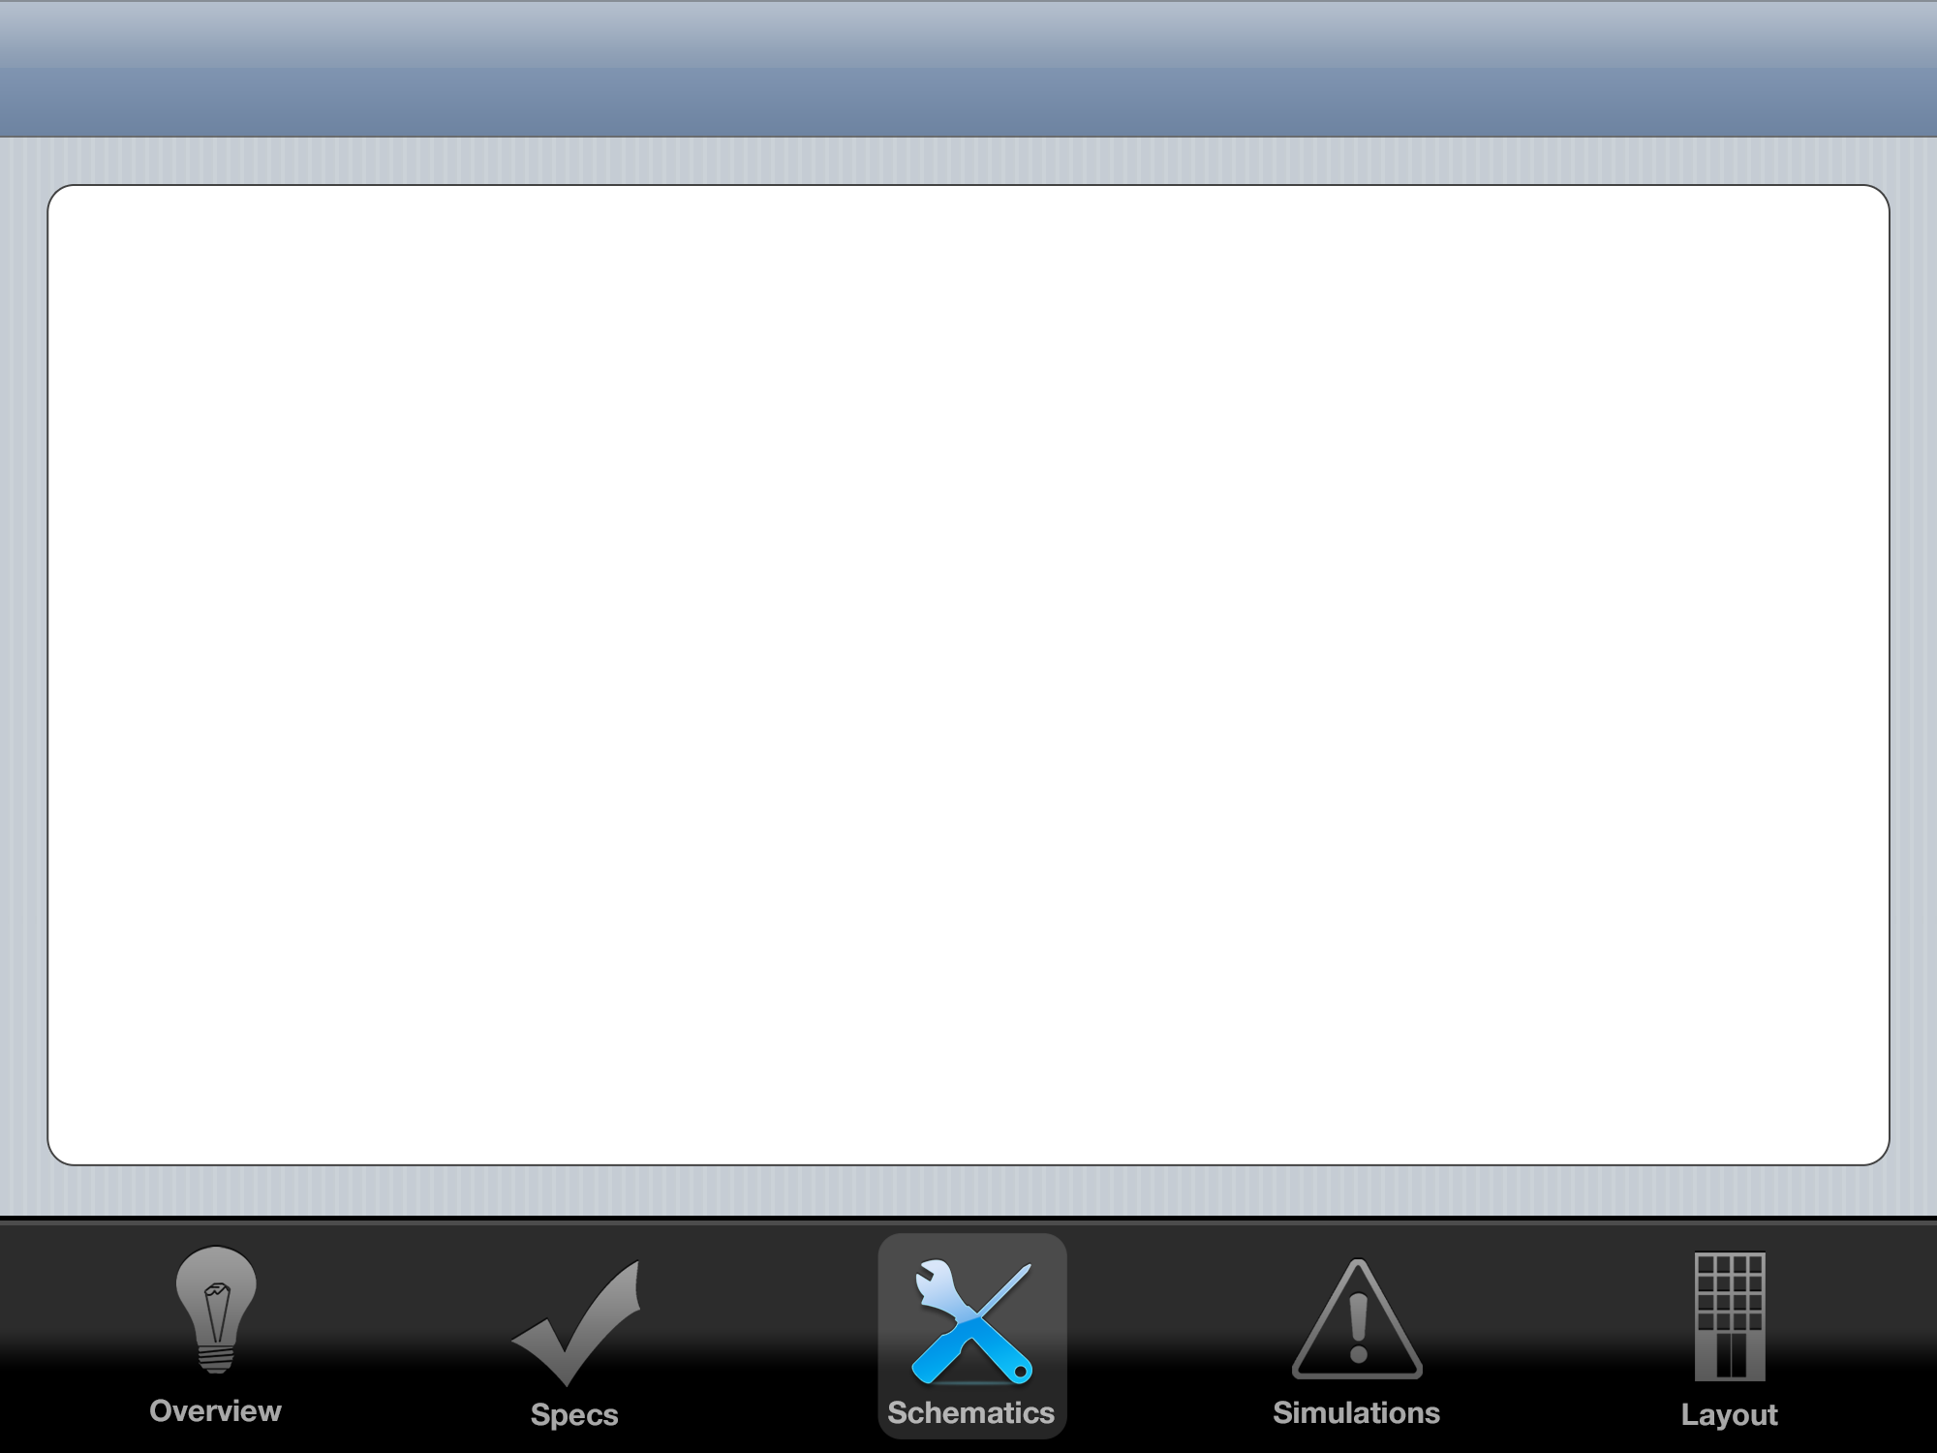
First Control System Attempt: PID
K_{P}
+
-
Gate
Drive
+
+
+
H
Vout
Vref

Slide 6
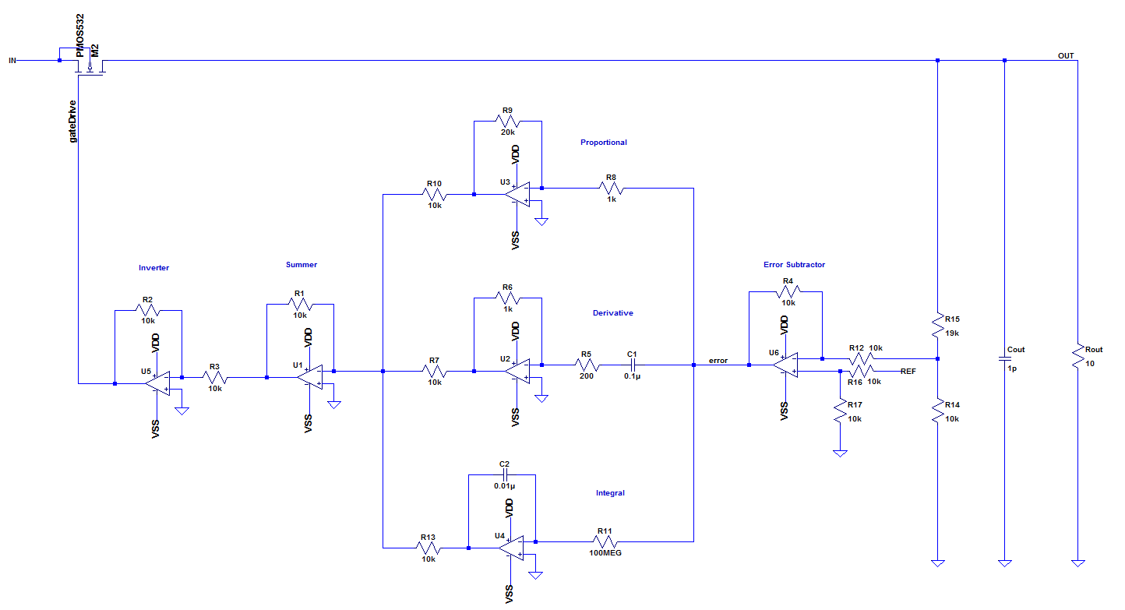
PID: Great Results, But Too Large

Slide 7
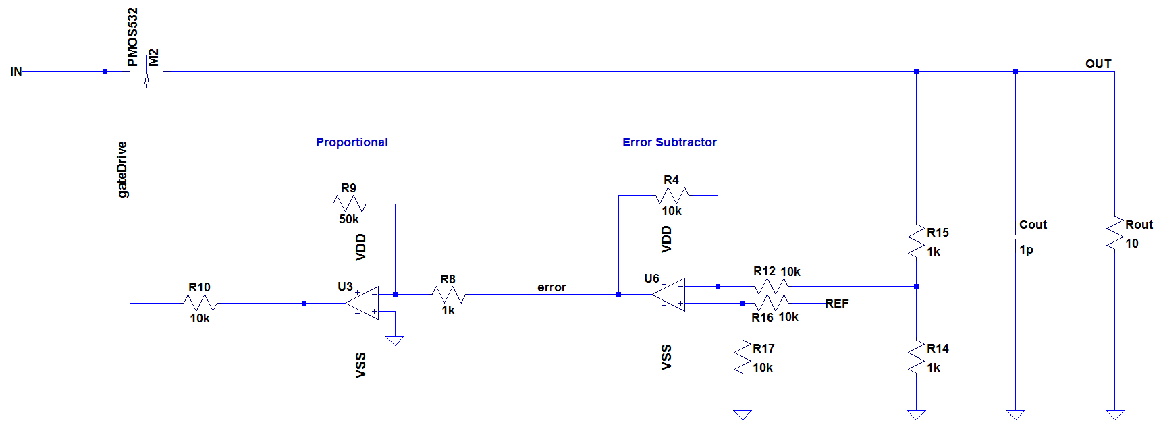
Reduce to P: Small Enough to Fab

Slide 8
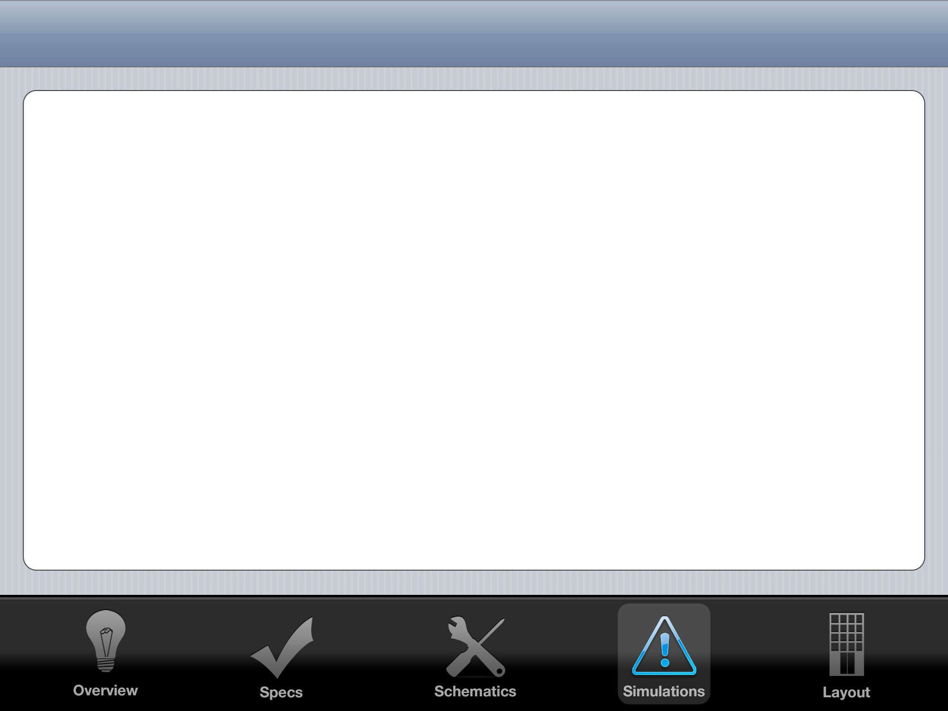
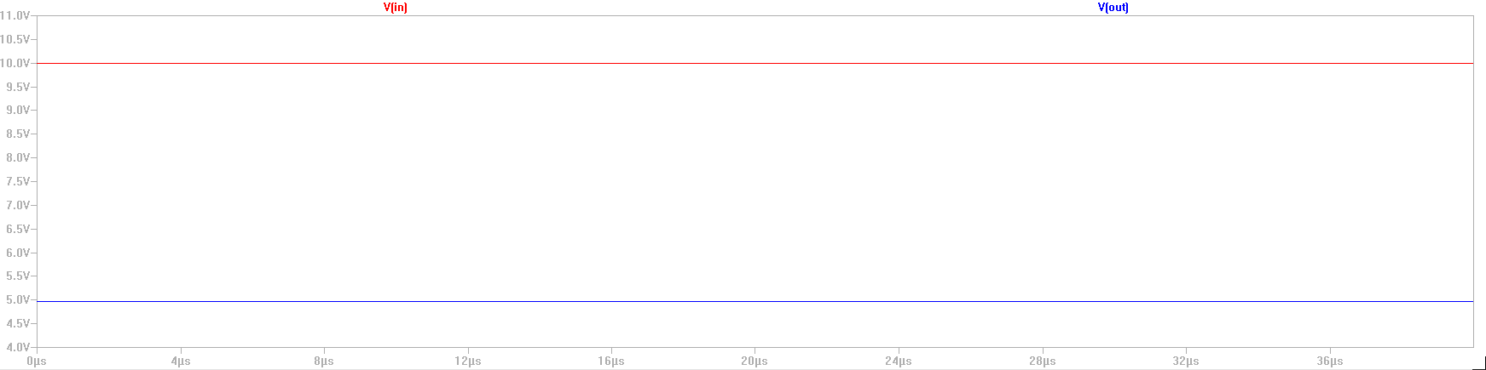
Steady State Output
Given 10 Volt Input
Easily Produces 5V Output

Slide 9
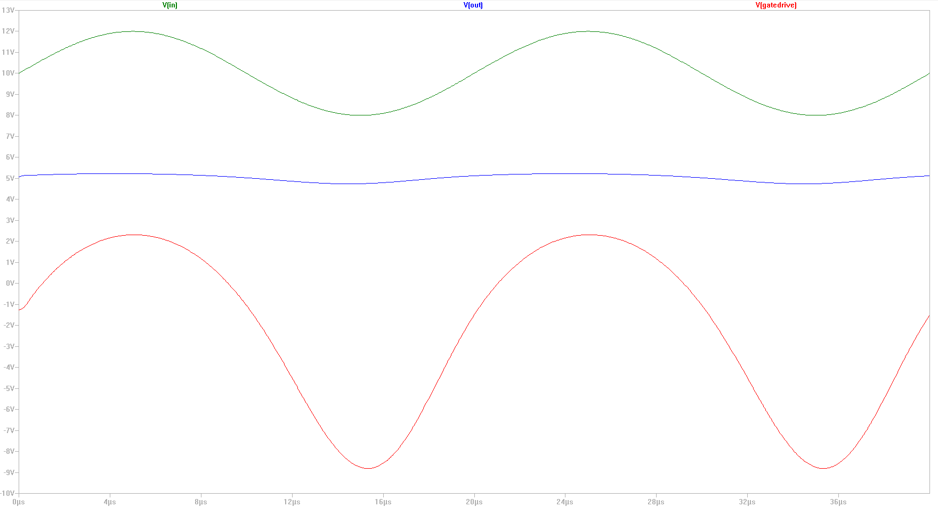
4V Sine Wave on Input

Slide 10
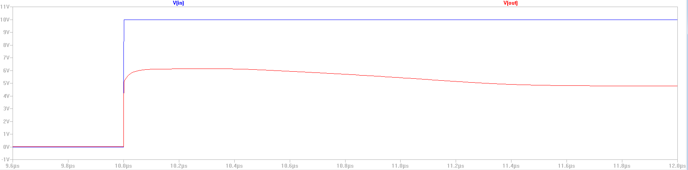
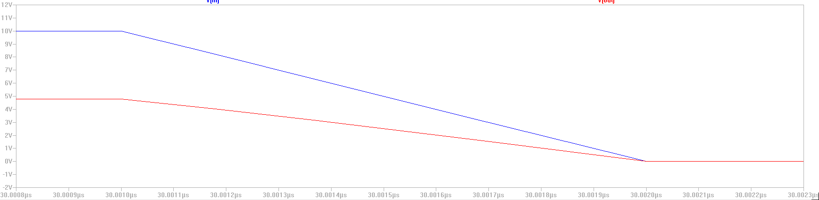
Step Response

Slide 11
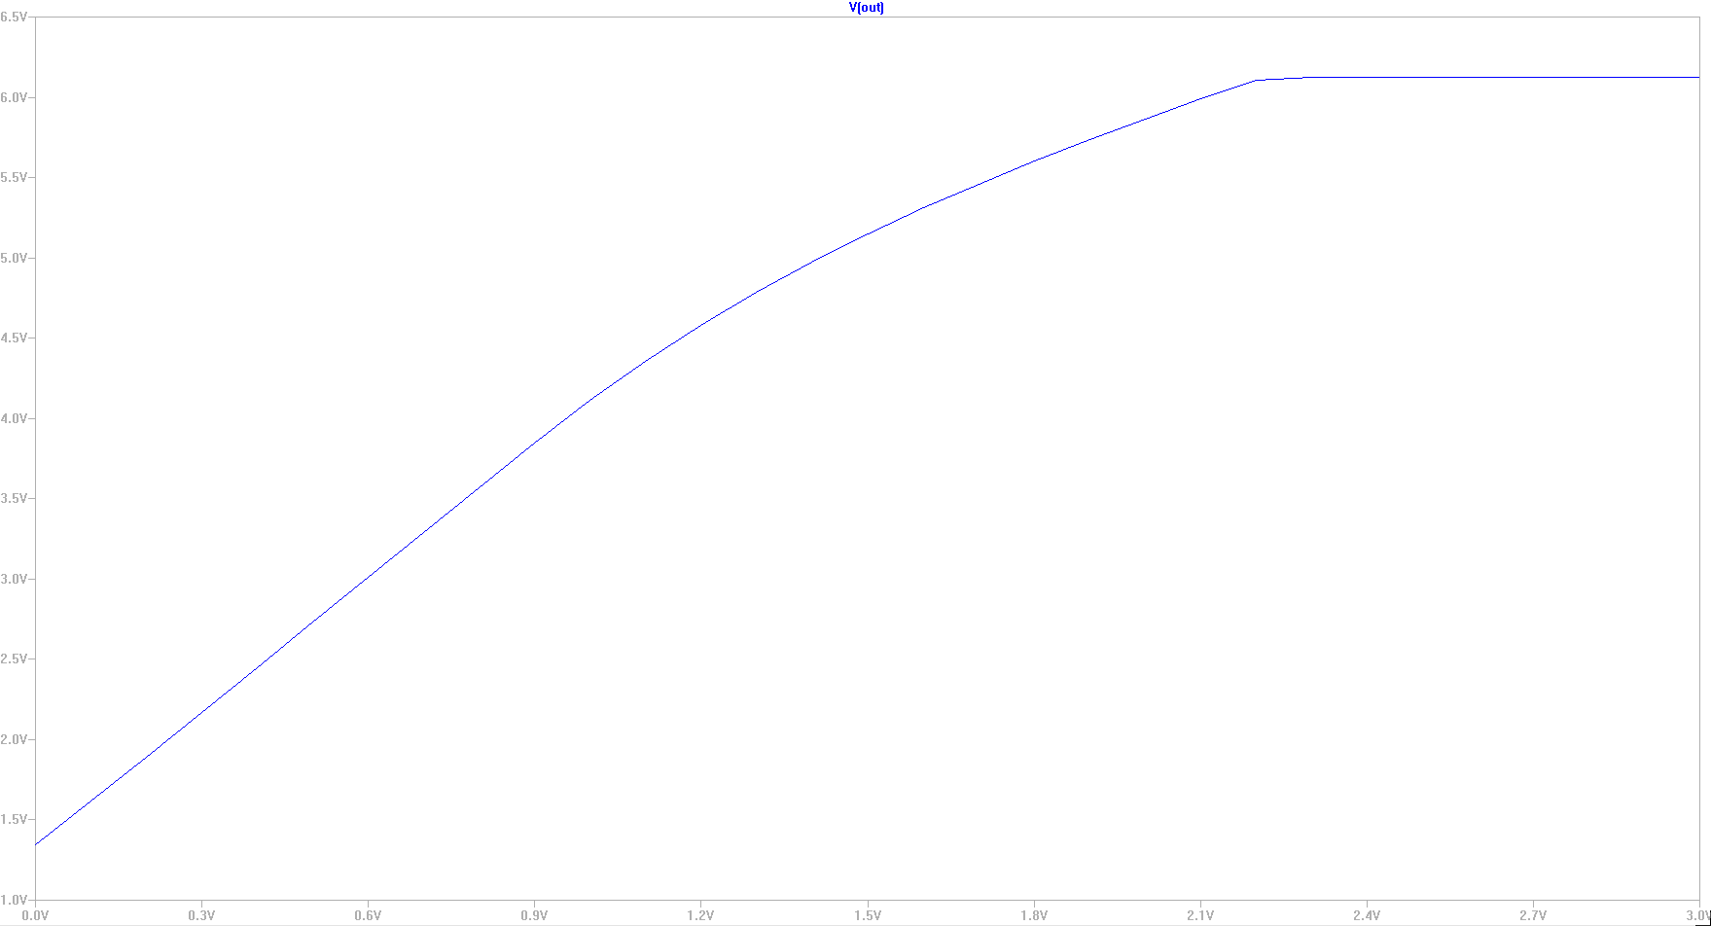
VREF Sweep: Create Many Outputs

Slide 12
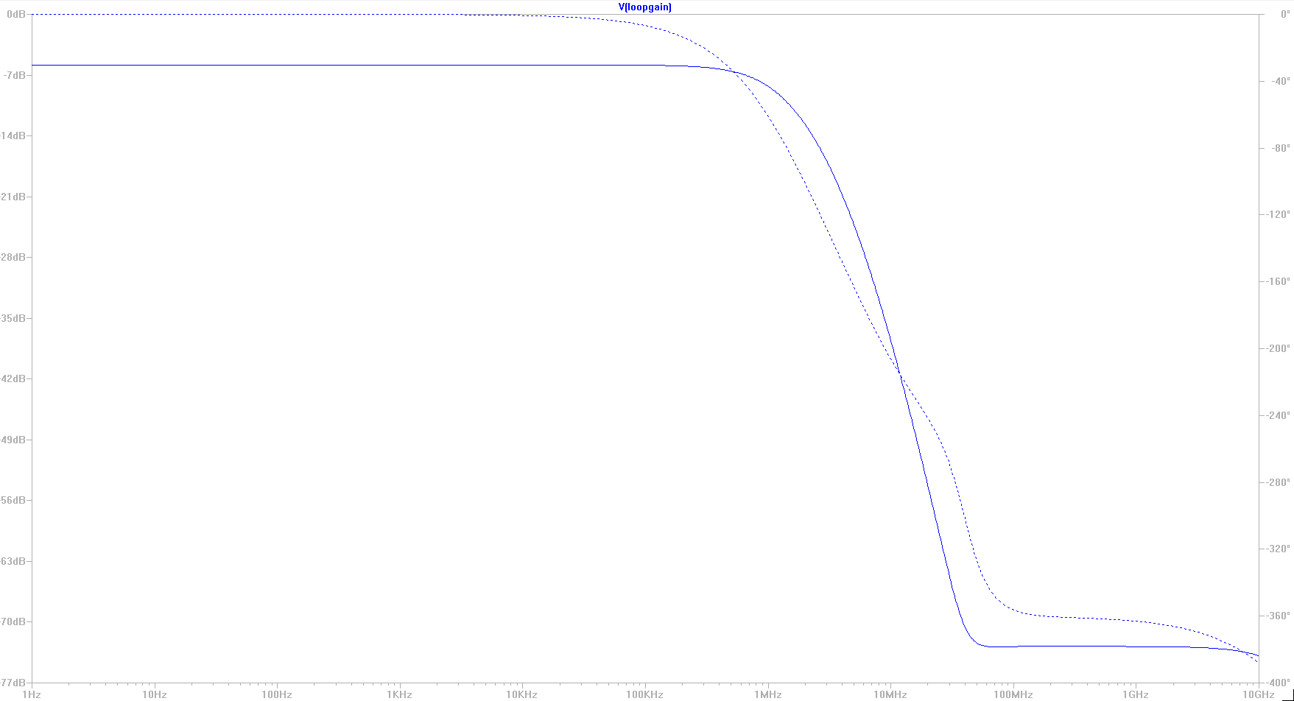
Loop Gain

Slide 13
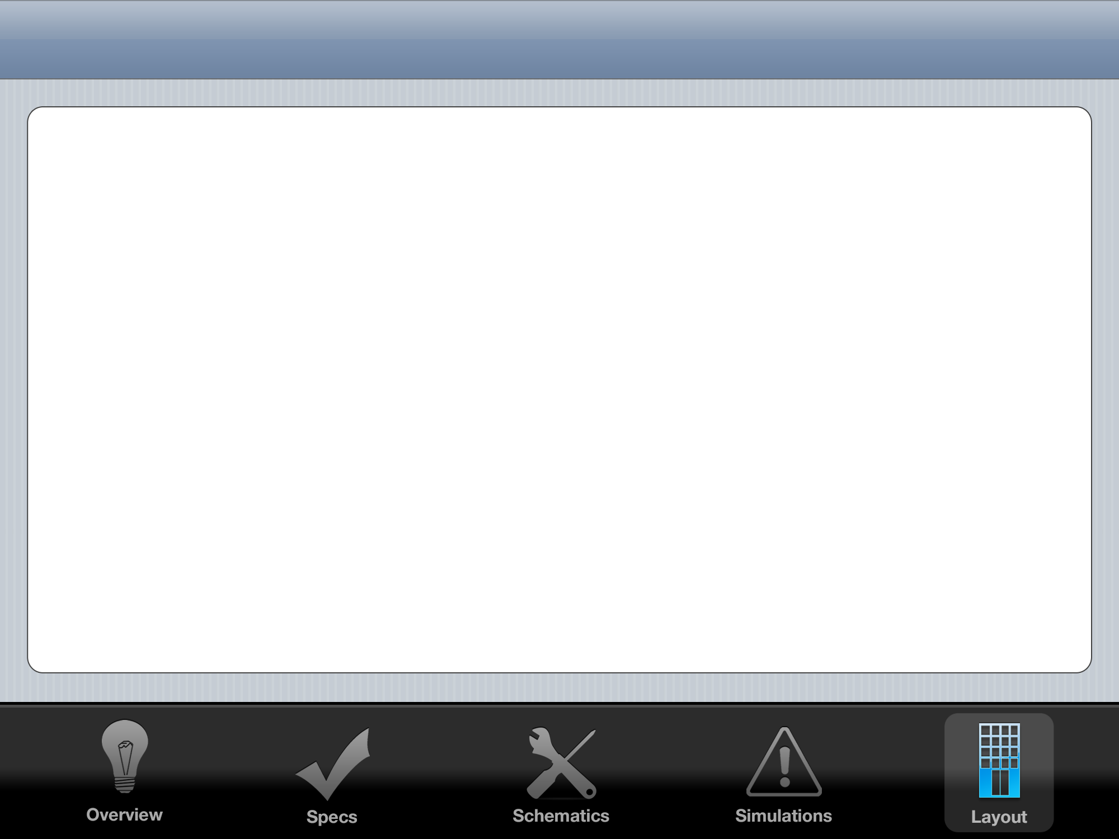
Layout Floorplan
0.47 mm
20 μm
VIN RAIL
VOUT RAIL
200 μm
200 μm
70 μm
OP AMP 1
OP AMP 2
Power
MOSFET
0.29 mm
250 μm
Common
Centroid
Precision
Resistors
20 μm
GND RAIL

Slide 14
Common Centroid Plan
Inverting
Amplifier
Differential
Amplifier
Feedback
Divider
Op Amps
R1: 50 kΩ
R2: 1 kΩ
Unit Resistor
for common
centroid:
1 kΩ
R1: 10 kΩ
R2: 10 kΩ
R3: 10 kΩ
R4: 10 kΩ
Unit Resistor
for common
centroid:
2.5 kΩ
R1: 1 kΩ
R2: 1 kΩ
Unit Resistor
for common
centroid:
500 Ω
Common centroid
already completed
in homework 4

Slide 15
TODO
(1) Loop Gain
Not very high, I need to figure out how to increase it
This will increase my noise rejection
(2) Power MOSFET Tuning
Currently using a single MOSFET with W/L = 1000
Will experiment with different sizes
(3) Decrease Loop Phase Margin
Faster Response, fairly overdamped currently
(4) Finish Layout

Slide 16
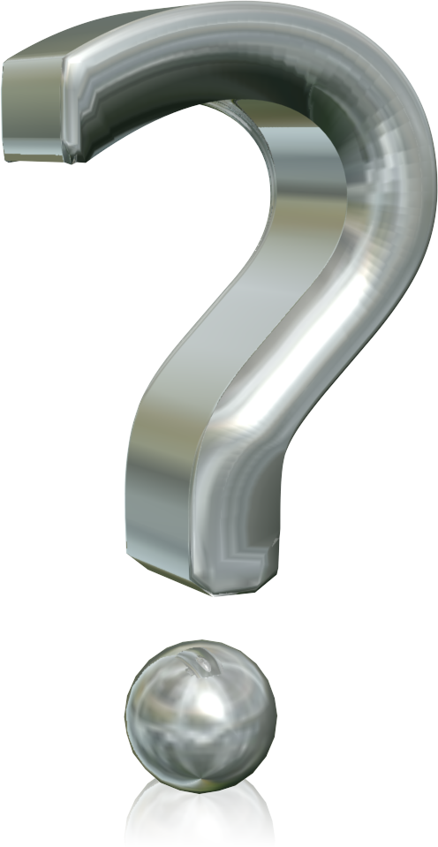
Thank You

