Slide 1


System Spec Goals
 | My LDO | Texas Instruments TLV1171
Minimum Drop Out | 1.0 V | 0.455 V
Required Capacitance | 1 pF | 1 μF
Pos. Settling Time | 10 nano sec | ~ 5 μ sec
Neg. Settling Time | 8 nano sec | ~ 5 μ sec
Pos. Slew Rate | 100 V / μ sec | 5V / μ sec
Neg. Slew Rate | 166 V / μ sec | 5V / μ sec
Quiescent PWR Loss | 2.5 mW | 0.2 mW
Area | 0.33 mm² | >> 1.0 mm²
Max. Input | 5.3 Volts | 5.5 Volts
Min. Input | 4.7 Volts | 2 Volts
Max Output Current | 8 mA | 1.0 A
Temperature Range for Vout ±200 mV | 10°C to 45°C | -55°C to 150°C

Slide 2
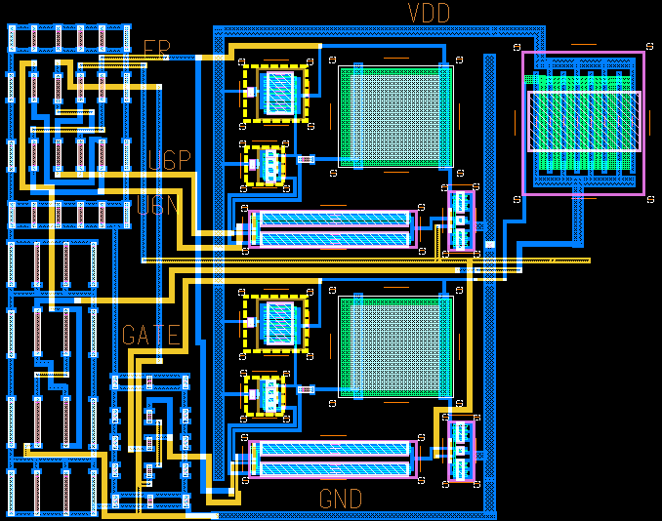
0.51 mm
0.66 mm

Slide 3
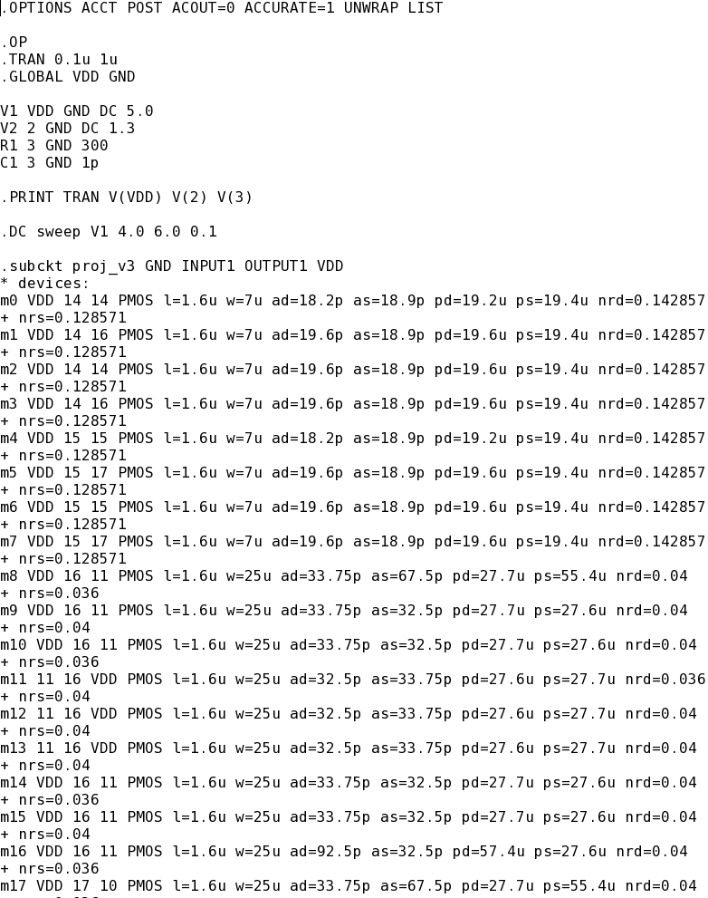
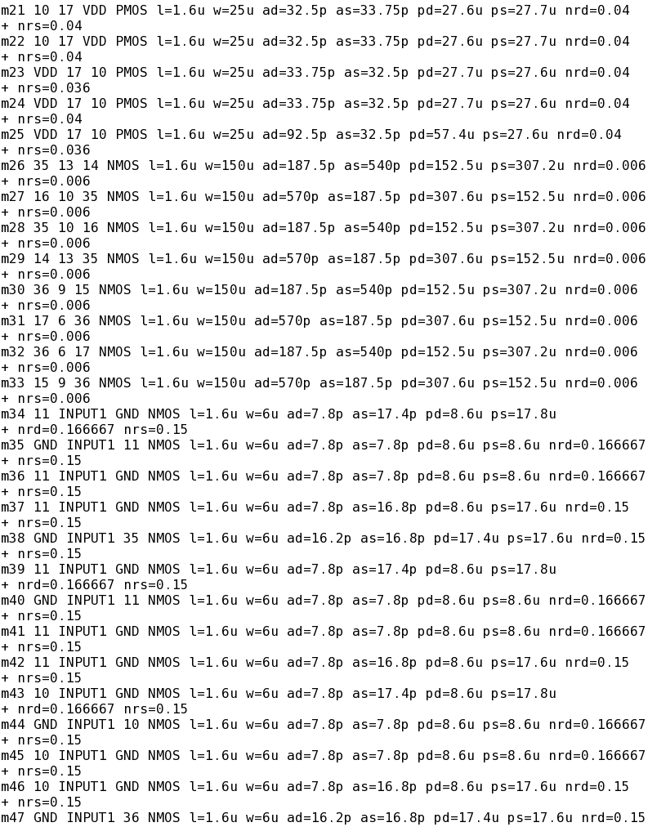
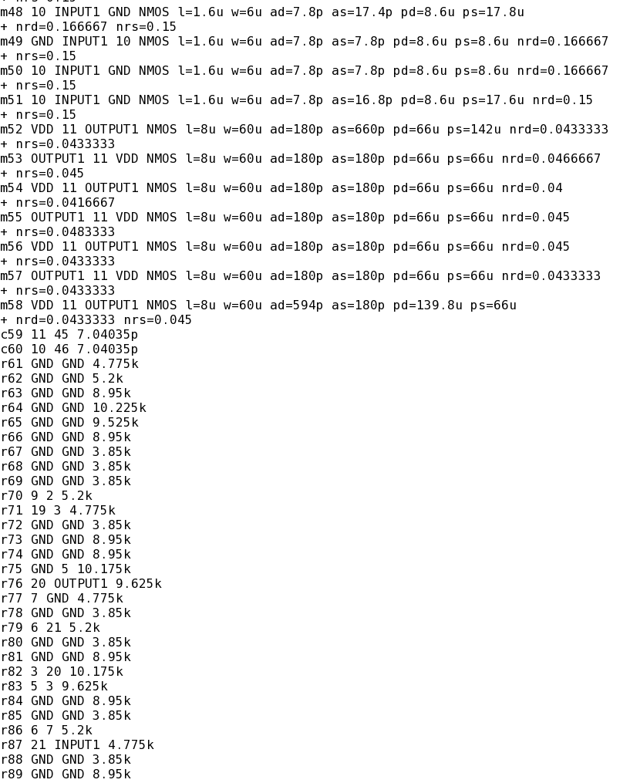
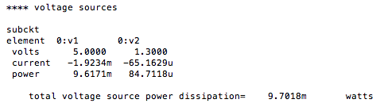

Slide 4
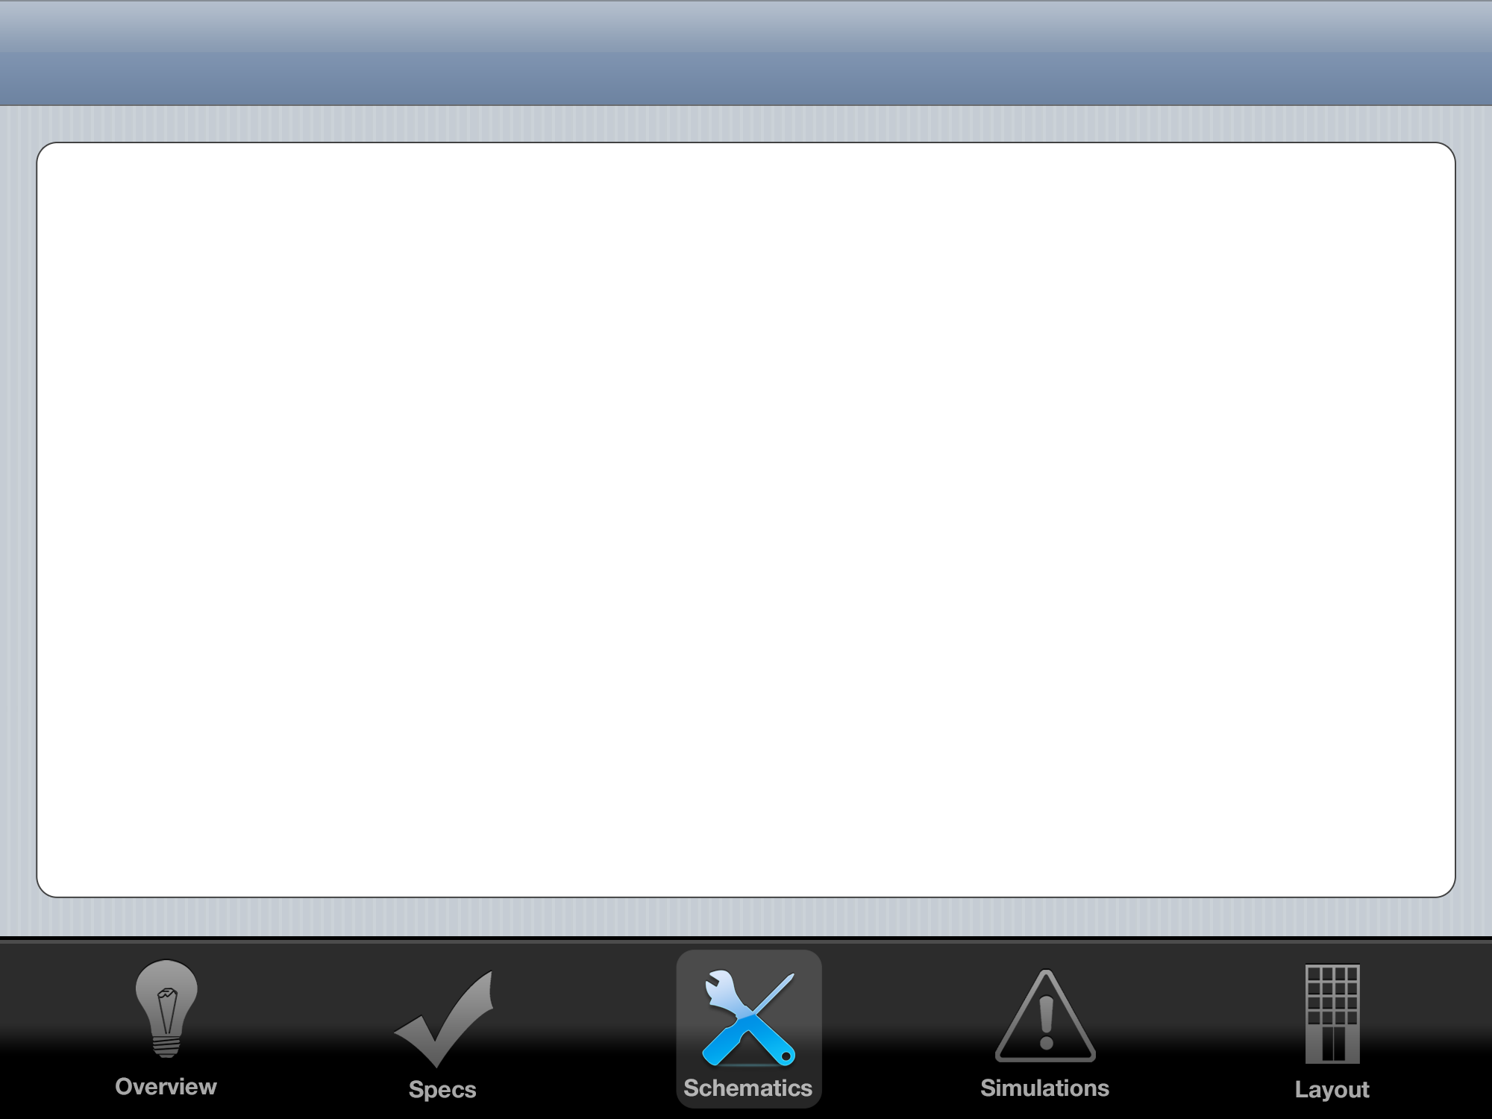
First Control System Attempt: PID
K_{P}
+
-
Gate
Drive
+
+
+
H
Vout
Vref

Slide 5
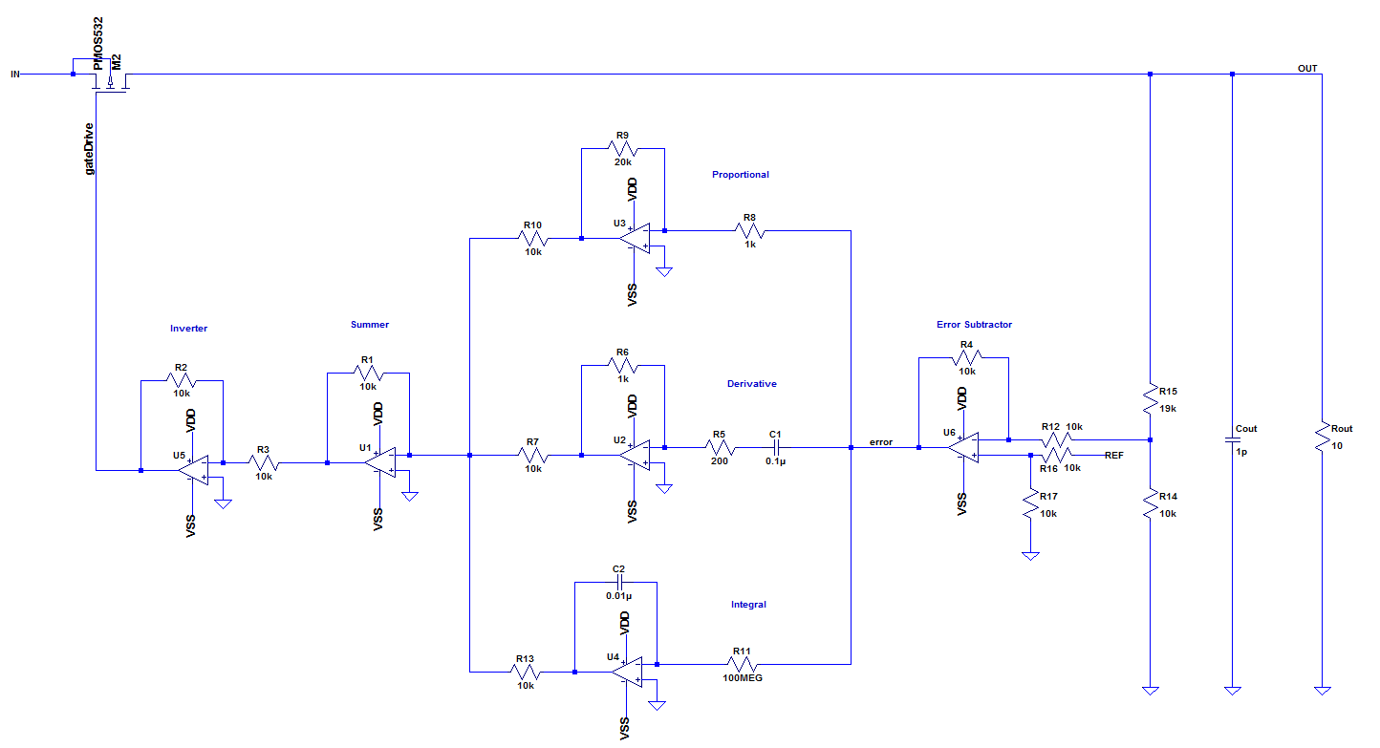
PID: Great Results, But Too Large

Slide 6
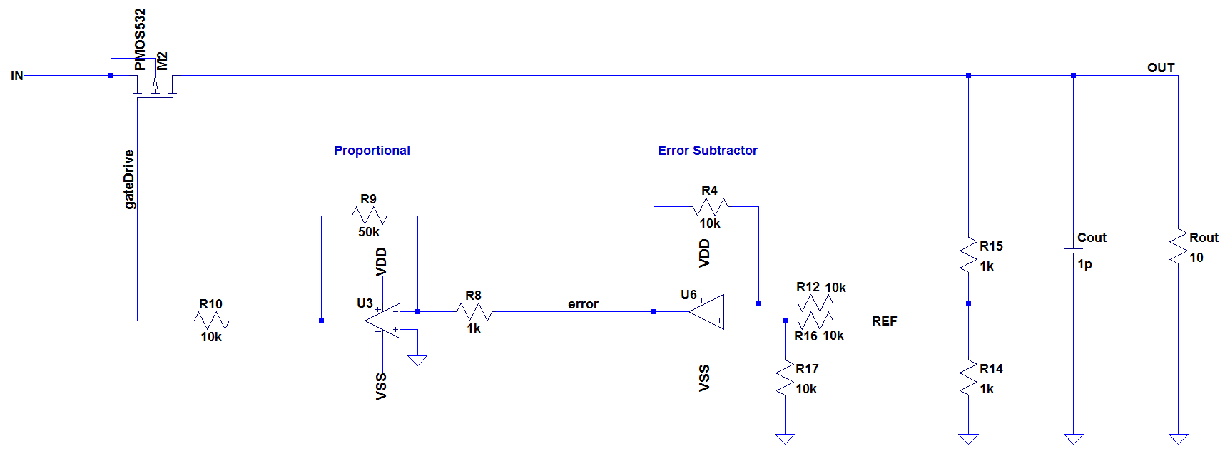
Reduce to P: Small Enough to Fab

Slide 7
LDO
Regulator
5.0 Volt VIN
VOUT
GND
GND
1.3 Volt VREF

Slide 8
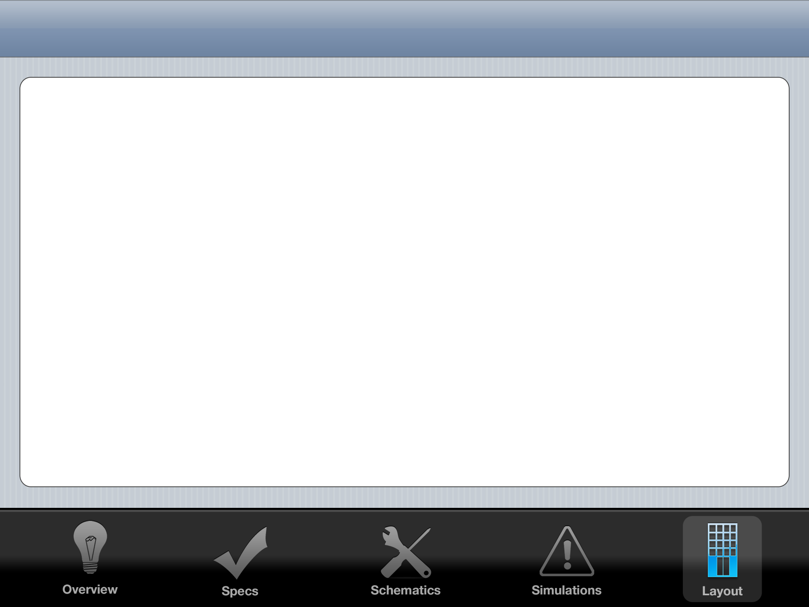
Layout Floorplan
0.47 mm
20 μm
VIN RAIL
VOUT RAIL
200 μm
200 μm
70 μm
OP AMP 1
OP AMP 2
Power
MOSFET
0.29 mm
250 μm
Common
Centroid
Precision
Resistors
20 μm
GND RAIL

Slide 9
Common Centroid Plan
Inverting
Amplifier
Differential
Amplifier
Feedback
Divider
Op Amps
R1: 1 kΩ
R2: 2 kΩ
Unit Resistor
for common
centroid:
1 kΩ
R1: 10 kΩ
R2: 10 kΩ
R3: 10 kΩ
R4: 10 kΩ
Unit Resistor
for common
centroid:
5 kΩ
R1: 20 kΩ
R2: 20 kΩ
Unit Resistor
for common
centroid:
10 kΩ
Common centroid
already completed
in homework 4

Slide 10
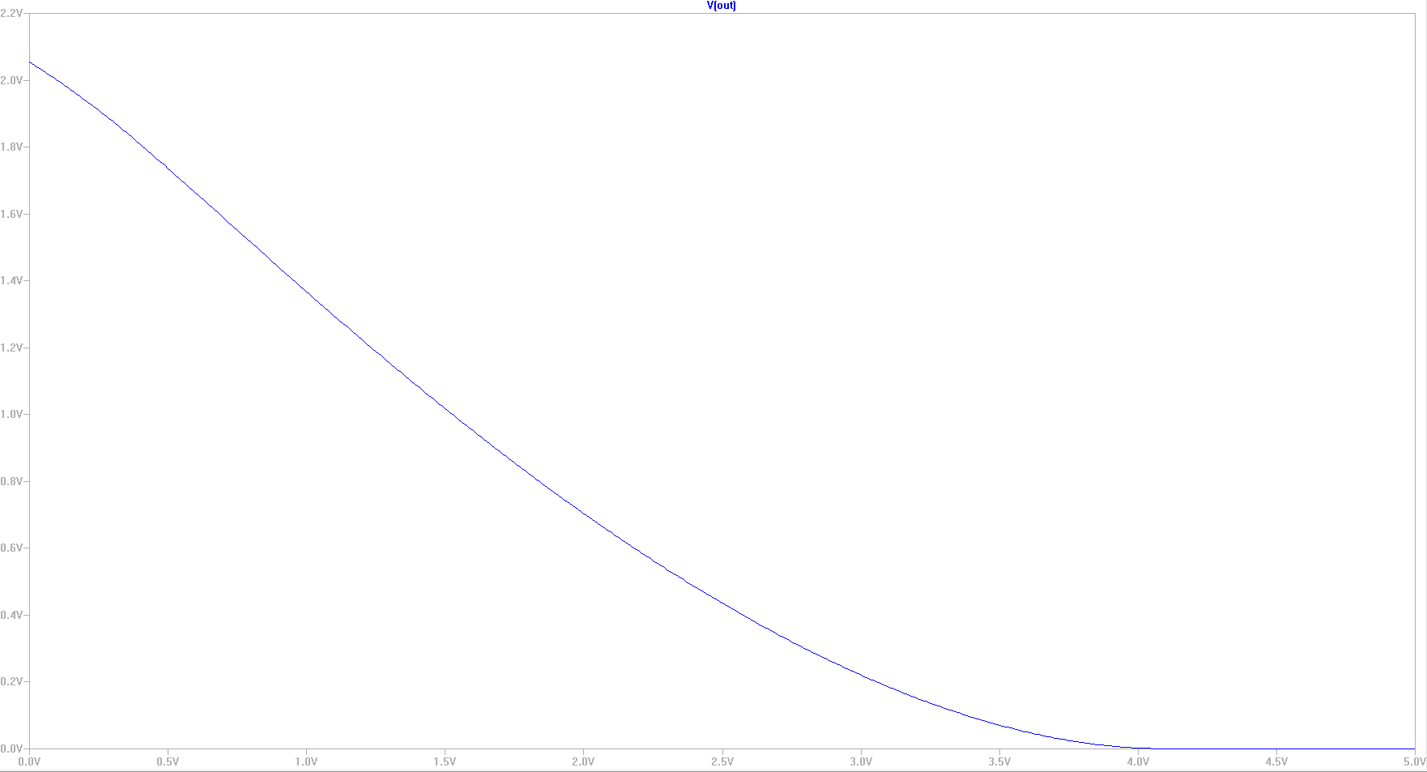
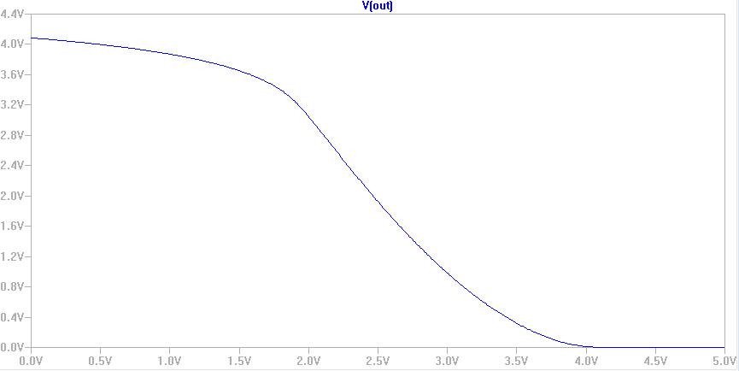
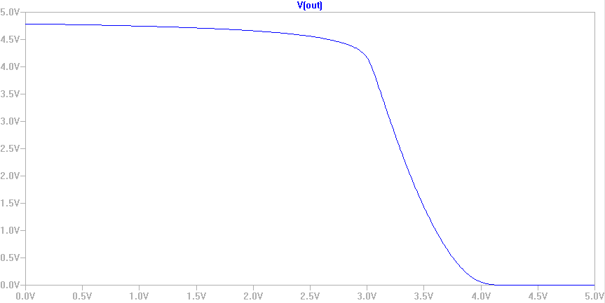

Slide 11
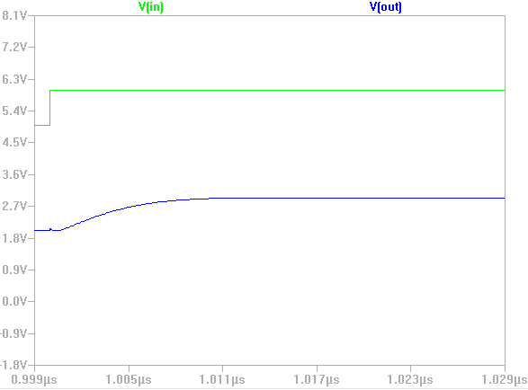

Slide 12
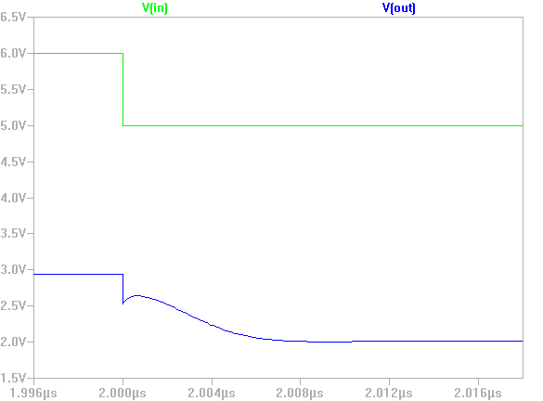

Slide 13
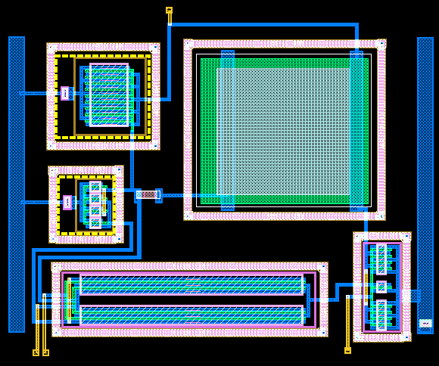
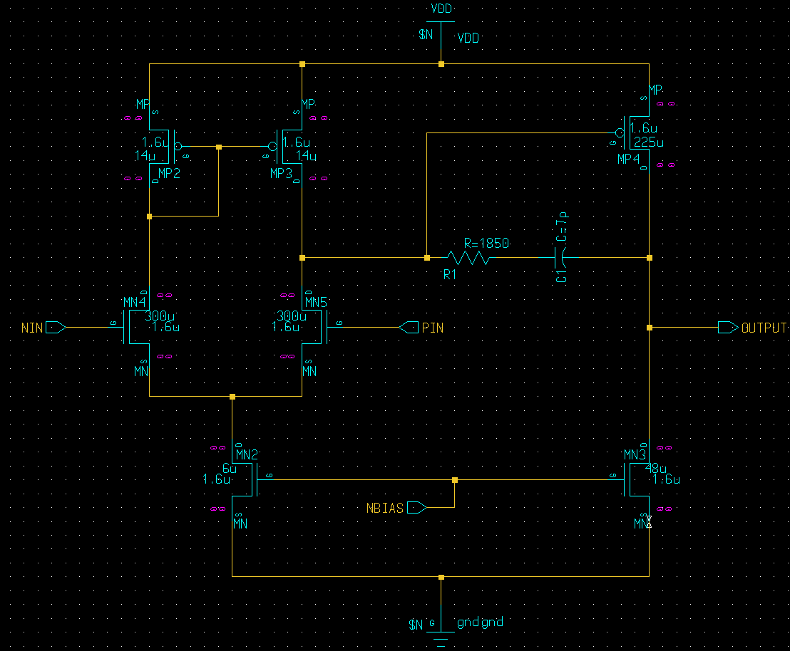

Slide 14
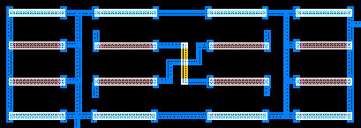
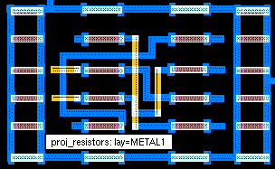
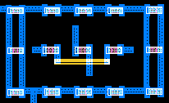

Slide 15
