Slide 1


System Spec Goals
 | My LDO | Texas Instruments TLV1171
Minimum Drop Out | 0.5 V | 0.455 V
Required Capacitance | 1 pF | 1 μF
Pos. Settling Time | 16 nano sec | ~ 5 μ sec
Neg. Settling Time | 25 nano sec | ~ 5 μ sec
Pos. Slew Rate | 5 V / μ sec | 5V / μ sec
Neg. Slew Rate | 66 V / μ sec | 5V / μ sec
Quiescent PWR Loss | 2.4 mW | 0.2 mW
Area |  | >> 1.0 mm²
Max. Input (+200 mV) | 5.3 Volts | 5.5 Volts
Min. Input (-200 mV) | 4.7 Volts | 2 Volts
Max Output Current | 8 mA | 1.0 A
Temperature Range for Vout ±200 mV | 0°C to 50°C | -55°C to 150°C

Slide 2
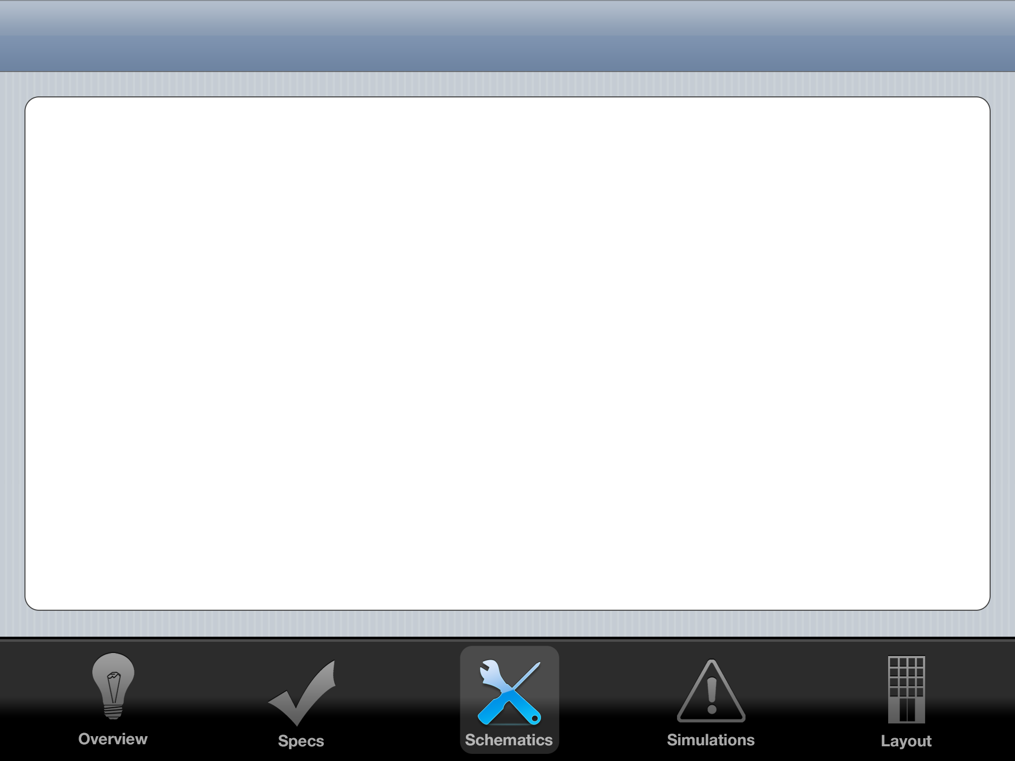
First Control System Attempt: PID
K_{P}
+
-
Gate
Drive
+
+
+
H
Vout
Vref

Slide 3
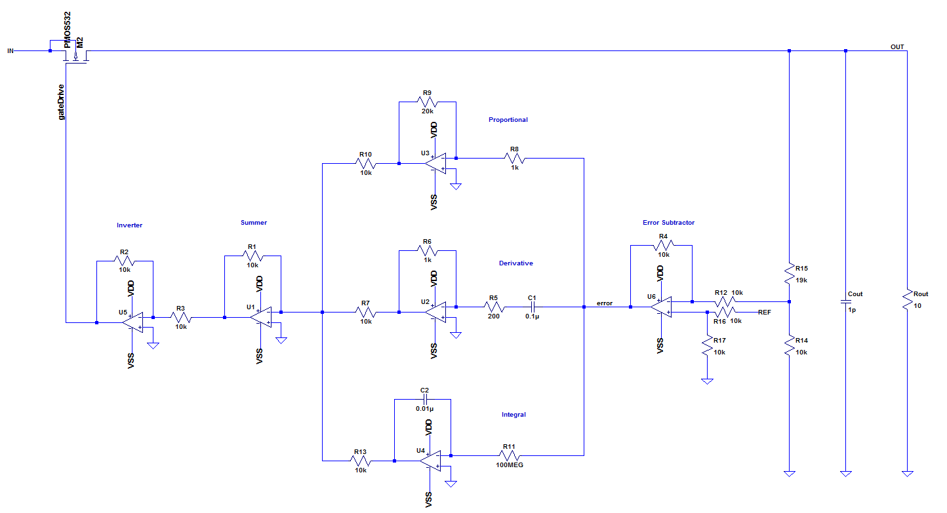
PID: Great Results, But Too Large

Slide 4
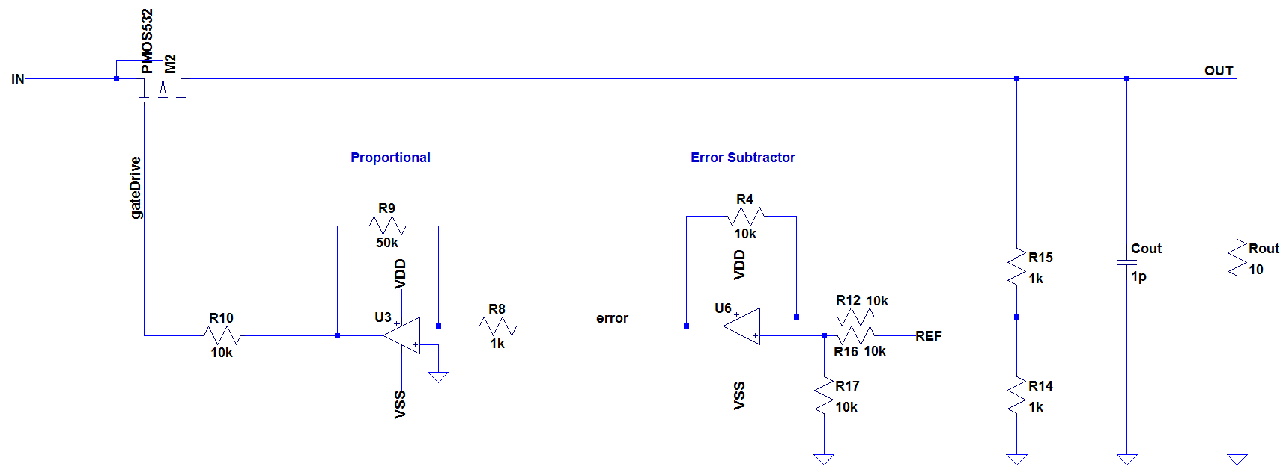
Reduce to P: Small Enough to Fab

Slide 5
LDO
Regulator
5 Volt VIN
2.5 Volt VOUT
GND
GND
1.3 Volt VREF

Slide 6
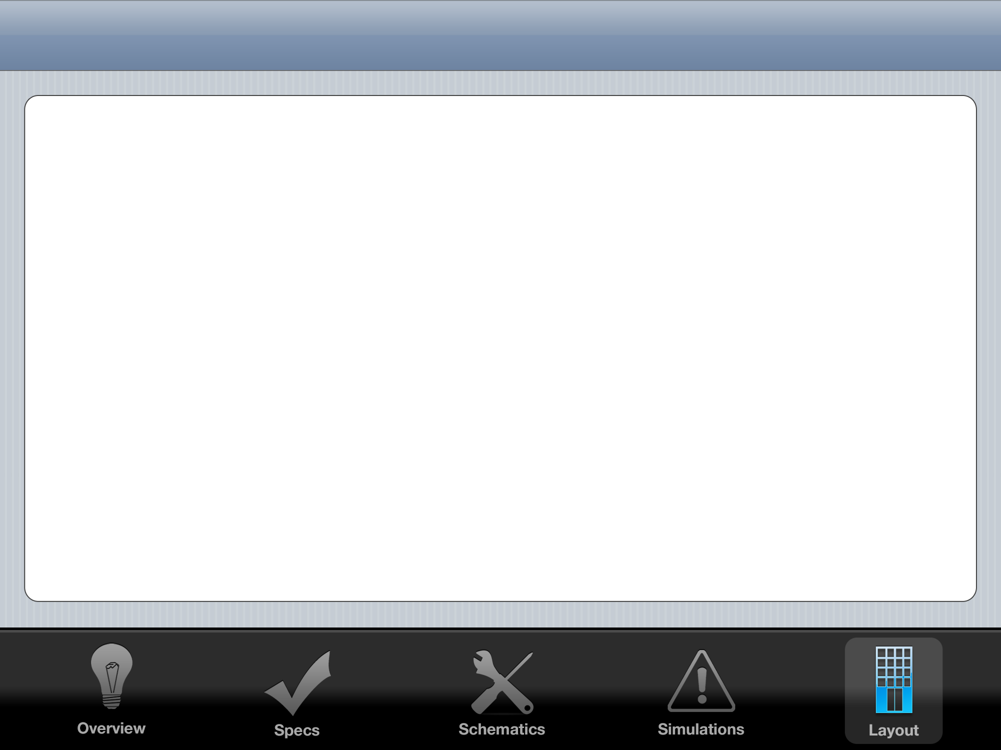
Layout Floorplan
0.47 mm
20 μm
VIN RAIL
VOUT RAIL
200 μm
200 μm
70 μm
OP AMP 1
OP AMP 2
Power
MOSFET
0.29 mm
250 μm
Common
Centroid
Precision
Resistors
20 μm
GND RAIL

Slide 7
Common Centroid Plan
Inverting
Amplifier
Differential
Amplifier
Feedback
Divider
Op Amps
R1: 50 kΩ
R2: 1 kΩ
Unit Resistor
for common
centroid:
1 kΩ
R1: 10 kΩ
R2: 10 kΩ
R3: 10 kΩ
R4: 10 kΩ
Unit Resistor
for common
centroid:
5 kΩ
R1: 50 kΩ
R2: 50 kΩ
Unit Resistor
for common
centroid:
25 kΩ
Common centroid
already completed
in homework 4

Slide 8
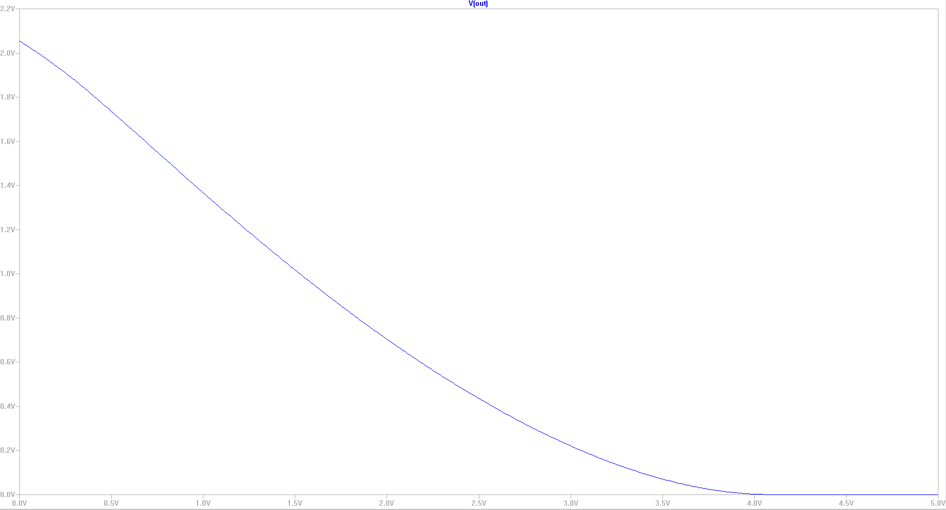
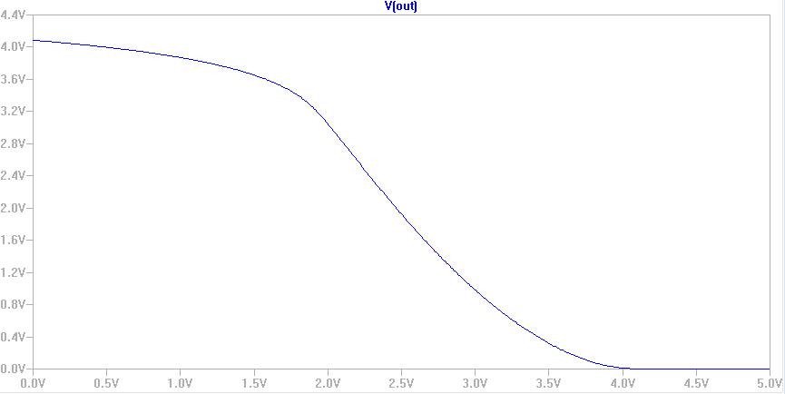
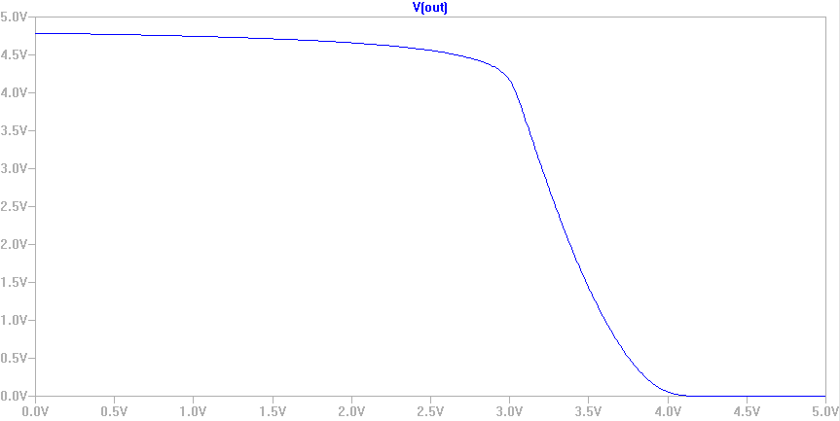

Slide 9
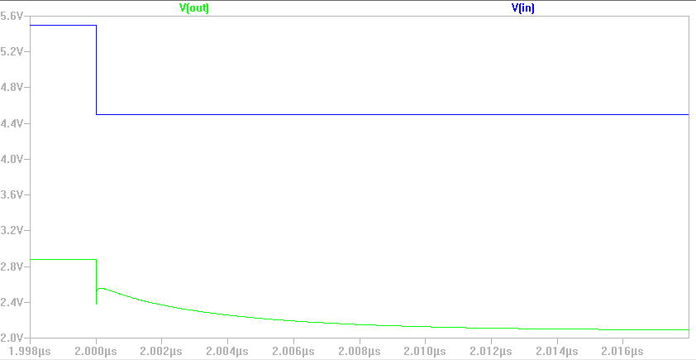

Slide 10
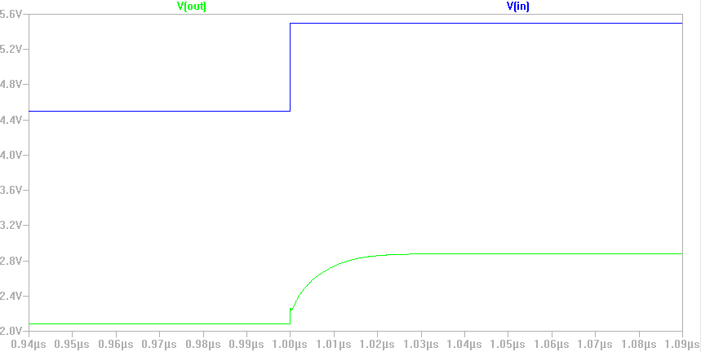

Slide 11
